Slide 1

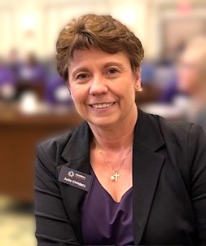
Academics for New Student Service Members
Julie Childers, Academic Coordinator in CCD
2026

Slide 2








This is Oklahoma CareerTech

Slide 3
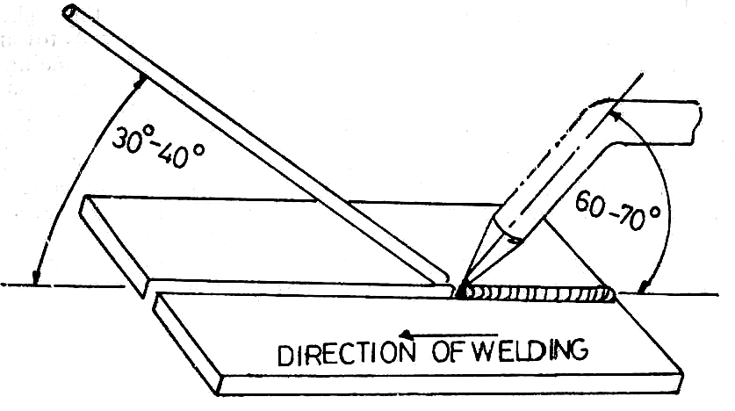
The “need to know”!
What is an OCAS Code and why do we need them?
Where do I find information about academics? Grades?
What is a “Certification” and Why does the K-12 school need to know about them?
What difference does it make if there are high school students and adults taking the same program?
What are “Post Secondary Opportunity Points” and Why is the person calling me so upset?

Slide 4

What is an OCAS Code and why do we need them?
OCAS Code:
A cost accounting number, 4 digits long, used to identify a subject taught by a teacher
A number used by the Oklahoma State Dept. of Education for reports to pay teachers and to represent what is being taught in an Oklahoma school
A consistent number representing a course or program a student is receiving credit for on a transcript

Slide 5

OCAS Codes for Transcripts
Program Codes: a code in the 9000’s is used to represent a 360 or 480 hour long set of courses intended to lead to an occupation, only used by CareerTech
Course Codes: a code in the 1000’s to 8000’s used to represent a 60- or 120-hour course (class)
CareerTech Course Code: a code in the 8000’s used only for career tech courses taught by a career tech certified teacher
Proper Name: the name given to a course or program and used officially for grade transcription
For Your Sending Schools- Instructional Level for CT Courses and Programs is 74033

Slide 6

Where do I find information about academics?
Oklahoma State Dept of Education (OkSDE)
9-12 Subject Codes: chrome-extension://efaidnbmnnnibpcajpcglclefindmkaj/https://oklahoma.gov/content/dam/ok/en/osde/documents/services/accreditation/Course%20Codes%20SY2026-2027%20PreK-12%20Official.pdf
Oklahoma State Dept of Career and Technology Education (ODCTE) Course Codes and Subject Codes: https://oklahoma.gov/careertech/educators/ocas-codes.html

Slide 7

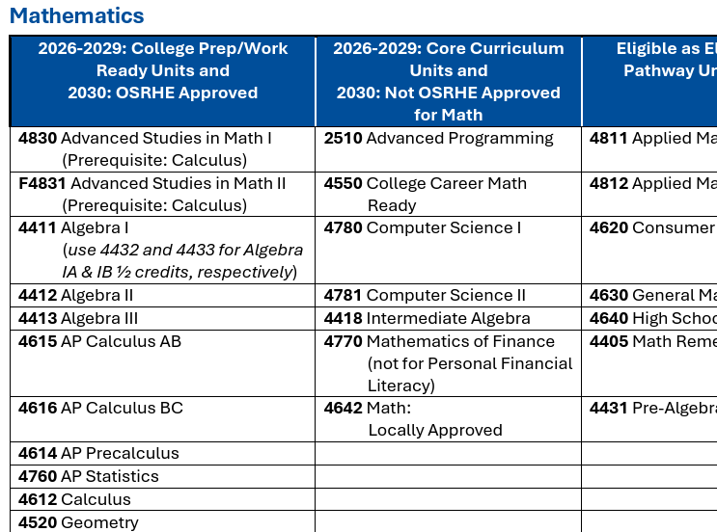
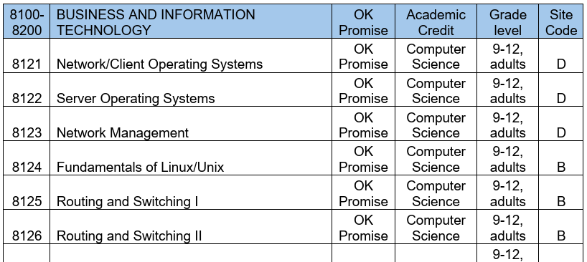
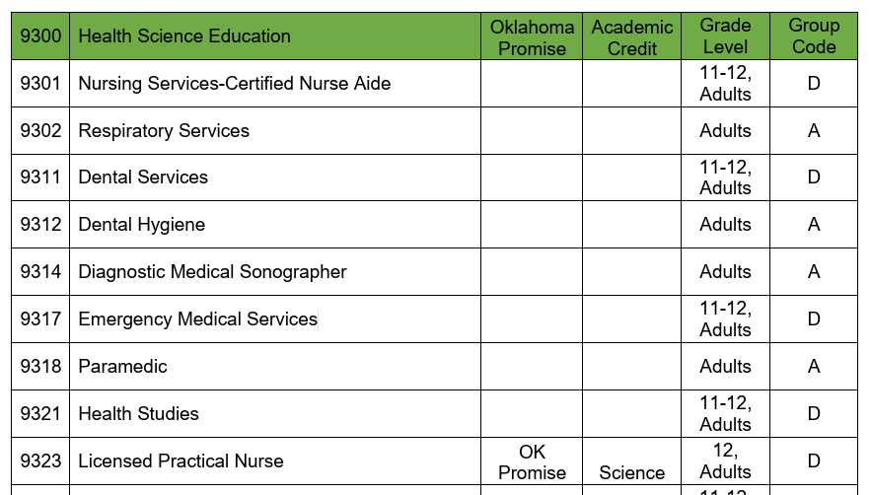
Examples:

Slide 8

Important Note about Grades:
Don’t:
Use course vendor identifiers (i.e., “PLTW” for Project Lead The Way) on the transcript alongside the course title.
Change the Names of Courses and Programs when sending grades for transcripts.
Give schools a lot of choices. (contrary to popular belief choices do not make it easier for k-12 schools)
Send a grade for a course w/o an OCAS Code.
Do:
Use approved course titles and course codes for transcript purposes.

Slide 9

Examples:
Program Name/Number: 9537 Digital Design & Publishing
Embedded Course Credit: 8169 Fundamentals of Technology
And 8149 Desktop Publishing and Graphic Design
What goes on a transcript for K-12?
If a technology centers memorandum of understanding states a student will receive 3 hours of credit for the year, then:
Grades should be sent for 1 credit of 9537*, 1 credit of 8169, and 1 credit of 8149
* Will be explained in the next set of slides.

Slide 10

Other Important Notes:
Courses Embedded in Programs need separate grades.
EX. Medical Terminology, Geometry, Fundamentals of Technology, Digital Electronics, Anatomy/Physiology, etc.
Concurrent Enrollment Grades come from the College or University awarding the credit.

Slide 11

What is a “Certification” and Why does the K-12 school need to know about them?
A certification is an official credential awarded by a professional organization, industry body, or corporation that validates an individual's skills, knowledge, or expertise in a specific field. It is typically earned by passing a standardized assessment and often requires prior experience or continuing education to maintain.

Slide 12

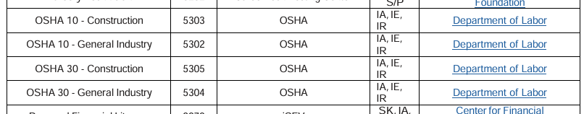
CareerTech Certifications
House Bill 3218 (2016)
CareerTech: Any business or industry recognized endorsements must be reported on the transcript as provided by the local Career Technology Center.
Chrome-extension://efaidnbmnnnibpcajpcglclefindmkaj/https://oklahoma.gov/content/dam/ok/en/careertech/educators/certifications-and-badging/certifications-page/credentials-book.pdf
Certifications should be sent in a timely manner that allows the K-12 time to post them on the transcript. Best Practice 2 or more times a year.

Slide 13

What difference does it make if there are high school students and adults taking the same program?
The technology center lives in more than one world: K-12 education, higher education, and workforce.
K-12 education runs on Carnegie Units- 120 hour blocks of time earn one credit.
Higher Education works off the Federal Financial Aide definition for credit.
Workforce creates short term learning based on skill acquisition.

Slide 14

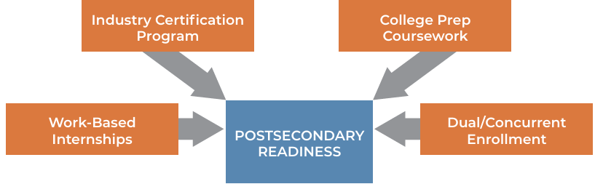
What are “Postsecondary Opportunity Points” and Why is the person calling me so upset? chrome-extension://efaidnbmnnnibpcajpcglclefindmkaj/https://oklahoma.gov/content/dam/ok/en/osde/documents/services/accountability/oklahoma-report-card-resources/F_2022-Postsecondary-Opportunities-Spotlight.pdf
Under the federal Every Student Succeeds Act (ESSA), states were required to include an indicator of school quality or student success. ….This indicator encourages schools and students to participate in activities and programs that enhance preparation for life after high school. Points earned reward schools for helping their students gain early college and career exposure.
Points earned under the Postsecondary Opportunities indicator are based on the percentage of high school juniors and seniors completing at least one of the approved options to prepare for life after high school.

Slide 15
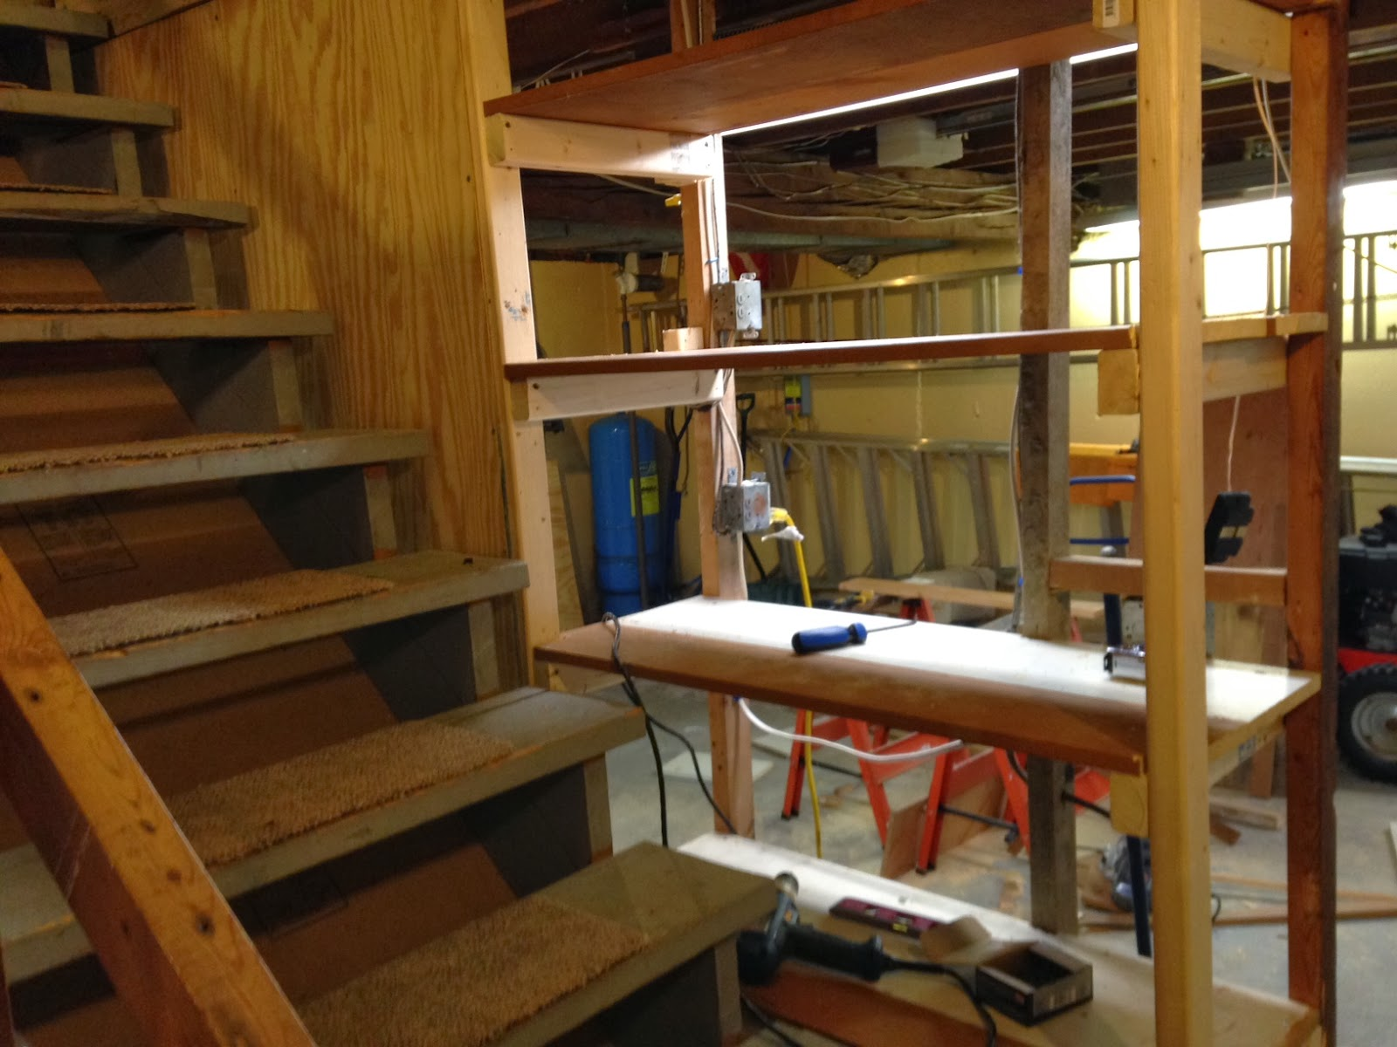

*Back to the asterisk.
9000 program codes need 2 semester grades. (no exceptions)
How those grades can be transcribed include:
2 grades in the same semester still labeled semester 1 and semester 2.
2 grades one for semester 1 and one for semester 2.

Slide 16
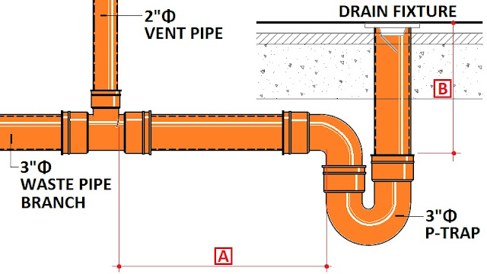
For more information on Academics in CareerTech:
Julie Childers
Julie.childers@careertech.ok.gov
405-743-5110
And
Shawna Nord
Shawna.nord@careertech.ok.gov
405-743-5524
Oklahoma CareerTech:
Rules for Career and Technology Education

