Slide 1
Student Services and Special Populations: What You Need to Know
Katlyn Hudgins, M.Ed., CCC
Career Development Coordinator – Special Populations
Oklahoma Department of Career & Technical Education
Kari Stomprud, M.Ed.
Special Needs Coordinator
Canadian Valley Technology Center

Slide 2
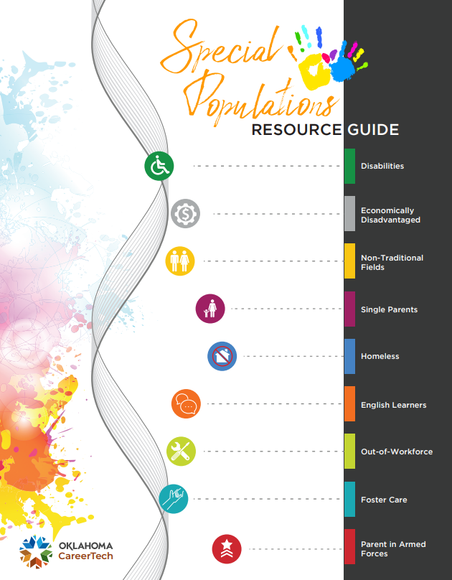
What are Special Populations?
Disabilities
Economically Disadvantaged
Non-Traditional Fields
Single Parents
Homeless
English Learners
Out-of-Workforce
Foster Care
Student with a Parent in the military
Notes:
KATLYN

Slide 3
How does working with special populations affect me?
Special Populations are in every single program!
Greater understanding
Ability to provide appropriate services
Best serve students!
Notes:
KATLYN -While the type of “special population” may vary, there are STILL special populations in every program.
Greater understanding->When we understand who falls under special populations, and we take a moment to discern how we can support them, then we are able to serve them in a holistic way that benefits not just the student, but everyone else that is involved, including peers, instructors, the institution, and even the community. Our end goal is to produce productive, employable, citizens!

Slide 4
ADA
The Americans with Disabilities Act of 1990 (ADA) prohibits discrimination and ensures equal opportunity for persons with disabilities in employment, State and local government services, public accommodations, commercial facilities, and transportation.
Notes:
KARI -Take a look at the graphic on this slide. What do you think is my favorite thing about this picture? Someone who looks able-bodied

Slide 5
Individuals with Disabilities Education Act (IDEA)
13 Categories of Disability under IDEA
Specific Learning Disability (SLD)
Other Health Impairment
Autism Spectrum Disorder (ASD)
Emotional Disturbance
Speech or Language Impairment
Visual Impairment (including blindness)
Deafness
Hearing Impairment
Deaf-Blindness
Orthopedic Impairment
Intellectual Disability
Traumatic Brain Injury (TBI)
Multiple Disabilities
The Individuals with Disabilities Education Act (IDEA) is a law that makes available a free appropriate public education (FAPE) to eligible children with disabilities throughout the nation and ensures special education and related services to those children.
Children and youth ages 3 through 22 receive special education and related services under IDEA Part B.
Notes:
KARI

Slide 6
Individualized Education Plan (IEP)
To ensure that students can receive appropriate services under IDEA, support staff utilizes an Individualized Education Program (IEP).
These students fall under at least one of the 13 categories AND their performance is affected due to a disability
A legal document that outlines the special education program for a student with a disability. This document is developed, reviewed, and revised annually by a team including:
Parents
Teachers
Special Education Teacher
CareerTech Instructor
School Administrator
Others as determined appropriate by the team. Special Populations Handbook
The purpose of the IEP is to outline a series of specific actions and steps where educational providers, parents, and the student themselves may reach the child's stated goals.
If a parent is concerned that an IEP is inappropriate for their child, or that their child is not receiving needed services, they have the right under IDEA to challenge their child's treatment, which is known as due process.
APA
Notes:
KARI An IEP is governed by a special education law.Think of an IEP as a living document. Discuss the importance of working with the sending school and the counselors at your tech center to make sure that you are part of the IEP team. You are required to be invited to the IEP meetings. Why is this so important? As a teacher, if you are not invited to the IEP meetings, then it is much harder to best serve the student.

Slide 7
Section 504
Section 504 is part of the Rehabilitation Act, which allows individuals with disabilities to receive necessary accommodations in their specific CareerTech program. - OK Secondary Transition Handbook.
Section 504 is designed to prevent those with a disability, who do not need specialized instruction, against discrimination.
If a student wishes to receive accommodations in postsecondary education, then they must disclose the disability.
Notes:
KARI A 504 plan is governed by civil rights law

Slide 8
Examples of 504 Services
Supplemental Aids and Services
Speech and Language Therapy
Physical Therapy
Occupational Therapy
Counseling
Specialized Instruction
Classroom and testing accommodations and modifications
Reasonable Accommodations
Interpreters
Note Takers
Priority Registration
Recorded Lectures
Extended Test time
Assistive Technology
Accessible Educational Materials
Notes:
KARI

Slide 9
Accommodations: Adjustments to curriculum, instruction, or procedures to allow students with disabilities to participate and have access to content and instruction. An accommodation does not alter the content or expectations.
Accommodations for testing can be different from those used for teaching.
For example, using spellcheck might help a student with writing difficulties take notes during class. However, it wouldn’t be appropriate during a weekly spelling test. Instead, a student might benefit from having extra time to complete the spelling test or use a keyboard if the physical act of writing is difficult.
Modification: Changes that provide a student access to a program, but with lower expectations.
Modifications in testing often mean that a student covers less material — or material that is less complex.
For example, a spelling test may require the class to study 20 words. However, a student with modifications might only have to study 10 of them. Or, there might be two different lists of spelling words. - Understood
Notes:
KARI

Slide 10
Family Educational Rights and Privacy Act (FERPA)
Federal law that protects the privacy of student education records (20 U.S.C. § 1232g; 34 CFR Part 99).
The law applies to all schools that receive funds under an applicable program of the U.S. Department of Education.
Gives parents certain rights with respect to their children's education records.
Rights transfer to the student when he or she reaches the age of 18 or attends a school beyond the high school level.
Students to whom the rights have transferred are "eligible students."
Notes:
KARI

Slide 11
Under FERPA, Information can be released without notifying the parent or student for the following situations:
In an emergency to protect health and safety of students or others
To personnel who have legitimate educational interest
For auditing purposes
Appropriate parties involved with a student’s financial aid
Officials of another school where the student seeks to enroll
State and local juvenile justice system
Court orders or subpoenas
Notes:
KARI

Slide 12
FAQ’S about FERPA Cont…
Are schools required to record the disclosure of personally identifiable information (PII) from students’ education records whenever they make disclosures?
Schools must maintain a record of each request for access to, and each disclosure of PII from, the education records of each student, as well as the names of state and local educational authorities and federal officials and agencies
However, schools do not have to record disclosures of PII from education records that were made to: 1) the parent or eligible student 2) a school official 3) a party with written consent from the parent or eligible student 4) a party seeking directory information 5) a party seeking or receiving records related to disclosures of subpoenas or court orders.
Notes:
KARI

Slide 13
FAQ’S about FERPA Cont…
Are there any limitations to sharing information based on personal knowledge or observations?
FERPA does not prohibit a school official from releasing information about a student that was obtained through the school official’s personal knowledge or observation unless that knowledge is obtained through his or her official role in making a determination maintained in an education records about the student.
For example, under FERPA a principal or other school official who took official action to suspend a student may not disclose that information, absent consent or an exception under § 99.31 that permits the disclosure.
Notes:
KARI

Slide 14
Friendly Reminders about Confidentiality: Faculty & Staff
Each administrator is responsible to ensure all special education records are maintained in a confidential manner and stored in a private area.
Discussions concerning confidential information are to take place in secured locations (not hallways, staff lounges, parking lots, Wal-Mart, or anywhere others may overhear).
Should not be left as a message with a secretary or on a voicemail.
Be careful using e-mail to discuss confidential information (remember all e-mail can be subpoenaed).
All staff members should be held to the same standard of confidentiality.
schoolcounselor.org
Notes:
KATLYN

Slide 15
Confidentiality and Communication Cont…
Casual conversations with colleagues about a student with a disability is inappropriate.
Appropriate staff to know:
Student’s Instructor
Disability Support Specialist
Counselor
Administrator – if there is a valid reason
Notes:
KATLYN

Slide 16
Communication with Students
When making appointments with students over the phone, try not to repeat their name
Discussion of a student – keep their name anonymous
If a student wishes for staff and students to know that they have a disability, make sure it is in writing first!
Help them to understand FERPA and put it in “layman’s terms”
Do not assume that other students with a disability know who their peers are with a disability
What to do when you are the student’s “person”?
Notes:
KATLYN

Slide 17
When is it Necessary to Disclose?
Notes:
KATLYN

Slide 18
Referrals
When is it appropriate?
Do you have a licensed counselor on staff?
Do you have written from the student or parent/guardian to send a referral?
Notes:
KATLYN

Slide 19
Ask yourself:
Why am I sharing this information?
How will it benefit the student?
Notes:
KATLYN

Slide 20
Good rule to follow . . .
Do not write or say anything you would not want to be repeated in a due process hearing, in front of your superintendent, the student and their parents.
Notes:
KATLYN

Slide 21
How to Build Partnerships
Think Synergy, not silos!
Connect with the staff at sending schools that have the same/similar role as you and share information.
Create an excel sheet or directory of important contacts
Invite your sending school staff to events at your tech center to showcase what CareerTech is all about!
If you are on an IEP team, offer to host IEP meetings at the tech center.
Boost morale by focusing on student success and inform parents of opportunities to see what their child is doing and opportunities for prospective students.
Notes:
KATLYN

Slide 22
Katlyn Hudgins, M.Ed., CCC
Career Development Coordinator – Special Populations
Oklahoma Department of Career & Technical Education
Katlyn.Hudgins@careertech.ok.gov
405-743-5596
Kari Stomprud, M.Ed.
Special Needs Coordinator
Canadian Valley Technology Center – El Reno
kstomprud@cvtech.edu
405-422-2284

