Slide 1


Your Path to Your Future
Lesson Three
Decision Making

Slide 2

Apollo 13 Video https://www.youtube.com/watch?v=pbBS8sHrDgA
Notes:
How many of you have been faced with a difficult situation, looked at your resources and wondered how you were going to solve the issue or make a decision? Sometimes in life, it feels like we are being asked to place a square peg in a round hole, doesn’t it?
How many of you have made a decision that you were proud of or worked out well for you? Would your like to share your experience and the steps you took to make the final decision? (A: Wrote down pros & cons, consulted a friend/family member, flipped a coin, etc.)
How many of you have made a decision that did not work out as you had hoped? Would you like to share your experience and the steps you took? What would you do differently next time?

Slide 3

Planning
Notes:
Knowing what kind of decision-maker you are will help you with future decisions. There are eight different types of decision-making processes. There is no right or wrong way to make a decision, but can we all agree some work better than others in certain situations? There are so many factors that influence how we make decisions.
Planning: You weigh everything you can think of that might be involved and conduct a step-by-step process to come to a final decision.
Example: You’re ready to ditch your jalopy car. That thing leaks more oil than ... never mind. This is Oklahoma; all praise Big Oil. Anyway, you’ve found three different cars you like; researched all about them for reliability, safety, efficiency and cool factor; and decided to go with the one slightly more expensive, but should last a lot longer.

Slide 4

Painful/Agonizing
Notes:
Painful/Agonizing: You spend a lot of time and energy mulling over the positives and the negatives, but all that is involved is overwhelming and in the end, you never make a decision.
Example: Should you move to a different house/neighborhood?

Slide 5

Impulsive
Notes:
Impulsive: You make a decision quickly without fully evaluating all the pros and cons or considering alternatives.
Example: You see a cute pair of shoes or nice pair of boots on sale. It is not payday, and you haven’t paid all your bills yet. An impulsive decision would be to buy the shoes/boots anyway without checking your bank account to make sure you had enough money to cover the bills first.

Slide 6

Compliant
Notes:
Compliant: Someone else makes a decision for you with your permission, or you follow someone else’s lead, as the outcome was good for that person.
Example: You are at a new restaurant and have no clue what to order as it all sounds good. Your friend has eaten at this restaurant before and knows what you like to eat. The friend offers to order for you, and you agree.

Slide 7

Delaying
Notes:
Delaying: Either you do not realize a decision needs to be made or you put making a decision on the back burner until a later date.
Example: You want to change phone plans but don’t want to deal with customer service.

Slide 8

Intuitive
Notes:
Intuitive: You make decisions on your gut feelings.
Example: Trying to decide on where to eat is often a gut decision (pause for laughs).

Slide 9

Fatalistic
Notes:
Fatalistic: You leave it up to fate to make the decision.
Example: You have two job interviews with two different companies for which you would love to work. You allow fate to decide which job will be offered to you as the best job for you to have.

Slide 10

Paralysis
Notes:
Paralysis: You know a decision has to be made, but you just cannot seem to come to a conclusion.
Example: You know you need to change jobs or make a career change, but you have no idea what other kinds of jobs for which you would qualify. The whole idea is too overwhelming to figure out, so you just remain in your current job.

Slide 11

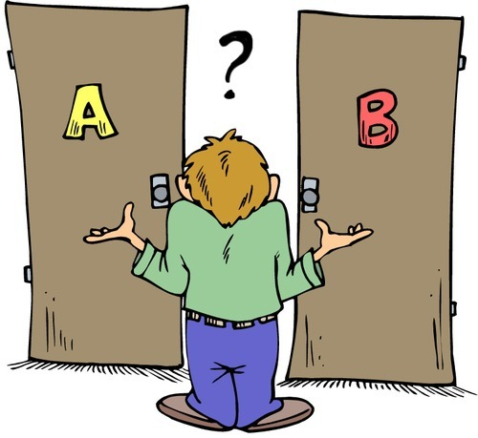
Decision Making Activity
Notes:
Ask each student to write down a decision he or she had to make regarding his or her education or work and in 2-3 sentences explain how they arrived at that decision.

Slide 12





