Slide 1


Your Path to Your Future
Lesson Five
Occupational Exploration

Slide 2
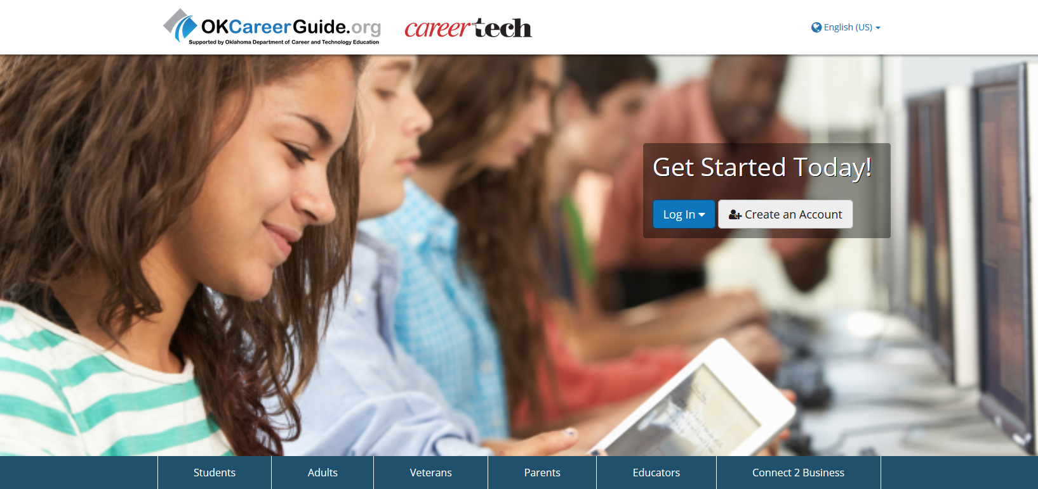
OKCareerGuide Deeper Dive
Notes:
Ask students to pull out their OK Career Guide homework from the previous week.
Distribute the goal sheets so students can transfer the pertinent information.
Ask students to share their top result from each category (in groups or as a class). (Slide 2)
Students should share if the information was at all surprising and why or why not. Collect the goal sheets again for later use.

Slide 3
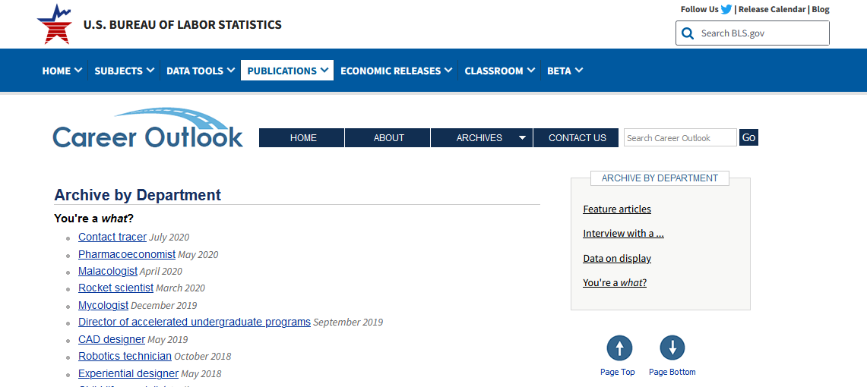
https://www.bls.gov/careeroutlook/department/youre-a-what.htm

Slide 4
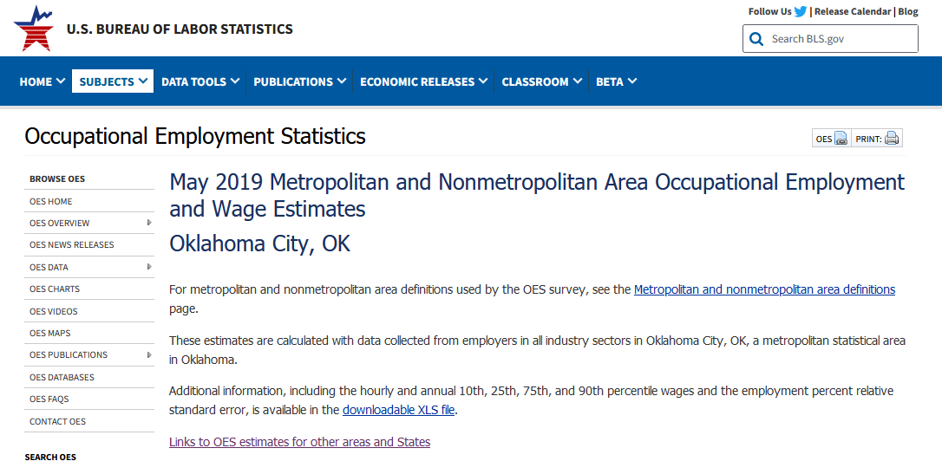
https://www.bls.gov/oes/current/oes_36420.htm
Notes:
Make sure you click on the circled links to take the student to their parts of the state.

Slide 5
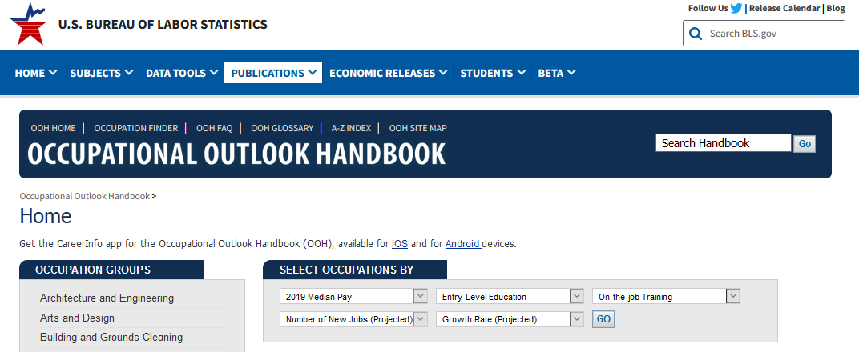
https://www.bls.gov/ooh/
Notes:
The handbook contains projected trends and viability of occupations in the future. It provides information regarding projected growth or decrease of occupations. Choose an occupation group from the left side of the page to see specific occupations with brief job descriptions, minimum education level requirements and median wages. Clicking on a specific occupational title will give the outlook information regarding the future of that occupation. Have students research a couple of occupations.
Ask: What did you think about the minimum education requirements? Did they surprise you?

Slide 6
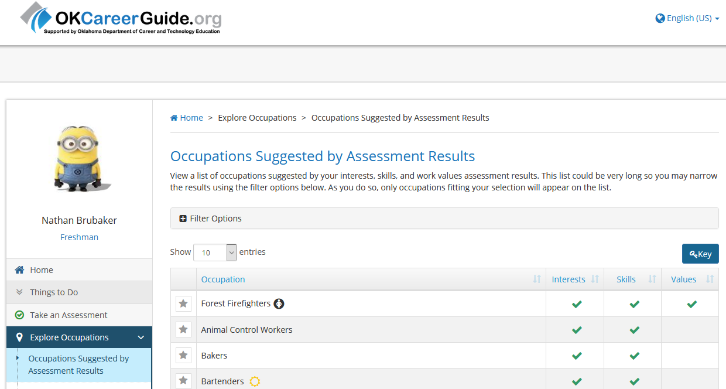
Notes:
Click on Explore Occupations on the left side of the screen.
When the page opens, click on Occupations Suggested by Assessment Results.
Look through all the occupations suggested and select the one you used in the first part of the worksheet. This should be the one you chose from the OK Career Guide Results Sheet.
Does the occupation that you used have a key symbol by it?

Slide 7
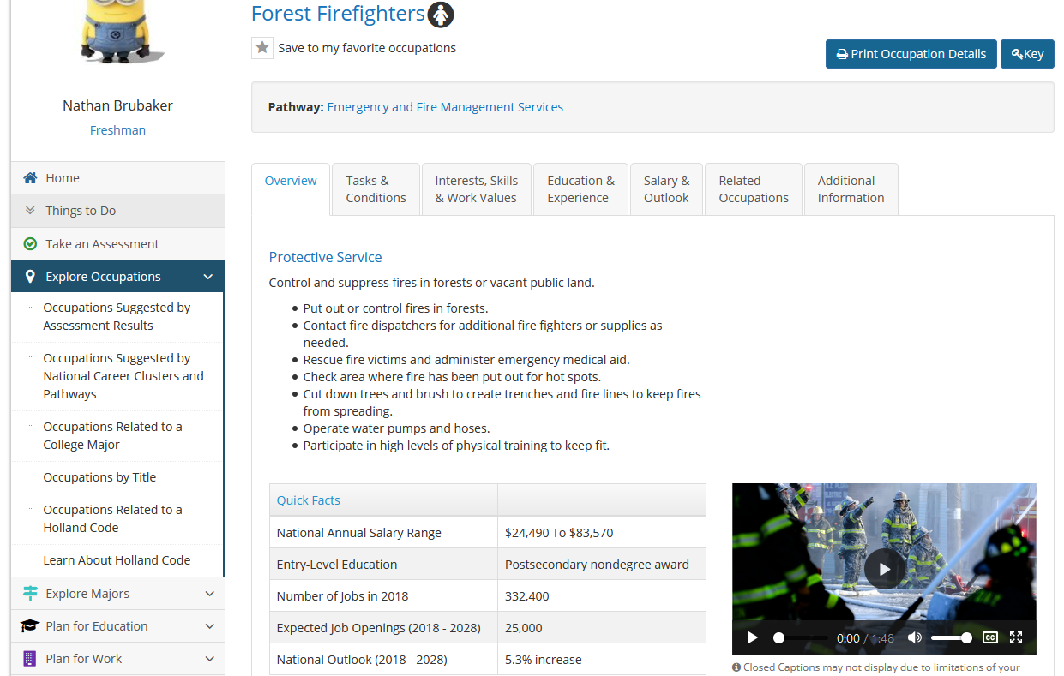

Slide 8

