Slide 1


Your Path to Your Future
Lesson Six
Educational Exploration

Slide 2

OKCareerGuide Deeper Dive
Notes:
Ask students to pull out their OK Career Guide homework from the previous week.
Distribute the Exploring Training and Education worksheet.

Slide 3
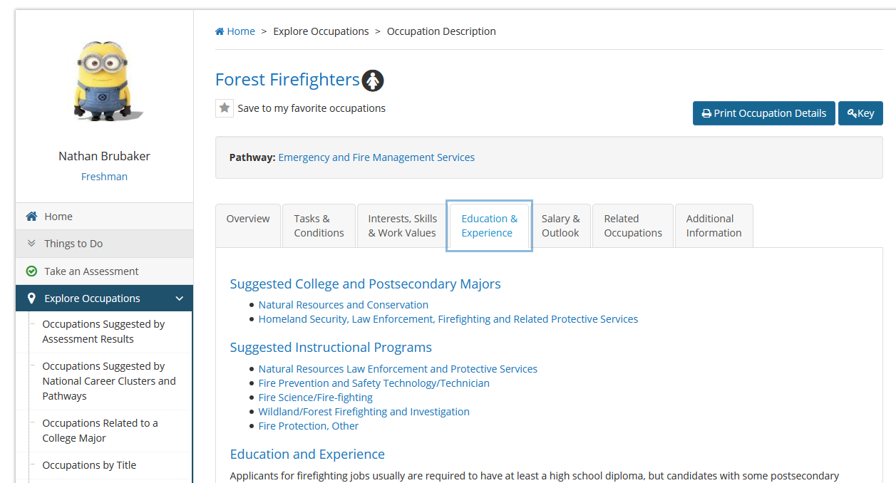
Notes:
Choose one of the occupations above look up in the left side of the page and open Explore Occupations. At the bottom, select Occupations by Title and type in the title from above. Repeat this until you find the occupation you want to use in the next steps.

Slide 4
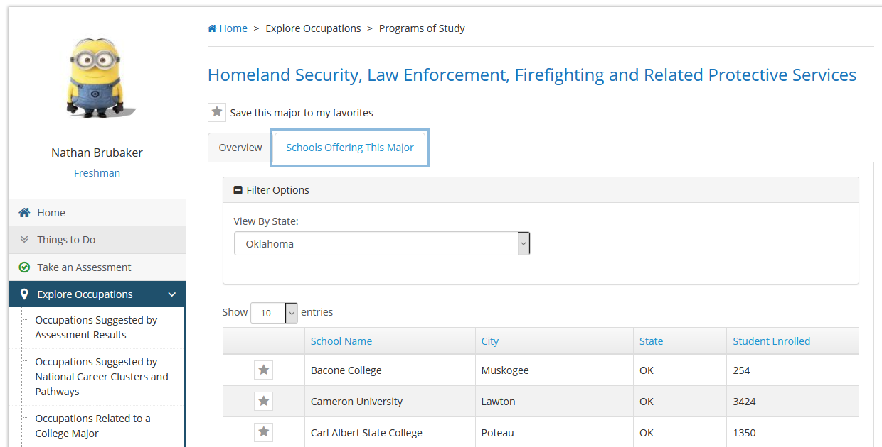
Notes:
Click on one of the college and postsecondary majors to go to a page with that major. Click on Schools Offering This Major to see if there is a school close to your location. Repeat with other majors and instructional programs until you have found a school near you.

Slide 5
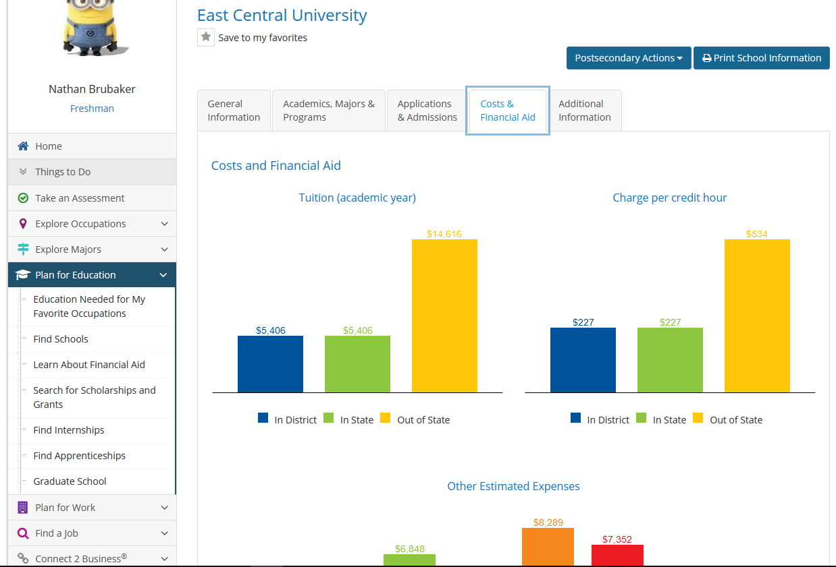
Notes:
Click on the school. When it opens, click on Cost & Financial Aid and answer the questions below.

Slide 6
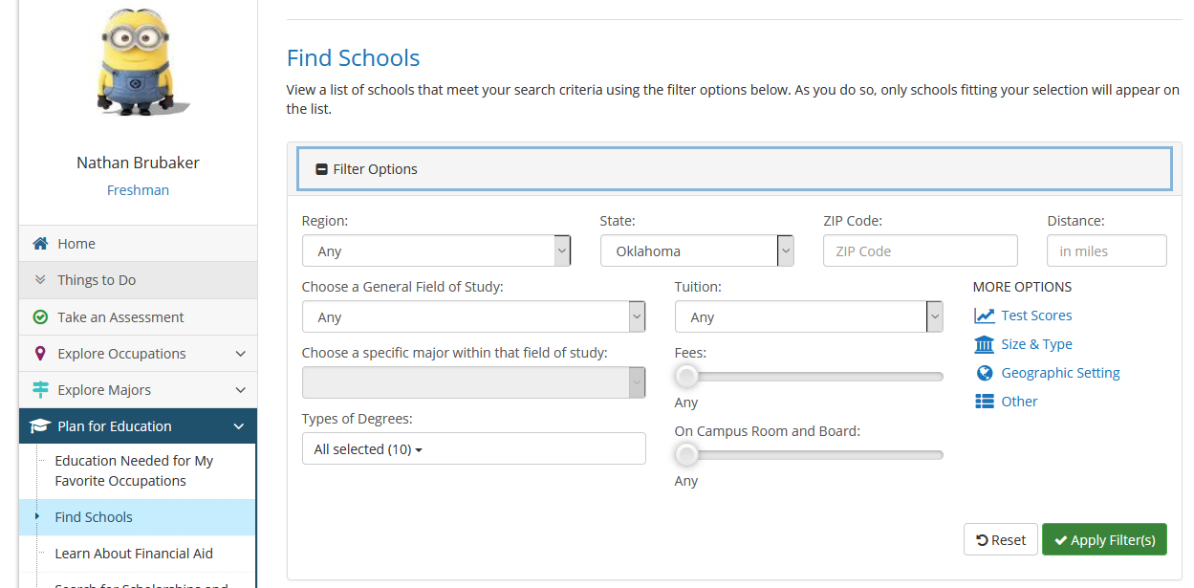

Slide 7





