Slide 1


Your Path to Your Future
Lesson Seven
Budgeting

Slide 2

https://www.pacareerzone.org/budget/
Notes:
Ask students to log onto https://www.pacareerzone.org/budget/. There are two options: the one on the left helps students calculate what they need to earn to fit their lifestyles; the one on the right helps them budget based upon the wages they earn. For this class purpose, have students choose the option on the left, “Budget How Much Money You’ll Need.”

Slide 3
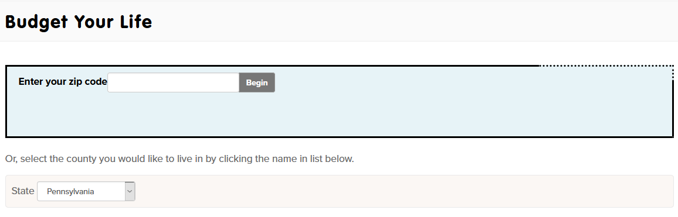
Notes:
Click on the bar to open a demographic location page.
Select “Oklahoma” from the drop-down list of states. Select the county in which you live

Slide 4
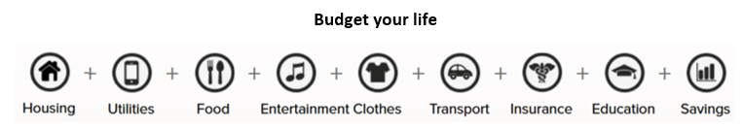
Notes:
Work through a list of categories that affect your lifestyle and income.
Please complete this activity and write down the minimum average salary provided at the end of the activity on your worksheet.

Slide 5
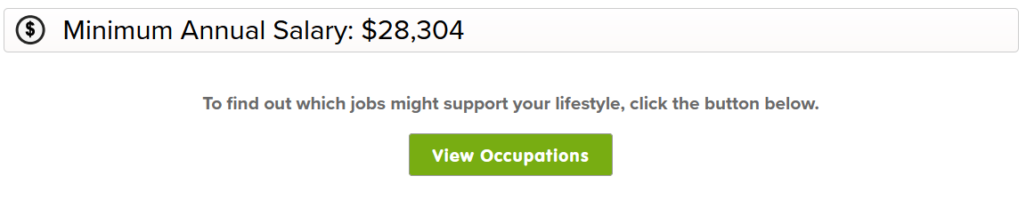
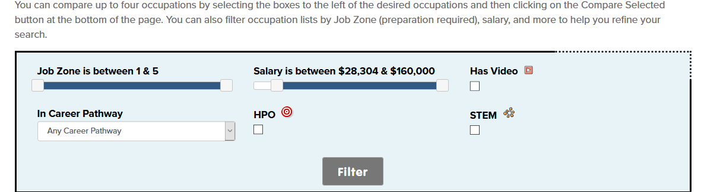
Notes:
At the bottom of the page, click on “View Occupations.” This list contains suggestions of occupations that have the potential to provide that minimum average salary.

Slide 6

