Slide 1
Your Path to Your Future
Lesson Nine
Successful Applications

Slide 2
Notes:
Have students log into OKCareerGuide.org and open Plan for Work in the left menu and select View a Sample Job Application. Make students aware that employers may reject incomplete applications. They also need to be aware that a lot of one-line applications use a system that looks for key words that match the actual job description.

Slide 3
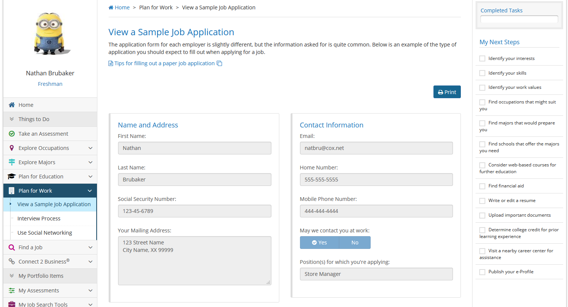
Notes:
Give an empty job application form and template to each student, along with Tips for Completing an Application. Compare the online application with the paper application. What are the differences?

Slide 4
