Slide 1
FCS
Spring PI
Meeting
2023

Slide 4
Open Positions/filled New Teachers 2023-2024
SE 1 SE 2
Norman Longfellow- Caitlin Bludworth
Prague HS-Amanda Camren
Strother HS
Choctaw HS
Alcott MS
SE 3 SE 4
Konawa HS-pending
SE 5
Wright City HS-
Please contact me if you plan to retire or switch schools.

Slide 5
Job Openings
(Watch the following for openings)
ctYou.org
OSSBA website

Slide 6
FCS Deadlines:
May 31-
CESI second semester data
Documentation for ctYou folder
FCCLA Connections article
Advisory committee report in folder
412-314 Program assistance report in folder

Slide 7
412/314 Program Funding
Remember to use your 412 money to purchase $300 worth of conference attire.
You will still be able to use $524 of your 412 money to affiliate members for your FCCLA chapter in 2023-2024.

Slide 8
Program Evaluations for 2023-2024 School Year
Ada HS Ada MS
Allen Antlers
Boswell Byng
Fort Towson Keota
Konawa Latta
Rattan Soper
Stigler Strother Tecumseh Valliant
Wewoka Okla. School for Deaf

Slide 9
“Newsletter”
READ for the most current information
Join us on OKFACSED
FACEBOOK!

Slide 10
CareerTech Badging
Should I or do I have to give my students the EOI?
There is now a better reason to give those EOI (End of Instruction) tests. These tests can now become a digital badge from CareerTech and Credly. Digital badges can be used in email signatures or digital resumes, and on social media sites such as LinkedIn, Facebook, and Twitter. This digital image contains verified metadata that describes your qualifications and the process required to earn them.
More information will be given at Oklahoma Summit, but if you would currently like to learn more about badging, click on the following link: https://oklahoma.gov/careertech/educators/certifications-and-badging/badging.html

Slide 11
Notes:
30 minute navigation demonstration CCFCS
Divide by courses to be taught
Work collaboratively on lesson plans, plugging-in current resources
School & Community Partnership
FCS Capstone

Slide 12
May Workshops
Registration link can be found in the newsletter or go to ctyou.org and click on FCS/FCS Registrations/May Workshops
There is also a block of rooms reserved at the Hampton Inn in Stillwater, when you click on the registration site for the workshop, the lodging information is listed.
Purchase orders are to be made to ODCTE.

Slide 13
State Conference is Tuesday, July 25th at Metro Technology Center. Registration is free.
Please watch the Newsletter for Registration link when it becomes available.

Slide 14
Looking for FREE lessons plans for foods and textiles classes?
Looking for grants for your foods and textiles classes?
Click on this link to see what Ag and Classroom has to offer https://oklahoma.agclassroom.org

Slide 15
Free Seeds
Looking for teachers who want to grow plants in your classroom, community gardens, raised beds, towers etc…
Kaleo Foundation has provided free seeds from all over the country to a small number of schools. Let your specialist know if you are interested in this project. They have the seeds with them. The goal is to teach students how to grow their own food then learn to cook/preserve it in their class.
Requirements:
Email Pam Walker at pwalker@thekaleofoundation.org with your
contact information
2) Follow the instructions on your sack
3) Take pictures, make sure everyone in the picture has permission to
be photographed take at least 4 pictures over a period of time.
4) Send a thank you email to Pam Walker who will then forward to the seed companies.
If you have any questions give her a call at 405-896-5613.

Slide 16
Want to know how to grow plants inside or outside of your classroom?
OSU Extension is hosting a School Gardening Conference on July 21st at the OSU convention Center 2500 NE 63rd St. Oklahoma City, Ok 73111
Cost: $15.00
Time: 8:30 to 3:30pm.
Only 120 spots available, first come.
Call or text Dr. Shelley Mitchel, OSU Extension Youth Horticulture Specialist shelley.mitchell@okstate.edu
405-744-1125

Slide 17
NEW Teacher Academy
Week of July 17-20, 2023
Open for teachers 1-3 years.
Watch the Newsletter for more information as it becomes available
https://www.eventbrite.com/e/new-teacher-academy-july-17-20-2023-1033-tickets-574826229727?utm_content=&utm_medium=email&utm_name=&utm_source=govdelivery&utm_term=

Slide 18
NEWSLETTER

Slide 19
OATFCS
Years of membership
Will be emailed to you so you can make necessary corrections and return to Program Specialist.
Please contact Holly Hanan at holly.hanan@careertech.ok.us
with questions.

Slide 20
OATFCS
We need you to be an OATFCS Officer!
The applications are due May 15 to gottschh@Cherokee.k12.ok.us and holly.hanan@careertech.ok.gov
Please use this application form: Officer Application link
The current positions that are open -
President-Elect - 3 Year Term
N Vice President
Treasurer-Elect – 4 Year Term
Occupational Vice President
We NEED officers to ensure strength in our Division!
!

Slide 21
OATFCS Scholarships
Teacher Scholarship: $500 scholarship for current OATFCS member who is working toward teacher certification, degree or completing industry certification requirements for ODCTE.
Application link: https://docs.google.com/document/d/1IVqOD7wIqKlcyy9DtMYUVZFHquToAsICDXy3ttFZUyM/edit?usp=sharing
Student Scholarship: Two $500 scholarships will be awarded to students interested in becoming Family and Consumer Sciences teachers.
Application link: https://docs.google.com/document/d/1X0GcSWJgbbh3CThC61HGDdON57evqQZ0NC8vEpAauWU/edit?usp=sharing
Opportunity Fund: A $500 stipend will be awarded to an OATFCS member for extended educational/professional activity.
Application link: https://docs.google.com/document/d/18lycY7mFhuBlvSHDUjDBD2Qjg2Av6PPPoAR3_ueQRug/edit?usp=sharing

Slide 22
Oklahoma Summit
REGISTRATION
$75.00 before July 1 after that moves to $100
Add $40.00 FCS registration
Oklahoma Summit Registration will open
May 2, 2022 at 8:00 am
Register at
Summit Registration
Or
Visit ctyou.org under FCS Registrations
for a direct link to registration

Slide 23
OATFCS Opportunity Fund
$5.00/teacher
Pay District Treasurer
Use Venmo app: @OATFCS (8920)
Write a check to OATFCS & give district treasurer
Funds go toward a $500 stipend for Professional Development for an OATFACS member
Deadline to apply for OPPORTUNITY FUND: June 1st application on OATFCS website (awards, scroll down)

Slide 24
OATFCS Fundraisers
Watch the weekly FCS NEWSLETTER for the
T-shirt Fundraiser
T-shirts at OK Summit
You can wear jeans (no holes) to DAY 2 with the OATFCS shirt.
If you choose not to wear the OATFCS shirt you need to be in professional dress
Ordering information will be included in the FCS Newsletter.
Shirts will shipped directly to you prior to OK Summit.
Proceeds go to the OATFCS Scholarship fund.

Slide 25
OATFCS Curriculum Showcase
Curriculum Showcase is one of our most popular sessions at Oklahoma Summit
Successful classroom activity, project, assignment, etc.
Curriculum Showcase presentation apply applications are due June 1
$50 stipend for presenting
The winner gets to present at ACTE Conference- VISION 2023 and receives a $725 stipend
This year VISION will be Phoenix Arizona from November 29- December 2, 2023.

Slide 26
OATFCS Curriculum Showcase cont.
Deadline to complete this form is June 1, 2023
5 applicants will be selected to present and will receive a $50.00 stipend for participating.
Presenters will be judged by a panel of teachers.
The first place showcase will represent OATFCS at the ACTE Vision 2023 held November 29-December 2, 2023 in Phoenix, AZ.
OATFCS will provide a $725 stipend towards travel expenses, upon attendance at ACTE.
Must be an OATFCS member to participate.
Application: Curriculum Showcase Application
DISCLOSURE: You are responsible for all equipment and supplies needed for your project. Your presentation must be transportable to the ACTE Convention if selected as the overall OATFCS Curriculum Showcase winner.
NEW: If you are chosen to present at the Summer Summit, be prepared to submit a 5 minute digital presentation along with your handouts and PowerPoints. These will be due June 15, 2023 to the OATFCS Officers

Slide 27
OK Summit
Aug. 1-2, 2023
Tulsa Cox Convention Center
FCS will be at the
convention center both days

Slide 28
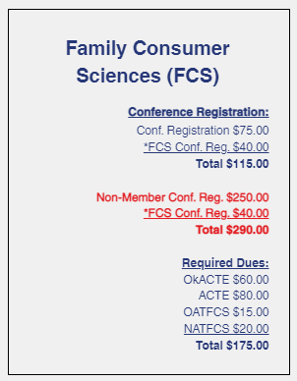
Registration Oklahoma Summit 2023
Oklahoma Summit Registration
will open
May 1, 2023 at 8:00 am
Register at
https://www.okacte.org/2023-oklahoma-summit
Visit ctyou.org under FCS Registrations
for a direct link to registration

Slide 29
OKACTE Membership Dues Installment Plan
Deadline for the 2 payment installments is August 8, 2023.
Visit the OkACTE Membership Dues Installment Plan at the link below or you can contact Carmen Jones at:
cjones@okacte.org
Installment plan: 2 payment installment plan

Slide 31
Year End Wrap Up
Remember to complete/update your classroom inventory
Add your end of year 412 report to your 5 year folder
Add your end of year FCCLA activities report to your 5 year folder

Slide 33
State Executive Council
President- Brandon Weibel, Silo FCCLA (SE) | VP of Public Relations- Tessa Inman, Lindsay FCCLA (S)
First Vice President- Santana Scraper, Stilwell FCCLA (NE) | VP of Competitive Events- Gus Avendano, Fairview FCCLA (N)
VP of Community Service- Jaden Taylor, Latta FCCLA (SE) | VP of Development- Raylee Holstine, Tushka FCCLA (SE)
VP of Marketing- Maegan Runnels, GPTC FCCLA (S) | National Officer Candidate- Davin Budy, Cherokee FCCLA (N)
VP of Membership- Ava Jenkins, Minco FCCLA (S) | National Officer Candidate- Olivia Boeckman, Drummond FCCLA (N)
Post-Secondary Officer- Elijah Allen, GPTC FCCLA (S)

Slide 34
New SE Region District Officers
Region/District | First Name | Last Name | Office | School
SE 1 | Emily | Faulkenberry |  | Marietta
SE 1 | Rosalyn | Henbest |  | Caney
SE 1 | Kyla | Conley |  | Silo
SE 1 | Maddie | Mueller |  | Colbert
SE 1 | Kooper | Walker |  | Kingston
SE 2 | Veronica | Arambula |  | Norman North
SE 2 | Mayleigh | Vandusen |  | Gordon Cooper Tech
SE 2 | Peyton | Box |  | Gordon Cooper Tech
SE 2 | Piper | Newberry |  | Choctaw
SE 2 | Tinley | Sylsberry |  | Seminole
SE 3 | Sara | Mearns |  | Latta
SE 3 | Summer | Wilson |  | Latta
SE 3 | Khloe | Goodson |  | Allen
SE 3 | Sherra | Patterson |  | Byng
SE 3 | Roxanne | Thompson |  | Byng
SE 4 | Rylee | Branch |  | Panama
SE 4 | Addison | Fioretti |  | Stigler
SE 4 | Kendall | Stout |  | Stigler
SE 4 | Kaylee | Truax |  | Bokoshe
SE 4 | Bryanna | Urchison |  | Bokoshe

Slide 35
New North Region District Officers
Region/District | First Name | Last Name | Office | School
SE 5 | Kennedy | Weaver |  | Tushka
SE 5 | Chloe | Clements |  | Idabel
SE 5 | Mackalynn | Dansby |  | Valiant
SE 5 | Tennyson | Elrod |  | Wright City
SE 5 | Kaydence | West |  | Boswell

Slide 36
FCCLA Need to Know Information
STAR Events trophy/medals
Have your winner send a thank you note to the person’s name on the sticker of their trophy. We hear from them when they receive the thank you note and it matters!!
OUTSTANDING FINANCIAL BALANCES
R EMINDER – If you have outstanding balances from this fiscal year, including National FCCLA balances, you will not be able to affiliate/register for anything in August until all balances are paid in full. Please call the office to confirm you do not have a balance before leaving for summer!
CONNECTION MAGAZINE
Articles are due May 31st and the form for submission will be on the OK FCCLA website.

Slide 37
FCCLA Need to Know Information
Lead Conference –
Required conference for all FCCLA chapters. Attend your region’s Lead Conference as Fall PI meetings will be taking place during the workshop sessions.
Registration Deadline: August 31, 2023
This conference is for chapter officers/leaders and it prepares them for their leadership role within the chapter.
$10 per person with a limit of 7 per chapter.
Taking place 9 am – 12 pm.
PLEASE DO NOT LEAVE BEFORE 12:00.
September 6th, Enid, North Region
September 7th, TBD, NE Region
September 13th, Duncan, S Region
September 14th, McAlester, SE Region

Slide 38
Upcoming Events
DOT- June 14-16.
Oakridge Camp, Anadarko, OK
First advisor is free 2nd is paid for out of District funds. There will be an electronic waiver emailed to all counselors and officers. It MUST be completed prior to camp. Campers should arrive at between 12:00 pm – 1:00 pm having already had lunch. Camp will begin at 1:00 pm. Camp ends at 11:00 am Friday, June 16th.

Slide 39
Upcoming Events cont.
Summer Leadership Summit
June 8th Edmond North HS
Registration is open
$75 per student
First time attendees will be trained by Kelly Barnes and go through a full day of low ropes course activities
Returners will be with Kaitlyn Kirksey learning how to take FCCLA information and apply it to projects/competitive events
Deadline is May 12th, 2023

Slide 40
Upcoming Events cont.
National Leadership Conference
July 1 - July 7, 2023
Intent to Compete Form must be completed by April 20th.
Oklahoma NLC Package order due April 20, 2023. Required of everyone attending NLC. Cost is $95, registration is on the Oklahoma FCCLA website under Attend – National Leadership Conference.
Oklahoma Delegation Voting Delegate application due April 20, 2023
Need STAR Event volunteers – 1 volunteer for every 3 competitors attending. It’s a great way to learn about STAR Events. Members, advisers, and chaperones may volunteer.

Slide 41
Upcoming Events cont.
Oklahoma Riversports Day
September 16, SAVE the DATE! Cost and rafting signups will be available soon.
Take AIM
October 12, 2023
Cost - $50 per person
Moore-Norman Technology Center – Penn Campus
Includes lunch and polo for attendees

Slide 42
NEW Competition – Meat Cookery Competition
Guidelines will be posted May 1, 2023
Requires students to create their own recipe using beef and Made In Oklahoma (MIO) Products
Requires nutritional analysis and cost analysis
Information and instructional video of dish being prepared must be submitted by August 28, 2023 to be considered as a finalist. Finalists will be notified by September 5 if they have been chosen to compete at the Fairgrounds
Finalists compete at the State Fairgrounds September 18 (Levels 1 and 2) September 23 (Levels 3 and 4) and the grand champion competition September 23
Each competitor and ONE adviser per chapter will receive free fair admission for the day of competition
Students may compete in this event AND other STAR Events
Must be in chef uniform to compete

Slide 43
Wrapping up the Year
Elect New Officers
Create T-shirt designs for next year
Work with new officers to create membership recruitment campaign
If school allows, open Purchase Orders for new fiscal year dated July 1 for:
T-shirts
Affiliation (made payable to Nationals)
Lead Conference (made payable to OK FCCLA)
Take AIM (made payable to OK FCCLA)
STAR Event registrations (made payable to OK FCCLA)
FCCLA District/District Conference fees (made payable to your district bookkeeper)
FCCLA State convention (made payable to OK FCCLA) Date to be deremined.

Slide 45
Thank you all for your hard work this year and everything you have done for your students.
We in the FCS division of the State Agency see what you do and commend you!!
You are greatly appreciated and we know we don’t tell you all that enough.
THANK YOU!!!
Remember to take time for yourself this summer!! You deserve it!

Slide 46
DISTRICT PLANNING

Slide 47
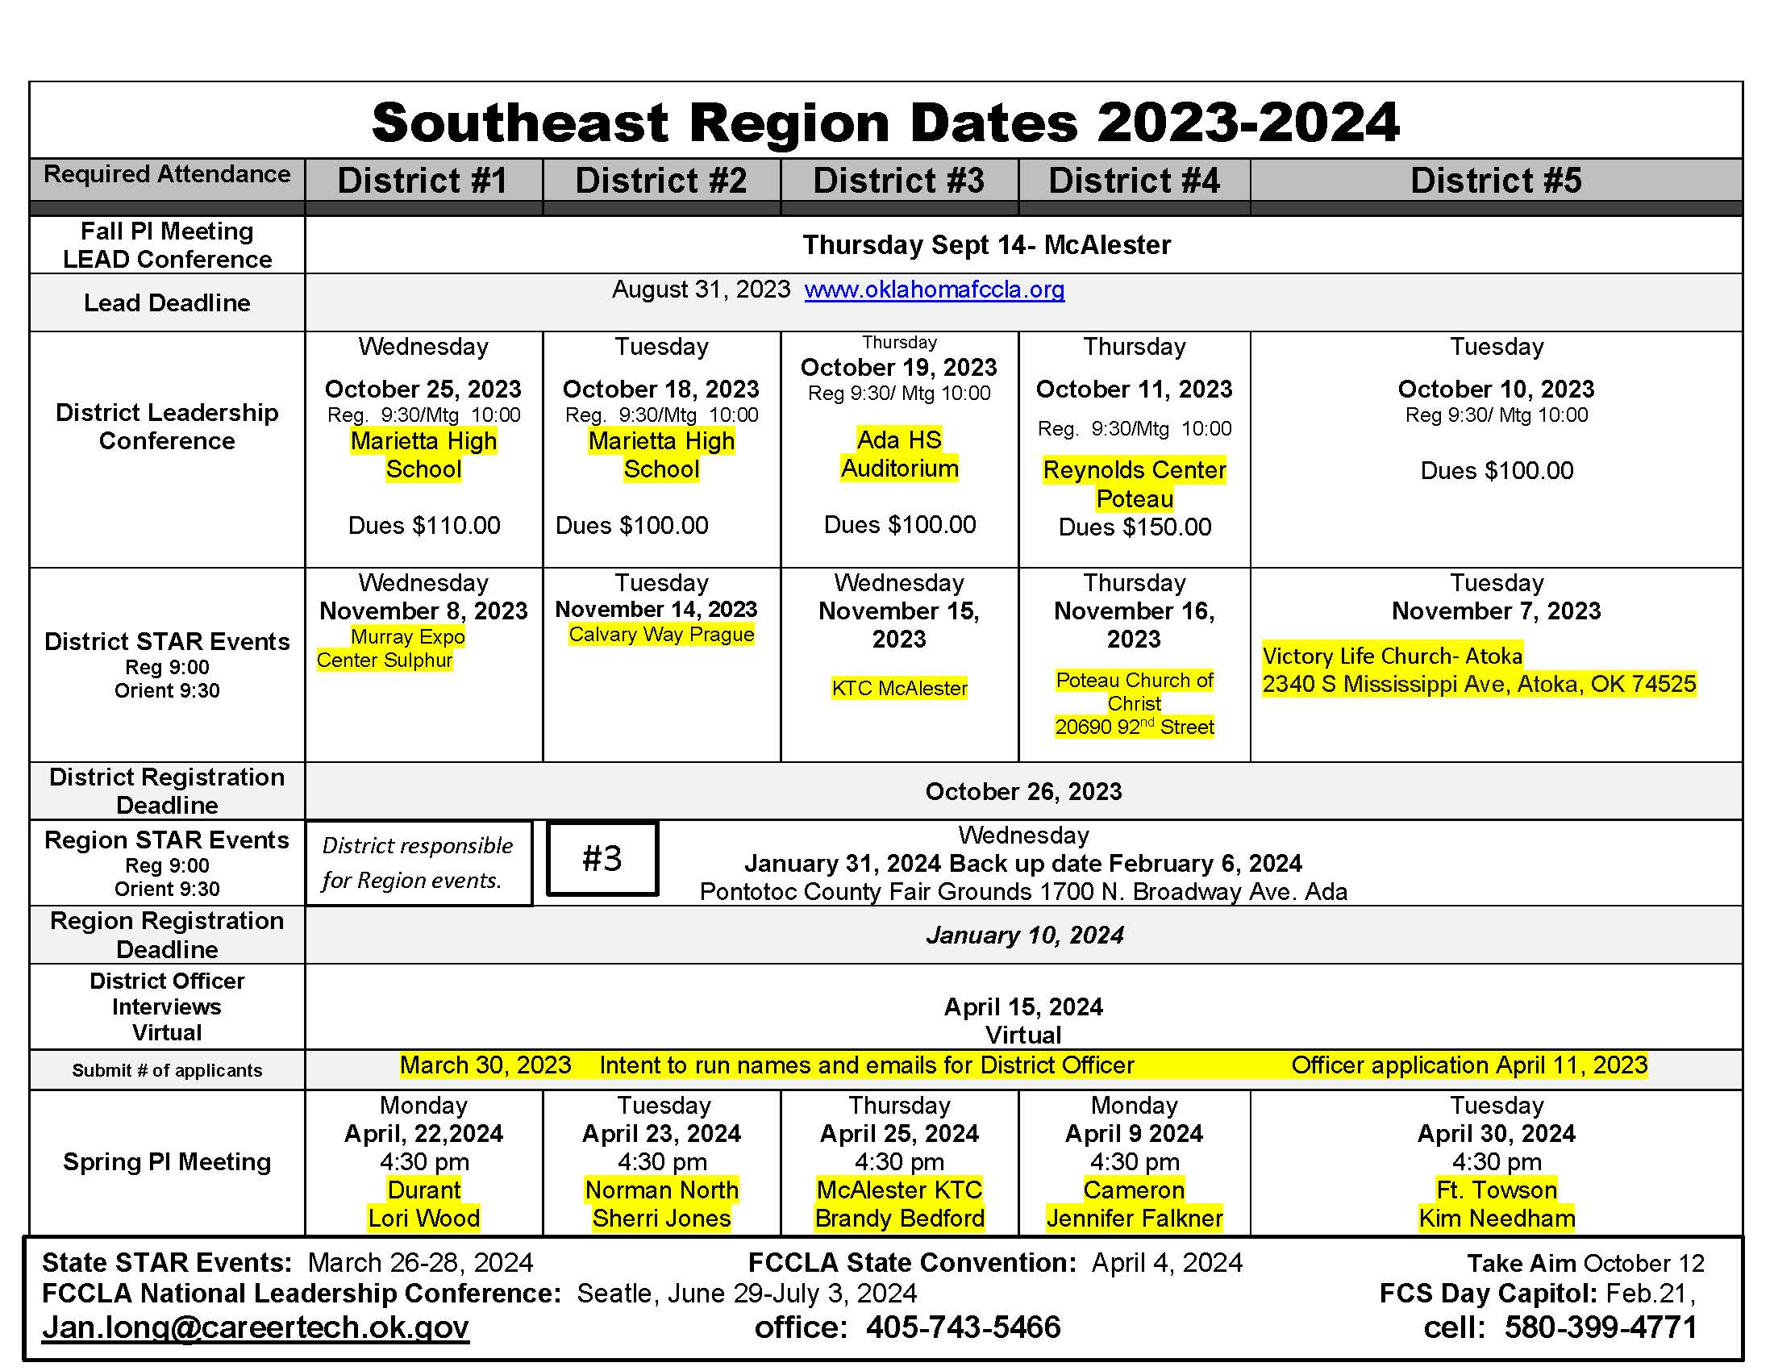

Slide 48
Show and Tell items, lesson plans or other cool stuff for your classroom

