Slide 1
Registrar Training 2023
The use of proper OCAS CODES for Courses and Programs with Ok Graduation Requirements, OK Promise, College Credit, and Postsecondary Opportunity Points

Slide 2
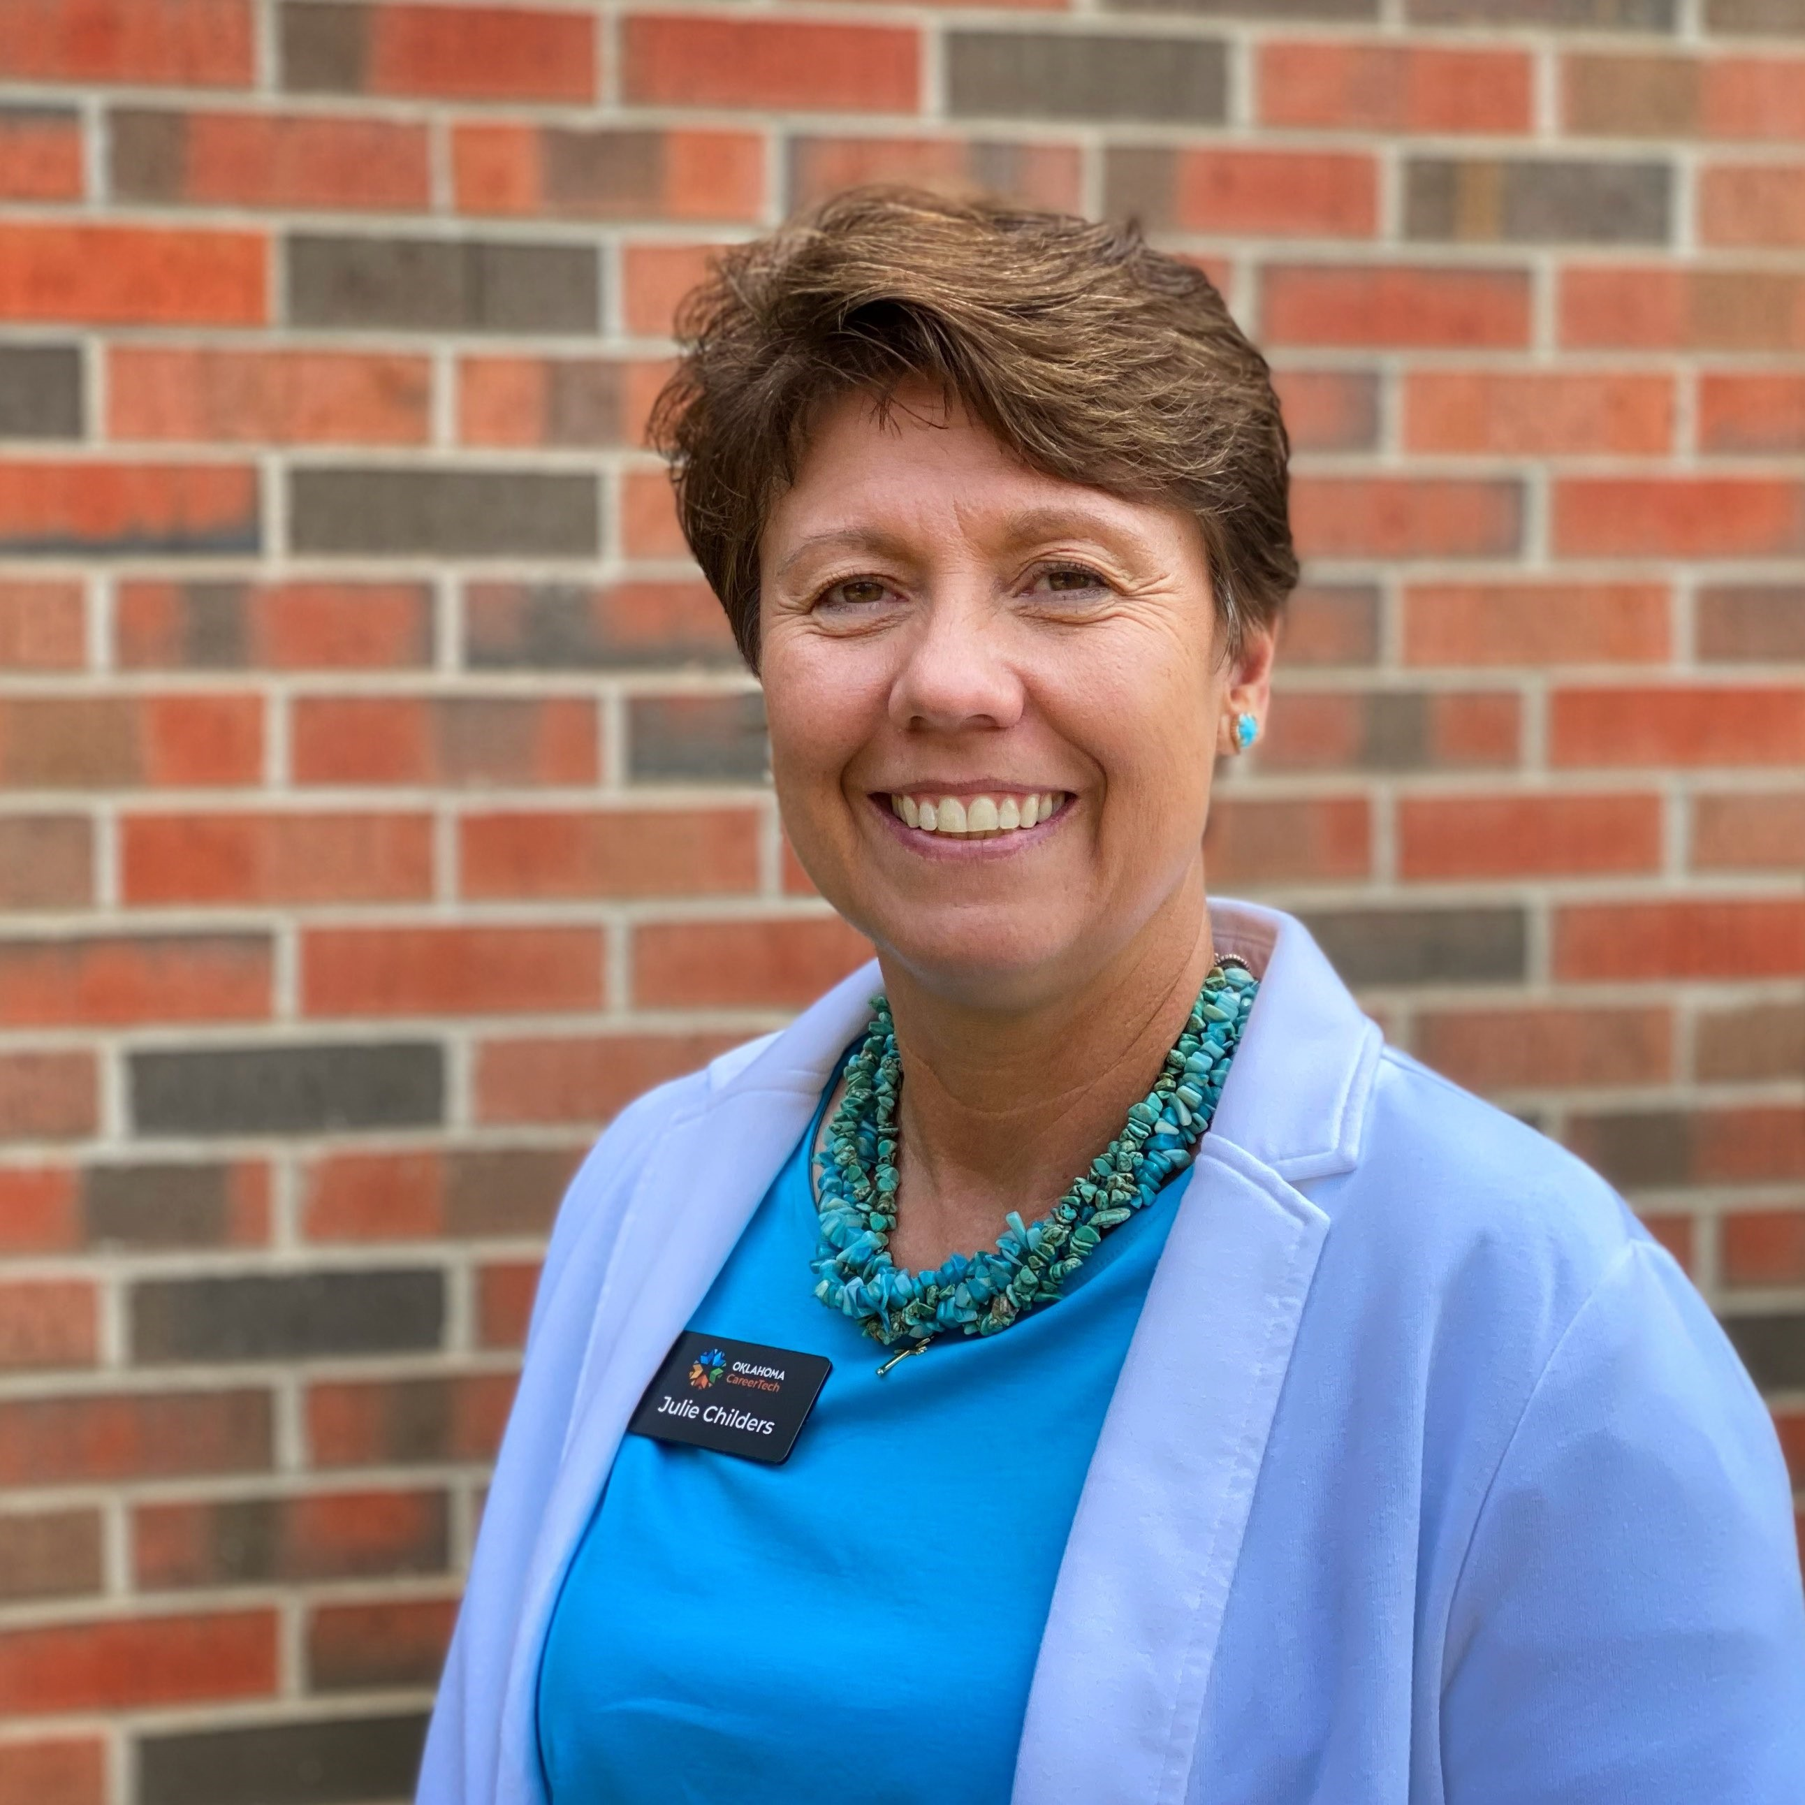
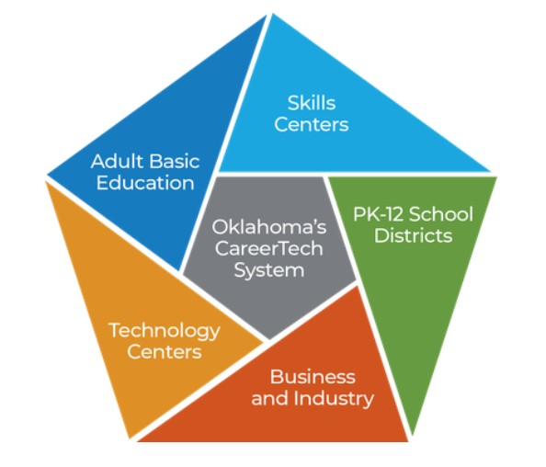
Oklahoma CareerTech has 5 Delivery Arms!
Today's focus is PK-12 and Technology Centers.
Julie Childers, Academic Coordinator
27 Years in Public Education
24 Years as a School Counselor
School Size: Class B to 4A
Bachelors: Oklahoma State University
Masters: University of Central Oklahoma
Notes:
Good Morning I am Julie Childers and I am the academic coordinator at the Oklahoma department of career and technology education, CareerTech. This first slide has just a little information about the delivery arms of careertech. Through our arms of delivery we service Oklahomans from PK through adulthood. So careertech is not just your local technology center or a set of great classes at your school, it is a large organization serving Oklahoma. Today we will focus on the K-12 courses and our technology center programs.

Slide 3
What is an OCAS Code?
The common name in K-12 Education is “Subject Codes”.
On the student support page of SDE website you will find the link to “High School Subject Codes”
On the Oklahoma Department of CareerTech Website you will find the CTE OCAS Codes for Course and OCAS Codes for Program Codes.

Slide 4
Why does it make a difference?
CareerTech people say courses and some high school people say classes.
ex. He is in a BMITE course.
He is in a BMITE class.
Both a course and a class fall under the Carnegie Rule, 120 hours equals 1 credit. A course can be worth math, science, computer, or elective credit.
CTE Codes for Courses can be used for classes at the high school or courses within a program at a technology center.

Slide 5
Program vs. Course or Class
CareerTech people say programs and some high school people say classes or courses.
ex. He is in a health careers program.
He is in a health careers class.
Full-Time Programs, as defined by “3rd Math Credit on Core” and eligibility for “PSO Points”, are a 3 hour long 9000 coded program ending in the ability to gain industry recognized certification. Programs are always transcripted as electives.

Slide 6
Technology centers send grades to high schools.
Because Oklahoma is a local control educational state, there are many ways to send grades to high schools. What is important is the information a technology center sends. Best Practice would always include the OCAS code.
Here is a version where the student gets only elective credit.
Student Name, 9057 Electricity, S1- 96 A, 1.5 credits
Here is a version where the credit is not all elective.
Student Name, 9202 Administrative Support, S1- 88 B, .5 credit
Same Student, 8103 Fundamentals of Administrative Technology, S1- 96 A, .5 credit
Same Student, 8109 Computerized Accounting, S1- 80 B, .5 Credit

Slide 7
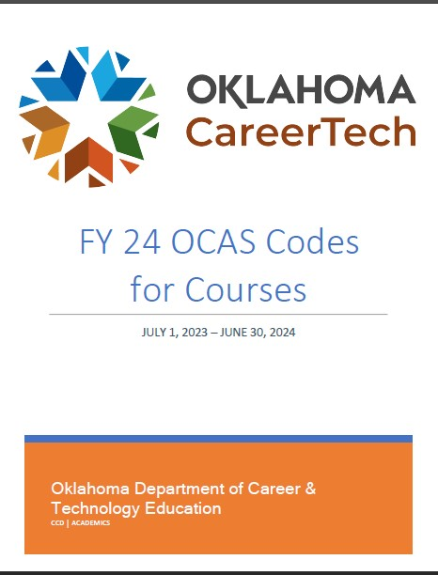
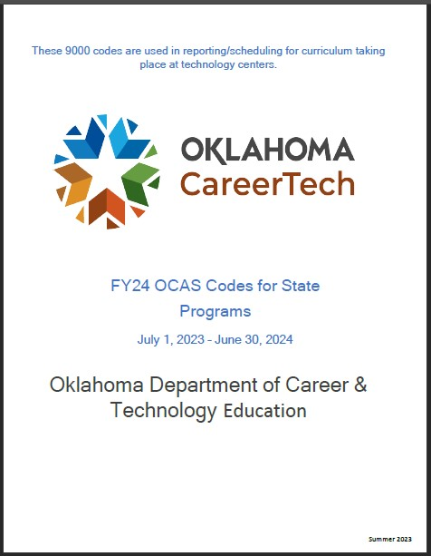
The 23-24 OCAS documents look very different.
Both documents tell you the OCAS code and CTIMS code.
Both documents tell you the state approved names for courses and programs.
Only the Course Codes tell you how much some specific courses are worth and what graduation requirement it can meet, if it’s not an elective.

Slide 8
Why is it important?
The official name of the program or course is what should be recorded by the high school on the transcript, not the technology center’s common name. Using the unofficial name could lead to a student not getting the correct credit toward graduation, OK Promise, or in some cases hours toward completion of a degree.

Slide 9
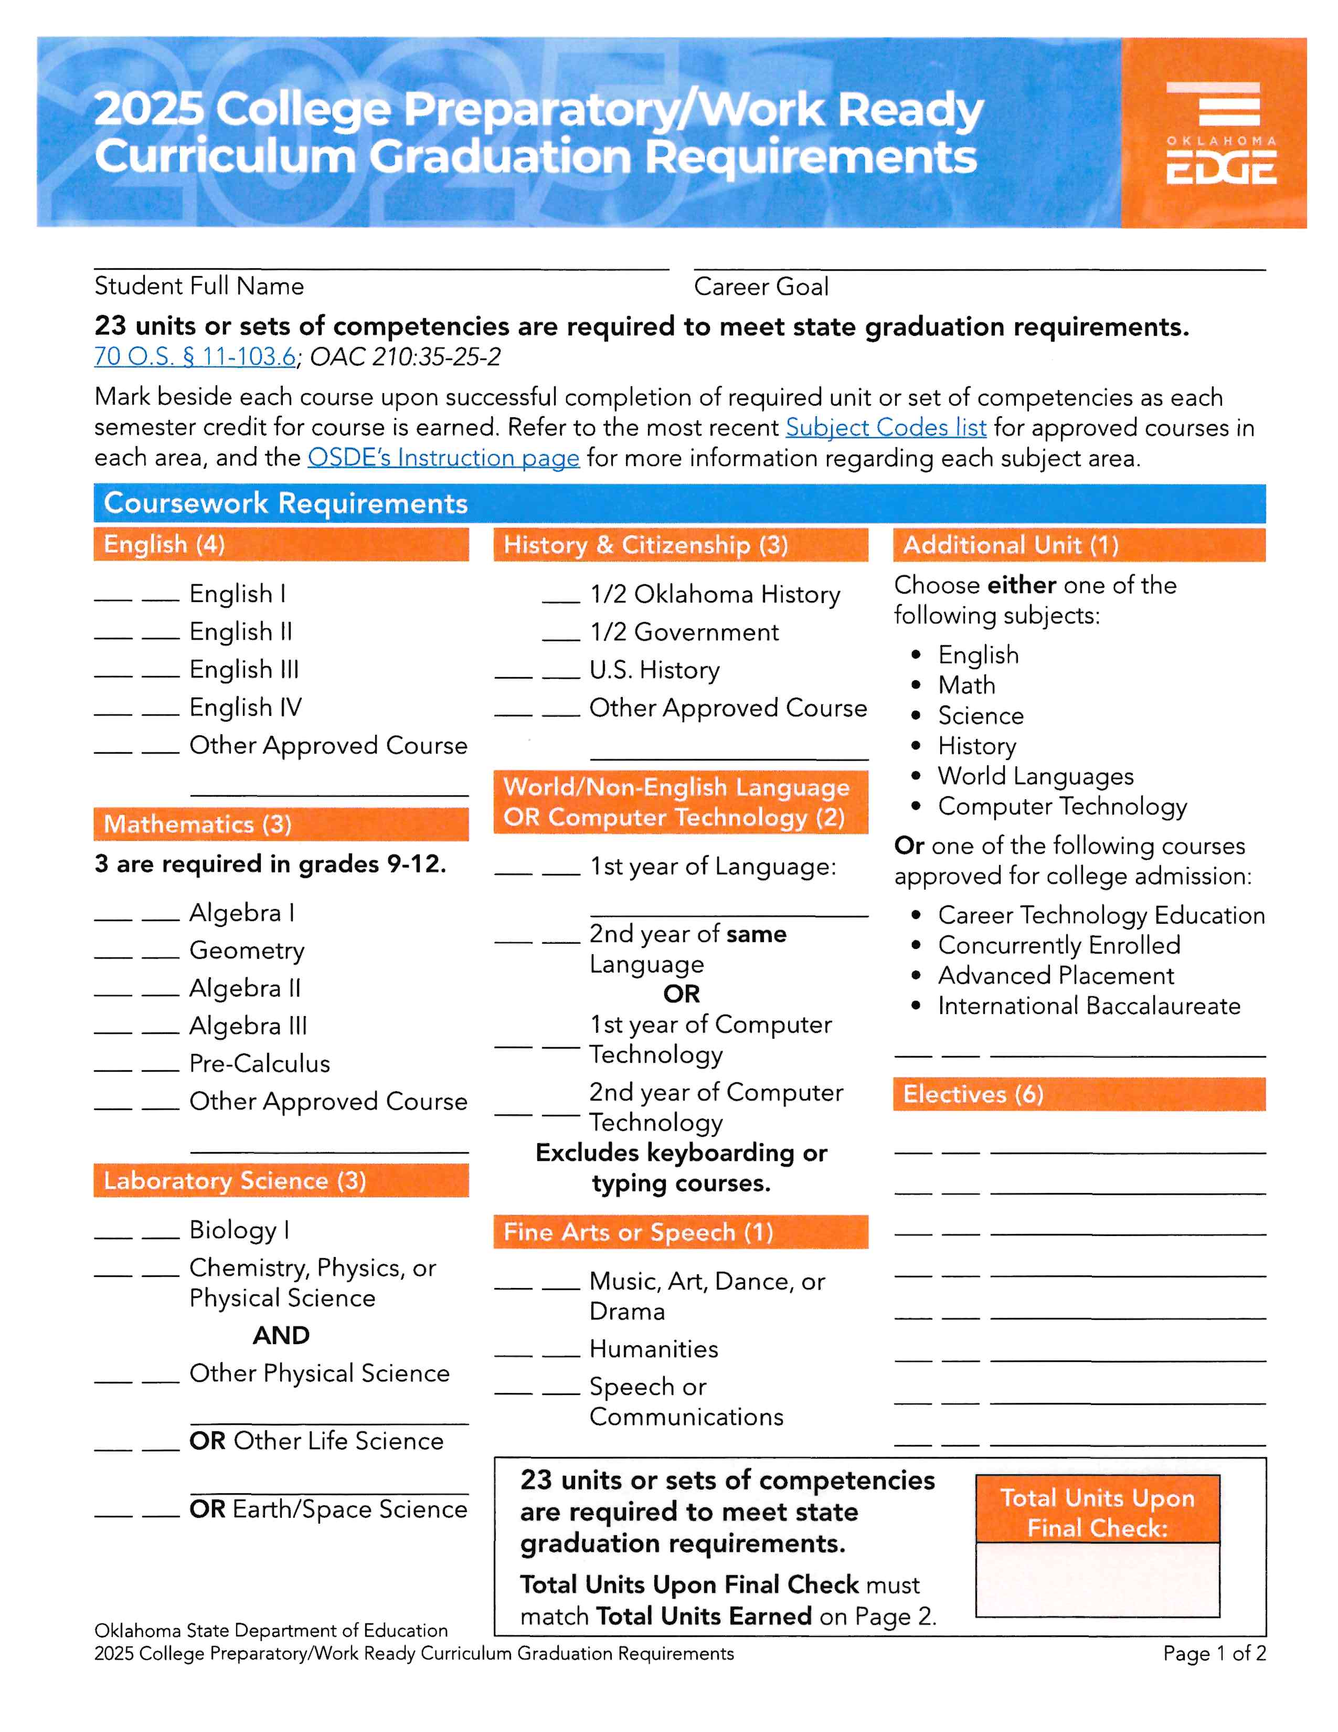
Here is a quick guide for looking at the College Prep graduation requirements.
The blue arrows are courses, the green arrow is programs, and the yellow arrow can be any of the blue arrows.

Slide 10
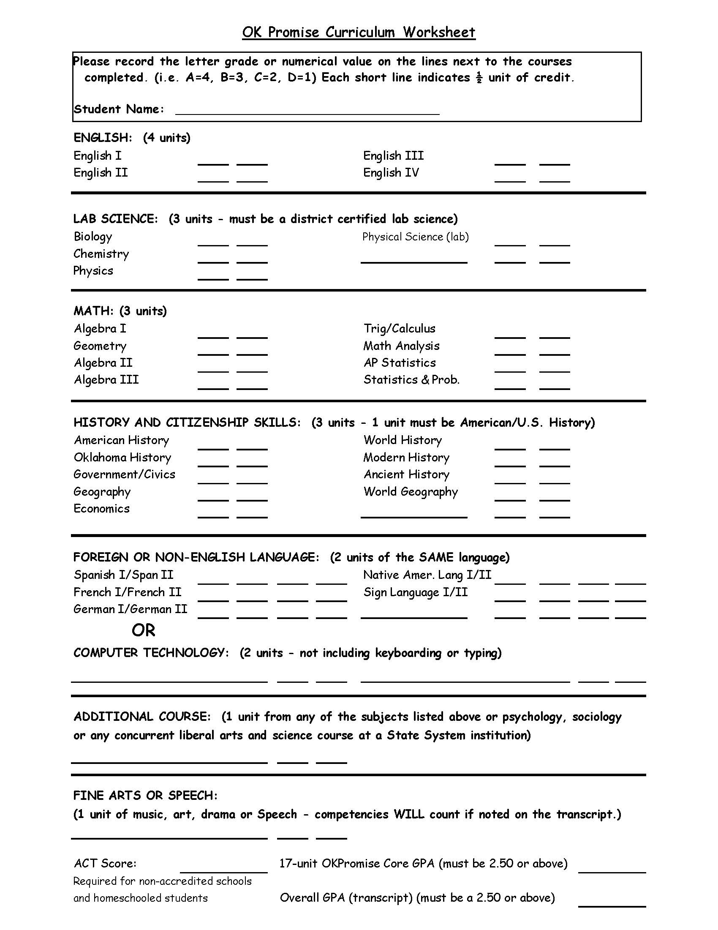
Here is an OK Promise Worksheet. The arrows show where specific “courses” can meet requirements.
In the CT OCAS Codes for Courses document, you can see which CT courses are accepted for OKPromise.
Here are the 4 requirement areas they can fulfill.

Slide 11
Effecting College Credit?
Attended a career technology center or have a professional license? Use knowledge learned from career technology center courses or occupational credentials toward college credit. - Show What You Know - Oklahoma (showwhatyouknowok.org)

Slide 12
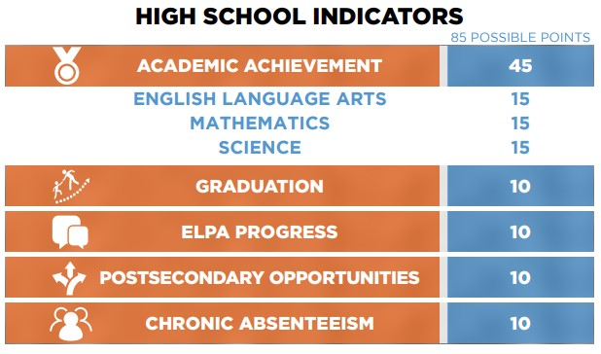
Why are 9000 codes so important?
9000 coded grades and a small number of capstone/internship course grades are the indicators that pull from the “Wave” and right now it requires a S1 grade and a S2 grade.

Slide 13
Newest PSO Guide June 2023
PO Coursework Guidance Doc 06072023.pdf (ok.gov)
High Schools get PSO points from Concurrent Enrollment, AP Classes, Internships, and CareerTech Programs.

Slide 14
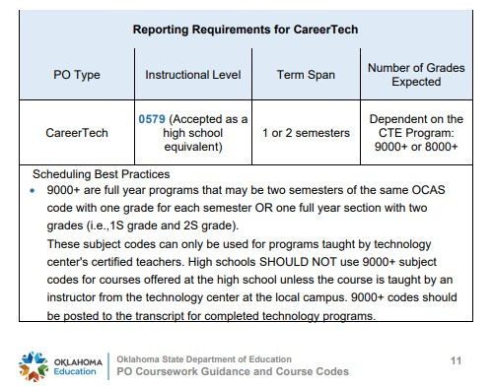
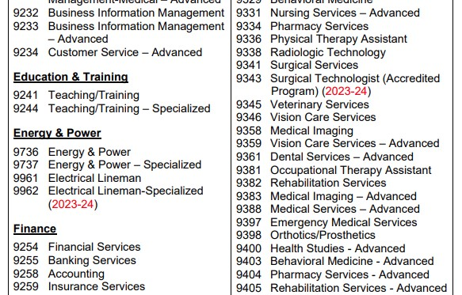
Every SIS is different and how courses and sections are created is not the same. Sometimes a K-12 needs to call tech support or a buddy.

Slide 15
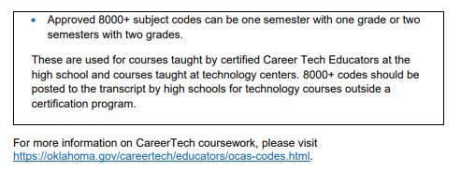
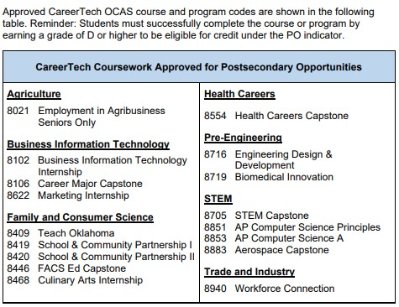
PSO continued:
The chart on your right are the CT 8000 codes the wave recognizes for PSO points.

Slide 16
Here is a reminder about transcripts. Why do technology centers not transcript high school students grades?
What Is a High School Transcript? How Do You Use Yours?
(SECURE)blog.prepscholar.com/what-is-a-high-school…
A high school transcript is basically a record of your academic accomplishments in high school. It lists every class you took, when you took them, and the grade you received in each class, and sometimes other information like standardized test scores and honors. ……..

Slide 17
Sending Certifications for High School Students
A Common Question on Certifications:
What Certification do technology centers send to high schools?
The statute is any certification that is “Nationally Recognized”.
The best practice is sending any certification test a student has taken and passed.

Slide 18
Lastly on, Certifications!
Proper Name of Test, Location Taken, Date Taken
Send them 2 or more times a year.
Best practice is to send all certifications earned and let the local districts policy decide if they transcript more than the “Nationally Recognized” tests.

Slide 19
Questions?

