Slide 1
Northeast
Region Meeting

Slide 3
Jeanette Blevins
Jeanette.Blevins@careertech.ok.gov
Office: 405-743-5463
Cell: 405-802-9555
Updates since last year:
Loving on Grandbabies/No new ones this year
Only visited Mexico 4 times
Took my husband to Disney World without children
Didn’t get fired

Slide 4
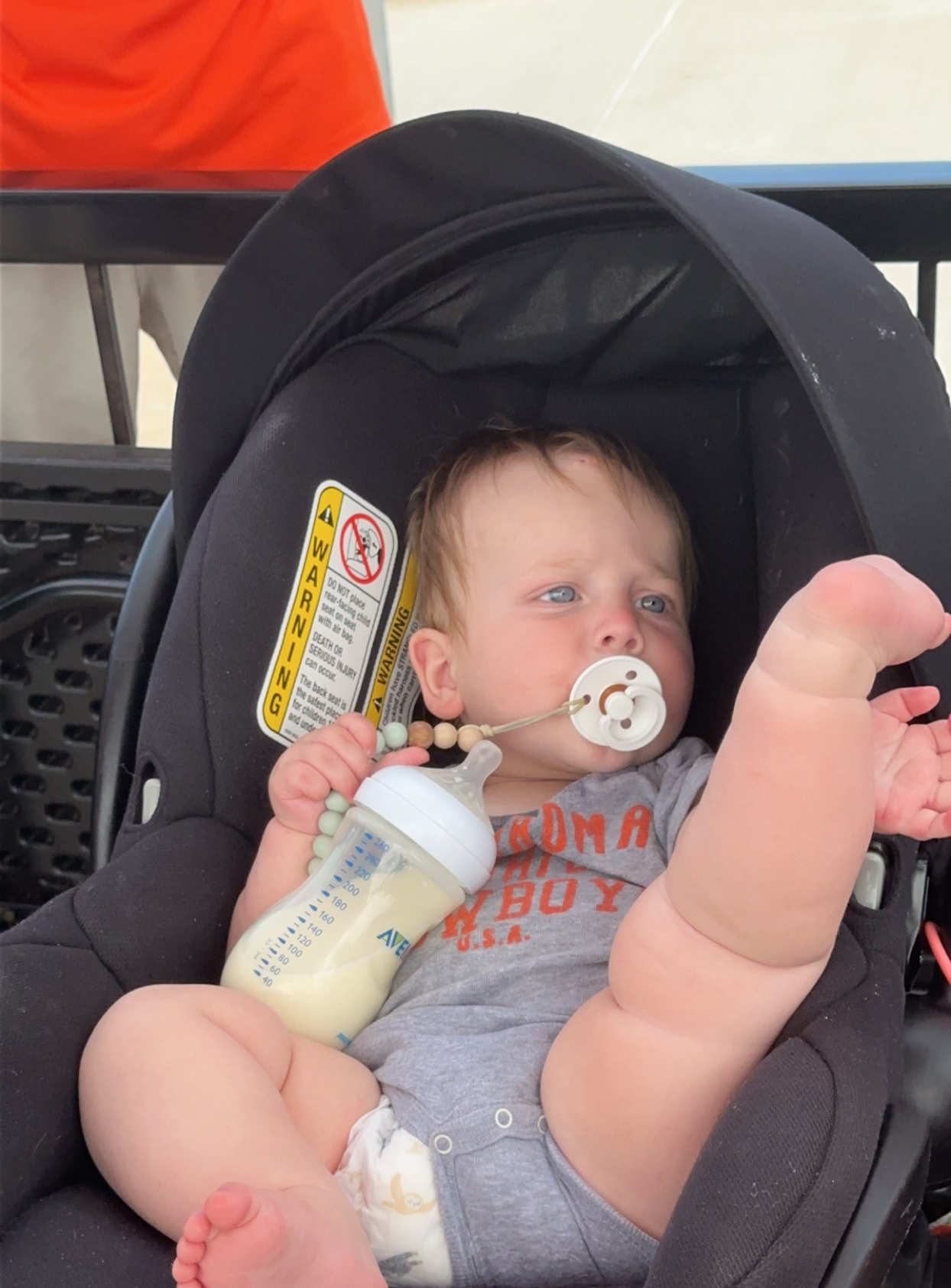
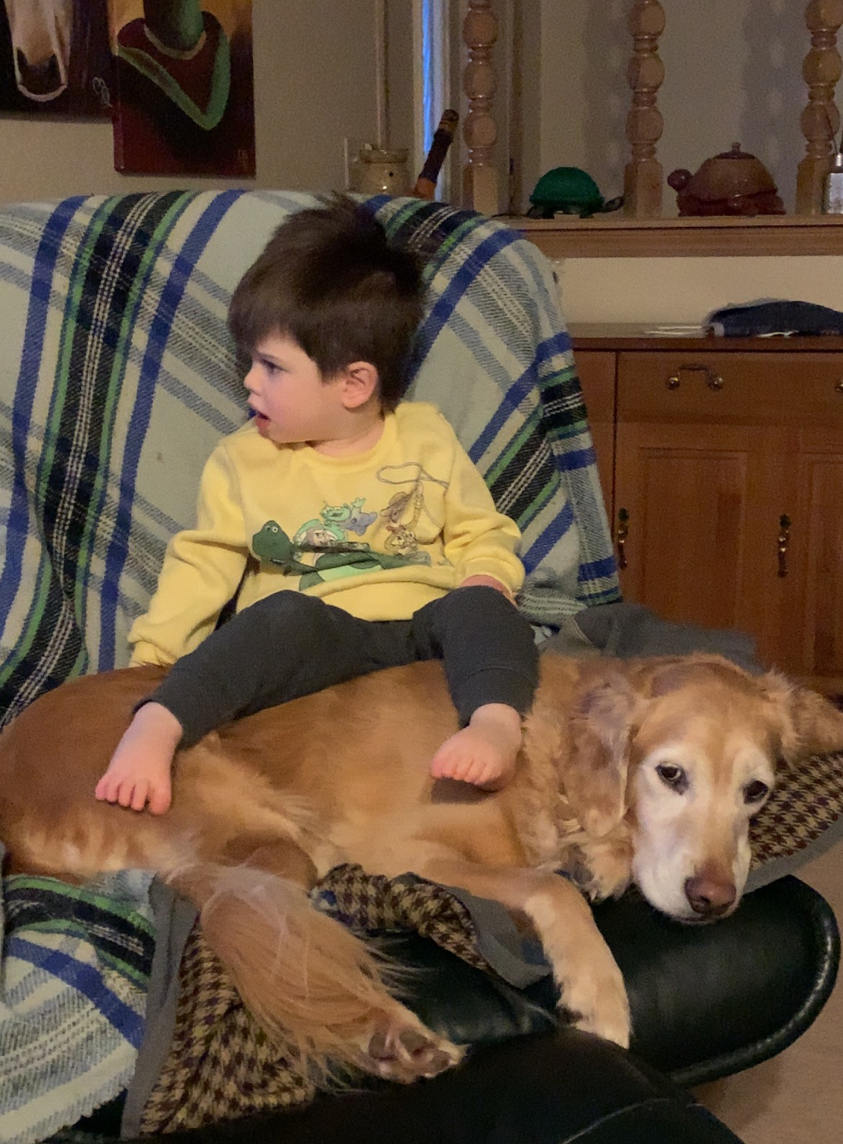
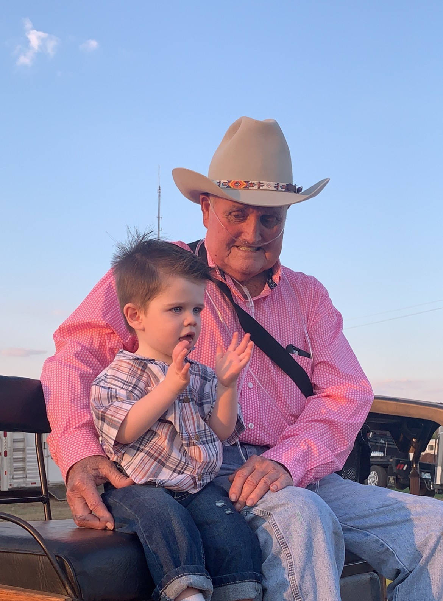
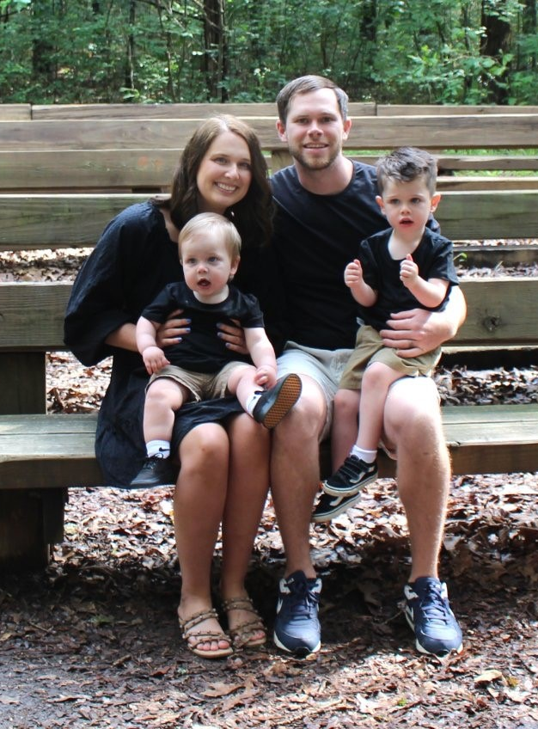
Paden & Pryse & Marshall & Sutton

Slide 5
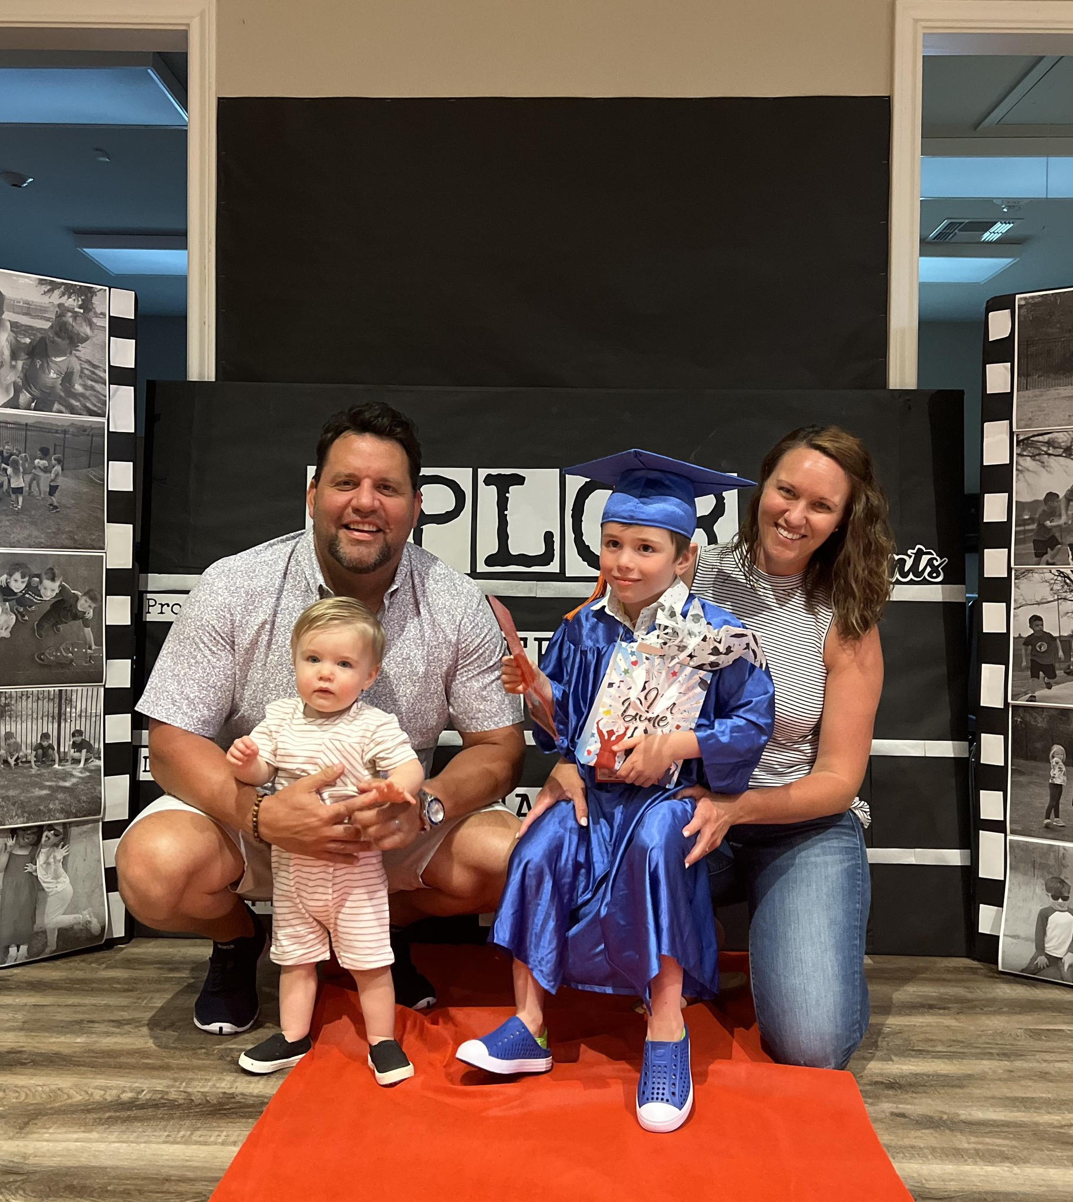
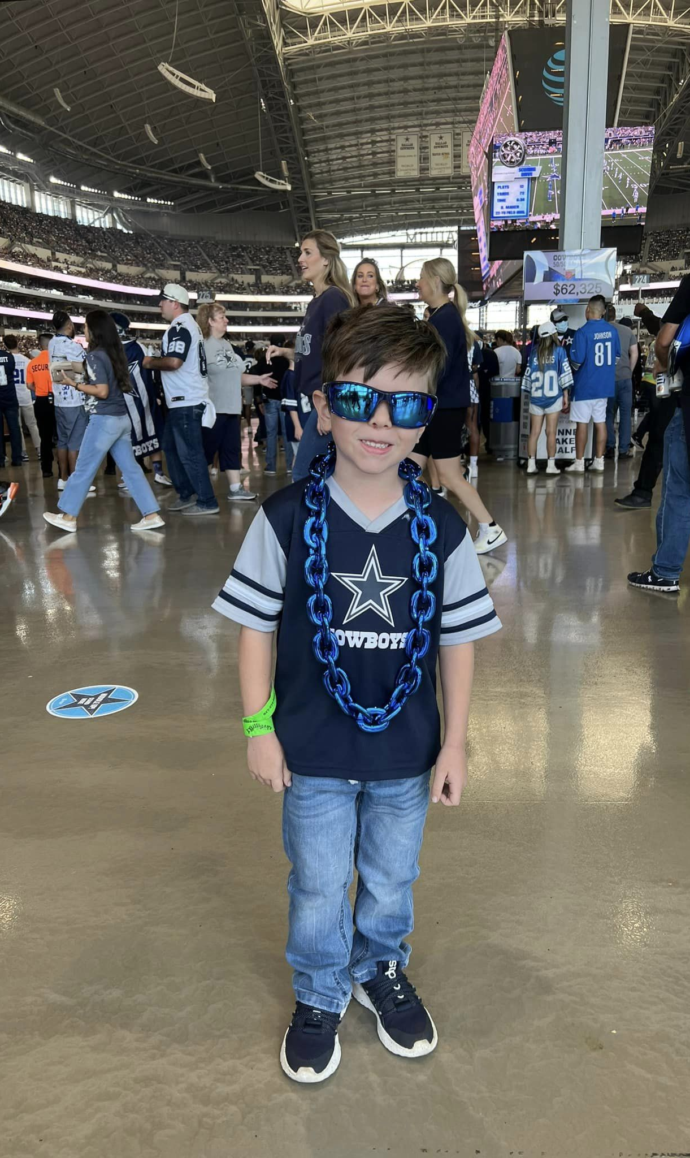
Jamie & Chris & Paxton & Cooper

Slide 6
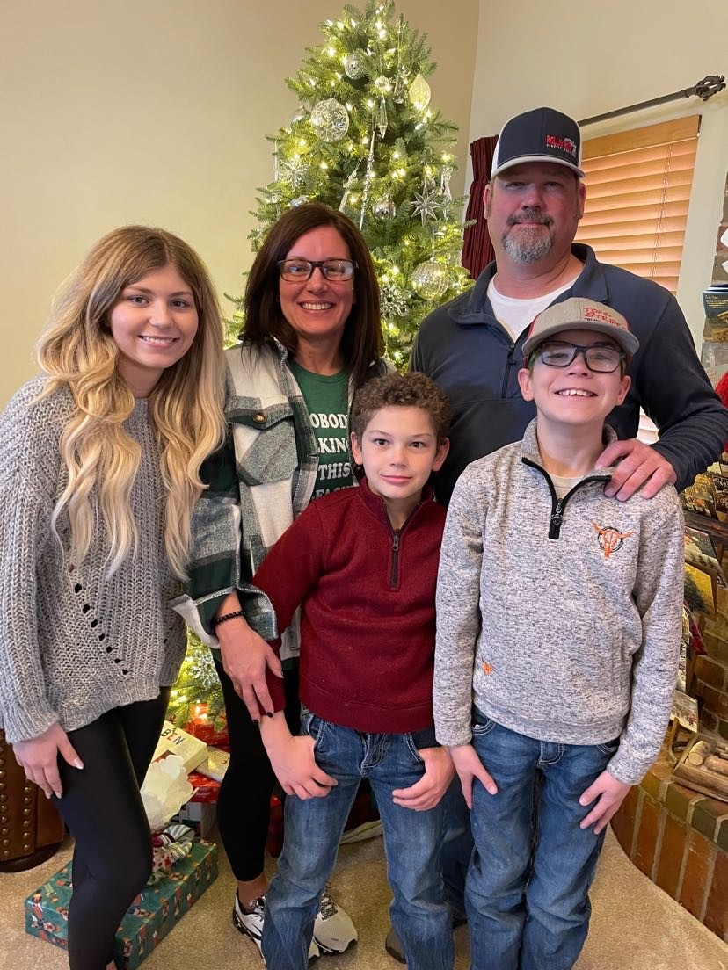
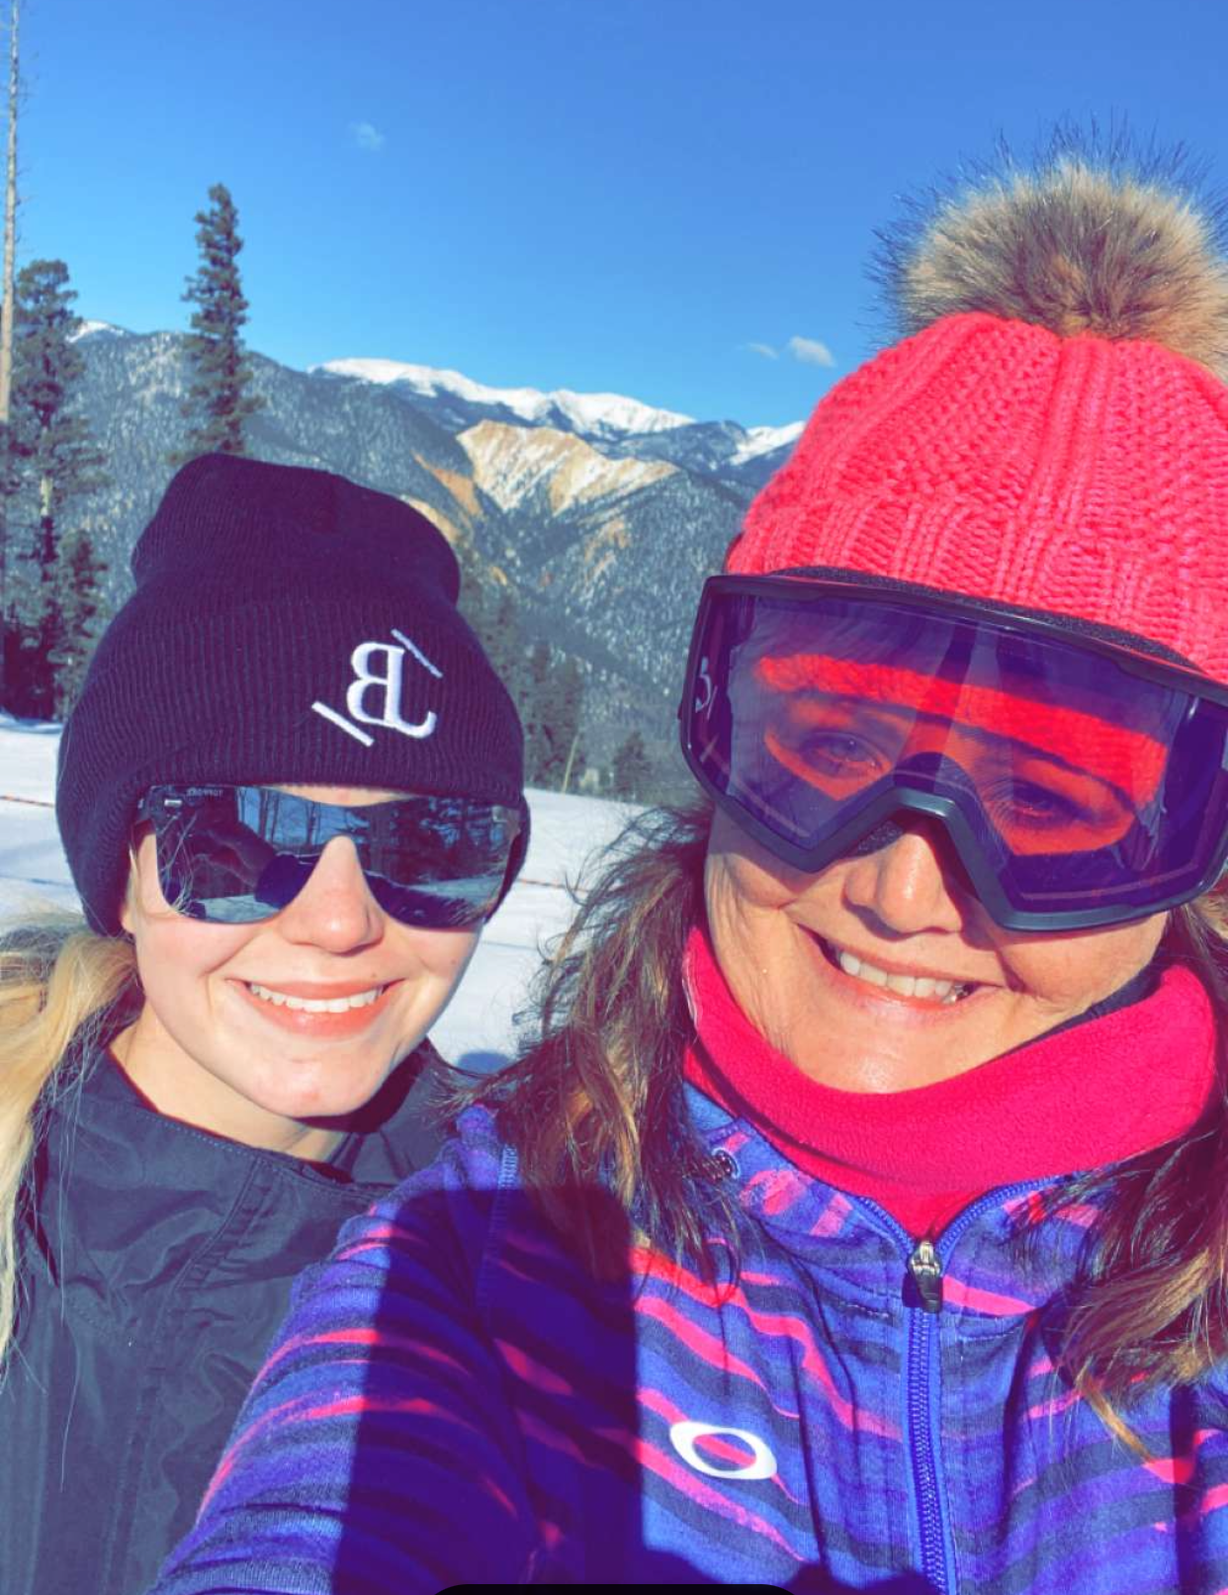
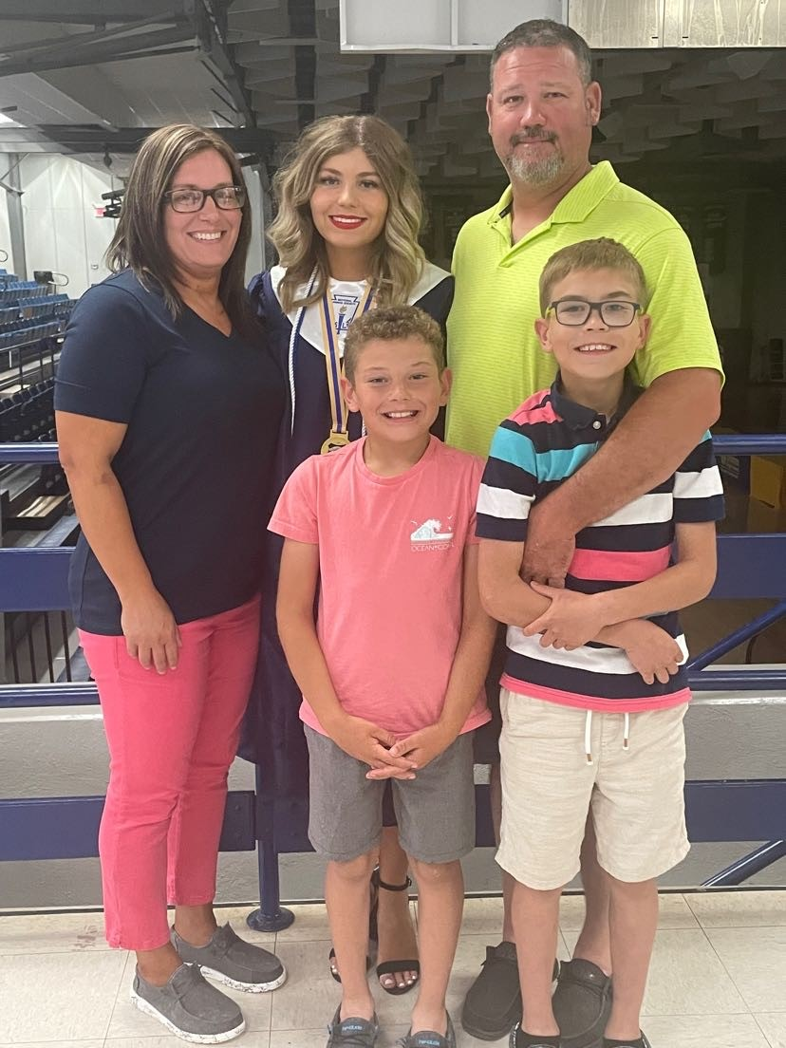
Jeremy & Jodie & Rylie & Karter & Kannon

Slide 8
New Teachers/Programs
/Teacher Changes
District 1
Owasso High School – Tara Hall

Slide 9
District 2
Miami HS–Bayley Hessee
Ketchum HS – Candace Cregan

Slide 10
District 3
Bixby HS – Brenna Humphrey
Bixby MS (new program)– Meredith Fuller
Jenks HS – Jillian Grable
Beggs MS (new program) – Stacy Youngblood
Tulsa Nathan Hale - OPEN

Slide 11
District 4
Broken Arrow HS (New Program) – Cindy Cantwell
Broken Arrow Freshman Acad – Lauren Seidenberger
Coweta HS – LouAnn Roberson
Okmulgee HS - Open

Slide 12
District 5
Hilldale HS – Michelle Howell

Slide 13
There are still several jobs openings across the state. If you know someone who would like to teach FCS, send them to our job listings on ctYou under FCS/Bulletin Board/FCS Job Openings.

Slide 14
In the Northeast:
Okmulgee HS
Tulsa Nathan Hale HS (Culinary Instructor)

Slide 15
Program Funding
412 Money = $8000.00 full-time
Salary Stipend (411 money) = $2200.00

Slide 16
Using 412 Money
Normal Expenditures
Equipment
Instructional Delivery/Supplies
Professional Development
Additional Expenditures this Year:
$900 FCCLA Affiliation per chapter
$450 for Half Time Chapters
$300 Official Dress/Conference Dress/Chef Attire

Slide 17
www.ctYou.org
Create an account
Region/District information
Course Resources
FCCLA
Safety Test (Fc$2023)
5-Year Comprehensive Evaluation folder for your program

Slide 18
FCS Directory
On CtYou
Will be under “FCS Regions”
Password protected
Will be the same as Safety Tests

Slide 19
Utilize advisory board members/community guest speakers in classes and with FCCLA meetings
OK Career Guide
Training videos available on https://www.okcareertech.org/educators/career-and-academic-connections/ok-career-guide/ok-career-guide-training
OK Career Guide Curriculum
https://www.okcareertech.org/educators/career-and-academic-connections/ok-career-guide/ok-career-guide-resources
Can be used to help students with their Individual
Career Plan (ICAP)

Slide 20
Will be providing digital coupons again, please watch
for an email from FCS within the next week
Have a student to write a thank you note to:
Sarah Steely
PO Box 1567
Shawnee, Ok 74802-1567

Slide 21
Watch the newsletter for most up to date information.

Slide 22
Watch the newsletter for most up to date information.

Slide 23
Certification Tests
Every student that has completed FCS Basics and/or Human Growth and Development should be taking the ODCTE 7101 Entry Level Child Care Training (ELCCT). It is considered a certification test. Anyone who takes this assessment can go to work at a day care center.
We will be researching and identifying other certification tests your students will be eligible to take. Our administration is pushing more and more that our divisions should be offering more certifications. So watch the newsletter for future updates on certification tests our students will be able to take.

Slide 24
Program Reporting
September 30 Salary & Teaching Schedule
October 1 Follow Up Reports Open
October 31 CESI Reports initial submission
November 30 Follow Up Reports Due
January 31 CESI (additional students added)
May 31 CESI (final updates)
May 31 Comprehensive folders should be updated for the year
Advisory Committee Report in folder
Updated 412/314 report

Slide 25
Salary and Teaching Report
1. Make sure you are adding your lunch period and your planning period.
2. If you have an ‘Other’ such as advisory or study hall please note that in the comment section.
3. If ‘Other’ is listed please do not place students in this one unless you are actually teaching a FCS related course. If student numbers are listed you must explain in the comment section what is being taught.
4. The ‘Contact Info’ section is NOT YOU. It is usually your HR person or someone who can answer questions about your contract.
5. In the salary section, if you put any amount in the other box you must put a comment itemizing that amount. Example: $1500 should be broken down to $1000 Student Council, $500 Sr Class Sponsor. DO NOT INCLUDE THE FCS STIPEND $2200.
6. Break down of what goes in each category of the Salary Information:
Base Salary: your base salary plus anything else FCS related ie: FCCLA stipend from school not the $2200
Health: any type of Insurance ie: health, life, etc. Itemize in the comment section what amount is paid for each different insurance.
Retirement: all school paid retirements
Other: extra duty pay other than FCCLA
7. In the acknowledgment section note which pathways you teaching in.

Slide 26
Program
Evaluations
and
Accreditations

Slide 27
Comprehensive Program Evaluations
Afton HS – Jan 31 or Feb 1
Beggs MS and HS – Nov 28
Collinsville – April 22
Dewar-April 30
Fairland – Jan 31 or Feb 1
Grove – Jan 31 or Feb 1
Ketchum – Jan 31 or Feb 1
Miami – Sept 19
Okmulgee – Nov 28
Quapaw- Sept 19
Tulsa Nathan Hale –April 17
Vinita-Jan 31 or Feb 1
Wyandotte – Sept 19

Slide 28
CareerTech Accreditations
Northeast Tech Center

Slide 29
New Teacher Assistance Visits
Miami HS
Ketchum HS
Jenks HS
Bixby MS
Bixby HS
Broken Arrow HS
Broken Arrow BAFA
Coweta HS

Slide 30
2nd Year Teacher Assistance
As needed

Slide 31
We are always willing to answer questions, but first:
Please Read the Newsletter
Please check the website Oklahoma FCCLA – Home or ctYOU.org
Please Read the Email
Most all of the answers to any of your questions could be discovered in one of the above resources.

Slide 33
Introduce 2022-2023 OATFCS Officers
President –Karin Davis
President-Elect –Eva Woolman
Past President- Jeanine Clark
Secretary – Mary Dushane
Treasurer – Mary Beth Carver
Treasurer Elect – Lacey England
N VP- Dulayna Murray
NE VP – Emily Colvin
S VP – Jalee Victory
SE VP – Richard Boone
Occ. VP – Kelly Brock

Slide 34
Committees and Legislative Network
Must be an OATFCS member
Most correspondence by mail, email or fax
Time commitment: 1-3 times per year
Need committee volunteers from each region/district

Slide 35
Nominating/Awards Committee | Will seek and nominate teachers from the membership for the following awards:
Membership Committee | Work to increase membership involvement in OAFTFACS; maintains a communications network
Public Information Committee | Recognize individual teachers and programs who have made outstanding contributions to FACS; promote Curriculum Showcase
Scholarship Committee | Recruit applicants for the scholarship program; review applications and determine recipients

Slide 37
2023-24 State Executive Council
President
Brandon Weibel, Silo HS
First Vice President
Santana Scraper, Stillwell HS
Vice President of Community Service
Jaden Taylor, Latta HS
Vice President of Development
Raylee Holstine, Tushka HS
Post Secondary Officer
Eli Allen, Great Plains Tech Center
Vice President of Membership
Ava Jenkins, Minco HS
Vice President of Programs
Davin Budy, Cherokee HS
Vice President of Public Relations
Tessa Inman, Lindsay HS
Vice President of Competitive Events
Gus Avendano, Fairview HS
National Vice President of Community Service
Olivia Boeckman, Drummond HS

Slide 38
2023-2024 State Executive Council
2023-2024 SEC Challenge:
2023-2024 Service Project: Citizens Caring for Children & Pearl House
2023-2024 National Program: Families First

Slide 39
Lead Conferences
Theme: Leadership Under Construction
September 6- North Region
September 7 - NE Glenpool Conference Center
September 13 – South Region
September 14 – Southeast Region
Deadline for registration:
August 31, 2023
DON’T wait until the last minute!

Slide 40
NLC Northeast Top 10 STAR Event recognition:
1st place - Instructional Video Design Level 3-Shayla Hargreaves & Serena Phang - Tulsa Tech Fashion Design
1st place – Sustainability Challenge Level 3 – Kathleen Salamon – Tulsa Tech Fashion Design
2nd Place – Hospitality, Tourism & Recreation Level 4– Elizabeth Miles – Indian Capital Technology Center
3rd Place – Professional Presentation Level 2 – Addison Hummingbird – Warner High School
5th Place – Parliamentary Procedure Level 2 – Okay High School
6th Place – Promote and Publicize Level 3 – Allie Brackett, Madison Fountain, & Lauren Grogg – Collinsville High School
6th Place – Repurpose & Redesign Level 2 – Larisa Mitchell – Wagoner High School
9th Place – Parliamentary Procedure Level 3 – Okay High School

Slide 41
Awards & Recognition
Chapter of Excellence Awards for Northeast Region
GOLD
SILVER
BRONZE
Oklahoma Union HS
Sallisaw HS
Tulsa Tech-Fashion
Westville HS
Gore HS
Inola HS
Skiatook HS

Slide 42
NATIONAL FCCLA HEADQUARTERS ADDRESS:
National FCCLA
13241 Woodland Park Road, Suite 100
Herndon, VA 20171

Slide 46
PLEASE MOVE INTO YOUR DISTRICT SECTIONS FOR DISTRICT PLANNING

Slide 47
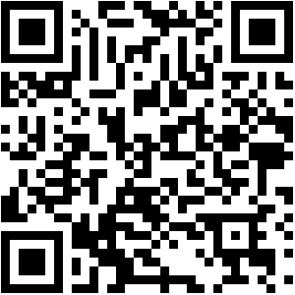
Below is the QR Code you will use for your verification forms for this year. This will take you to a digital form to complete. You will need to answer every question. Then it will be emailed to you so you can print it.

