Slide 1
BRITTANI PHILLIPS, OKLAHOMA FCCLA STATE ADVISER

Slide 2
State Executive Council

Slide 3
Brandon Weibel, State President – Silo ; Ashley West, Adviser
Santana Scraper, First Vice President – Stilwell; Diane Eubanks, Adviser
Gus Avendano, VP of Competitive Events – Fairview
Jaden Taylor, VP of Community Service – Latta; Darci Reeves, Adviser
Raylee Holstine, VP of Development – Tushka, Peggy Chambers, Adviser
Ava Jenkins, VP of Membership – Minco; Audrey Rice, Adviser
Davin Budy, VP of Programs – Cherokee, Victoria Plunkett, Adviser
Tessa Inman, VP of Public Relations – Lindsay, Kristi Bray, Adviser
Elijah Allen, Post-Secondary Officer – GPTC; Lori Grant/Ginger Seibold, Advisers
Olivia Boeckman, National VP of Community Service – Drummond; Loren Dillingham, Adviser

Slide 4
National Leadership Conference Recap
46 STAR Events National Top 10
Seven National Champions
Four National Runners-Up
Seven National Third Place Events

Slide 5
Membership
2022-2023 Membership Total:
17, 351
Largest membership since 1977-1978

Slide 6
Membership Packages
Fully funded programs – use $900 of 412 per chapter
Partially funded programs – use $450
Unlimited Package - $1,114
Up to 25 members
$569
Middle Level - $524

Slide 7
Membership Campaign
R Cubed
Recruit – 7 first year members
Retain – maintain membership from 22-23 school year
Recognize – monthly challenges

Slide 8
Membership is Vital for 2023-2024
Proposed Changing Purposes
Major National Bylaws Changes
Membership = more Voting Delegates

Slide 9
Updated National Program – Families First
Five new units
Included in membership packages
$60 to purchase if your portal does not have it
329 pages of activities, lesson plans, handouts, and tools

Slide 10
Updated National Program – Families First
Each Unit Contains:
2 lesson plans tied to competitive events
2 lesson plans tied to peer-to-peer projects
Resource list tied to the unit
PowerPoint
Pre and Post Test
Printable handouts
Classroom activities and project ideas

Slide 11
State and International Outreach Projects
Helping foster children and families in Oklahoma
Helping scholars in Ghana, Africa by funding a Home Economics classroom for the Pearl House Academy

Slide 12
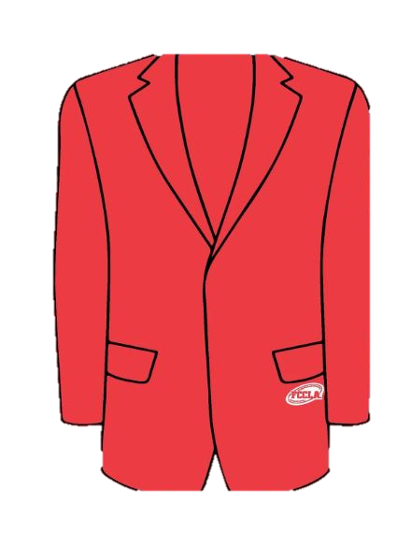
NEW – Official Dress Supplier
Every Body Uniforms
Cost is $64 -- $59 PLUS the $5 patch
(website says $59)

Slide 13
Competitive Events Updates
Work Ready Job Interview is now called Work Ready: Interview Skills
Culinary Grill – Level 2 is doing 2 cheeseburger sliders, levels 3 and 4 will do bacon cheeseburger sliders.
Must bring ALL equipment, including gridle
Children’s Literature Theme: The Four Seasons
Cake Decorating Theme: Sweet 16 Birthday

Slide 14
Competitive Events
FCS Research Challenge
Takes place at FCS Day at the Capitol
Essentially a “science fair” project
Great classroom project – begin now!

Slide 15
Competitive Events
OK FCCLA Cook Off
Submit recipes by September 1, 2023
Sponsored by Made in Oklahoma Coalition and the Farm Bureau Women’s Leadership Committee
Levels 1-2 compete September 18
Level 3-4 compete September 21
Grand Champion Showcase Saturday, September 23
Fair ticket for competitor and ONE adviser provided

Slide 16
Competitive Events
Many events are now levels 1 – 4
Each event has scaffolding
Rubrics are in the FCCLA portal! Woo!!
Baking and Pastry & Culinary Arts - offering ACF Certification with these events -- additional $35 for the ACF certification process

Slide 17
Competitive Events – NEW National Events
Lesson Plan Development and Modification – Skill Demonstration Event at National Fall Conference
Red Talk – Online STAR Event in “Ted Talk” format
Oklahoma FCCLA PILOTING – Teaching Strategies at State STAR Events
Reminder: if your student placed first place at State STAR Events, they may NOT compete in the same event level.

Slide 18
Leadership
District Officers – reach out to your counselors to invite them to speak at your school!
District Officer Program Changes – survey being sent to all advisers
NEW – 2024-2025 State Officer Applications– chapters will be allowed to run two at-large candidates. Both can be placed on the At-Large ballot, but only one may be placed on the National Officer ballot. Candidates will have a choice to run at-large or national when interviewing.

Slide 19
STAR Event Bootcamp
Advisers only
September 26, 2023
FREE to attend

Slide 20
FCCLA Events
Lead Conference
North Region – September 6, Enid, Oklahoma
Northeast Region – September 7, Glenpool, Oklahoma
South Region – September 13, Duncan, Oklahoma
Southeast Region – September 14, McAlester, Oklahoma
Register up to 7 students by August 31st
Must assign them to a “Leadership Track”
$10 per student, no adviser fee

Slide 21
FCCLA Events
Riversports Day – September 16; cost is $35 per person
Take AIM – October 4, Meridian Technology Center (Guthrie Campus)
Cost is $50 per student, $25 per Adviser
Get SET – December 6 (Metro Technology Center) and December 7 (Tulsa Tech – Owasso)

Slide 22
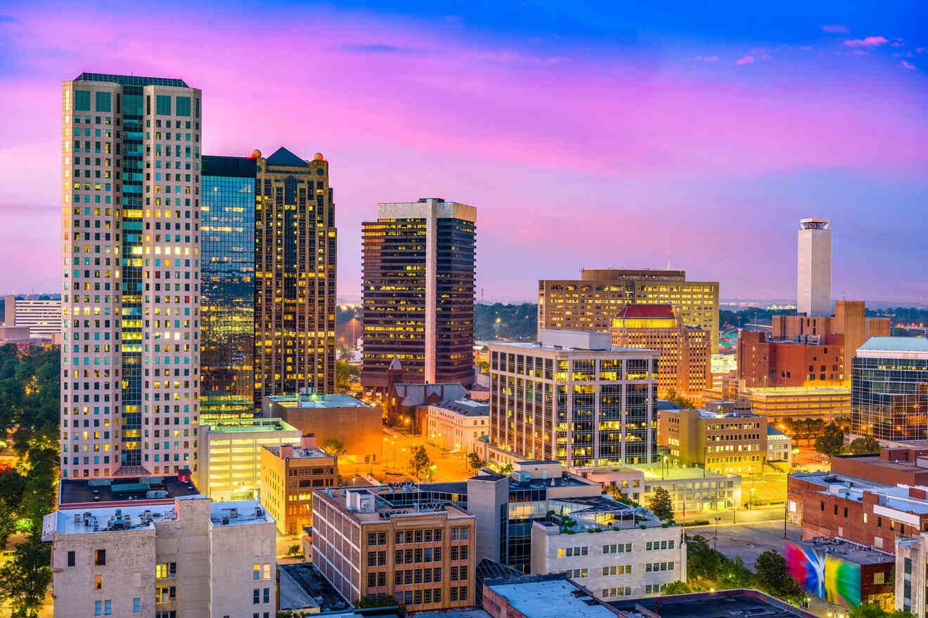
National Fall Conference
November 10-12, 2023
Birmingham, Alabama
$80 per person registration
$35 per Skill Demonstration Event
$25 for Online Knowledge Test

Slide 23
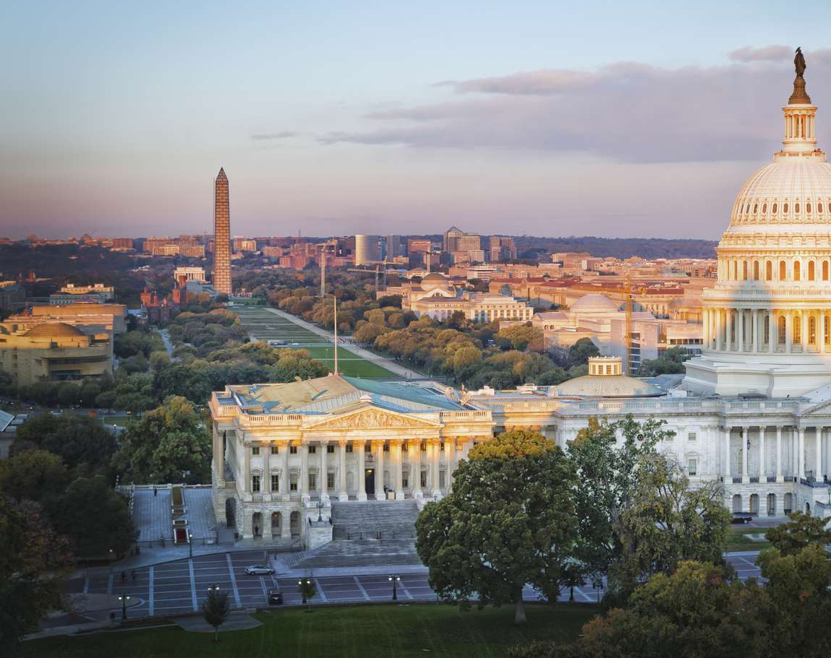
Capitol Leadership
Washington, D.C.
October 9 – 11, 2023
$150 per person registration

Slide 24
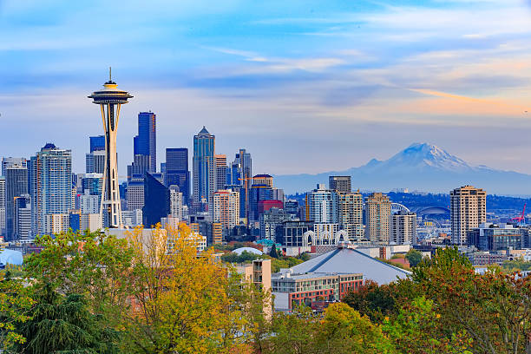
Chapter Adviser Summit
January 25-27, 2024
Seattle, Washington
$150 per person

Slide 25
National Leadership Conference
June 29-July 3, 2024
Seattle, Washington
$160 per person
STAR Events raised to $55 per person

Slide 26
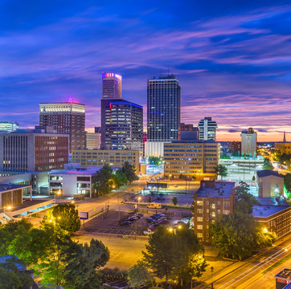
FCCLA State Convention
April 11, 2024
NEW HOME --- Tulsa Cox Convention Center

Slide 27
BRITTANI PHILLIPS, OKLAHOMA FCCLA STATE ADVISER

