Slide 1

August 2023

Slide 2

<iframe width="560" height="315" src="https://www.youtube.com/embed/1AZnTPT9MSg?start=16" title="YouTube video player" frameborder="0" allow="accelerometer; autoplay; clipboard-write; encrypted-media; gyroscope; picture-in-picture; web-share" allowfullscreen></iframe>

Slide 3


Slide 4


Slide 5

FCS
State
Staff

Slide 6

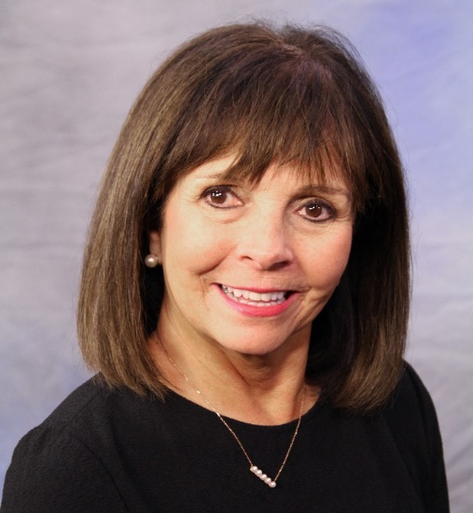
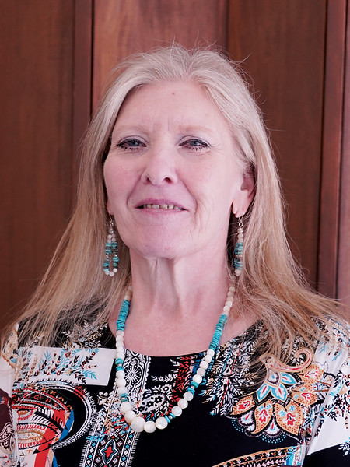
Teena Friend
North Program Specialist
Joann Carter
South Program Specialist

Slide 7
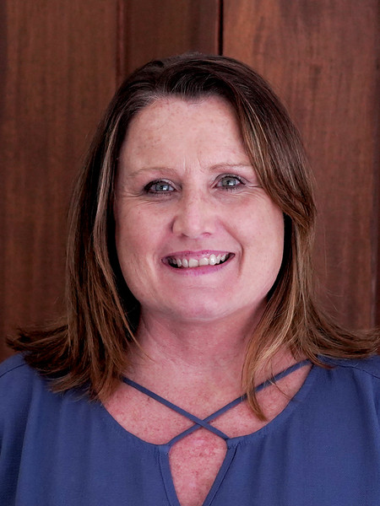
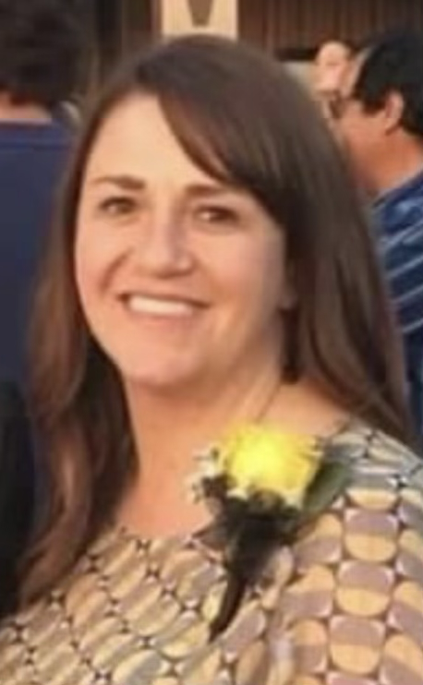
Christina Spurgin
Southeast Program Specialist
Jeanette Blevins
Northeast Program Specialist

Slide 8

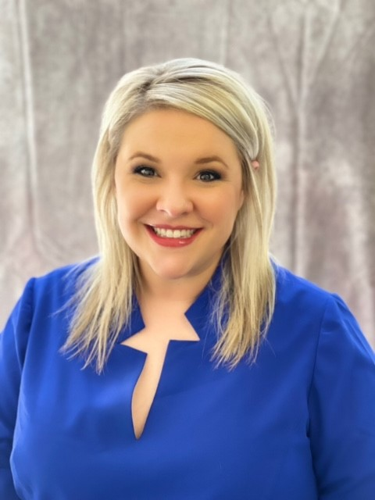
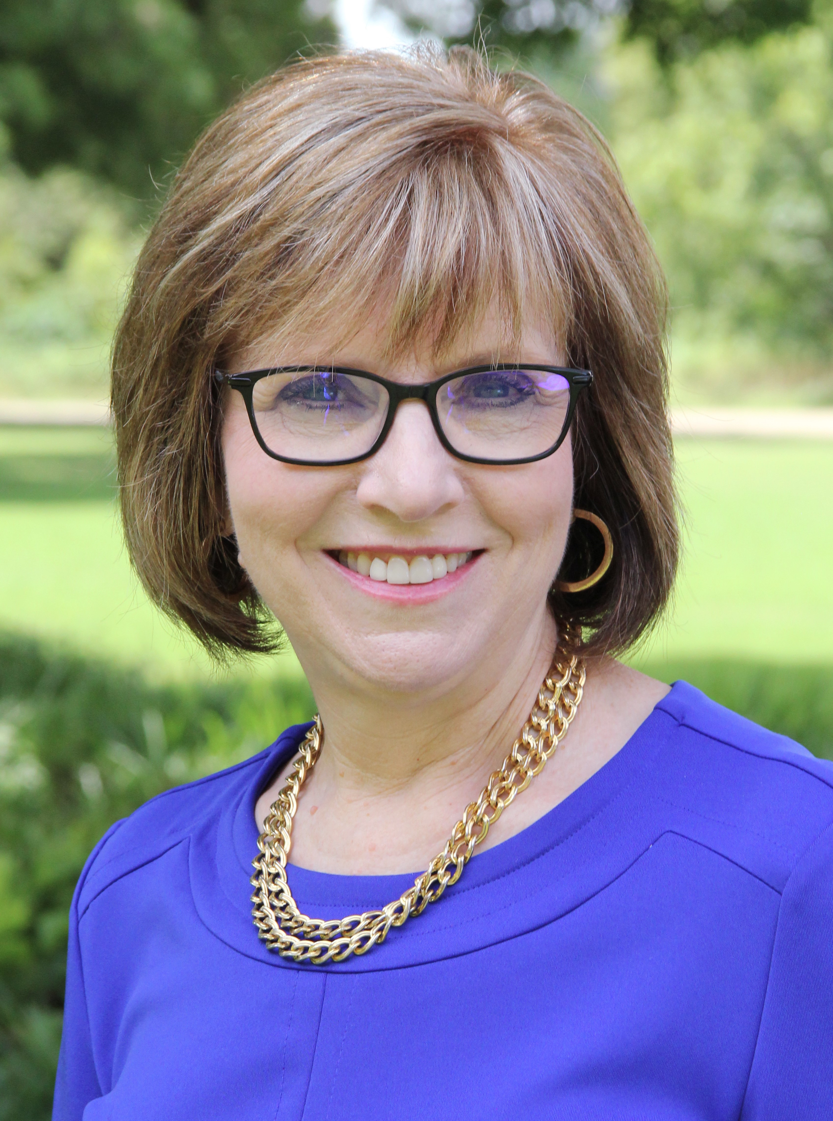
Mary Jane Grayson
Instructional Coach
FCS Program Specialist
Brittani Phillips
FCCLA State Adviser

Slide 9

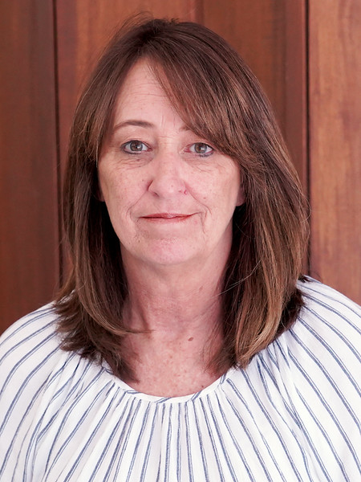
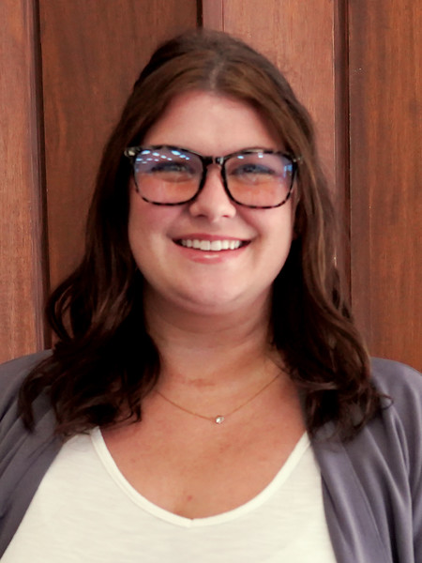
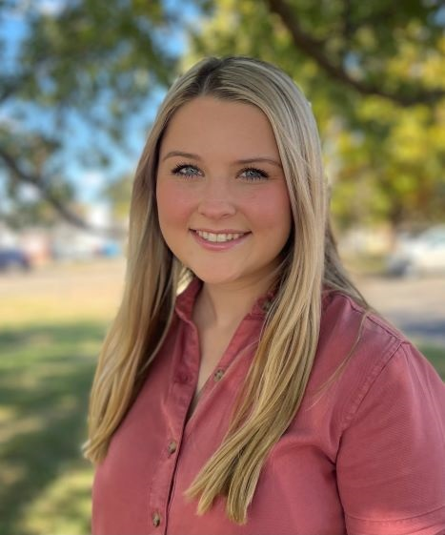
Rose Mangold
FCS
Administrative
Assistant
Ashli Hall
FCS Administrative
Assistant and
FCCLA Bookkeeper
Malynn Broomfield
FCS
Student Intern

Slide 10

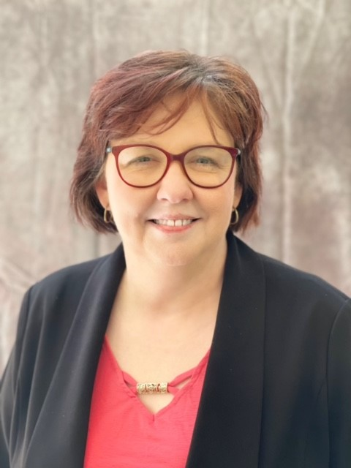
Holly Hanan
State Program Manager

Slide 11
FCS Programs
K12 programs 381
Tech Center 52

Slide 12
NEW PROGRAMS
Ardmore MS
Beggs MS
Bixby MS
Ponca City East MS
Silo MS
Broken Arrow HS
Edmond Santa Fe HS
Lawton HS
Mustang HS
Newkirk HS
Prague HS
Westmoore HS
K-12
Tech Ctr.
CVTC-El Reno: Teacher Prep
CVTC-Chickasha: SC Hospitality
MetroTech: Culinary Arts

Slide 13
FCS Job Openings

Slide 14
Funding
We asked….
We received!!

Slide 15
ALL approved
Family and Consumer Sciences
programs are
FUNDED

Slide 16

Program Assistance
$8000

Slide 17
1st time funding
$8000 + $5000=
$13,000
this year

Slide 18
Salary Stipend remains
$2,200

Slide 19
Using 412/314 money
Equipment
Instructional Deliver/Supplies
Professional Development

Slide 20
Using 412/314 money
FCCLA
Affiliation= $900/chapter
Official dress/convention dress/chef attire=
$300/chapter

Slide 21
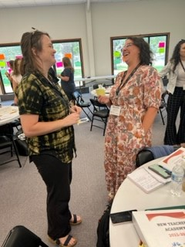
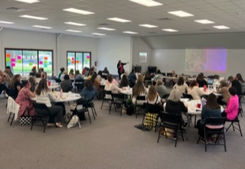

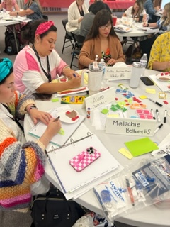
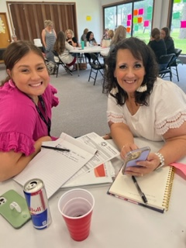
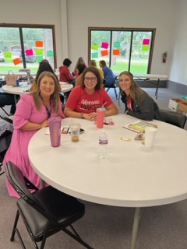
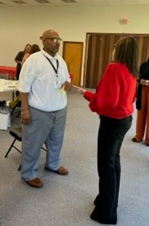
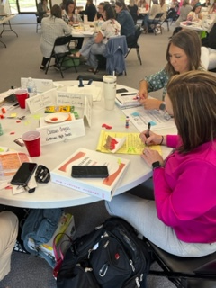
60+
New Teacher Academy

Slide 22
Lottery Grants
Congratulations to this year’s recipients
Spend your money ASAP
Preferably Fall semester
Send reimbursements in
Deadline: February 1, 2024

Slide 23
FCS Newsletter
Continue to send weekly- Tuesday morning
Information for all- to reduce the number of emails we send
If you don’t receive it- email your Program Specialist and ask to be added to the list

Slide 24
Fall PI meetings will be held
during LEAD Conference
Be sure to register your students ASAP

Slide 25
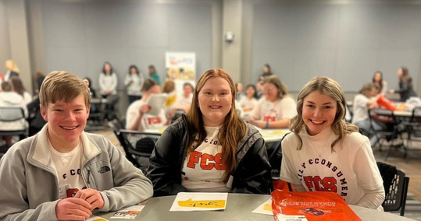
Say YES to FCS
Oct 24
Registration opens Sept.1

Slide 26
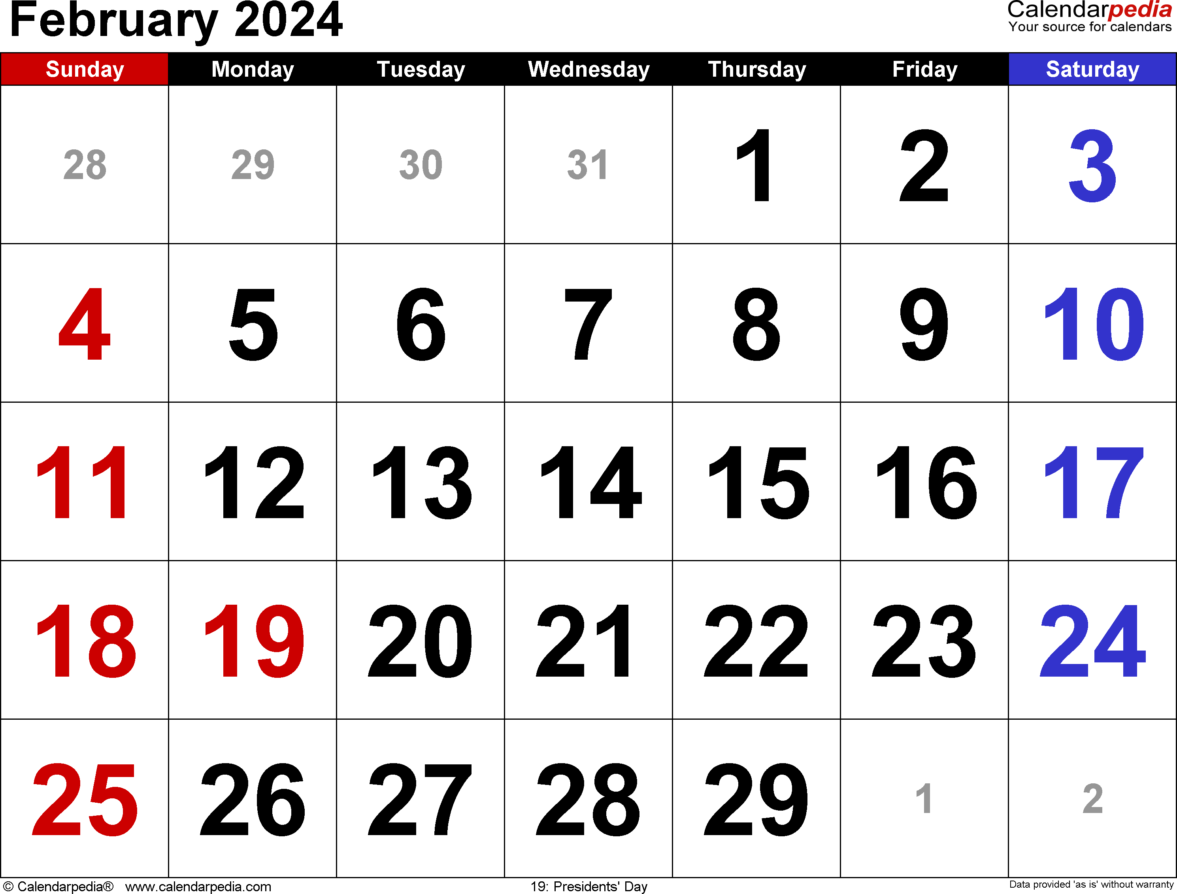
FCS Day at the Capitol
Registration will open December 1

Slide 27





Slide 28
  OATFCS Involvement Form: Committees- Nominating/Awards, Public Information, Membership, Scholarship
  (During Region meetings)
Get your community involved in your program
  Guest speakers
  Advisory committee
  Volunteers
  STAR Event evaluators
  Mentors
  Internships
  Etc.

Slide 29
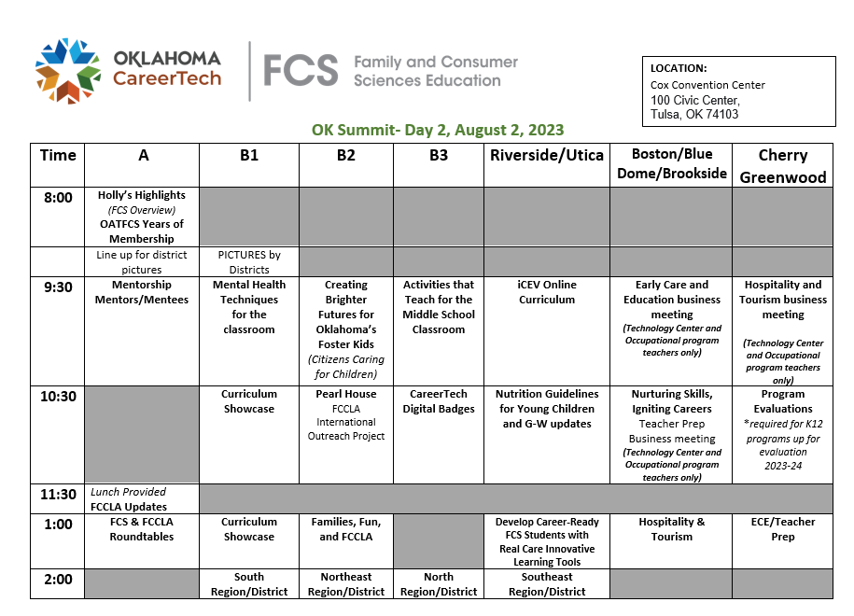

Slide 30
Verification form
QR code
during
Region meetings

Slide 31

Back to School

Slide 32
Awards

Slide 33

2023 OATFCS AWARDS
August 2, 2023

Slide 34
5 YEARS OF OATFCS MEMBERSHIP
Lisa Blaine
Denise Bowen
Amanda Davis
Kristen Ellis
Jeff Howard
Comelia Jackson
Carol Jenkins
Jason Marsh
Prince Mason
Daniel Morrison
Terry Ryles
Taylor Sanders
Jeanie Siegrist
Paula Tripp
Brenda Walker

Slide 35
10 YEARS OATFACS MEMBERSHIP
Guy Ailstock
Brenda Breakiron-Voice
Kacie Cantrell
Teena Friend
Jan Long
Ginger Lugo
Tamra May
Sherri Meadows
Dana Stuff
Susan Thompson
Carol Walker
Cindy Williams

Slide 36
15 YEARS OF OATFCS MEMBERSHIP
Carly Austin
Carla Harnly
Kristen Harris
Becky Hines
Brooke Kusch
Susan Malena
Trina Renfrow
Carrie Snyder-Renfro

Slide 37
20 YEARS OF OATFCS MEMBERSHIP
Mary Beth Carver
Lisa Cookson
Cheryl Flippin
Brenda Ostercamp
Laura Wallace

Slide 38
25 YEARS OF OATFCS MEMBERSHIP
Tammie Conaway
Lori Shepherd
Donna Victor

Slide 39
30 YEARS OF OATFCS MEMBERSHIP
Sherri Hall

Slide 40
40 YEARS OF OATFCS MEMBERSHIP
Sherrie Haub

Slide 41
50 YEARS OF OATFCS MEMBERSHIP
Nancy Nelson

Slide 42
55 YEARS OF OATFCS MEMBERSHIP
Brenda Brixey

Slide 43
Congratulations!!

Slide 44
DISTRICT
PICTURES

