Slide 1

August 2024

Slide 2


Slide 3


Slide 4


Slide 5

FCS
State
Staff

Slide 6

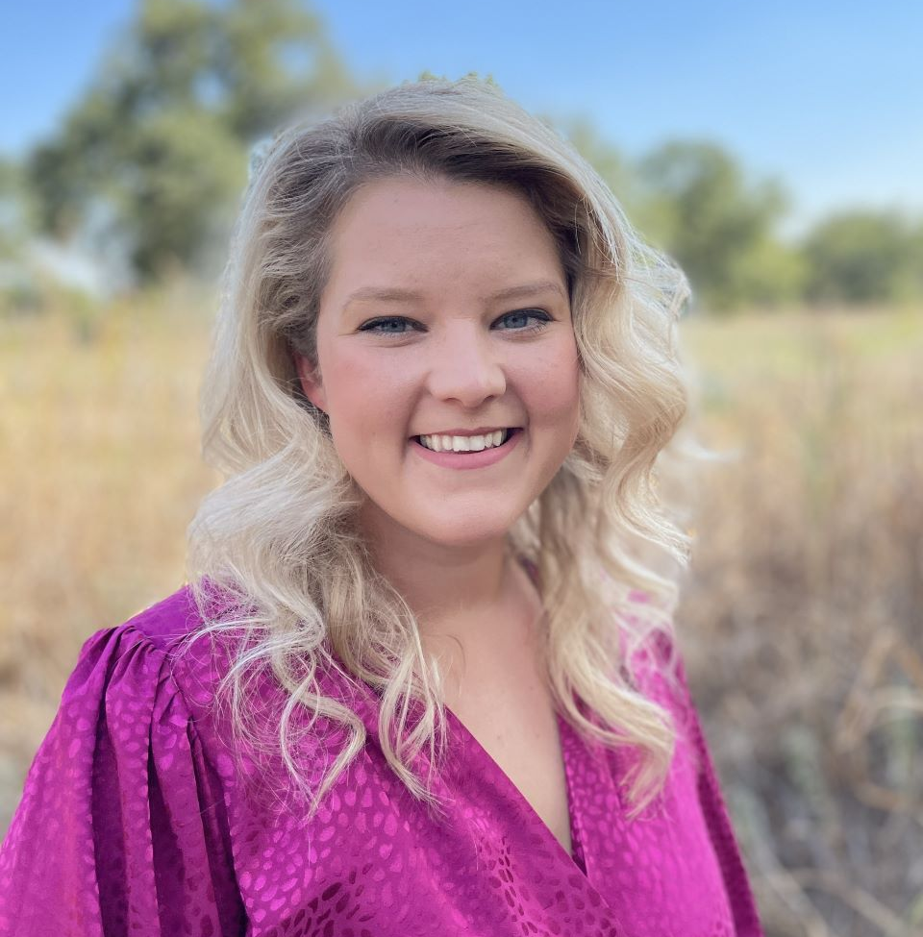
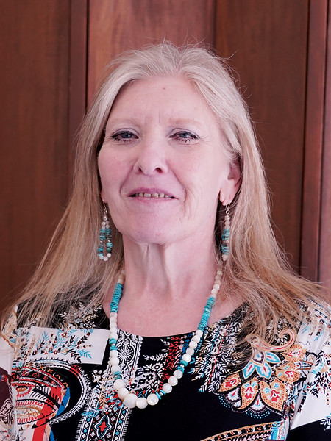
Teena Friend
North Program Specialist
Jessica Maker
South Program Specialist

Slide 7
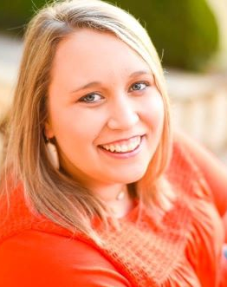
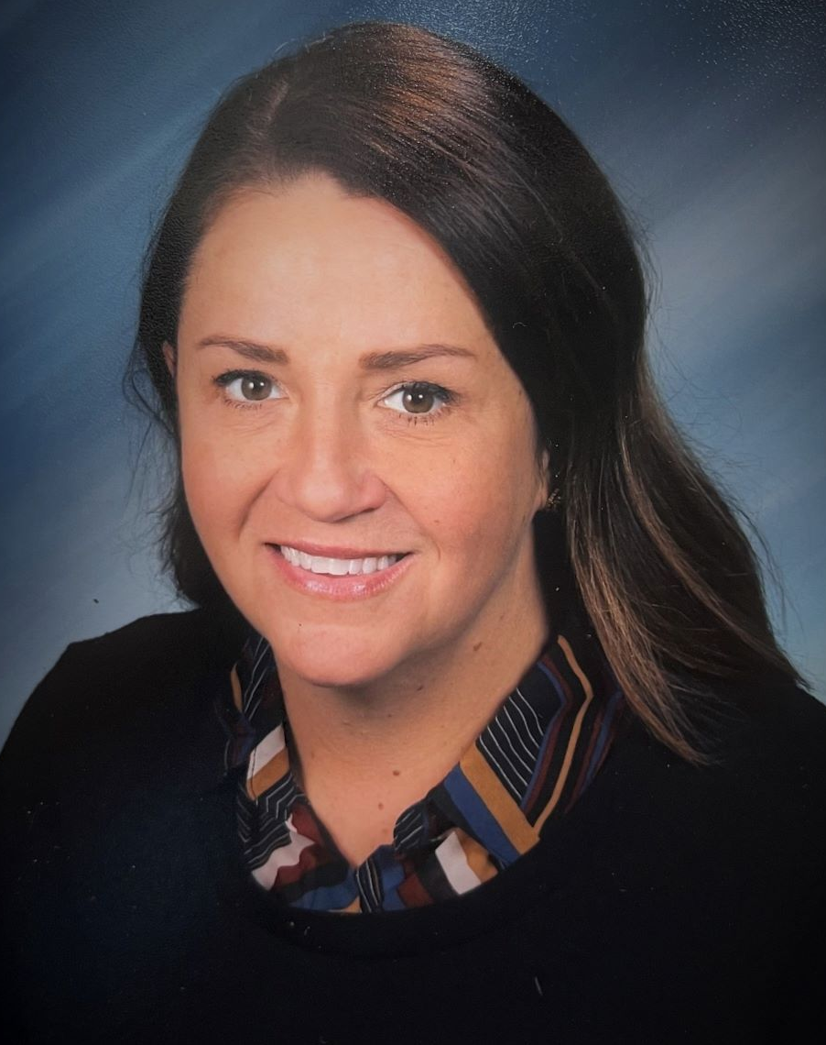
Christina Spurgin
Southeast Program Specialist
Jessi Beebe
Northeast Program Specialist

Slide 8

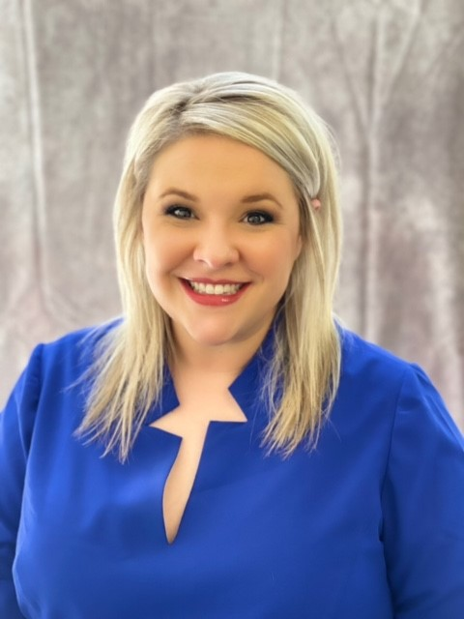
Brittani Phillips
FCCLA State Adviser

Slide 9

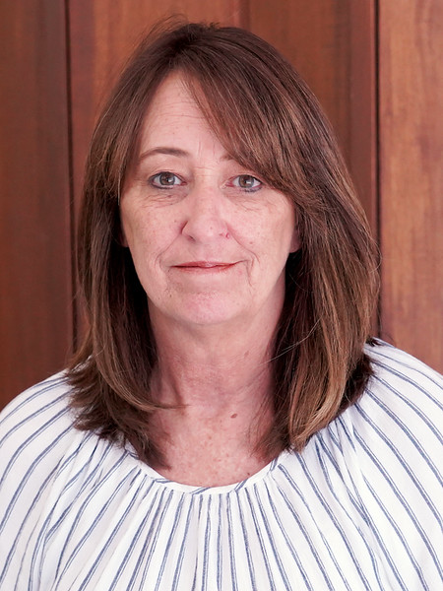
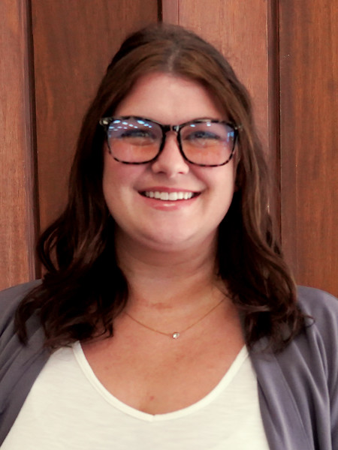
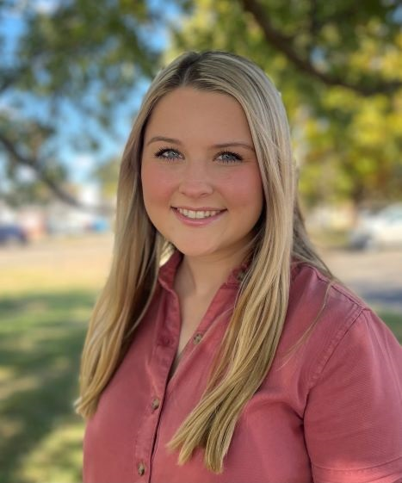
Rose Mangold
FCS
Administrative
Assistant
Ashli Hall
FCS Administrative
Assistant and
FCCLA Bookkeeper
Malynn Broomfield
FCS
Student Intern

Slide 10

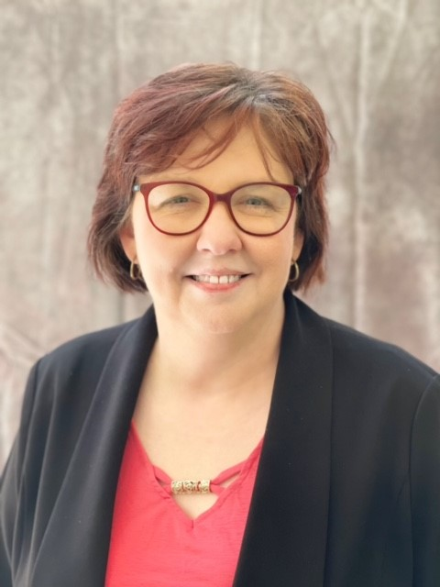
Holly Hanan
State Program Manager

Slide 11
FCS Programs
K12 programs 385
Tech Center 52

Slide 12
NEW PROGRAMS
Choctaw-Nicoma Park Middle School
Collinsville Middle School
Hominy High School
Mustang Middle School
Mustang Central Middle School
Mustang North Middle School
K-12
Tech Center
Meridian Tech- Early Care & Education/Teacher Prep

Slide 13
FCS Job Openings
Gans High School
Putnam City- Mayfield MS
Moore High School

Slide 14
ALL approved K12
Family and Consumer Sciences
programs are
FUNDED

Slide 15

Program Assistance
$8000

Slide 16
Salary Stipend remains
$2,200

Slide 17
Using 412/314 money
Equipment
Instructional Deliver/Supplies
Professional Development

Slide 18
Using 412/314 money
FCCLA
Affiliation= $900/chapter
Official dress/convention dress/chef attire=
$300/chapter

Slide 19

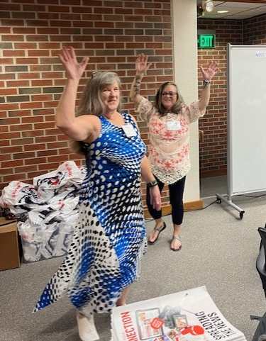
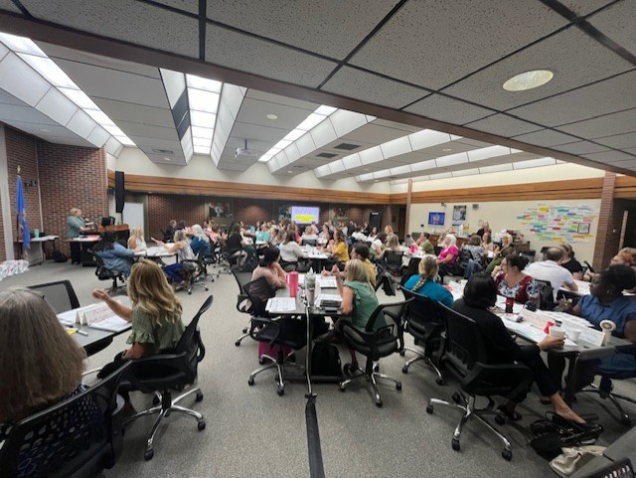
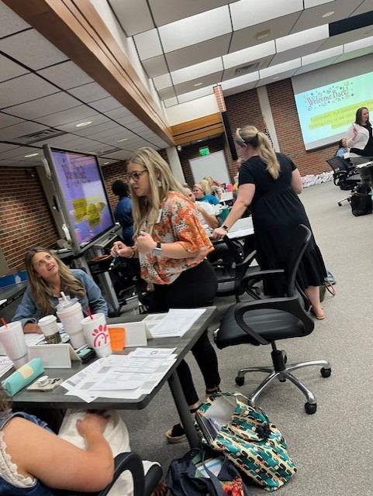
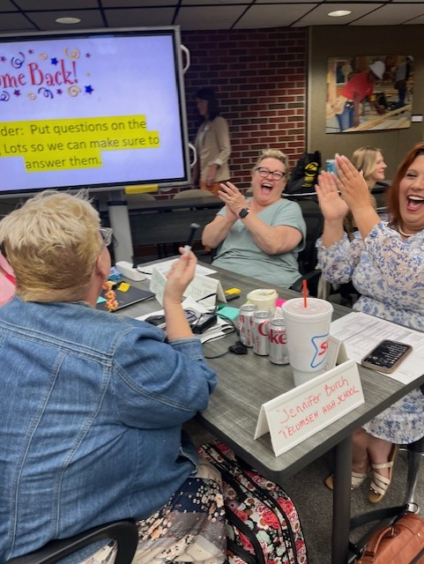
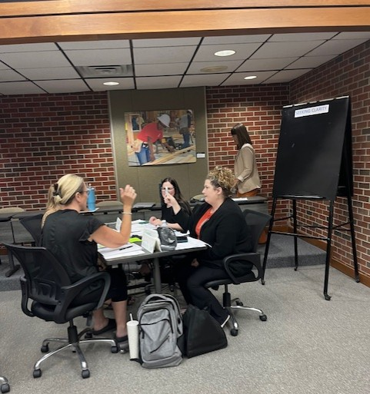
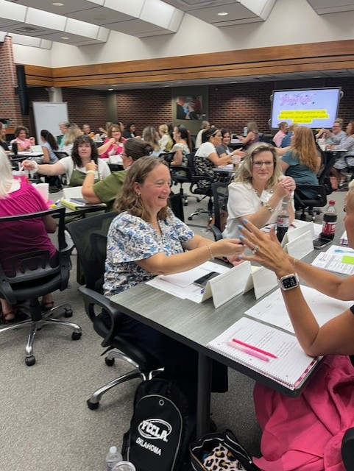
68
New Teacher Academy

Slide 20
Lottery Grants
Congratulations to this year’s recipients
Spend your money ASAP
Preferably Fall semester
Send reimbursements in
Deadline: February 1, 2025

Slide 21
FCS Newsletter
Continue to send weekly- Tuesday morning
Information for all- to reduce the number of emails we send
If you don’t receive it- email your Program Specialist and ask to be added to the list

Slide 22
Fall PI meetings will be held
during LEAD Conference
Attendance required.
Be sure to register your students ASAP

Slide 23
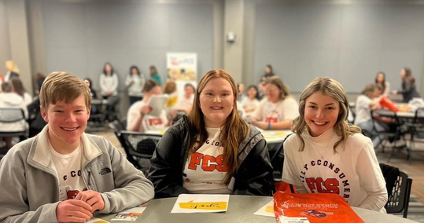
Say YES to FCS
Oct 23
Registration opens Sept.1

Slide 24
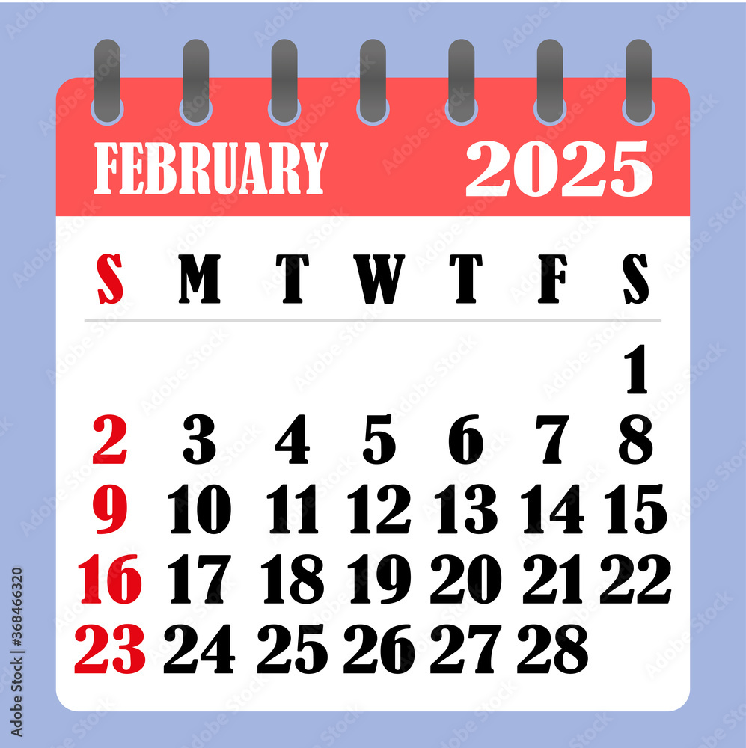
FCS Day at the Capitol
Registration will open January ??

Slide 25




Slide 26
  OATFCS Involvement Form: Committees- Nominating/Awards, Public Information, Membership, Scholarship
  (During Region meetings)
Get your community involved in your program
  Guest speakers
  Advisory committee
  Volunteers
  STAR Event evaluators
  Mentors
  Internships
  Etc.

Slide 27
New Graduation Requirements
Goal
Every student finding their pathway to career success!
What does that mean??
Flexible attainment of educational requirements in secondary education.
Integrating career focused courses and programs into secondary educational careers.
A focus on educational training and work-based learning experience to highlight postsecondary opportunities.

Slide 28
Timeline
Optional this year for schools or students (HB2672/conference bill)
"Beginning with the 2024-2025 school year, students whose parent or legal guardian approve modification of the existing graduation track as outlined in subsections B and C of this section, subject to school approval, may complete a minimum of twenty-three (23) curriculum units or sets of competencies at the secondary level."
Mandatory in 2025-2026 school year for students enrolled in the 8th grade (HB3278)
"Beginning with students entering the eighth grade in the 2025-2026 school year, in order to graduate from a public high school accredited by the State Board of Education with a standard diploma, students shall complete a minimum of the following twenty-three (23) curriculum units or sets of competencies at the secondary level."

Slide 29
HB 2672 Language
Beginning with the 2024-2025 school year, students whose parent or legal guardian approve modification of the existing graduation track as outlined in subsections B and C of this section, subject to school approval, may complete a minimum of twenty-three (23) curriculum units or sets of competencies at the secondary level as listed below; and students entering the eighth grade in the 2025- 2026 school year, in order to graduate from a public high school accredited by the State Board of Education with a standard diploma, students shall complete a minimum of the following twenty-three (23) curriculum units or sets of competencies at the secondary level.

Slide 30
HB 2672 Language Continued
A school district shall determine the specific description of the locally approved math and science-based application courses allowed pursuant to paragraphs 2 and 3 of subsection D of this section. Formal notification with the specific course description shall be provided to the State Department of Education prior to July 1 of each school year. The notification shall include what courses will be coded as locally approved math and science-based application courses for the ensuing school year.

Slide 31
23 Units or Sets of Competencies are Required to
meet State Graduation Requirements:
(4) English
(4) Mathematics
(3) Laboratory Science
(3) History & Citizenship
(6) Pathway Courses
(3) Approved by Local School Board

Slide 32
English (no change)
Four units or sets of competencies of English to include:
  Grammar
  Composition
  Literature
  or any English course approved for college admission requirements

Slide 33
Mathematics (can begin in 8th grade)
Four units or sets of competencies of mathematics, two of which shall be:
  Algebra I
  and either Algebra II or Geometry.
The other two units may include:
            Computer Science
            College courses approved for dual credit
            Approved full-time postsecondary career and technology program
            Locally approved math-based application course
            or any mathematics course with content and/or rigor above Algebra I
            Algebra II
            Geometry
            Trigonometry
            Math Analysis
            Calculus
            Statistics
            Math of Finance

Slide 34
Laboratory Science (same language as the CORE path)
Three units or sets of competencies of laboratory science approved for college admission requirements including one unit or set of competencies of life science meeting the standards for Biology I; one unit or set of competencies of physical science meeting the standards for Physical Science, Chemistry, or Physics
and one unit or set of competencies from the domains of:
            physical science
            life science
            or earth and space science
            or approved fulltime postsecondary career and technology program or locally approved science-based application course
            or any science course with content and/or rigor above Biology I or Physical Science

Slide 35
Anything not specifically listed in the bill or not having content and/or rigor above Algebra I, for math, must be approved by the local school board.
Anything not specifically listed in the bill or not having content and/or rigor above Physical Science or Biology I,
for science, must be approved by the local school board.

Slide 36
History and Citizenship (no change)
Three units or sets of competencies of history and citizenship skills including:
    One unit of American History
    1/2 unit of Oklahoma History
    1/2 unit of United States Government
    and one unit from the subjects of:
History
Government
Geography
Economics
Civics
or non-western culture and approved for college admission requirements

Slide 37
Pathway Units
Six pathway units or sets of competencies approved at the discretion of the school district board of education which align with each student's Individual Career and Academic Plan (ICAP) and may include, but are not limited to,
any additional units or sets of competencies as provided in paragraphs 1 through 4 of this subsection (slide 6-9)
World or non-English language
Computer technology
Junior Reserve Officers' Training Corps (JROTC)
Internship or apprenticeship programs
Career and technology education courses
Concurrently enrolled courses
Advanced placement courses
International Baccalaureate courses approved for college admission requirements,
Music, art, drama, speech, dance, media arts, or other approved courses

Slide 38
Approved by Local School Board
Three units or sets of competencies of elective courses approved by the school district board of education

Slide 39
Technology Center
Program Framework
Committee meetings will be set up
to help determine the
program framework for FY26

Slide 40

Download the app to see the agenda

Slide 41
Verification form
QR code
during
Region meetings

Slide 42

Back to School

Slide 43
Awards

Slide 44
5 YEARS OF OATFCS MEMBERSHIP
Lisa Bryan
Seth Day
Mary Dushane
Jennifer Falkner
Rebecca Green
Jessica Maker
Janelle Pease
Dawnnie Ross
Bambi Slimp
Rusty Stafford
Julie Star-Southern
Whitney Strother
Dana Stroud

Slide 45
10 YEARS OATFACS MEMBERSHIP
Lori Criner
Kristi Lindley
Rikki Manous
Tonya Quinby
Jennifer Savala
Ashley West

Slide 46
15 YEARS OF OATFCS MEMBERSHIP
Kate Beck
Jolene Bryant
Tara Burkhead
Sandy Combs
Lisa Danker
Janelle Hammer
Teresa Widick

Slide 47
20 YEARS OF OATFCS MEMBERSHIP
Erica Carey
Jeanine Clark
Cindy Franks
David Gardner
Allison Garner
Keri Laxton
Christina Spurgin

Slide 48
25 YEARS OF OATFCS MEMBERSHIP
Regina Barton
Joann Carter
Tina Clawson
Shelly Crawford
Kari Lollis-Daggs
Randa Pirrong

Slide 49
30 YEARS OF OATFCS MEMBERSHIP
Leigh Anne Bradberry

Slide 50
35 YEARS OF OATFCS MEMBERSHIP
Ginger Seibold
Cynthia Snider
Regina Wylie

Slide 51
40 YEARS OF OATFCS MEMBERSHIP
Vickie Schmidt

Slide 52
50 YEARS OF OATFCS MEMBERSHIP
Carolyn Cotton

Slide 53
Congratulations!!

Slide 54
Following District Pictures
Culinary Arts will go to OneGas Eat Space
          Jessica Maker
Early Care and Education and Teacher Prep
        Teena Friend and Christina Spurgin

Slide 55
DISTRICT
PICTURES
Line up in your district
Tallest to Shortest

