Slide 1











OKLAHOMA FCS
NE REGION MEETING
PLEASE SIT WITH YOUR DISTRICTS

Slide 2
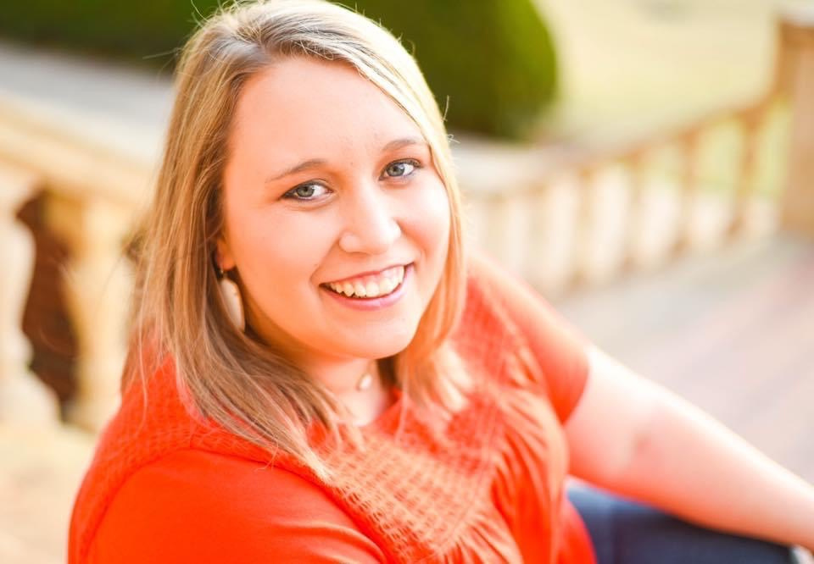
PROGRAM SPECIALIST
Contact Info: ​
Jessi.Beebe@careertech.ok.gov​
405-743-5463
Personal Info: ​
  From Garber, OK (a proud product of Mrs. Nancy Nelson’s FCS Program) - TFD ​
  OSU HDFS Alum, 2018 & 2020​
  Taught FCS in the North Region​
  Passionate volunteer & mentor

Slide 3
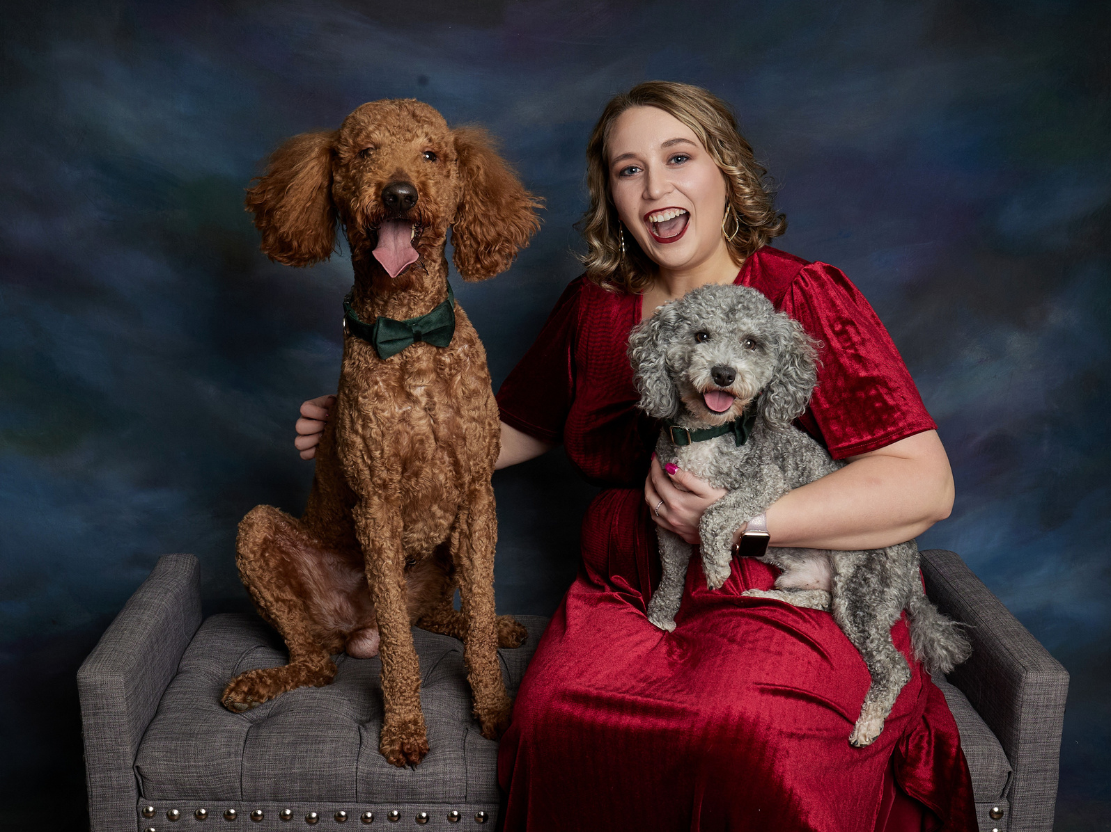

Portraits with my Pups! Rudy (Goldendoodle) & Murphy (Mini Poodle)

Slide 4
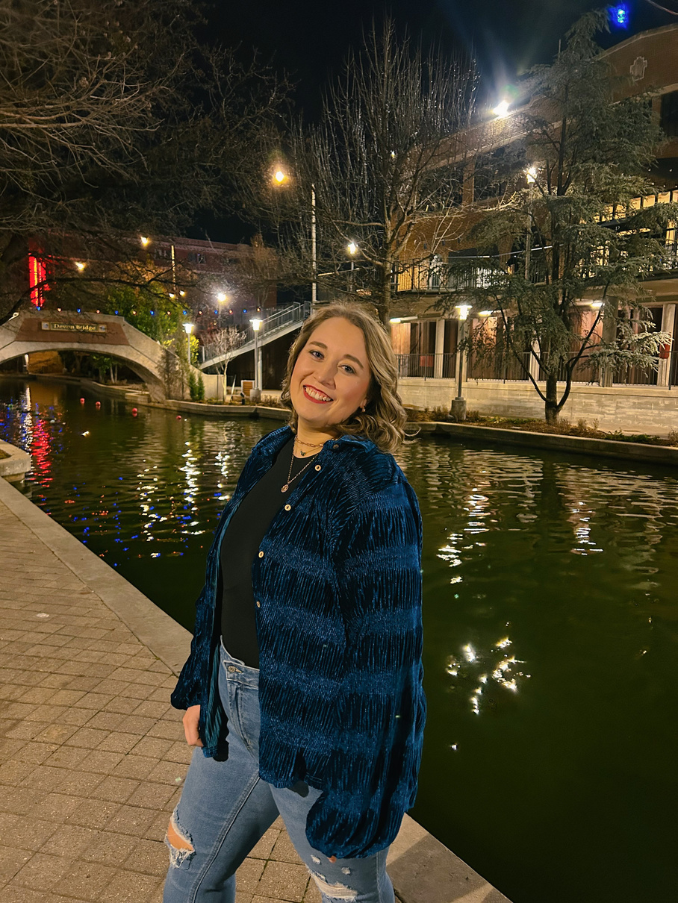

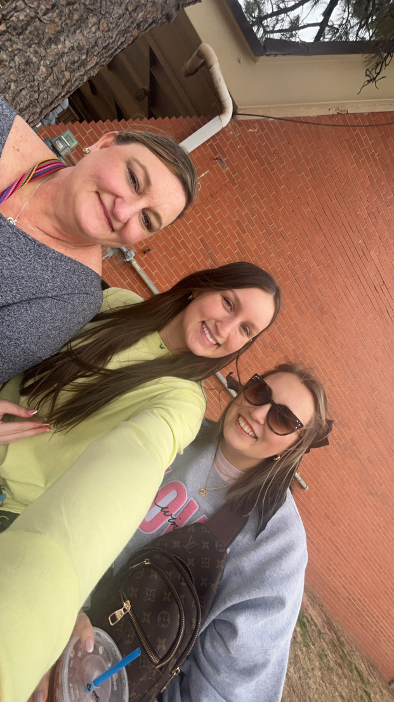
My birthday spent with family @ Affair of the Heart and in Bricktown.

Slide 5
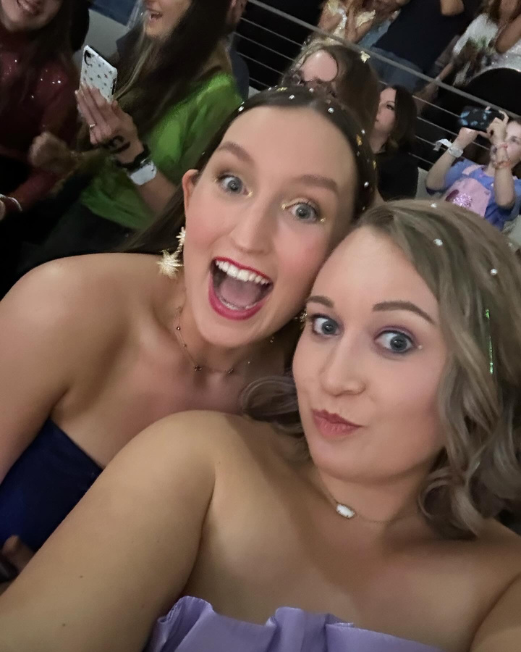

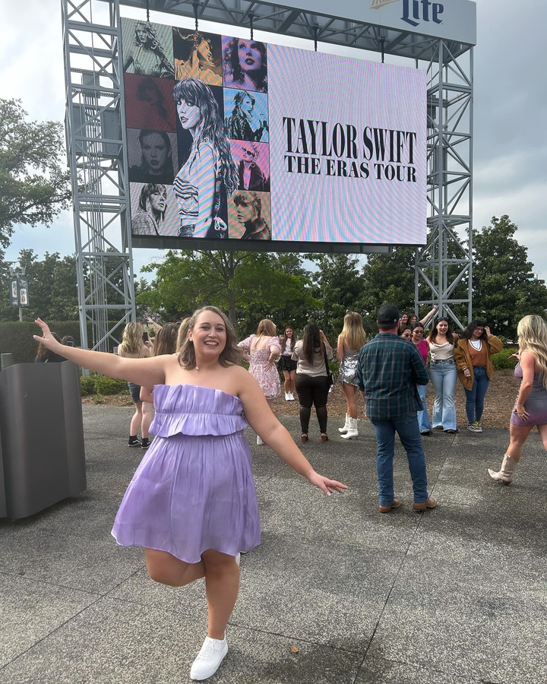
Oh no… She is a Swiftie… :)​
Arlington N3; will be attending NOLA N3 in October.

Slide 6
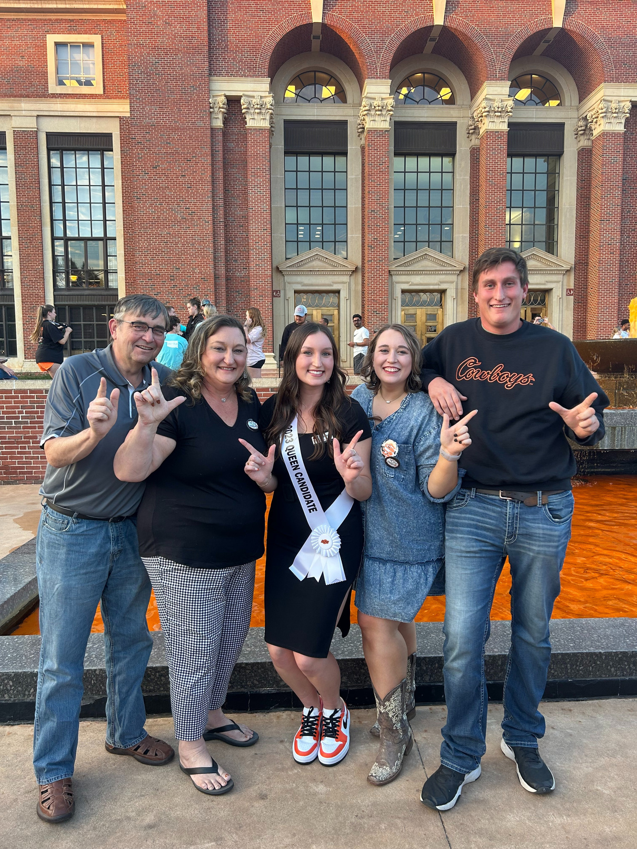
Family ​
Photo @ OSU Homecoming 2023

Slide 7
~PSA~
THIS ENTIRE POWERPOINT WILL BE POSTED TO CTYOU AFTER OK SUMMIT. YOU CAN REVIEW IT HERE:
***CTYOU.ORG - LOGIN***
FCS --> FCS REGIONS --> NORTHEAST REGION RESOURCES --> NE REGION GENERAL INFO

Slide 8

NEW TEACHERS!
NE1
NE2
NE3
NE4
NE5
  Megan Hulse
  Colleen Morrison
  Kelli McElroy
  Brieann Lloyd
  Bradley Muck
  Dezari Pierce
  Amie Vaughan
  Michelle Ford
  Cynthia Standifird
  TC: Denise Bowen
  TC: Stacy Youngblood
  Blake Cowden
  Jackie Seals
  Lauren Fort
  Sheila Uehlin
  TC: Dixie Shope

Slide 9
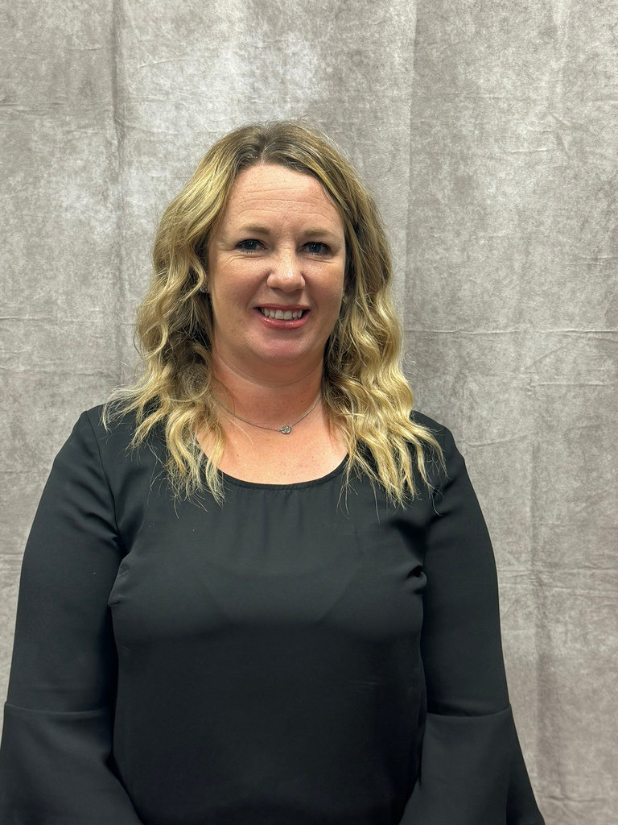
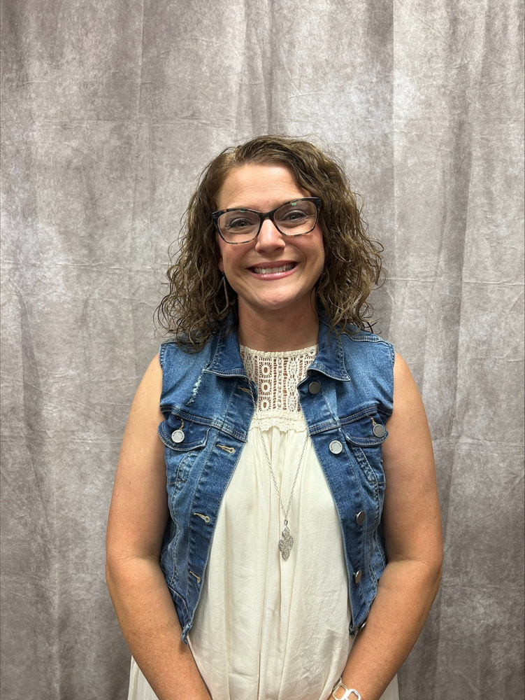
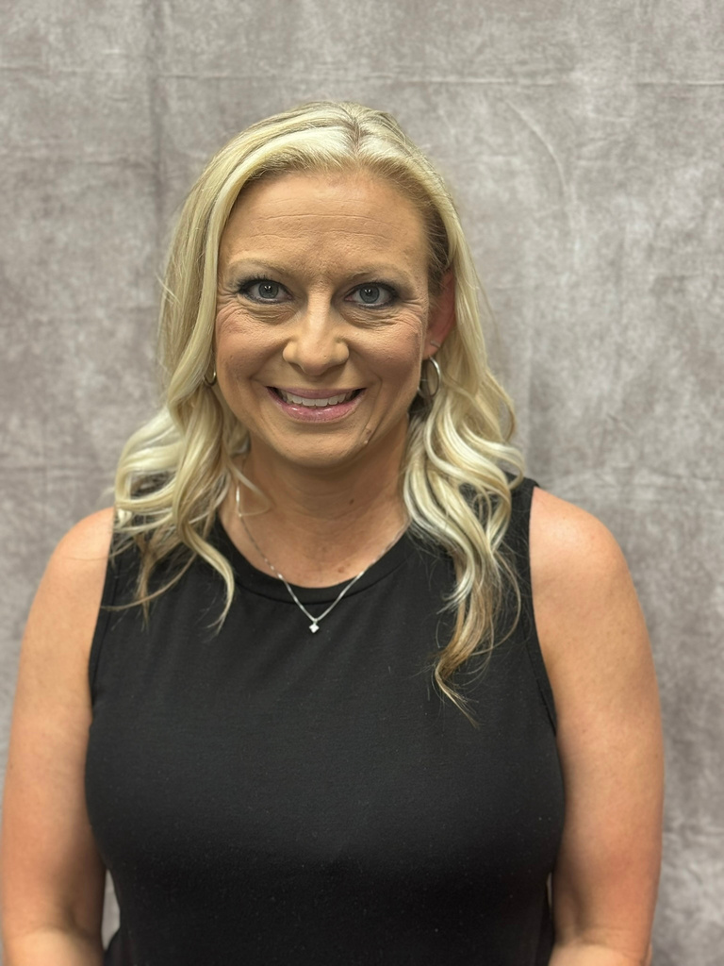
NE1
COLLEEN MORRISON:
CHELSEA HS
MEGAN HULSE:
OWASSO 8TH GRADE CENTER
KELLI MCELROY:
OOLOGAH-TALALA HS

Slide 10
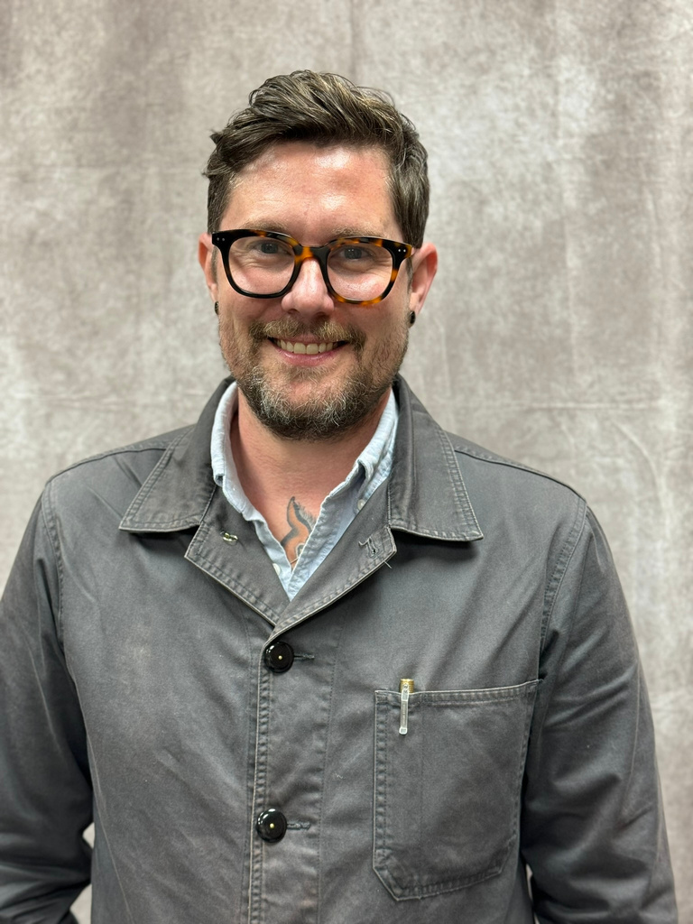
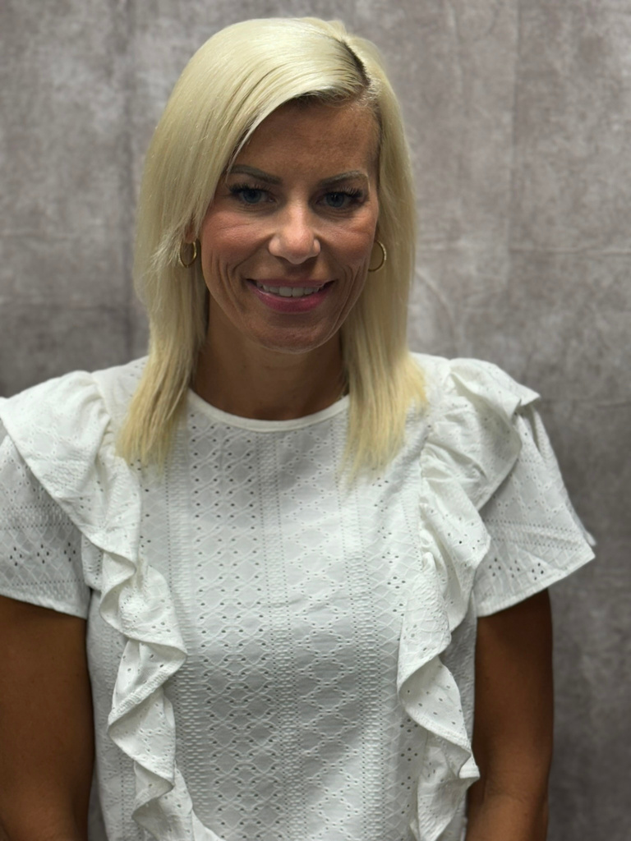
BRIEANN LLOYD:
COLLINSVILLE MS
TARA HALL:
OWASSO HS
BRADLEY MUCK:
TULSA TECH
NE1

Slide 11
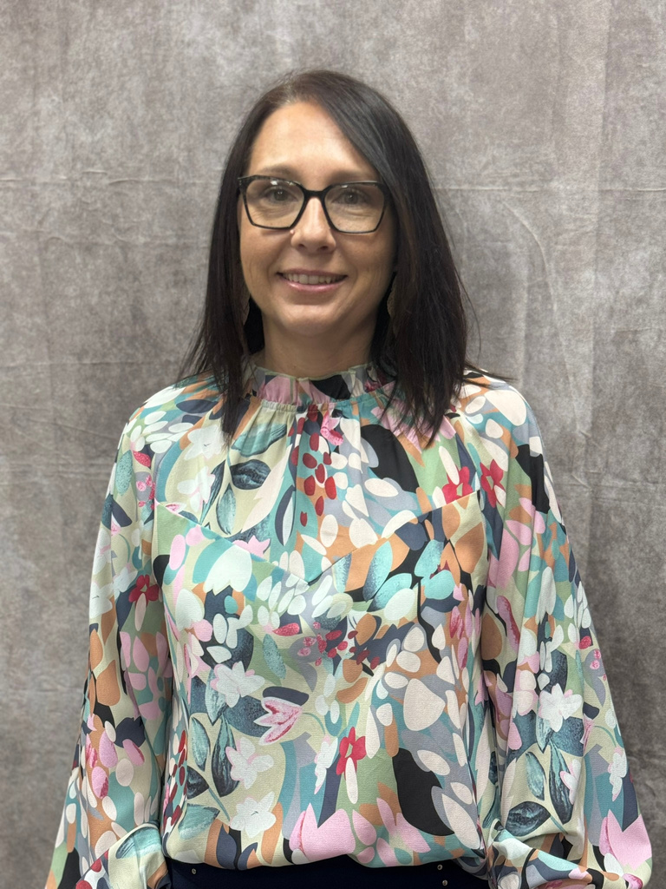
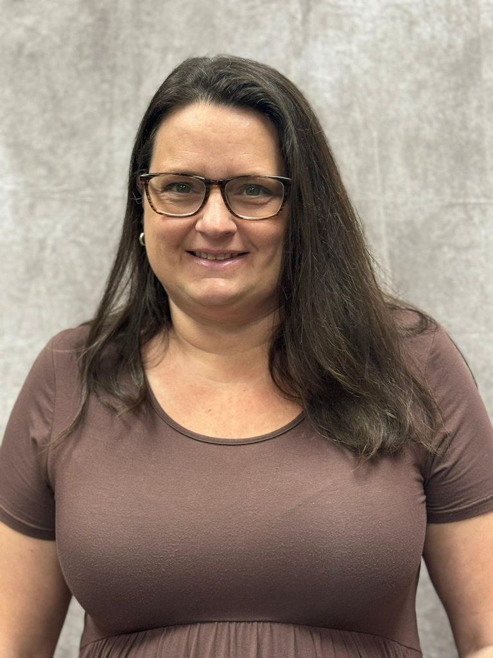
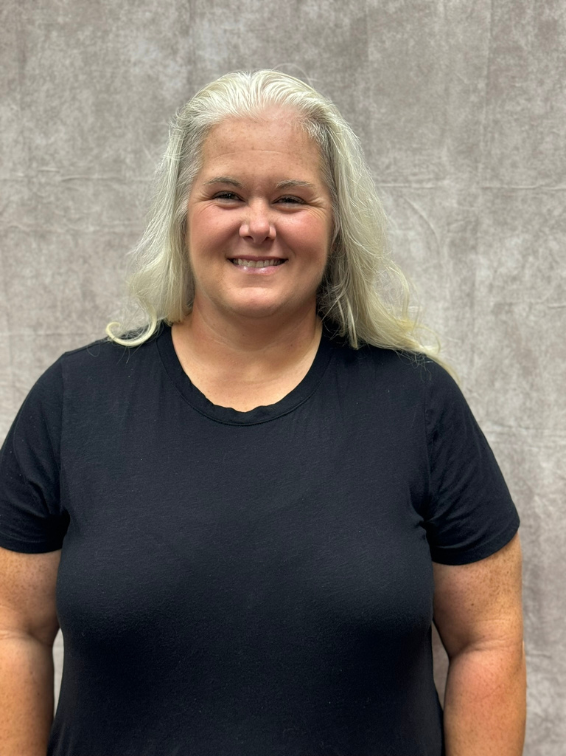
NE2
AMIE VAUGHAN
KANSAS HS
DEZARI PIERCE:
AFTON HS
MICHELLE FORD
MIAMI HS

Slide 12
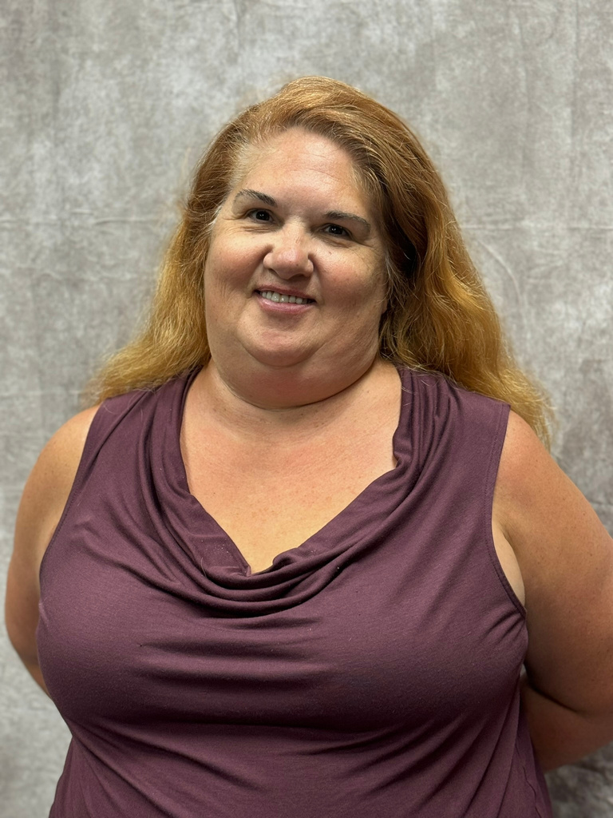
CINDY STANDIFIRD:
TULSA - NATHAN HALE
TEACHER CHANGE:
DENISE BOWEN
LIBERTY HS
TEACHER CHANGE:
STACY YOUNGBLOOD BEGGS HS
NE3

Slide 13
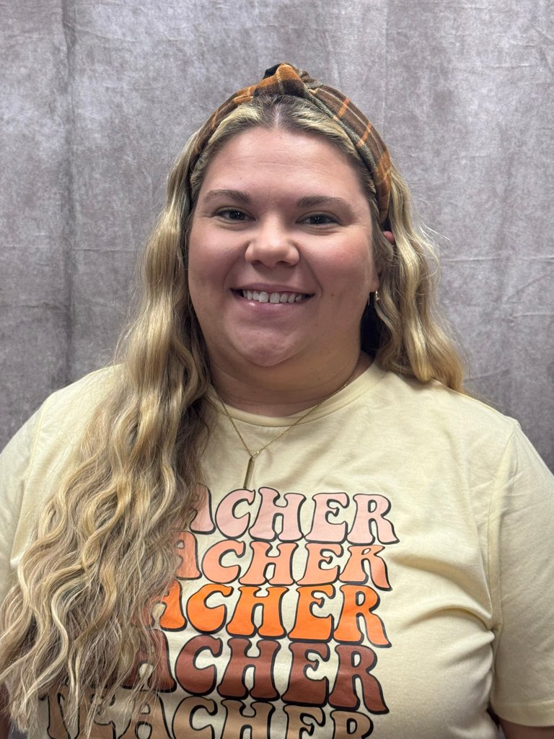
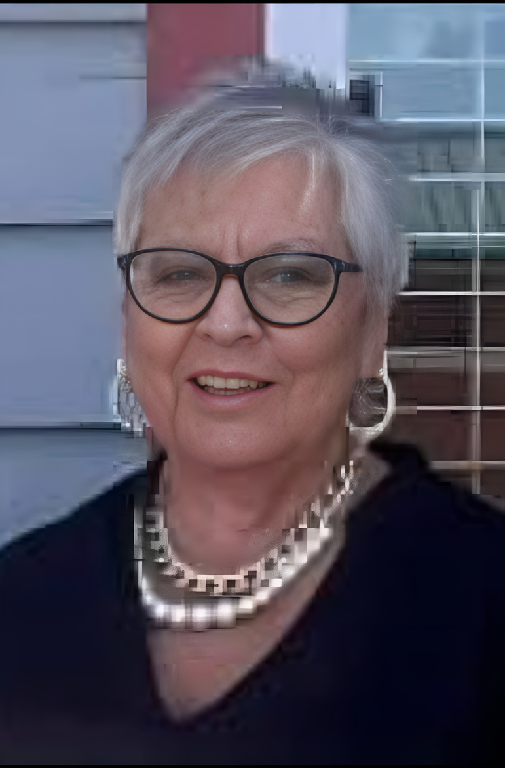
BLAKE COWDEN:
OKAY HS
JACKIE SEALS
PORTER HS
NE4

Slide 14
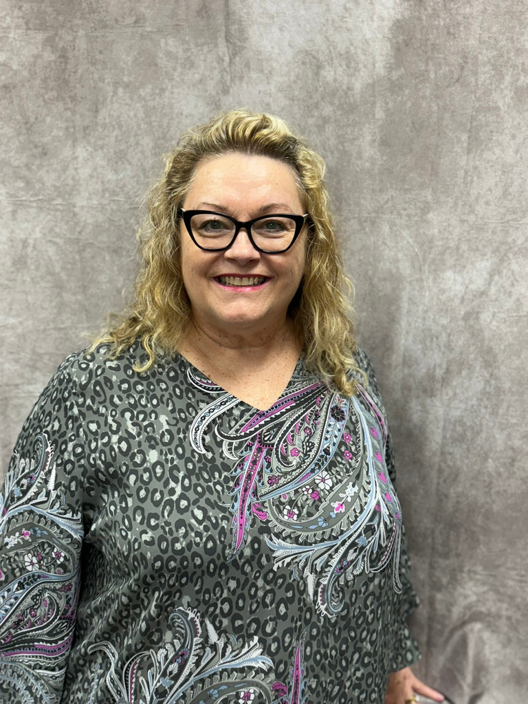
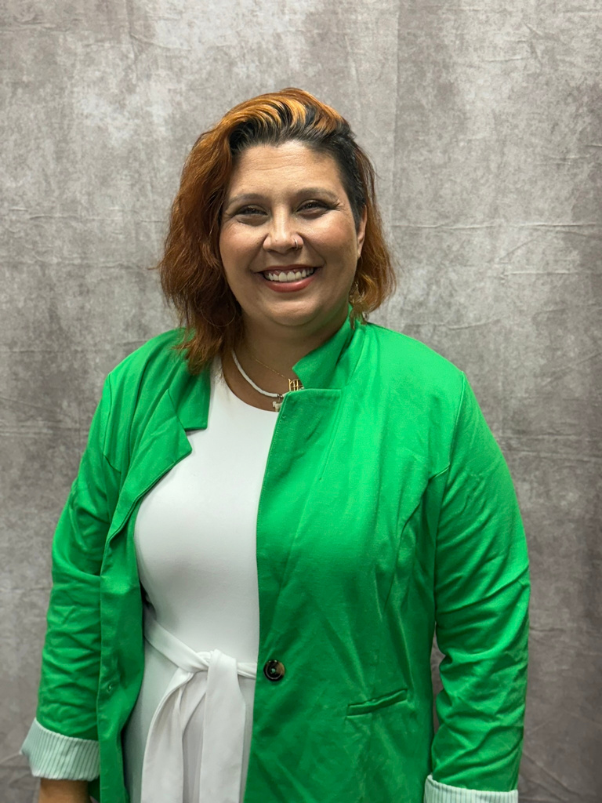
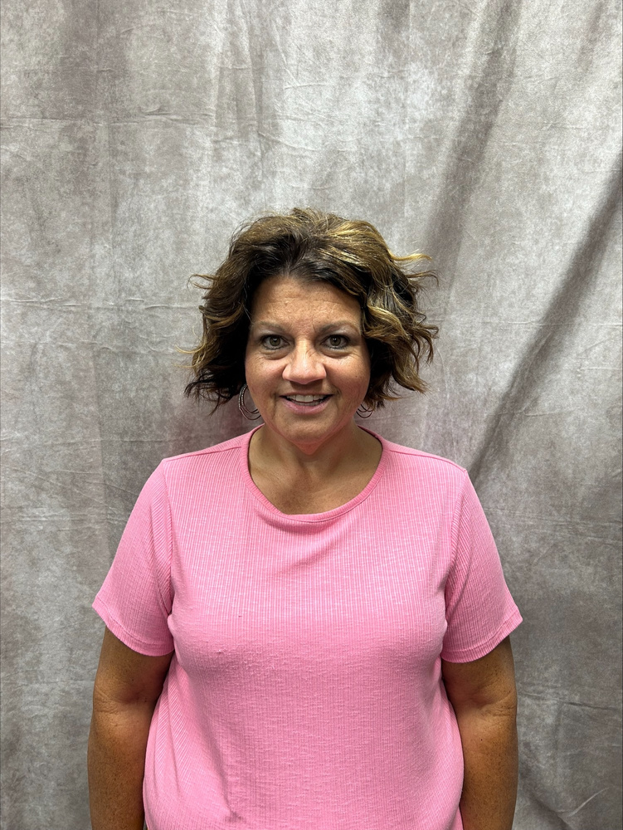
NE5
LAUREN FORT:
MUSKOGEE HS
SHEILA UEHLIN:
TAHLEQUAH MS
TEACHER CHANGE:
DIXIE SHOPE
HILLDALE HS

Slide 15
JOB OPENINGS!
There are still several jobs openings across the state. If you know someone who would like to teach FCS, send them to our job listings on ctYOU under the FCS/Bulletin Board/FCS Job Openings!

Slide 16

FCS PROGRAM FUNDING
412 MONEY
SALARY STIPEND
8000
2200
FULL TIME PROGRAMS
(411 MONEY)

Slide 17



USING 412 MONEY
Classroom Equipment
  Appliances
  Sewing Machines
  Laptops/Tablets
Instructional Supplies
  Curriculum/Textbooks
  Simulations/Real Care
  Food Lab Ingredients
Professional Development
  Chapter Adviser Summit
  Vision Conference
  May Workshops

Slide 18
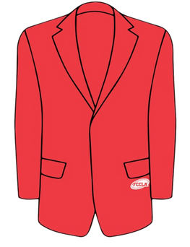
ADDITIONAL EXPENDITURES FY25
$900 FCCLA AFFILIATION PER CHAPTER
$300 OFFICIAL DRESS/CONFERENCE DRESS/CHEF ATTIRE

Slide 19

CTYOU HELP
www.ctYOU.org
  Create an account (tip use a personal email)
  It is okay if you are viewing items as a guest... you will have the password to anything that is locked.
  Locate helpful resources like:
    Region/District info
    Course Resources
    FCCLA Information
    Safety Tests (Fc$2024)
    5 Year Comprehensive Evaluation Folders for your program

Slide 20
FCS DIRECTORY
located on ctYOU
Will be under “FCS Regions”
Password Protected: Fc$2024
(once the new directory is posted you may need to clear browser cookies to see it instead of the old directory)

Slide 21

GRADUATION REQURIEMENT REFORM
More information to come from Holly.

Slide 22
CAREER INTEGRATION IN THE CLASSROOM
  Utilize advisory board members/community guests speakers in classes and FCCLA meetings
  OK Career Guide
    Training
    OK Career Guide Curriculum
    Connect 2 Business
  These integrations can be used to help students with their Individual Career Plan (ICAP)

Slide 23

SHAWNEE MILLS
  Coupons were emailed to your school email address on July 10. Contact Rose Mangold if you did not receive them at rose.mangold@careertech.ok.gov
  Please have students write a thank you note to:
    Sarah Steely
    PO Box 1567
    Shawnee, OK 74802-1567

Slide 24

OKLAHOMA PORK COUNCIL
Watch the newsletter for most up to date information on this grant opportunity.

Slide 25

OKLAHOMA BEEF COUNCIL
Watch the newsletter for most up to date information on this grant opportunity.

Slide 26

CERTIFICATION TESTS
Students completing FCS Basics & Human Growth & Development should be taking the ODCTE 7101 Entry Level Child Care Traning (ELCCT) certification test. Those who pass can work at daycare centers.
***There is still a large push for certification tests for our students. PLEASE watch the newsletter for future updates on certification tests to give your students.

Slide 27

PROGRAM REPORTING
Follow-Up Reports Open
CESI Reports initial submission
CESI Reports additional students added
Oct. 1
Oct. 31
Jan. 31
Sept. 30
May 31
Nov. 30
Salary & Teaching Report
Follow up Reports Due
CESI Final Reports Due
5 yr Folders Updated
Advisory Committee Report
412/314 Reports

Slide 28
SALARY & TEACHING REPORT: DUE SEPT 30TH
  Add your entire school day! Don’t forget your plan period and your lunch!
  If you have an ‘Other’ such as advisory or study hall please note it in the comments.​
    DO NOT place students in an “OTHER” course; unless you are teaching a FCS-related course. If student numbers are listed in other, an explanation is needed describing what material is being taught.​
  The ‘Contact Info’ section is NOT YOU. Use someone who can answer questions about your contract.​
  In the salary section, if you put any amount in the other box you must put a comment itemizing that amount.
    Example: $1500 should be broken down to $1000 Student Council, $500 Sr. Class Sponsor.
    DO NOT INCLUDE THE FCS STIPEND $2200.​
  Break down of what goes in each category of the Salary Information:​
    Base Salary: your base salary plus anything else FCS related i.e.: FCCLA stipend from school not the $2200​
    Health: any type of Insurance i.e.: health, life, etc. Itemize in the comment section what amount is paid for each different insurance.​
    Retirement: all school-paid retirements​
    Other: extra duty pay other than FCCLA​
  In the acknowledgment section note which pathways you teach.

Slide 29
PROGRAM VISITS, EVALUATIONS, & ACCREDITATIONS

Slide 30
COMPREHENSIVE PROGRAM EVALS (K12)
    NE1: Nowata, OK Union, Oologah-Talala, Sequoyah HS
    NE2: Colcord, Jay, Kansas
    NE4: Okay
    NE5: Hilldale, Sallisaw
CHECK YOUR EMAIL FOR DATE CONFIRMATION

Slide 31
CAREERTECH ACCREDITATIONS
Tri-County
Green Country
Indian Capital
DATES HAVE BEEN SCHEDULED

Slide 32
NEW TEACHER VISITS
NE1: Owasso 8th Grade Center, Chelsea, Oologah-Talala, Owasso HS, Collinsville MS, Tulsa Tech - Muck
NE2: Afton, Kansas, Miami
NE3: Tulsa - Nathan Hale HS
E4: Okay & Porter
NE5: Muskogee, Tahlequah MS
CHECK YOUR EMAIL FOR DATE CONFIRMATION

Slide 33
2ND YEAR AND MORE TEACHER VISITS
As needed, I may call and pop in!
I really want to know your programs so that I can best support and advocate for you ALL!

Slide 34
We are always willing to assist, although:
95%
of questions can be answered if you check:
Our Websites
The Newsletter
Your Email
Oklahoma FCCLA
ctYOU.org

Slide 35


Slide 36
24-25 OATFCS OFFICERS
President: Rita Hartwick
N-VP: Dulayna Murray
Pres.-Elect: Mary Dushane
NE-VP: Emily Colvin
Past President: Karin Davis
S-VP: Tina Clawson
Secretary: Jeanine Clark
SE-VP: Keri Laxton
Treasurer: Mary Beth Carver
Occ. VP: Kelly Brock
Treas.-Elect: Jaylee Victory
Div. Advisor: Holly Hanan

Slide 37
GET INVOLVED WITH OATFCS
OATFCS MEMBERSHIP
TIME COMMITMENT
CORRESPONDENCE
Will need OATFCS members to work on committees and legislative networks to improve FCS programs in Oklahoma.
The time commitment of serving with OATFCS is about 1-3 meetings a year.
Typically correspondence occurs via mail, email, or fax.
WILL NEED VOLUNTEERS FROM EACH REGION & DISTRICT

Slide 38

THANK YOU FOR SERVING
Membership Committee
  Work to increase membership in OATFACS
  maintains a communication network
Public Information Committee
  Recognize teachers and programs making outstanding contribultions to FCS
  promote curriculum showcase
Scholarship Committee
  review applications of scholarships
  determine scholarship recipients
Nominating/Awards Committee
  Recruit applicants for the scholarship program.
  Assist with hosting awards ceremony.

Slide 39


Slide 40
2024-2025 SEC
President​
Tessa Inman, Lindsay HS​
​
First Vice President​
Davin Budy, Cherokee HS​
​
Vice President of Community Service​
Jaden Taylor, Latta HS​
​
Post Secondary Officer​
Jackie Bennally, Great Plains Tech Center​
​
National Officer Candidate​
Hannah Brake, Sallisaw HS
Vice President of Membership​
Chloe Clements, Idabel HS​
​
Vice President of Programs​
Kendall Stout, Stigler HS​
​
Vice President of Public Relations​
Snowy Rich, Gore HS​
​
Vice President of Competitive Events​
Emily Faulkenberry, Marietta HS​
​
President
National Executive Council
Brandon Weibel, Silo HS

Slide 41




2024-2025 SEC UPDATES
24-25 SEC MEMBERSHIP CHALLENGE:
24-25 SERVICE PROJECT:
24-25 NATIONAL PROGRAM:
“Rally
the Red”

Slide 42





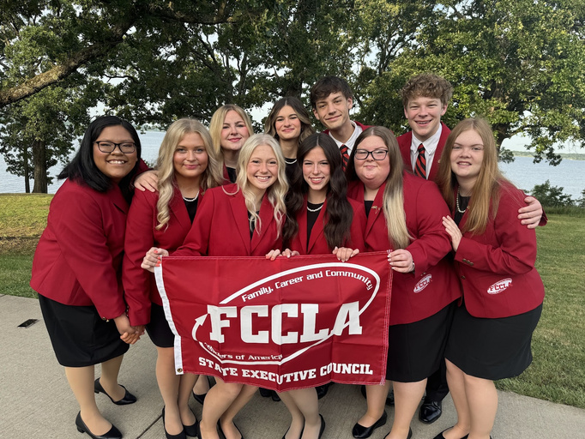
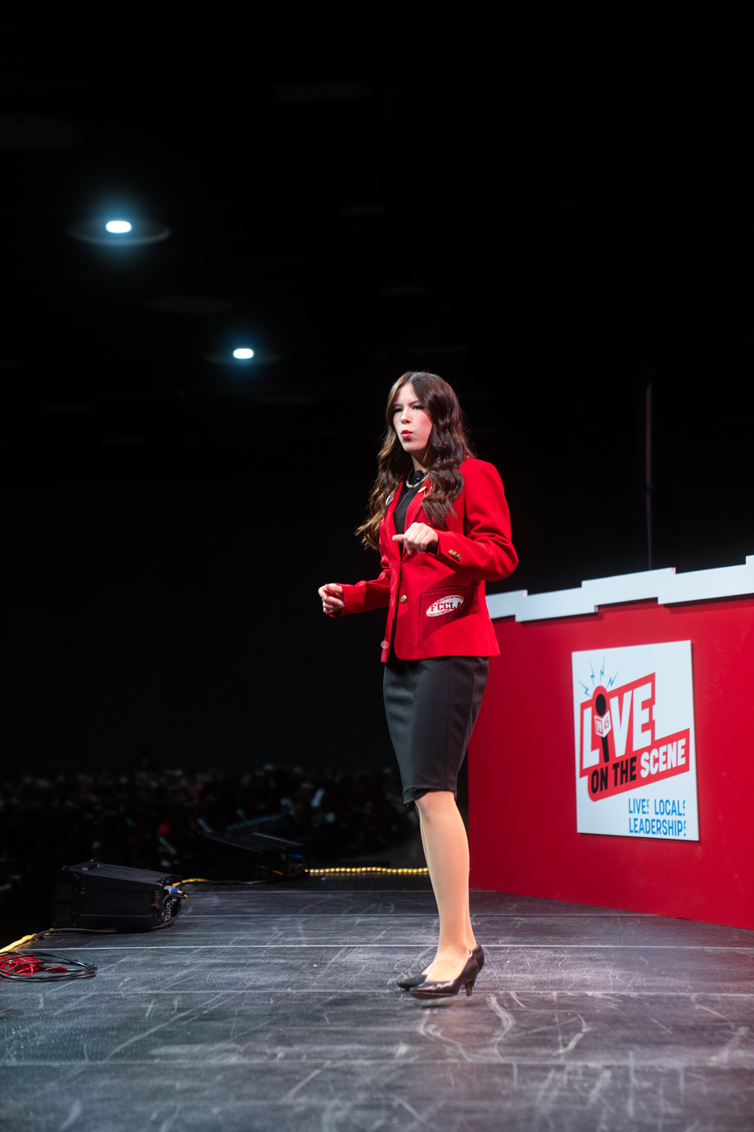
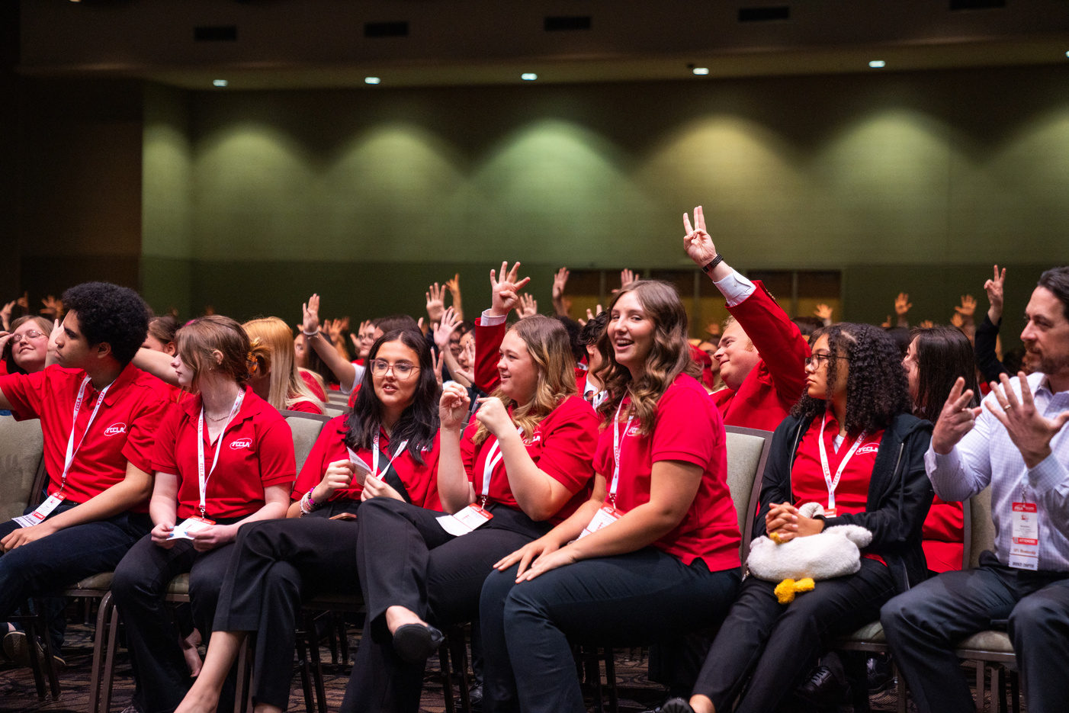


2024
LEAD
REGISTRATION DEADLINE:
AUGUST 31ST
DON’T WAIT!
REGISTER NOW!
CONFERENCE
Gold Medal Leadership!
Sept
North Region
Sept
Northeast Region
11
Stride Bank Center
301 S Independence St
Enid, OK 73701
17
Glenpool Conf. Center
12205 S Yukon Ave.
Glenpool, OK 74033
Sept
South Region
Sept
Southeast Region
12
Simmons Center
800 Chisholm Trail Pkwy
Duncan, OK 73533
18
Life Church
1300 S George Nigh Expy
McAlester, OK 74501
$15
per Student
more at oklahomafccla.org

Slide 43

STATE CONVENTION:
7 WONDERS OF LEADERSHIP
TULSA, OK
APRIL 10, 2025

Slide 44

NATIONAL LEADERSHIP CONVENTION:
ORLANDO, FL
JULY 5-9, 2025

Slide 45
NLC CHAPTERS RECOGNITION - TOP 10 PLACEMENT
Collinsville High School FCCLA
Okay High School FCCLA
Quapaw High School FCCLA
Sallisaw High School FCCLA
Tulsa Tech FCCLA - Fashion - Davis
Warner High School FCCLA
Westville High School FCCLA

Slide 46
FCCLA NATIONAL HEADQUARTERS ADDRESS:
NATIONAL FCCLA
13241 Woodland Park Road,
Suite 100
Herndon, VA 20171
*** Address is needed for reasons such as Affiliation Payments

Slide 47
~PSA~
PLEASE SEND ME AN EMAIL WITH URGENT QUESTIONS... IF YOU ASK ME IN PERSON TODAY, IT MIGHT NOT MAKE IT BACK TO THE OFFICE.

Slide 48
CLOSING DETAILS
  DISTRICT PLANNING MEETINGS
  NORTHEAST REGION DATE SHEET
  SUBMITTING DISTRICT STAR EVENT JUDGES (QR CODE ON DUTY SHEET)
  VOLUNTEERS FOR OATFCS COMMITTEES
  SCAN THE QR CODE TO GET YOUR OK SUMMIT PD CERTIFICATE (WON’T GET IMMEADIATELY)

Slide 49
PLEASE MOVE INTO YOUR DISTRICT SECTIONS FOR DISTRICT PLANNING MEETINGS

