Slide 1
FCCLA Planning Process
A Planning Tool for FCCLA Chapters

Slide 2





FCCLA Planning Process
Identify Concerns\
Act
Set A Goal
Follow Up
Form A Plan

Slide 3
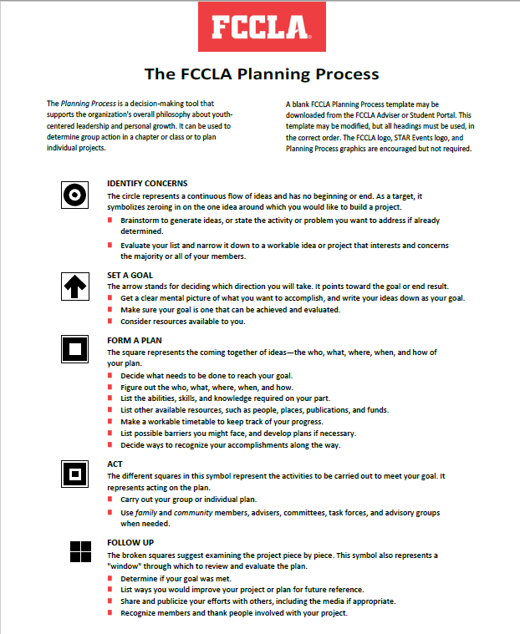
The FCCLA Planning Process
The Planning Process is a decision-making tool that supports the organization's overall philosophy about youth-centered leadership and personal growth. It can be used to determine group action in a chapter or class or to plan individual projects.

Slide 4
FCCLA Planning Process
Identify Concerns

Slide 5
Identify Concerns
The circle represents a continuous flow of ideas and has no beginning or end.
As a target, it symbolizes zeroing in on the one idea around which you would like to build a project.

Slide 6
Identify Concerns
Brainstorm to generate ideas, or state the activity or problem you want to address if already determined.
Evaluate your list and narrow it down to a workable idea or project that interests and concerns the majority or all of your members.

Slide 7
FCCLA Planning Process
Identify Concerns
Set A Goal

Slide 8

Set A Goal
The arrow stands for deciding which direction you will take. It points toward the goal or end result.

Slide 9
Set A Goal
Get a clear mental picture of what you want to accomplish, and write your ideas down as your goal.
Make sure your goal is one that can be achieved and evaluated.
Consider resources available to you.

Slide 10
FCCLA Planning Process
Identify Concerns
Set A Goal
Form A Plan

Slide 11
Form A Plan
The square represents the coming together of ideas—the who, what, where, when, and how of your plan.

Slide 12
Form A Plan
Decide what needs to be done to reach your goal.
Figure out the who, what, where, when, and how.
List the abilities, skills, and knowledge required on your part.
List other available resources, such as people, places, publications, and funds.
Make a workable timetable to keep track of your progress.
List possible barriers you might face, and develop plans if necessary.
Decide ways to recognize your accomplishments along the way.

Slide 13
FCCLA Planning Process
Identify Concerns
Act
Set A Goal
Form A Plan

Slide 14
Act
The different squares in this symbol represent the activities to be carried out to meet your goal. It represents acting on the plan.

Slide 15
Act
Carry out your group or individual plan.
Use family and community members, advisers, committees, task forces, and advisory groups when needed.

Slide 16
FCCLA Planning Process
Identify Concerns
Act
Set A Goal
Follow Up
Form A Plan

Slide 17
Follow Up
The broken squares suggest examining the project piece by piece. This symbol also represents a "window" through which to review and evaluate the plan.

Slide 18
Follow Up
Determine if your goal was met.
List ways you would improve your project or plan for future reference.
Share and publicize your efforts with others, including the media if appropriate.
Recognize members and thank people involved with your project.

