Slide 1











REGION MEETINGS
OKLAHOMA FCS

Slide 2
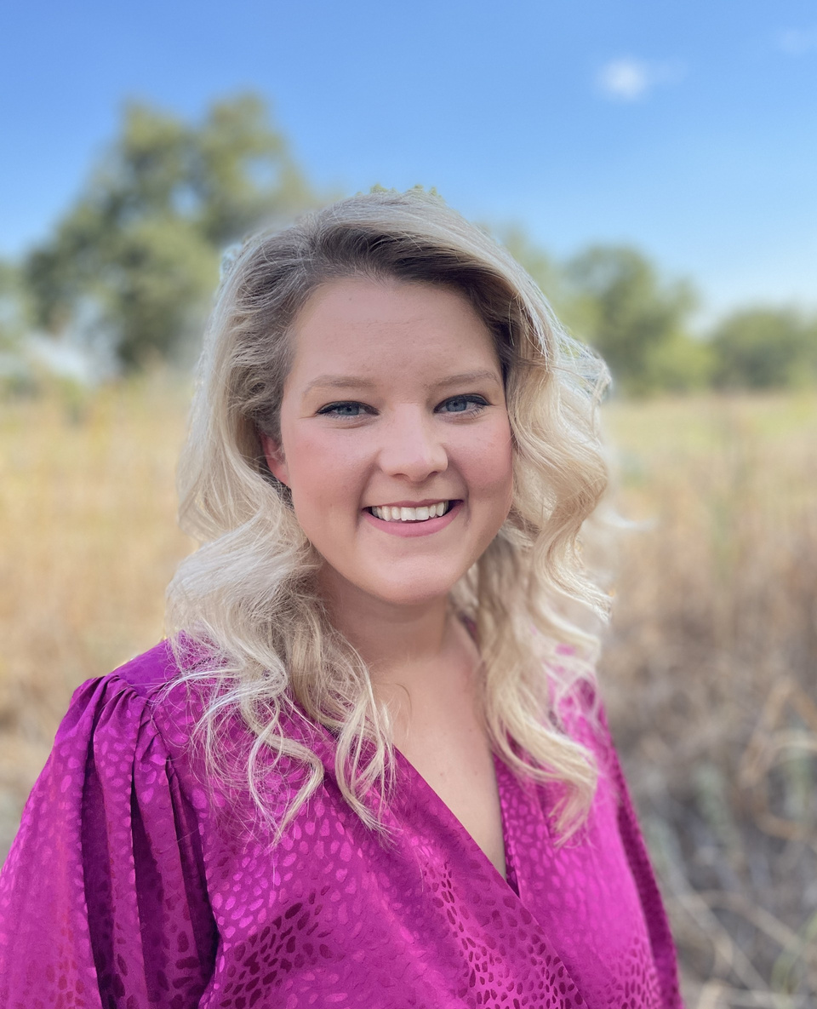
PROGRAM SPECIALIST
Contact Info
Jessica Maker
jessica.maker@careertech.ok.gov
405-743-6809

Slide 3





Slide 4
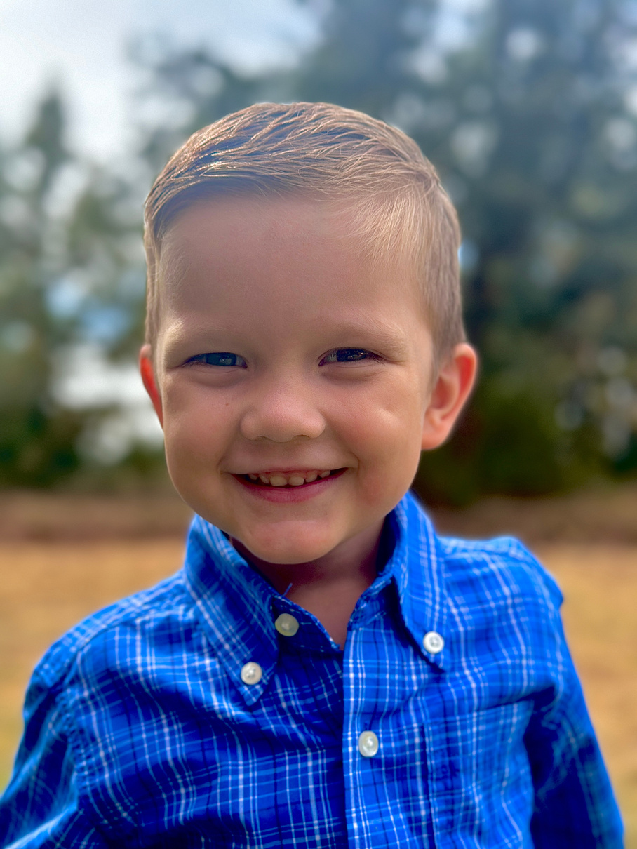
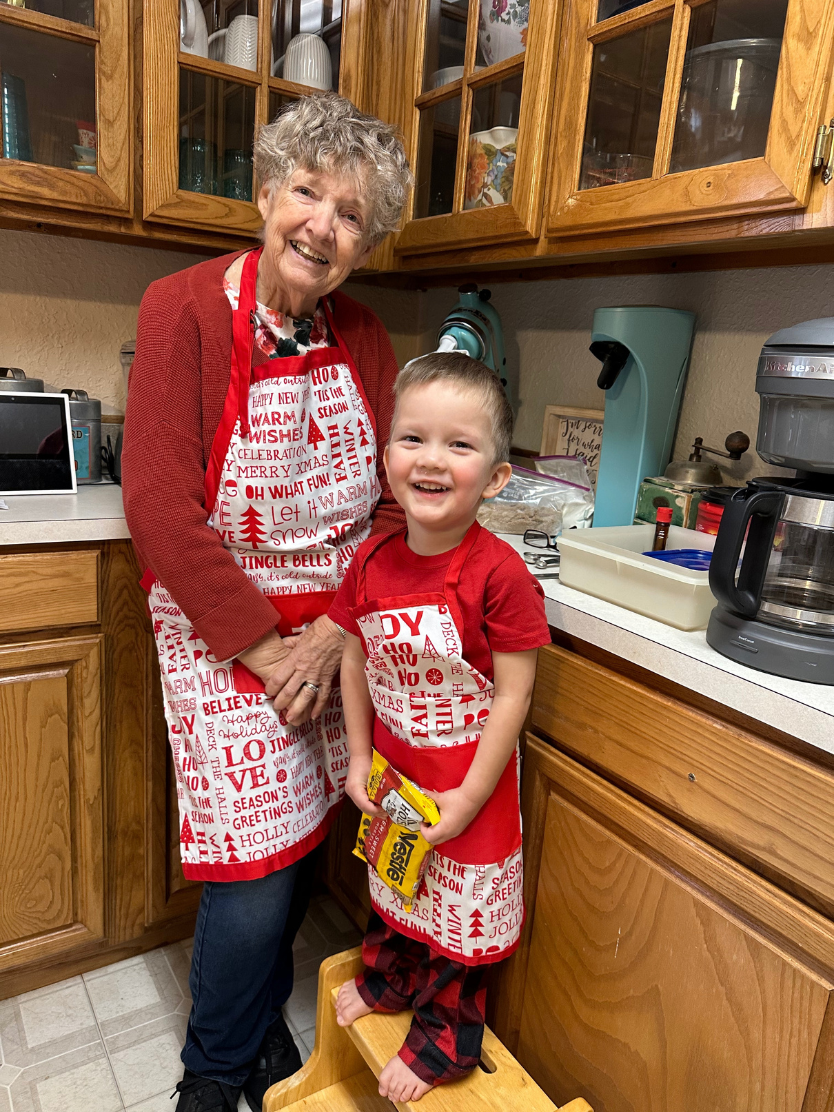
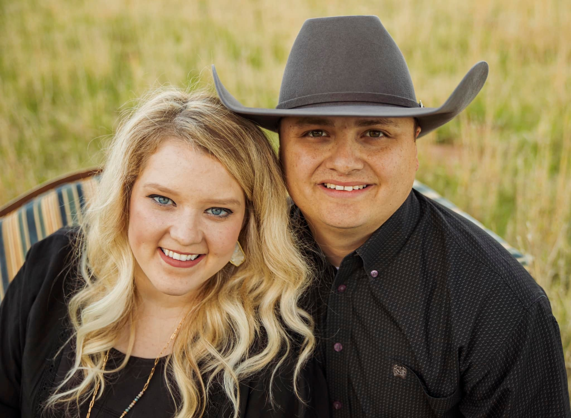
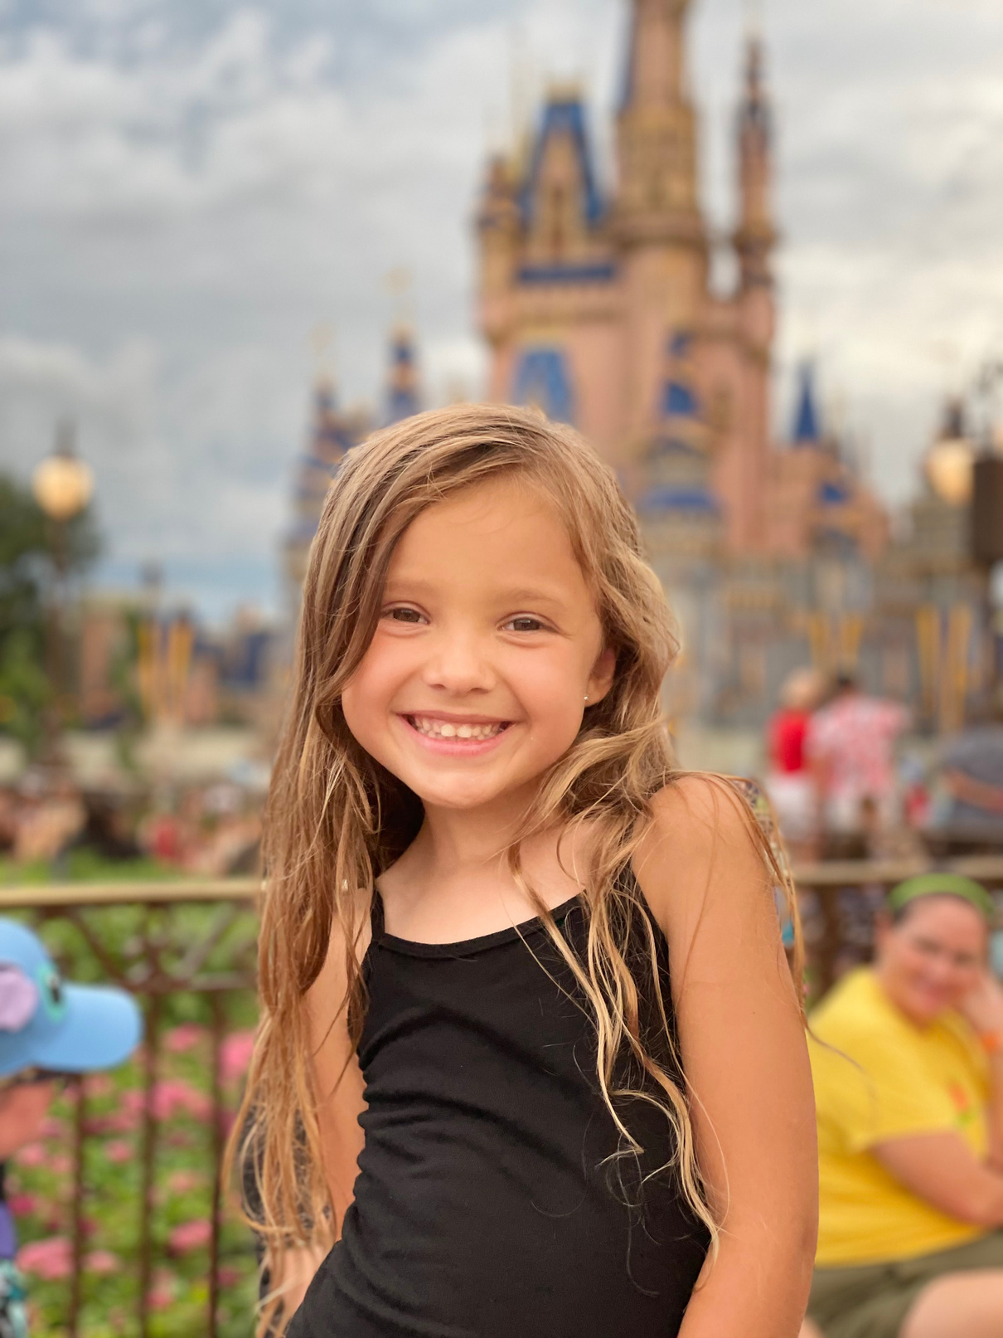

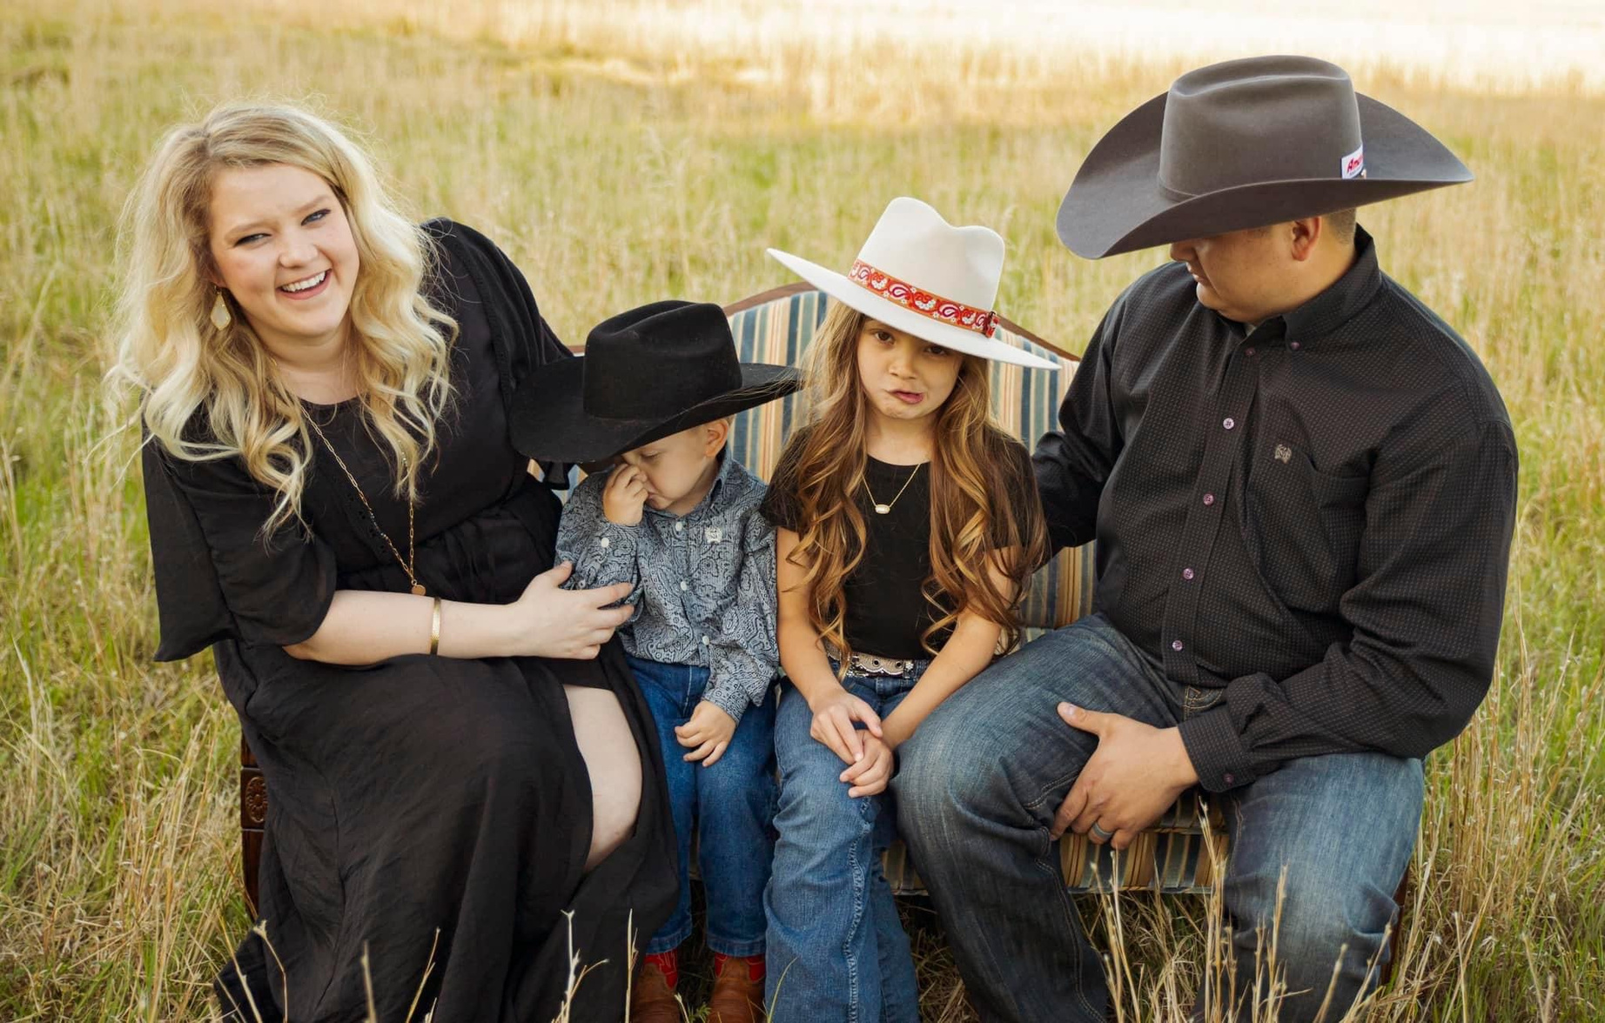
TENNY
GRAMCRACKER
DUSTIN
JAXCIE
OUR FAMILY
IN LAWS

Slide 5
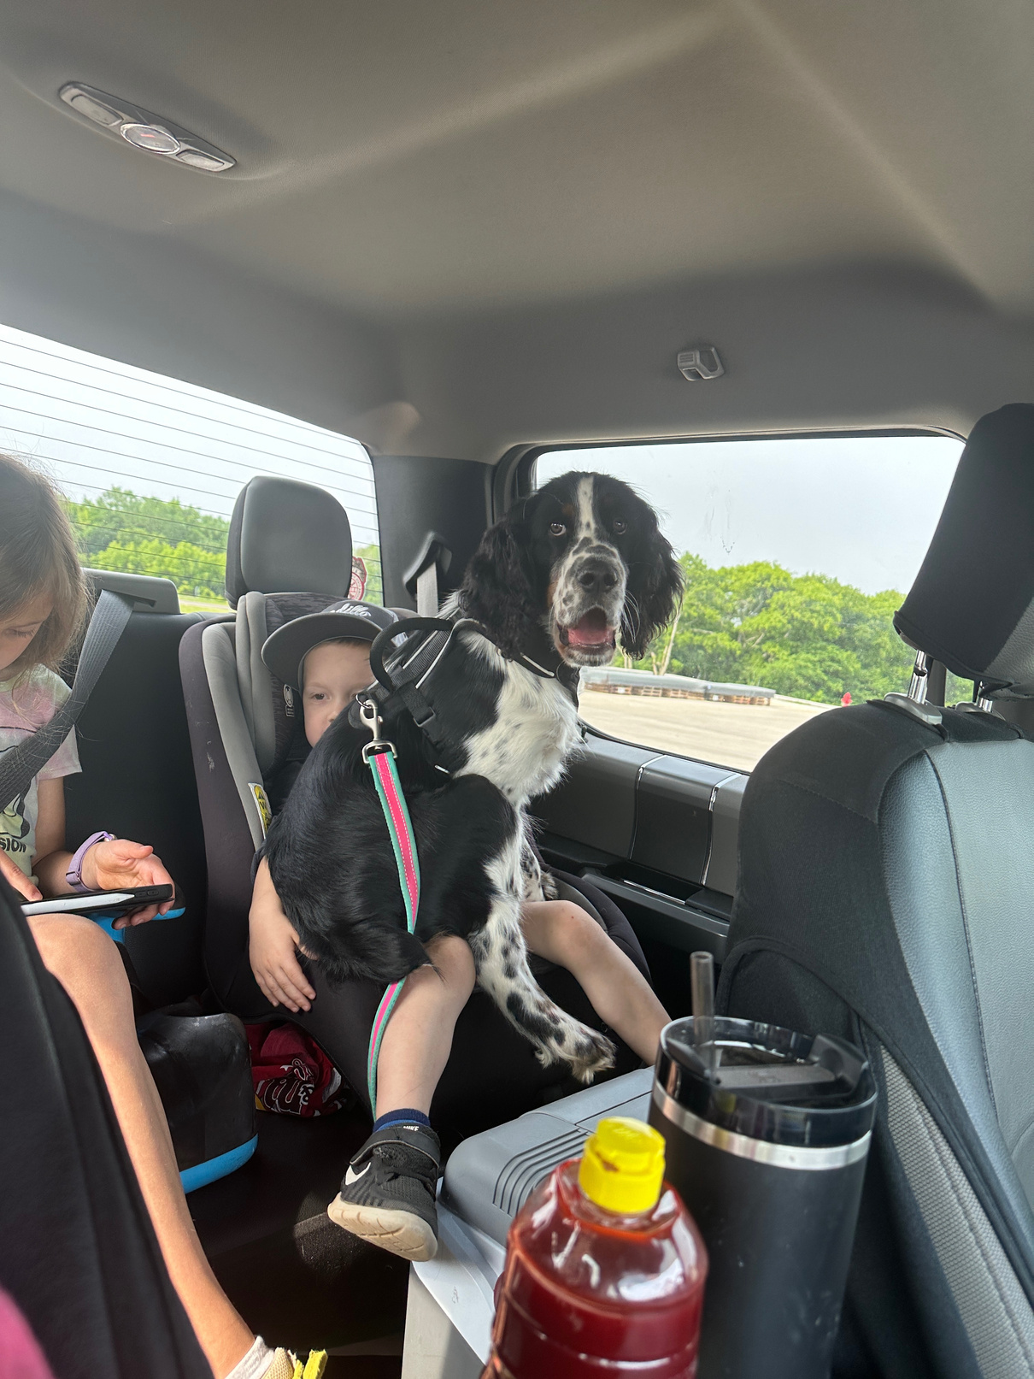
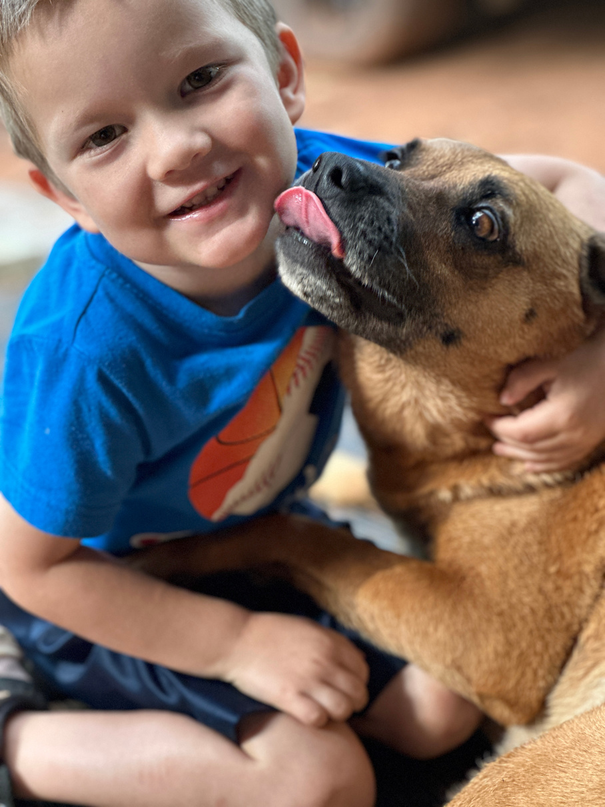
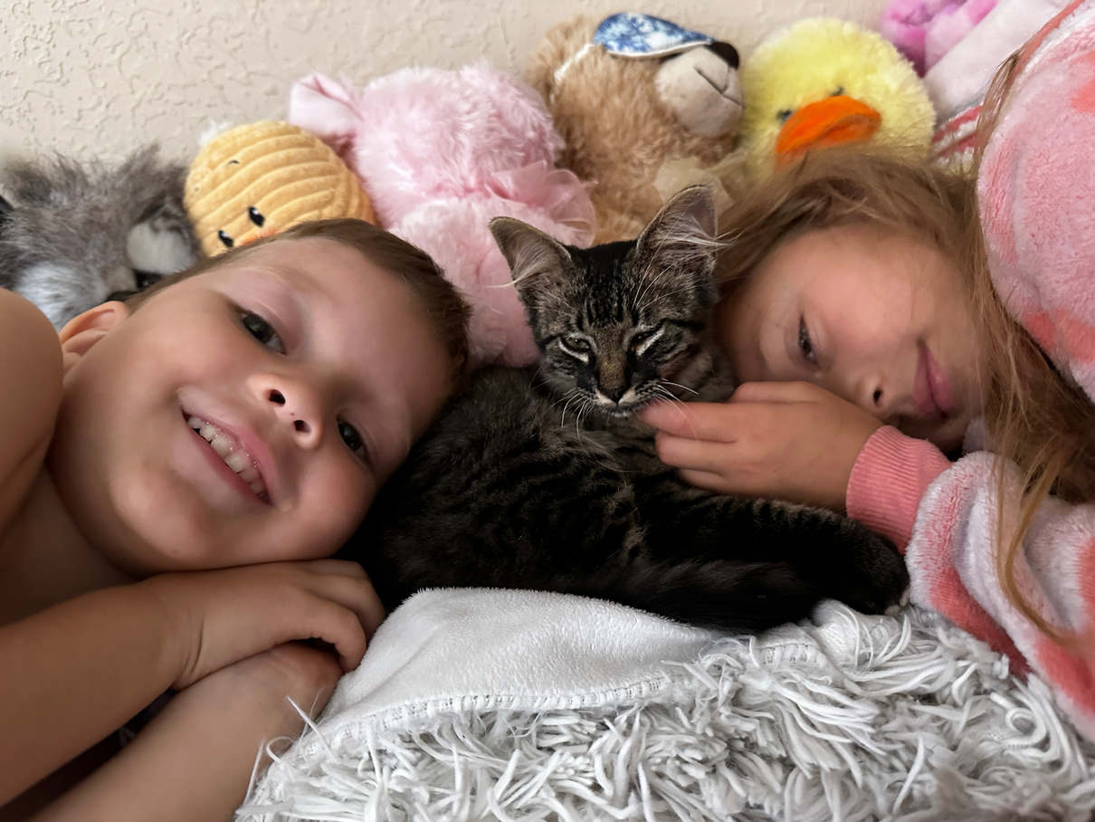
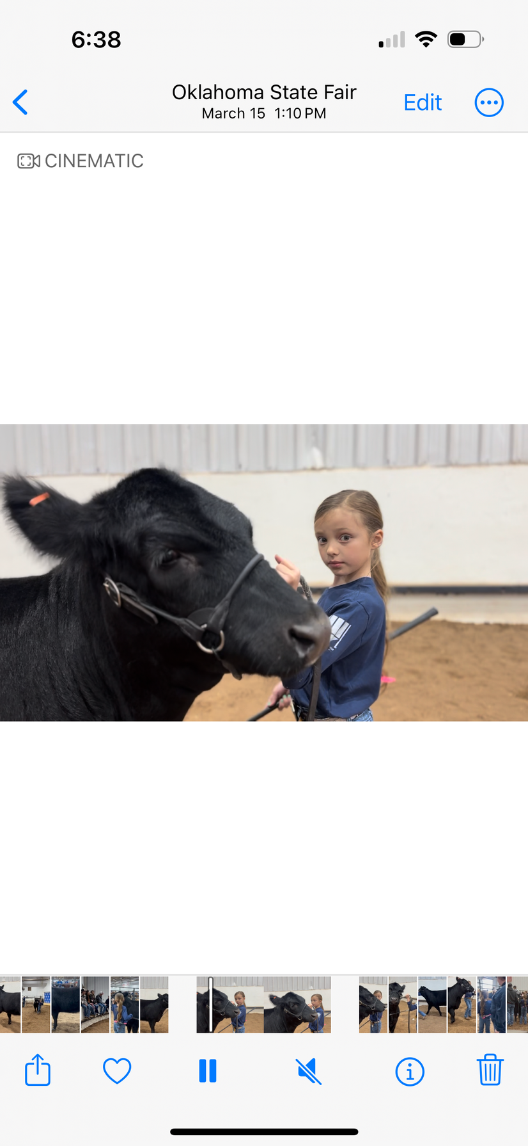
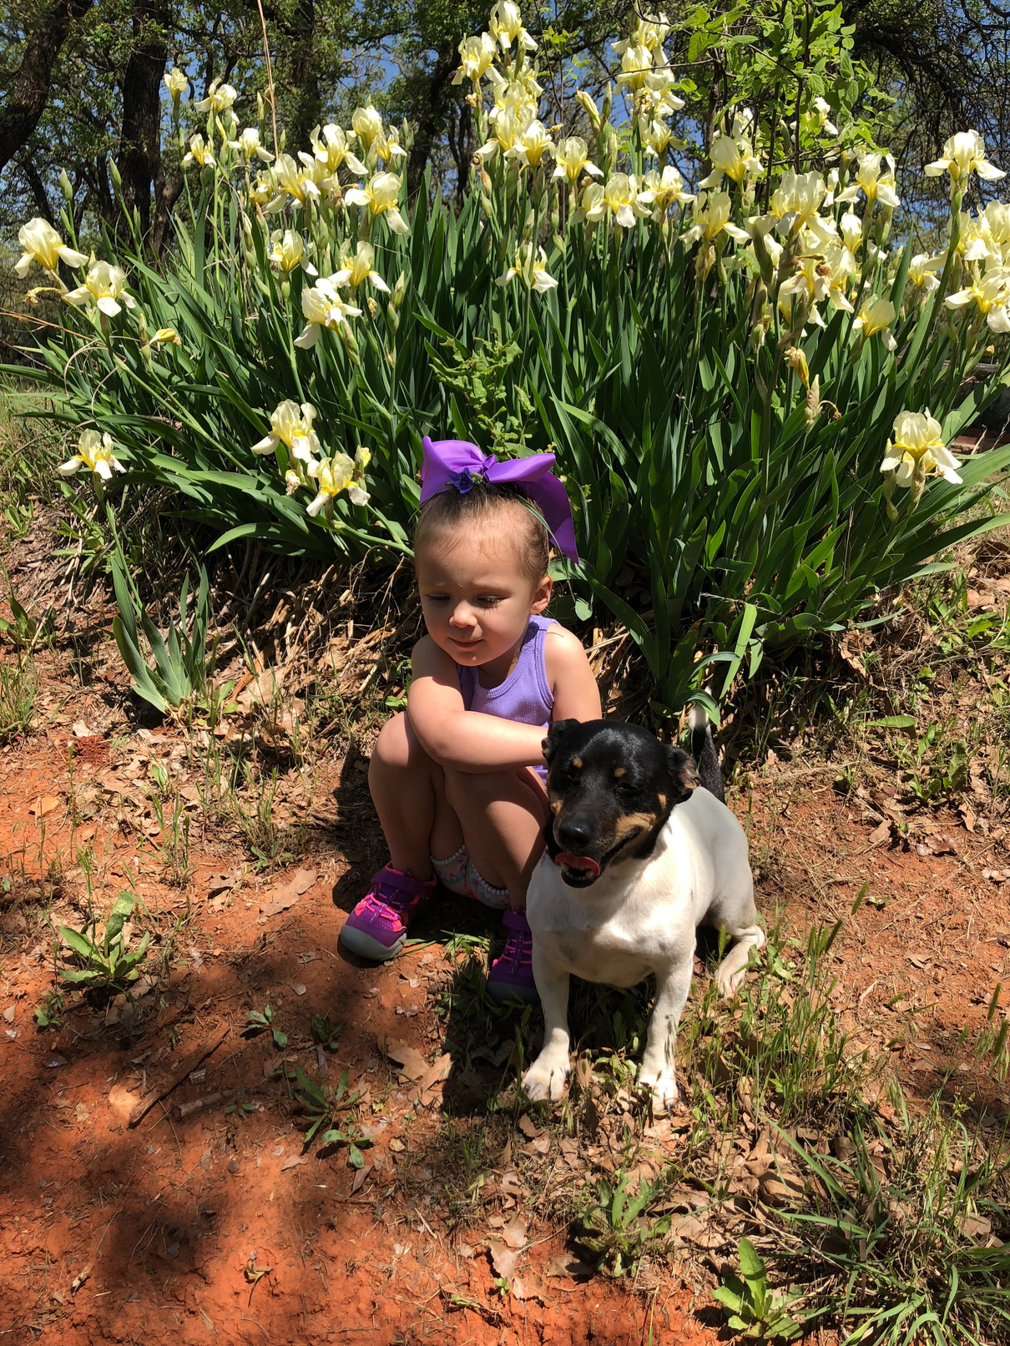
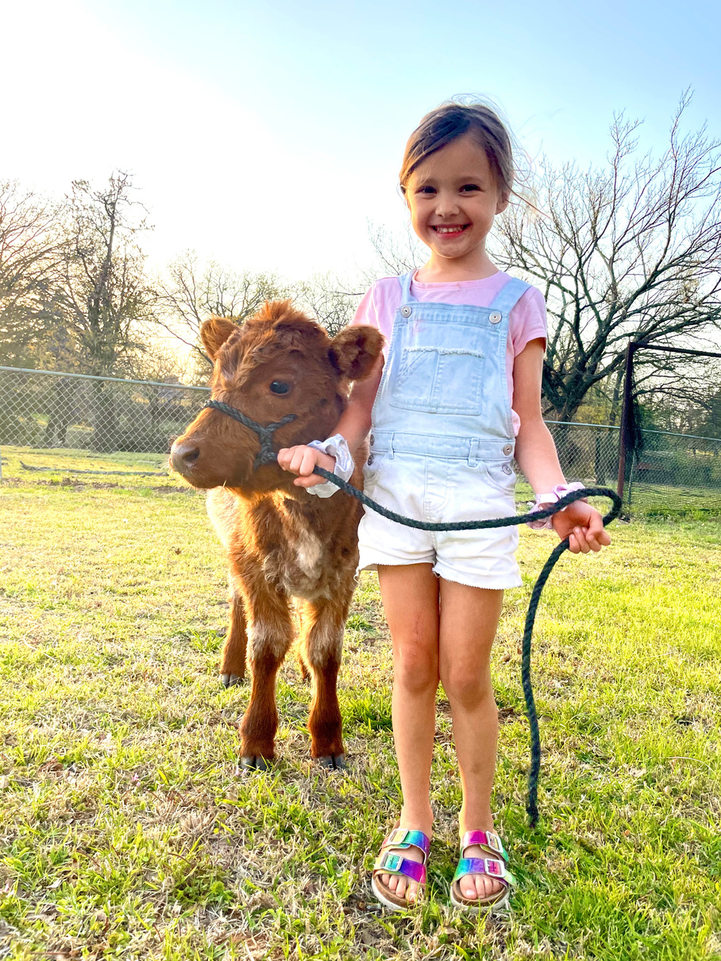
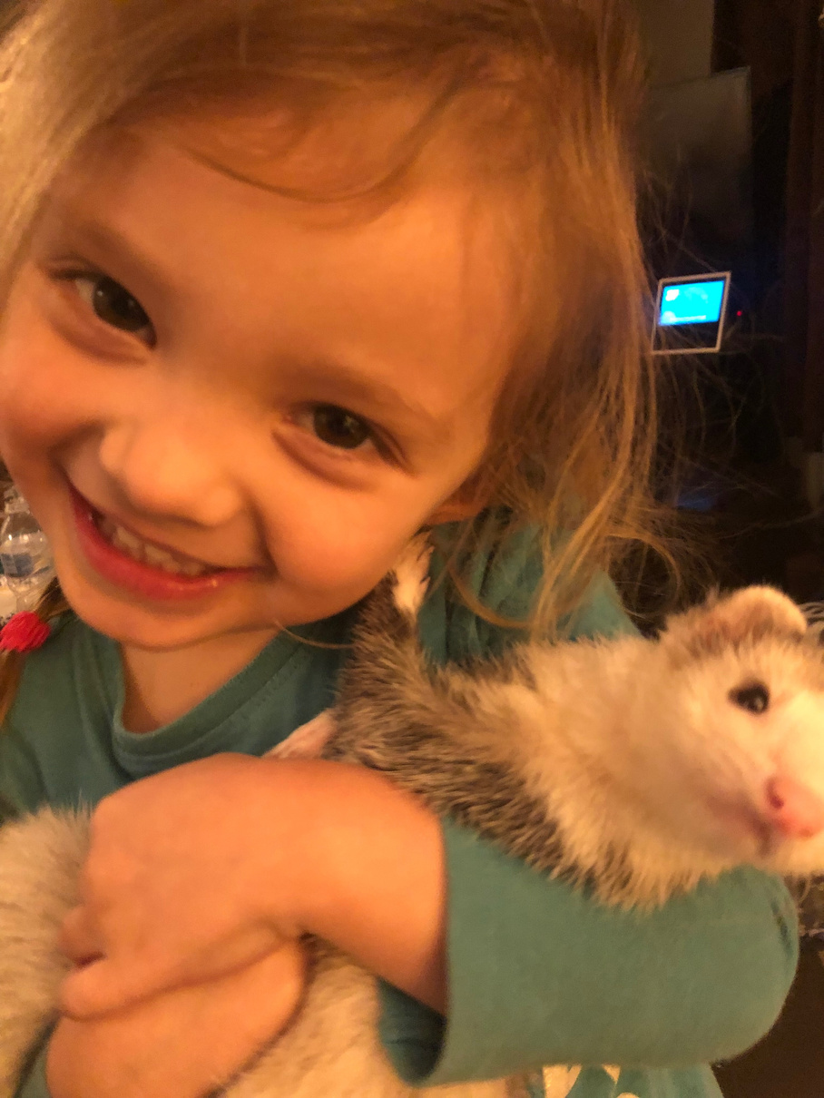
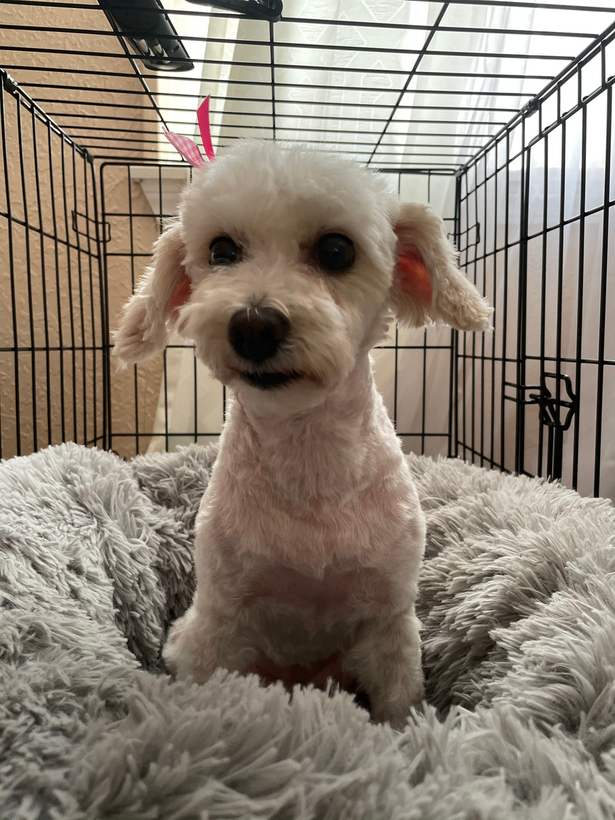
FARM LIFE

Slide 6

NEW TEACHERS!
S1
S2
S3
S4
S5
  Christel Funkhouser
    Hobart HS
  Helena (Lena) Lewallen
    Western Technology Center
  Alisa Boecker
    Weatherford HS
  Amanda Langham
    Fort Cobb HS
  Kristi Hahn
    Hinton Hs
  Jacquelyn Smith
    Anadarko
  Kaitlyn Buchanan
    Newcastle HS
  Ashlea Morgan
    Noble- Curtis Ingle MS
  Christina Roby
    Mustang North MS
  Tara Hardeman
    Mustang Central MS
  Jennifer Morris
    Mustang MS
  Kimberly Griffin
    PC-Hefner MS
  Kristy Hicks
    Putnam City HS
  Gloria Neatherly
    Putnam City North HS
  Crystal Lamoureaux (2nd year)
    Western Heights MS
  Jamie Marugg
    PC- Western Oak MS
  PC- Mayfield- OPEN
  Cari Clodfelter
    Apache HS
  Whitney Watkins
    Fox HS
  Trish Rose (2nd year)
    Wynnewood HS
  Amber Martin
    Fletcher
  Janna Holley
    LRC-Lawton
  Sierra Dodson
    Sterling HS
  Brittani Wood
    Waurika
  Athena Mathis
    Westmoore HS
  Ciane Hartzell
    Midwest City HS
  Annamarie Ball
    OKC- Roosevelt MS
  Brock Sizemore (2nd year)
    OKC- Capitol Hill HS
  Charitee Evans (2nd year)
    OKC-US Grant
  Alicia Underwood (2nd year)
    Midwest City MS
  Moore HS- OPEN

Slide 7
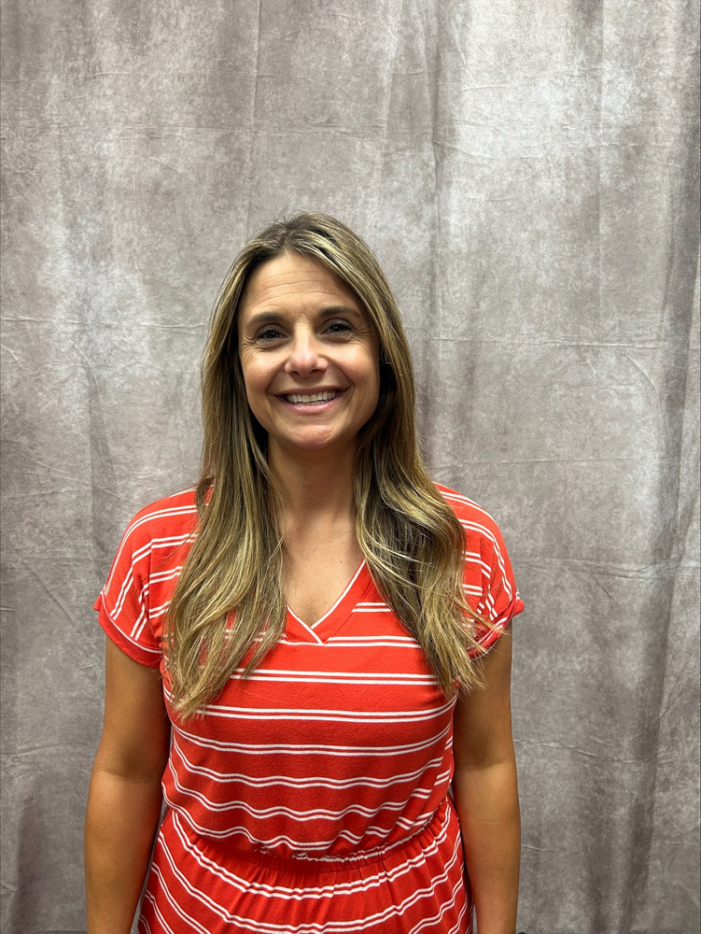
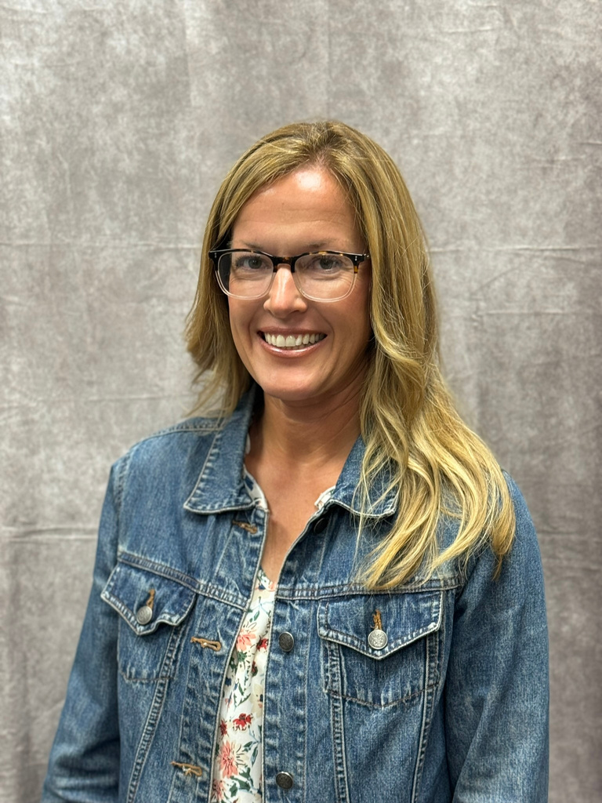
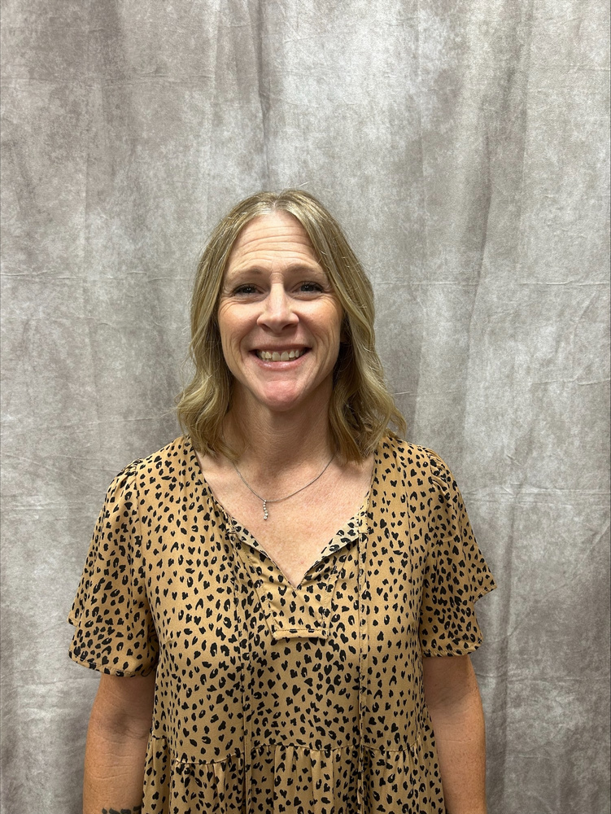
ALISA BOECKER
CHRISTEL FUNKHOUSER
AMANDA LANGHAM

Slide 8
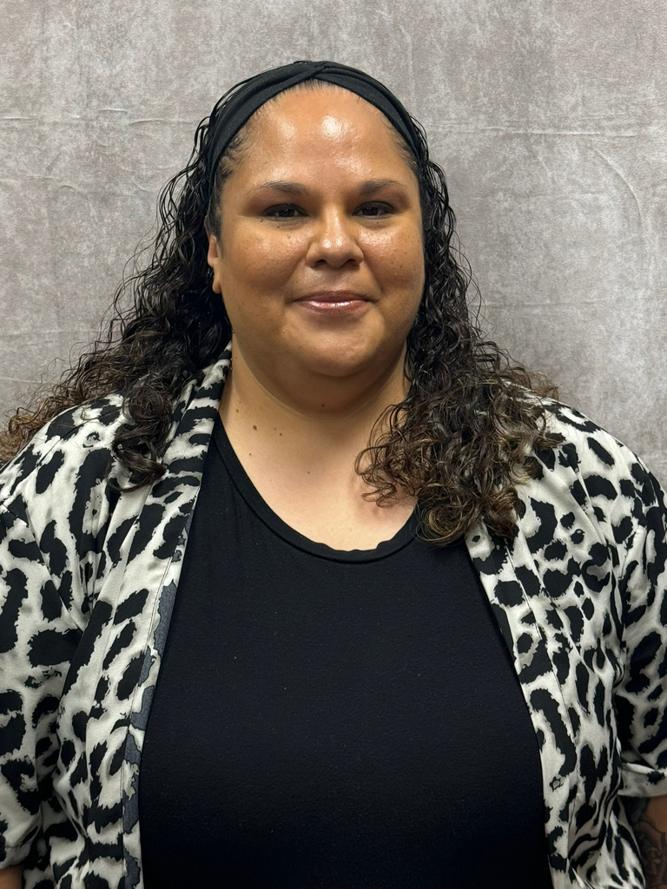
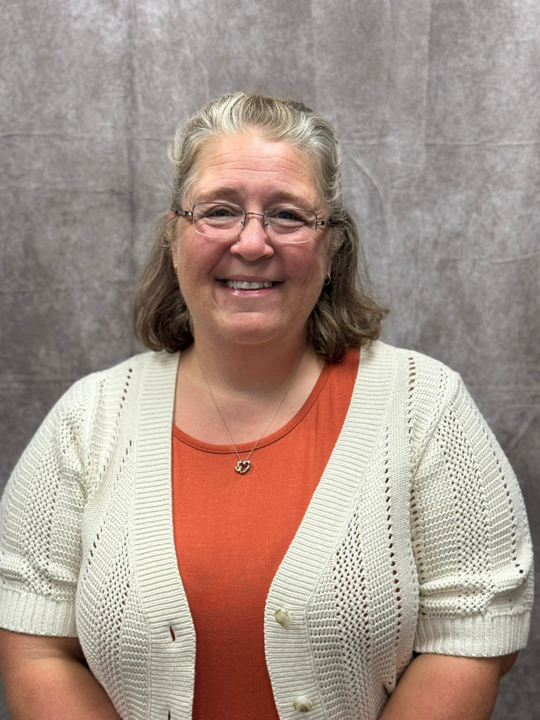
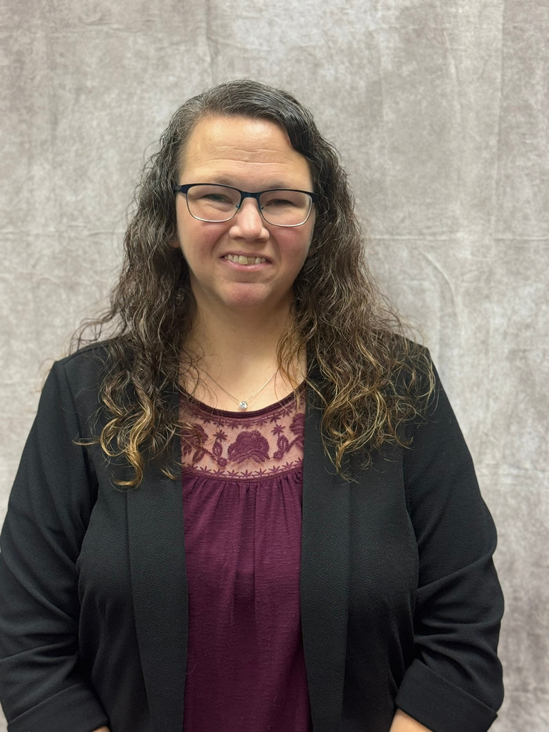
KRISTI HAHN
CHRISTINA ROBY
JACQUELYN SMITH

Slide 9
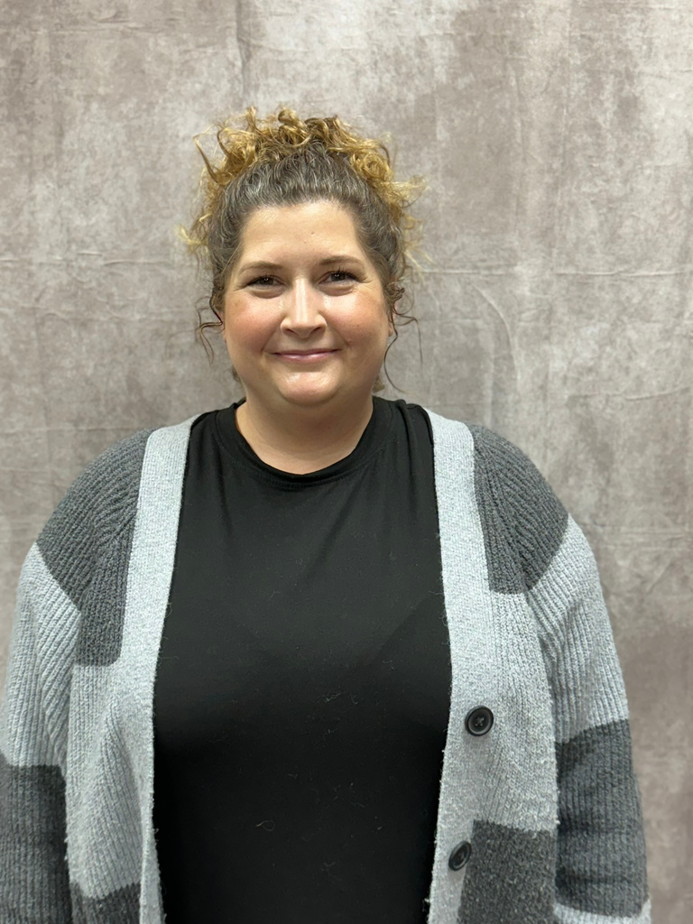
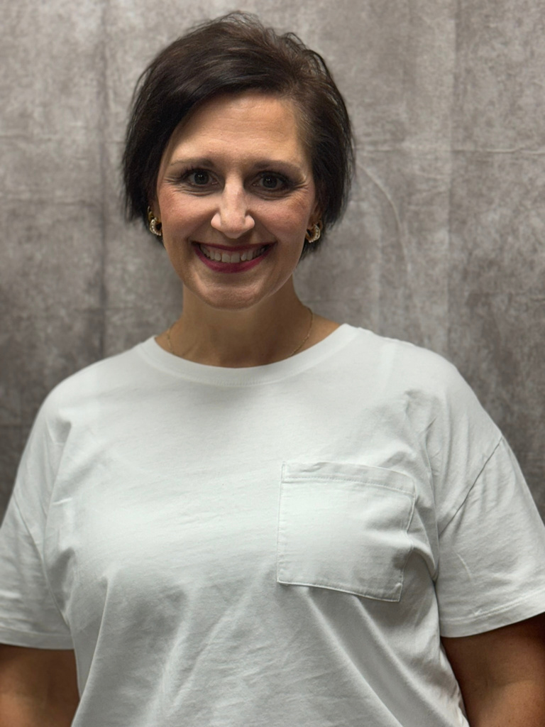
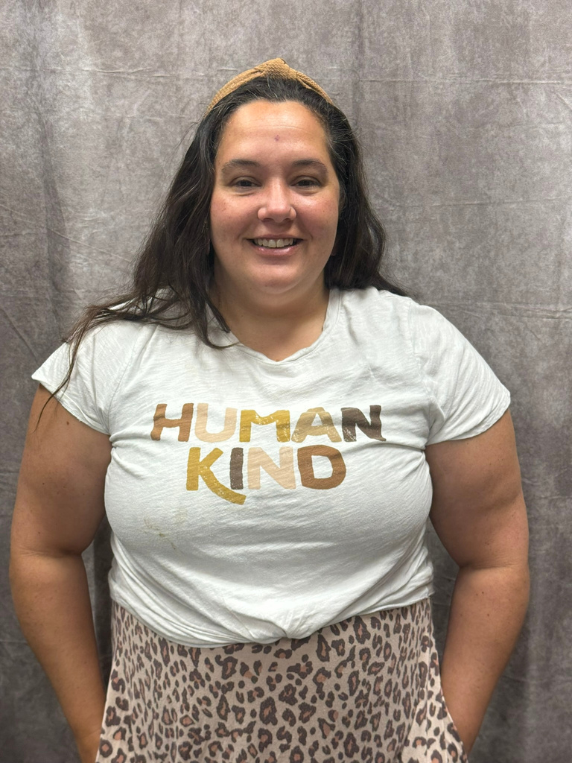
JAMIE MARUGG
CRYSTAL LAMOUREAUX
JENNIFER MORRIS

Slide 10
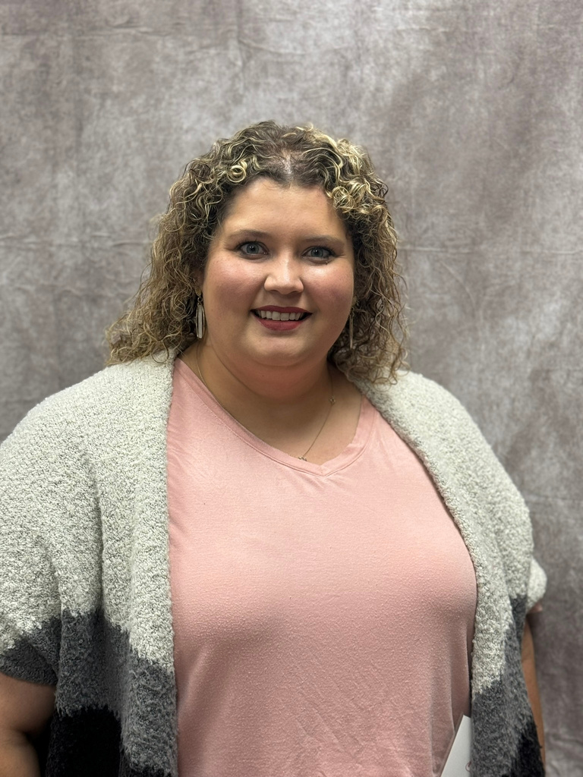
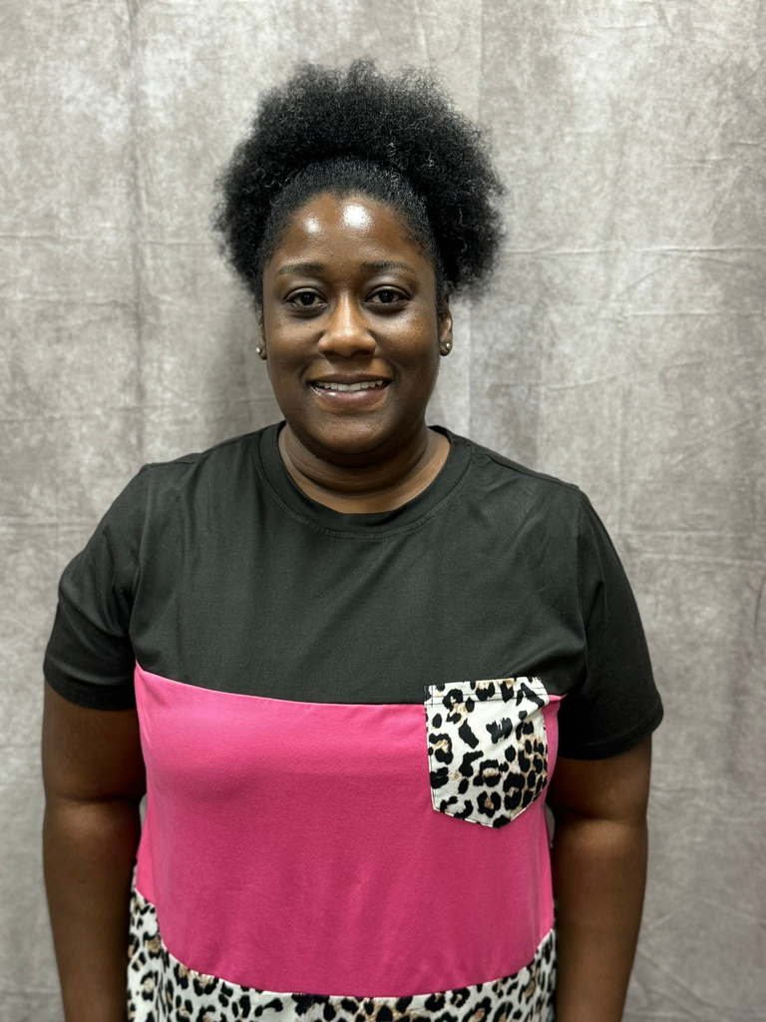
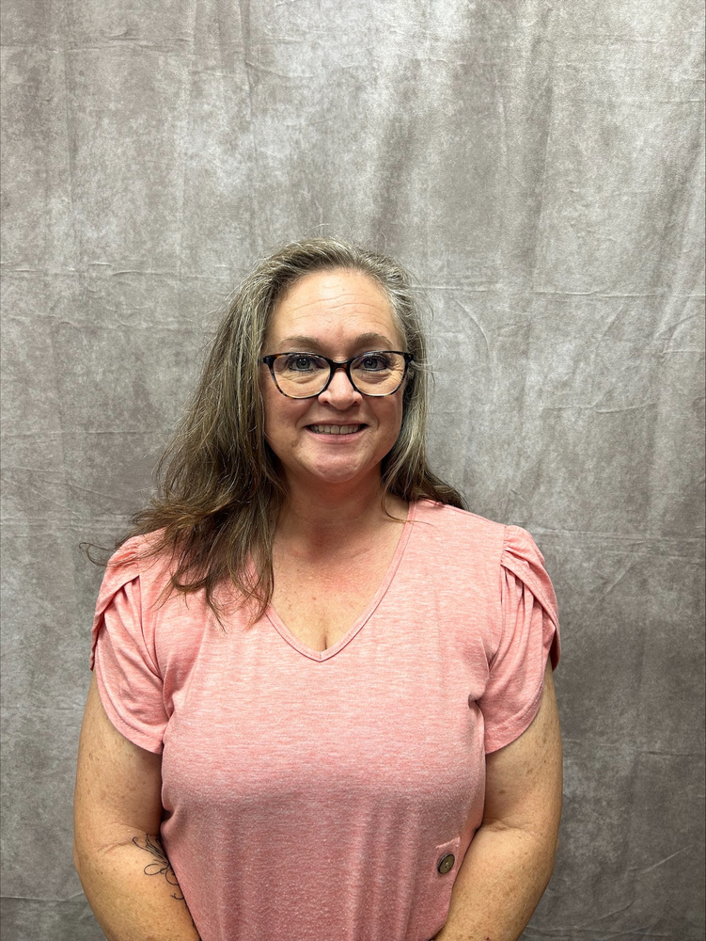
KIMBERLY GRIFFIN
KRISTY HICKS
TARA HARDEMAN

Slide 11
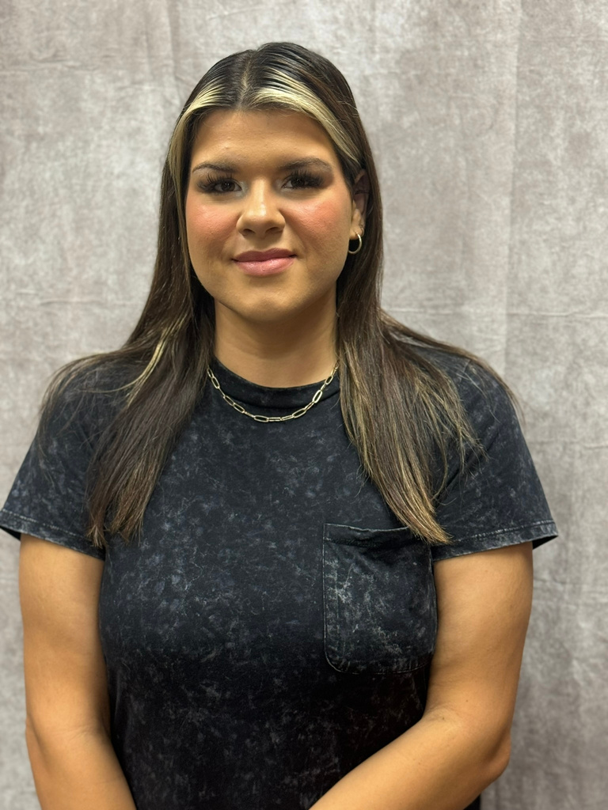
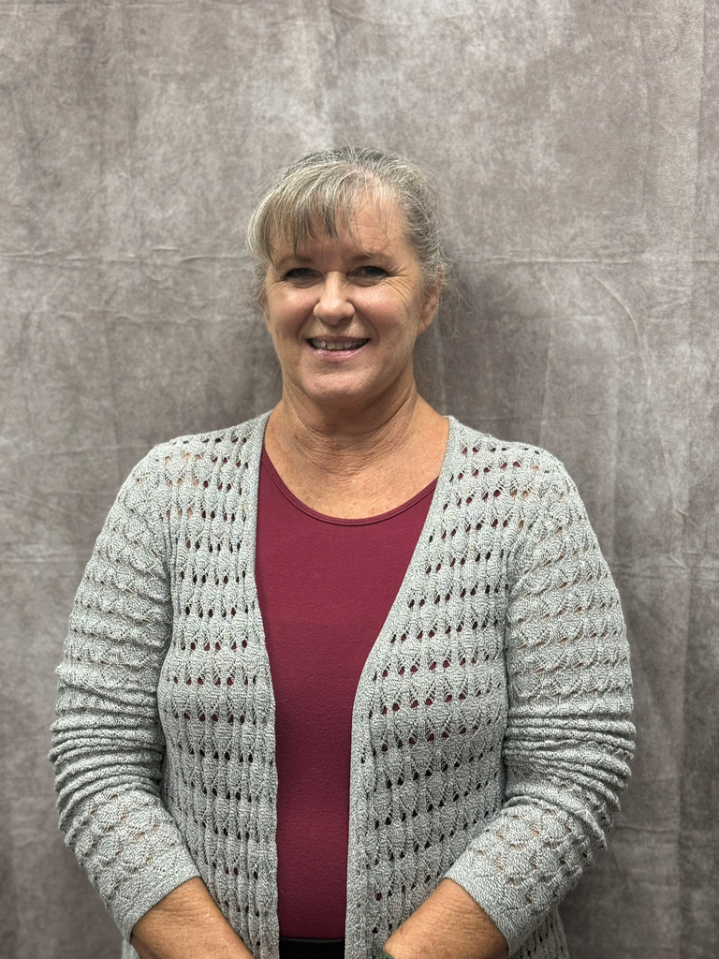
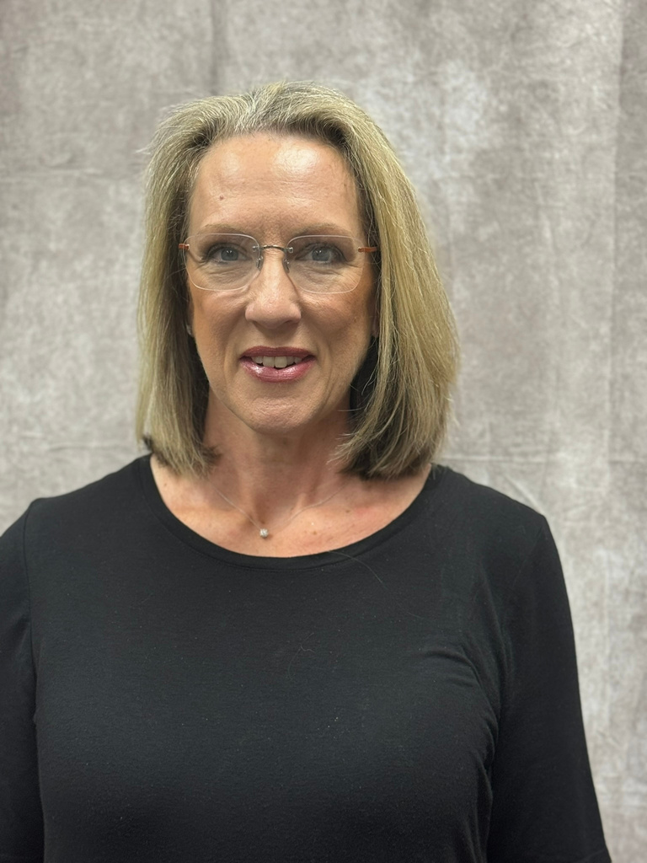
CARI CLODFELTER
AMBER MARTIN
TRISH ROSE

Slide 12
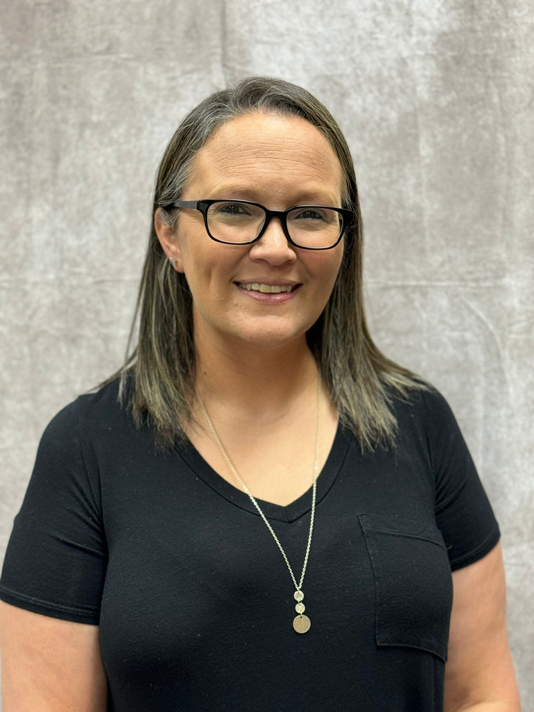
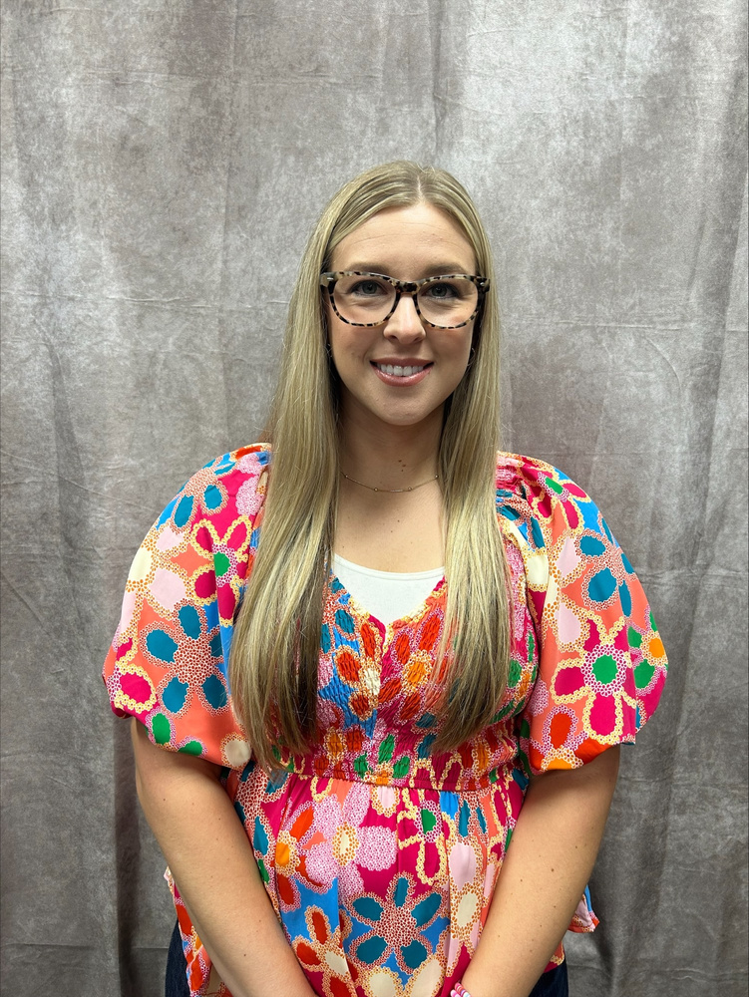
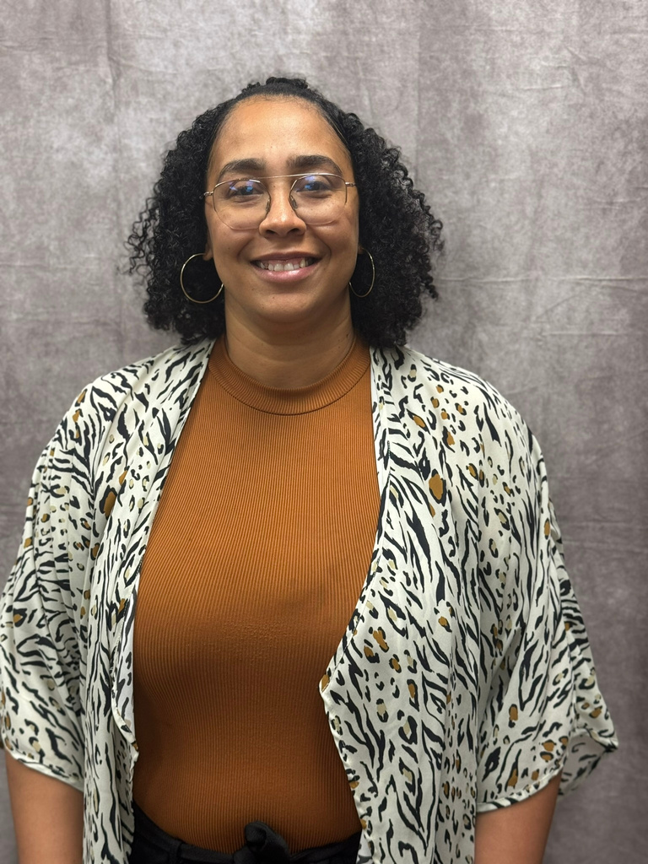
SIERRA DODSON
ALICIA UNDERWOOD
WHITNEY WATKINS

Slide 13
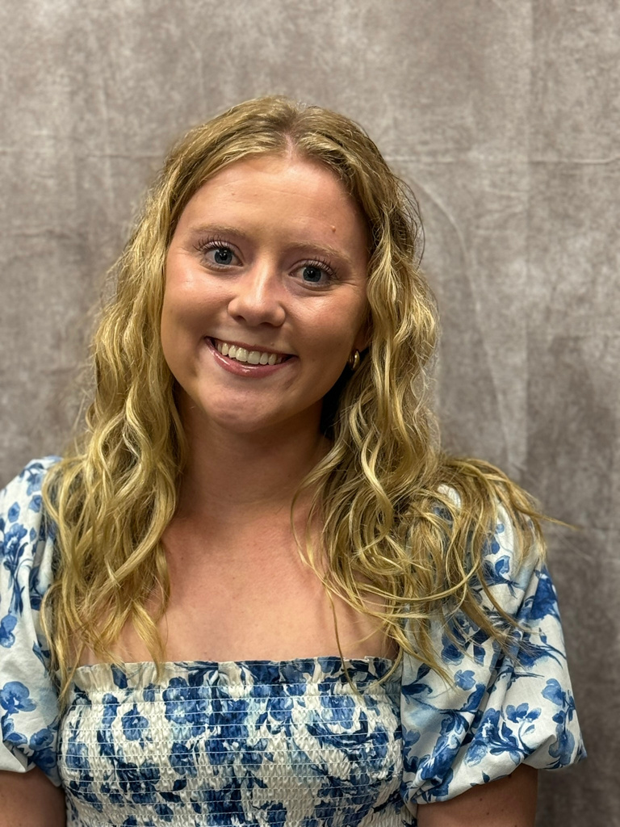
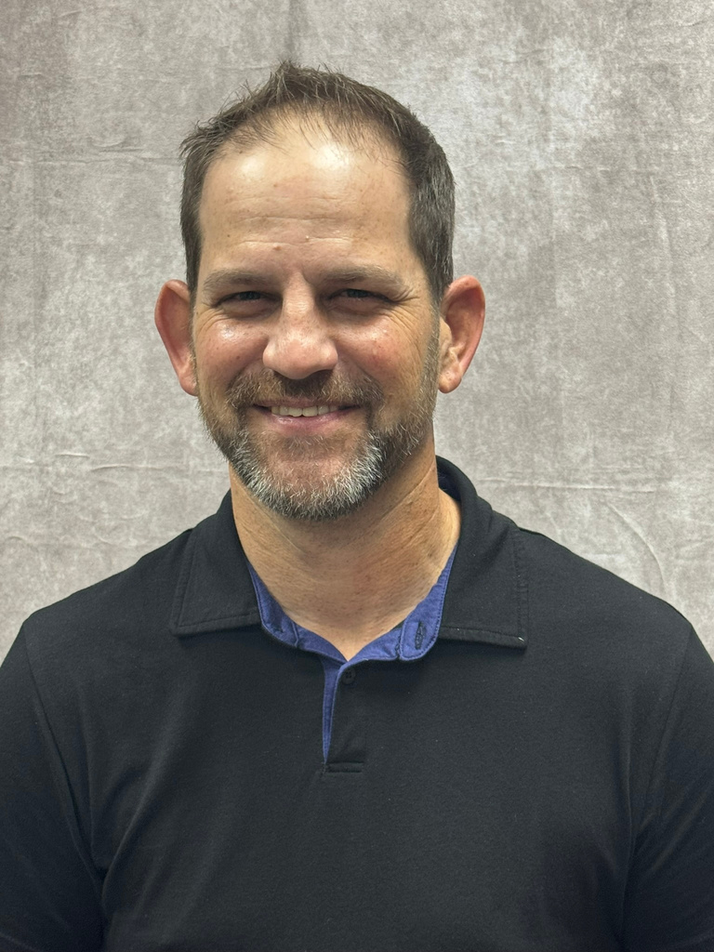
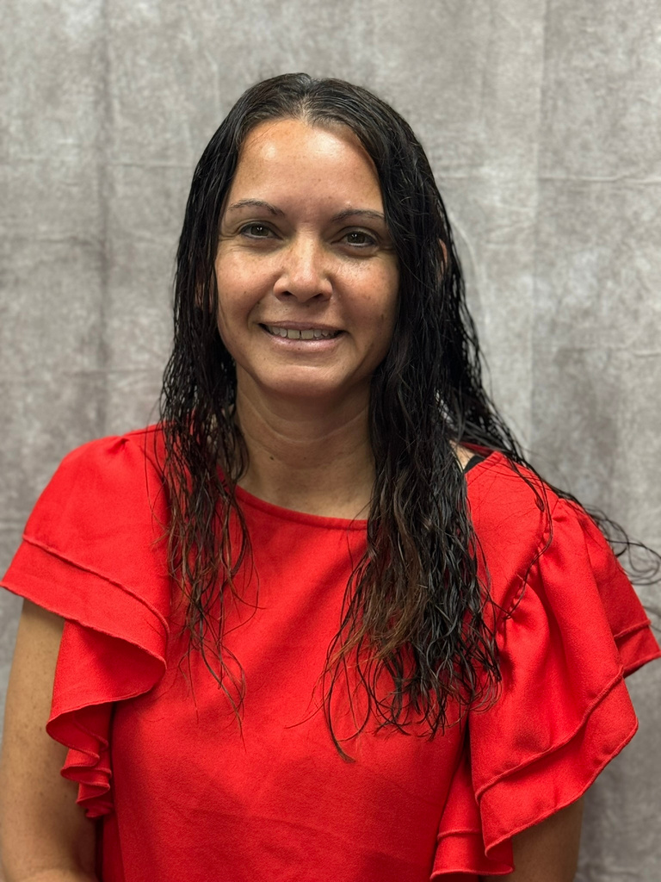
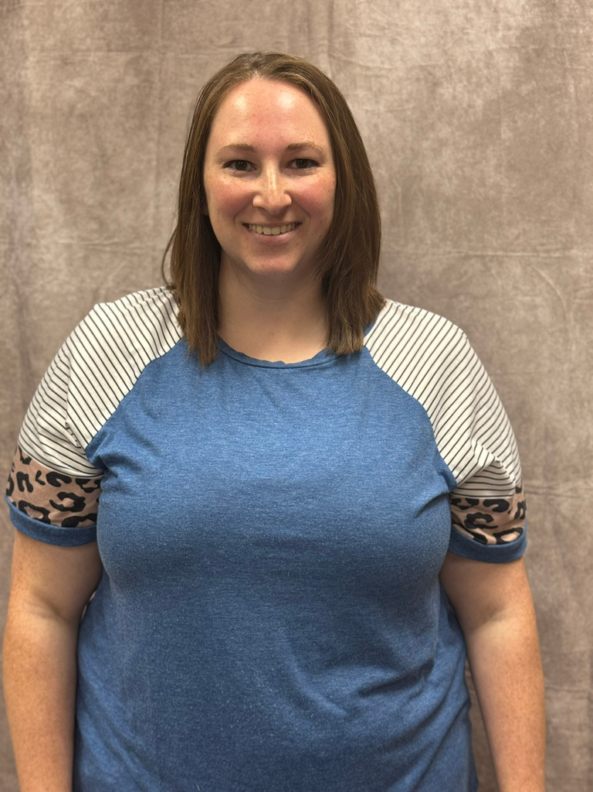
ATHENA MATHIS
CIANE HARTZELL
ANNAMARIE BALL
BROCK SIZEMORE

Slide 14
JOB OPENINGS!
There are still several jobs openings across the state. If you know someone who would like to teach FCS, send them to our job listings on ctYOU under the FCS/Bulletin Board/FCS Job Openings!

Slide 15
South Job Openings
MOORE HS
PC- MAYFIELD MS

Slide 16

FCS PROGRAM FUNDING
412 MONEY
SALARY STIPEND
8000
2200
FULL TIME PROGRAMS
(411 MONEY)

Slide 17



USING 412 MONEY
Classroom Equipment
  Appliances
  Sewing Machines
  Laptops/Tablets
Instructional Supplies
  Curriculum/Textbooks
  Simulations/Real Care
  Ingredients for food labs
Professional Development
  Chapter Adviser Summit
  Vision Conference
  May Workshops

Slide 18
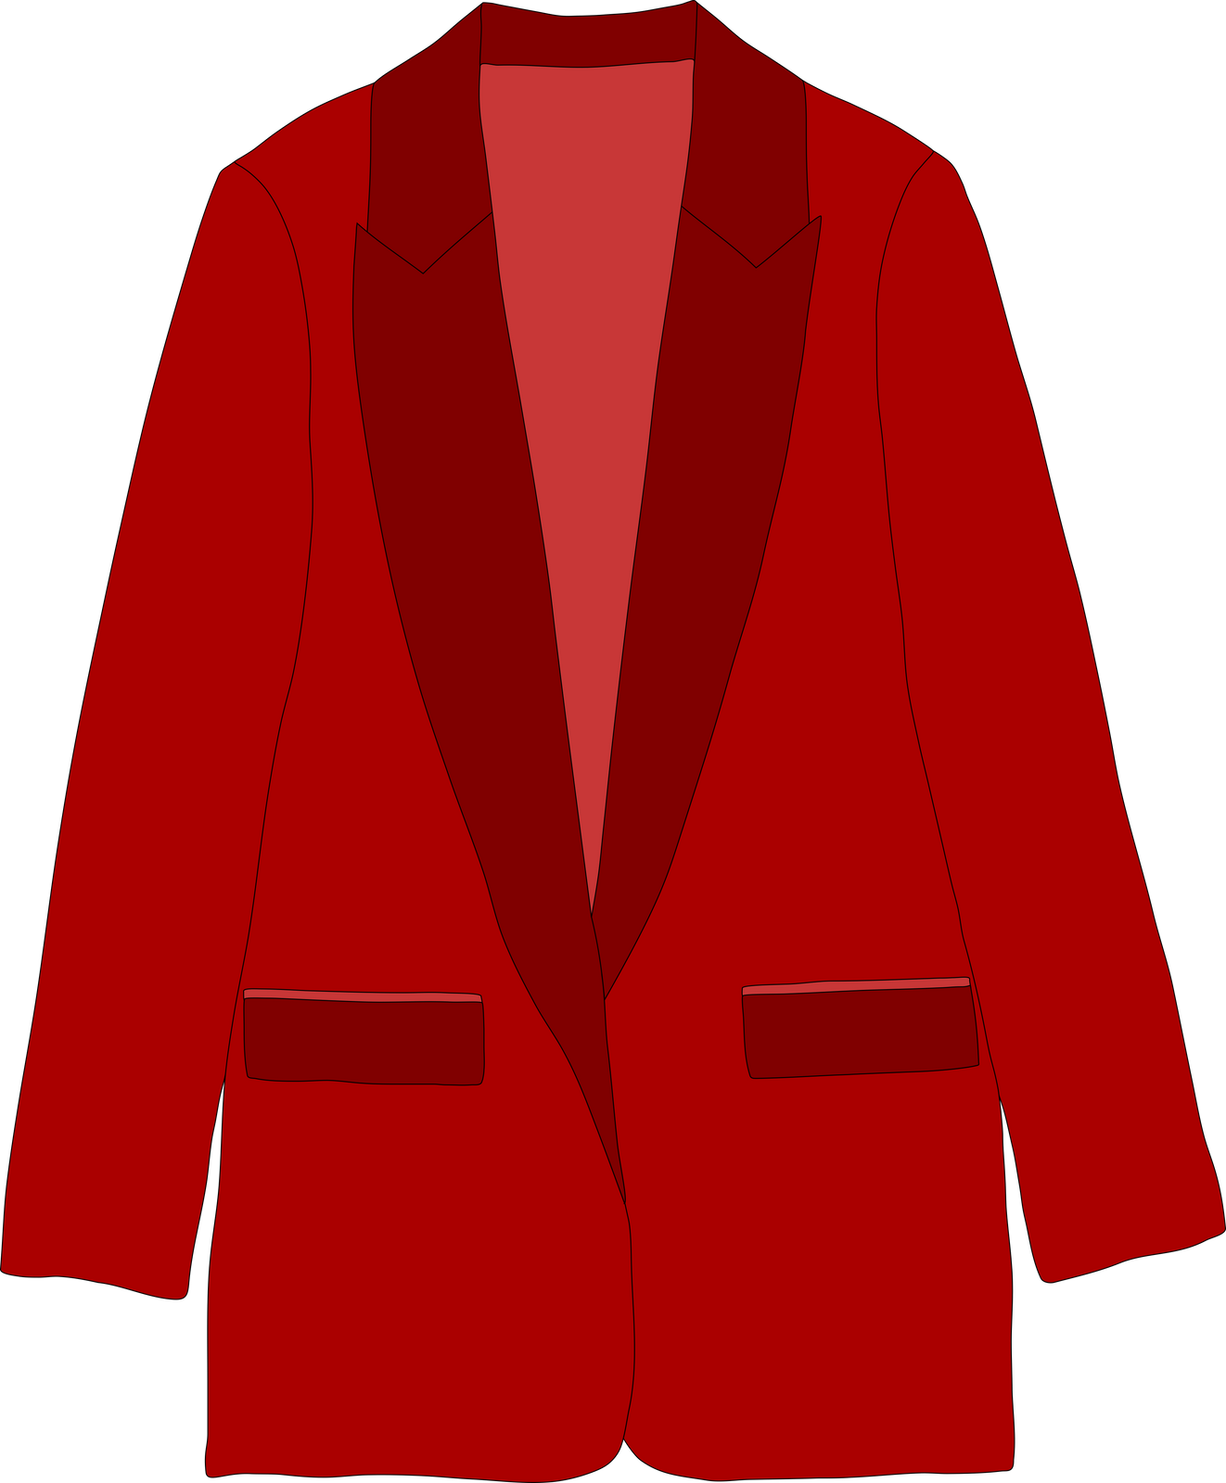
ADDITIONAL EXPENDITURES FY25
$900 FCCLA AFFILIATION PER CHAPTER
$300 OFFICIAL DRESS/CONFERENCE DRESS/CHEF ATTIRE

Slide 19

CTYOU HELP
www.ctYOU.org
  Create an account (tip use a personal email)
  Locate helpful resources like:
    Region/District info
    Course Resources
    FCCLA Infomation
    Safety Tests (Fc$2024)
    5 Year Comprehensive Evaluation Folders for your program

Slide 20
FCS DIRECTORY
located on ctYOU
Will be under “FCS Regions”
Password Protected: Fc$2024
(once the new directory is posted you may need to clear browser cookies to see it instead of the old directory)

Slide 21

GRADUATION REQURIEMENT REFORM
More information to come from Holly.

Slide 22
CAREER INTEGRATION IN THE CLASSROOM
  Utilize advisory board members/community guests speakers in classes and FCCLA meetings
  OK Career Guide
    Training
    OK Career Guide Curriculum
    Connect 2 Business
  These integrations can be used to help students with their Individual Career Plan (ICAP)

Slide 23

SHAWNEE MILLS
  Coupons were emailed to your school email address on July 10. Contact Rose Mangold if you did not receive them at rose.mangold@careertech.ok.gov
  Please have students write a thank you note to:
    Sarah Steely
    PO Box 1567
    Shawnee, OK 74802-1567

Slide 24

OKLAHOMA PORK COUNCIL
Watch the newsletter for most up to date information on this grant opportunity.

Slide 25

OKLAHOMA BEEF COUNCIL
Watch the newsletter for most up to date information on this grant opportunity.

Slide 26

CERTIFICATION TESTS
Students completing FCS Basics & Human Growth & Development should be taking the ODCTE 7101 Entry Level Child Care Traning (ELCCT) certification test. Those who pass can work at daycare centers.
***There is still a large push for certification tests for our students. PLEASE watch the newsletter for future updates on certification tests to give your students.

Slide 27

PROGRAM REPORTING
Follow-Up Reports Open
CESI Reports initial submission
CESI Reports additional students added
Oct. 1
Oct. 31
Jan. 31
Sept. 30
May 31
Nov. 30
Salary & Teaching Report
Follow up Reports Due
CESI Final Reports Due
5 yr Folders Updated
Advisory Committee Report
412/314 Reports

Slide 28
SALARY & TEACHING REPORT: DUE SEPT 30TH
  Add your entire school day! Don’t forget your plan period and your lunch!
  If you have an ‘Other’ such as advisory or study hall please note it in the comments.​
    DO NOT place students in an “OTHER” course; unless you are teaching a FCS-related course. If student numbers are listed in other, an explanation is needed describing what material is being taught.​
  The ‘Contact Info’ section is NOT YOU. Use someone who can answer questions about your contract.​
  In the salary section, if you put any amount in the other box you must put a comment itemizing that amount.
    Example: $1500 should be broken down to $1000 Student Council, $500 Sr. Class Sponsor.
    DO NOT INCLUDE THE FCS STIPEND $2200.​
  Break down of what goes in each category of the Salary Information:​
    Base Salary: your base salary plus anything else FCS related i.e.: FCCLA stipend from school not the $2200​
    Health: any type of Insurance i.e.: health, life, etc. Itemize in the comment section what amount is paid for each different insurance.​
    Retirement: all school-paid retirements​
    Other: extra duty pay other than FCCLA​
  In the acknowledgment section note which pathways you teach.

Slide 29
PROGRAM EVALUATIONS & ACCREDITATIONS

Slide 30
COMPREHENSIVE PROGRAM EVALS (K12)
  Bridge Creek
  Cache
  Elgin
  Fletcher
  Healdton
  Lawton (3 Programs)
  Midwest City HS (2 Programs
  Plainview
  Putnam City (13 Programs)
  Sterling
  Wynnewood

Slide 31
CAREERTECH ACCREDITATIONS
NONE FOR SOUTH REGION
24-25

Slide 32

NEW TEACHER VISITS

Slide 33
We are always willing to assist, although:
95%
of questions can be answered if you check:
Our Websites
The Newsletter
Your Email
Oklahoma FCCLA
ctYOU.org

Slide 34


Slide 35
24-25 OATFCS OFFICERS
President: Rita Hartwick
N-VP: Dulayna Murray
Pres.-Elect: Mary Dushane
NE-VP: Emily Colvin
Past President: Karin Davis
S-VP: Tina Clawson
Secretary: Jeanine Clark
SE-VP: Keri Laxton
Treasurer: Mary Beth Carver
Occ. VP: Kelly Brock
Treas.-Elect: Jaylee Victory
Div. Advisor: Holly Hanan

Slide 36
GET INVOLVED WITH OATFCS
OATFCS MEMBERSHIP
TIME COMMITMENT
CORRESPONDENCE
Will need OATFCS members to work on committees and legislative networks to improve FCS programs in Oklahoma.
The time commitment of serving with OATFCS is about 1-3 meetings a year.
Typically correspondence occurs via mail, email, or fax.
WILL NEED VOLUNTEERS FROM EACH REGION & DISTRICT

Slide 37

THANK YOU FOR SERVING
Membership Committee
  Work to increase membership in OATFACS
  maintains a communication network
Public Information Committee
  Recognize teachers and programs making outstanding contribultions to FCS
  promote curriculum showcase
Scholarship Committee
  review applications of scholarships
  determine scholarship recipients
Nominating/Awards Committee
  Recruit applicants for the scholarship program.
  Assist with hosting awards ceremony.

Slide 38


Slide 39
2024-2025 SEC
President​
Tessa Inman, Lindsay HS​
​
First Vice President​
Davin Budy, Cherokee HS​
​
Vice President of Community Service​
Jaden Taylor, Latta HS​
​
Post Secondary Officer​
Jackie Bennally, Great Plains Tech Center​
​
National Officer Candidate​
Hannah Brake, Sallisaw HS
Vice President of Membership​
Chloe Clements, Idabel HS​
​
Vice President of Programs​
Kendall Stout, Stigler HS​
​
Vice President of Public Relations​
Snowy Rich, Gore HS​
​
Vice President of Competitive Events​
Emily Faulkenberry, Marietta HS​
​
President
National Executive Council
Brandon Weibel, Silo HS

Slide 40




2024-2025 SEC UPDATES
24-25 SEC MEMBERSHIP CHALLENGE:
24-25 SERVICE PROJECT:
24-25 NATIONAL PROGRAM:
“Rally
the Red”

Slide 41





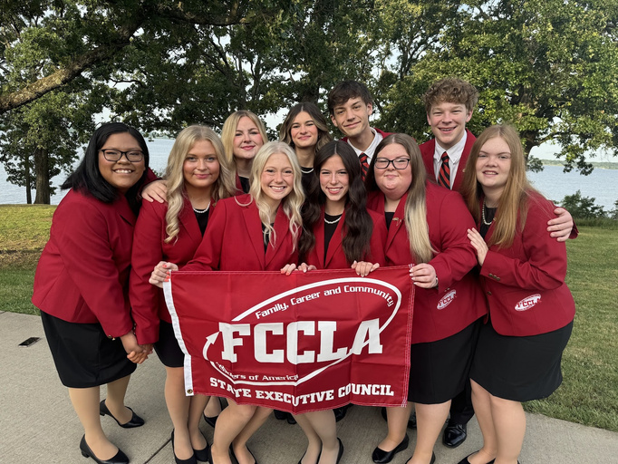
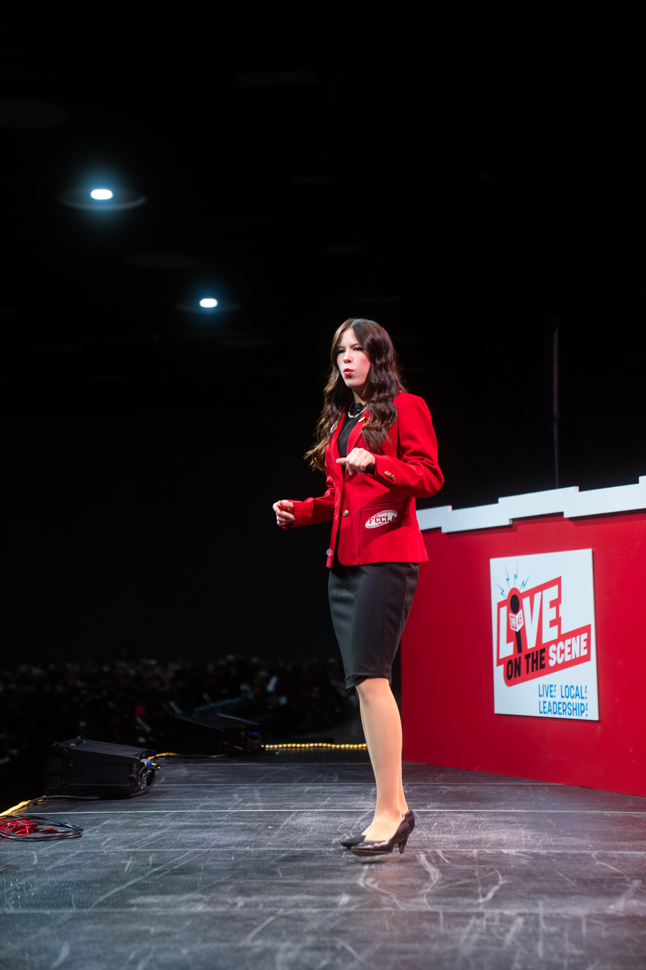
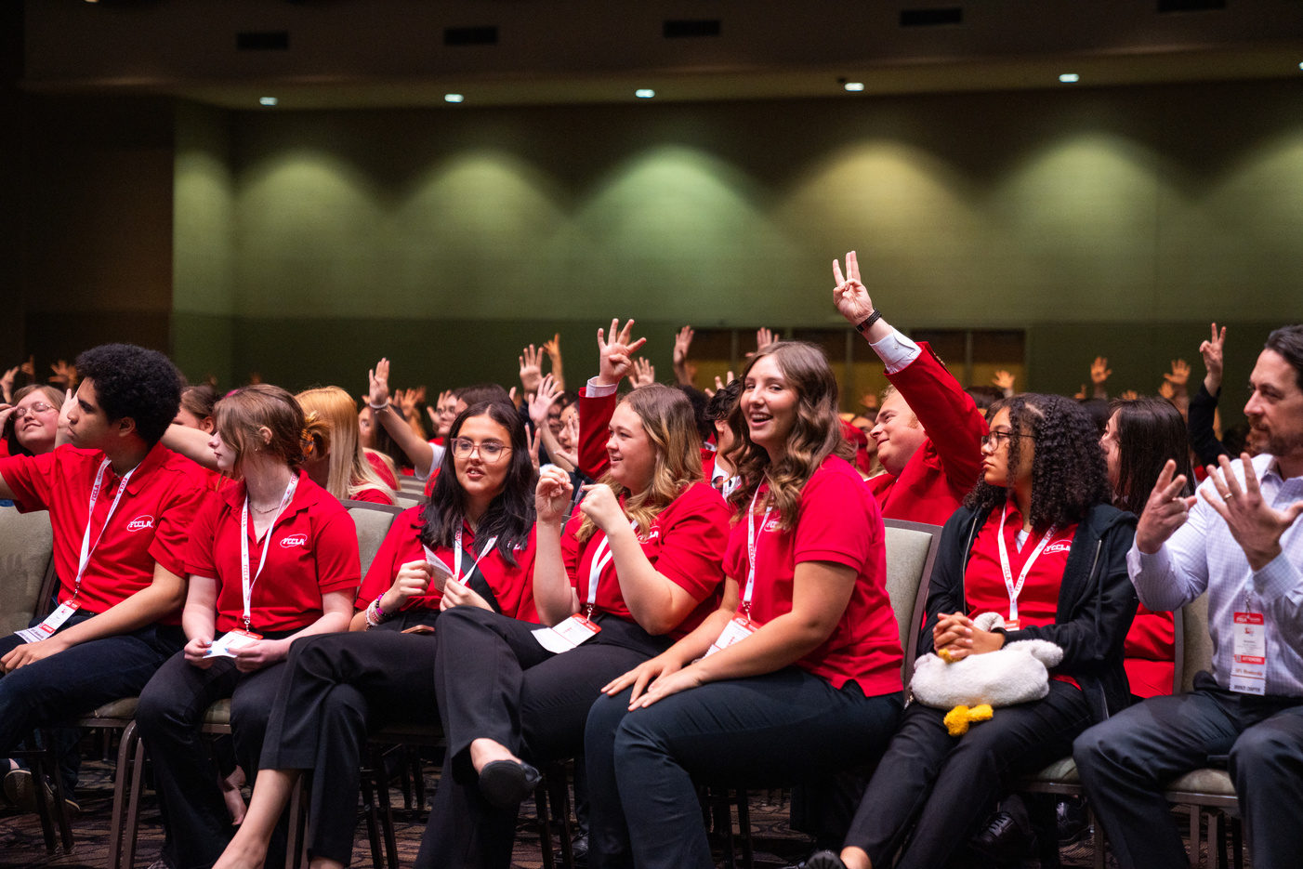

2024
LEAD
REGISTRATION DEADLINE:
AUGUST 31ST
DON’T WAIT!
REGISTER NOW!
CONFERENCE
Gold Medal Leadership!
Sept
North Region
Sept
Northeast Region
11
Stride Bank Center
301 S Independence St
Enid, OK 73701
17
Glenpool Conf. Center
12205 S Yukon Ave.
Glenpool, OK 74033
Sept
South Region
Sept
Southeast Region
12
Simmons Center
800 Chisholm Trail Pkwy
Duncan, OK 73533
18
Life Church
1300 S George Nigh Expy
McAlester, OK 74501
$15
per Student
more at oklahomafccla.org

Slide 42

STATE CONVENTION:
7 WONDERS OF LEADERSHIP
TULSA, OK
APRIL 10, 2025

Slide 43

NATIONAL LEADERSHIP CONVENTION:
ORLANDO, FL
JULY 5-9, 2025

Slide 44
NLC CHAPTERS RECOGNITION - TOP 10 PLACEMENT
Bridge Creek High School FCCLA
Minco High School FCCLA
Moore - Southmoore High School FCCLA
Lindsay High School FCCLA
Great Plains Tech Center - Teacher Prep FCCLA
Francis Tuttle Tech FCCLA
Washington High School FCCLA

Slide 45
FCCLA NATIONAL HEADQUARTERS ADDRESS:
NATIONAL FCCLA
13241 Woodland Park Road,
Suite 100
Herndon, VA 20171
*** Address is needed for reasons such as Affiliation Payments

Slide 46
PLEASE MOVE INTO YOUR DISTRICT SECTIONS FOR DISTRICT PLANNING MEETINGS

