Slide 1



Oklahoma Professional Development Registry (OPDR)
www.cecpd.org

Slide 2
What is the
Professional Development Ladder?
The Professional Development Ladder (PDL) reflects formal job-related education and credentials gained through universities, 2-year colleges, technology centers, credentialing bodies, and Registry approved training sponsors.
The various levels indicate training and educational milestones for childcare providers and provide connection with other areas of the state’s professional development system, such as Quality Rating and Improvement Systems (QRIS), and Scholars for Excellence in Child Care.

Slide 3
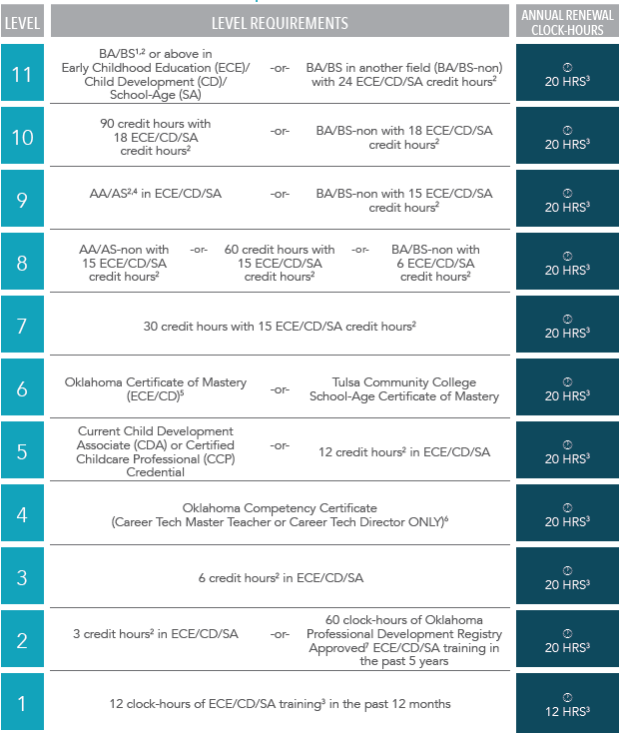
Professional Development
Ladder
To meet requirements, you must prove minimum criteria in the row.
Example: For Level 4, you must have an Oklahoma Competency Certificate.
For Level 7, you must have 30 cumulative credit hours with at least 15 college credits in ECE/SA/CD

Slide 4
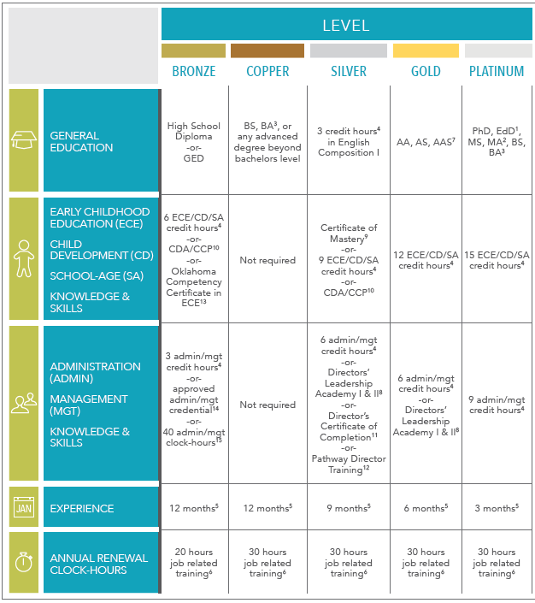
Oklahoma Director’s Credential
To meet requirements, you must prove each criteria in the column.
Example: For Gold Level, you must have at least an Associate degree, have 12 college credits in ECE/SA/CD, 6 college credits in administration/management (or Leadership Academy I&II), and 6 months of qualifying experience.

Slide 5

How do I submit a PDL/ODC application?
Application can be submitted online or with a paper application.
  Online:
    Log into your individual account at www.okregistry.org, select apply/renew. There are no fees to apply/renew a PDL/ODC.
  Paper application can be found at:
    www.cecpd.org Provider Programs Oklahoma Professional Development Registry Forms

Slide 6
Official Transcripts
To add college coursework to a participant’s Registry account, we must have an OFFICIAL TRANSCRIPT.
The official transcript must be mailed to us from you or from your college/university.
Copies/faxes/emails will not be accepted.
We can accept an electronic transcript sent directly from your college/university. It must be emailed from the school to cecpd@ou.edu. It cannot be opened by you first then forwarded to CECPD. Transcripts forwarded via a third party are considered unofficial and cannot be accepted by the Registry.
Notes:
If a participant is participating in the Scholars for Excellence in Child Care Program – the Registry receives reports after grades are reported each semester of the college courses completed. These courses are then added by Registry Advisors. An official transcript is not needed, unless a Certificate of Mastery or degree has been obtained, in which case an official transcript showing degree/certificate awarded will be needed in order to verify.

Slide 7
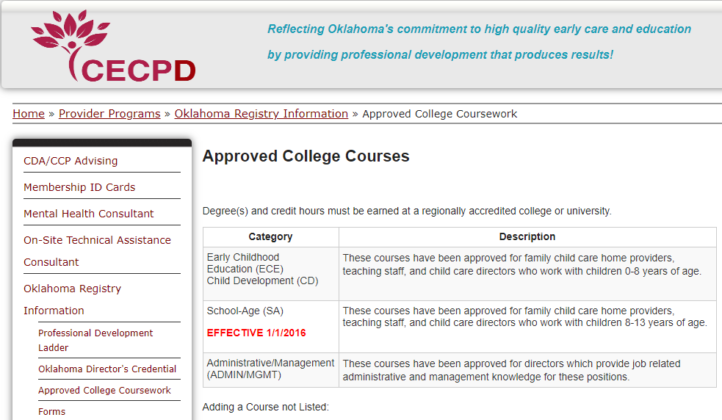
Approved Coursework
A list of approved college coursework can be found at www.cecpd.org
This will show approved college coursework in Early Childhood Education/Child Development/School-Age and Business from the colleges/universities in Oklahoma.

Slide 8
Approved Classes
Classes are broken into 3 categories.
  Early Childhood Education/Child Development
  School Age (Elementary Education & Special Education)
  Administrative/Management (This is used for the ODC applications.)
Notes:
If you have courses that are not on the approved college coursework list – a copy of the syllabus and course description can be submitted for review. Please email to cecpd@ou.edu –Attn: Angela Meyer, Kristina Allen

Slide 9
When do I need to renew?
You can renew your PDL or ODC before it expires.
Your renewal period begins 60 days prior to the expiration date listed on your PDL or ODC certificate.

Slide 10
Renewal Information
What if all my information is already on my account?
  If all information, including education and training, is current and accurate, you do not need to submit any additional documentation.
  When you apply online, you will get an automated confirmation email that will request education and training documentation. This is sent to every applicant. You only need to submit that which applies to you.

Slide 11
**How to calculate training hours?
Training dates are specific to each individual.
  Not the employees’ start date or the program start date.
  Training hours do not rollover to the next year.
New certificate: 12 months prior to application received date.
  Example: Application received 2/10/2024. Training starts after 2/10/2023.
Renewal: Training hours are calculated from the current certificates issue date.
  Example: Certificate issued 5/1/2023. Training date starts 5/2/2023.
Exemptions: Early CDA or CCP expiration dates, level drops due to expired credential, level updates (includes level drop updates, additional training updates, college coursework updates, credential updates.
**When in doubt, email cecpd@ou.edu for specific dates for YOU.

Slide 12
What is the processing time and status of my application?
Applications are processed within 30 business days from the date they are received.
You can check the status of your application by logging into your Registry account at www.okregistry.org. You will login using the email address on record with the Registry and the password you created.
All received supporting documents will be reviewed during the application process.

Slide 13
Help! I cannot log into my Registry Account.
Participants that have a Registry account can make updates to their account using a Participant Update Form.
  Email address
  Employment information
  Phone number or mailing address
Where can I find the Participant Update Form?
www.cecpd.org Provider Programs Oklahoma Professional Development Registry Forms

Slide 14
My information is not showing on my Training Record.
Approved Training Sponsors
  Responsible for entering and verifying training on participants training records. Trainings cannot be entered or verified by Registry staff. Approved training sponsors have 2 weeks from the last date of the event to enter rosters.
  How do I know if the training is from an approved training sponsor?
    www.cecpd.org Trainer Info Approved Training Organization
  Visit the Statewide Training Calendar at https://okregistry.org/v7/trainings/search
Informal Training
  In-house training requires individual training certificates for each participant. (attendance logs, sign up sheets cannot be accepted)
  Required information: Participant Name, Topic Covered, Training Date, Training Hours, Sponsor/Center Name/Trainer Name

Slide 15
My information is not showing on my Training Record.
CPR/First Aid Certification
  Documents must be submitted for review.
  Front and back of cards required.
  Approved CPR and First Aid Training Organizations
    www.cecpd.org Training Info CPR and First Aid Training
Official Transcripts
  Printed- mailed or drop off in person at 1801 N Moore Avenue, Moore, Oklahoma, 73160.
  Electronically- to cecpd@ou.edu directly from institution via e-script
  Transcripts must have all security features present to be considered official.

Slide 16
I need access to my Organization Profile.
Registering your Organization Profile Create Profile (new program)
Linking your Organization Profile Find Profile
www.cecpd.org Provider Program Oklahoma Professional Development Registry Direct Care Organizations

Slide 17
Need additional assistance? Contact Information?
Registry- Individual Users
  www.cecpd.org Provider Programs Oklahoma Professional Development Registry Individual Users
Registry- Director and Family Home Providers
  www.cecpd.org Provider Program Oklahoma Professional Development Registry Direct Care Organizations
  www.cecpd.org Director’s Chair (at the bottom of the home page)
CECPD Online Training
  https://cecpdonline.org/
  Local: 918-919-7010 or Toll Free: 877-710-5158
  support@cecpdonline.org
  Monday-Friday 8:00Am–5:00 PM

Slide 18

Additional Registry Questions

Slide 19
Professional Contributions
Examples of Professional Contributions
  Presenter: in-house, Resource and Referral, or community presentation.
  Leadership position at local level: PTA, church, or Smart Start OK.
  Professional observer: NAEYC, CDA, CLASS evaluator.
  Member of accredited center, home, or program: NAEYC, OCCA
Proof of Professional Contributions
  Indication of Professional Contributions: letter or note on document.
  Copy of meeting agenda, membership card, letter from the organization on letterhead
  Copy of training certificate with presenter name and position.

