Slide 1











REGION MEETINGS
SOUTHEAST
OKLAHOMA FCS

Slide 2
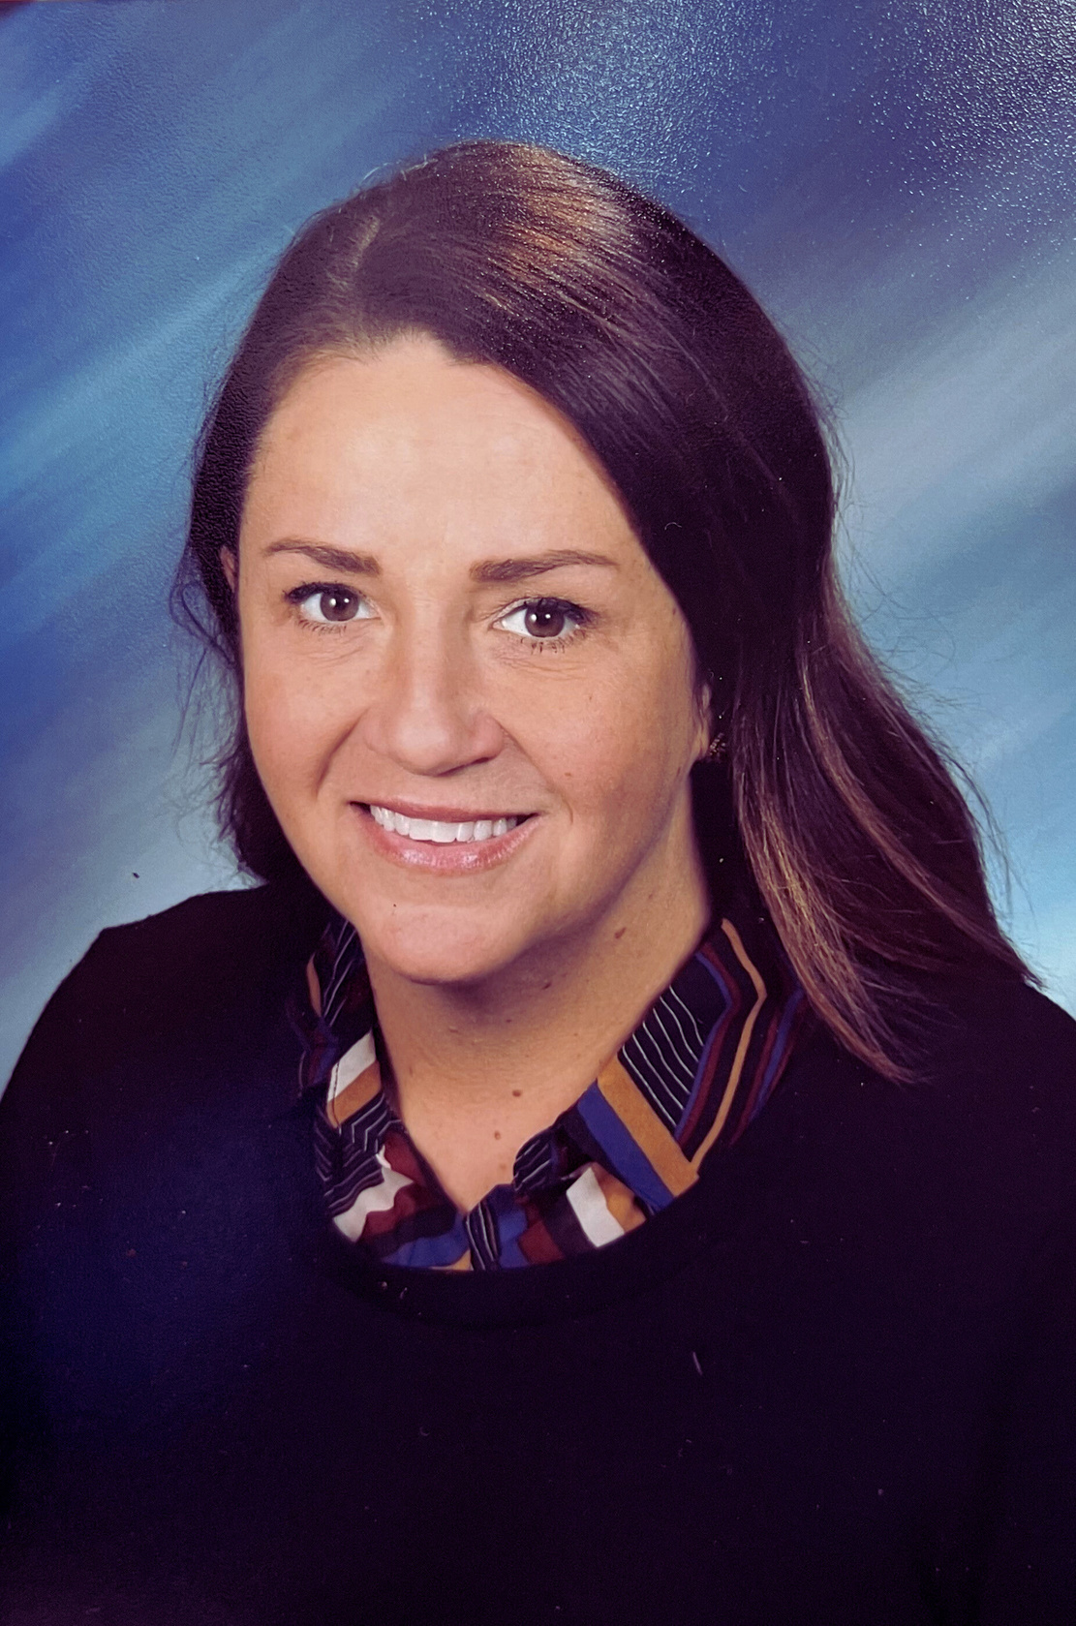
PROGRAM SPECIALIST
Christina Spurgin
christina.spurgin@careertech.ok.gov
Personal Info: ​
  Three kids. One out of college, two still in.
  Taught at Tecumseh for over 20 years

Slide 3

NEW or Fairly new TEACHERS!
SE1
SE2
SE3
SE4
SE5
  kali Whisenhunt Calera
  Carleigh Woods
Choctaw HS
  Gail Stanton Shawnee HS
  Michelle Moss McLoud
  Lori Dunlap Paden
  Rebekah Newman Choc Nicoma Park
  Jennifer Burch Tecumseh
  Kristin Frith, Irving MS Norman
  Jade Stohel Haileyville
  Christy Stearns Savannah
  Kimberly Walker Konowa
  Talana Hailey Holdenville
  Katie Stubbs Poteau MS
  Kenda Capps
Atoka HS

Slide 4
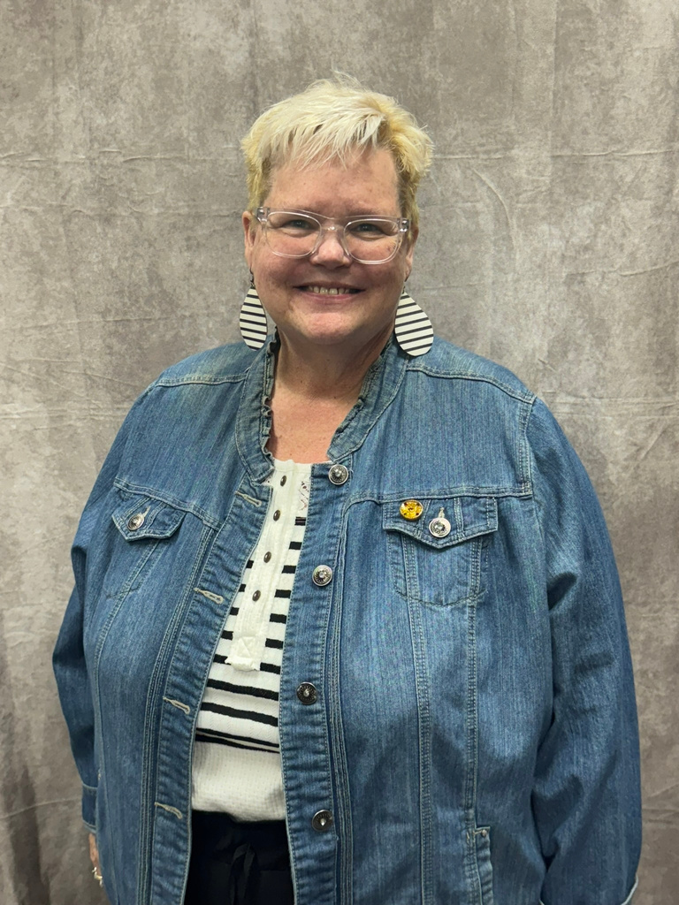
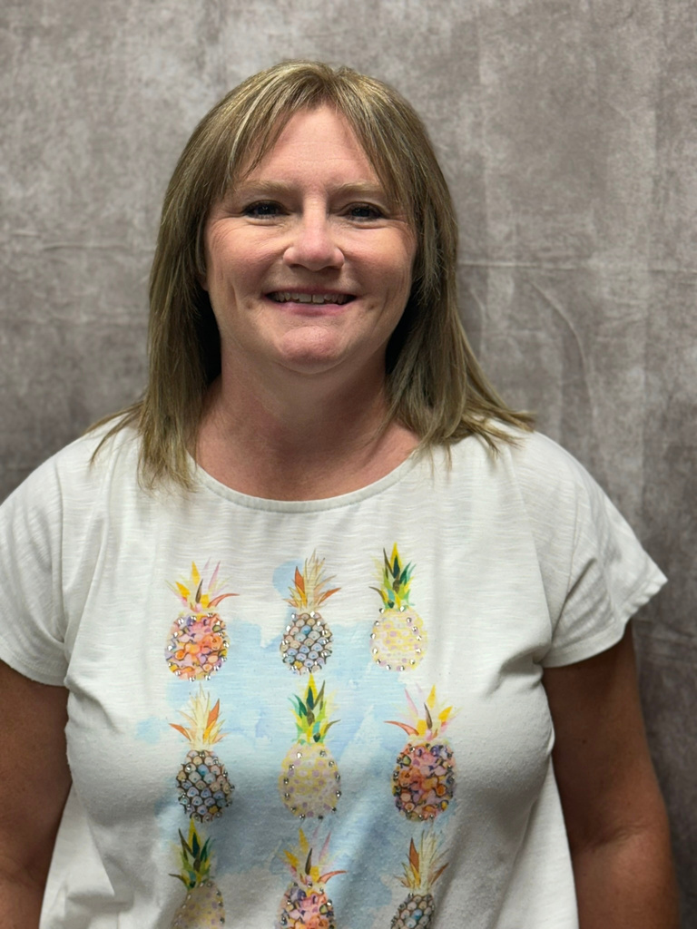
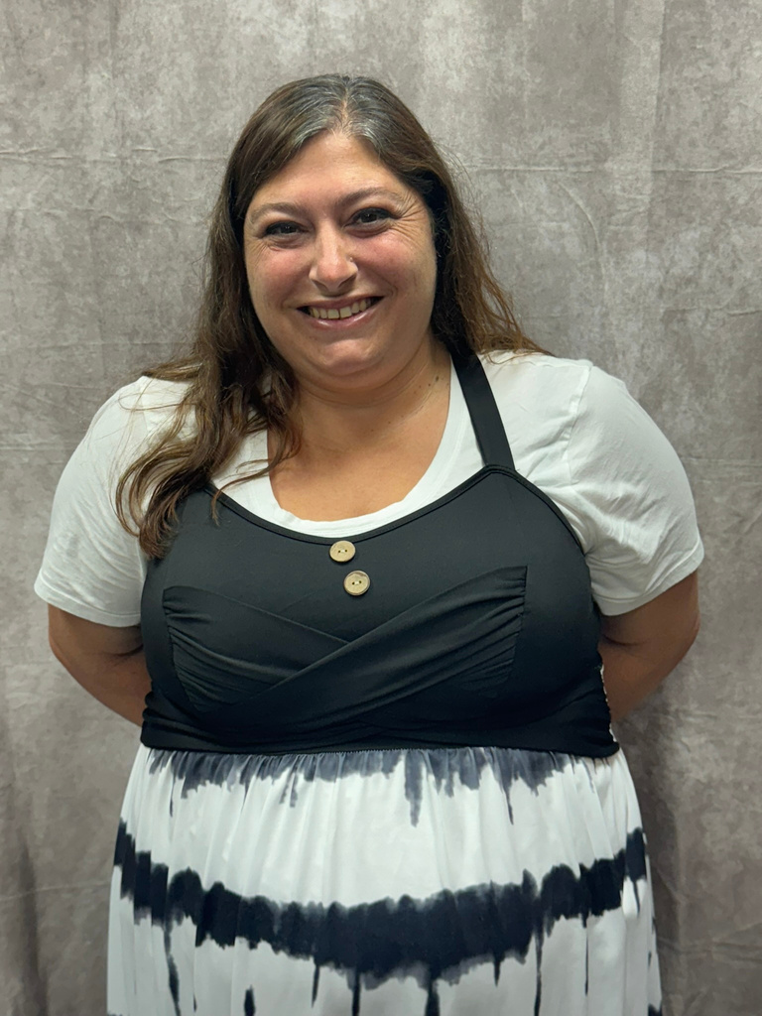
KRISTINE FRITH
JENNIFER BURCH
LORI DUNLAP

Slide 5
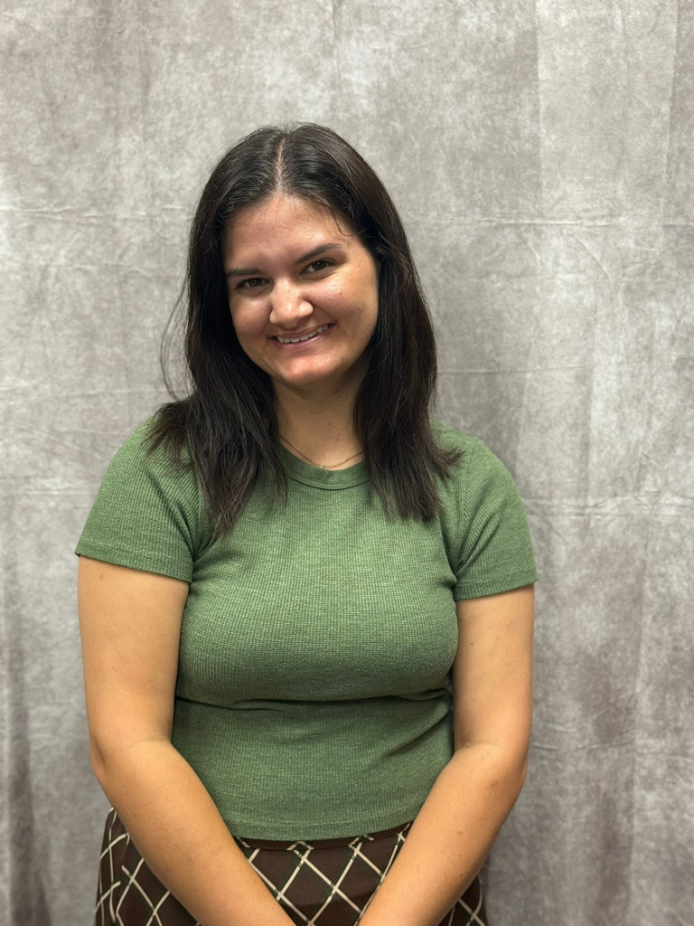
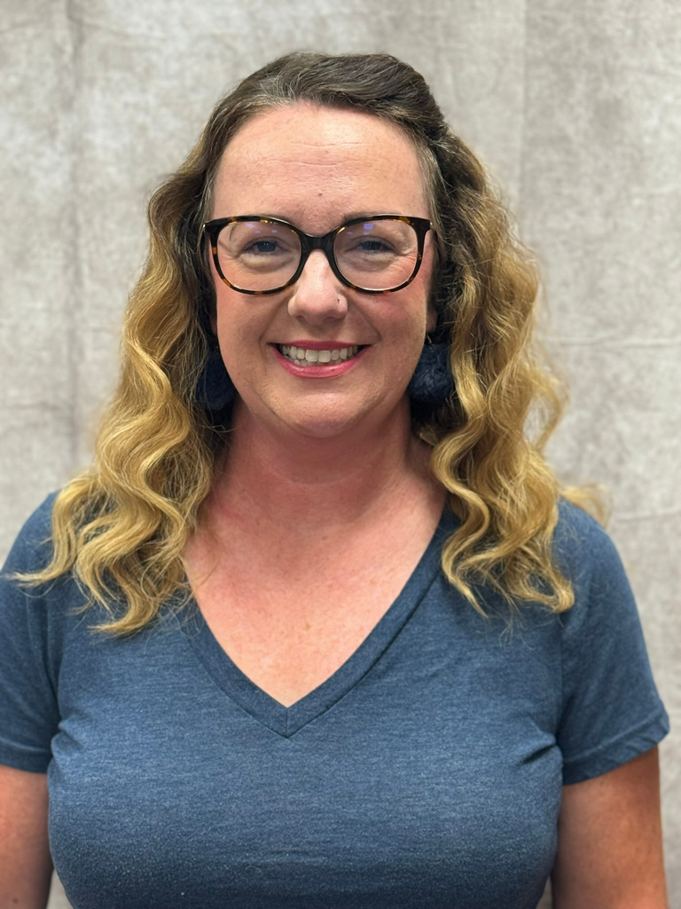
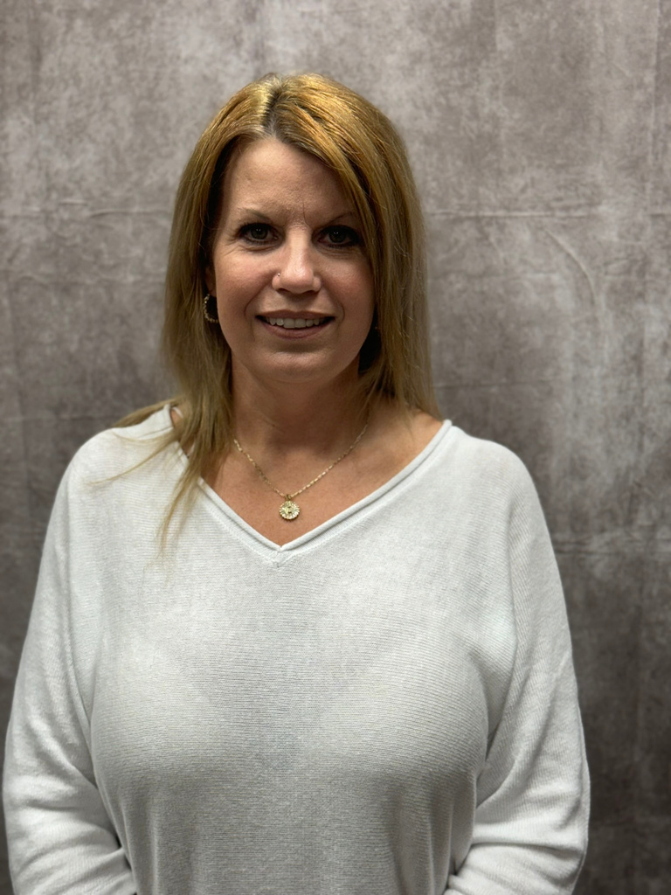
MICHELLE MOSS
KALI WHISENHUNT
REBEKAH NEWMAN

Slide 6
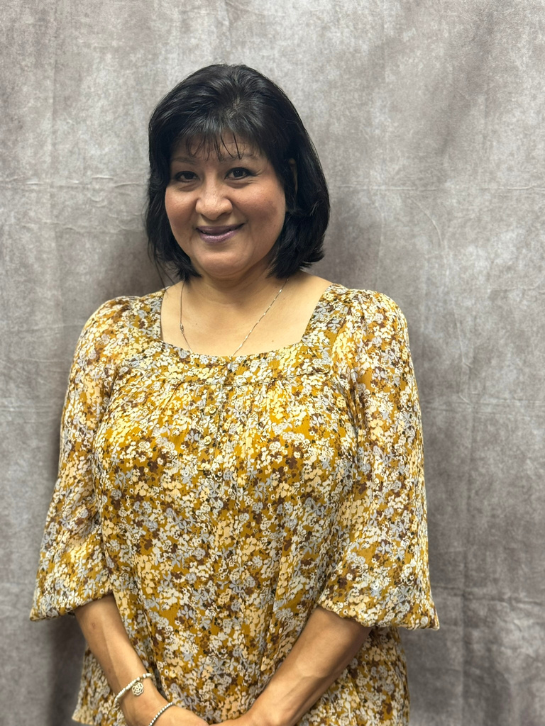
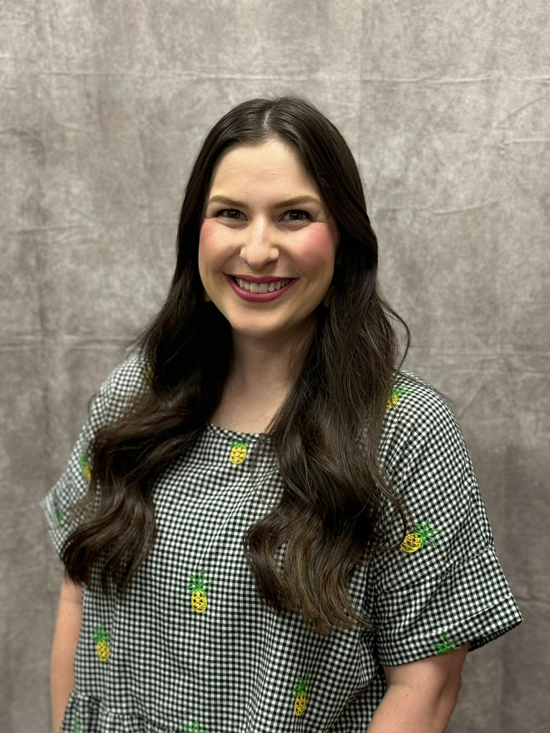
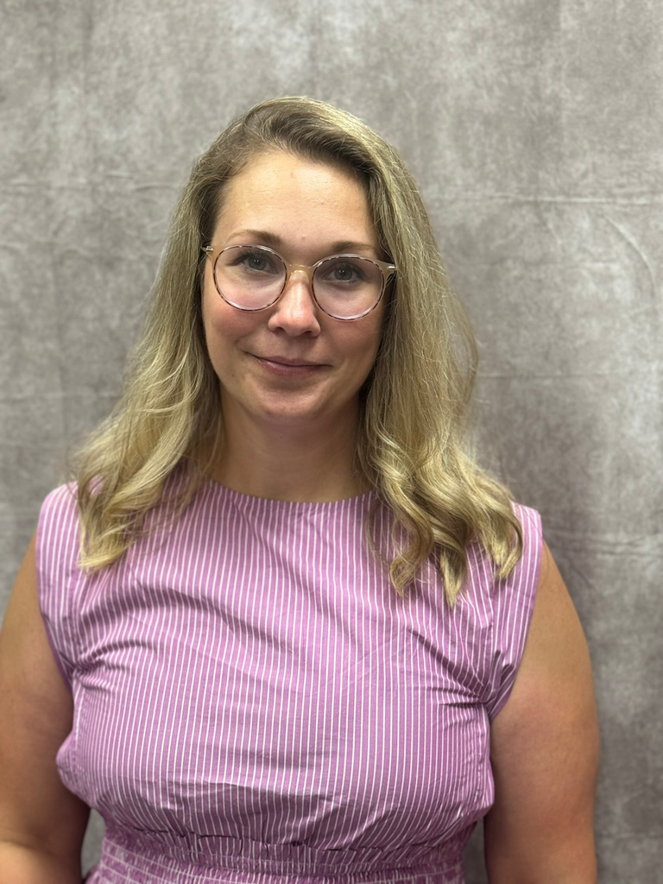
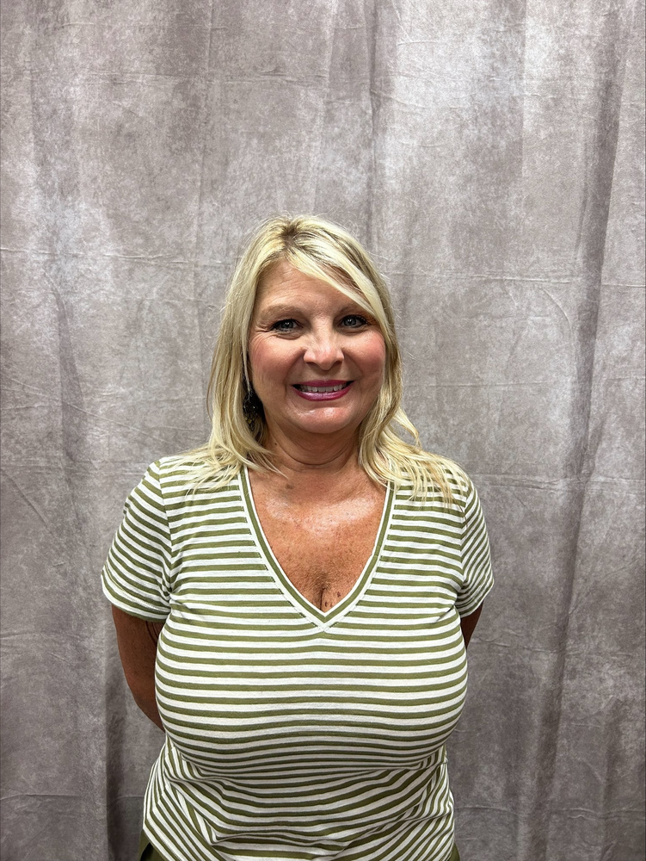
CHRISTY STEARNS
KIMBERLY WALKER
TALANA HAILEY

Slide 7
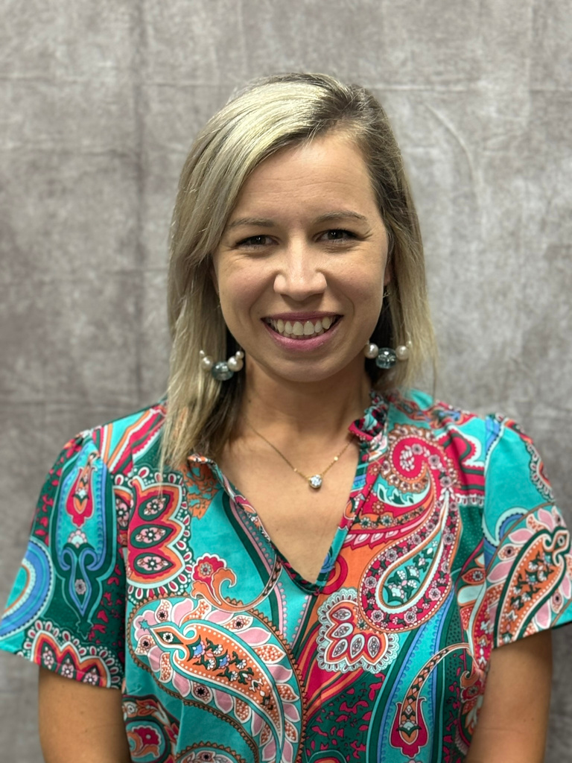
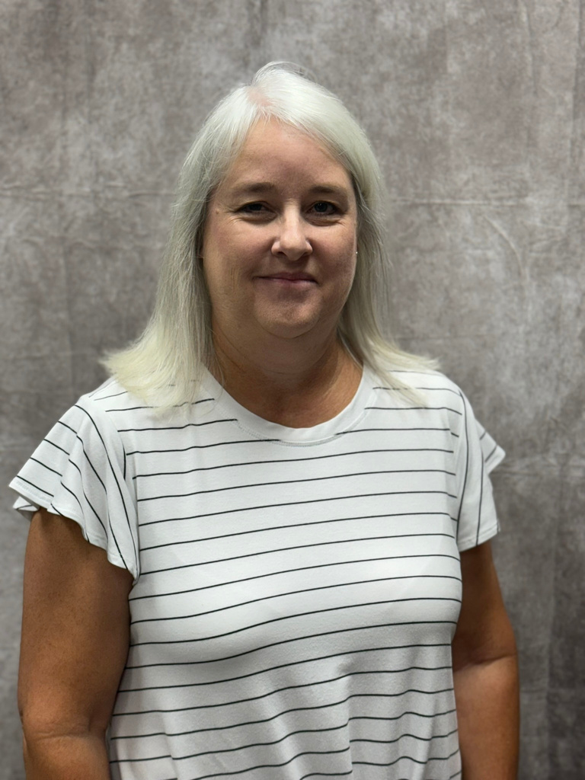
CARLEIGH WOODS
KATIE STUBBS
KENDA CAPPS

Slide 8
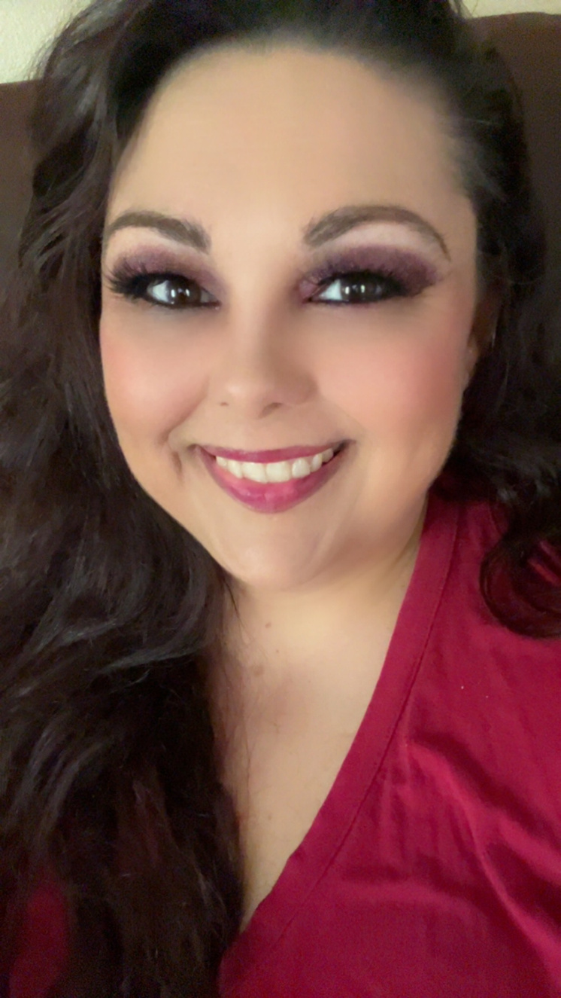
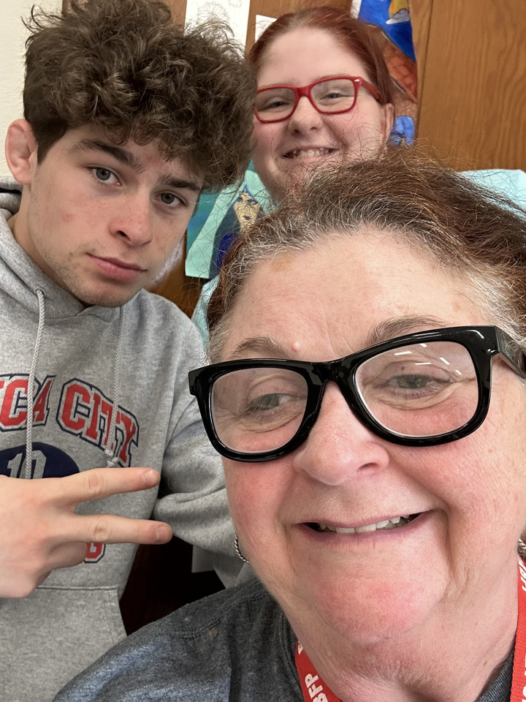
JADE STOHEL
GAIL STANTON

Slide 9
JOB OPENINGS!
There are still several job openings across the state. If you know someone who would like to teach FCS, send them to our job listings on ctYOU under the FCS/Bulletin Board/FCS Job Openings!

Slide 10
Southeast Job Openings
Gans
Cottonwood
Ardmore HS

Slide 11

FCS PROGRAM FUNDING
412 MONEY
SALARY STIPEND
8000
2200
FULL TIME PROGRAMS
(411 MONEY)

Slide 12



USING 412 MONEY
Classroom Equipment
  Appliances
  Sewing Machines
  Laptops/Tablets
Instructional Supplies
  Curriculum/Textbooks
  Simulations/Real Care
  Ingredients for food labs
Professional Development
  Chapter Adviser Summit
  Vision Conference
  May Workshops

Slide 13
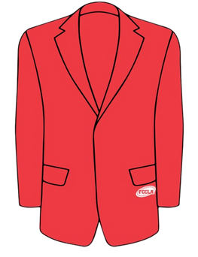
ADDITIONAL EXPENDITURES FY25
$900 FCCLA AFFILIATION PER CHAPTER
$300 OFFICIAL DRESS/CONFERENCE DRESS/CHEF ATTIRE

Slide 14

CTYOU HELP
www.ctYOU.org
  Create an account (tip use a personal email)
  Locate helpful resources like:
    Region/District info
    Course Resources
    FCCLA Infomation
    Safety Tests (Fc$2024)
    5 Year Comprehensive Evaluation Folders for your program

Slide 15
FCS DIRECTORY
located on ctYOU
Will be under “FCS Regions”
Password Protected: Fc$2024
(once the new directory is posted you may need to clear browser cookies to see it instead of the old directory)

Slide 16

GRADUATION REQURIEMENT REFORM
More information to come from Holly.

Slide 17
CAREER INTEGRATION IN THE CLASSROOM
  Utilize advisory board members/community guests speakers in classes and FCCLA meetings
  OK Career Guide
    Training
    OK Career Guide Curriculum
    Connect 2 Business NEW!!!!!
  These integrations can be used to help students with their Individual Career Plan (ICAP)

Slide 18

SHAWNEE MILLS
  Coupons were emailed to your school email address on July 10. Contact Rose Mangold if you did not receive them at rose.mangold@careertech.ok.gov
  Please have students write a thank you note to:
    Sarah Steely
    PO Box 1567
    Shawnee, OK 74802-1567

Slide 19

OKLAHOMA PORK COUNCIL
Watch the newsletter for most up to date information on this grant opportunity.

Slide 20

OKLAHOMA BEEF COUNCIL
Watch the newsletter for most up to date information on this grant opportunity.

Slide 21

CERTIFICATION TESTS
Students completing FCS Basics & Human Growth & Development should be taking the ODCTE 7101 Entry Level Child Care Traning (ELCCT) certification test. Those who pass can work at daycare centers.
***There is still a large push for certification tests for our students. PLEASE watch the newsletter for future updates on certification tests to give your students.

Slide 22

PROGRAM REPORTING
Follow-Up Reports Open
CESI Reports initial submission
CESI Reports additional students added
Oct. 1
Oct. 31
Jan. 31
Sept. 30
May 31
Nov. 30
Salary & Teaching Report
Follow up Reports Due
CESI Final Reports Due
5 yr Folders Updated
Advisory Committee Report
412/314 Reports

Slide 23
SALARY & TEACHING REPORT: DUE SEPT 30TH
  Add your entire school day! Don’t forget your plan period and your lunch!
  If you have an ‘Other’ such as advisory or study hall please note it in the comments.​
    DO NOT place students in an “OTHER” course; unless you are teaching a FCS-related course. If student numbers are listed in other, an explanation is needed describing what material is being taught.​
  The ‘Contact Info’ section is NOT YOU. Use someone who can answer questions about your contract.​
  In the salary section, if you put any amount in the other box you must put a comment itemizing that amount.
    Example: $1500 should be broken down to $1000 Student Council, $500 Sr. Class Sponsor.
    DO NOT INCLUDE THE FCS STIPEND $2200.​
  Break down of what goes in each category of the Salary Information:​
    Base Salary: your base salary plus anything else FCS related i.e.: FCCLA stipend from school not the $2200​
    Health: any type of Insurance i.e.: health, life, etc. Itemize in the comment section what amount is paid for each different insurance.​
    Retirement: all school-paid retirements​
    Other: extra duty pay other than FCCLA​
  In the acknowledgment section note which pathways you teach.

Slide 24
PROGRAM EVALUATIONS & ACCREDITATIONS

Slide 25
COMPREHENSIVE PROGRAM EVALS (K12)
Ardmore
Arkoma
Bokoshe
Cameron
Gans
Heavner
Howe
Kingston
Leflore
Muldrow
North Rock Creek
Panama
Pocola
Poteau
Red Oak
Roland
Spiro
Wister

Slide 26
CAREERTECH ACCREDITATIONS
  Wes Watkins- Wetumka

Slide 27
We are always willing to assist, although:
95%
of questions can be answered if you check:
Our Websites
The Newsletter
Your Email
Oklahoma FCCLA
ctYOU.org

Slide 28


Slide 29
24-25 OATFCS OFFICERS
President: Rita Hartwick
N-VP: Dulayna Murray
Pres.-Elect: Mary Dushane
NE-VP: Emily Colvin
Past President: Karin Davis
S-VP: Tina Clawson
Secretary: Jeanine Clark
SE-VP: Keri Laxton
Treasurer: Mary Beth Carver
Occ. VP: Kelly Brock
Treas.-Elect: Jaylee Victory
Div. Advisor: Holly Hanan

Slide 30
GET INVOLVED WITH OATFCS
OATFCS MEMBERSHIP
TIME COMMITMENT
CORRESPONDENCE
Will need OATFCS members to work on committees and legislative networks to improve FCS programs in Oklahoma.
The time commitment of serving with OATFCS is about 1-3 meetings a year.
Typically correspondence occurs via mail, email, or fax.
WILL NEED VOLUNTEERS FROM EACH REGION & DISTRICT

Slide 31

THANK YOU FOR SERVING
Membership Committee
  Work to increase membership in OATFACS
  maintains a communication network
Public Information Committee
  Recognize teachers and programs making outstanding contributions to FCS
  promote curriculum showcase
Scholarship Committee
  Review applications for the scholarship program
  Determine scholarship recipients.
Nominating/Awards Committee
Recruit applicants for the scholarship program
Assist with hosting awards ceremony

Slide 32


Slide 33
2024-2025 SEC
President​
Tessa Inman, Lindsay HS​
​
First Vice President​
Davin Budy, Cherokee HS​
​
Vice President of Community Service​
Jaden Taylor, Latta HS​
​
Post Secondary Officer​
Jackie Bennally, Great Plains Tech Center​
​
National Officer Candidate​
Hannah Brake, Sallisaw HS
Vice President of Membership​
Chloe Clements, Idabel HS​
​
Vice President of Programs​
Kendall Stout, Stigler HS​
​
Vice President of Public Relations​
Snowy Rich, Gore HS​
​
Vice President of Competitive Events​
Emily Faulkenberry, Marietta HS​
​
President
National Executive Council
Brandon Weibel, Silo HS

Slide 34




2024-2025 SEC UPDATES
24-25 SEC MEMBERSHIP CHALLENGE:
24-25 SERVICE PROJECT:
24-25 NATIONAL PROGRAM:
“Rally
the Red”

Slide 35





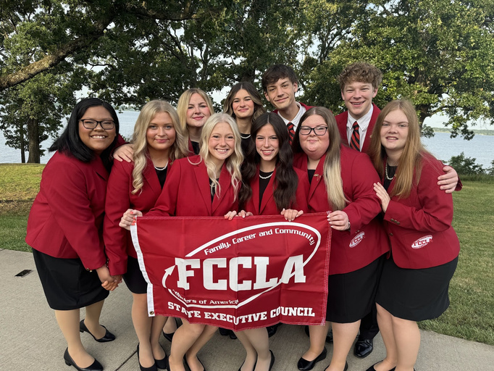
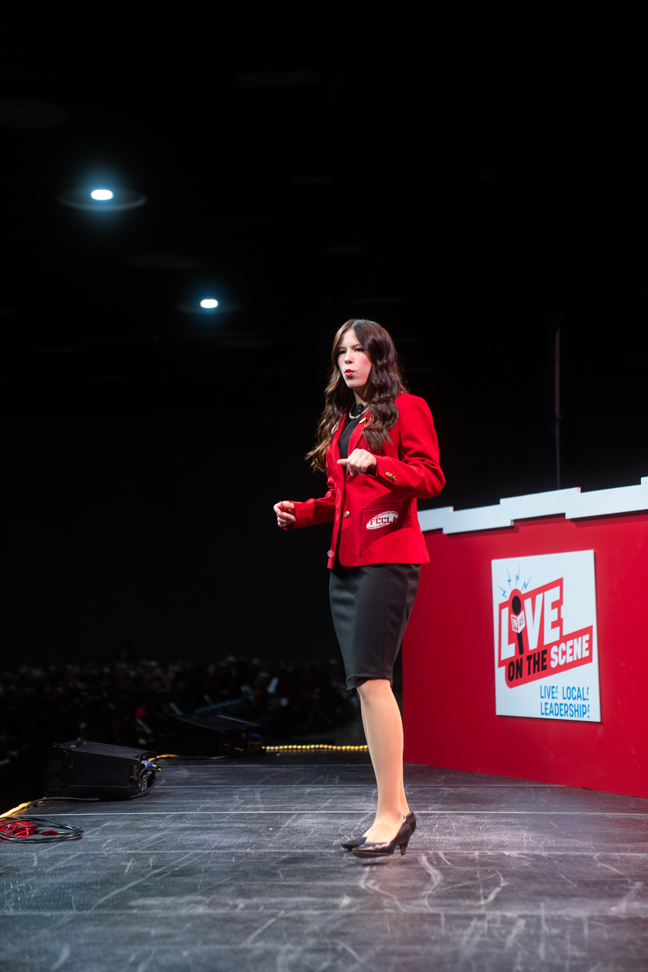
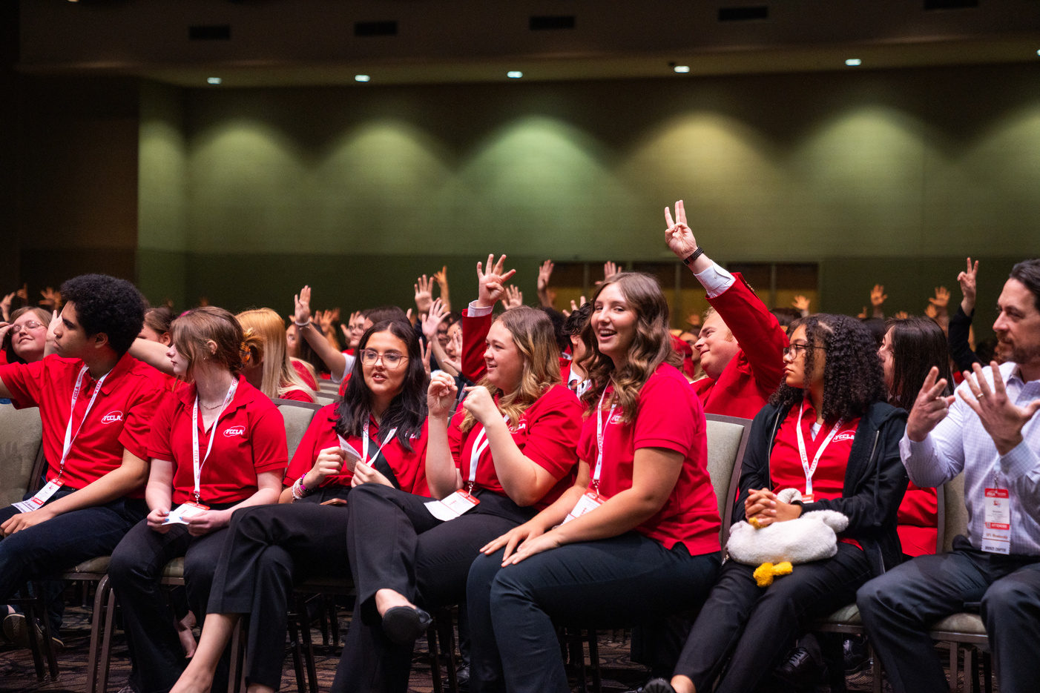

2024
LEAD
REGISTRATION DEADLINE:
AUGUST 31ST
DON’T WAIT!
REGISTER NOW!
CONFERENCE
Gold Medal Leadership!
Sept
North Region
Sept
Northeast Region
11
Stride Bank Center
301 S Independence St
Enid, OK 73701
17
Glenpool Conf. Center
12205 S Yukon Ave.
Glenpool, OK 74033
Sept
South Region
Sept
Southeast Region
12
Simmons Center
800 Chisholm Trail Pkwy
Duncan, OK 73533
18
Life Church
1300 S George Nigh Expy
McAlester, OK 74501
$15
per Student
more at oklahomafccla.org

Slide 36

STATE CONVENTION:
7 WONDERS OF LEADERSHIP
TULSA, OK
APRIL 10, 2025

Slide 37

NATIONAL LEADERSHIP CONVENTION:
ORLANDO, FL
JULY 5-9, 2025

Slide 38
NLC CHAPTERS RECOGNITION - TOP 10 PLACEMENT
Battiest High School FCCLA
Caney High School FCCLA
Gordon Cooper Tech FCCLA
Haworth High School FCCLA
Idabel High School FCCLA
Kingston High School FCCLA
Marietta High School FCCLA
Spiro High School FCCLA
Stigler High School FCCLA
Valliant High School FCCLA
Wilburton High School FCCLA

Slide 39
FCCLA NATIONAL HEADQUARTERS ADDRESS:
NATIONAL FCCLA
13241 Woodland Park Road,
Suite 100
Herndon, VA 20171
*** Address is needed for reasons such as Affiliation Payments

Slide 40
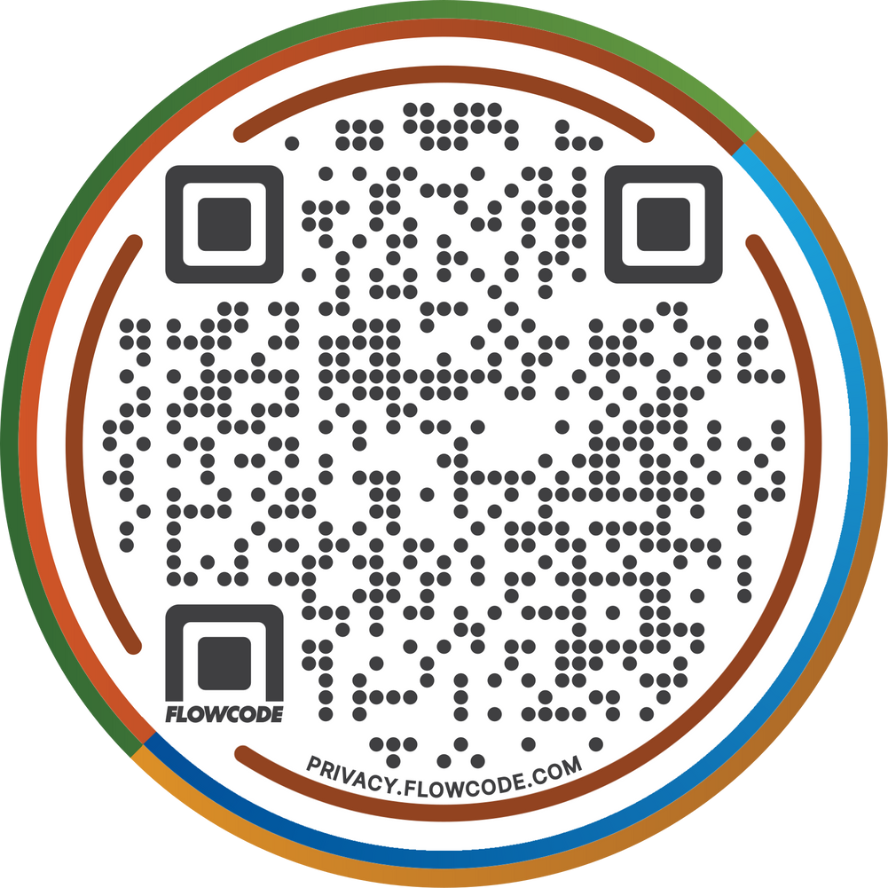
QR CODE VERIFICATION
Below is the QR Code you will use for your verification forms for this year. This will take you to a digital form to complete. You will need to answer every question. Then it will be emailed to you so you can print it.

Slide 41
PLEASE MOVE INTO YOUR DISTRICT SECTIONS FOR DISTRICT PLANNING MEETINGS

