Slide 1

ctYOU.org is like your best friend....sometimes you don't like it, but you always love it!
Jeanette Blevins
Northeast Program Specialist

Slide 2
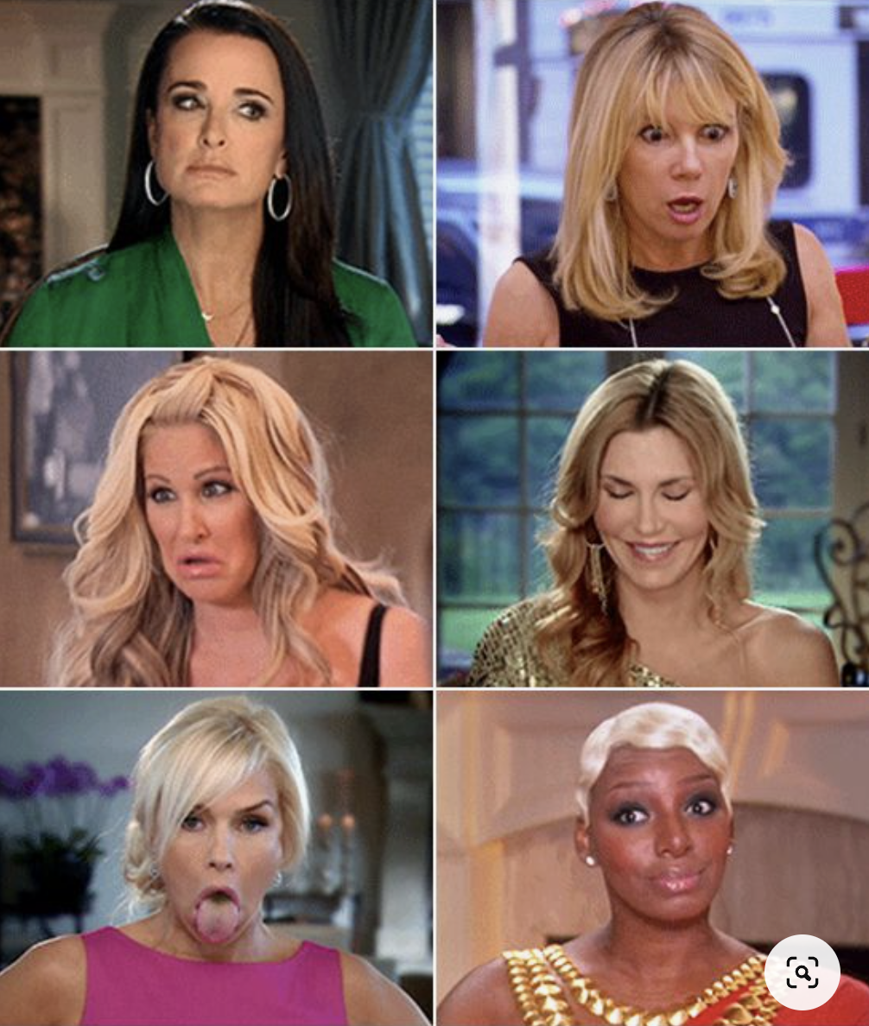
Everything you feel when you are on ctYOU.org

Slide 3
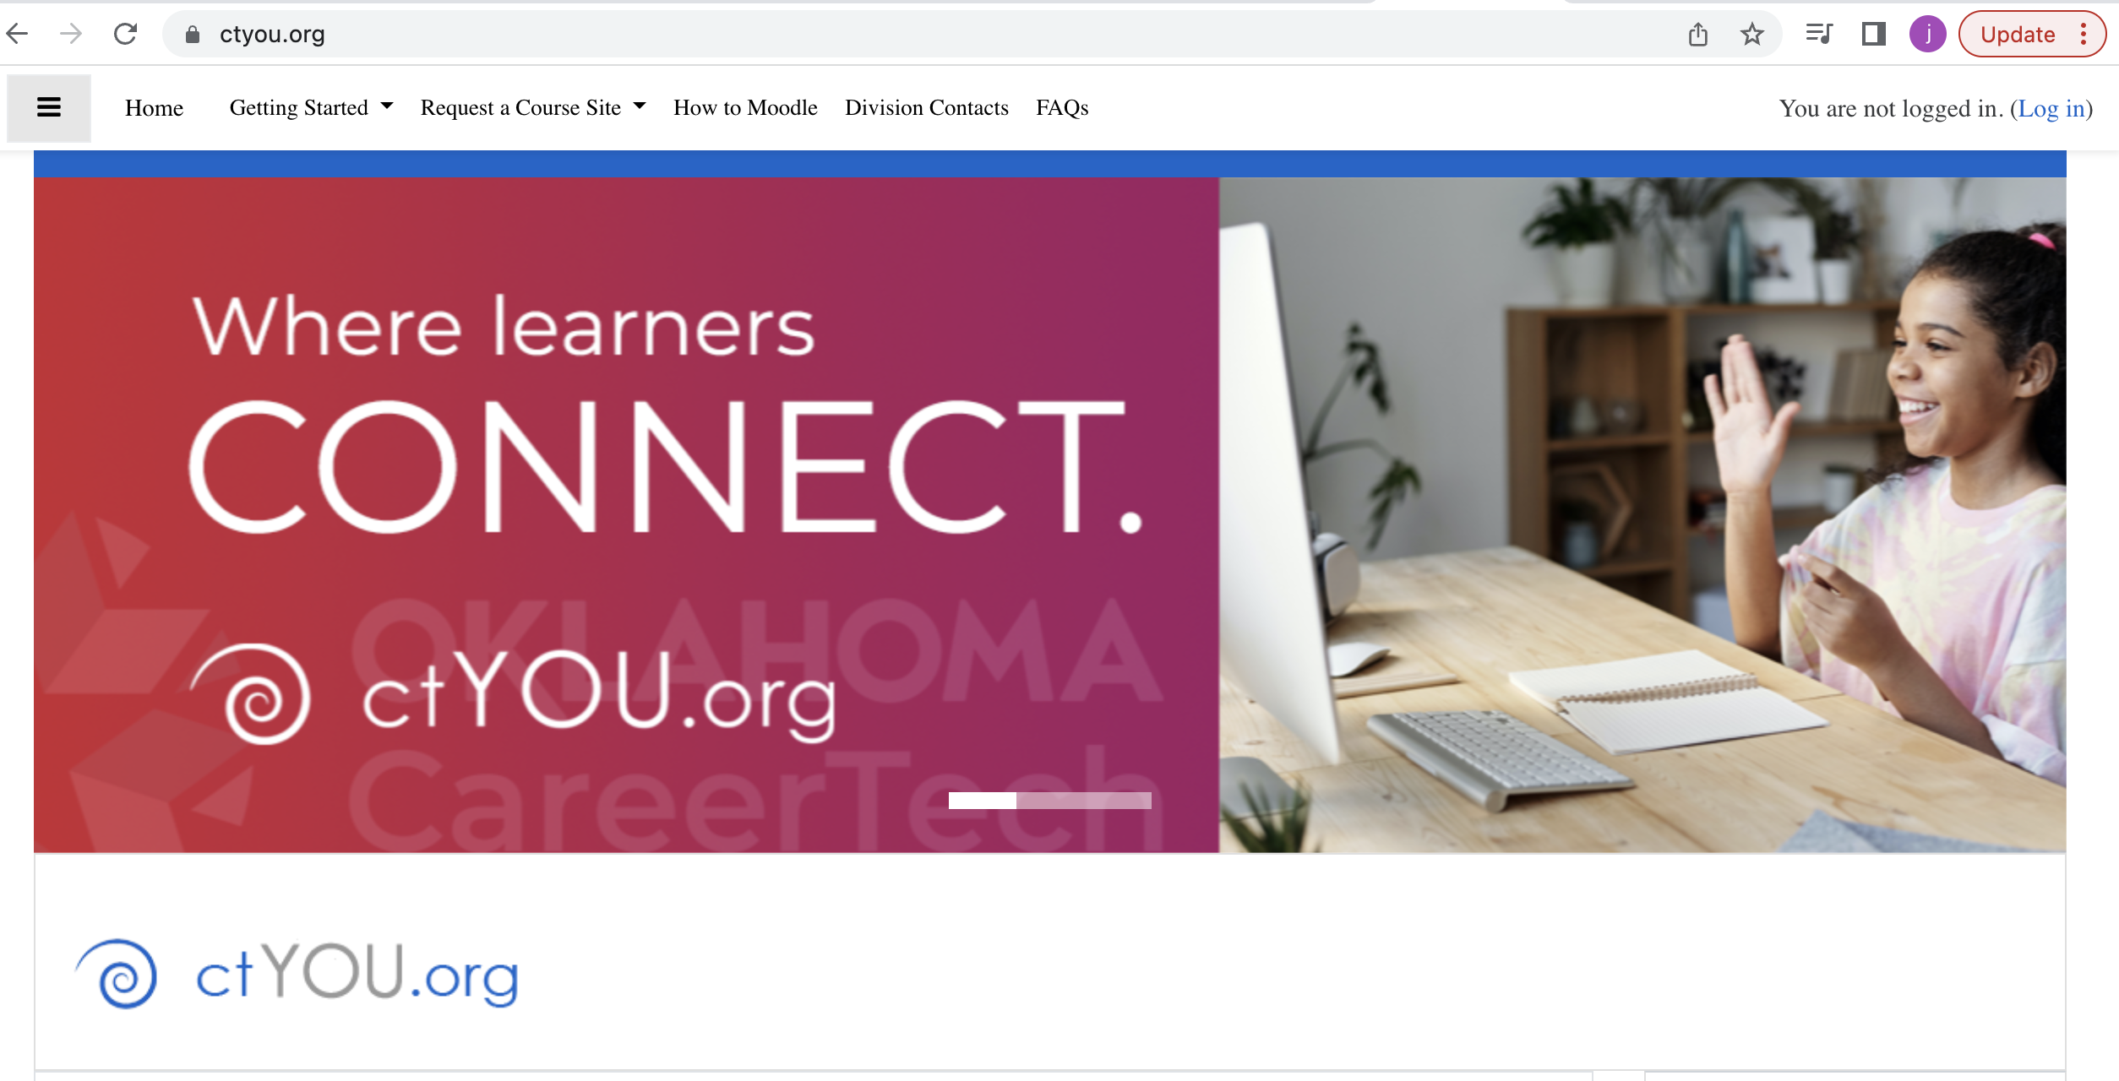
This is what you will see when you are on the ctYOU.org website: Notice the “Log In” section on the top right!

Slide 4
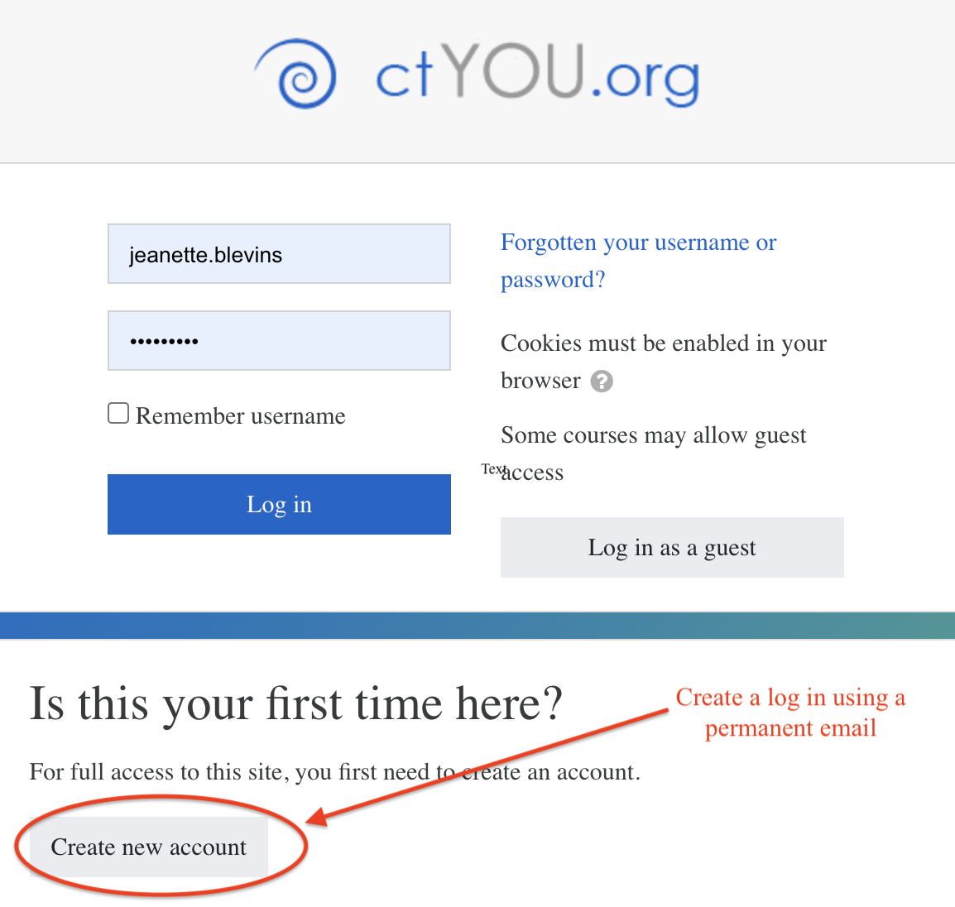
It is good to use a permanent email that will follow you
There are many pages you will be able to see as a guest, but it is good to get into the habit of logging in every time you get on to ctYOU.org
If you are not seeing information that you think should be up to date, be sure to clear your cookies.

Slide 5
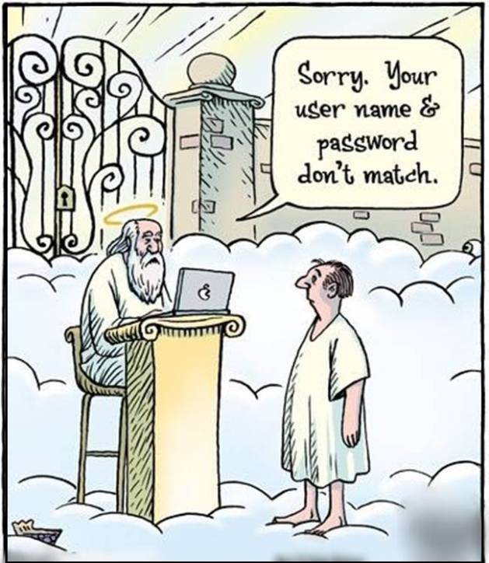
We CAN work wonders in our office, but we CAN’T remember your username and password.
We would love to help you once you are logged in!
Use your permanent email, so in the event you change schools, you will always have access to ctYOU.org and are able to retrieve your password.

Slide 6
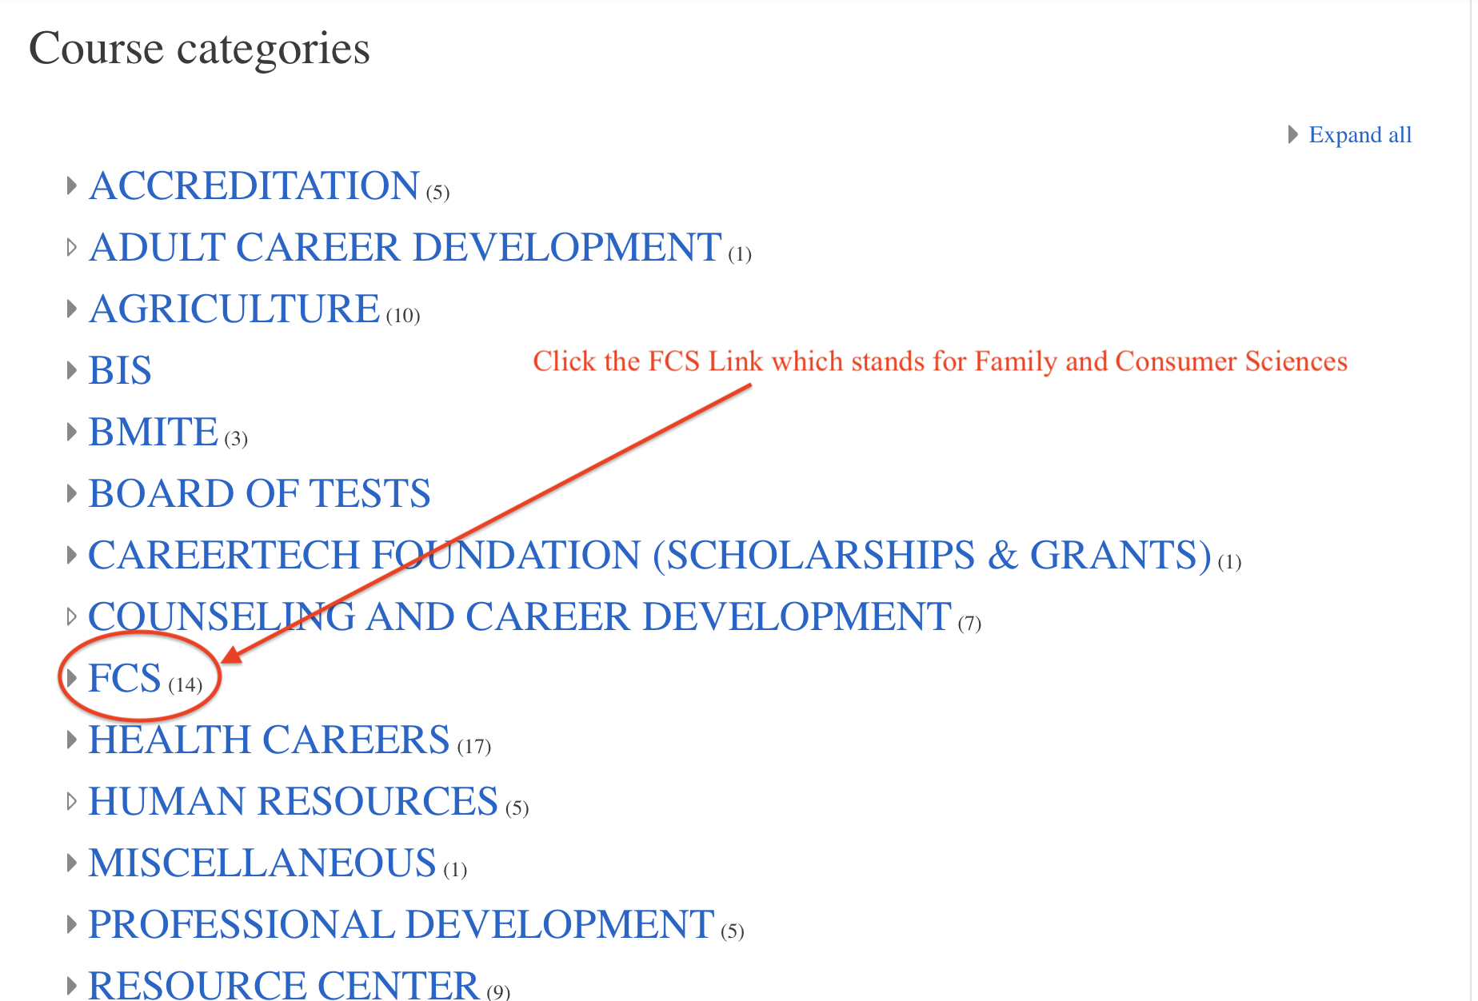
This is the landing page for ctYOU.org. To find our content, you will click on the FCS link

Slide 7
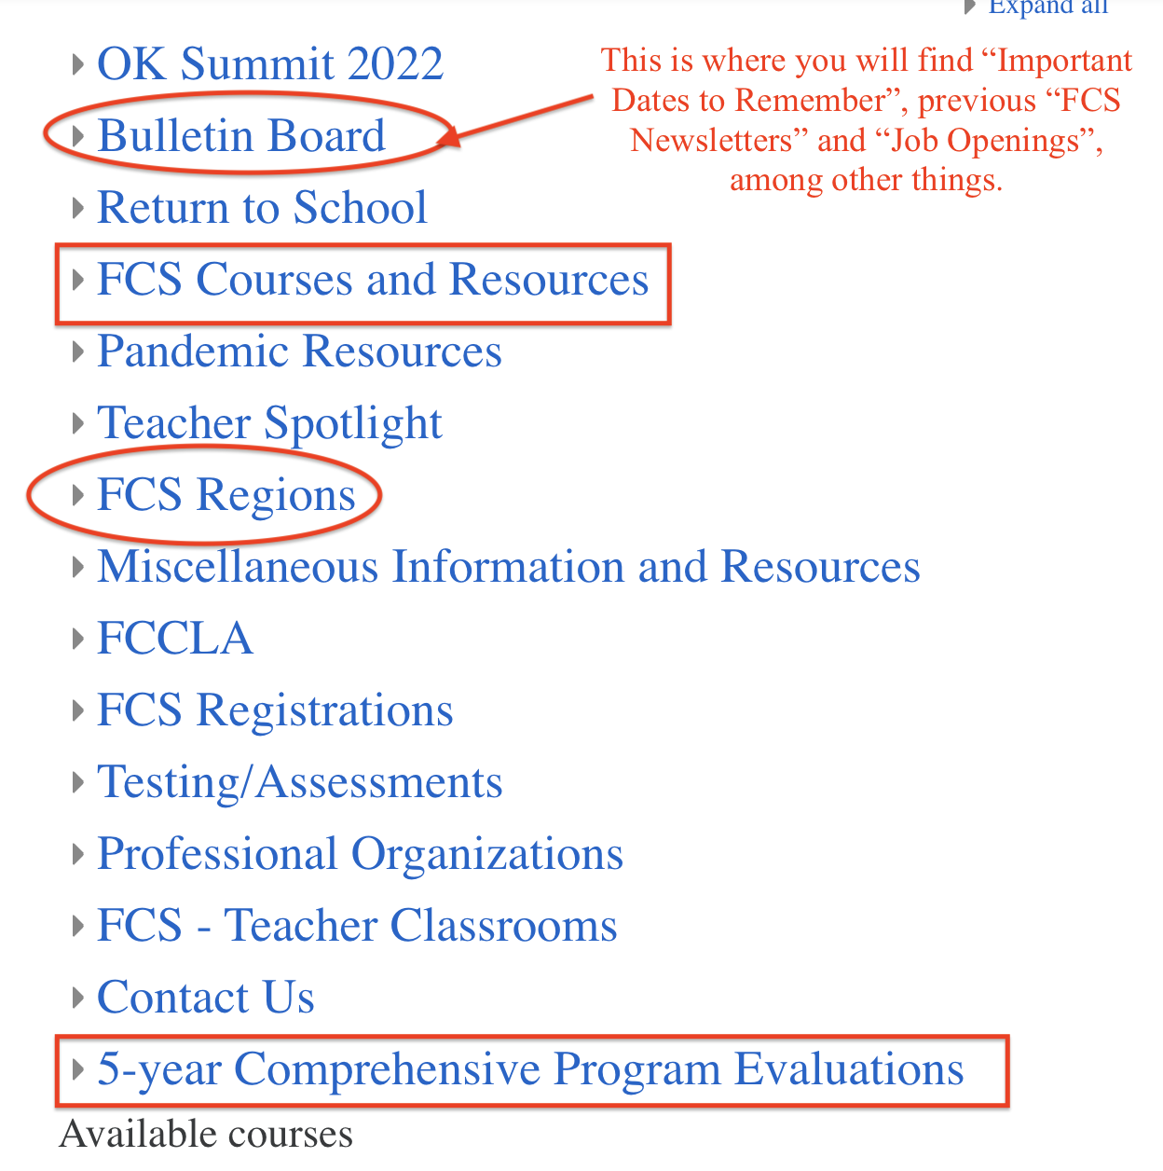
Bulletin Board highlights include but are not limited to:
Former newsletters
Quick tour video to reference
Community service ideas
Dates to Remember (state wide)
FCS Job Openings

Slide 8
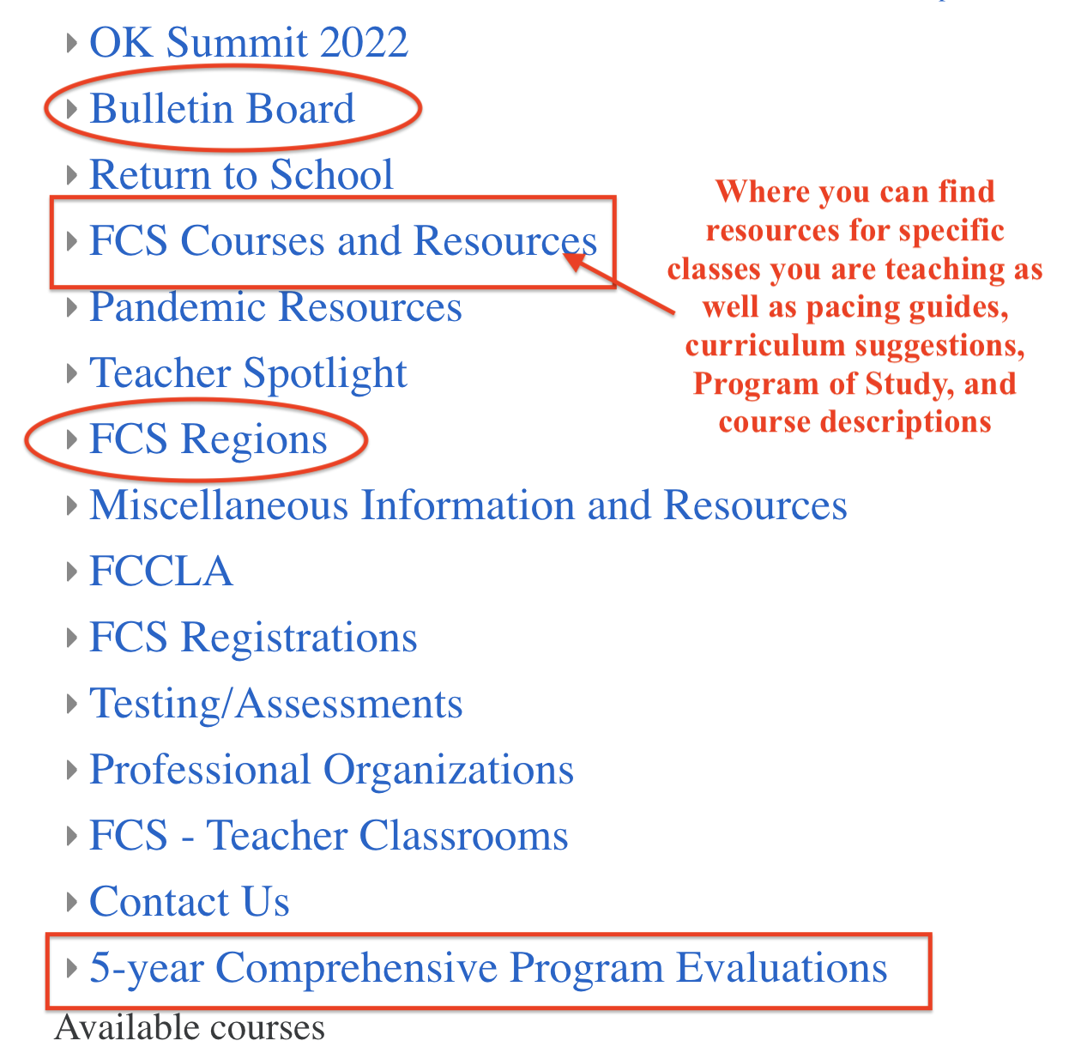
FCS Courses and Resources is probably the most vital link for you to find on ctYOU.org
Here is where you go to:
See all of the courses that are approved for FCS teachers
Resources and project ideas for courses you are teaching
Pacing Guides
Program of Study
Curriculum Suggestions
Course descriptions

Slide 9
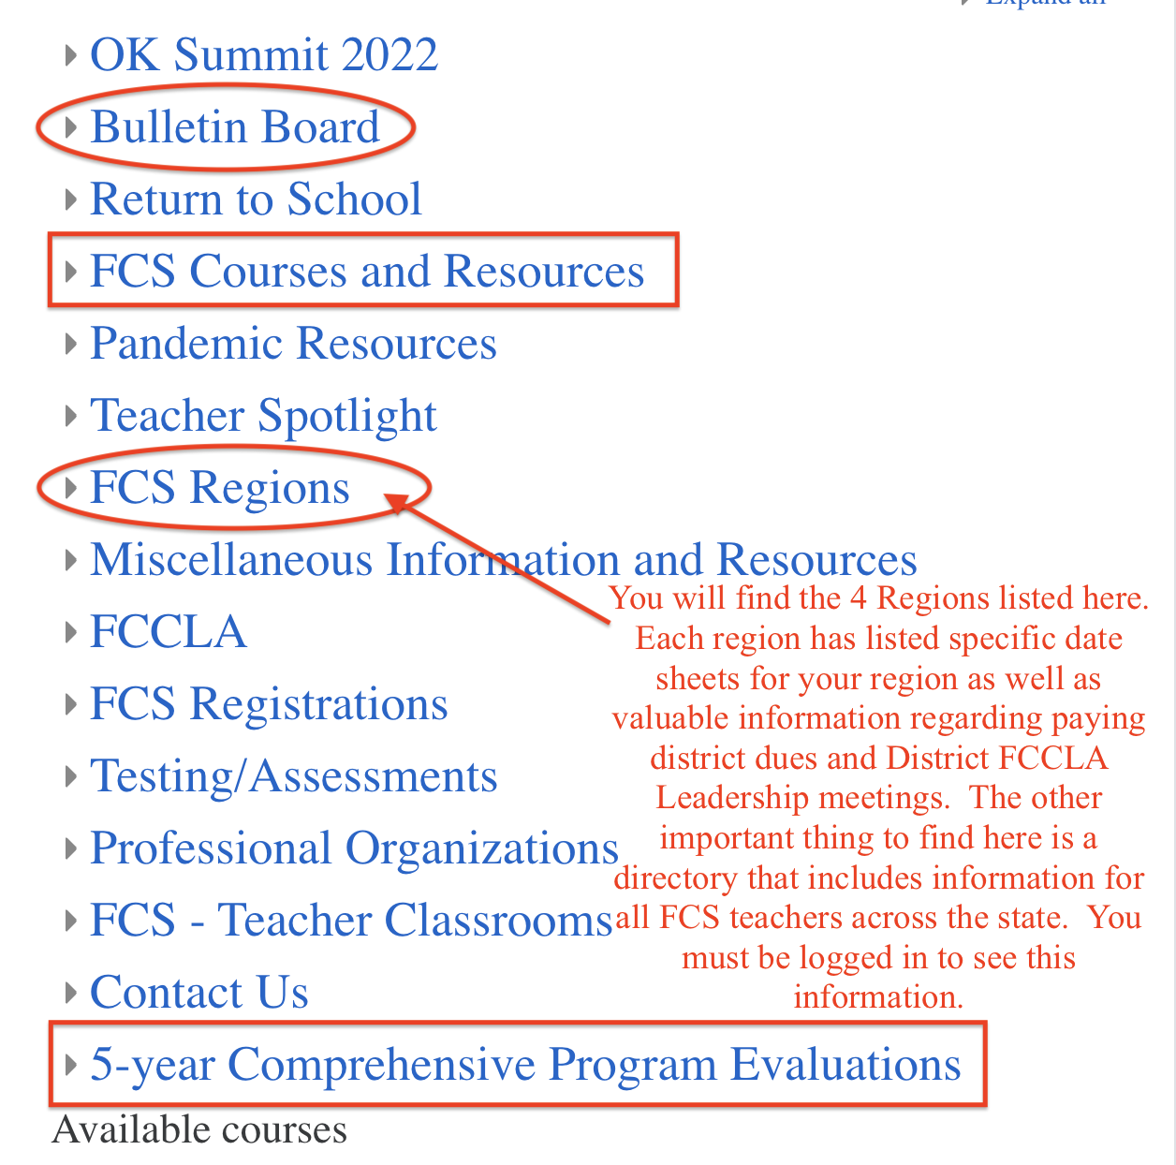
FCS Regions you will find:
Specific dates for your district and region
Valuable information regarding FCCLA District Leadership Meetings as well as invoices for district dues
FCS Directory – contact information for FCS teachers across the state as well as pics to that you may put a face to a name if needed.

Slide 10
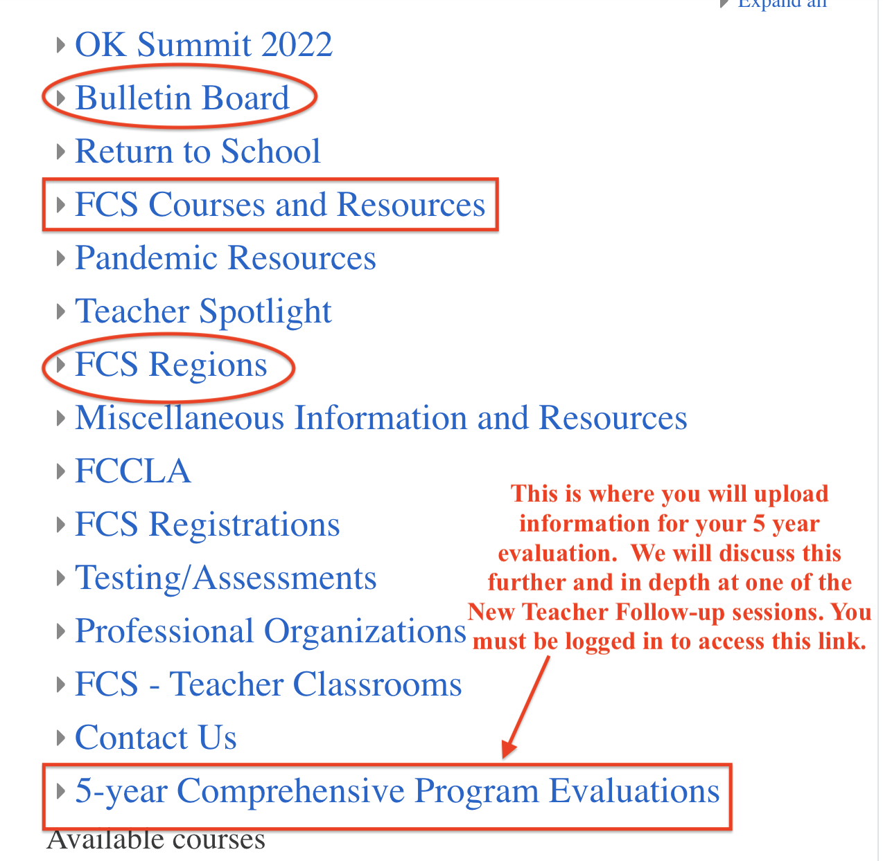
5-Year Comprehensive Program Evaluation:
You will be uploading supporting documents into this online folder. Your Program Specialist will be using this to help complete your 5 year evaluation, but there are times that we do access this folder so it is important to keep the information up to date…..do not wait until the day before your evaluation to upload information. Things we check on a yearly basis is your program 412 spending and your Advisory Committee Meeting report.

Slide 11
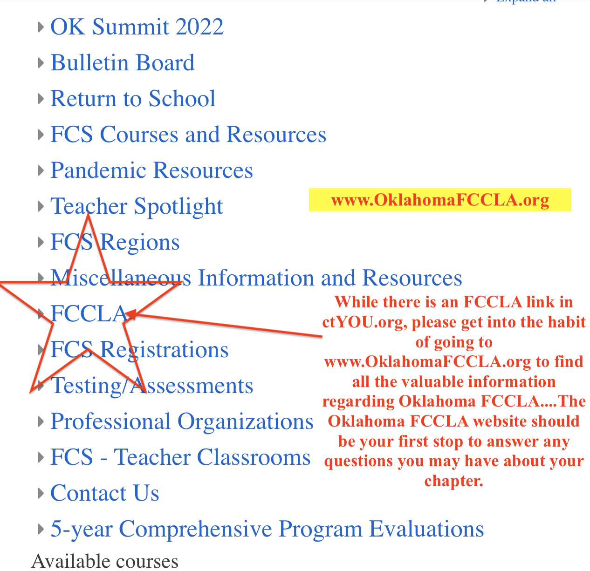

Slide 12
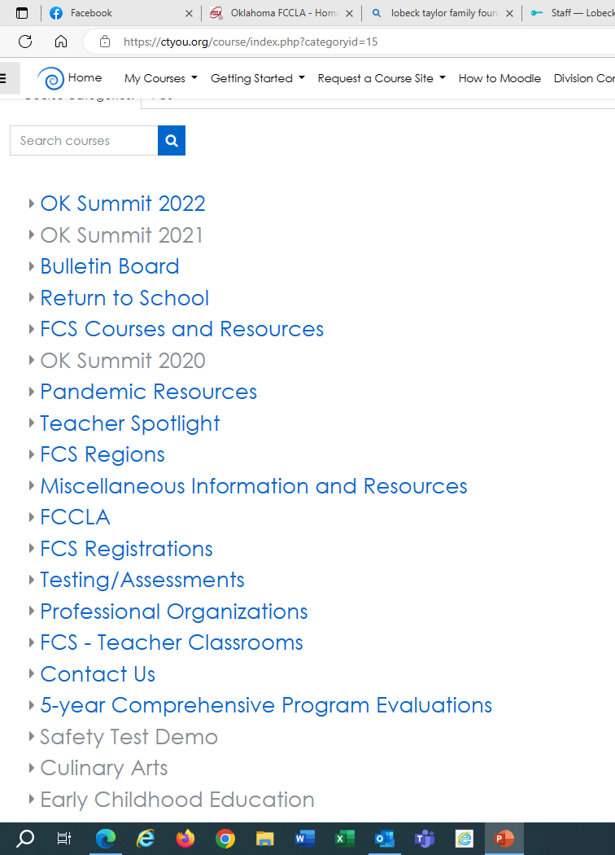
The 2 places you must use a password to enter are:
FCS Regions to view: “FCS Directory” (If you don’t see the current year, you will need to clear your cookies)
Testing/Assessments to view: “FCS Safety Tests” (scroll down the Testing/Assessments page to find the FCS Safety Tests link)

Slide 13
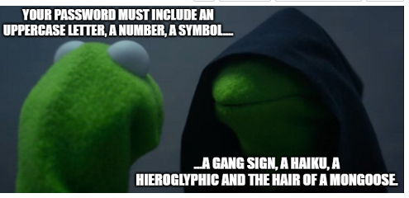
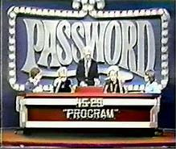
And the Password is…
Fc$2023

Slide 14
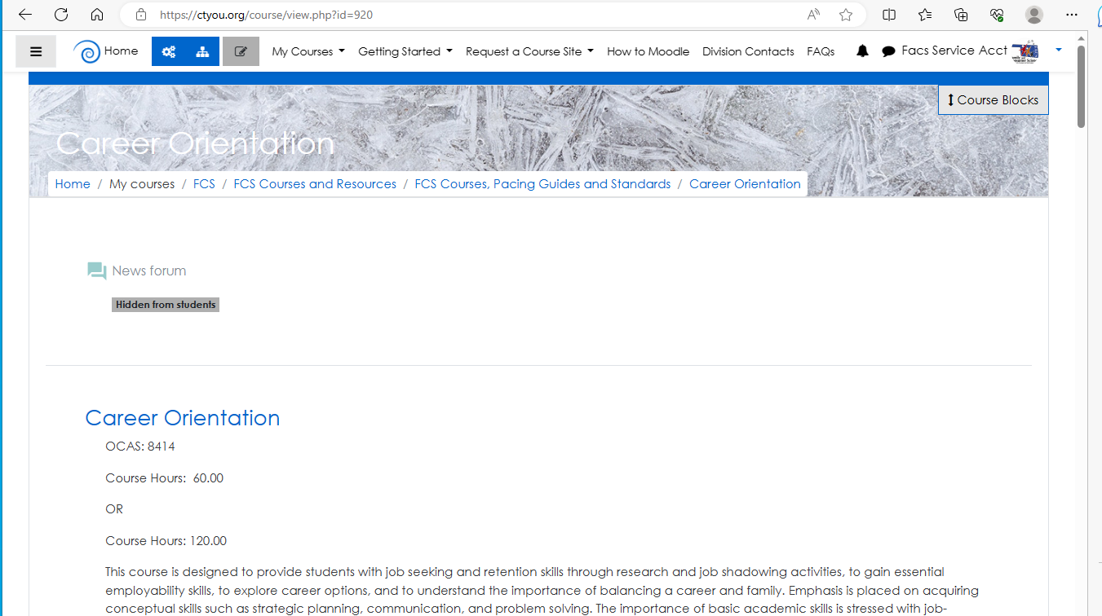
You can use these buttons to toggle back to previous pages
You can use these three buttons to create a side panel, although, I just feel that it is confusing at times…toggle on or toggle off…it’s your preference!

Slide 15




Thank you
Jeanette Blevins
Jeanette.Blevins@careertech.org
405.743.5463

