Slide 1
REGION MEETINGS
OKLAHOMA FCS

Slide 2
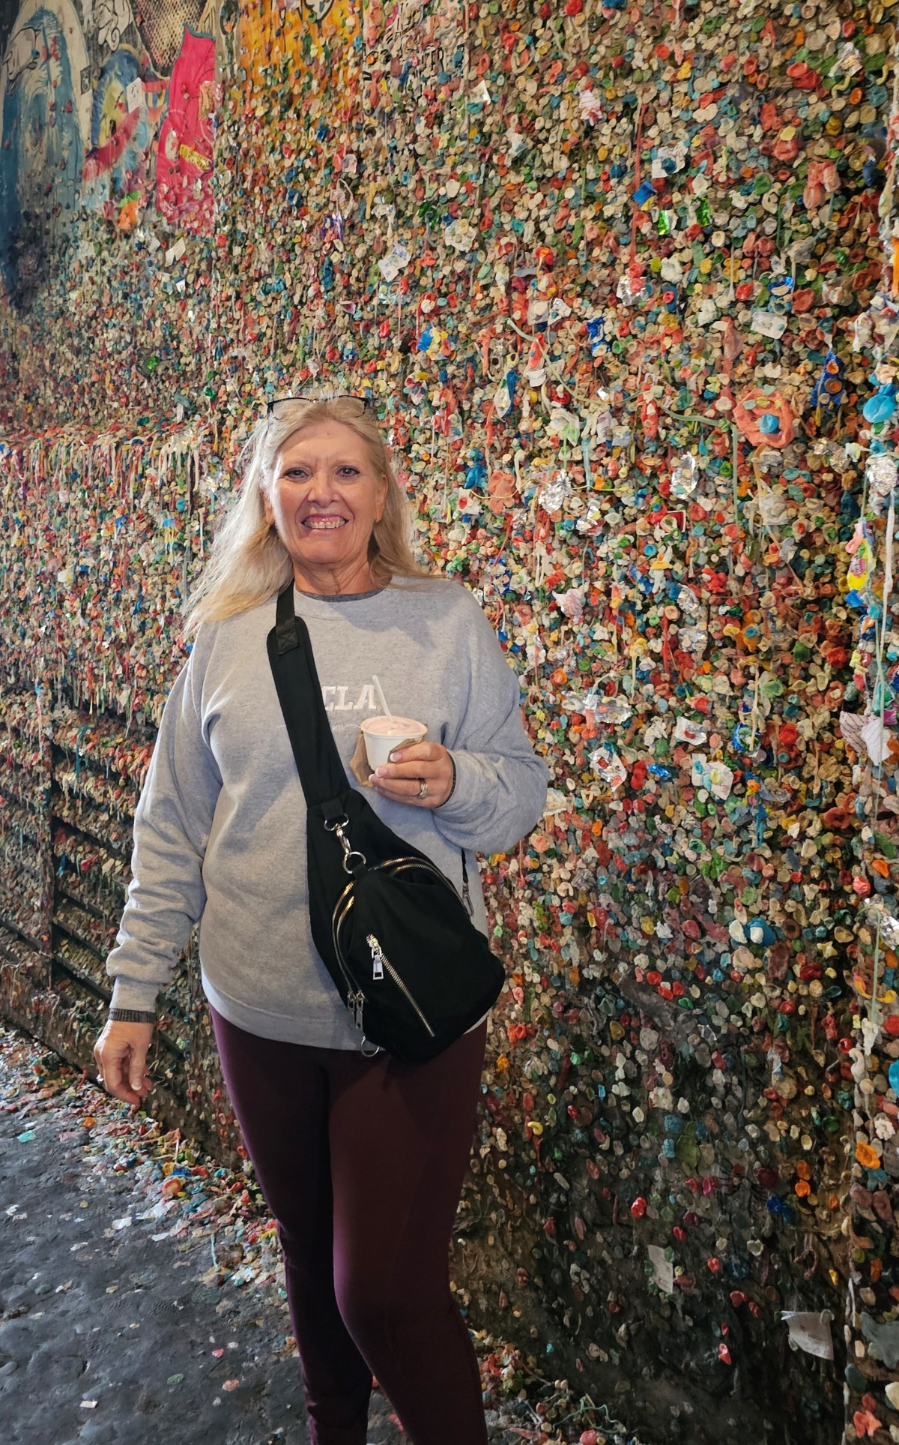
PROGRAM SPECIALIST
Contact Info: Teena Friend
​teena.friend@careertech.ok.gov
405-743-5468
Personal Info:
tmfriend1962@gmail.com
405-880-0317
I do not answer calls after 8:00 p.m.
Please text with your name in case I don’t have you in my phone.

Slide 3
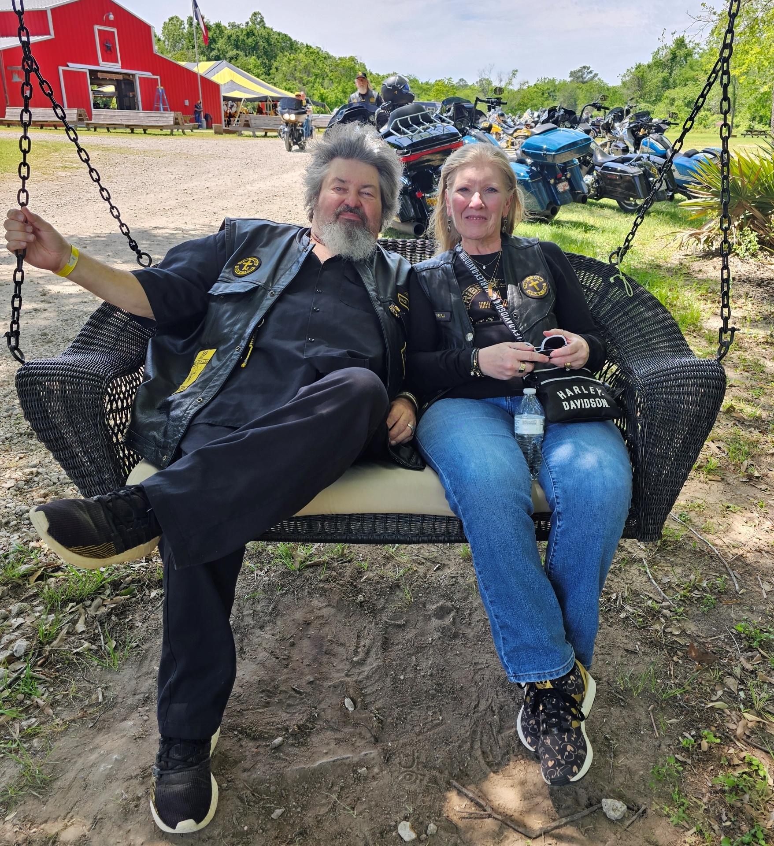
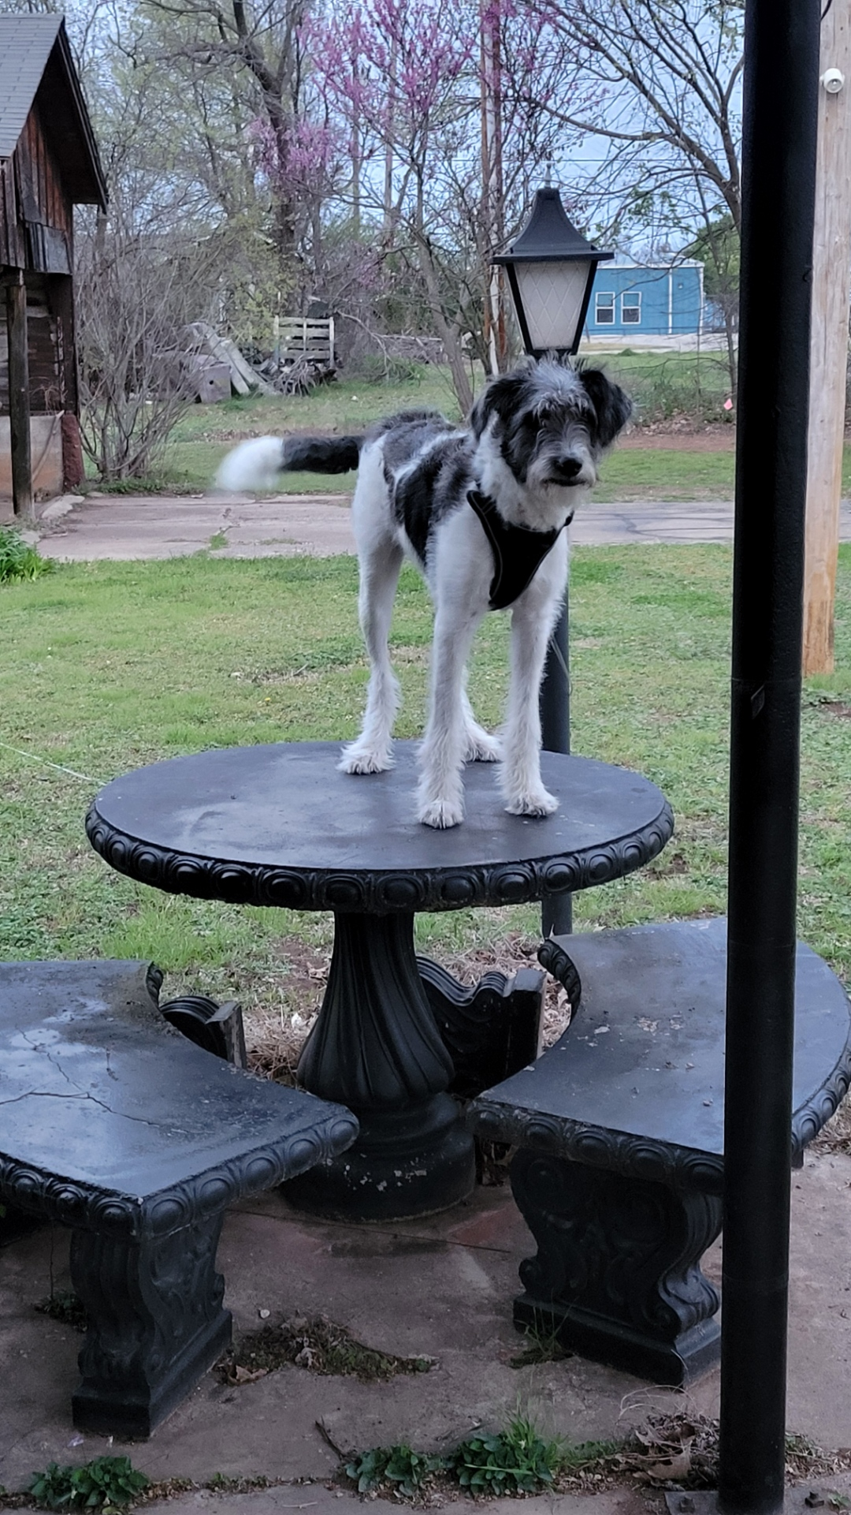

Slide 4
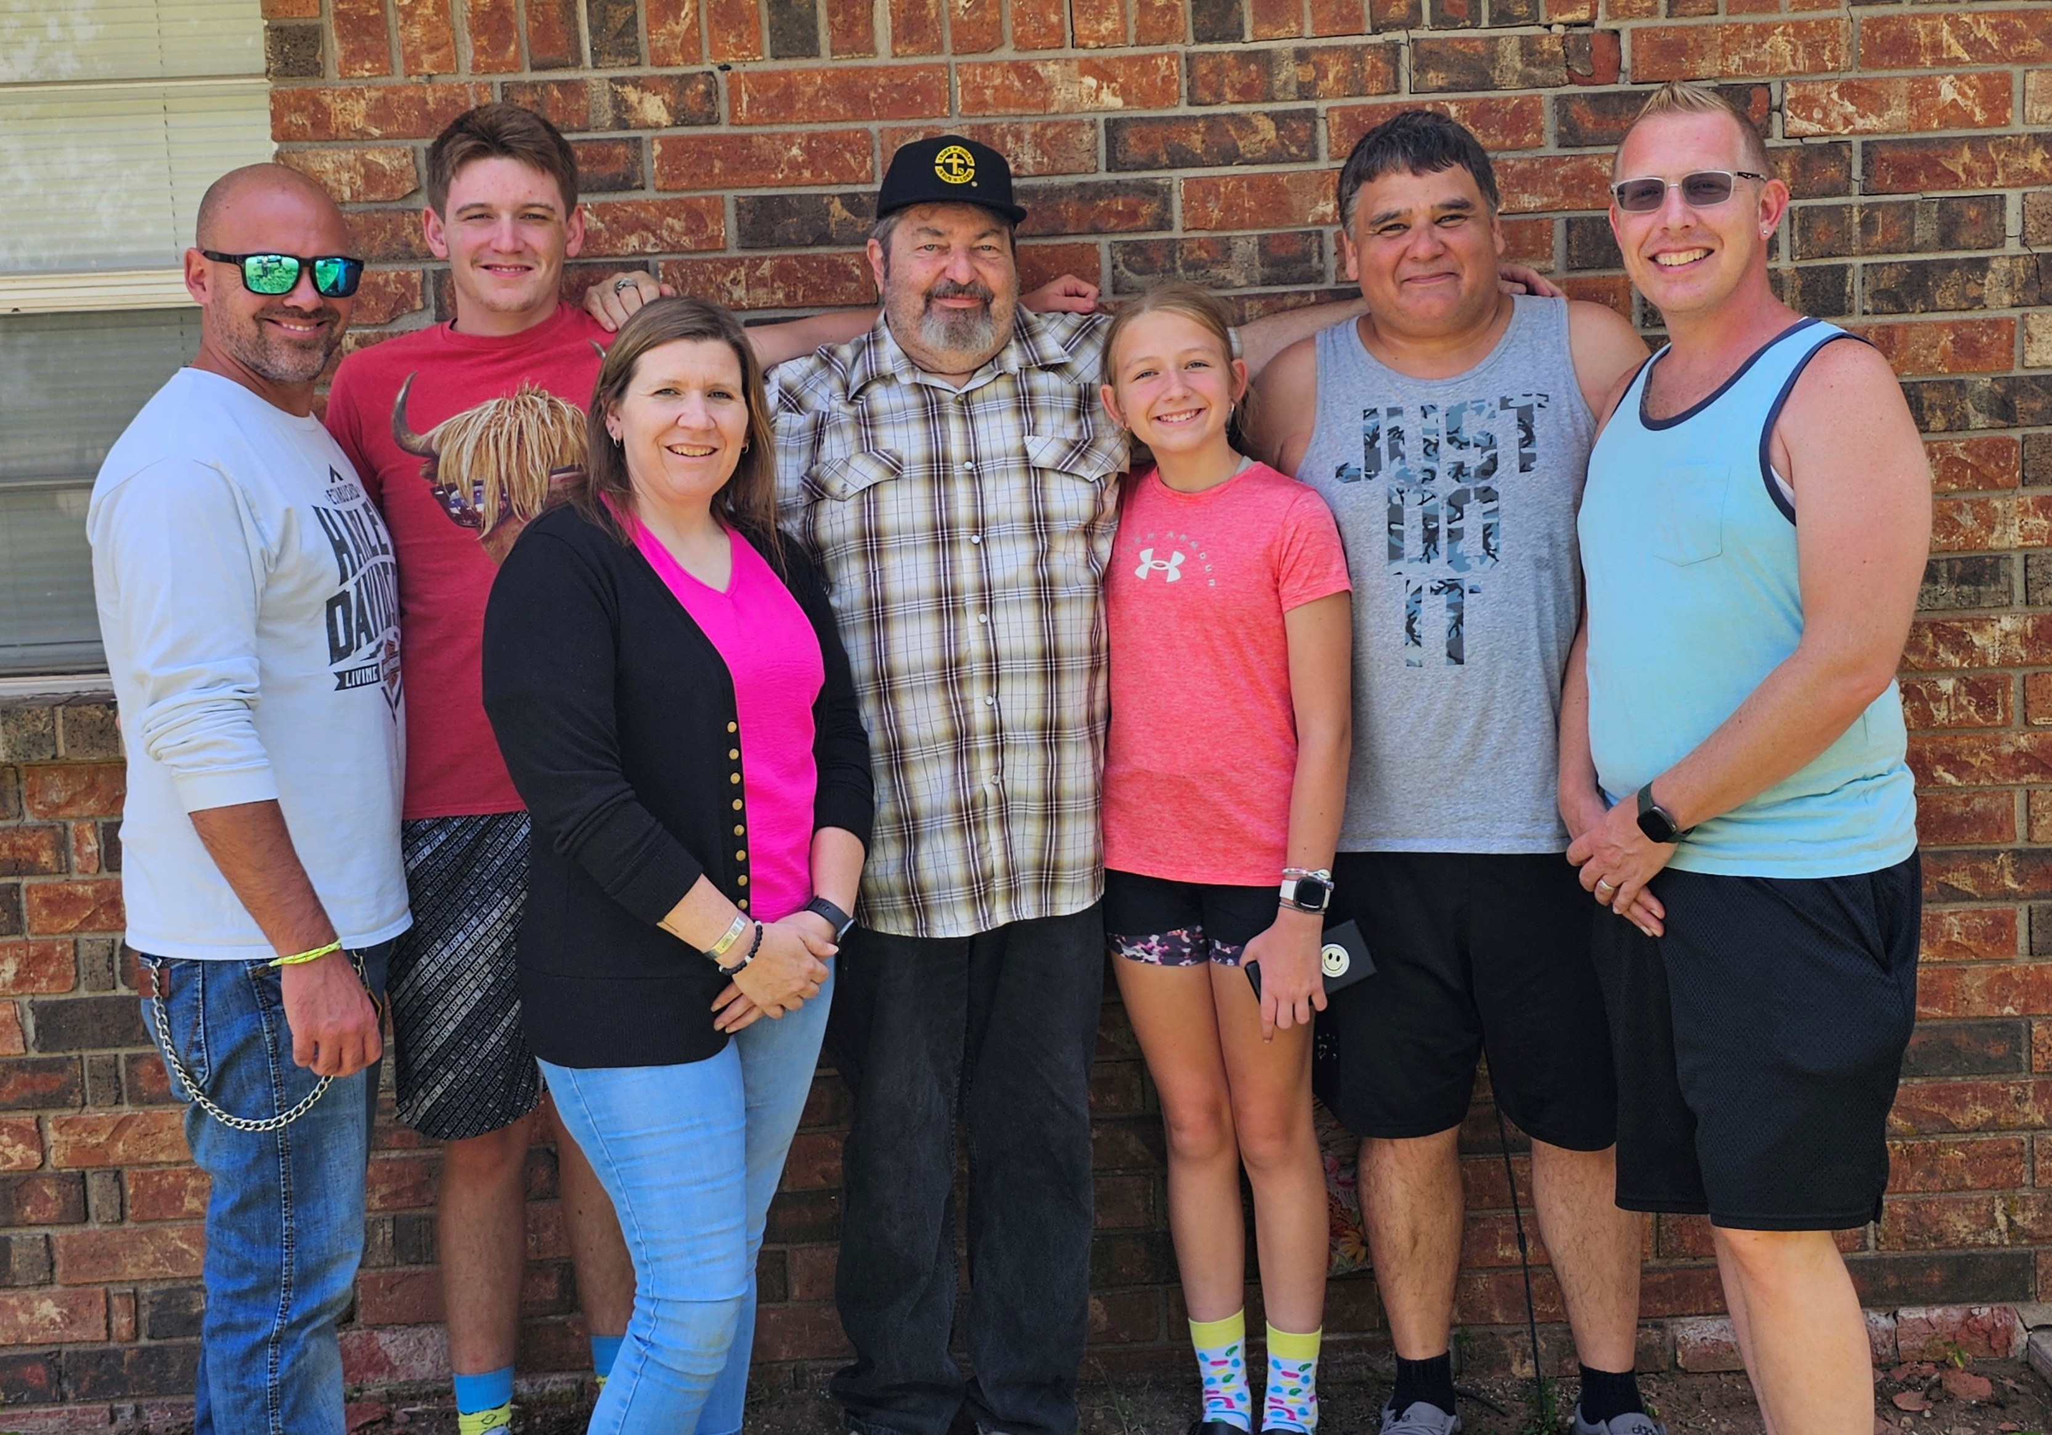
text
Father’s Day 2024

Slide 5
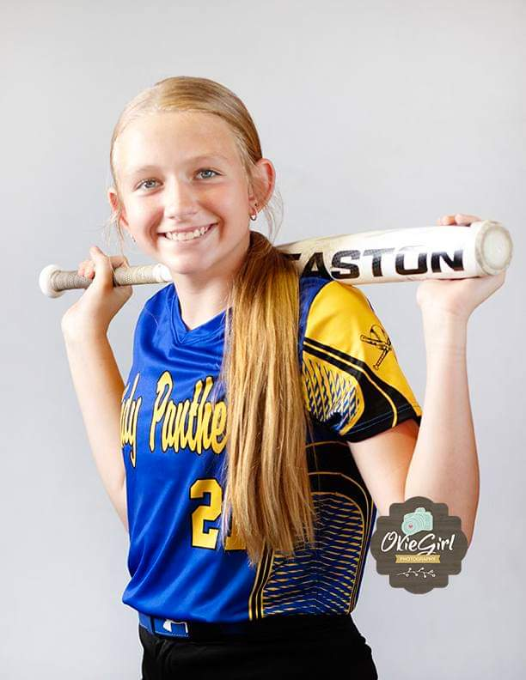
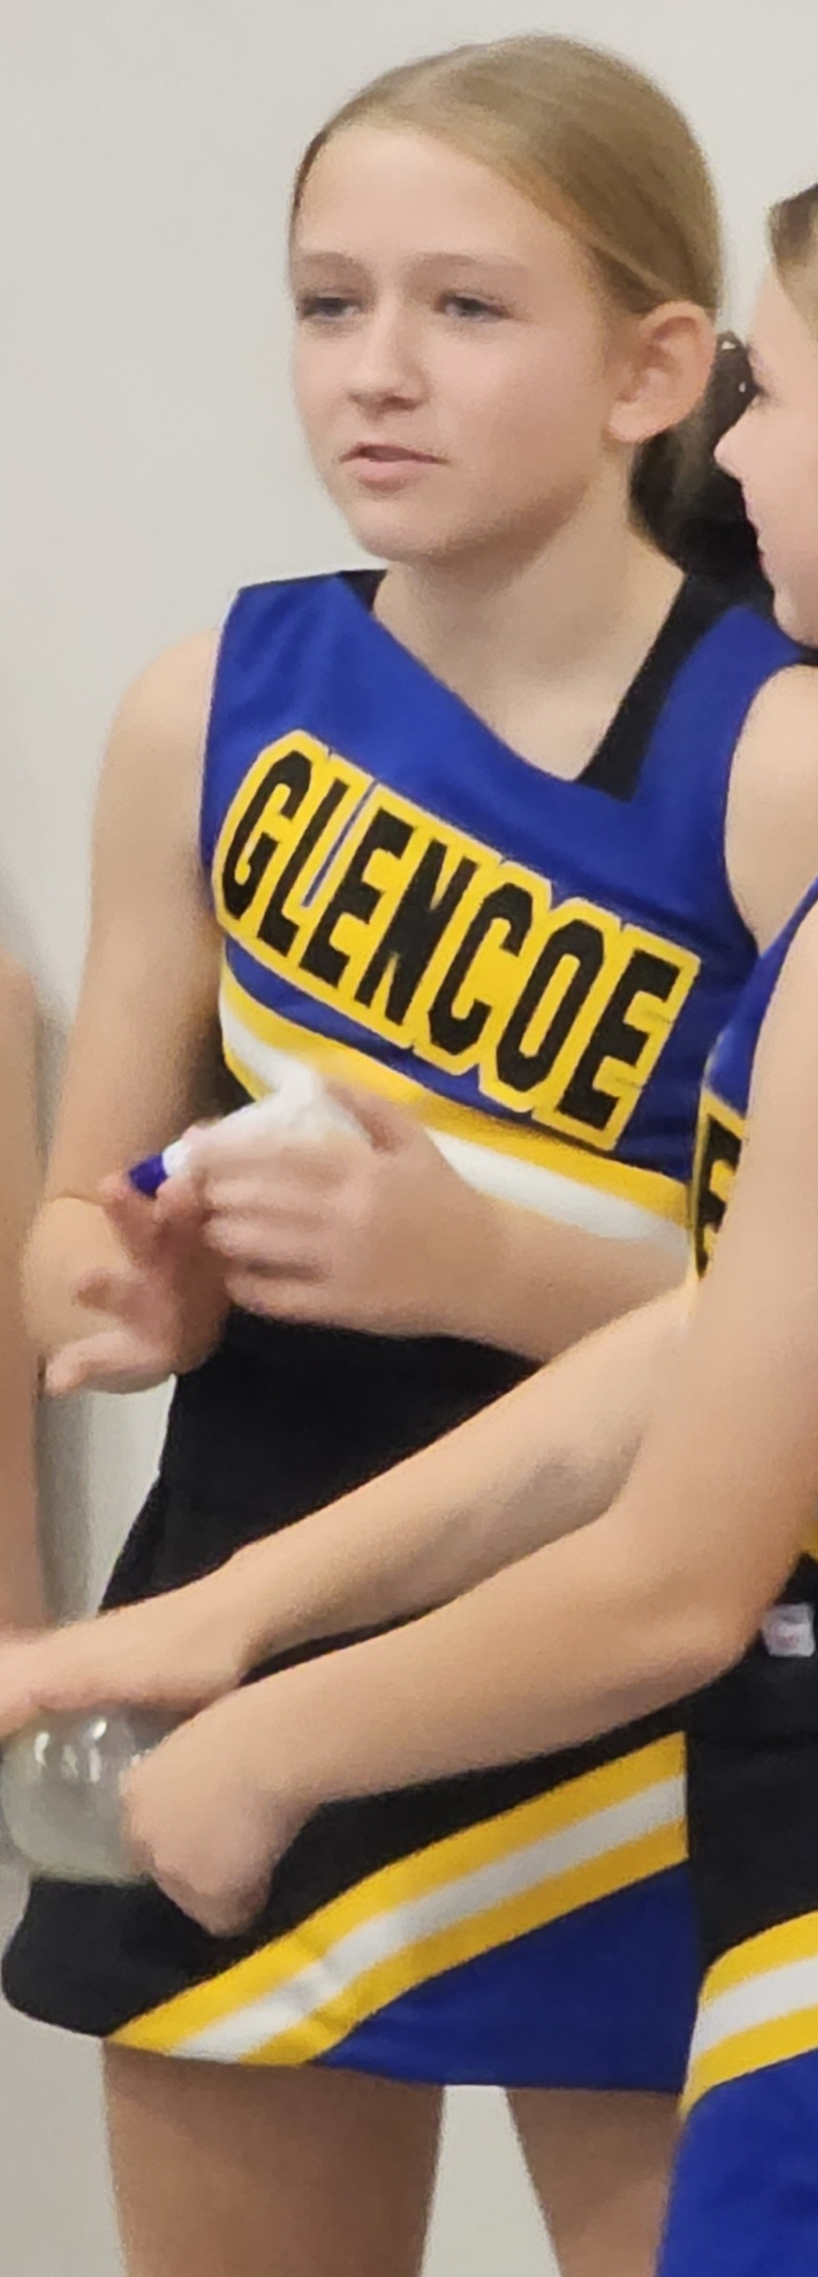
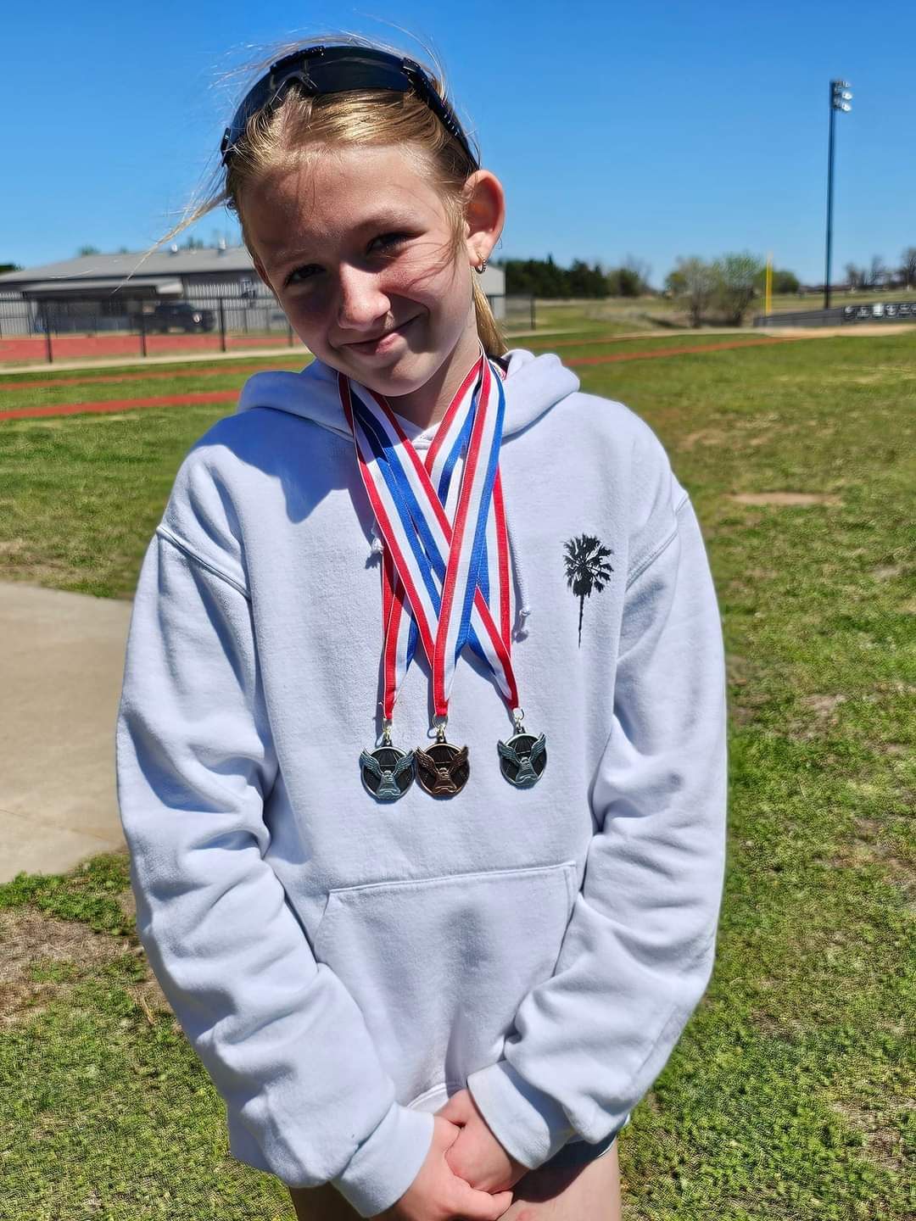
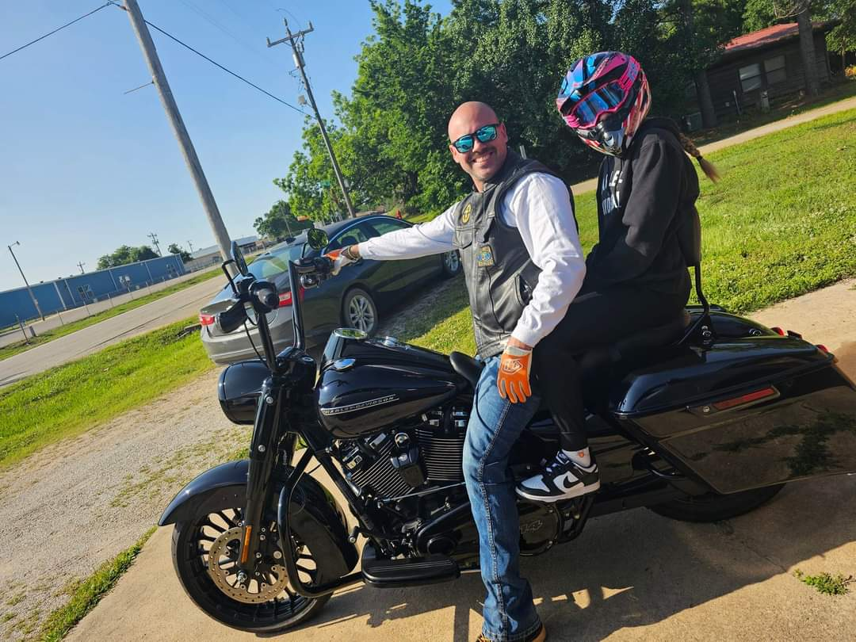
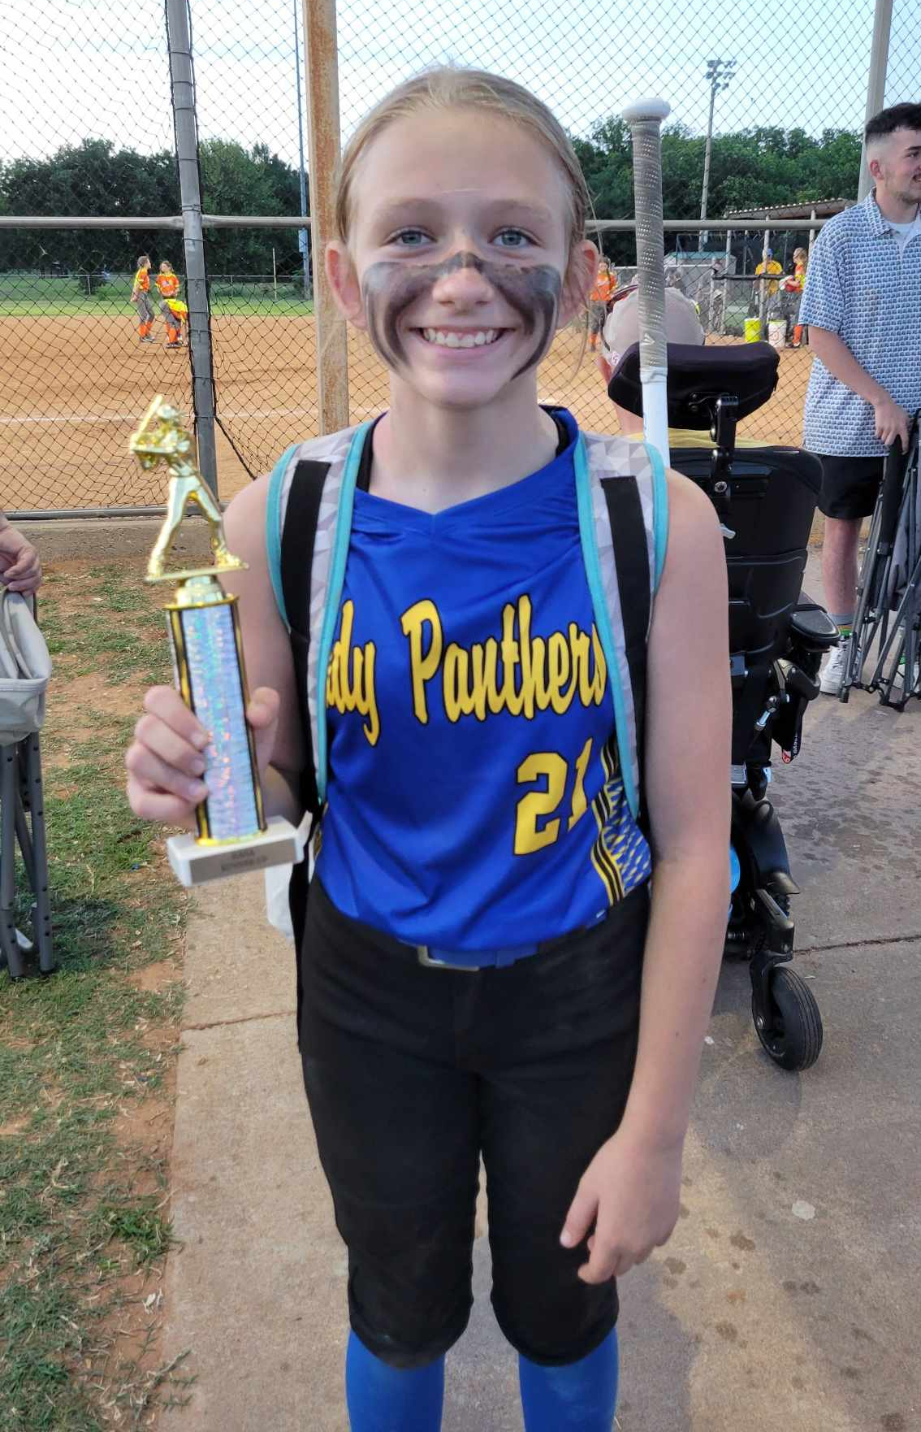
Harper Lee

Slide 6
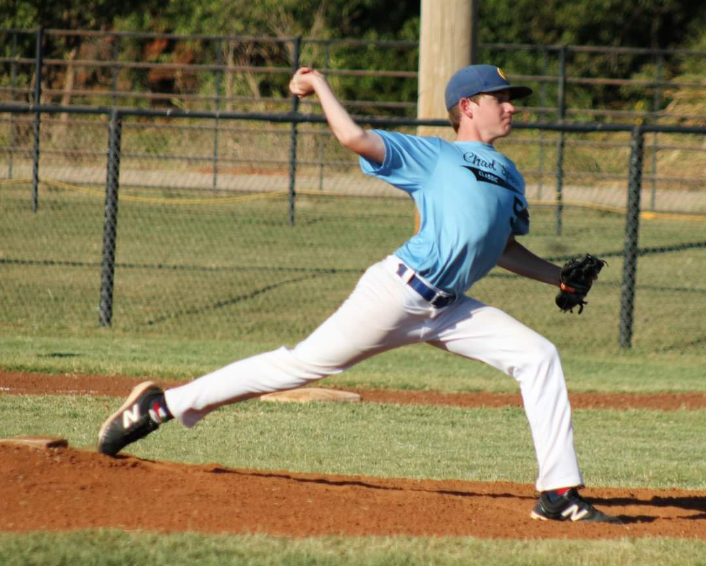
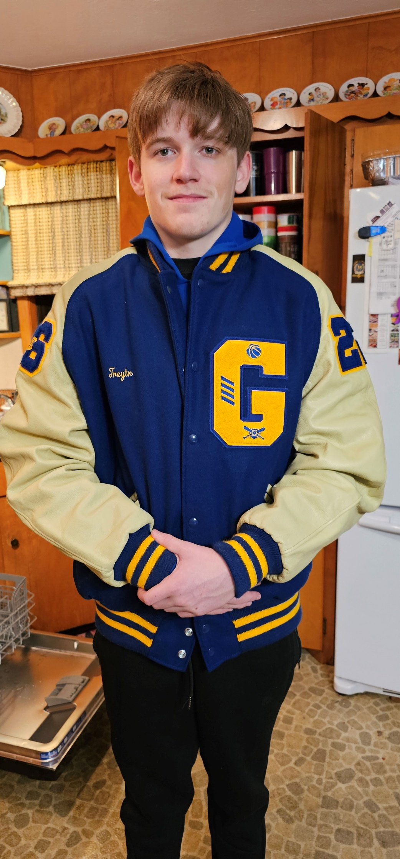
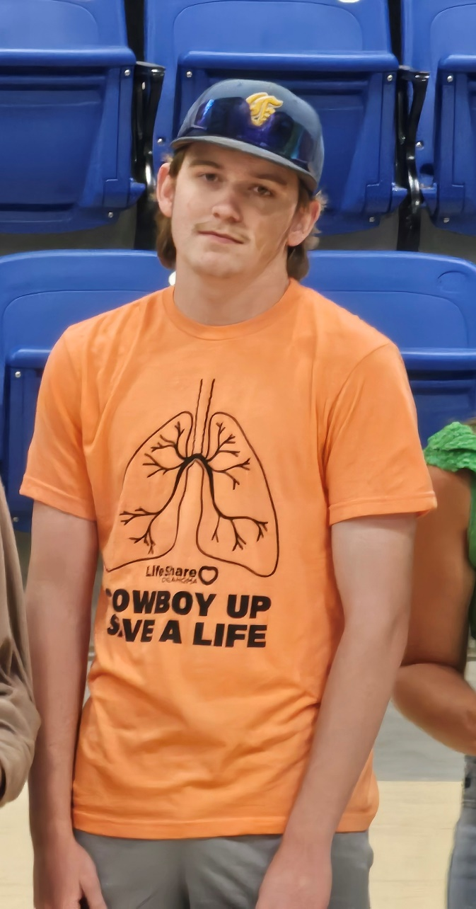
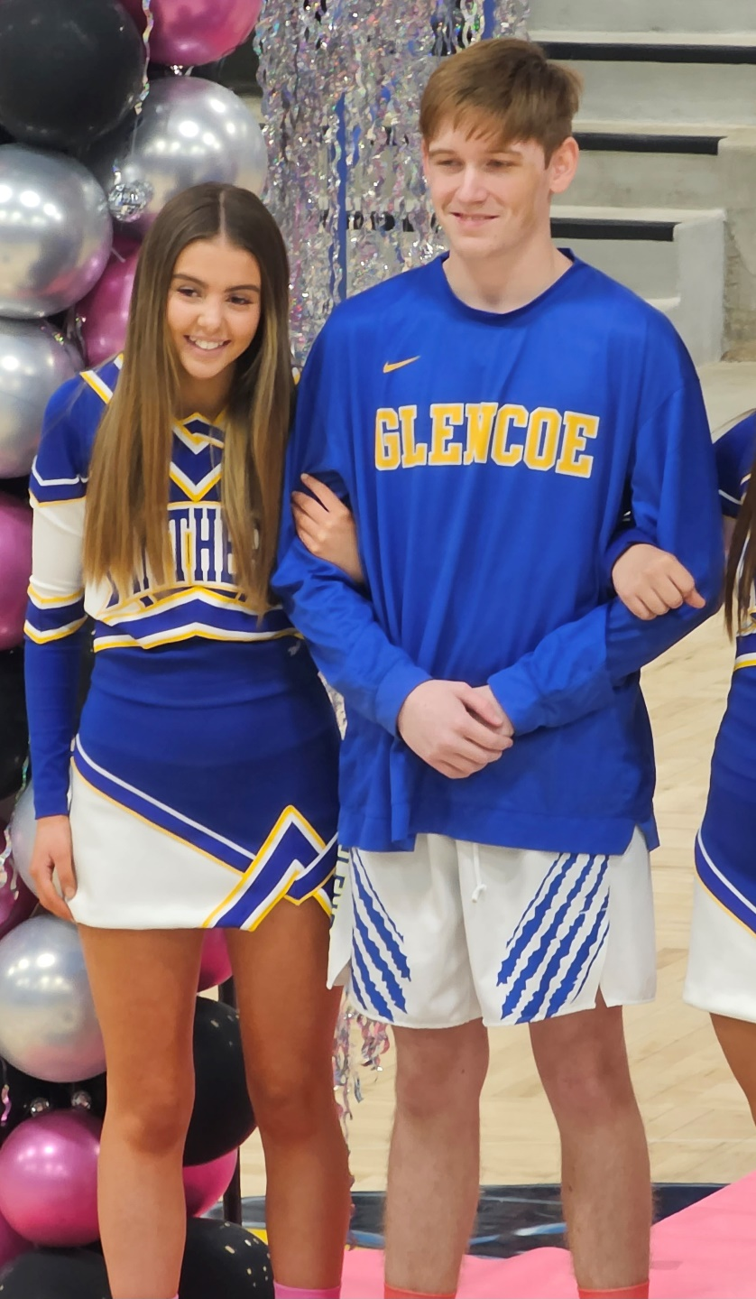
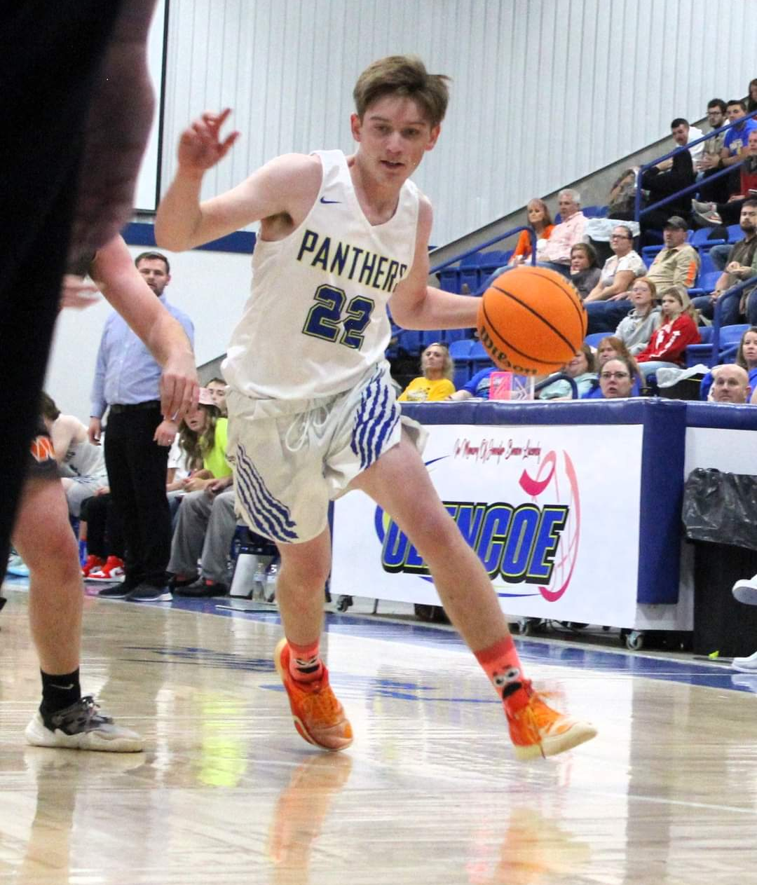
Treytn Chad

Slide 7
NEW TEACHERS!
N1
N3
N5
N4
N2
Katelynn Brasch
Stephanie Boley
Denise Clark
Returning Teachers
Jamie Clark
Michelle Meyer
Jennifer Lawter
Jeff Waddle
Returning Teachers
Sandra Thompson
Chelsea Christian
Kaitlyn Albrecht
Kami Pope
Returning Teachers
Victoria Kahle
Jennifer Richardson
Blair Poulter
Erin Harp

Slide 8
N1 New Teachers
STEPHANIE BOLEY
DENISE CLARK
KATELYNN BRASCH
JULISSA MARTINEZ

Slide 9
N2 New Teachers
BLAIR POUTLER
JENNIFER RICHARDSON
ERIN HARP

Slide 10
N3 New Teacher
N4 New Teachers
KAITLYN ALBRECHT
JENNIFER LAWTER

Slide 11
N4 New Teachers
EMILY GOFF
MADISON CAMP
KAMI POPE

Slide 12
N5 Teachers who attended NTA 2024
CHRISTIE MALONE
LESLIE RODRIGUEZ
CHELSEA KENDLE

Slide 13
JOB OPENINGS!
There are still several jobs openings across the state. If you know someone who would like to teach FCS, send them to our job listings on ctYOU under the FCS/Bulletin Board/FCS Job Openings!

Slide 14
FCS PROGRAM FUNDING
412 MONEY
SALARY STIPEND
8000
2200
FULL TIME PROGRAMS
(411 MONEY)

Slide 15
USING 412 MONEY
Classroom Equipment
Appliances
Sewing Machines
Laptops/Tablets
Instructional Supplies
Curriculum/Textbooks
Simulations/Real Care
Ingredients for food labs
Professional Development
Chapter Adviser Summit
Vision Conference
May Workshops

Slide 16
ADDITIONAL EXPENDITURES FY25
$900 FCCLA AFFILIATION PER CHAPTER
$300 OFFICIAL DRESS/CONFERENCE DRESS/CHEF ATTIRE

Slide 17
CTYOU HELP
www.ctYOU.org
Create an account (tip use a personal email)
Locate helpful resources like:
Region/District info
Course Resources
FCCLA Information
Safety Tests (Fc$2024)
5 Year Comprehensive Evaluation Folders for your program

Slide 18
FCS DIRECTORY
located on ctYOU
Will be under “FCS Regions”
Password Protected: Fc$2024
(once the new directory is posted you may need to clear browser cookies to see it instead of the old directory)

Slide 19
GRADUATION REQURIEMENT REFORM
More information to come from Holly.

Slide 20
CAREER INTEGRATION IN THE CLASSROOM
Utilize advisory board members/community guests speakers in classes and FCCLA meetings
OK Career Guide
Training
OK Career Guide Curriculum
Connect 2 Business
These integrations can be used to help students with their Individual Career Plan (ICAP)

Slide 21
SHAWNEE MILLS
Coupons were emailed to your school email address on July 10. Contact Rose Mangold if you did not receive them at rose.mangold@careertech.ok.gov
Please have students write a thank you note to:
Sarah Steely
PO Box 1567
Shawnee, OK 74802-1567

Slide 22
OKLAHOMA PORK COUNCIL
Watch the newsletter for most up to date information on this grant opportunity.

Slide 23
OKLAHOMA BEEF COUNCIL
Watch the newsletter for most up to date information on this grant opportunity.

Slide 24
CERTIFICATION TESTS
Students completing FCS Basics & Human Growth & Development should be taking the ODCTE 7101 Entry Level Child Care Traning (ELCCT) certification test. Those who pass can work at daycare centers.
***There is still a large push for certification tests for our students. PLEASE watch the newsletter for future updates on certification tests to give your students.

Slide 25
PROGRAM REPORTING
Follow-Up Reports Open
CESI Reports initial submission
CESI Reports additional students added
Oct. 1
Oct. 31
Jan. 31
Sept. 30
May 31
Nov. 30
Salary & Teaching Report
Follow up Reports Due
CESI Final Reports Due
5 yr Folders Updated
Advisory Committee Report
412/314 Reports

Slide 26
SALARY & TEACHING REPORT: DUE SEPT 30TH
Add your entire school day including your plan period and your lunch!
The ‘Contact Info’ section is NOT YOU. Use someone who can answer questions about your contract.
​
In the salary section, you must itemize “Other” amounts.
Example: $1500 should be broken down to $1000 Student Council, $500 Sr. Class Sponsor.
DO NOT INCLUDE THE FCS STIPEND $2200.​
Break down of what goes in each category of the Salary Information:​
Base Salary: your base salary plus anything else FCS related i.e.: FCCLA stipend from school not the $2200​
Health: any type of Insurance i.e.: health, life, etc. Itemize in the comment section what amount is paid for each different insurance.​
Retirement: all school-paid retirements​
​
In the acknowledgment section note which pathways you teach.

Slide 27
PROGRAM EVALUATIONS & ACCREDITATIONS

Slide 28
COMPREHENSIVE PROGRAM EVALS (K12)
Agra HS Ripley
Beaver Stillwater
Cushing Taloga
Guthrie
Hominy
Morrison
Pawnee
Perkins-Tryon
Perry

Slide 29
CAREERTECH ACCREDITATIONS
Meridian Tech
Northwest

Slide 30
NEW TEACHER VISITS
Canton Edmond Summit - Lawter
Woodward MS Edmond Sequoyah MS
Mooreland HS Francis Tuttle TC
Seiling HS Edmond Santa Fe -Heintzman
Taloga HS Guthrie HS
Hennessey HS Guthrie MS
Covington Douglas HS Stillwater HS - Pope
Cashion HS Morrison HS
Hominy Kellyville HS

Slide 31
2ND YEAR TEACHER VISITS
As needed

Slide 32
We are always willing to assist, although:
95%
of questions can be answered if you check:
Our Websites
The FCS/FCCLA Newsletter
Your Email
Oklahoma FCCLA
ctYOU.org

Slide 34
24-25 OATFCS OFFICERS
President: Rita Hartwick
N-VP: Dulayna Murray
Pres.-Elect:
NE-VP: Emily Colvin
Past President: Karin Davis
S-VP: Tina Clawson
Secretary: Mary Dushane
SE-VP: Keri Laxton
Treasurer: Mary Beth Carver
Occ. VP: Kelly Brock
Treas.-Elect: Jaylee Victory
Div. Advisor: Holly Hanan

Slide 35
GET INVOLVED WITH OATFCS
OATFCS MEMBERSHIP
TIME COMMITMENT
CORRESPONDENCE
Will need OATFCS members to work on committees and legislative networks to improve FCS programs in Oklahoma.
The time commitment of serving with OATFCS is about 1-3 meetings a year.
Typically correspondence occurs via mail, email, or fax.
WILL NEED VOLUNTEERS FROM EACH REGION & DISTRICT

Slide 36
THANK YOU FOR SERVING
Work to increase membership in OATFACS
maintains a communication network
Membership Committee
Public Information Committee
Recognize teachers and programs making outstanding contribultions to FCS
promote curriculum showcase
Scholarship Committee
review applications of scholarships
determine scholarship recipients
Nominating/Awards Committee
Recruit applicants for the scholarship program.
Assist with hosting awards ceremony.

Slide 38
2024-2025 SEC
President​
Tessa Inman, Lindsay HS​
​
First Vice President​
Davin Budy, Cherokee HS​
​
Vice President of Community Service​
Jaden Taylor, Latta HS​
​
Post Secondary Officer​
Jackie Bennally, Great Plains Tech Center​
​
National Officer Candidate​
Hannah Brake, Sallisaw HS
Vice President of Membership​
Chloe Clements, Idabel HS​
​
Vice President of Programs​
Kendall Stout, Stigler HS​
​
Vice President of Public Relations​
Snowy Rich, Gore HS​
​
Vice President of Competitive Events​
Emily Faulkenberry, Marietta HS​
​
President
National Executive Council
Brandon Weibel, Silo HS

Slide 39
2024-2025 SEC UPDATES
24-25 SEC MEMBERSHIP CHALLENGE:
24-25 SERVICE PROJECT:
24-25 NATIONAL PROGRAM:
“Rally
the Red”

Slide 40
2024
LEAD
REGISTRATION DEADLINE:
AUGUST 31ST
DON’T WAIT!
REGISTER NOW!
CONFERENCE
Gold Medal Leadership!
Sept
North Region
Sept
Northeast Region
11
Stride Bank Center
301 S Independence St
Enid, OK 73701
17
Glenpool Conf. Center
12205 S Yukon Ave.
Glenpool, OK 74033
Sept
South Region
Sept
Southeast Region
12
Simmons Center
800 Chisholm Trail Pkwy
Duncan, OK 73533
18
Life Church
1300 S George Nigh Expy
McAlester, OK 74501
$15
per Student
more at oklahomafccla.org

Slide 41
STATE CONVENTION:
7 WONDERS OF LEADERSHIP
TULSA, OK
APRIL 10, 2025

Slide 42
NATIONAL LEADERSHIP CONVENTION:
ORLANDO, FL
JULY 5-9, 2025

Slide 43
NLC CHAPTERS RECOGNITION - TOP 10 PLACEMENT
Blackwell High School FCCLA
Canadian Valley ECE El Reno FCCLA
Cherokee High School FCCLA
Edmond - Cheyenne MS FCCLA
Edmond - Santa Fe HS FCCLA
Fairview High School FCCLA
Francis Tuttle Tech FCCLA
Guthrie High School FCCLA
Medford High School FCCLA
Perkins-Tryon Jr. High School FCCLA
Pioneer Tech FCCLA - Ponca City
Waynoka HS FCCLA
Woodward High School FCCLA

Slide 44
FCCLA NATIONAL HEADQUARTERS ADDRESS:
NATIONAL FCCLA
13241 Woodland Park Road,
Suite 100
Herndon, VA 20171
*** Address is needed for reasons such as Affiliation Payments

Slide 45
PLEASE MOVE INTO YOUR DISTRICT SECTIONS FOR DISTRICT PLANNING MEETINGS

