Slide 1
First Days of School
Tips to Help You to Survive

Slide 3
Most effective classroom management tool =
Be Prepared
By using engaging, hands-on activities, strategies and projects
The result of yearlong, unit and daily lesson planning

Slide 4
Set routines and expectations
Practice routines and expectations for the first 2 weeks
Quiz and test over routines and expectations

Slide 5
“Don’t smile ‘til
Christmas”
Be kind; stay firm

Slide 6
Day 1
Plan fun get-to-know you activities
M & M or toilet paper squares game
T-shirt or brick wall
Name tents & name description
Orally share t-shirt or tent
Discuss clean-up expectations and class dismissal
Day 2
Introduce journal writing and beginning of class procedures
Complete oral presentations from Day 1
Begin classroom rules and expectations using syllabus

Slide 7
Day 3
Journal assignment
Oral quiz over classroom rules and expectations
Collect signed syllabus for a grade of 100 and a prize
Introduce FCCLA Unit
Day 4-10 (12)
FCCLA Units
Day 11-15
Safety Unit and tests or other unit such as child care or relationships

Slide 8
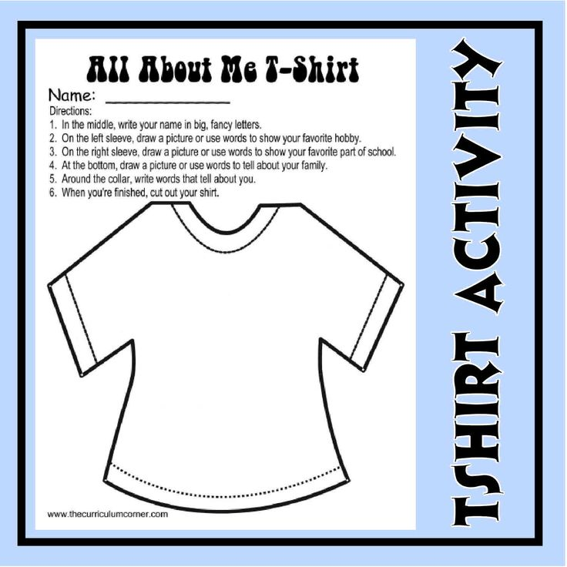

Slide 9
Getting to Know You Bingo
Select 3 M&M’s
-State your name and for each color M&M:
*orange- tell your favorite movie
*blue-something you did this summer
*green-where you were born
*yellow-Your “dream” vehicle”
*red-something about your favorite family tradition
*brown-favorite pastime or hobby

Slide 10
Other items to include:
“Meet the Teacher”
Multiple Intelligences Inventory

Slide 11
Students will use chromebooks and Google Slides:
create a 6 slide presentation about themselves
minimum of 1 graphic/photo on each slide

Slide 12
At the end of class, have
students write:
What I liked about today
What I learned today
What could have been better about today

Slide 13
Why is a syllabus important?

Slide 14
A well-designed syllabus is an essential tool for effectively managing a course. It gives students a clear understanding of your expectations and a road map for how the course will be conducted. When done right, a syllabus can prevent a lot of misunderstandings as the semester progresses.

Slide 15
What should be included in a syllabus?

Slide 16
Course Description
Course Content and Objectives or Goals
Grading Policy
Classroom expectations, behavior expectations, and procedures
Consequences for not meeting behavior expectations
Classroom routine (when can they work on the computer, sharpen pencil, etc.)
Leaving the classroom (when to ask, how many times, etc.)
Supplies needed (Paper and pencil each day)
Attendance and make-up work expectations
Textbook used and care policy
Cheating and plagiarism policy (If this is not stated in school hand book)
Your expectations and maybe even extra points for parents attending conferences
FCCLA and how it fits into your program
Any other item you feel necessary to inform students and parents of the expectations of your classroom

Slide 17
Recommend that the student and the parent sign the classroom syllabus.
Either the teacher holds the signed form or students keep in the classroom folder kept in the classroom.

Slide 18
Have a theme for your classroom
Turn to the partner on your right and share your theme for your classroom

Slide 19
Use a PowerPoint & students fill in the blanks
Use a doodle sheet to take notes

Slide 20
Technology Tips for the Classroom from OSU
ctyou.org
FCS
Miscellaneous Information and
Resources
Technology Resources

Slide 21
Substitute Teacher
Choices magazine

Slide 22
“I’ve come to a frightening conclusion that I am the decisive element in the classroom. It’s my personal approach that creates the climate. It’s my daily mood that makes the weather. As a teacher, I possess a tremendous power to make a child’s life miserable or joyous. I can be a tool of torture or an instrument of inspiration. I can humiliate or heal. In all situations, it is my response that decides whether a crisis will be escalated or de-escalated and a child humanized or dehumanized.” ― Haim Ginott

Slide 23
You
set the tone for your classroom!

Slide 24
Have the best year teaching FCS!

Slide 25
If you have questions regarding the Program of Study and/or curriculum:
maryjane.grayson@careertech.ok.gov
405.743.5469 (office)
405.614.2243 (cell)
Or contact your program specialist

