Slide 1
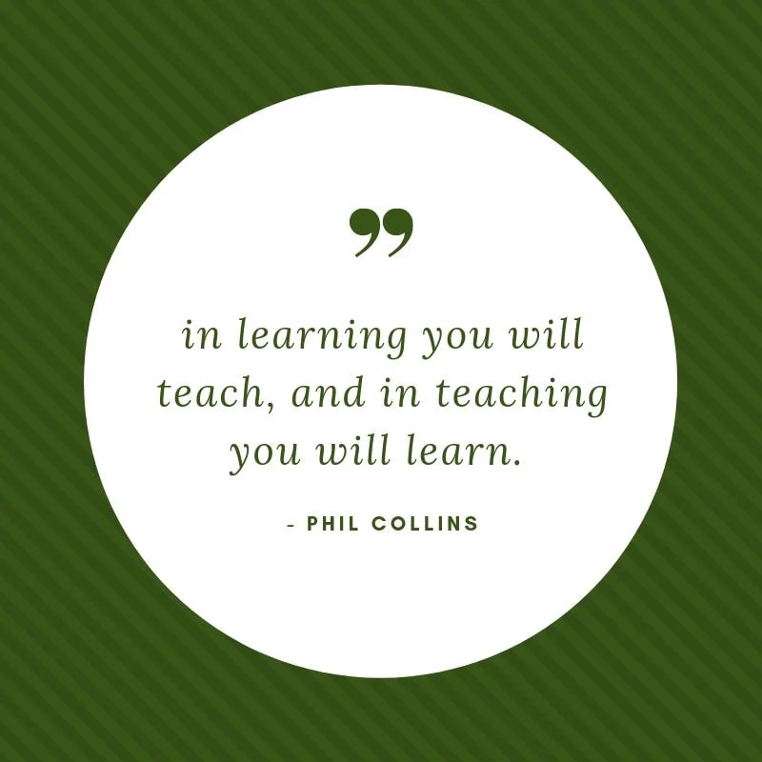
Welcome to FCS!
New Teacher Academy
2023

Slide 2
A - I have a FCS or Home Economics
degree
B - I am alternatively certified in FCS
C - I am working towards certification in
FCS

Slide 3
I have taught for ____years

Slide 4
Other subjects I have taught:

Slide 5
What do I teach?
FCS
FACS
FCCLA is the student organization for FCS
= FCCLA Adviser

Slide 6

Why did I choose or agree to be the FCS teacher?

Slide 7

Road
Map

Slide 8
Programs of Study
.....A ROADMAP of FCS Courses

Slide 9

16 Career Clusters (National Career Clusters Framework) represents 79 career pathways
https://www.indeed.com/career-advice/finding-a-job/what-are-the-career-clusters
https://careertech.org/career-clusters
https://www.onetonline.org/find/ (Good resource for researching careers)

Slide 10
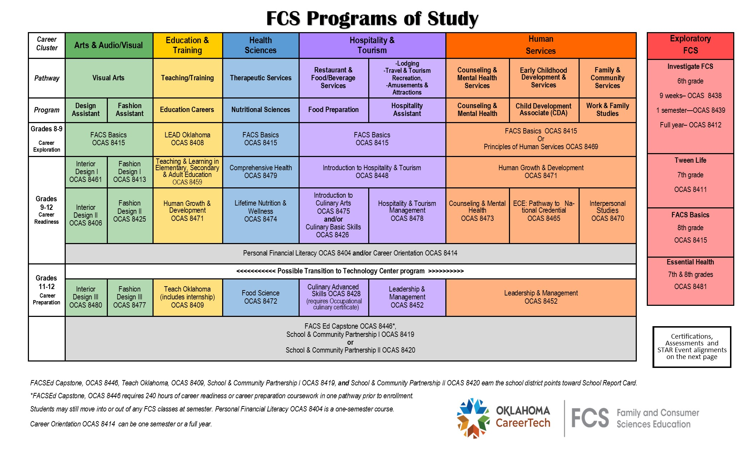

Slide 11
Questions to use to engage participants:
What is the first thing that you notice about the chart?
What do you notice about FACS Basics?
3. What does Interior Design and Fashion Design I, II and III indicate to you?
4. LEAD Oklahoma and Teach Oklahoma, do you think that there might be
similarities of those 2 courses?
5. What topics might Human Growth & Development include?
6. What might be the similarities between Comprehensive Health and Essential
Health?
Note: sexual health component; do not teach sex education in the state of OK
we teach good decision making skills, physical development and healthy
choices

Slide 12
What do you think students might do in Lifetime Nutrition & Wellness and Food Science courses?
What might the course Hospitality & Tourism involve?
What course in the Human Services pathway gives the opportunity for a student to receive a certification that allows them to work immediately following high school if criteria is met?
10. Explain how relevant that Counseling & Mental Health and Interpersonal
Studies are to students today?
What would a School and Community Partnership course include?

Slide 13
These are the only courses that a CareerTech FCS teacher in the state of Oklahoma can teach
Use these titles for enrollment and reporting purposes due to the current transcripts

Slide 14
Each FCS Teacher = 1 FCS Program
A school with 1 Program will rotate courses within 2-3 pathways (colors) over a 2-3 year period
Multi teacher programs will need to coordinate rotation of courses

Slide 15
OCAS Codes
Please help your counselor/administration to report correct OCAS codes to SDE
www.okcareertech.org
Educators
        OCAS Codes

Slide 16
Only courses reported with the 8000 level OCAS codes give your students as well as the school CareerTech credit

Slide 17
Course Catalog
.....ROADMAP of Course Descriptions

Slide 18

FCS Course Catalog
  Description of course
  Grade levels
  Course length
  Curriculum/textbook recommendations
Which 2 courses are the exception of year-long?

Slide 19
All things Oklahoma FCS
ctyou.org

Slide 20
FCS Course Catalog
  Can be found on https://ctyou.org
  FCS
    FCS Courses and Resources
      FCS Course Catalog and Programs of Study

Slide 21
How do I know which courses to teach?
FCS Program of study
Have courses been set for fall enrollment?
What career plans are in place within your school? What jobs are available in the community?
What courses have been taught in the past?
Speak with your administration
Talk with program specialist

Slide 22

End of Instruction Tests:
FACS Basics
Personal Financial Literacy
Introduction to Hospitality
and Tourism

Slide 23
Using the white paddle boards, please answer the following questions:
Have you been in your FCS classroom?
  Do you know what you will be teaching?
Do you know what curriculum is in your classroom?

Slide 24
Curriculum
.....ROADMAP of lesson planning

Slide 25
What you might find in your classroom!
Surviving and Thriving (Interpersonal Relationships)
Personal Financial Literacy (Dave Ramsey, CIMC)
Touring Oklahoma (Introduction to Hospitality and Tourism)
Parenting and Child Development (Human Growth & Development)
Marriage and Family Life (Interpersonal Relationships)
Tween Life (6th and 7th grade curriculum)
OLD…..FACS I and II (Throw out!)

Slide 26
CCFCS - Curriculum Center for Family and Consumer
Sciences (sponsored by B-Sew Inn)
Goodheart-Willcox - https://www.g-w.com/
CEV
Everfi
CIMC – CareerTech website
Curriculum Contacts handout in notebook

Slide 27
How do I use the curriculum?
Organize it!
Supplement it!
Localize it!
Personalize it!

Slide 28
Supplement it!
  Videos
  Websites
  Assignment sheets
  Unit projects
  Teaching Strategies

Slide 29
Localize it!
Relate topic to your community
Use persons within your community as
guest speakers
Help students to connect local jobs or
careers with current subject area
Relate to current events - newspapers, Internet, TV

Slide 30
Personalize it!
“Hook and hold”
(Integration of Learning Styles and Multiple Intelligences)
Tell a story
Share an appropriate incident from your life

Slide 31
Discovery!
Encourage students to discover or seek the answers on their own
Offer assignment choices

Slide 32
If you have questions regarding the Program of Study and/or curriculum:
maryjane.grayson@careertech.ok.gov
405.743.5469 (office)
405.614.2243 (cell)
Or contact your program specialist

Slide 33


Slide 35

New Teacher Academy 2023
Pacing Guides & Yearlong Planning

Slide 36
Pacing Guides and Standards
.....A ROADMAP

Slide 37
NASAFACS national standards
are used by OK FCS

Slide 38
Pacing Guides:
recommended amounts of time to spend on an area of study to assist in staying on track to ensure that all topics are covered within the allotted time (year long courses)

Slide 39
All units within a course must be taught
It is not a pick and choose according to what the teacher likes

Slide 40
ctyou.org
FCS
FCS Courses and Resources
FCS Pacing Guides and Standards
~Select the appropriate course title
(currently listed in alphabetical order)

Slide 41
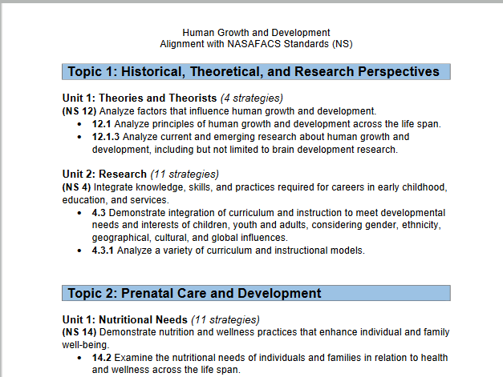

Slide 42
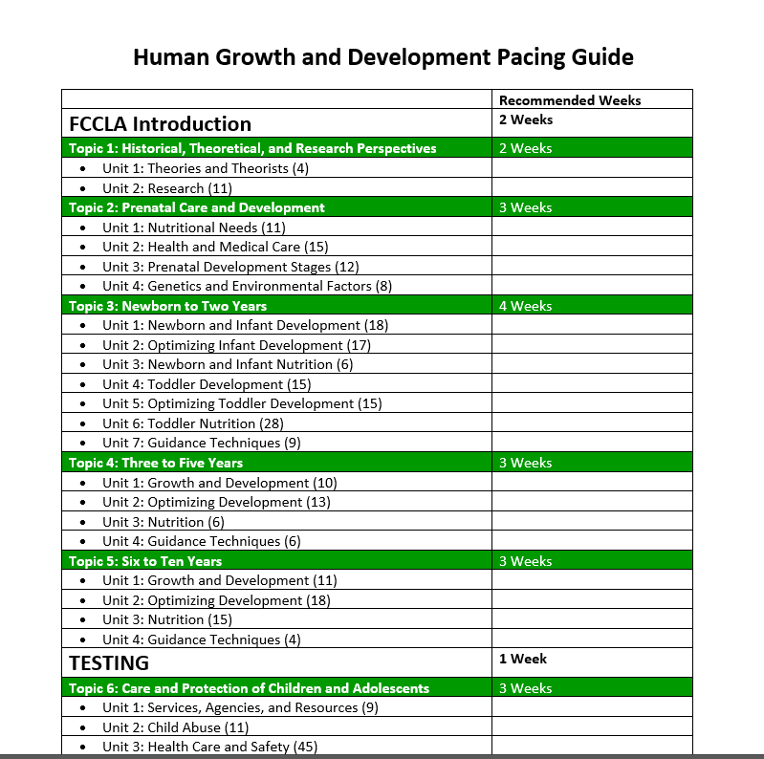

Slide 43

Yearlong Planning

Slide 44
Why plan???

Slide 45
P
P
P
P
P
rior
lanning
PPPPP
revents
oor
erformance

Slide 46
Most effective classroom management tool =
Be Prepared
By using engaging, hands-on activities, strategies and projects
The result of yearlong, unit and daily lesson planning

Slide 47
Standard 2 (of program standards/evaluation)
Instruction and Training
Course Syllabi
Integration of Core Academic Subjects
Year-Long Lesson Plans

Slide 48

Where do I begin with curriculum planning?

Slide 49
YEAR LONG PLANNING
Create a plan for the entire course
Year long
Semester (only CO, PFL or school decision)
Use Pacing Guides to determine how long to teach a unit
Plan foods units, sewing units, etc. at the same time if teaching same subject areas for more than one class

Slide 50
Suggestions for planning:
Use your school calendar and block out days that you are not in school with an X
Put in test dates (i.e. 2 days for 9 weeks; 4 for 9 weeks and semester)
Then select order of units to teach

Slide 51
What unit should I start the year with?
Are some subjects best taught at certain times of the year?
Are there any school expectations for functions?

Slide 52
Individually
Use the August – May calendar
Use the sticky notes to write the unit titles
decide which units should be taught within each month of the year and place under that month
use the FACS Basics Pacing Guide units or course of your choice
be sure to include ALL units

Slide 53
Homework Assignment:
Using information for the curriculum: FACS Basics (or a course of your choice-
use correct pacing guide)
Complete a School Year Instructional Plan of your choice
Map out which courses you will teach when and for how long

Slide 54
Suggestions for planning:
Use your school calendar and block out days that you are not in school with an X
Put in test dates (i.e. 2 days for 9 weeks; 4 for 9 weeks and semester)
Then select order of units to teach

Slide 55
School Year Instructional Plans
Class Title | August |  |  |  | September |  |  |  | October |  |  |  | November |  |  |  | December
Class Title | January |  |  |  | February |  |  |  | March |  |  |  | April |  |  |  | May

Slide 56
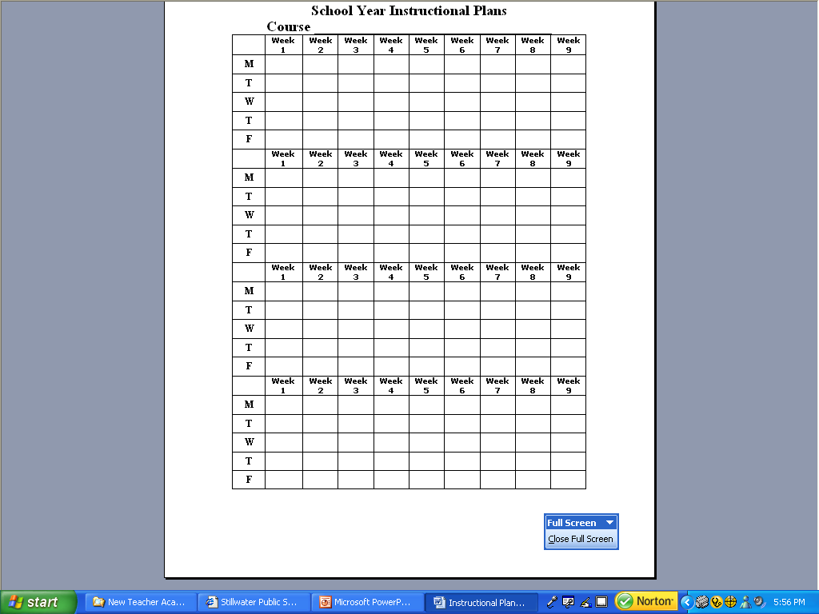

Slide 57
Link to an editable school calendar:
https://www.calendarlabs.com/school-calendar/
Planbook.com

Slide 58
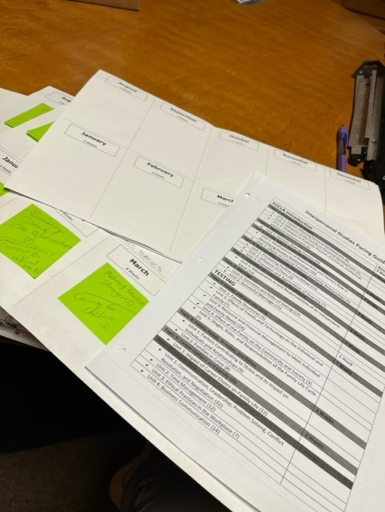
“The MOST helpful thing @ new teacher for me! I’m planning out my two new courses.”

Slide 59
Curriculum & Pacing Guides
Using only 1-2 words, write
  what seems most important
regarding curriculum
or
  what you will remember most about
curriculum?

Slide 60

The mediocre teacher tells.
The good teacher explains. The superior teacher demonstrates.
The great teacher inspires. -William Ward

Slide 61
Which teacher do you want to be for 2023-24?

Slide 62
“I’ve come to a frightening conclusion that I am the decisive element in the classroom. It’s my personal approach that creates the climate. It’s my daily mood that makes the weather. As a teacher, I possess a tremendous power to make a child’s life miserable or joyous. I can be a tool of torture or an instrument of inspiration. I can humiliate or heal. In all situations, it is my response that decides whether a crisis will be escalated or de-escalated and a child humanized or dehumanized.” ― Haim Ginott

Slide 63
You
set the tone for your classroom!

