Slide 1
Integrating FCCLA into the FCS Classroom
New Teacher Academy 2023

Slide 2
Hi!
I'M JESSI, 4TH YR FCS TEACHER & FCCLA ADVISER, AND I'LL BE SHARING WITH YOU IDEAS ON BRINGING FCCLA INTO THE FCS CLASSROOM. I’M NO EXPERT, BUT I’M EAGER TO SHARE WHAT HELPED ME IN MY FIRST YEARS!
JESSICA.BEEBE@OKSTATE.EDU
580-542-2996
ENID, OK
PLEASE DON’T HESITATE TO REACH OUT IF YOU NEED ANYTHING!

Slide 3
SESSION AGENDA:
FIRST WEEKS OF SCHOOL
ACCESS TO EXISTING LESSON PLANS
UTILIZING STAR EVENTS
SERVICE LEARNING OPPORTUNITIES
SELL THE “WHY”

Slide 4
FIRST THINGS FIRST:
FCCLA Membership - 3 R’s
RECRUIT
RETAIN
RECOGNIZE
Host Events, Create Membership Posters, Invite Members to speak to classes, create an FCCLA booth at an event, etc.
Create a fun and engaging environment for your student leaders: i.e. give them reasons to want to belong to this incREDible student leadership organization.
Prepare ways for your students to be rewarded for their unique contributions to their FCCLA chapter at various levels!
UTILIZE THIS MODEL IN YOUR CLASSROOM AS WELL!

Slide 5
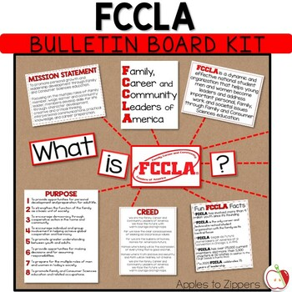
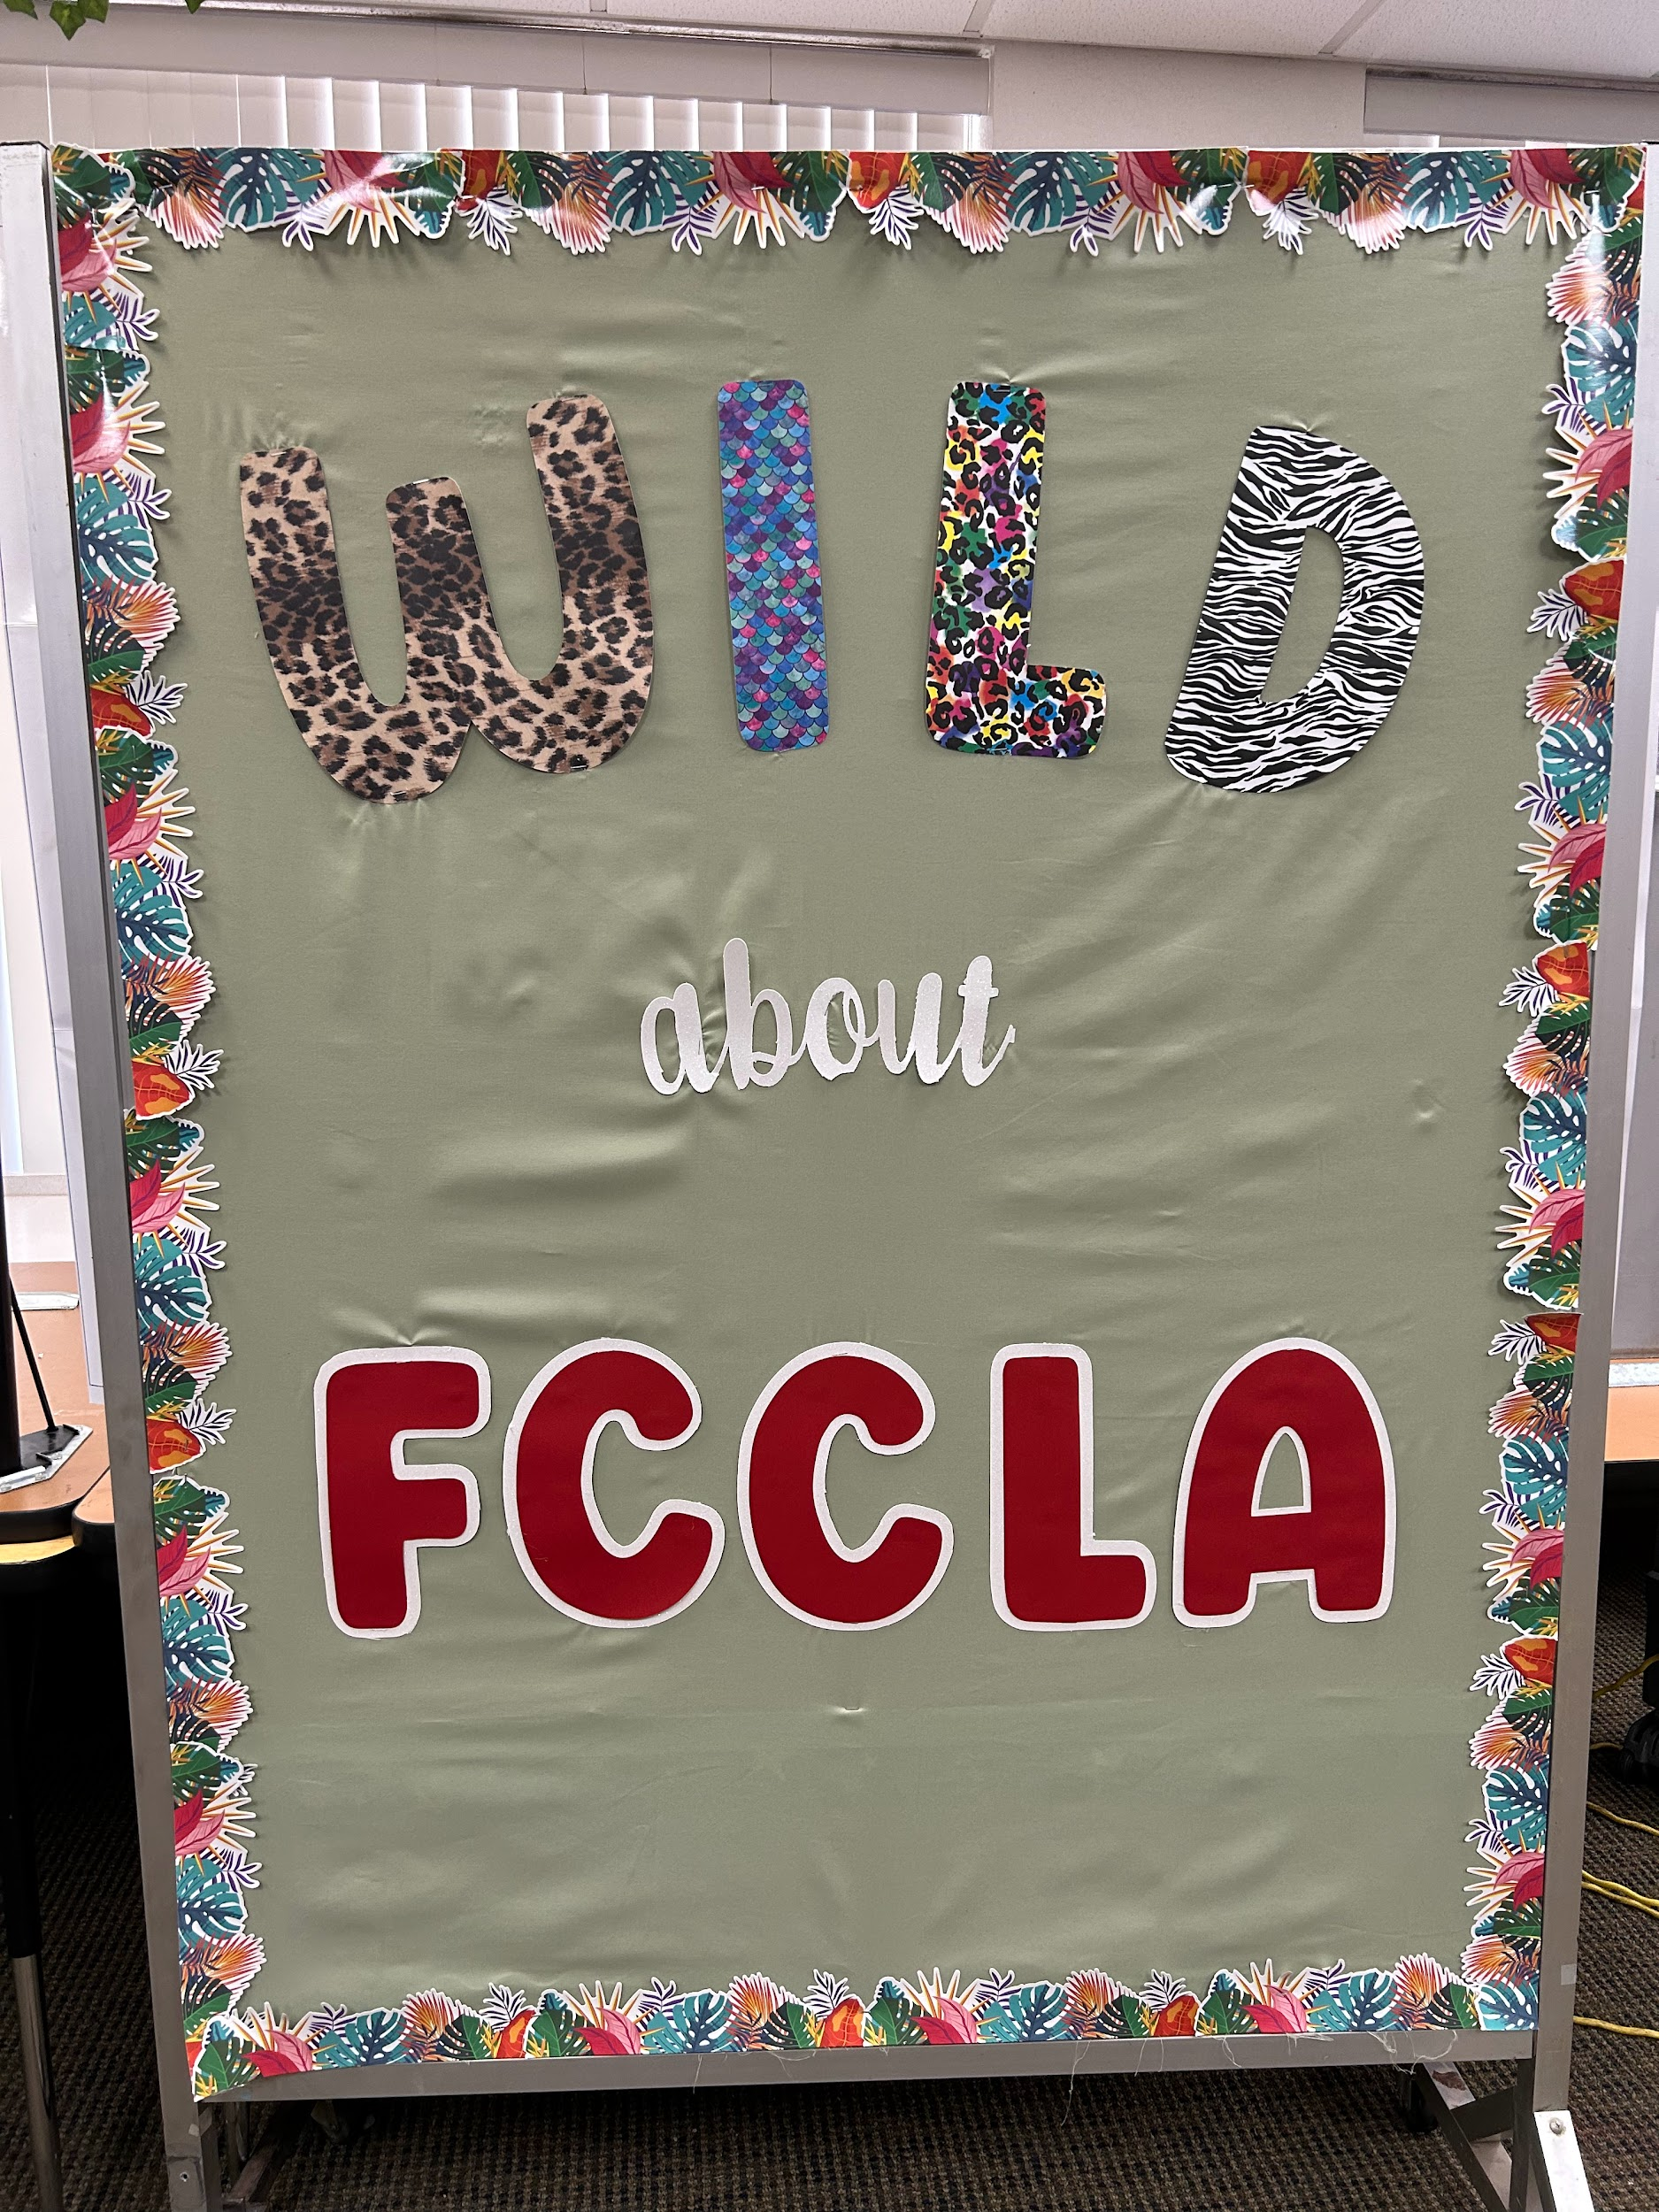
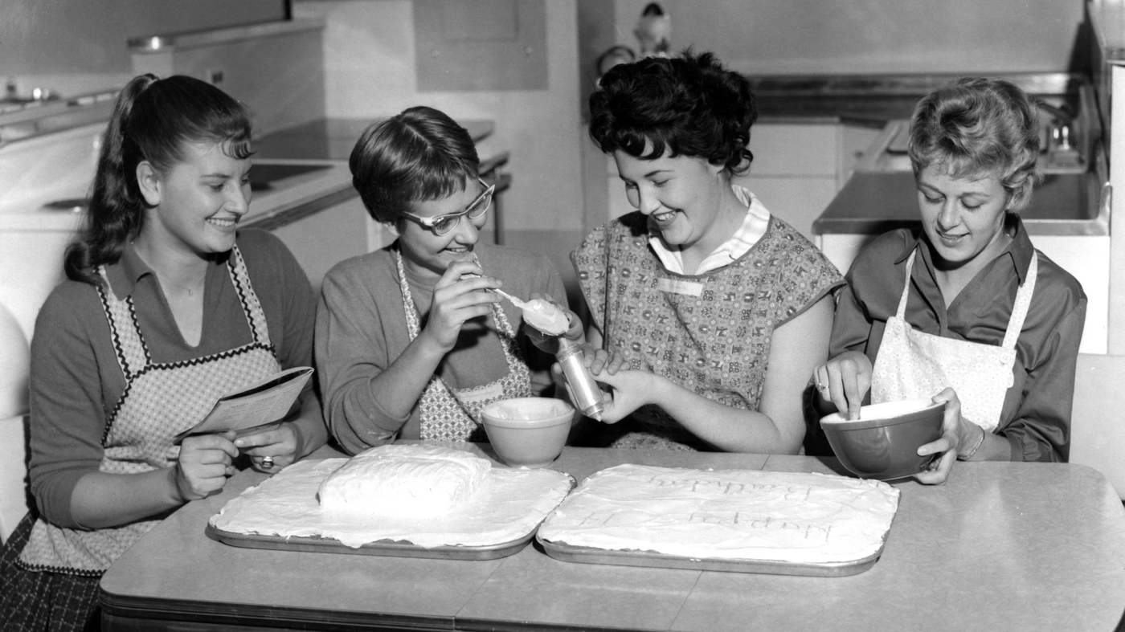
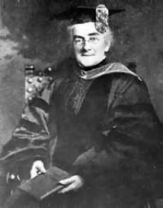
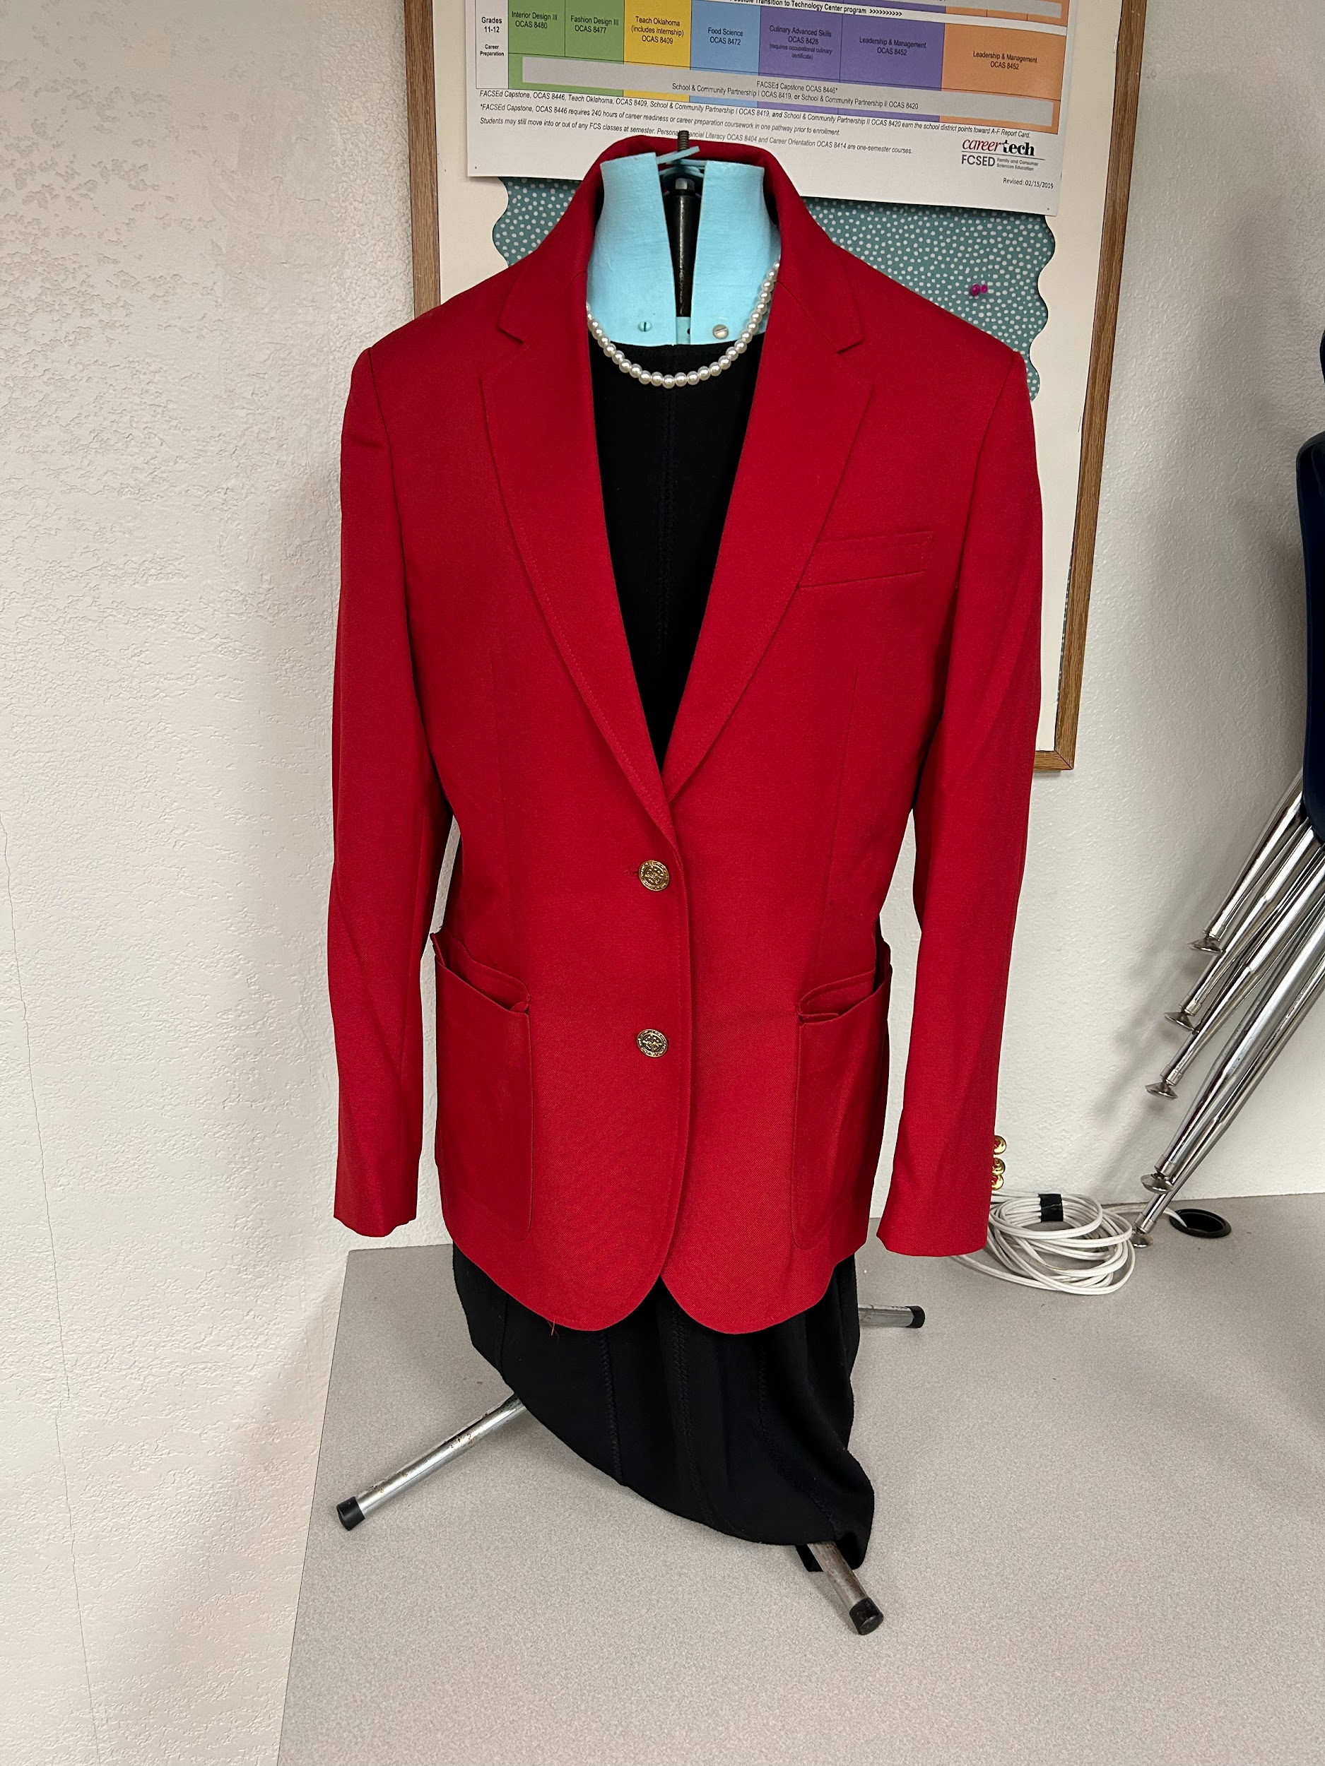
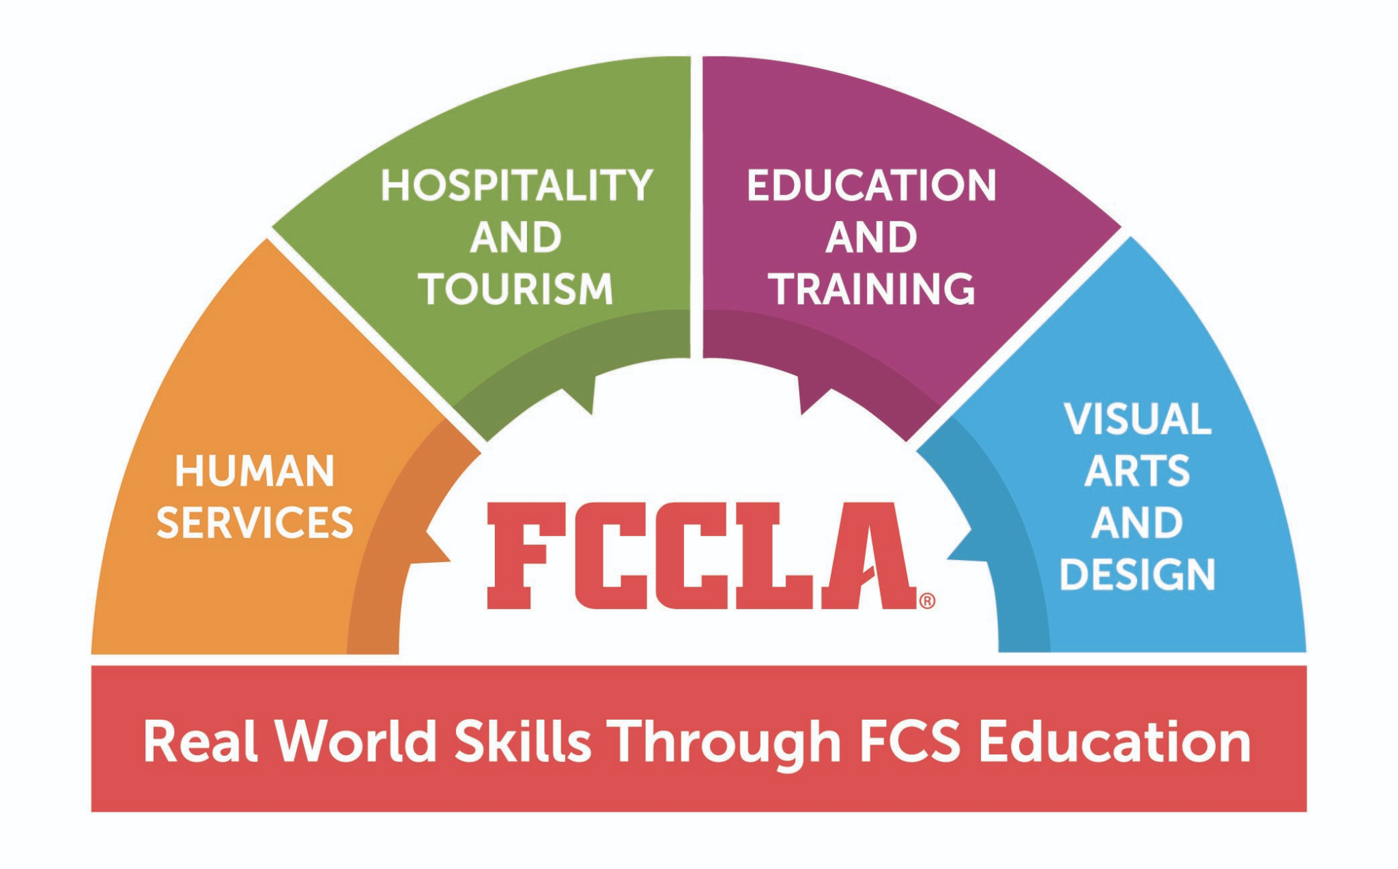
First Weeks of School:
RECRUIT
Physical Classroom: bulletin boards, posters, photos, display official dress, post travel opportunities, & A CHAPTER DATE SHEET/CALENDAR
Events/Activities: Host an informal recruitment event: TACO Bout FCCLA
FCS Classes & Curriculum:
History of FCCLA
FCCLA Creed
Competitive Events
Travel Opportunities
How to Become a Member
Ellen Swallow Richards; founder of Home Economics Movement

Slide 6
Taco ‘bout FCCLA
OBJECTIVE: TEACH VARIOUS COMPONENTS OF FCCLA AS YOU BUILD A TACO.
MATERIALS NEEDED: SMALL PAPER PLATES, CONSTRUCTION PAPER (BROWN, ORANGE, GREEN, RED, WHITE, ETC.) GLUE STICKS.
INSTRUCTIONS: GUIDE STUDENT LEADERS THROUGH THE VARIOUS COMPONENTS OF FCCLA AS THEY BUILD THEIR VERY OWN FCCLA TACO; STARTING WITH THE SHELL “FCCLA”, STUDENTS WILL ADD THE MEAT OF A CHAPTER (THE MEMBERS), THEN BEGIN TO DISCUSS OTHER COMPONENTS THAT MAKE UP FCCLA.
AFTER EACH STUDENT HAS SUCCESSFULLY COMPLETED THE FCCLA ACTIVITY THEY CAN ENJOY A TACO LUNCH/DINNER or WALKING TACOS.

Slide 7
Taco ‘bout FCCLA cont.
MEAT - What is the “meat” or heart of FCCLA?... OUR STUDENT LEADERS / MEMBERS!!!
TOMATOES - What do our Student Leaders get through FCCLA? (think about the mission)
LETTUCE - What are the opportunities for student leaders in FCCLA? (unique opportunities in FCCLA)
CHEESE - What are the skills gained from FCCLA participation?

Slide 8
In case we need it…
MISSION: Our Mission is to promote personal growth and leadership development through Family and Consumer Sciences education. Focusing on the multiple roles of family member, wage earner, and community leader, members develop skills for life through: character development, creative and critical thinking, interpersonal communication, practical knowledge, and career preparation

Slide 9
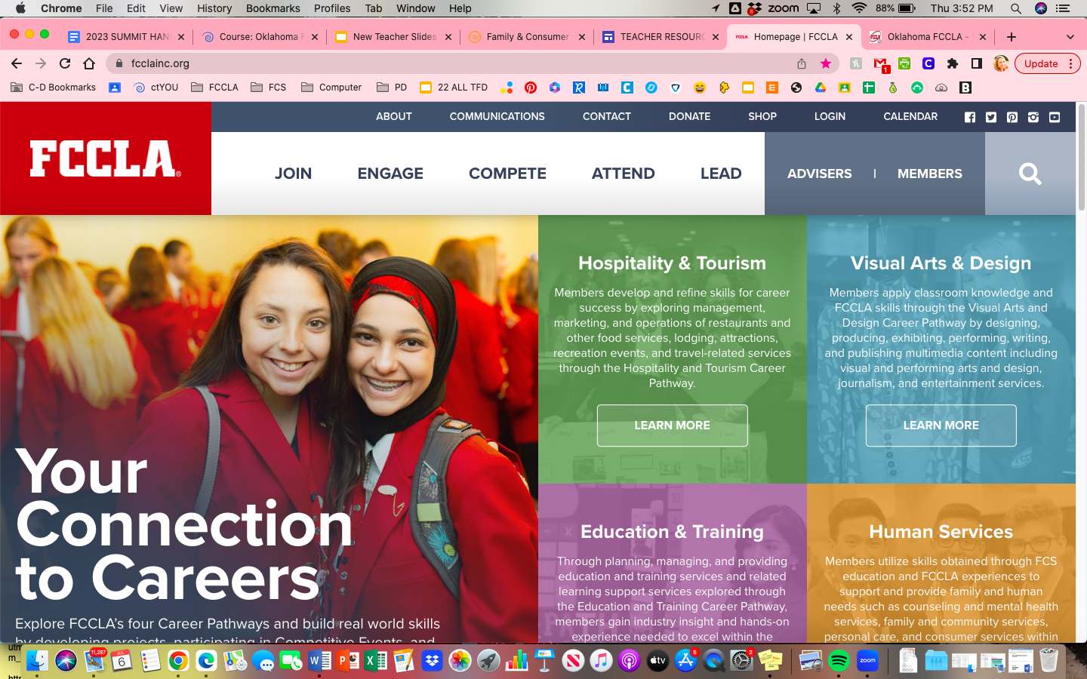
RECRUIT
EXISTING LESSON PLANS:
DON’T reinvent the wheel…
We’ve done the hard part for you!

Slide 10
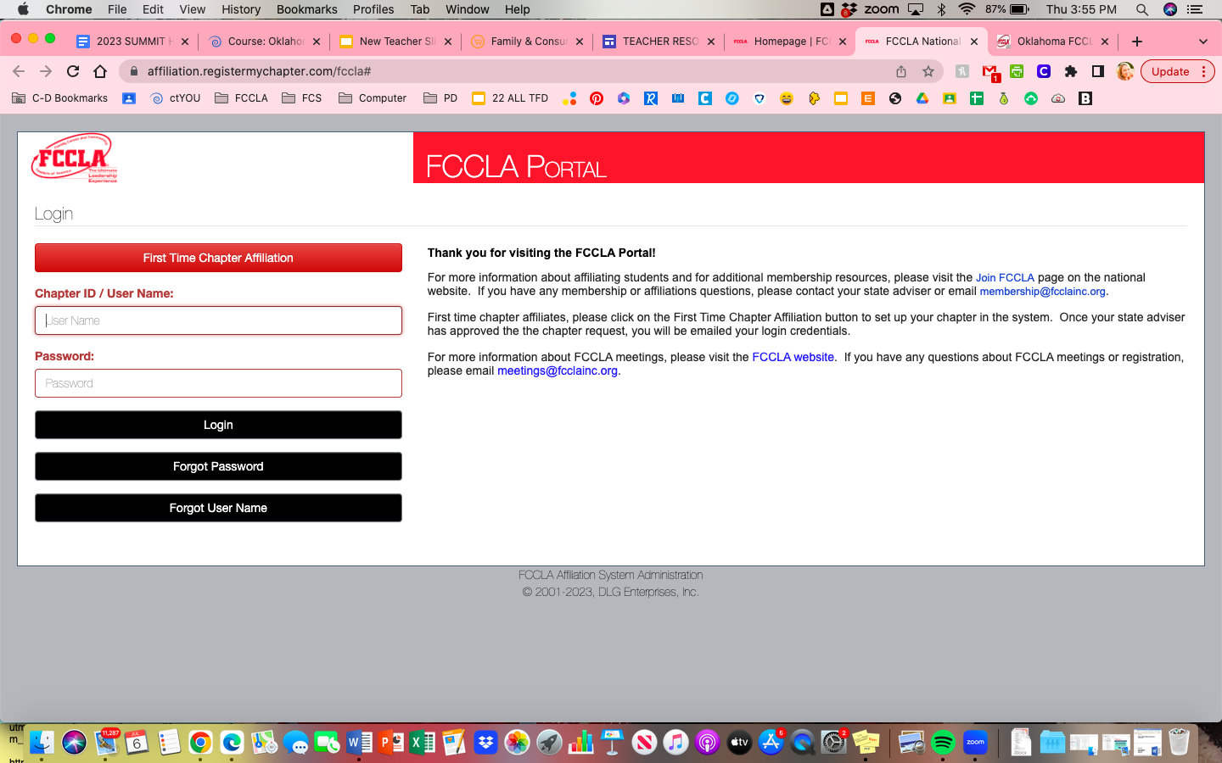
RECRUIT
FCCLA Portal
You will need the Chapter # and your Portal Password!

Slide 11
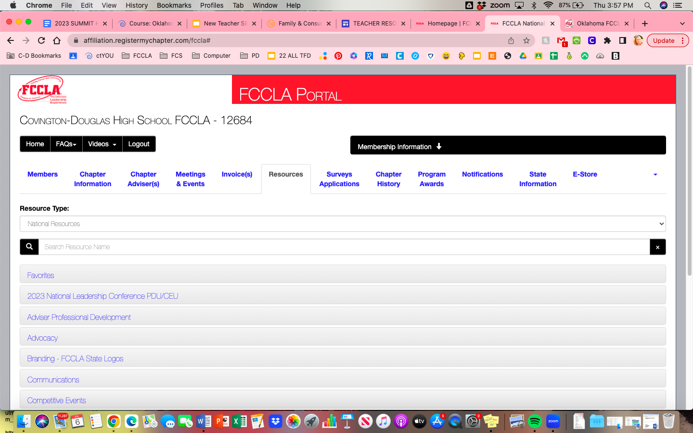
RECRUIT
FCCLA Portal
You will need the Chapter # and your Portal Password!

Slide 12
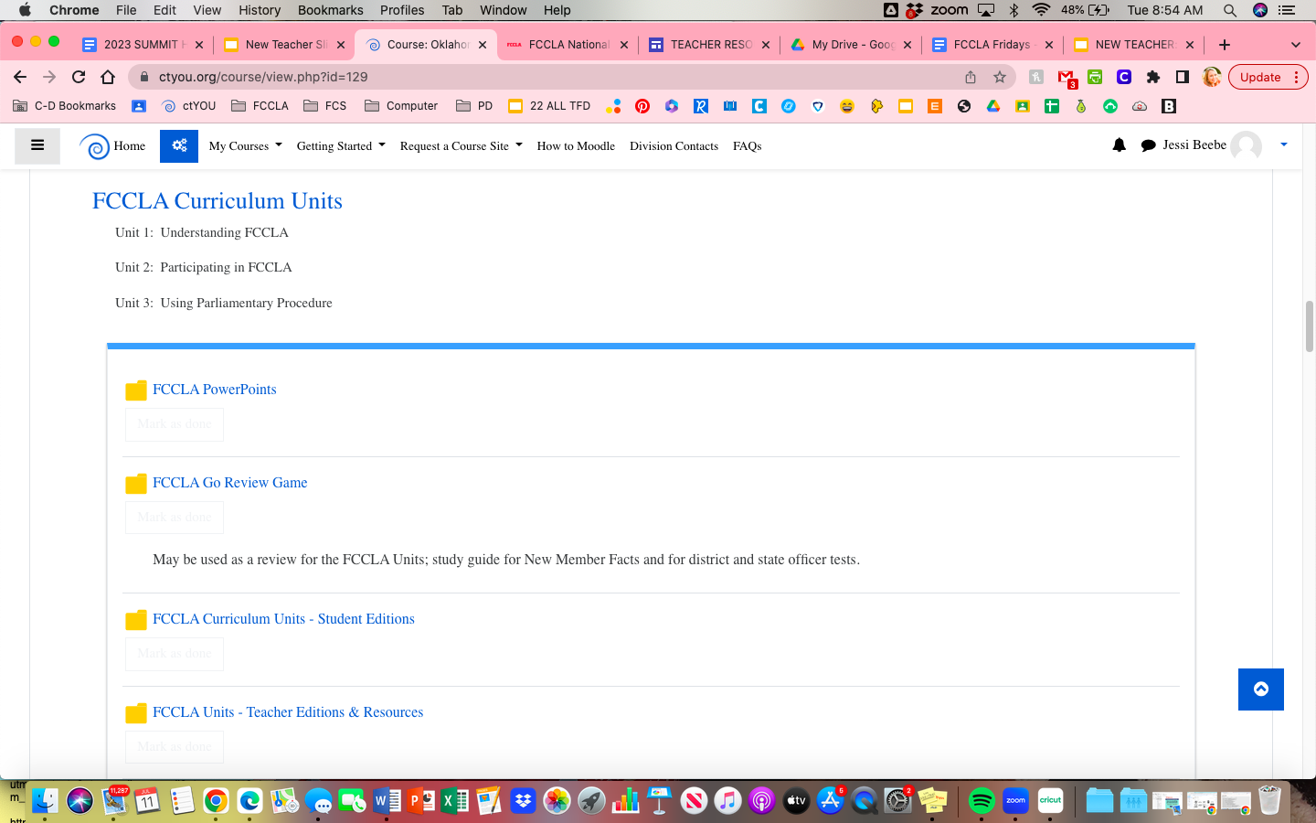
RECRUIT
OKFCCLA
You will need the ctYOU username and Password!

Slide 13
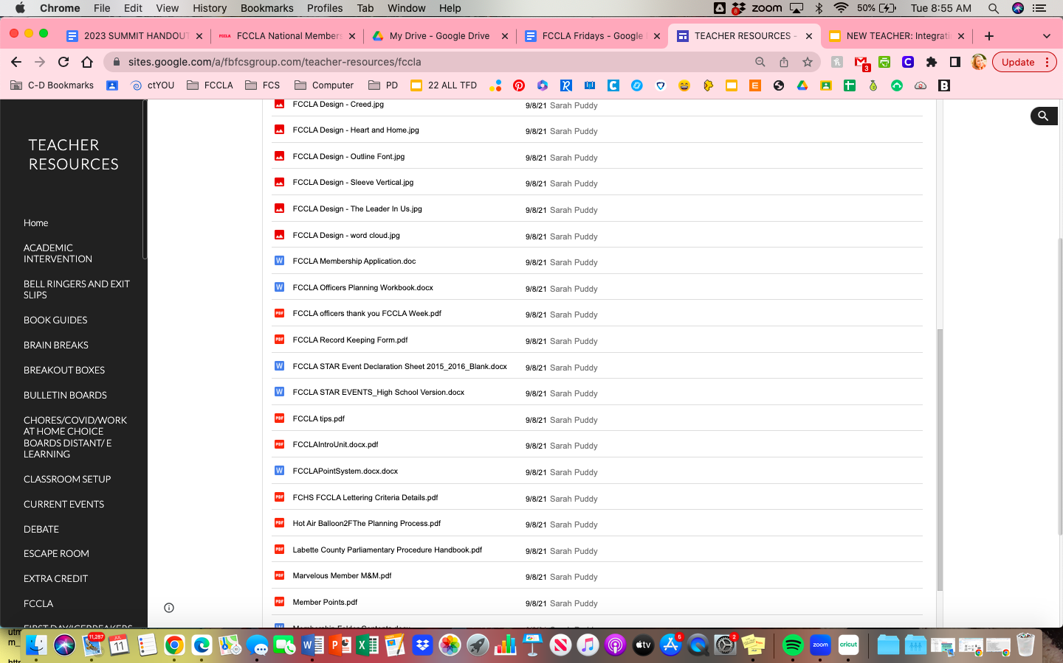
RECRUIT
The Gold Mine!
FCCLA/FCS Resources from Teachers all over. Things that work in classrooms.

Slide 14
RETAIN & RECOGNIZE
Utilize STAR Events in the Classroom!
Star Event Guides provide you with existing hands on & engaging classroom projects that you students could potentially compete with at various levels.
Disclaimer: This portion of the presentation was 100% STOLEN from a MVP at Latta High School, Kim Cupps; updated by me! :)

Slide 15
Integration of STAR Events into FCS Classes Model Explanation
FCS Pathway
FCS Course
FCCLA STAR Event

Slide 16
FCS Basics
Fashion Design
Repurpose/
Redesign
Career Investigation
Fashion/Interior Design I
Interior Design
Visual Arts & Design
Entrepreneurship
Fashion/Interior Design II
Fashion Construction
Promote & Publicize
Fashion/Interior Design III
Teach & Train
Professional Presentation

Slide 17
LEAD Oklahoma
Children’s Literature
Public Policy Advocate
Career Investigation
Teaching & Learning
Early Childhood
Education & Training
Say YES to FCS
Human Growth & Development
Job Interview
Focus on Children
Teach Oklahoma
Teach & Train
Interpersonal Communications

Slide 18
FCS Basics
Food Innovations
Entrepreneurship
Career Investigation
Comprehensive Health
Sports Nutrition
Health Sciences
Focus on Children
Lifetime Nutrition & Wellness
Public Policy Advocate
Nutrition & Wellness
Food Science
Teach & Train
Professional Presentation

Slide 19
FCS Basics
Cake Decorating
Event Management
Career Investigation
Intro to Hospitality & Tourism
Job Interview
Hospitality & Tourism
Entrepreneurship
Intro/Advanced Culinary
Culinary Arts
Sustainability Challenge
Hospitality & Tourism Mgmt - Leadership & Mgmt
Hospitality, Tourism, & Recreation
Professional Presentation

Slide 20
FCS Basics
Teach & Train
Children’s Literature
Career Investigation
Human Growth & Development
Interpersonal Communications
Human Services
Chapter Service Project
Interpersonal Studies
ECE: Pathway to Credentials
Counseling & Mental Health
Focus on Children/
Early Childhood
Public Policy Advocate
Leadership & Management
Leadership
Professional Presentation

Slide 21
Personal Financial Literacy
Career Investigation
Repurpose & Redesign
Career Investigation
Surviving & Thriving (Text)
Chapter Service Project
Older Courses
(General FCS)
Illustrated Talk (NFC)
School/Community Partnership
Chapter in Review
Leadership
FACS 1 & 2
(CIMC)
Parliamentary Procedure
Creed Speaking & Interpretation

Slide 22
Competitive Event Rubrics:
RETAIN & RECOGNIZE
Describe IN DETAIL what students need to do to be successful.
Events are scaffolded based on competitive level.
There is a lesson on reading rubrics on your FCCLA Portal.
Tips:
Note students interests to recruit for FCCLA competitions.
Black out everything but the high point column on students rubrics.
MAKE TIME for practicing speeches/presentations.
It’s okay to let them fail. Failure is a part of learning.
Celebrate successes, no matter how big/small.
Create FCS CLASSROOM Projects based on STAR Events.
A+ Projects can become 1st Place STAR Events

Slide 23
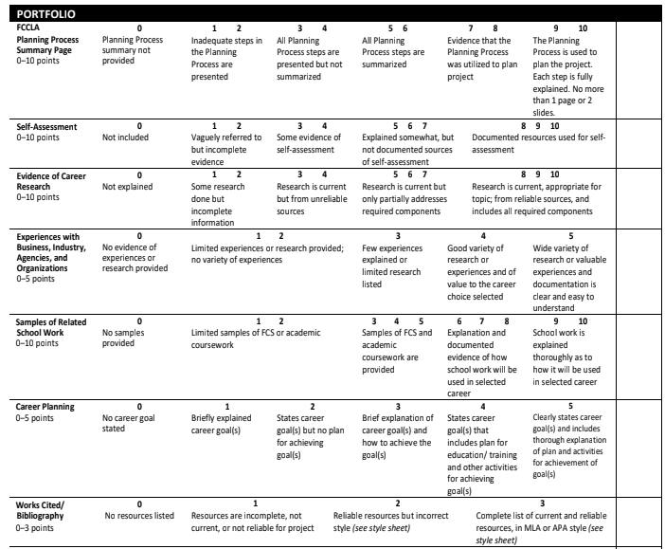
Career Investigation (Partial)
Before/After Rubric for Students
RETAIN & RECOGNIZE

Slide 24
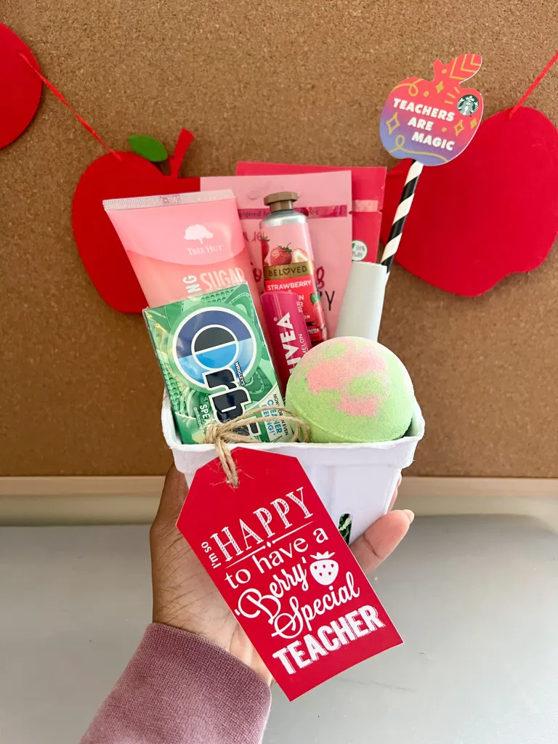
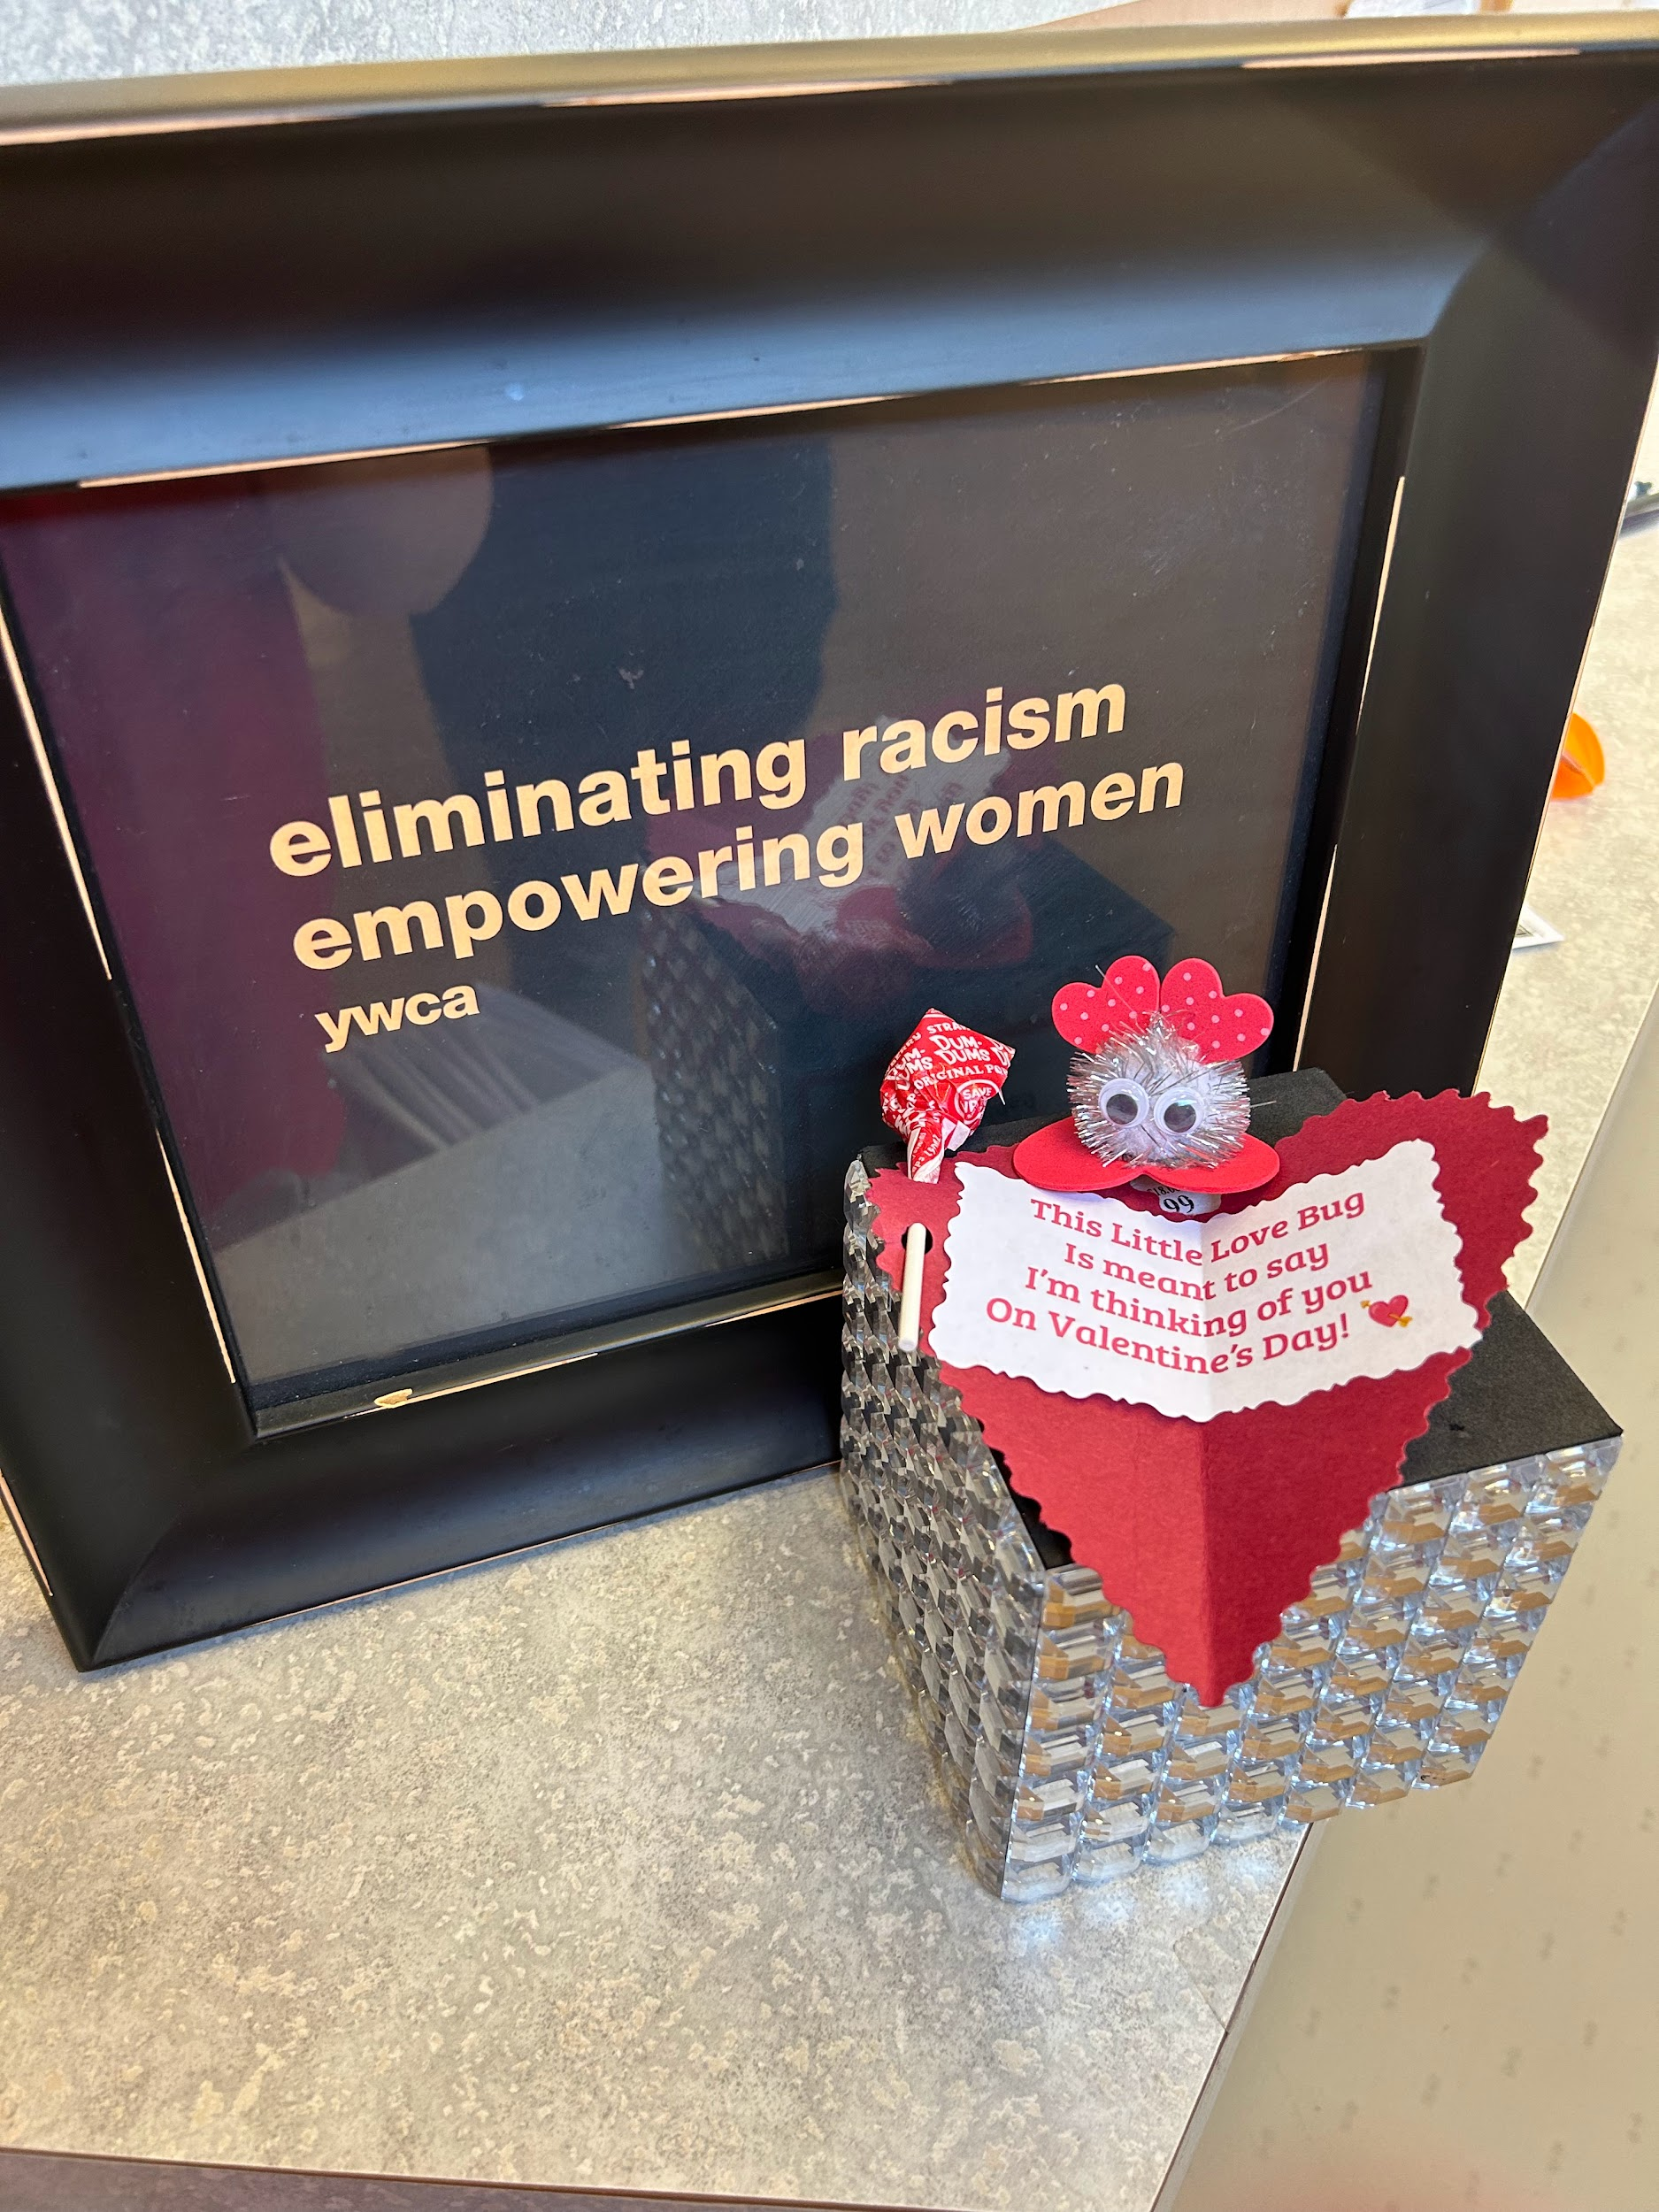
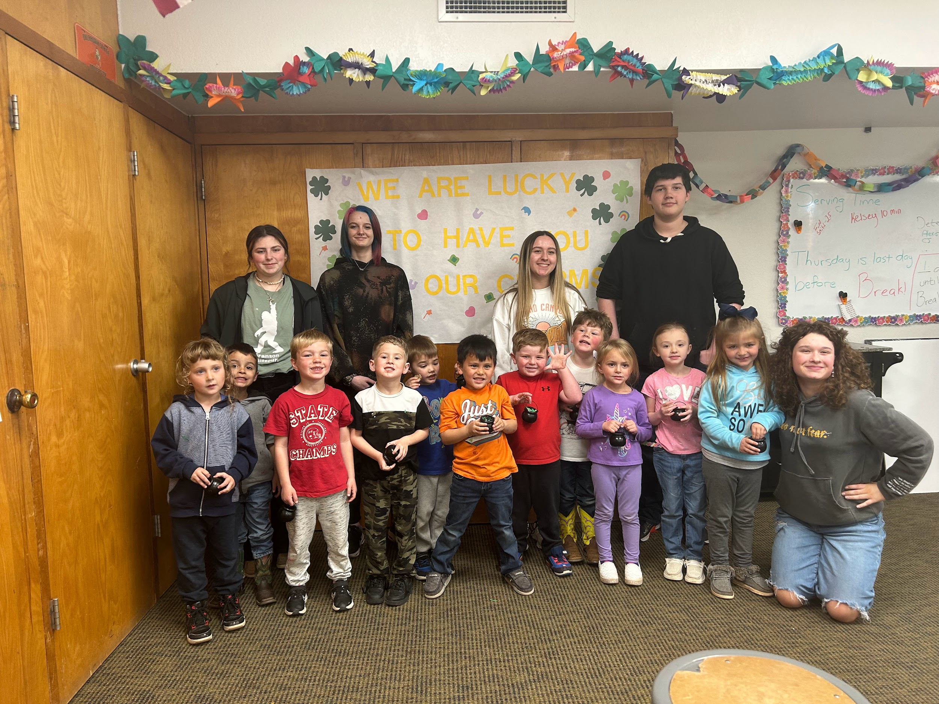
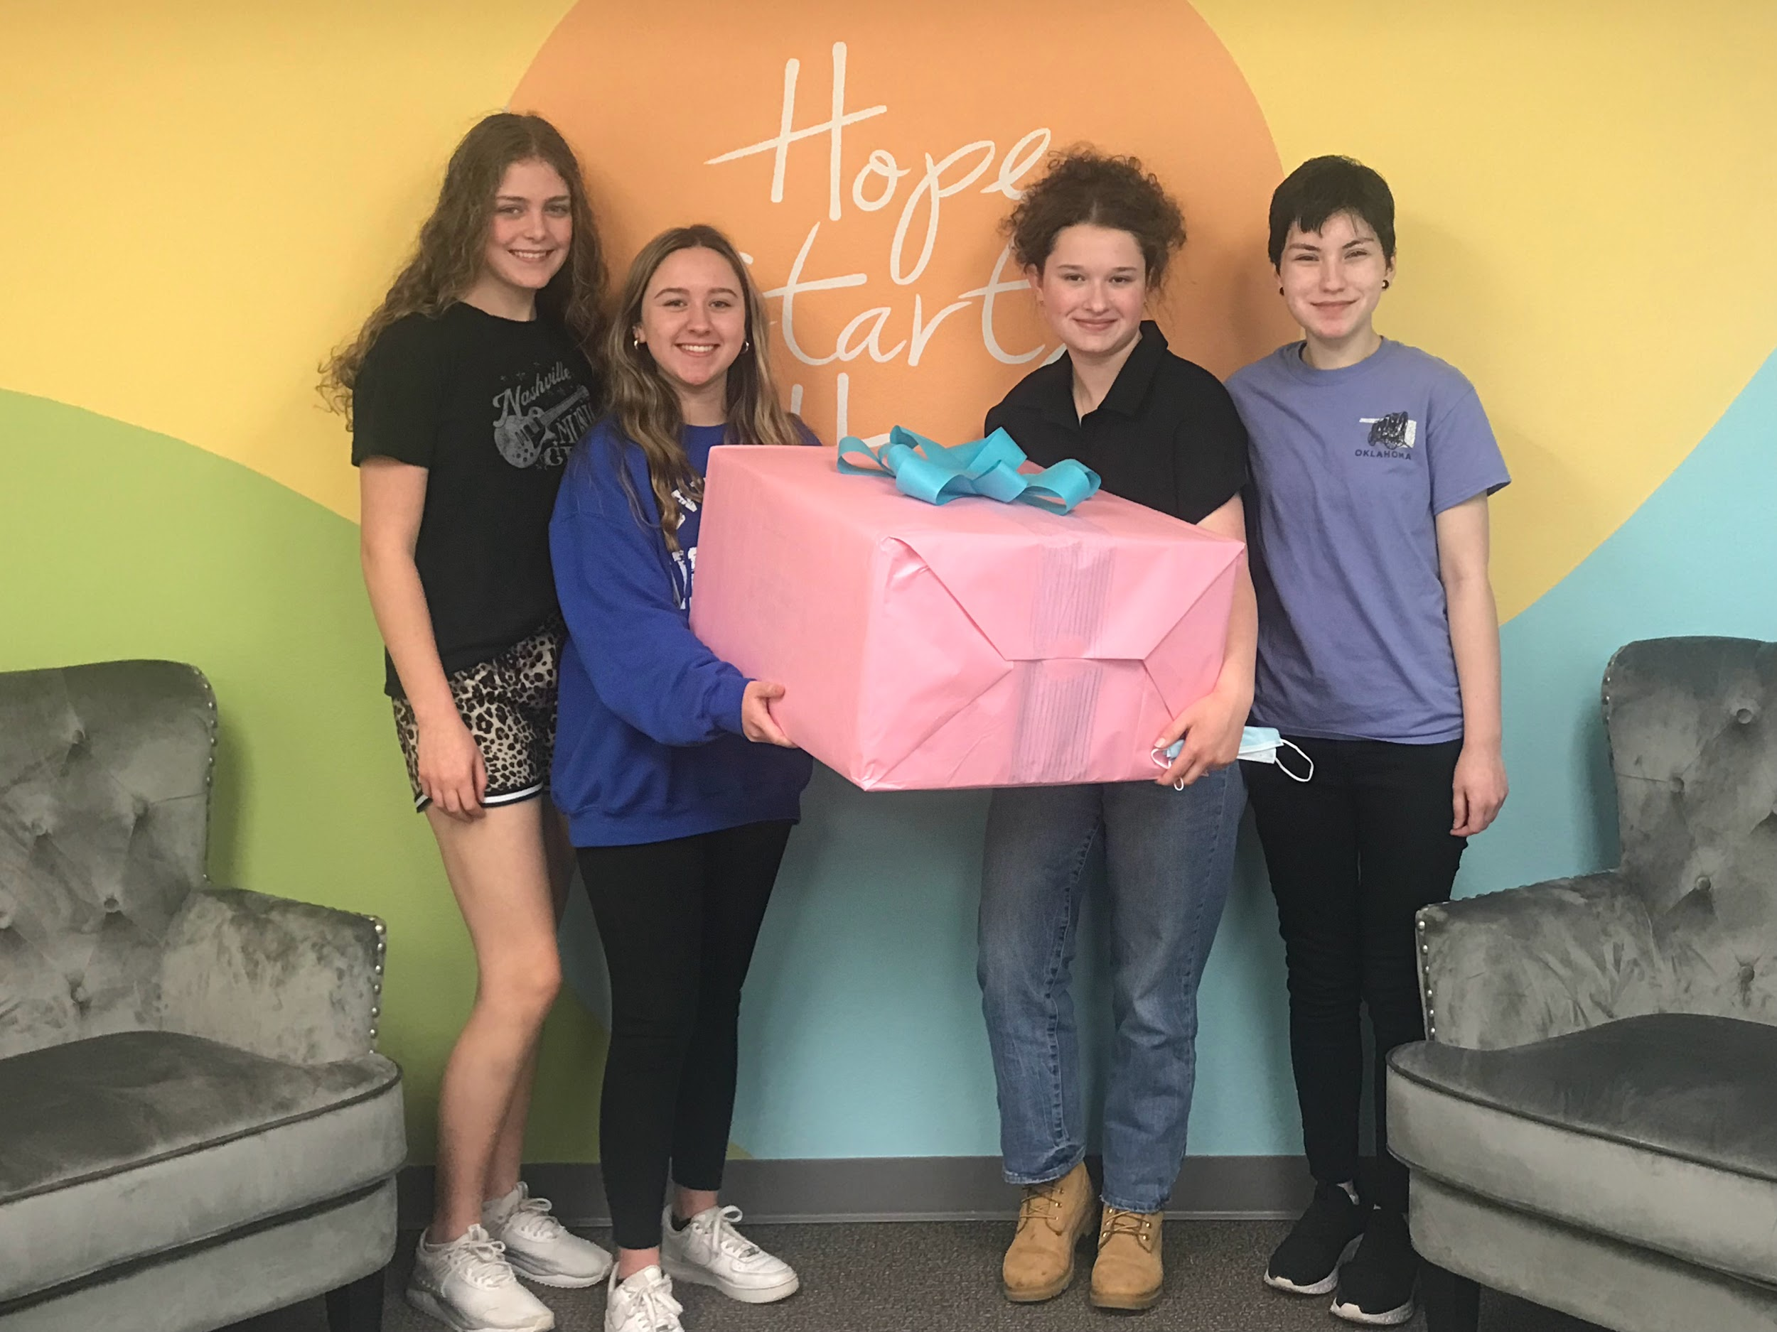
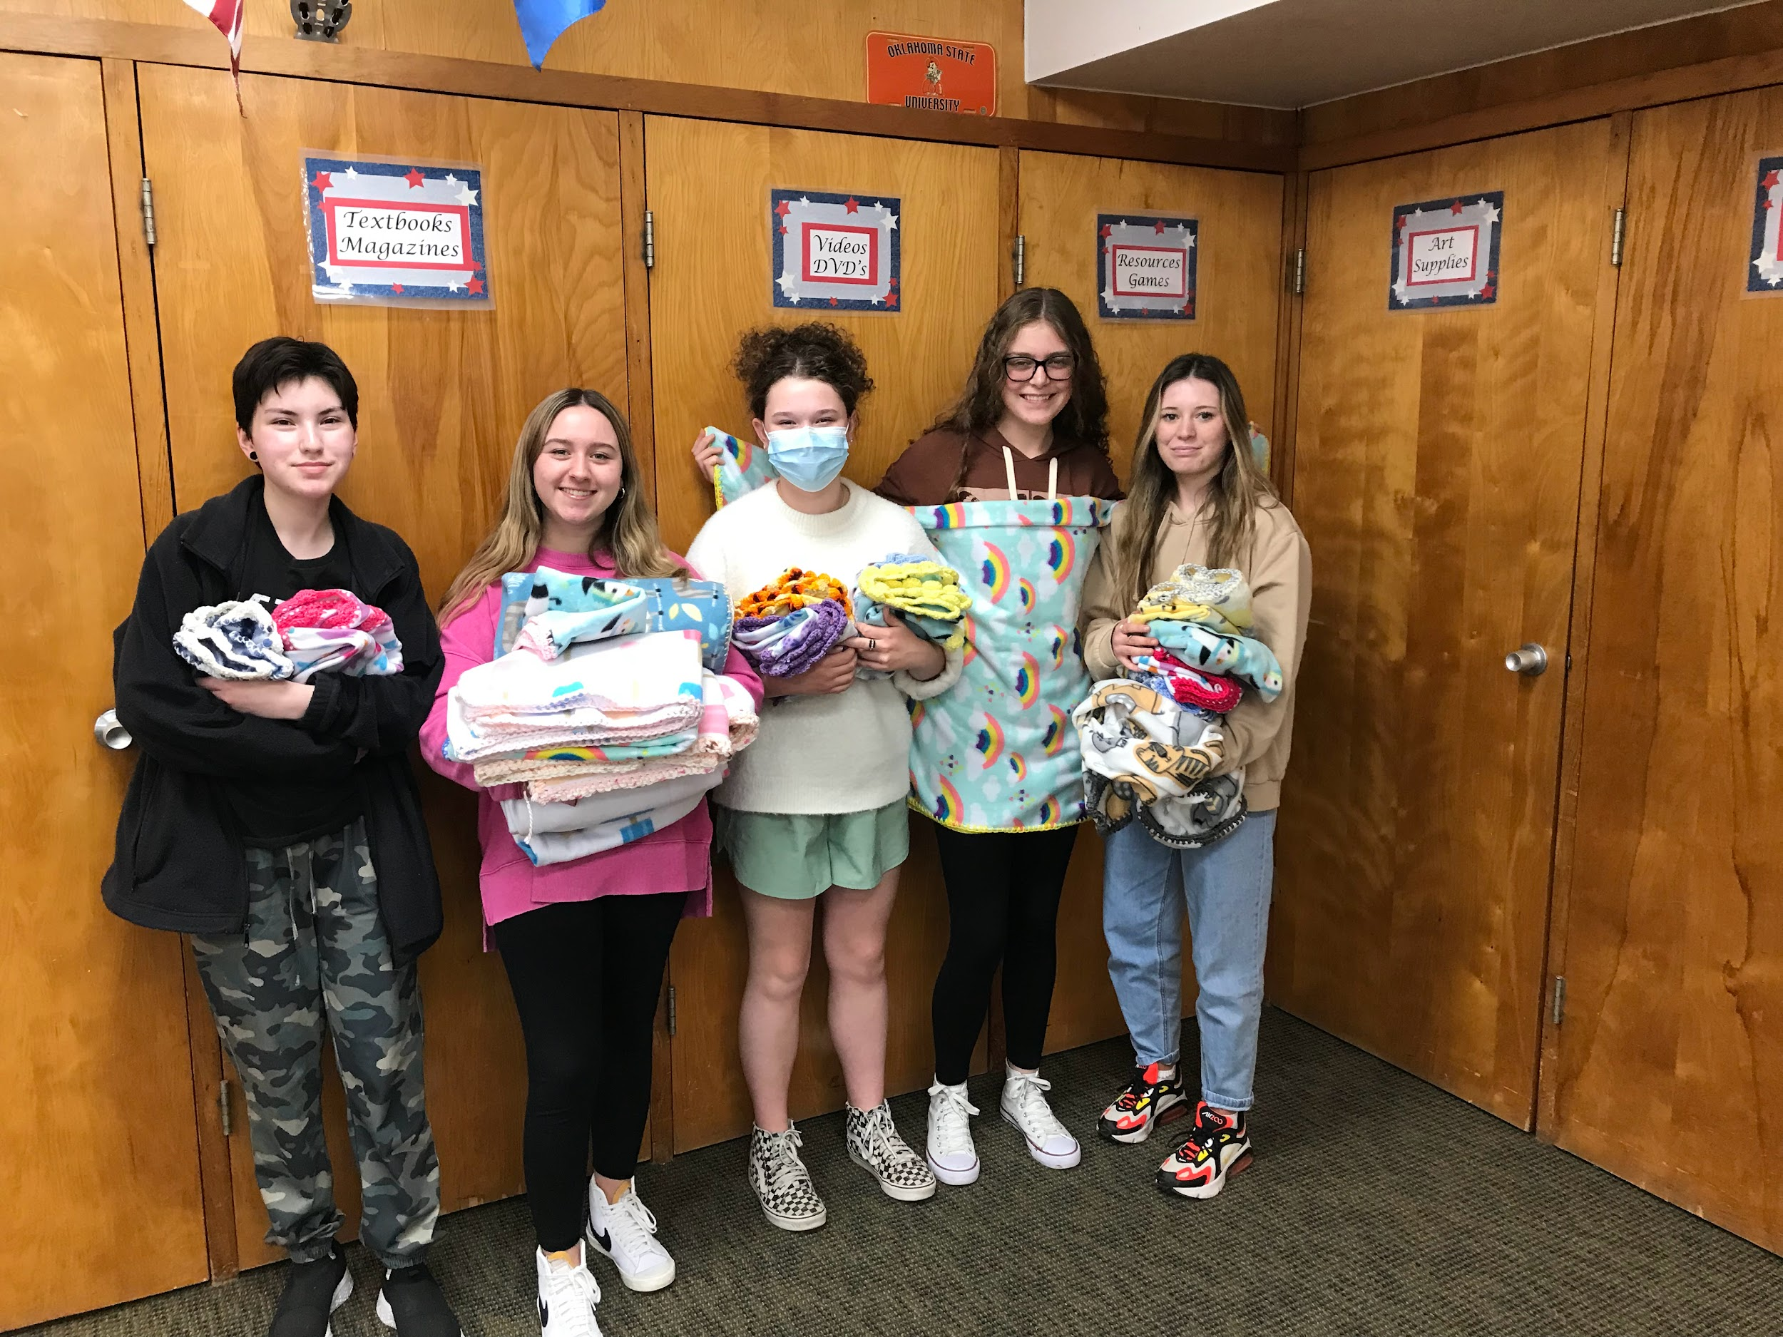
RETAIN & RECOGNIZE
Opportunities for Service Learning
😊
😊
😊
😊
😊
😊
😊
😊
😊
😊
😊
Guiding young people to seek out ways to improve their communities through service learning is always a goal in the development of incredible FCS classrooms as well as the development of dynamic student leaders!

Slide 25
RETAIN & RECOGNIZE
Things to consider:
What initiatives do students hold important?
2. What do students believe will benefit the community?
3. What types of projects fit with their abilities?
4. How can learning be incorporated into the project? i.e. field trip/tour, reading/writing, sewing/baking arithmetic, etc.

Slide 26
RETAIN & RECOGNIZE
Organizations to Partner with:
Youth & Family Services Agencies
YMCA/YWCA
Animal Welfare Organizations
Hunger Relief / Anti-Homelessness Orgs.

Slide 27
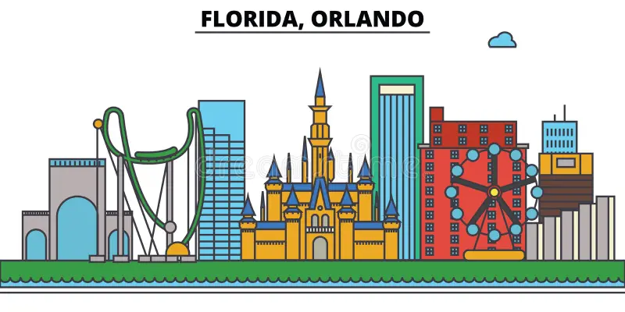
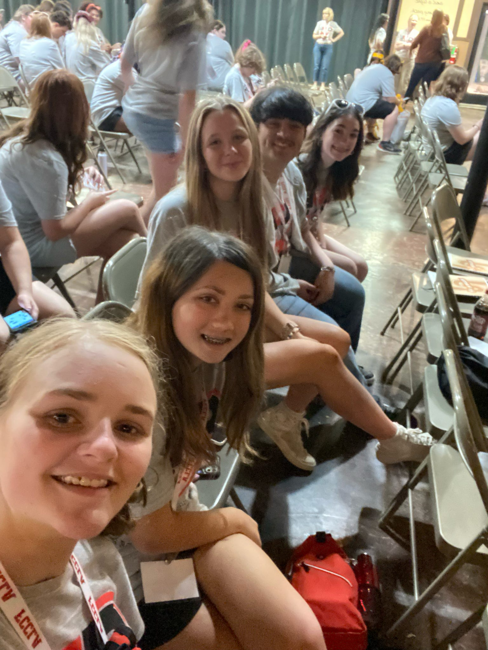
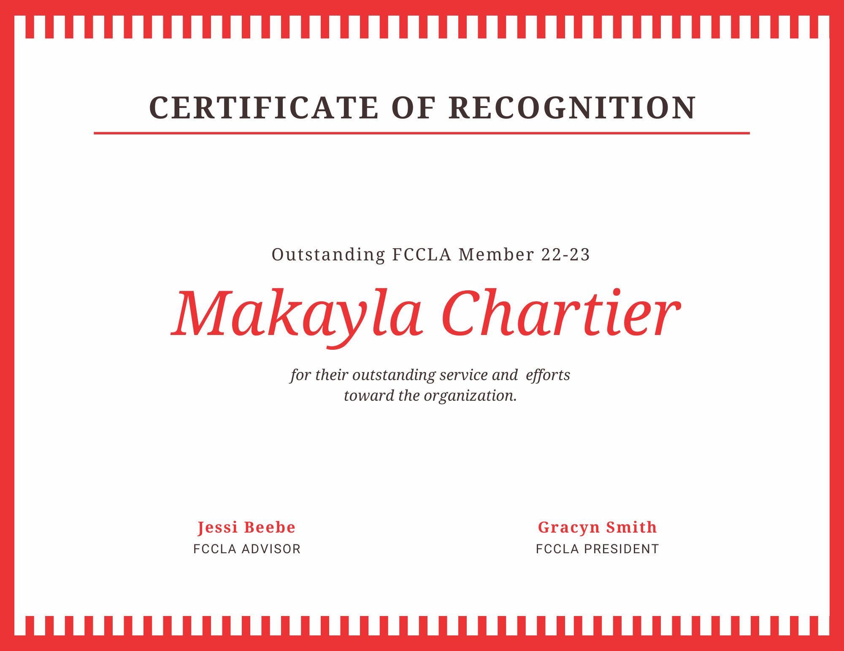
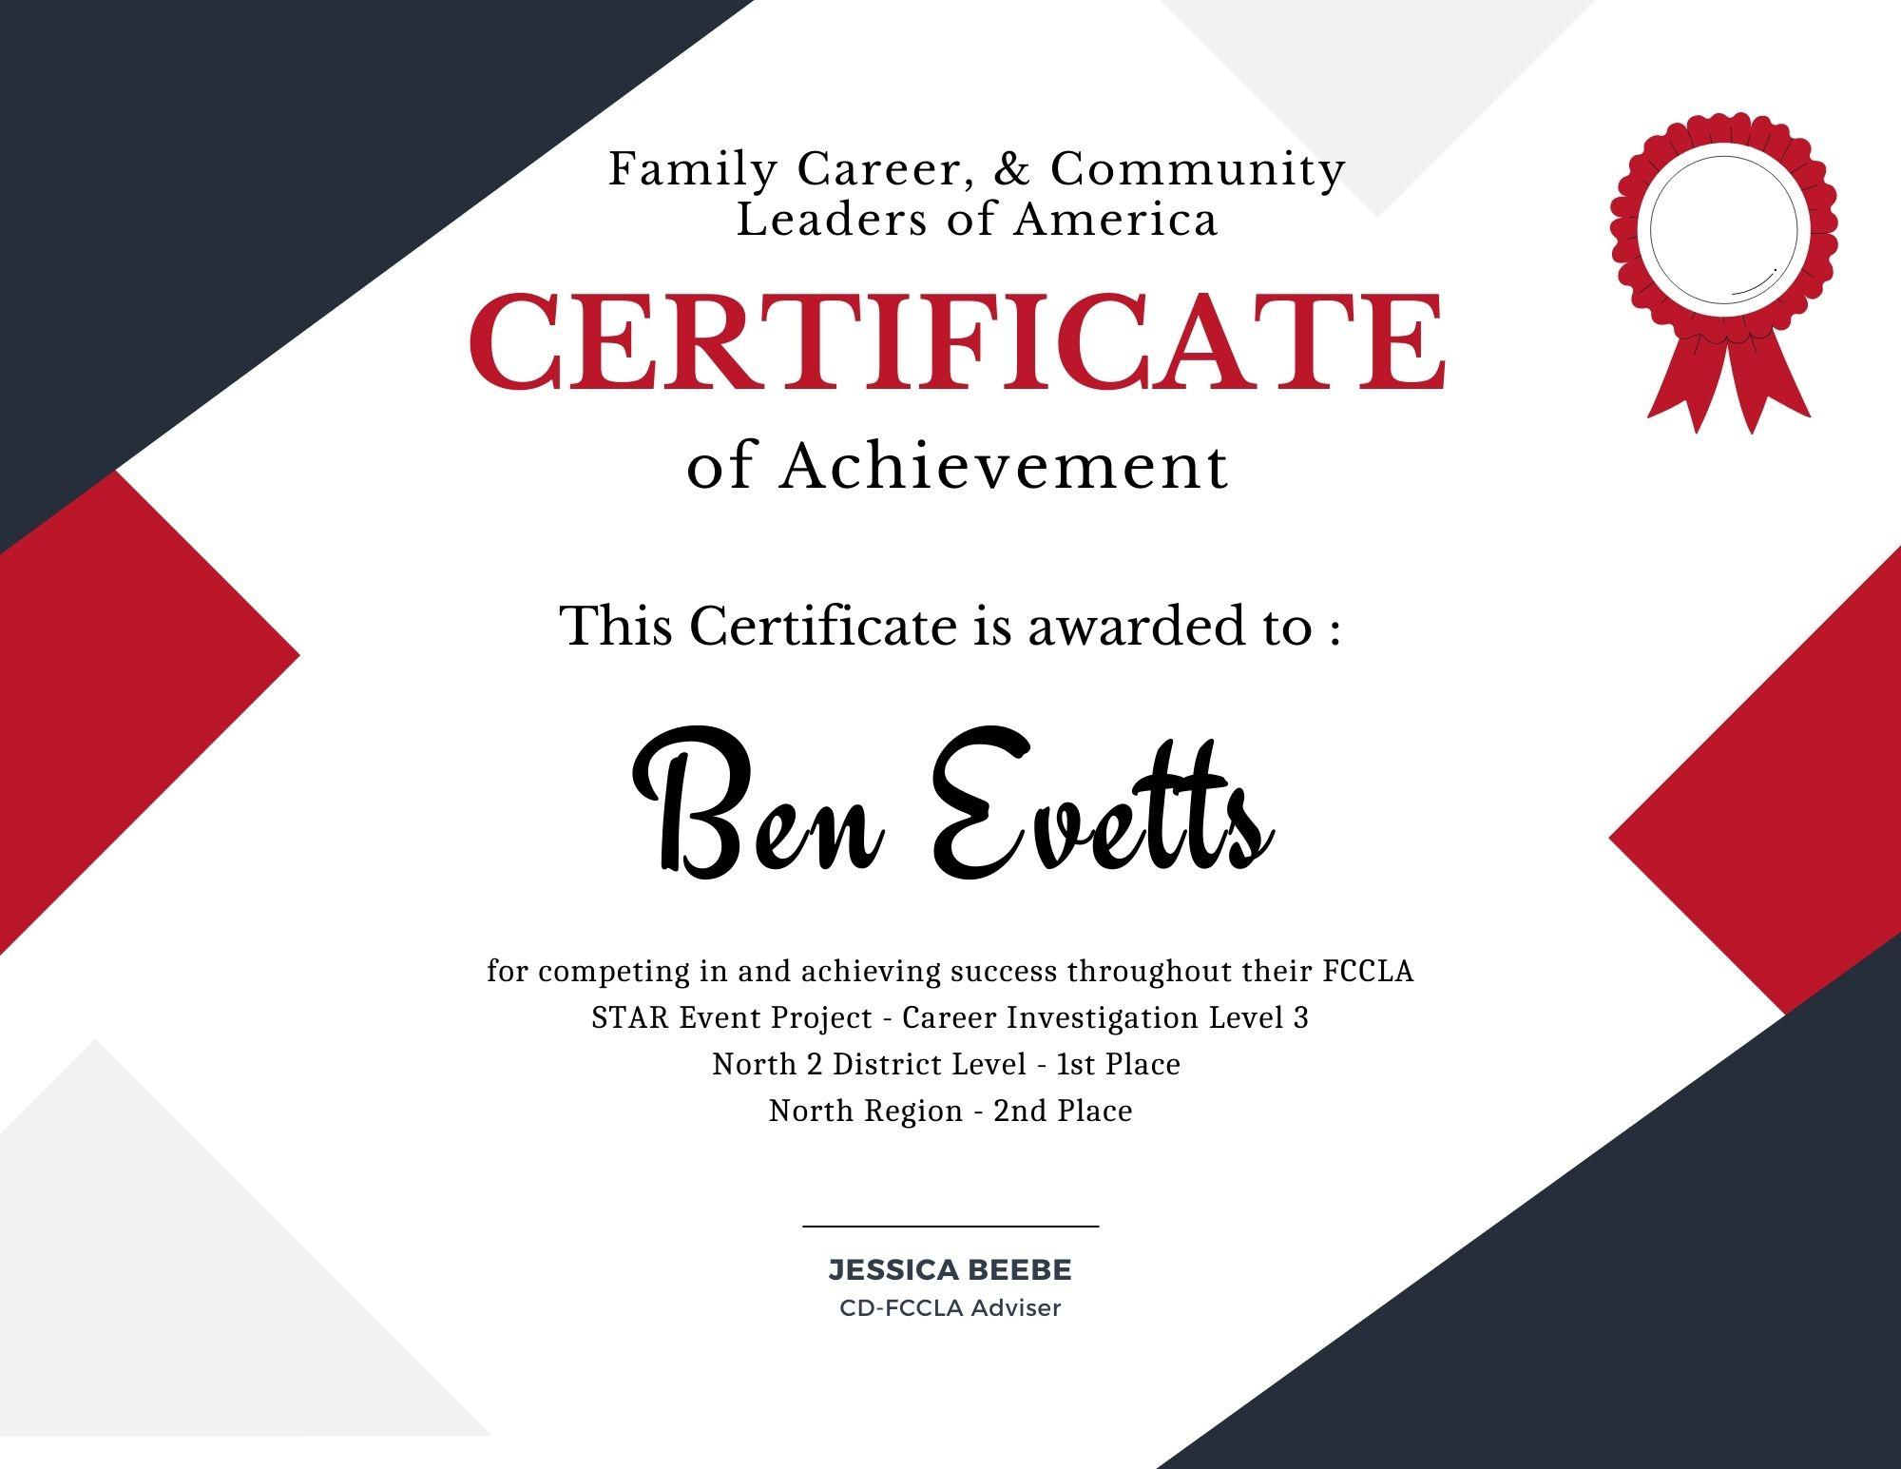
Sell the FCCLA “Why” in FCS Classes
RECRUIT, RETAIN, & RECOGNIZE
Unique Opportunities: being a FCCLA member you could:
Meet New People
Run for Office
Travel to Conferences
Develop Transferable Skills
Professional Portfolio Development:
Examples of Leadership
Pin Designing
Submitting Articles to Magazine
Ultimate Leadership Experience: Only CTSO with Family at its central focus. We all deserve to feel LOVED and FCCLA can serve as a place of BELONGING to many students.

Slide 28
Resources & Acknowledgements
Thank you State Staff for inviting me to New Teacher Academy!
Thank you NEW TEACHERS for entering into the most fun job ever!
- The impacts you make on your students are meaningful and will last a lifetime!
Resources for you!
Ms. Beebe’s Google Drive - FCCLA Resources
The “Gold Mine” of FCS & FCCLA Resources
Oklahoma FCCLA Website
National FCCLA Website
ctYOU Login

Slide 29
Thanks for your time!
JESSICA.BEEBE@OKSTATE.EDU
580-542-2996
ENID, OK

