Slide 1





2024
LEAD
CONFERENCE
Gold Medal Leadership!
Adviser PD Session - Sit with your District

Slide 2

Reporting Deadlines
September 30 - Salary and Teaching
October 1 - Follow-Up Opens
October 31 - CESI Due
November 30 - Follow-Up Due

Slide 3
New Teacher Academy: September Follow-Up 9/24/24
September 17- Last Day to Register
IMPORTANT NOTICE!!!
Venue has changed:
Meridian Technology - South Campus
3025 S. Division St., Guthrie OK 73044

Slide 4
Oklahoma FCCLA
Registration Deadlines
Riversports deadline - *PASSED*
Take AIM deadline- Sept. 19
Say YES to FCS (Jr. Sr. Only) - Oct. 1
District STAR Events - Oct. 29
Get SET - Registration opens Nov. 1

Slide 5
National FCCLA
Registration Deadlines
  Capitol Leadership
    (NOT HELD DURING ELECTION YEARS)
  National Fall Conference
    Orlando, Florida -October 18-22, 2024
    Anaheim, CA - October 24-27, 2024
*Says it is sold-out; check the Facebook groups!

Slide 6
FCCLA Adviser Academy
  Great PD sessions for New and Experienced Advisors through National FCCLA!
  Registrations open Nov. 1st, 2024
    Can be found in your FCCLA Portal!
  Chapter must be affiliated for you to participate!
  Must attend 3 of the 4 sessions to receive recognition for completion at NLC.
  Can be included as a membership package or cost is $45

Slide 7
Oklahoma Alumni & Associates
Adviser Summit Scholarship
$500 to attend Adviser Summit
January 15-18, 2025
Orlando, Florida
Applications due September 21st

Slide 8
OATFCS Updates
  Membership Total: 337 Members
  If you volunteered to serve on a committee... check your email for info about meetings.
  Mid-Winter Conference Info to come!
  Officers are working on some PD opportunities later in the year... stay up to date with Newsletter!

Slide 9

District
Meetings
Items to Review:
  District Leadership Conference Info
  District STAR Duty Sheets

Slide 10

STAR Events

Slide 11
District STAR Event Adviser Duties:
  Know the District Duty Sheet & STAR Events competing at the District level.
    Duty Sheet - Posted to ctYOU & in Jessi’s bag!
    Star Event Chart - posted on OK FCCLA Website
  Recruit your judges
  Day of District STAR Events:
    Collect Scoring Data
    Review to make sure the event is scored properly!
    Thank the judges for their time!

Slide 12
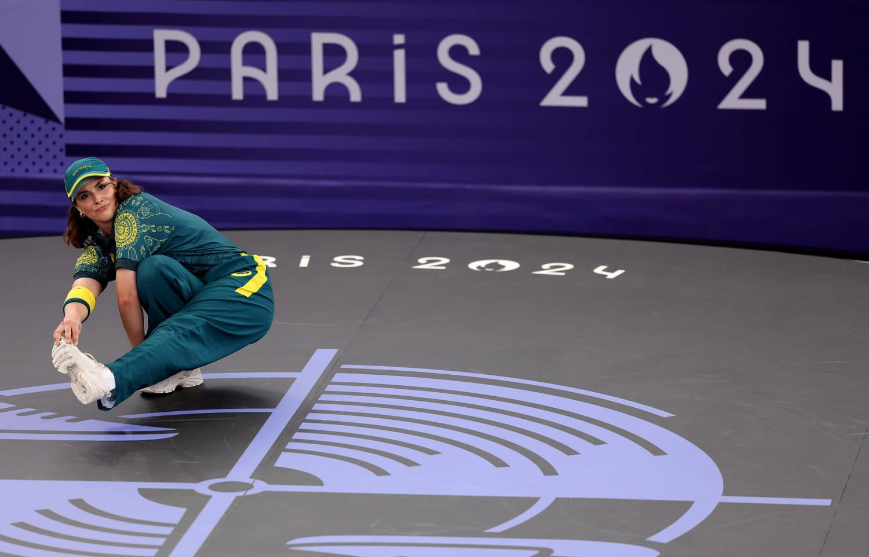
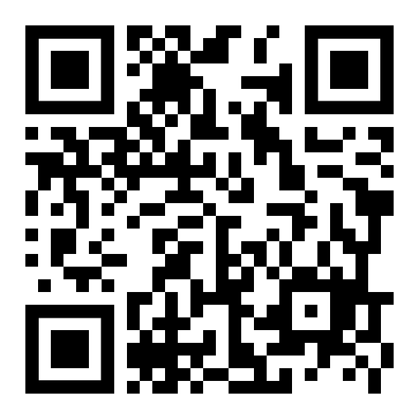
Collecting Judges!
  Recruit Community Members, Business Owners, Extension Agents, etc.
  Scan the Region QR Code to Submit the names of your judges!
  QR Code is also found on the district duty sheets.

Slide 13

Review Event Ahead of Time!

Slide 14

Lead Consultant - Oversee Event
Room Consultant - Run the Event

Slide 15
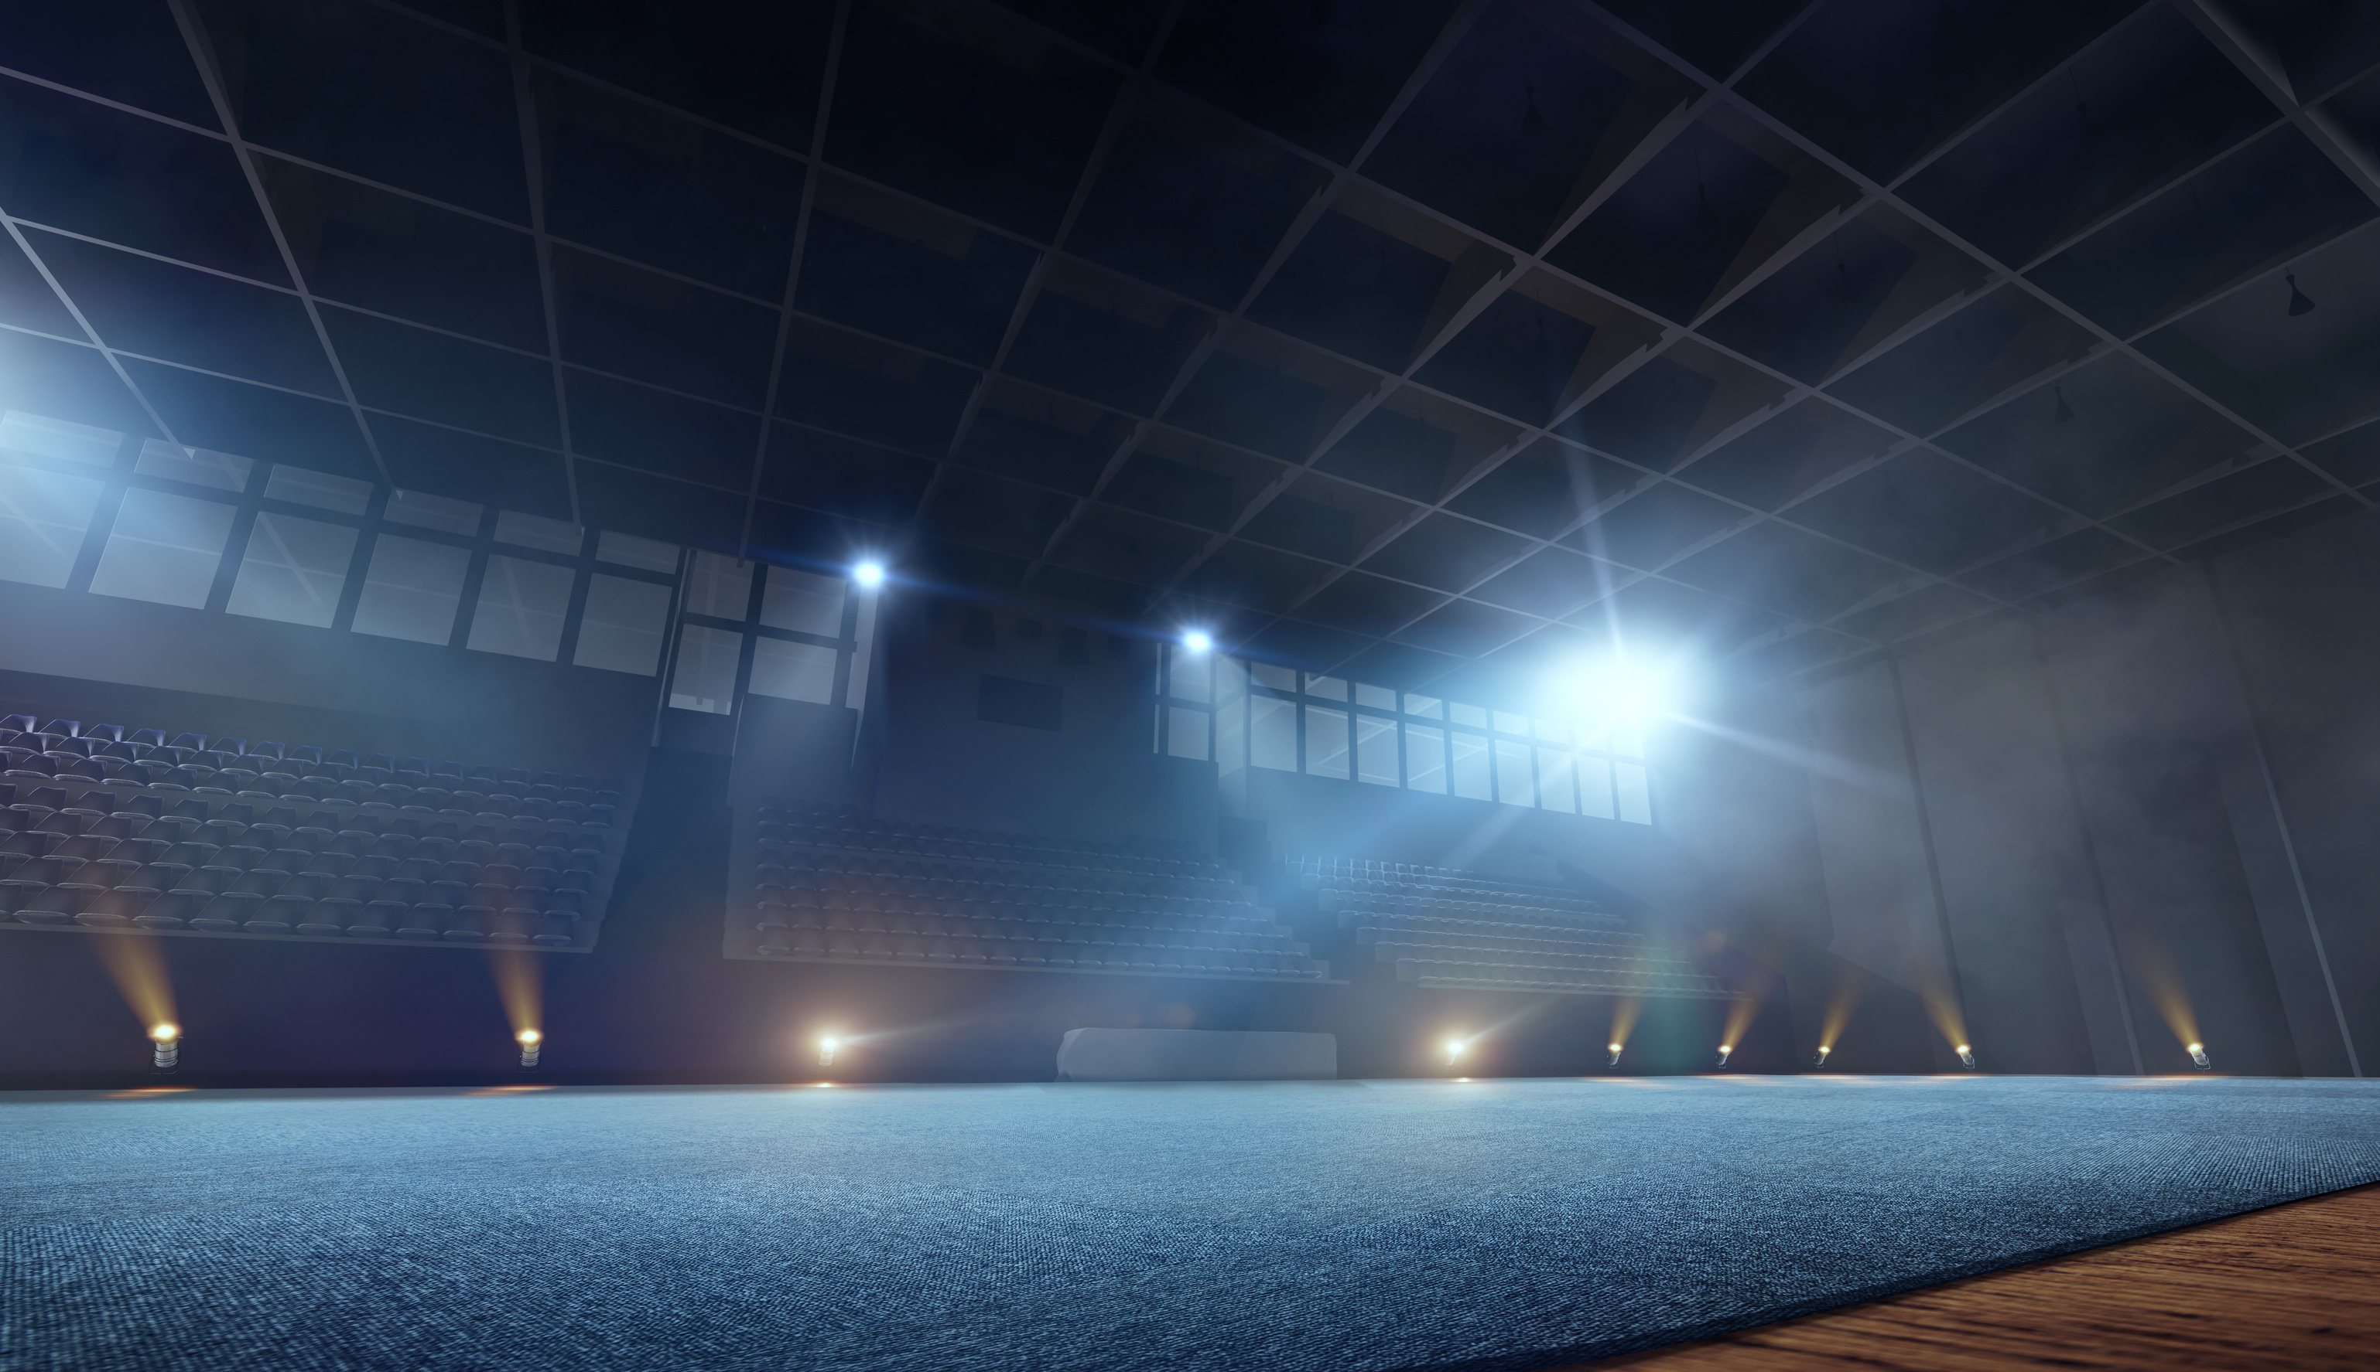
General Rules:
  Official dress, chef’s uniform, or meat ID uniform
  Follow the provided time requirements
  If judges/consultants deduct points, they MUST explain why
  Provide a positive experience for each competitor

Slide 16
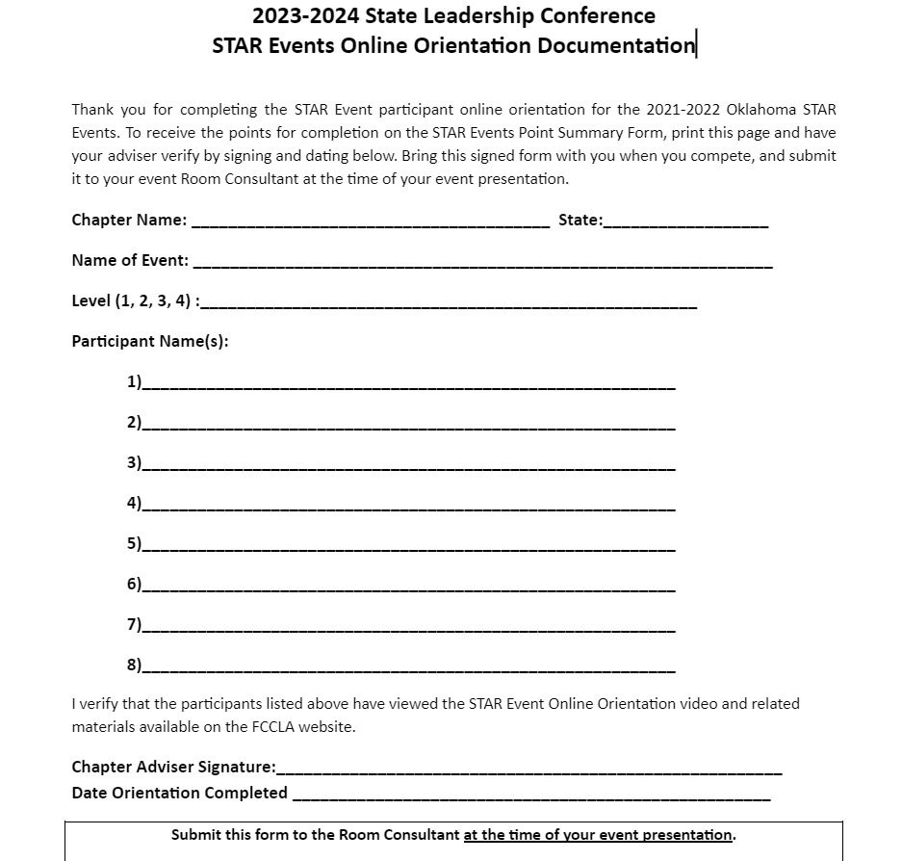

Can Be found on the Oklahoma FCCLA Site before STAR Event Competitions
Students must watch the orientation video then sign the form.

Slide 17
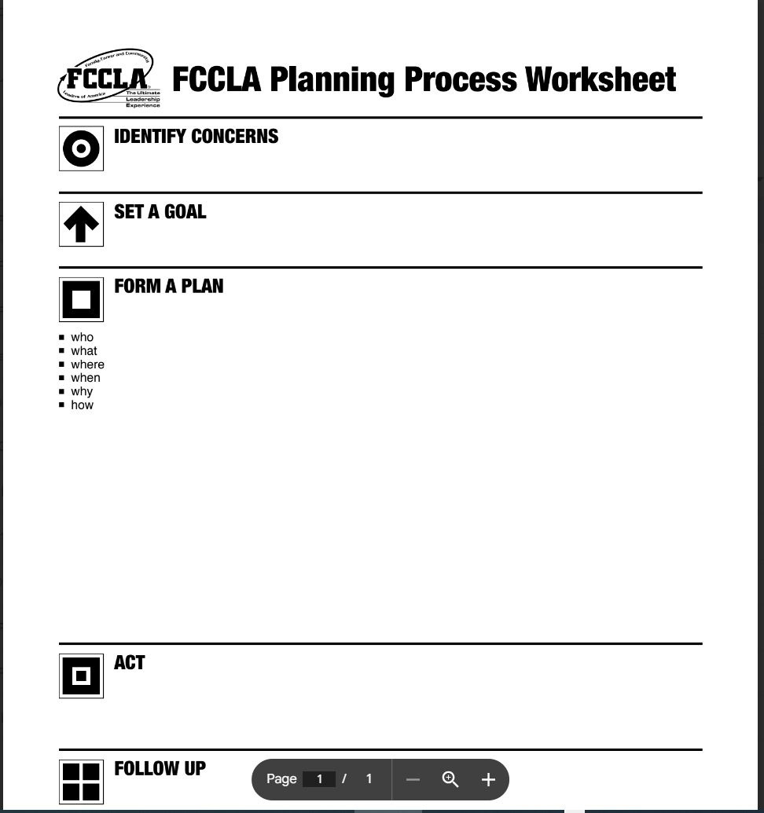
Needs to have the header titles
Does not have to have the images

Slide 18

Scoring
  Whole numbers per row
  Circle the number AND write it in the column

Slide 19

REMEMBER!
Students are competing against the STAR Event Rubric!

Slide 20
2024
LEAD
CONFERENCE
Gold Medal Leadership!
Please Break into groups by the District STAR Event you will run!

