Slide 1
Raising the Oklahoma Teacher’s
VOICE
Rachel Keith
2024 Oklahoma State Teacher of the Year

Slide 2
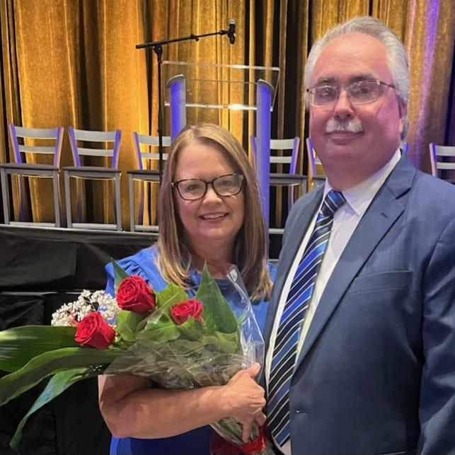
My Family of Educators

Slide 3
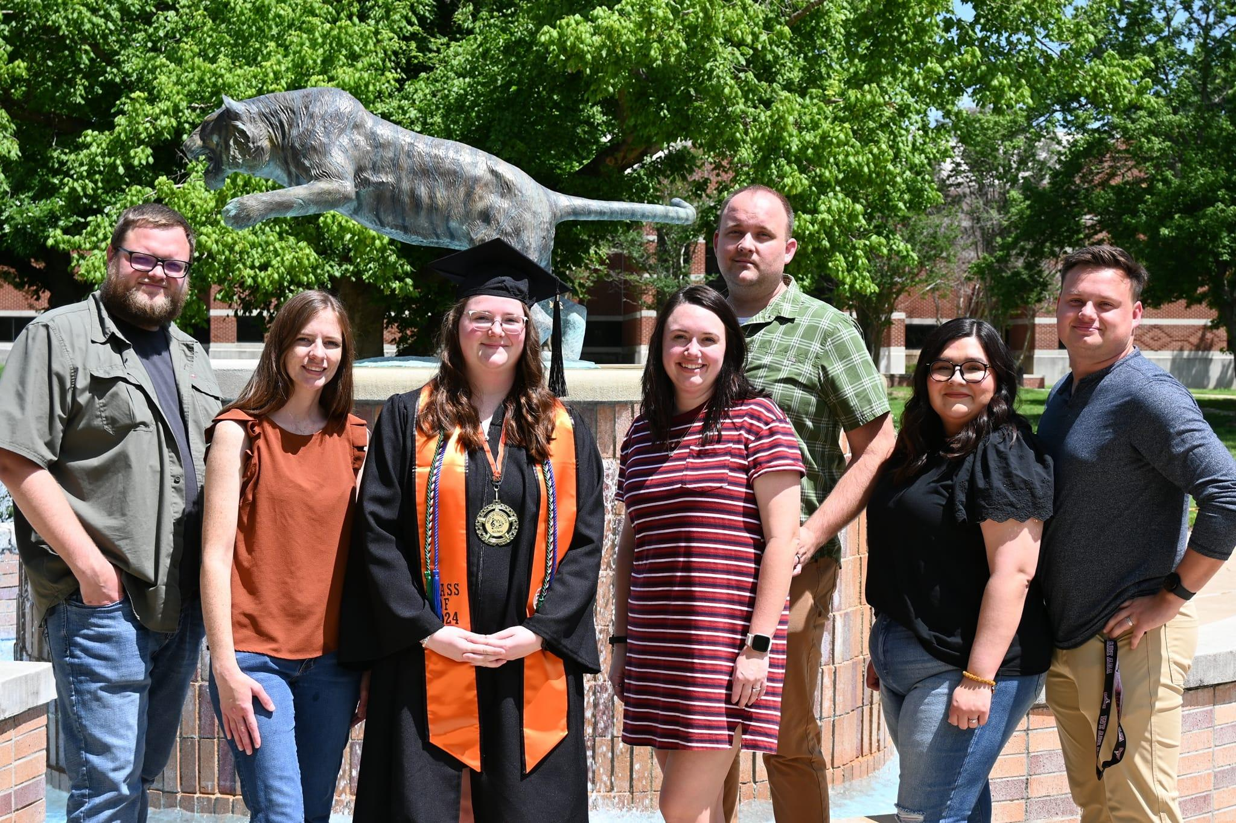
My Family of Educators

Slide 4
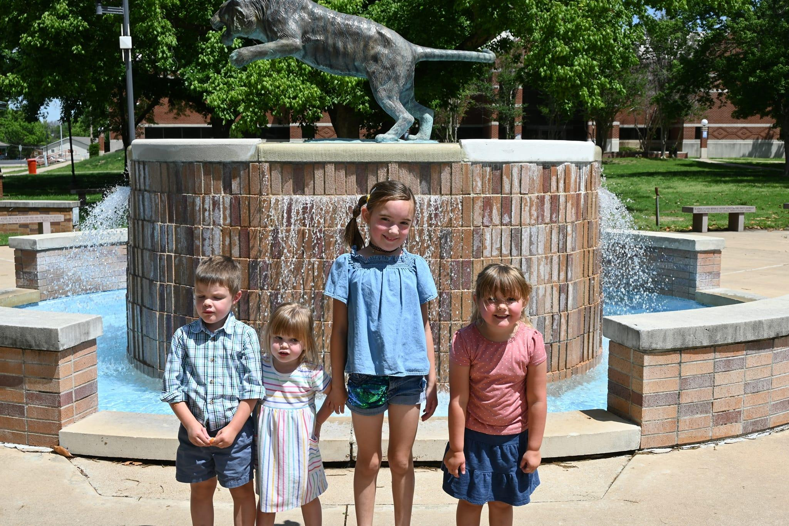
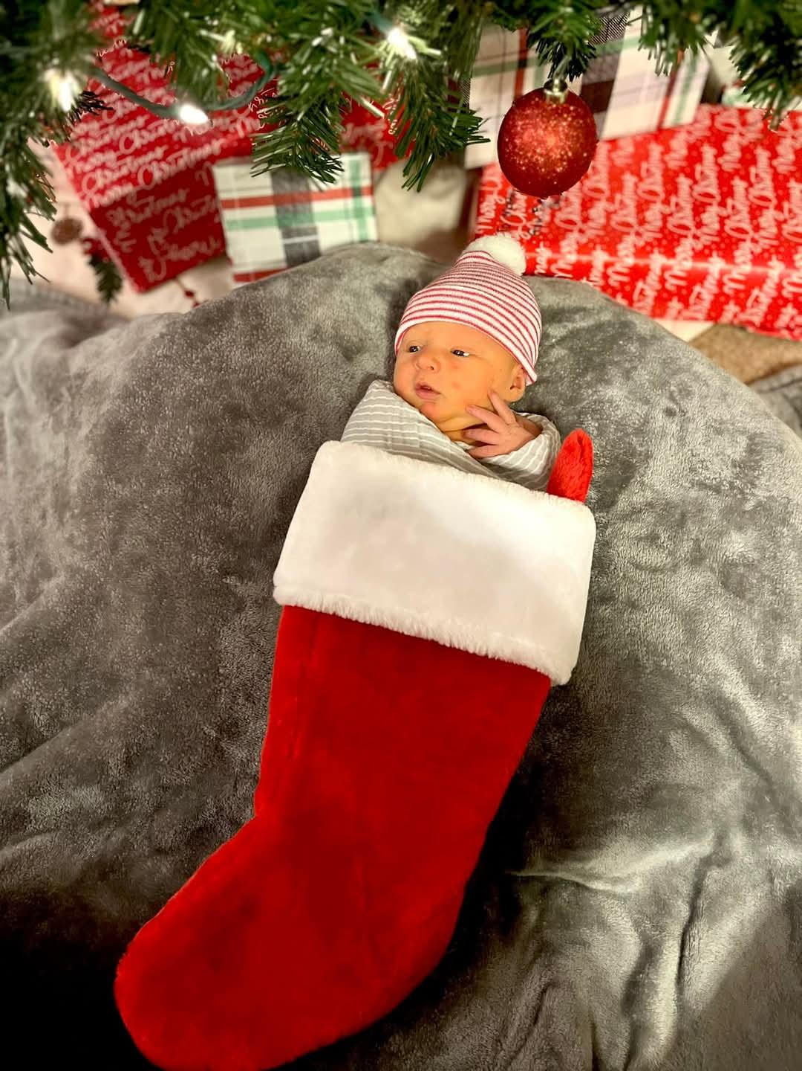
Future Educators? Maybe!!

Slide 5
Happy New Year!
Let your VOICE be heard in 2025!

Slide 6
Your VOICE creates a positive impact.
Stability for your students
Connection point
Model of respect
Future possibilities
Notes:
You Matter!

Slide 7
How can you help raise the Oklahoma teacher VOICE?

Slide 8
The 5 Core Principles of VOICE.
Strong, Confident, Consistent

Slide 9
Restoring the Oklahoma Teacher VOICE
Vision
Opportunity
Influence
Character
Excellence

Slide 10
What is VISION?
Vision is seeing beyond what exists to build the future you desire.
Creates the desire to build engaging lessons
Builds the endurance for longevity
Keeps the curriculum from being frozen & cold
Allows your skills to shine

Slide 11
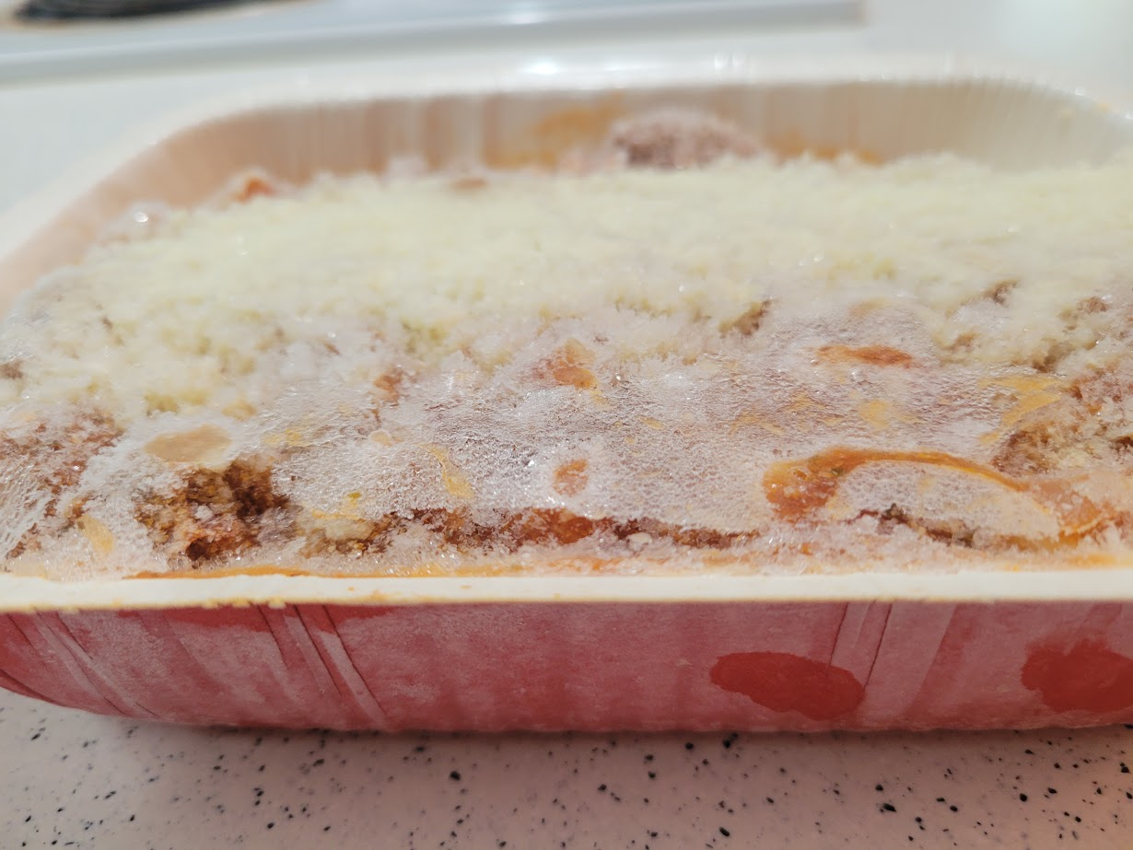
Two Pictures of VISION

Slide 12
How do I harness the power of VISION?
VISION is the oven to your frozen lasagna.
Build units based on student needs 425°
Practical application of standards 350°
Plan the end point first! 325°
Be flexible & adjust when necessary 250°
Use creative solutions

Slide 13
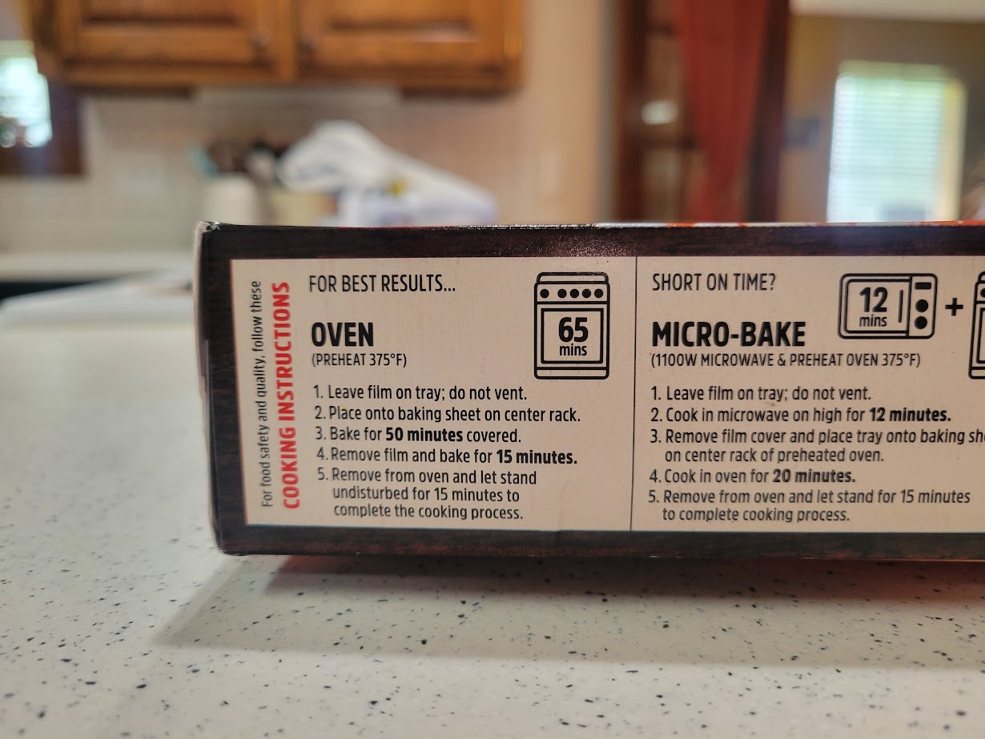
VISION needs clear directions.

Slide 14
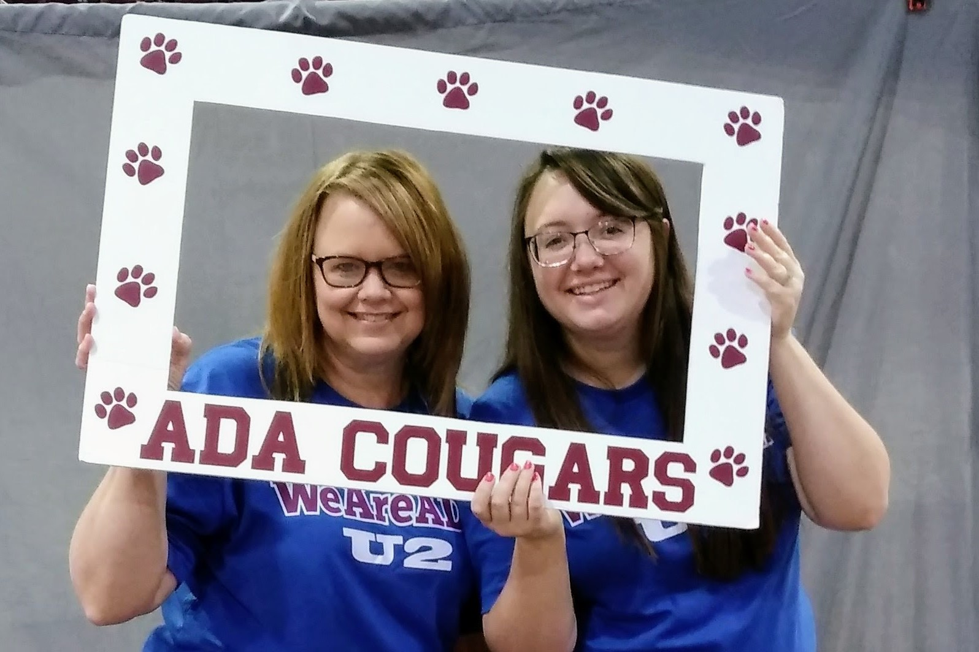
Roadblocks to VISION
Seeing through the lens of comparison
Believing you’re not enough
Not Smart Enough
Not Creative Enough
Not Special Enough

Slide 15
VISION accentuates my teacher VOICE!
Vision #1
Vision #2
Sophomore Poetry Unit
Personal Voice
Long-Term Impact
10 Years of Silence
Life Struggles
Recovery from Addiction

Slide 16
VISION
is a gift to your students.

Slide 17
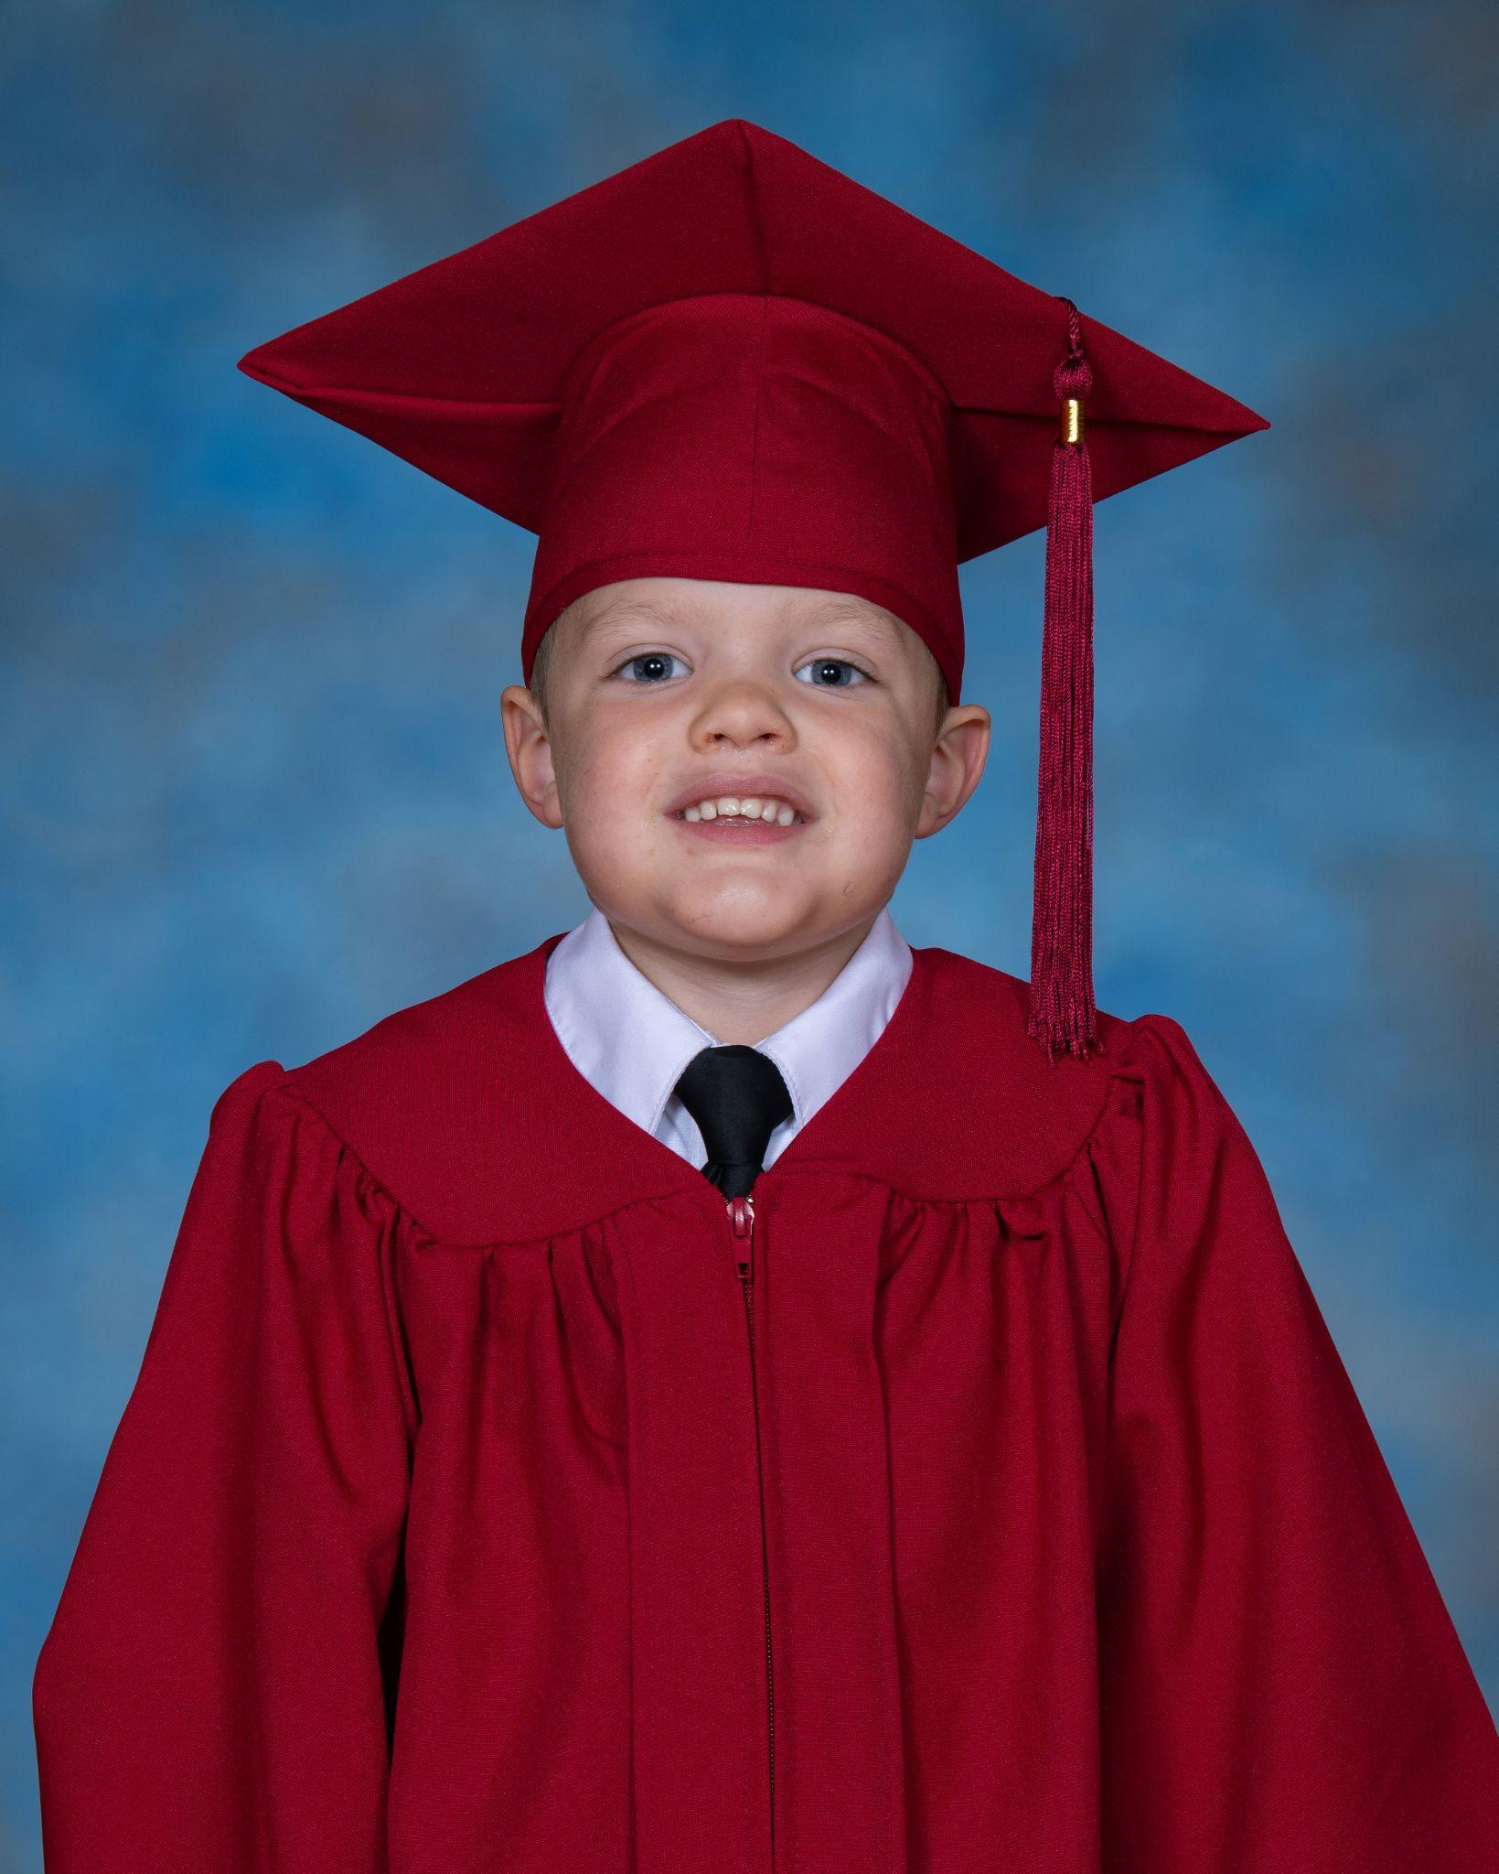
VISION creates OPPORTUNITY
Action Steps to fulfill Vision
Participles vs. Gerunds
Making Mistakes
Building a Growth Mindset

Slide 18
OPPORTUNITIES create growth!
Your VOICE doesn’t need to be the smartest in the room.
Model a Growth Mindset
Model Lifelong Learning
Don’t be right; be real!
Be a building block!

Slide 19
OPPORTUNITY leads to INFLUENCE
Consistency is KEY!
in your rules
in your procedures
in your daily practices
Consistency builds positive outcomes
builds relationships with your students
builds trust with your parents
builds respect with your colleagues

Slide 20
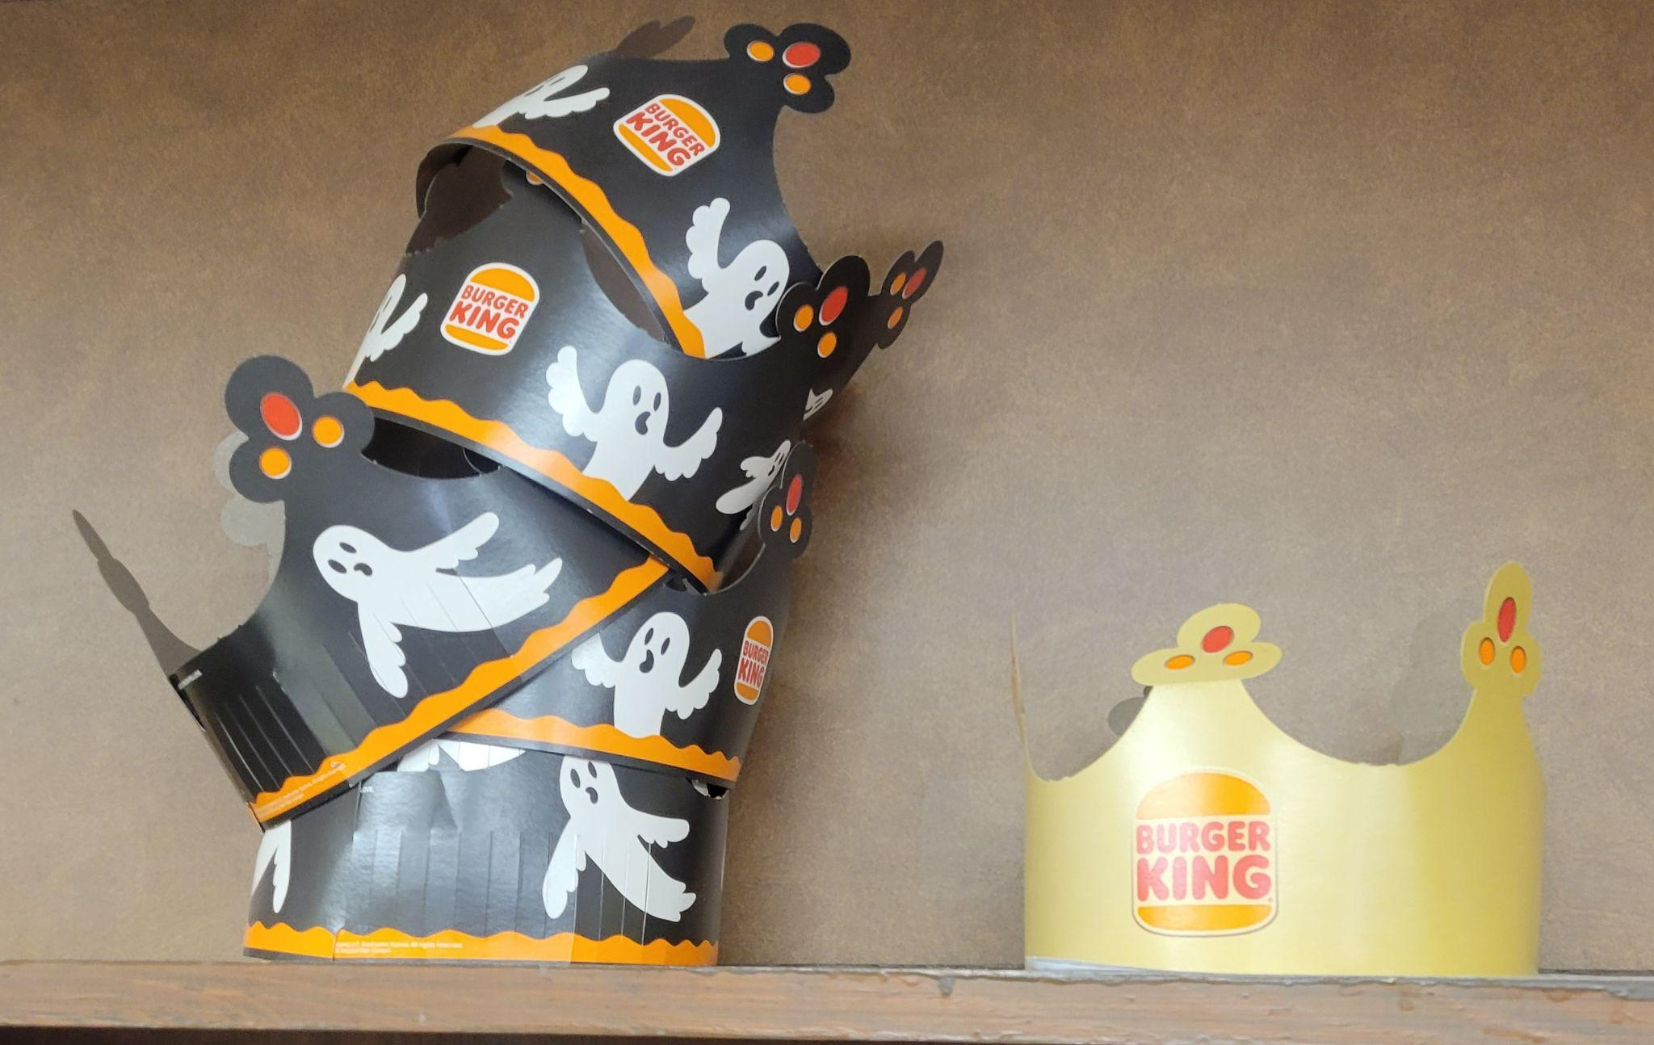
INFLUENCE shows up in many ways.

Slide 21
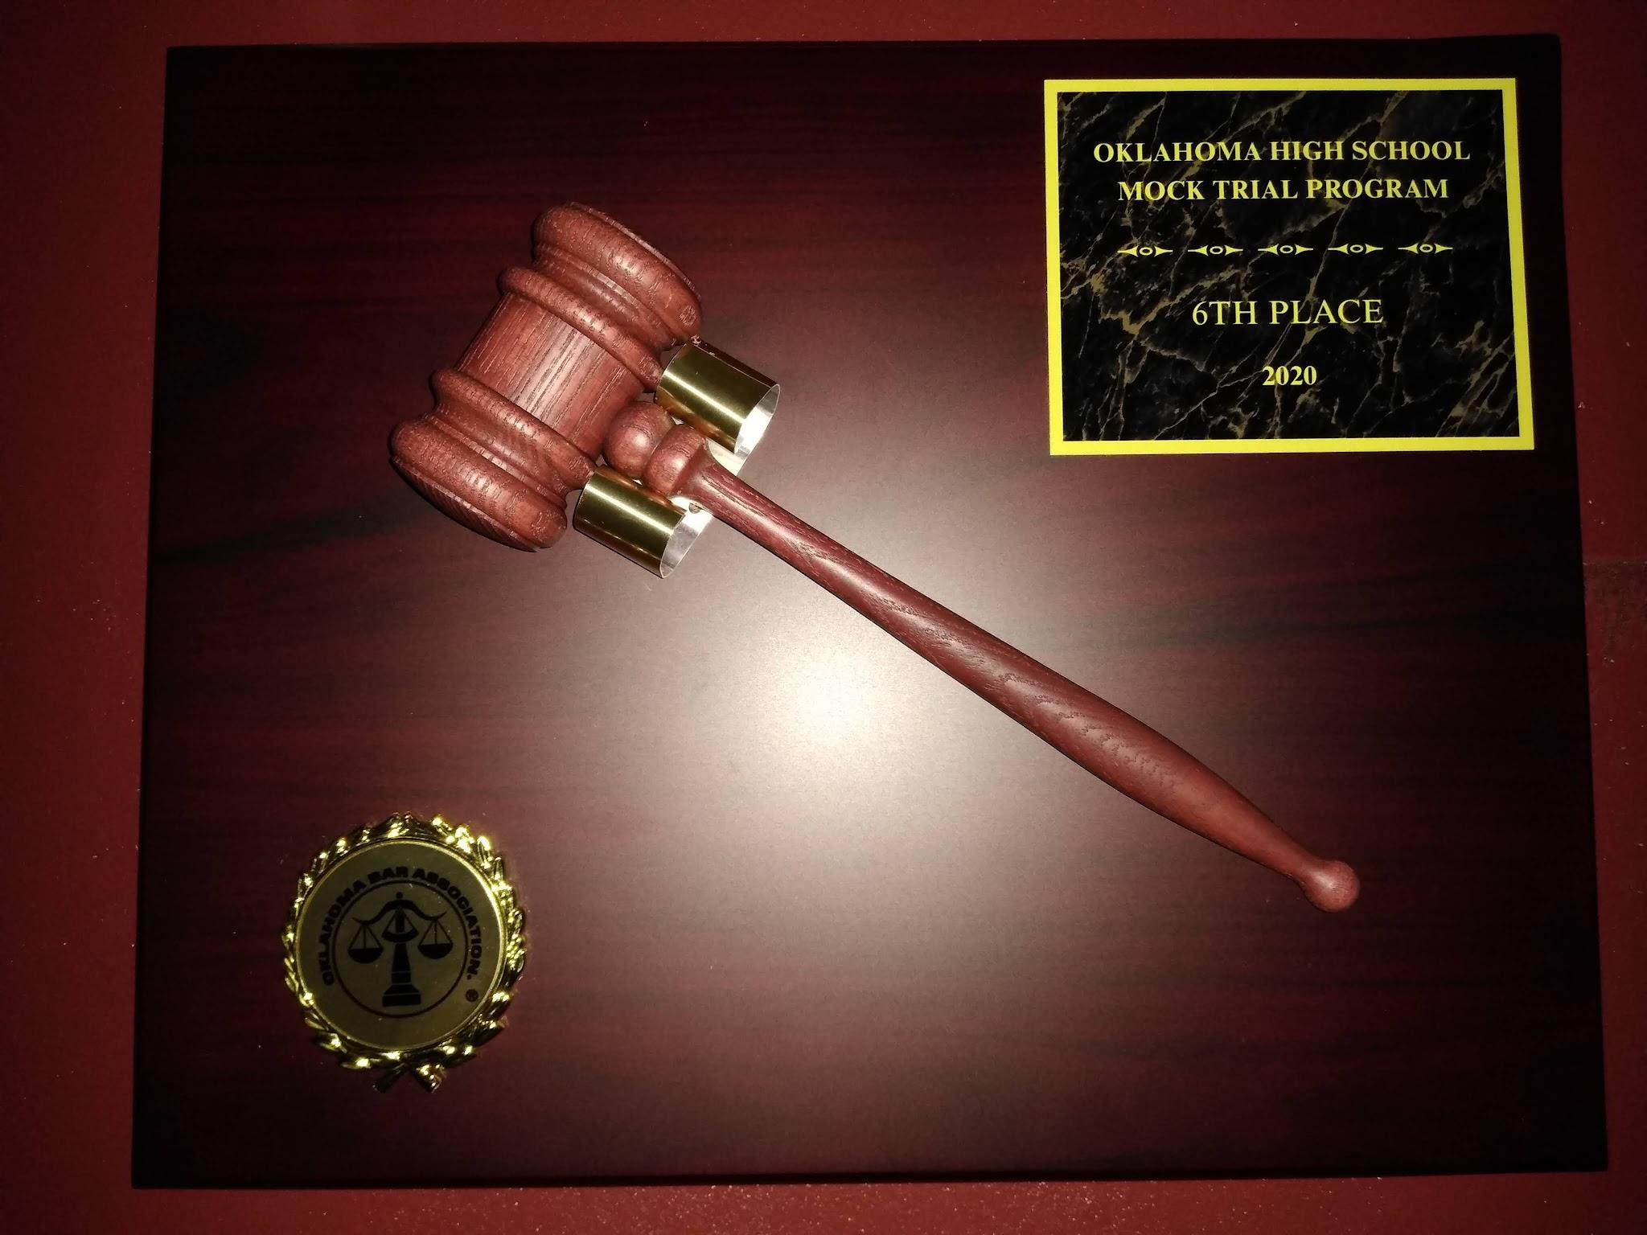
INFLUENCE shows up in many ways.

Slide 22
Influence
is a gift to your students.

Slide 23
INFLUENCE paired with CHARACTER
Caused by our belief in and adherence to professional ethics
Creates the consistency necessary to build influence
Compels us to do the next right thing for our students

Slide 24
INFLUENCE paired with CHARACTER
Doing the next right thing for your students
Snack drawer for hungry students
Consistent parent contacts
Mandatory reporting
A Weekend Gone Wrong

Slide 25
CHARACTER produces EXCELLENCE
Excellence doesn’t mean perfection.
Excellence is the natural outcome of a teacher who has found their VOICE and is willing to use that VOICE to better each of their students.

Slide 26
CHARACTER produces EXCELLENCE
What does Excellence look like in the classroom?
Earning a D
Brag Calls
Team Mentality
Work Life Balance

Slide 27
Excellence
is a gift to your students.

Slide 28
Let the teacher VOICE be heard!
VISION
OPPORTUNITY
INFLUENCE
CHARACTER
EXCELLENCE

Slide 29
Let’s raise the Oklahoma teacher VOICE, together!

Slide 30
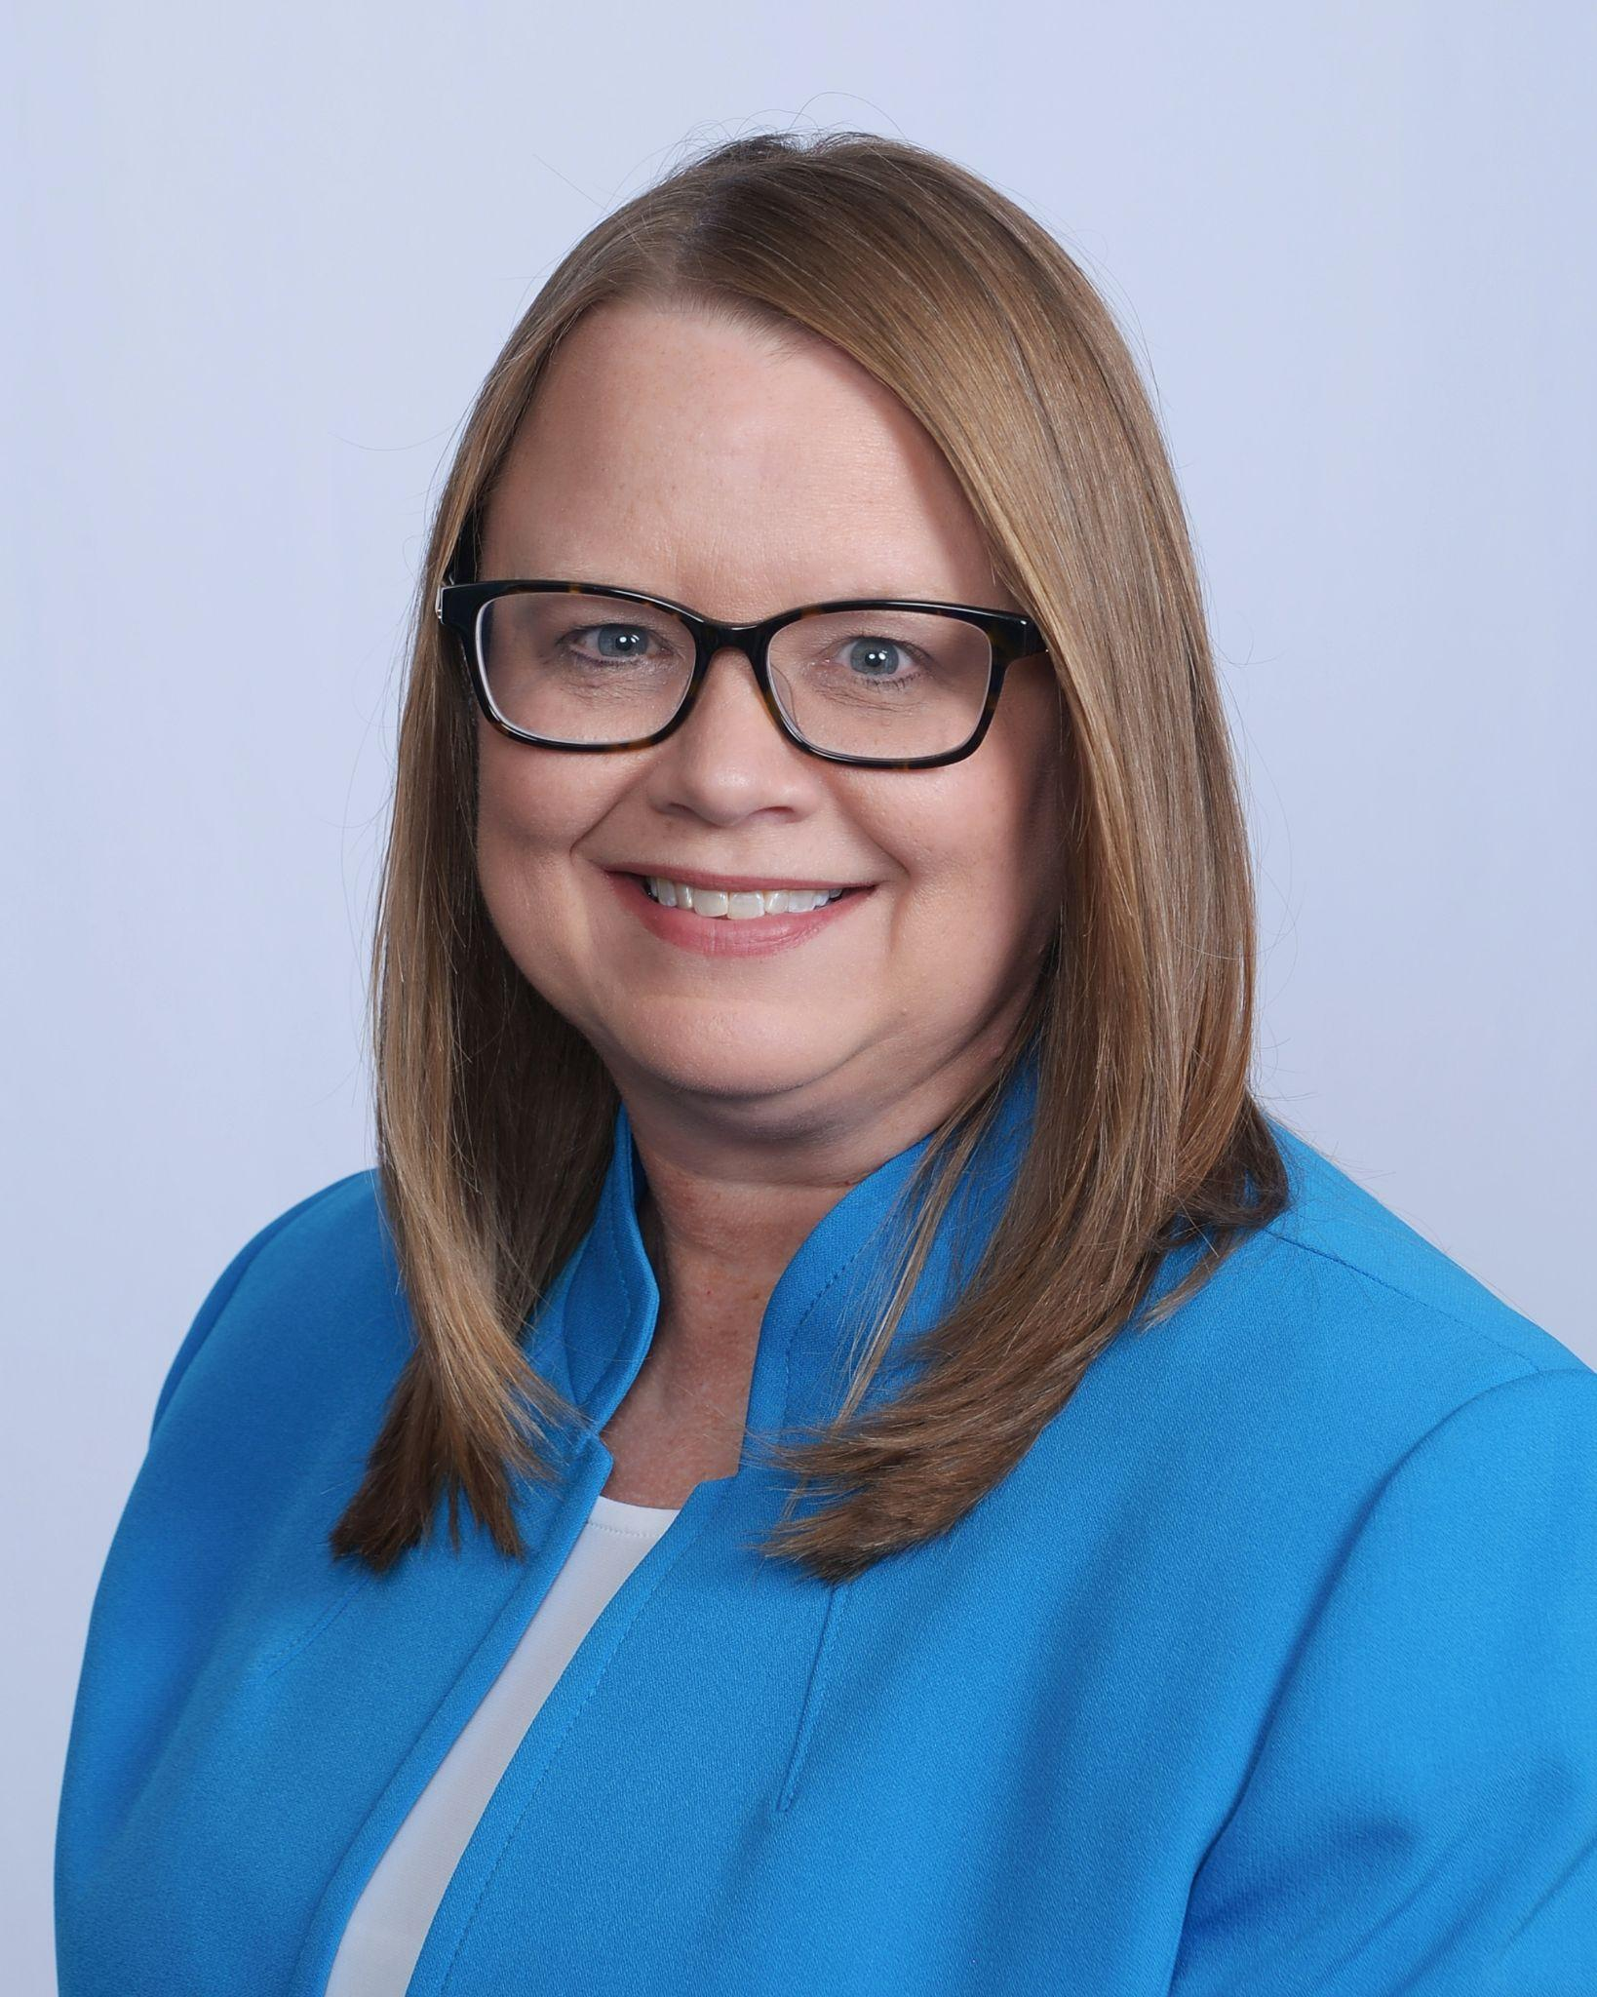
Connect with me!
Email: rachel.keith@sde.ok.edu
Find us on Facebook & Instagram:
Oklahoma State Teacher of the Year
Check out my YouTube Channel:
Oklahoma Teacher Mentor Moments

