Slide 1
Child Development Ages & Stages

Slide 2
Developmental Ages & Stages
Infant
Age: Birth-12 months
Toddler
Age: 1-3 years old
Preschooler
Age: 3-5 years old

Slide 3
Infant Development
First Month
Newborns have trouble controlling their actions.
Use natural reflexes for grasping, sucking, and rooting
Newborns are unaware of their surroundings.
Senses are immature
Spend the majority of time sleeping
Notes:
Babies grow astonishingly fast. By their first birthday, they will have tripled their birth weight and grown eight to ten inches.
A child grows more rapidly during his first 12 months than in any other period of his life
Newborns sleep ALL THE TIME, they generally are only awake to eat or get a diaper change.
Breastfed babies will eat every 1-2 hours. Formula fed babies will eat every 3-4 hours. These times will vary depending on the baby.
Newborns necks need to be supported.

Slide 4
Infant Development
Two to Three Months
Spend more hours awake
Use crying, cooing, and smiling to let care givers know what they need or want
Like watching their own hands and play with their fingers or toes
Move their heads to follow sound
Start reaching for objects
Notes:
Tummy time is important to strengthen neck muscles
Letting babies lay on their back too much can also cause flat head syndrome.

Slide 5
Infant Development
Four to Eight Months
Muscles become stronger
Can hold heads up without support
Begin rolling over
Laugh out loud
Start interacting more with other people
Very curious about their surroundings
Start crawling
Start babbling words indiscriminately
Notes:
Remember we talked about rapid growth for the first year. Well babies start having things called growth spurts where they want to eat all the time (this is very noticeable) they may do this for about a week and then start to sleep really soundly, and for several hours. Researchers believe this is when the rapid growth occurs. When the babies sleep their body is producing many hormones to aid in growth.
Tummy time helps babies neck muscles and helps them learn to roll. Babies typically will roll from their tummy to back first. Eventually they are able to roll from their back to tummy but may get their arm caught underneath them. Just help them when this happens and eventually they will do it on their own.
They love peek-a-boo and pat-a-cake and will generally start laughing out loud when playing these games.
They start exploring their surroundings, and rolling around to get all over the room. Some babies actually never crawl, they just roll or scoot.
They start making different noises and babbling things such as ma-ma-ma or da-da-da or ba-ba-ba

Slide 6
Infant Development
Nine to Twelve Months
Can pull themselves up and may start “cruising” along the furniture
Start understanding between right and wrong
Start self feeding
Start saying words like “mama” or “dada” discriminately
May start walking
Notes:
Cruising helps strengthen leg muscles so babies can start walking.
They understand no, and may even start shaking their head at everything.
They start saying small words such as mama, dada, cup, juice, milk.
May start walking by their 1st bday.

Slide 7
How Infants Learn
Using their senses
Playing (Peekaboo, Pat-a-Cake, etc.)
Love & Attention
Notes:
Peekaboo- Teaches them that objects and people can disappear and return again. Object permanence
Pat-a-Cake- helps them control their hands and arms.
Love & Attention- teaches them communication as well as trust.
If a child feels safe and loved, they will feel free to learn by exploring the world around them.

Slide 8
Toddler Development
Physical Development
Do not gain weight as quick as infants
Bodies become longer and straighter
Learn to use fingers to do small tasks
Physical changes allow toddlers to walk, climb, and feed themselves.

Slide 9
Toddler Development
Intellectual Growth & Development
Begin reasoning
Begin associating words with objects
Can name some body parts
Can complete simple puzzles or shape sorters
Notes:
It is important to name objects as you care for a toddler. What I mean by this is when you get a cup, tell the toddler you are getting a cup, and that you are putting juice or milk or water etc, and show them the drink. When you put their shoes on, say “we are going to put your shoes on now.” Or when you get them dressed say, “I am going to put your shirt on now.” This helps them associate the word with the object.
Also, when you are getting them dressed, you can make a game out of it. When putting their arms through the sleeve, say “where is your arm…etc” and then when their arm pops out say “ohhh I found your arm.” This teaches them how to get dressed because they realize, oh I have to put my arm through this hole and mommy can find my arm. etc

Slide 10
Toddler Development
Emotional Development
Become easily excited or upset
Scared of strange people
Experience separation anxiety
Temper tantrums are common
Notes:
Temper tantrums are common in toddlers because they get frustrated when they are unable to do something and they don’t know how to act when they feel that way. This is one of the only ways they know how to express their feelings. Scolding them does not help, in fact that can make it worse. The best thing to do is redirect the child to a different task, preferably before a tantrum starts.

Slide 11
Toddler Development
Social Development
Begin using language to communicate
Become more aware of their environment
One-year-olds tend to play by themselves
Two-year-olds begin playing around others but not with others (parallel play)
They say “no” often

Slide 12
How Toddlers Learn
Playing
Adults reading to them
Exploring

Slide 13
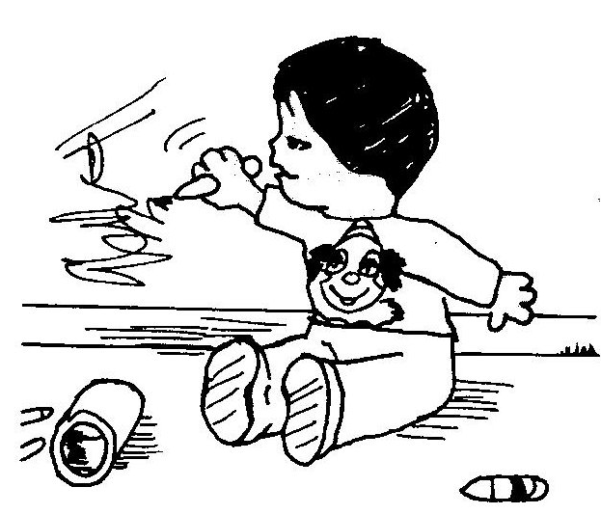
Respond without saying “no no”
Notes:
Since most of you have younger siblings or will start babysitting soon, here are some good things to remember when caring for toddlers.
Tell toddlers what they can do instead of what they can’t do. They will respond positively to positive requests rather than negative demands.
We should draw on paper instead of the wall. Then offer them paper to draw on.

Slide 14
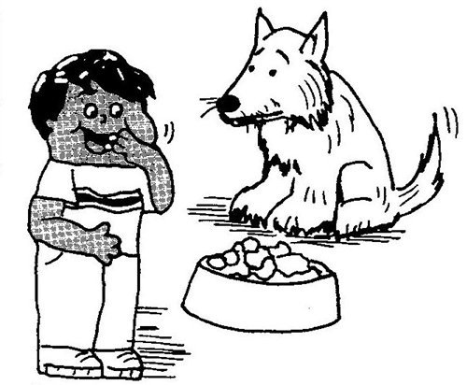
Respond without saying “no no”
Notes:
Dog food is for dogs. We eat different food. If you are hungry let’s have a snack.

Slide 15
Respond without saying “no no”
Notes:
If we rip pages out of the book, then we will be unable to read it. Can you read the book for me or let me read it for you and you can follow along?

Slide 16
What should you say?
Notes:
B; gives a child a choice

Slide 17
What should you say?
Notes:
2. B; gives a child a choice between two nutritious options.

Slide 18
What should you say?
Notes:
3. A; encourages child to help
You can also make a game out of it. Race to clean up the fastest.

Slide 19
What should you say?
Notes:
C; tells child what he or she can do, instead of what he or she can’t do.

Slide 20
Preschooler Development
Physical Development
Do not grow as fast as infants
Gain weight slowly while growing taller
Muscles grow stronger
Gain control of their large and small muscles
Dresses self
Notes:
Once they gain control of their small muscles in their fingers and hands they are able to do more complex tasks such as stringing beads, playing with a peg board, cutting with scissors, or drawing with crayons

Slide 21
Preschooler Development
Intellectual Development
More developed thinking skills
Starts reciting ABC’s and counting
Sorts objects by name and color
May repeat words several times because their brain works faster than their tongue can move

Slide 22
Preschooler Development
Emotional Development
Begin learning to control their emotions
They still need guidance and support
Moods can change quickly
Notes:
Preschoolers can be happy one second and throwing blocks and hitting people the next second. Tell them blocks are for stacking and when you hit someone it hurts them.

Slide 23
Preschooler Development
Social Development
More independent than toddlers
“I want to do it” is a common request
Likes helping out with household tasks
They say “no” less often than toddlers
Begin cooperative play
May fight but make up quickly

Slide 24
How Preschoolers Learn
Playing
Adults reading to them
Daily routines
Helping out with household tasks (even if they do things wrong)
Notes:
They learn from mistakes.

Slide 25
Things to Remember
Assist infants with early brain development by cuddling, playing, and talking to the baby in a consistent manner.
Each child grows and develops at a different rate.
Every child needs consistency, nurturing, love, affection and time to play in order to grow.
Children grow physically, intellectually, emotionally, and socially.
Notes:
If a baby is not stimulated or is neglected then this will affect brain development.
PLAY PLAY PLAY

