Slide 1

Health & Professional Certification Testing Staff Training
Jennifer Palacio
Assessment Manager

Slide 2
HPCP Test Site Coordinator
Train/monitor local test site
personnel (including CSOs if
applicable)
Ensure the security of testing
materials & verifies all
policies/procedures are followed
Coordinate HPCP test
registration, collecting fees, &
administration
Score clinical skills examinations
(if applicable)
Distribute results to candidates
Maintain testing records

Slide 3
TRAINING/MONITORING LOCAL TEST SITE PERSONNEL
All test site personnel associated w/ the HPCP certification process:
Must be listed on the HPCP Test Site Directory
Attend training on HPCP processes and procedures
Complete a Testing Personnel Training Requirement Form
Sign a Confidentiality Agreement (not required for CSOs – agreement is part of request form)
*

Slide 4
TRAINING/MONITORING LOCAL TEST SITE PERSONNEL
Clinical Skills Observers (CSOs) cont.
Test Site Coordinator is responsible for requesting/training CSOs
CSO must complete: (manual on website)
  Orientation on administering scenarios
  Review CSO Manual
  Complete 2 shadowing experiences with approved CSO
Current list on sFTP system
Request form on website - must include resume

Slide 5
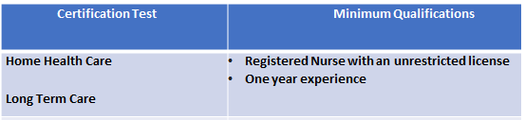
TRAINING/MONITORING LOCAL TEST SITE PERSONNEL
Clinical Skills Observers (CSOs)
CSO Qualifications – verified on OK Bd of Nursing & Multi-state compact
Prefer CSOs not be instructors – if so, cannot observe own students
Must administer 2 clinical skills exams per Fiscal Year
Administration – Clinical Skills Scenarios
  Clinical Skills Scenarios – schedule extra 15 minutes for preparing volunteer/providing instructions/answer questions (only time candidate can ask questions)
      Time Limits
        HHA/LTC – 60 minutes for 7 clinical skills
      Volunteers/Residents
        Many skills can be performed on manikin
        Some skills it is better for a “live” person
          - Helps prepare candidate for dealing with people in actual setting
        Cannot be another student in CNA or be a CNA
        Prefer non-medical person & need to be 18
Notes:
Reasons for removal in Test Site Coordinator Manual for CNA & CMA

Slide 6
Nurse Aide Information
Coordinating Registration & Scheduling (HCP Coordinator Manual & CSO Manual)
  Coordinate # of clinicals performed in a day
    7 – LTC, HHA
    Coordinate/verify required documentation for testing (Cheat Sheet Supplement)
    Nurse Aide – (CNA Testing File Documentation Checklist )
      Training verification form or Approval Letter from OSDH (only last 1 year) – verify matches candidate info
      Proof of the SSN:­
        Social Security Card
        Letter from Social Security Administration
        W-2
        Official Tax Return
        If unable to provide proof of SSN, a SSN Attestation Form must be completed
      Photo ID issued by government entity w/in the U.S.
      Affidavit of Lawful Presence – see info sheet for requirements
        Retain original & supporting docs for non-citizens in candidate testing folder
Notes:
Verification form – signature at the top can match the second area if RN Supervisor is also instructor. Verify with Jason regarding LPN’s teaching up to 16 hours (should they sign?)
It is important to get the social security # correct because state will not issue certs/licensure to someone that is not current on taxpayer/other obligations
Affidavit – US citizens do not have to complete a new form when deeming or retesting. For non-citizens, if more than a month have them sign another one because required documentation does have expiration dates. They must have a SS#.

Slide 7

Administration – Clinical Skills Scenarios
      Scenario consists of: - some sites color code sections – volunteer, candidate, etc
        Cover Sheet – Candidate Info to be completed by Coordinator prior to the exam
        Candidate Information – Scenario, Instructions, Document Sheet
        Volunteer/Resident Info – instructions, consent form
        CSO Information – equipment list, CSO Instructions, Scenario, Candidate Instructions, Documentation Sheet
        Evaluation Grid – marked by CSO as the candidate performs task
        Score Sheet – completed by Coordinator (or designee) – nurse aide only
      Scenarios include both critical, non-critical tasks, and vitals (nurse aide only)
        Critical tasks – usually deal with safety & infection control – must perform all with 100% accuracy
        - (hand-washing, donning/removing gloves &
        other PPE, handling biohazardous materials, etc…
        Non-Critical tasks – associated with performing tasks correctly – 80%
        Vitals, Input/Output – measure w/in acceptable limits – see scoring sheet

Slide 8


Slide 9
Results
Result distribution
  The result belongs to the student and the site that administered the exam
  Multiple locations for one tech center cannot openly share results with each other
    A request must be completed by the candidate for results to be shared from one location to another
    If a candidate needs a result, it is easier for them to have the site that tested them request it because we can send it to you to distribute. You can verify their identity in person and we cannot.

Slide 10
Activity Reports
Activity Reports
  Summarized Price Sheet showing Candidate amount & amount invoiced to each Test Site located on sFTP
  Usually provided the week after the end-of-the-month after HPCP office reconciles monthly report with daily uploads
  Information included on report:
    TR Code – Training facility Code
    REF – score
    Assessment Title
    Date/Time Completed
    Candidate First Name
    Candidate Last Name
    Charges
    Counts
  We are now sending the reports in Excel with the TR Code & Score to allow each of the sites to keep a running log of assessments
    Why you may ask? – so you can always figure your own pass rates, average scores, etc…by training facility code
    We will still provide one at the end of the calendar year because we provide that information to our agency partners – but it takes some time to complete

Slide 11
Maintain Test Records
Testing & Training records need to be separate (instructors have access to training information, but should not have access to testing records)
  provides credibility – no other testing site would have them together
All testing records should only be accessible to individuals listed on test site directory
No off-site training programs or CSO’s
Keep records no less than 4 calendar years (current, plus 3 previous)
Documentation requirements outlined in Cheat Sheet Supplement

Slide 12


Slide 13
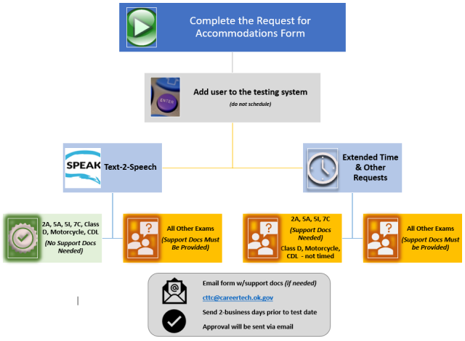
Accommodations

Slide 14
Accommodations – how this works
  All request must complete the Request for Accommodations form
  Candidate needs to make the request – not the instructor
  If only asking for a reader or Text to Speech –
    form is all that is needed for LTC. If request for these exams also includes any other requests (i.e. extended time) supporting documentation must be included for it
  Supporting documentation examples listed on Page 2 of request form
    We do not need to see the full IEP or 504 if that is the docs being used – only a letter from a counselor or someone that has seen the document and can say it includes the need
  We do provide some accommodations for Clinical Skills – extended time, amplified stethoscope, etc…

Slide 15
Any other Questions?

Slide 16





Contact Information
cttc@careertech.ok.gov
  Shared email account monitored by several people
Jennifer.palacio@careertech.ok.gov
  My direct email
Website: https://www.okhcp.com
Social Media

