Slide 1




New Teacher
Academy
2025
Family &
Consumer Sciences

Slide 2
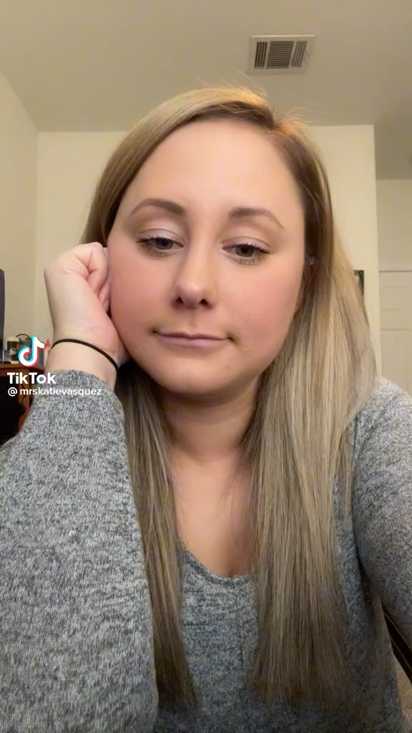
I wish they would
bring back
Home
Economics.

Slide 3

Welcome to FCS
New Teacher Academy

Slide 4


Slide 5
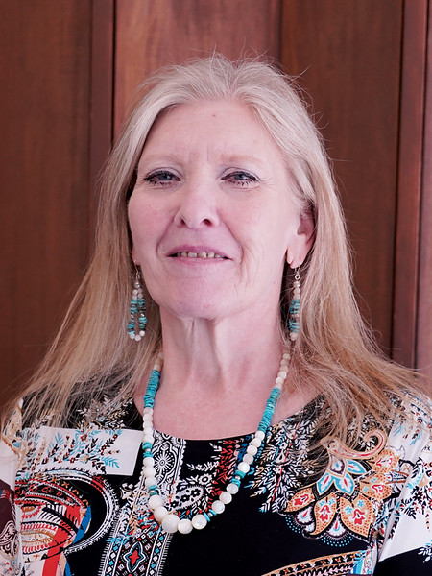
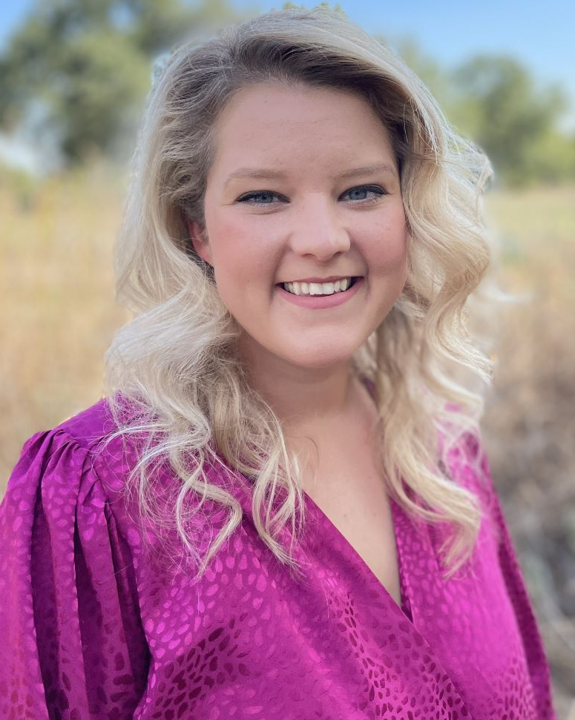
Teena Friend
North Program Specialist
Jessica Maker
South Program Specialist

Slide 6

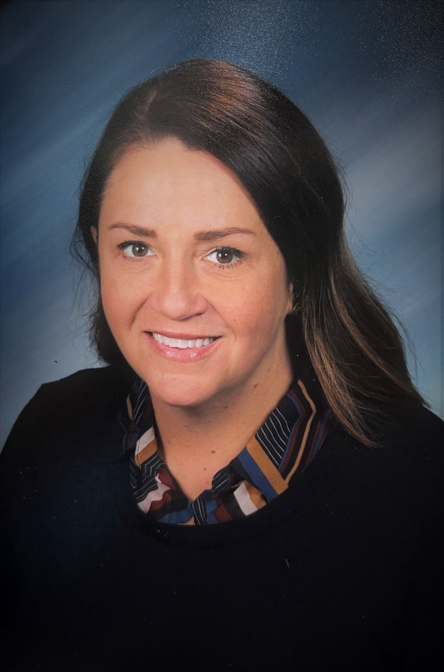
Jessi Beebe
Northeast Program Specialist
Christina Spurgin
Southeast Program Specialist

Slide 7
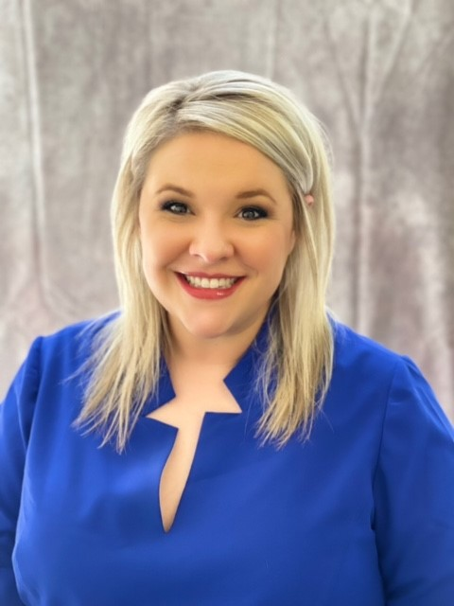
Brittani Phillips
FCCLA State Adviser

Slide 8
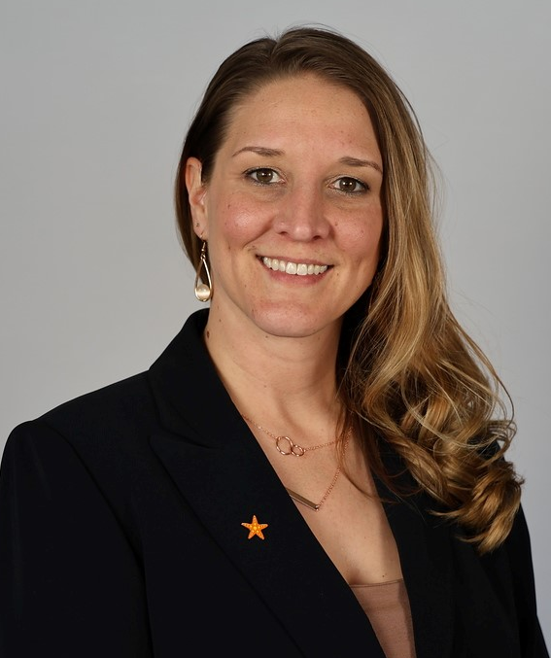
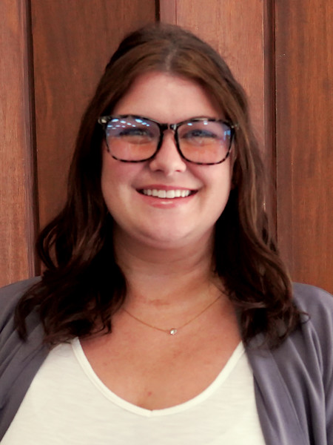
Tiffiany Peters
FCS Administrative Assistant
Ashli Hall
FCS Administrative Assistant & FCCLA Bookkeeper

Slide 9
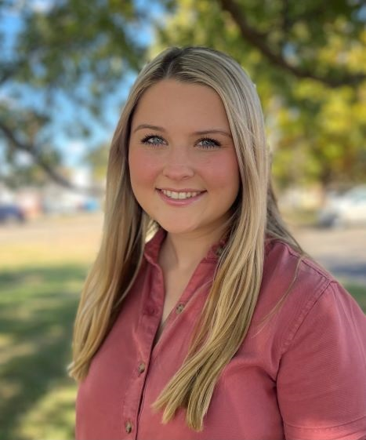
Malynn Broomfield
FCS Student Intern

Slide 10
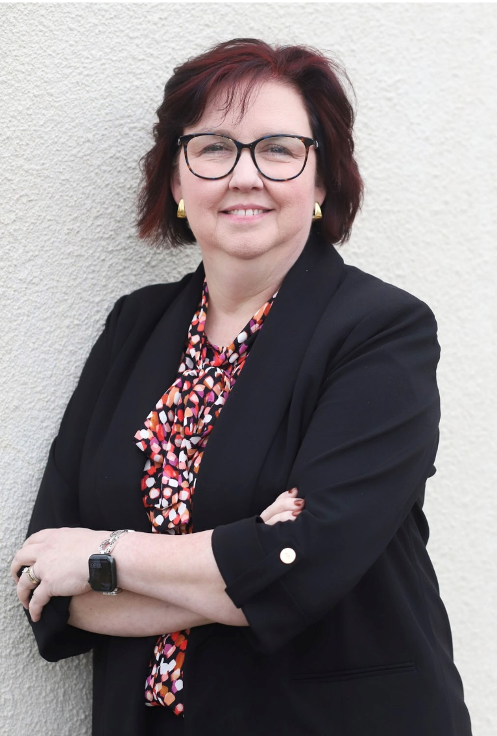
Holly Hanan
FCS State Program Manager

Slide 11


Slide 12





4 Seasons
Move around the room and find 4 different people to put on your note. (CANNOT be at your table or the table next to you)
Introduce yourself
Tell where you teach
Agree which spot you will sign for each other (Both choose the same season)
Take a sticky note
Draw intersecting lines to create 4 boxes
Label each box with a season: Spring, Summer, Fall, Winter

Slide 13


Utilize the Parking Lots around
the room to ask questions.

Slide 14


Slide 15
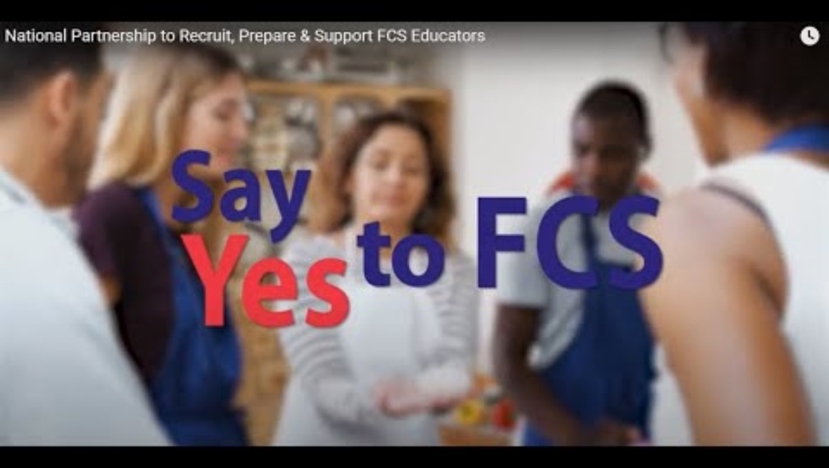

Slide 16
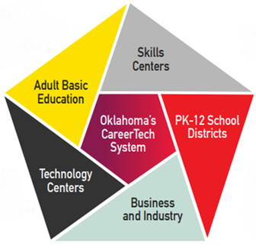
CareerTech
System
Notes:
394 PK12 school districts
29 Tech Center districts
14 Skills Centers Sites
31 Adult Basic Education providers (Adult Education and Family Literacy)

Slide 17

CareerTech Rules
Guidelines for operating a CareerTech program
Updated annually
https://oklahoma.gov/careertech/about/rules.html

Slide 18

CareerTech Contract- pg. 8
Reporting- pg. 51
Salary & Teaching
CESI
Follow-up
412 expenditures
Advisory Committee- pg. 53

Slide 19

Program Money – pg. 10
Program Assistance (412/314 money)
FY22: $8,000.00 (Full-time)
What can I purchase?
(Equipment, Instructional Delivery/Supplies, Professional Development)
Teacher salary supplement (411 money)
FY22: $2,200.00 (Full-time)
Required to attend OK Summit and other CareerTech required PD
(New Teacher Academy including Follow-up sessions, PI meetings,
District Leadership Conference, LEAD, etc.)
This is not a stipend for FCCLA.

Slide 20
Program Operation- pg. 8
Comprehensive (K12)
  6th -12th grade students
  Experience hands-on experiential and problem-based learning to explore opportunities for careers, post-secondary transitions and pathways in family and consumer sciences related areas
Occupational (K12 or Tech Ctr.)
  Prepare students for careers in specific family and consumer sciences occupations
Only FCS approved courses
Programs of Study
  Single teacher: 2 programs in different clusters
  Multi teacher: 1 more program than the number of teachers
Active FCCLA Chapter required

Slide 21
Comprehensive (K12)
  Full-time: 7 period day=6 FCS courses + 1 planning period
  Part-time: 7 period day= 3 FCS courses + 1 planning period
Occupational (K12)
  Full-time: 2 or more classes, 2-3 period length
  11-12th grade students
Occupational (Tech Center)
  Full-time: 2 classes, 3 periods length
  11-12th grade students and/or adult students
  1-2 years of training
Enrollment

Slide 22

Class Size
Comprehensive (K12)
Non-laboratory classes: 30 students
Laboratory classes: 24 students
Work-based learning (School & Community Partnership): 24 students/session
Occupational (K12 or Tech Center)
Minimum 10 students/section
Maximum 20 students/section

Slide 23


Slide 25
Professionalism
and
Ethical Behavior

Slide 26
Teachers should portray professionalism:
Conduct
Communication
Commitment
Punctuality
Appearance
Attitude
Respect
Confidentiality
Integrity
Clear and Concise
Active Listening
Timely Responses
Constructive Feedback
Continuous Learning
Collaboration
Adaptability
Passion for Teaching
Beyond the Classroom
Reflection

Slide 27
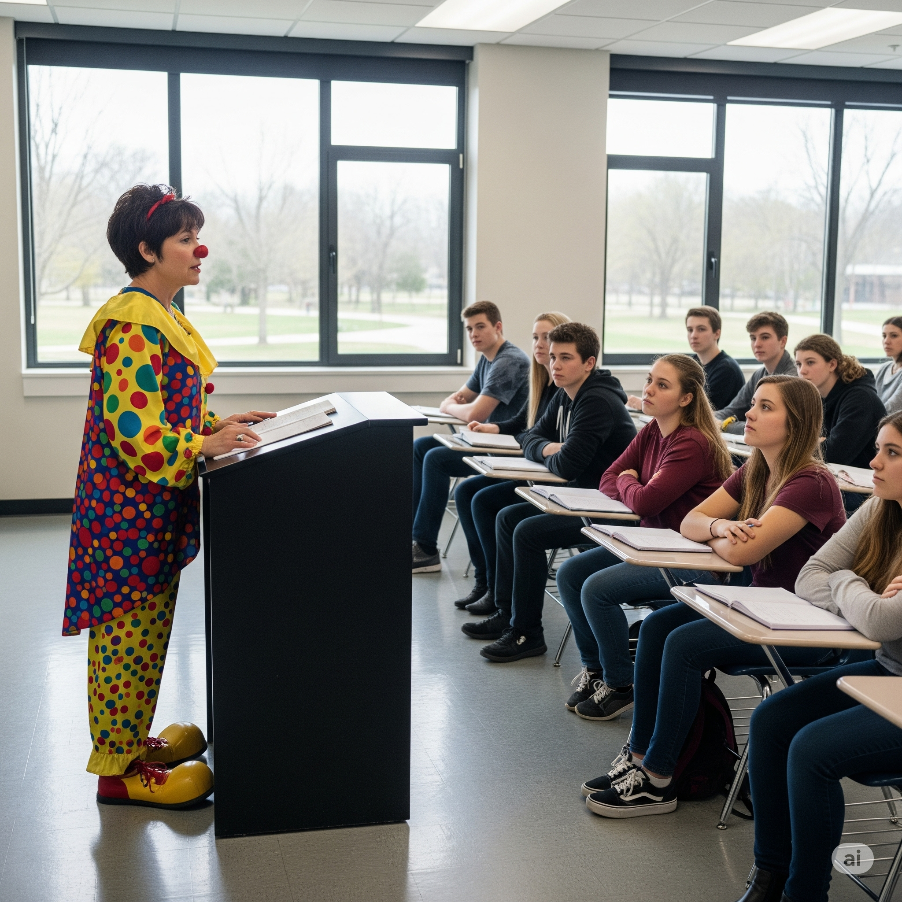
"Our presence speaks volumes, even before we say a word.”
Let's talk about the power of professional appearance in the classroom."

Slide 28

Business Casual Dress
Notes:
What is generally considered "professional" dress for teachers?
Business casual is often the standard: This typically includes collared shirts, blouses (modest necklines), dress slacks, skirts (knee-length or longer), and closed-toed shoes.
Avoid overly casual attire: Jeans (unless specifically allowed), t-shirts (other than school spirit wear), shorts, mini-skirts, athletic wear, flip-flops, and overly revealing clothing are generally discouraged.
Context matters: The appropriate dress can vary by subject (e.g., science labs, physical education), grade level (elementary vs. high school), and school district policy. Some schools may have more relaxed dress codes, while others are stricter.
Grooming: Neat and clean hair and nails are also part of a professional appearance.

Slide 29

When the students are in official dress,
you should be in
Business Professional Dress.
Notes:
Impact of Professional Dress on Students and Perceptions:
Student Perceptions:
Competence and Effectiveness: Studies consistently show that students perceive professionally dressed teachers as more competent, organized, knowledgeable, and effective.
Authority and Respect: Professional attire can help establish a teacher's authority and garner respect from students, parents, and colleagues.
Approachability (mixed results): While formal dress can increase perceptions of competence, some studies suggest that more casual attire might make teachers seem more friendly and approachable to students. However, this can sometimes come at the cost of perceived respect or disciplinary control.
Student Behavior: Some research indicates that professional attire can lead to improved student behavior and a more focused learning environment, and may even be inversely correlated with student misbehavior.
Academic Achievement: One study found that students scored higher on math quizzes when teachers were professionally dressed compared to when they were casually dressed or at baseline.
Teacher Credibility: Professional attire can enhance a teacher's credibility by demonstrating seriousness about their job and commitment to high-quality education.
Role Modeling: Teachers' dress is seen as important for establishing them as role models for students.
School Culture: Dress codes can impact school culture, and some administrators believe that as long as teachers are not wearing provocative or offensive clothing and student achievement isn't suffering, strict dress codes may be unnecessary.

Slide 30
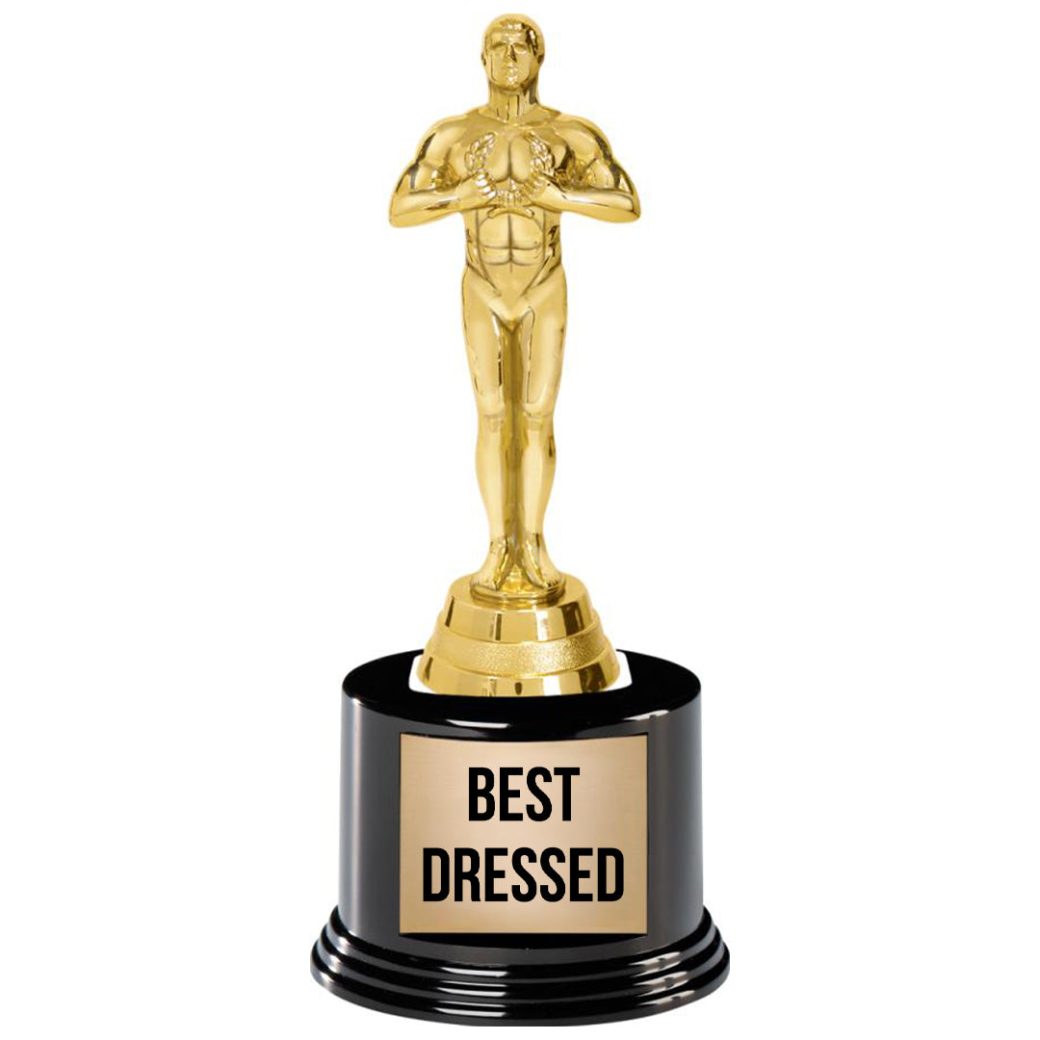

Slide 31
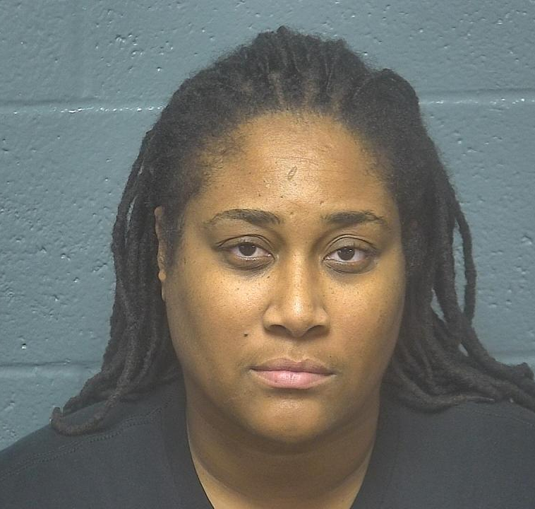
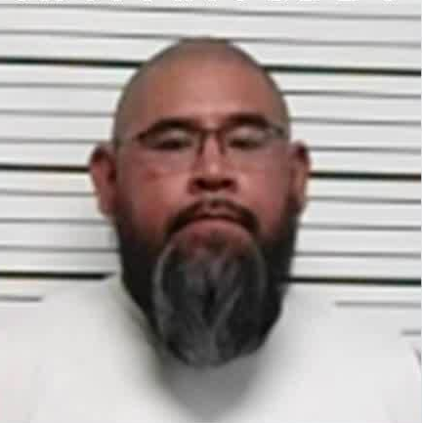
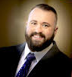
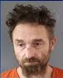
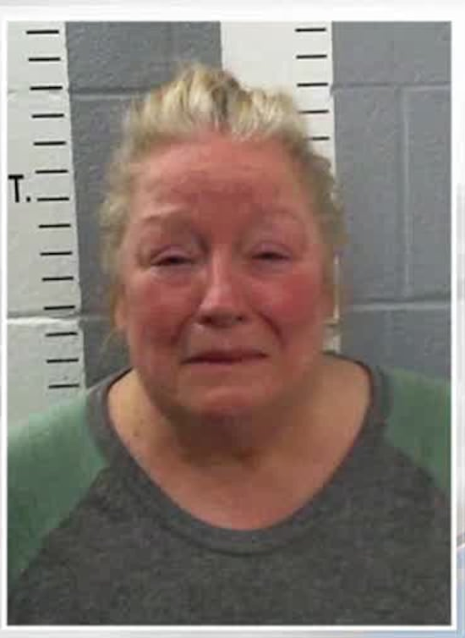
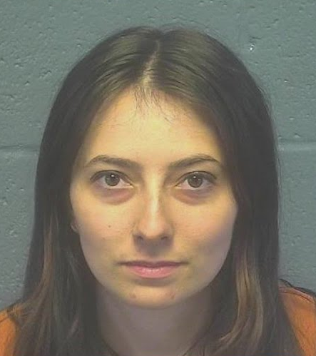
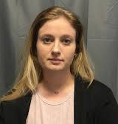
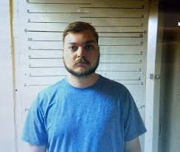
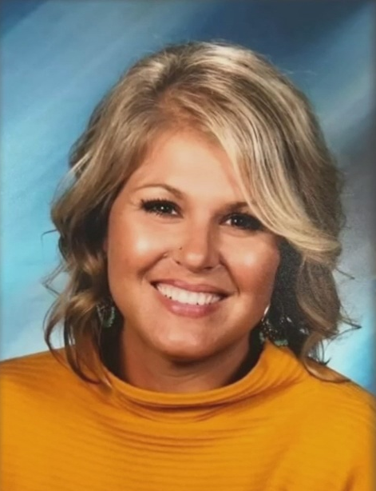
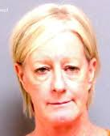
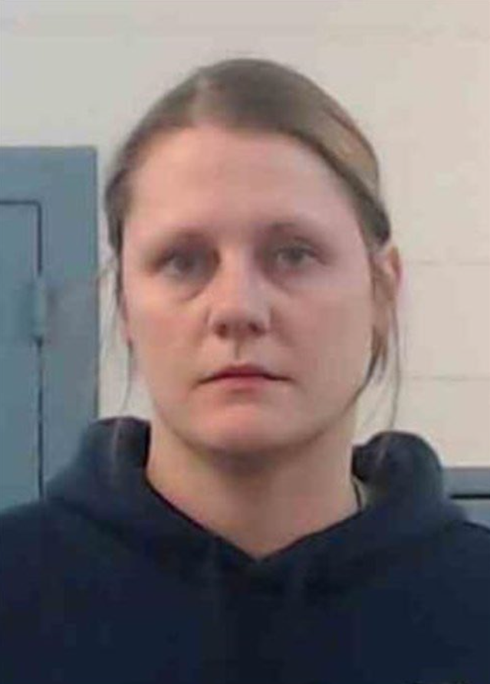
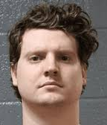
Sexting
Child Porn
Embezzlement
Drugs/Alcohol
Inappropriate
relationship
Physical abuse

Slide 32


Slide 33
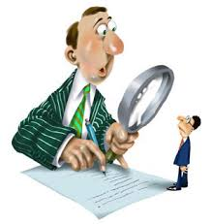
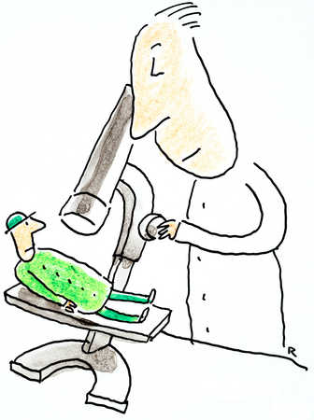

Your actions will
be scrutinized

Slide 34

Why Ethics Matter:
The Core of Our Practice
Ethics as the moral compass guiding teacher actions.
The unique position of trust teachers hold with students, parents, and the community.
Ethical behavior as a safeguard for student well-being and a foundation for a positive learning environment.

Slide 35

Guiding Principles of Ethical Conduct
Responsibility: To students, profession, community.
Respect: For all individuals, diversity, and differing viewpoints.
Fairness: Equitable treatment, unbiased decision-making.
Honesty/Integrity: Truthfulness, transparency, trustworthiness.
Confidentiality: Protecting sensitive student and family information.

Slide 36

Professionalism in Action:
The Classroom Environment
Instructional Excellence: High standards for teaching and learning, preparedness, effective pedagogy.
Classroom Management: Creating a safe, orderly, and respectful learning space.
Student Relationships: Maintaining appropriate boundaries, fostering positive rapport, avoiding favoritism.
Privacy and Confidentiality: Handling student information with utmost care. FERPA

Slide 37

Beyond the Classroom:
School and Community Engagement
Colleague Relationships:
Collaboration, respect, professional discussion, avoiding gossip.
Parent/Guardian Communication:
Timely, respectful, constructive, and professional interactions.
School Policies and Procedures:
Adherence to school and district guidelines.
Community Role:
Representing the profession positively, responsible social media use.

Slide 38

Navigating Ethical Dilemmas:
A Practical Approach
Acknowledge that ethical dilemmas are common.
Introduce a simple framework (e.g., Identify the dilemma, Gather information, Consider options, Evaluate consequences, Make a decision, Reflect).
Seeking guidance when unsure (mentor, administrator, etc).

Slide 39

Digital Citizenship:
Professionalism in the Online World
The blurred lines between personal and professional online presence.
Maintaining professional boundaries on social media (e.g., friending students).
Avoiding inappropriate content or comments online.
Protecting student privacy in digital contexts.
The permanence of online information.

Slide 40

Upholding Impartiality:
Avoiding Conflicts of Interest
Definition: Situations where personal interests could improperly influence professional judgment.
Examples: Tutoring own students for pay, accepting gifts that could create obligation, using school resources for personal gain.
Importance of transparency and disclosure.

Slide 41

The Professional Obligation to Report
Understanding when and how to report suspected unethical or illegal behavior.
Importance of protecting students and the integrity of the profession.
Knowing school/district reporting procedures.
Protection for whistleblowers.

Slide 42
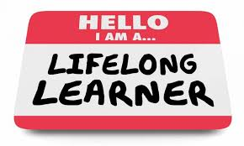
Lifelong Learning:
A Hallmark of Professionalism
Commitment to ongoing professional development.
Staying current with best practices, research, and educational trends.
Self-reflection and seeking feedback for improvement.
Modeling a growth mindset for students.

Slide 43
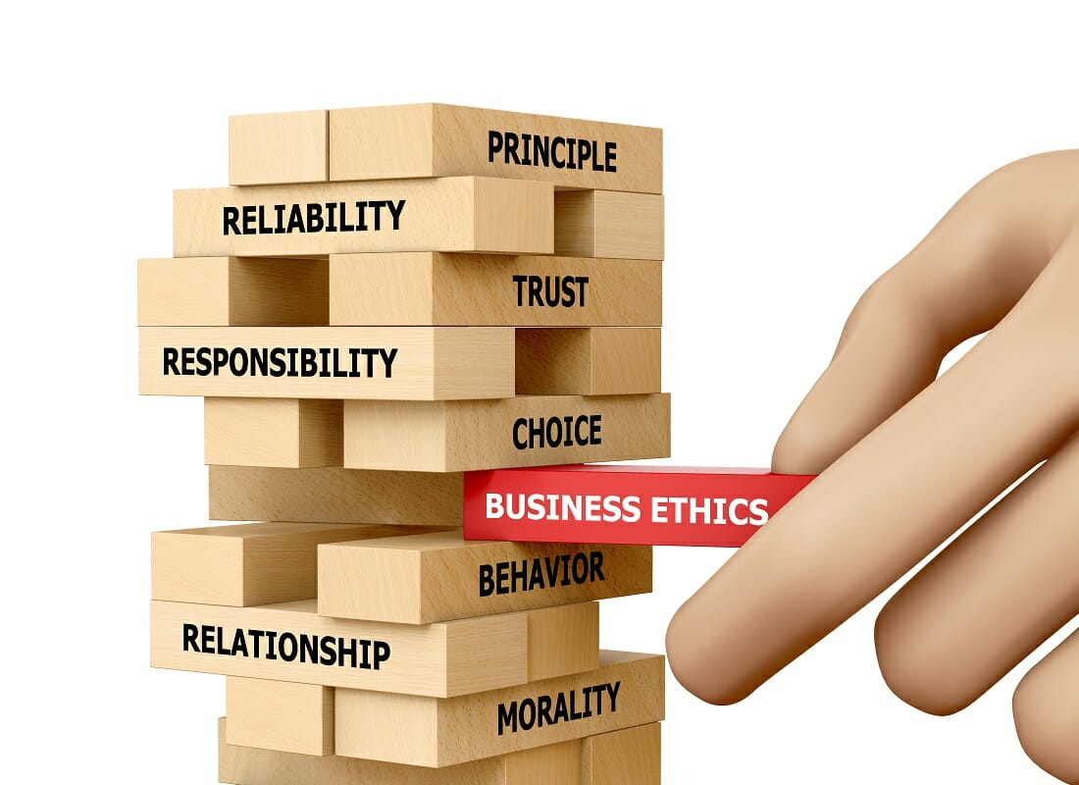
Embracing Professionalism:
Our Collective Commitment
Professionalism and ethics are fundamental to effective teaching and a thriving educational environment.
Understand the positive impact on students, colleagues, and the community.
Continue ongoing self-assessment and commitment to these principles.

Slide 44

Higher Standard
Teachers are held to a higher standard of conduct than ordinary citizens.
Moral standards are not absolute, varying within specific communities
When teachers break the law, the notoriety, or the extent to which a teacher’s behavior becomes known or controversial, can determine teacher dismissal.

Slide 45
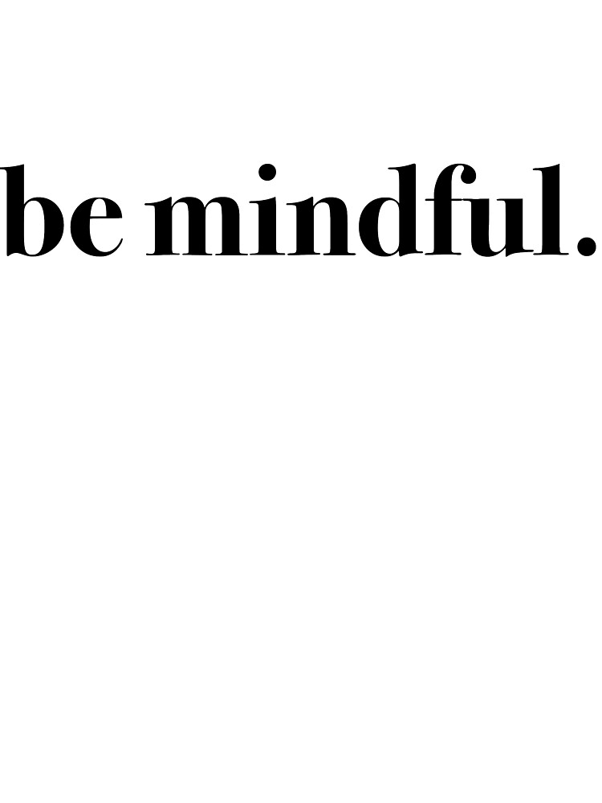
Social Media presence
Personal Behavior
Professional
Behavior
Appropriate Dress
Notes:
Social media presence
-Email- ANY written communication, regardless of intent or context, could be used to hold you liable for situations involving students
-Texting
-Twitter, FaceBook, TikTok, Instagram, etc.
Appropriate dress
Professional behavior (students, faculty, parents, community,)
Do not let them call you by your first name. (Mr. Mrs. Ms.)
Teacher absenteeism
Give up on students
FERPA- Family Educational Rights and Privacy Act
Speech/Language
Lack of support
Religious/Politically charged conversations
Above criticism
Inappropriate relations with students, staff, parents, etc.
Treating students differently (favorites, rude, bullying, etc)

Slide 46
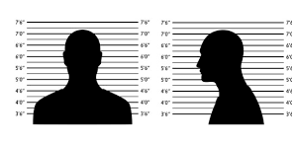
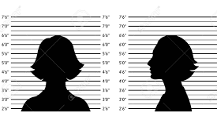
Don’t let this be you!

Slide 47
When in doubt,
DON’T !!!!

Slide 49

58th Annual Oklahoma Summit
Aug. 4-5, 2025
Arvest Convention Center | Tulsa, Oklahoma

Slide 50

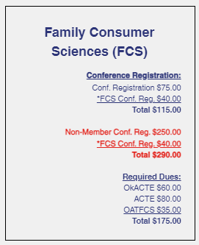
www.okacte.org
Click on Oklahoma Summit
Click Registration & Dues

Slide 51
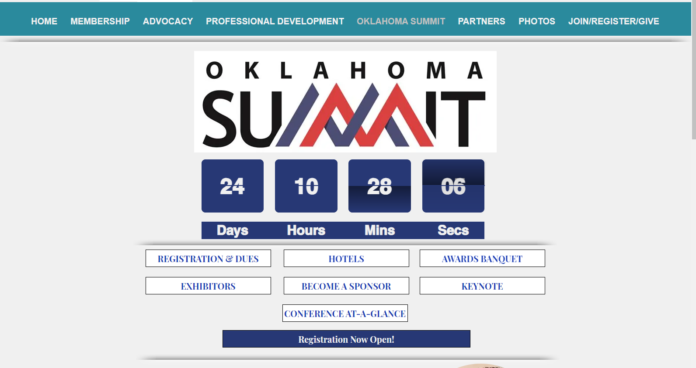

Slide 52
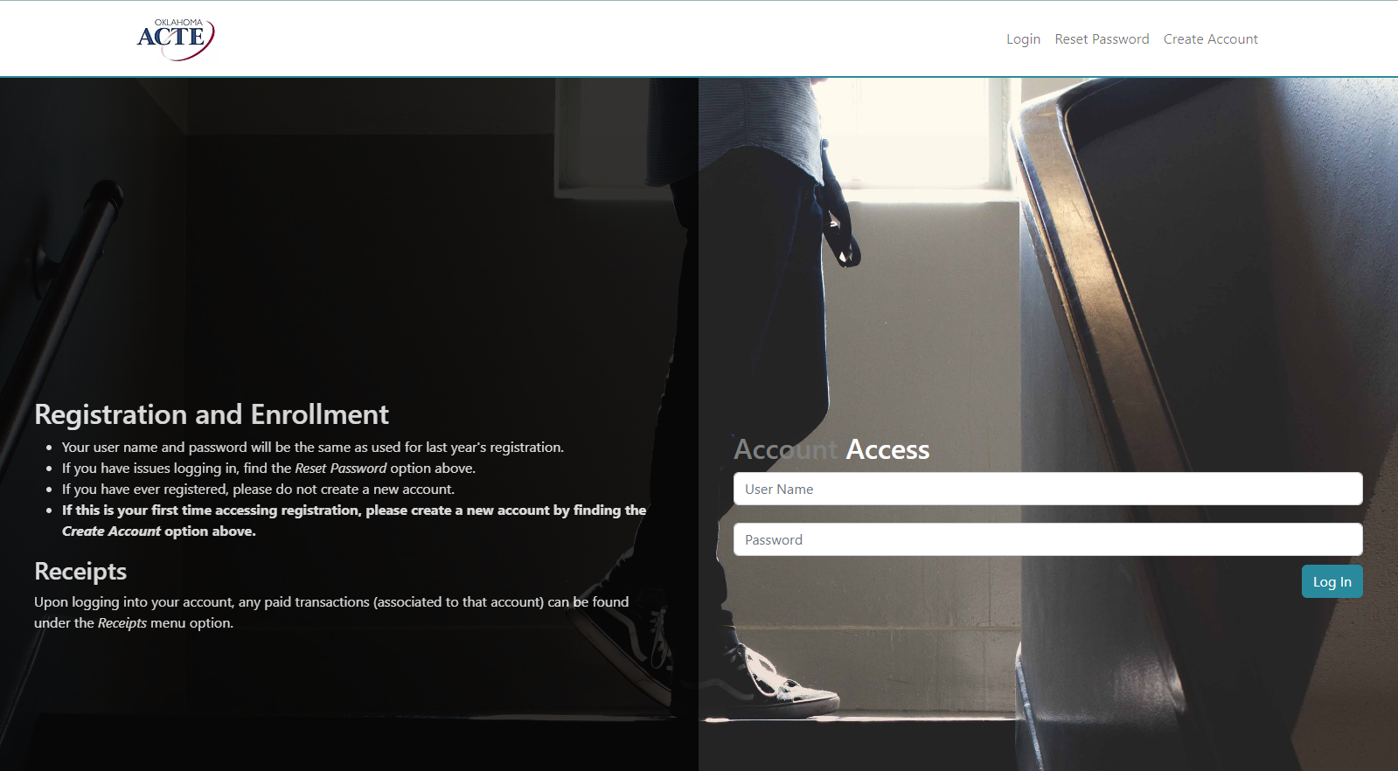

Slide 53
Call OkACTE office
Tell them you are a new teacher
and ask for the Early Bird price
Carmen Jones
405-525-8906

Slide 54
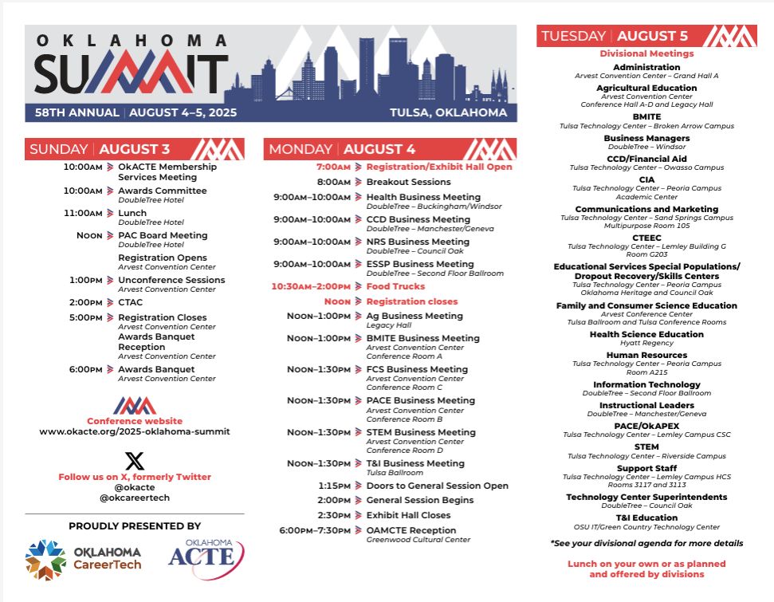

Slide 55
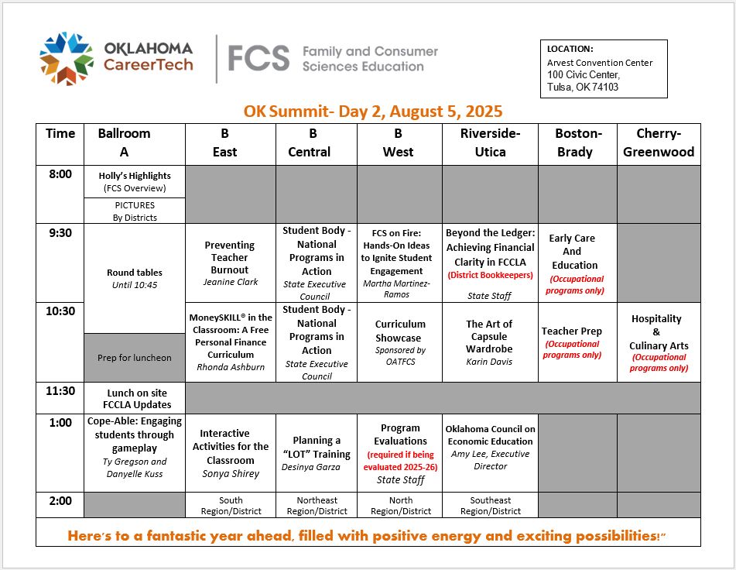
FCS
Workshops
Tuesday, August 5th

Slide 56
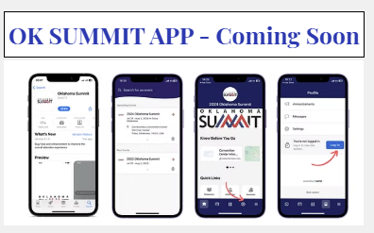

Slide 57
What are benefits of
attending
OK Summit?

Slide 58
Resources
Networking
Great way to start the school year
New Ideas
Expectations for Program

Slide 59
New Teacher Follow-Up workshops
Put on your calendar
September 23, 2025
January 21, 2026
You must complete all sections of
New Teacher Academy
to complete your CareerTech certification.

Slide 60

Al is changing the classroom.
Generate essays
Give feedback
Build lesson plans

Slide 61
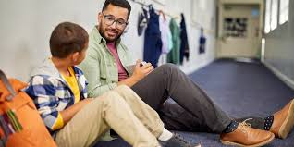


What AI cannot do…
When silent signals means something deeper
Lightbulb moments & curiosity kicks in
Trusted adult they need in their lives

Slide 62
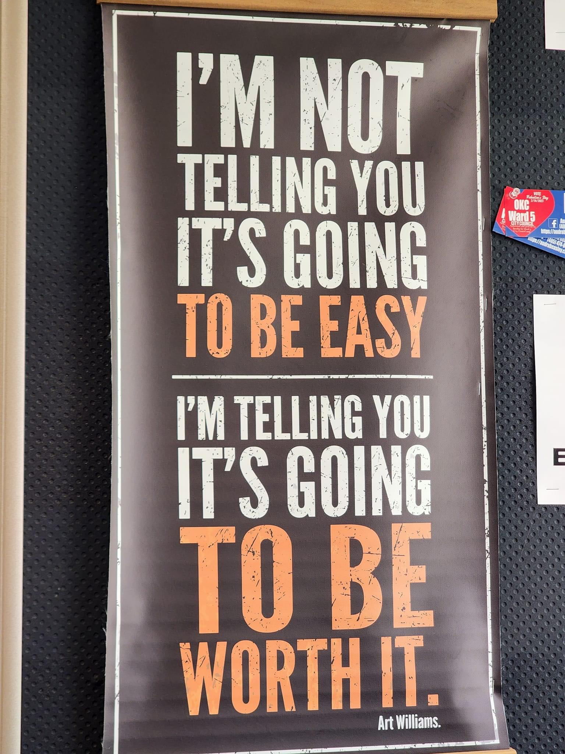

Slide 63
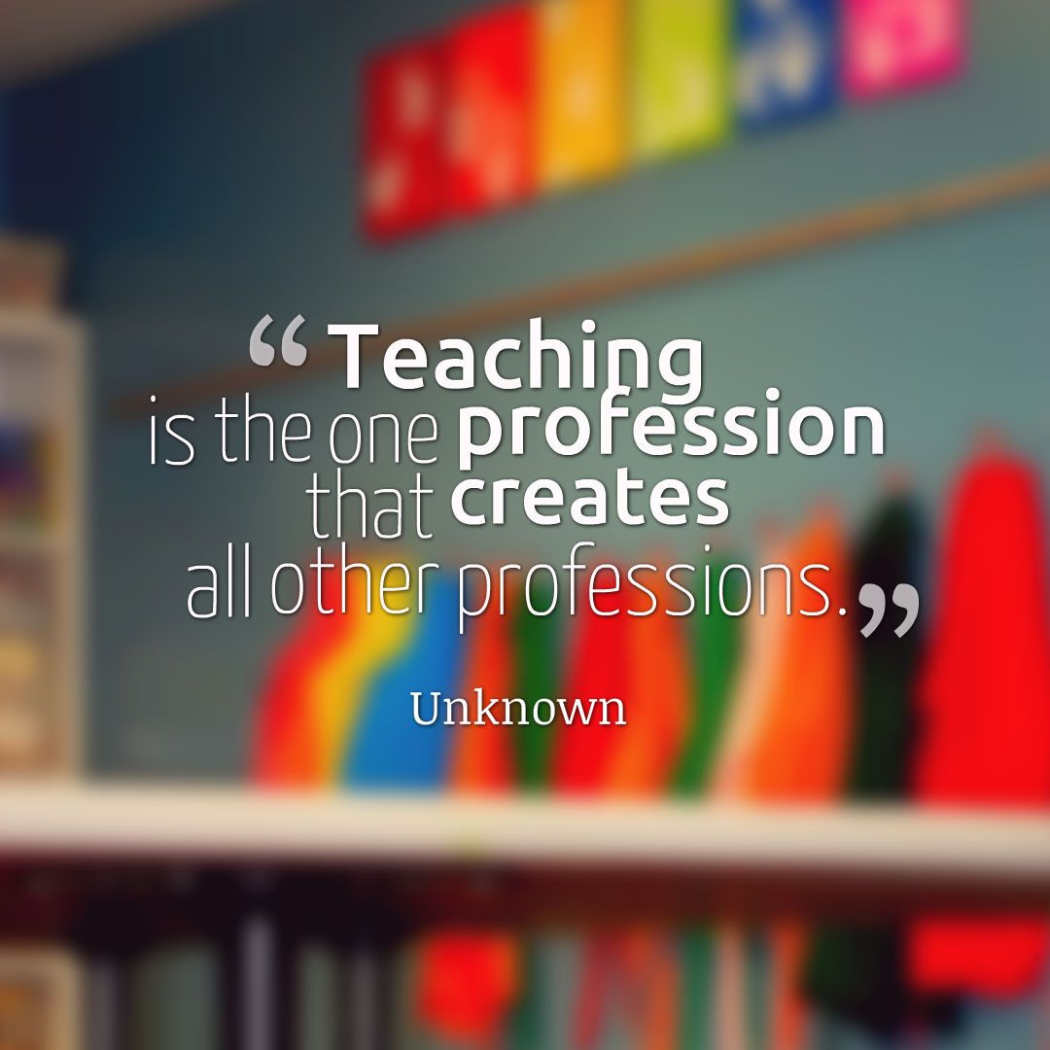


Slide 64


