Slide 1


FCS New Teacher Academy
July 21, 2025
CareerTech History
Gina Hubbard
Director of Statewide Outreach

Slide 2
Important Legislation
Smith-Hughes Act of 1917
*defined vocational education as employment preparation
*created the Federal Board of Vocational Education to approve state plans
*vocational education gets its own state-level division (liaison)
George Reed Act of 1929 – 900,000 enrollments = $1 million in funding
George-Ellzey Act of 1935 – increase for ag/home economics, teacher training and salary supplements for distributive education
The Vocational Education Act of 1946 – doubled federal funds and provided more flexibility for states

Slide 3
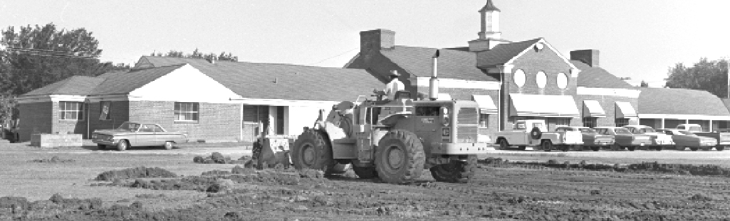
Relocation of the State Vocational Agency (1932)
Vocational education department operated from Oklahoma City since 1917
J.B. Perky moved the department to Stillwater and the OAMC campus
Current agency location was made available in 1958 by the renamed Oklahoma State University
Notes:
PRESENTER’S NOTES
OSU still owns the building
The only state agency in Stillwater

Slide 4
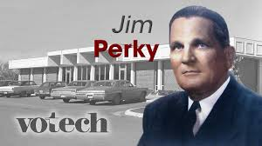
J.B Perky becomes the executive officer for the state board to represent vocational education
He was the first state director for vocational education
Remained the state supervisor for vocational agriculture education
1
9
4
1
Notes:
PRESENTER’S NOTES

Slide 5
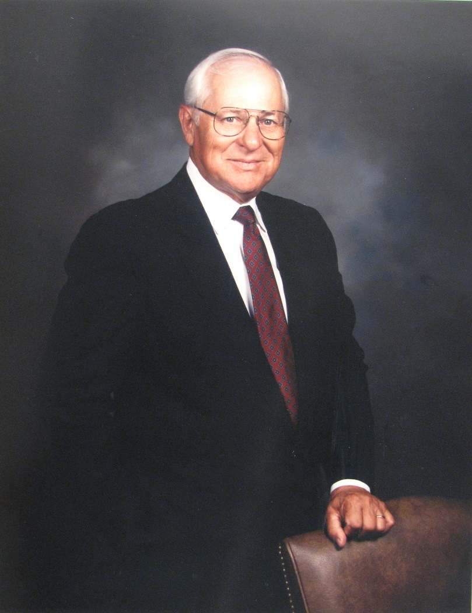
Hiring of Francis Tuttle as State Coordinator of the New Area Schools Division (1964)
Francis Tuttle—then superintendent of Muskogee Public Schools—accepted an offer from Oliver Hodge—state superintendent of public instruction—and from J.B. Perky to head the new Area Schools Division.
Notes:
PRESENTER’S NOTES
J.B. Perky had the vision that vocational education was something that Oklahoma could become the best at; Francis Tuttle was a long-time friend of Perky and would design a state system so innovative that it would require an amendment to the state constitution.

Slide 6
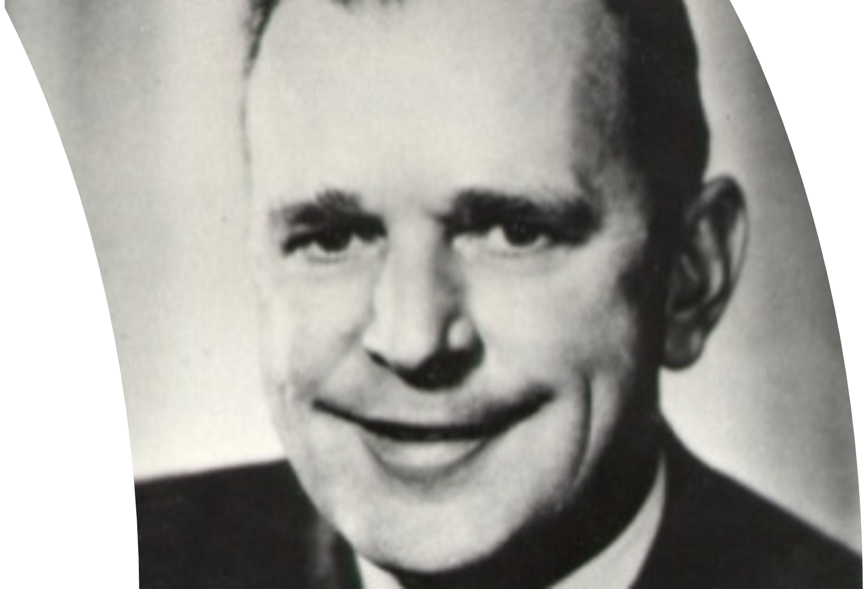

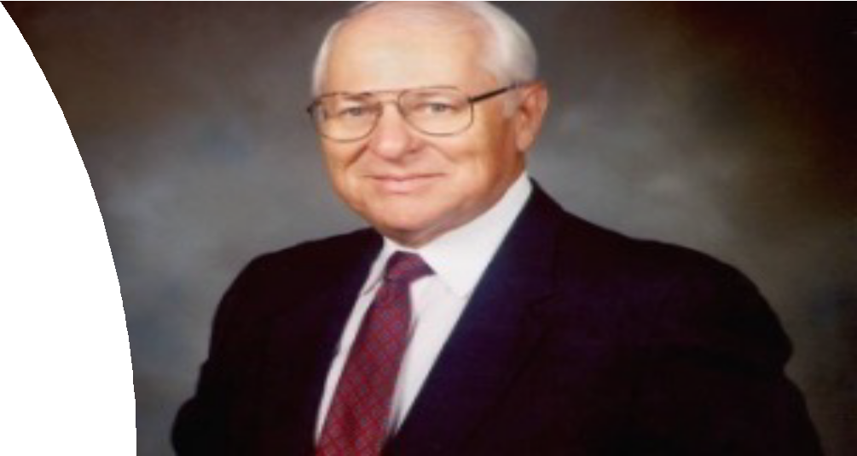
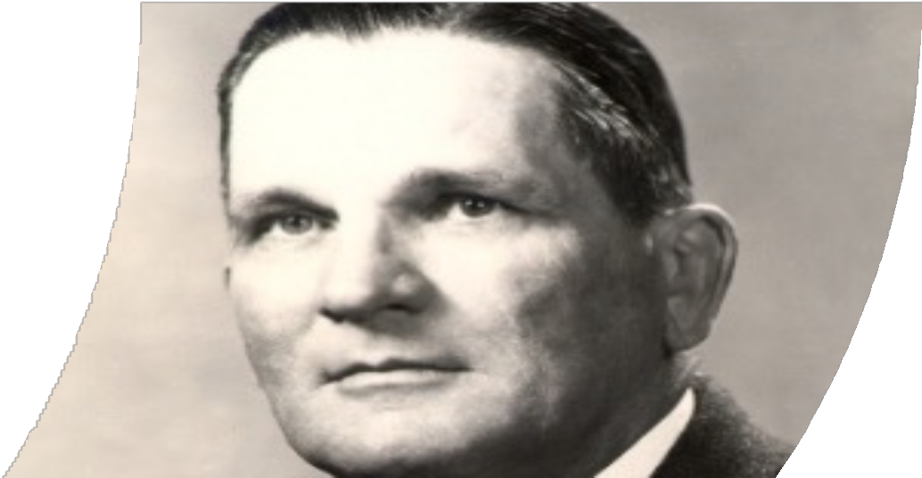
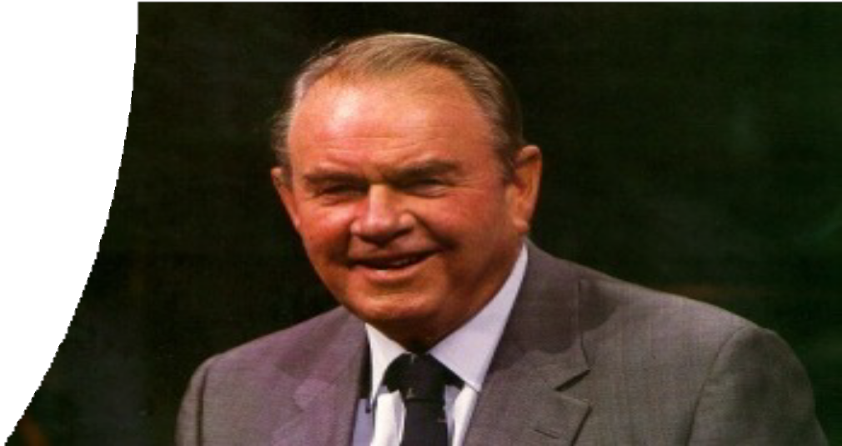
Dewey Bartlett Francis Tuttle JB Perky Henry Bellmon
The Career-Tech story is about a tale of four men who made Oklahoma’s world-class
vocational system possible
Notes:
Bellmon is current governor and Bartlett has aspirations to be governor – both republicans. Bartlett runs on being the job gettinest governor”
JP Perky & Francis Tuttle set on designing a first-class vocational education system like no other – they were both democrats.
Perky, Rep. Abbott and Tuttle pitch the idea to Bellmon and he loved if, Senator Bartlett co-authored the bill w/Abbott and the rest is history.

Slide 7
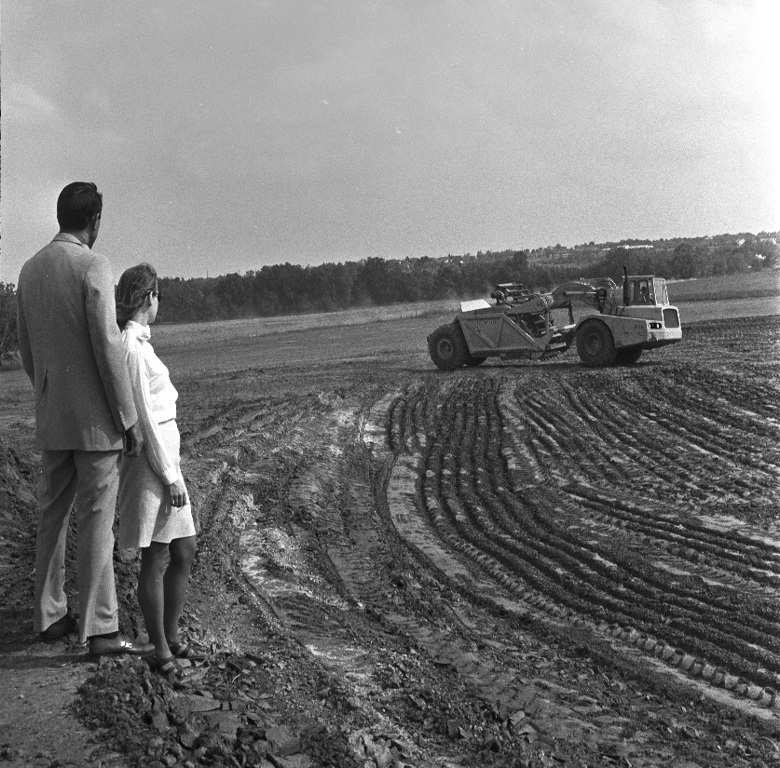
Approval of State Question 434 (1966)
Allowed one or more school districts to form a single vocational district with its own elected vocational board and expected to build and maintain area vocational-technical schools
Combined property rolls from the districts
State Constitutional Amendment that allowed districts to levy up to 5 mills for capital construction and ten mills more for operating expenses, subject to district voter approval
Notes:
PRESENTER’S NOTES
Passed 51% to 49%
Before the passage of SQ 434 in 1966, five area vocational-technical schools were formed that were a part of their public school districts: Tulsa Tech, Foster Estes (which would eventually become Metro Tech), Red River in Duncan, Southern Oklahoma in Ardmore and O.T. Autry in Enid. While it is recognized that Tulsa was the first entity to form an area school district, all five of these schools “stuck their necks out” to test the new concept of the “area vo-tech school.”
District voters approved Tri-County Tech in Bartlesville as the state’s first area vocational-technical school in 1967.

Slide 8
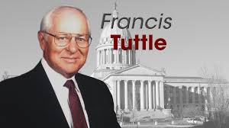
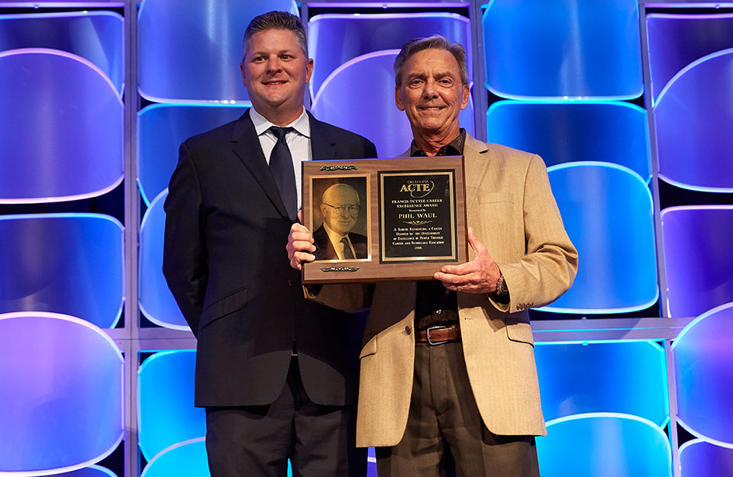
Challenges & Accomplishments
YouTube Links:
Interview Part 1
Interview Part 2

Slide 9
Important Milestones
1968 Established a separate State Board of Career &
Career & Technology Education
Bellmon commissioned a trip to South Carolina
1971 First delivery of vocational training to inmates
1976 Focus on economic development with Training for
Industry
1984-98 Carl Perkins, Youth Apprenticeships, Dropout Recovery

Slide 10
More Important Milestones
2000 House Bill 2128 officially changed the name of the system to Career & Technology Education
2004 House Bill 1271
*authorized CareerTech to teach math & science
*cooperative alliances with higher education
*Lottery Trust Fund
2024 Change in graduation requirements

Slide 11
Technology Center Districts Form
1968
Who was first?
1993
Who was #29?

Slide 12
Technology Center Districts:
Tri County
Caddo Kiowa
Central
Indian Capital
Gordon Cooper
Canadian Valley
Kiamichi
Mid-America
Great Plains
Northwest
Northeast
Western
Pioneer
Pontotoc
Autry
Meridian
Moore Norman
Tulsa Tech
Red River
Southern
Francis Tuttle
Metro
Eastern OK
High Plains
Wes Watkins
Chisholm
Southwest
Green Country
Mid-Del (I-52)*
Trivia: How many counties does OK CareerTech serve?

Slide 13
Over 40 years later…
Still facing some of the same challenges
Still refining rules, crafting legislation, and advocating for appropriations
Still working to remain relevant
Still creating opportunities for all Oklahomans
Still having an economic impact
“We empower students, support educators, and drive innovation
to create a world-class workforce for Oklahoma” -Director Haken

Slide 14

Questions
Resources: https://www.okhistory.org/publications/enc/entry?entry=AG003

Slide 15
System Delivery Arms

Slide 16


How many delivery arms does our system have?
TEST YOUR KNOWEDGE

Slide 17
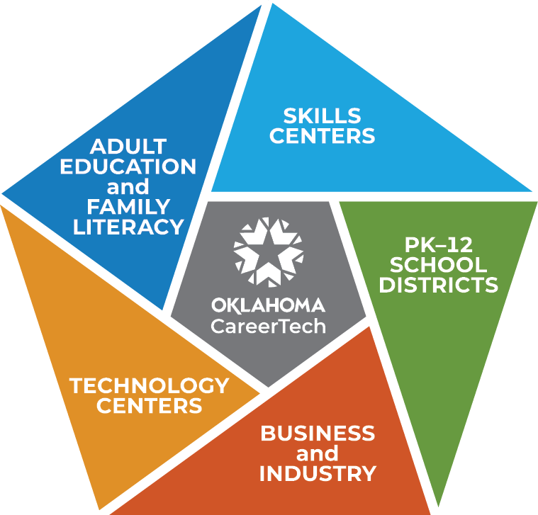


CareerTech Delivers
      One of the strengths of the CareerTech System is its accessibility to almost every Oklahoman.
      CareerTech offerings in 397 PK–12 school districts and 1,515 teachers
      29 technology center districts with 62 campuses and 1,305 teachers
      Business and industry training attracts new industry and helps existing businesses expand and prosper with 9,289 companies served
      16 skills center sites for inmates and juvenile offenders with 40 teachers
      32 adult education and family literacy providers at 118 sites

Slide 18
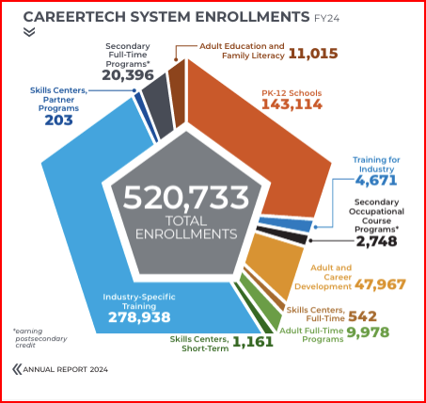

Slide 19

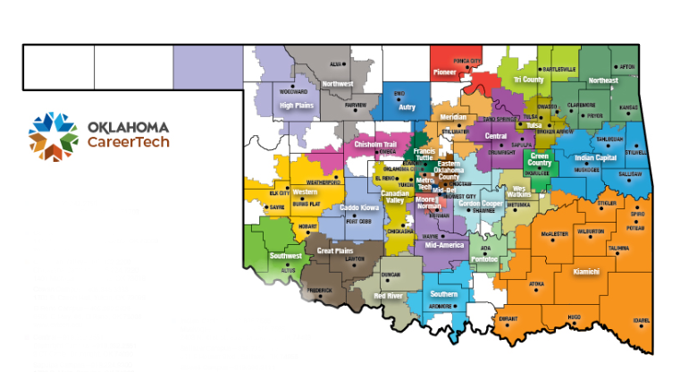
Technology Centers and Districts
29 Districts and 62 Campuses

Slide 20

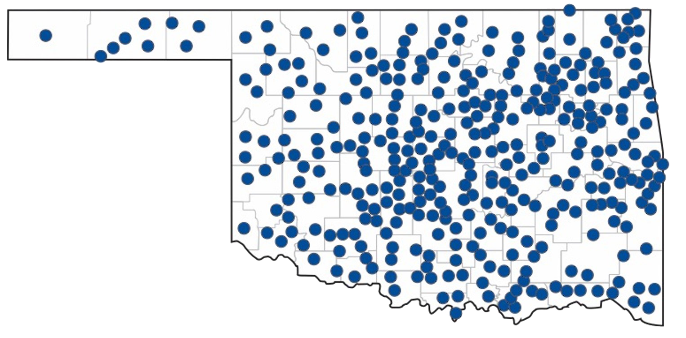
PK–12 Schools – 397 districts
Most of Oklahoma’s career and technology education students at the secondary level are enrolled in CareerTech programs in their local schools.
In FY23, a total of 1,474 CareerTech teachers in 397 PK–12 public school districts served a total of 139,505 enrollments.

Slide 21

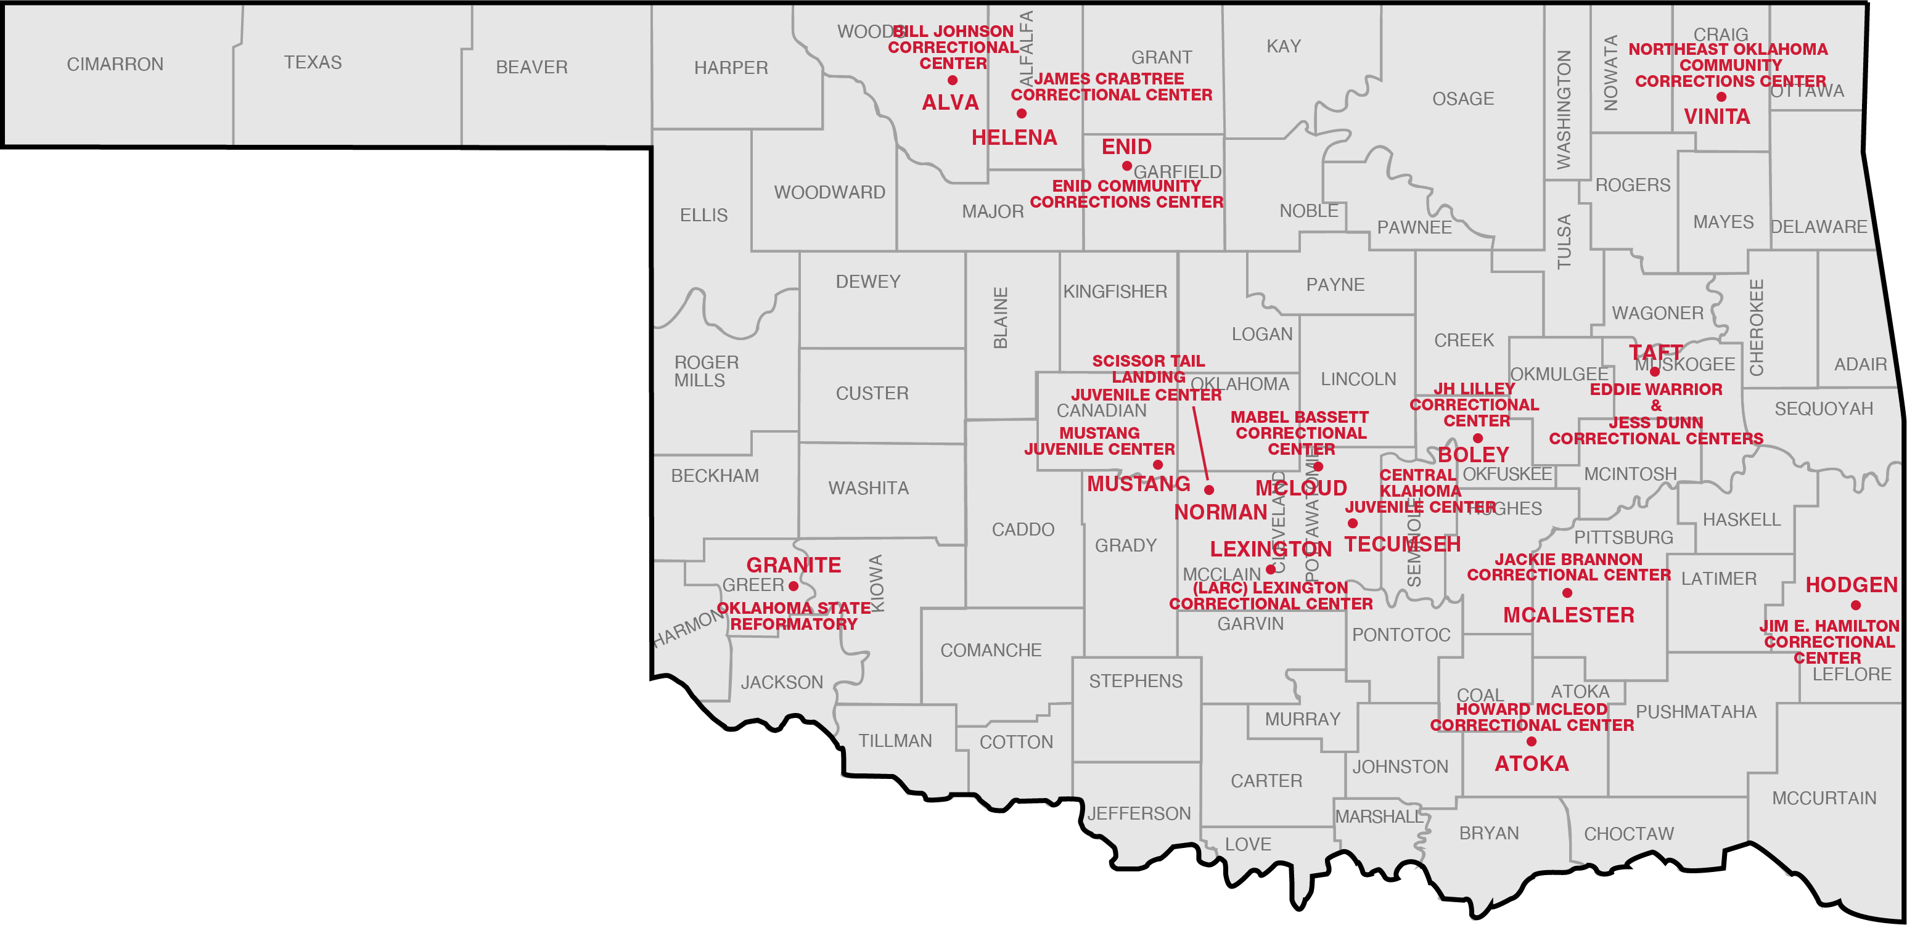
Skills Centers – 16 sites

Slide 22

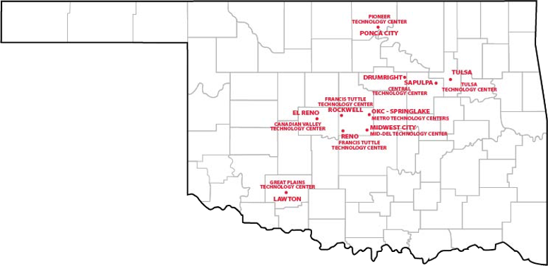
Dropout Recovery Programs - 10

Slide 23
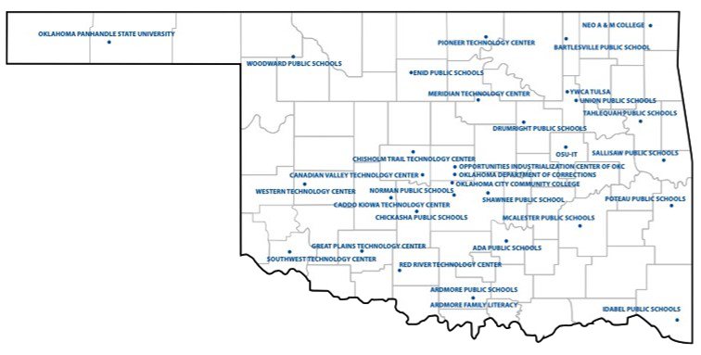
Program Locations – 118 sites
Adult
Education
and
Family
Literacy

Slide 24
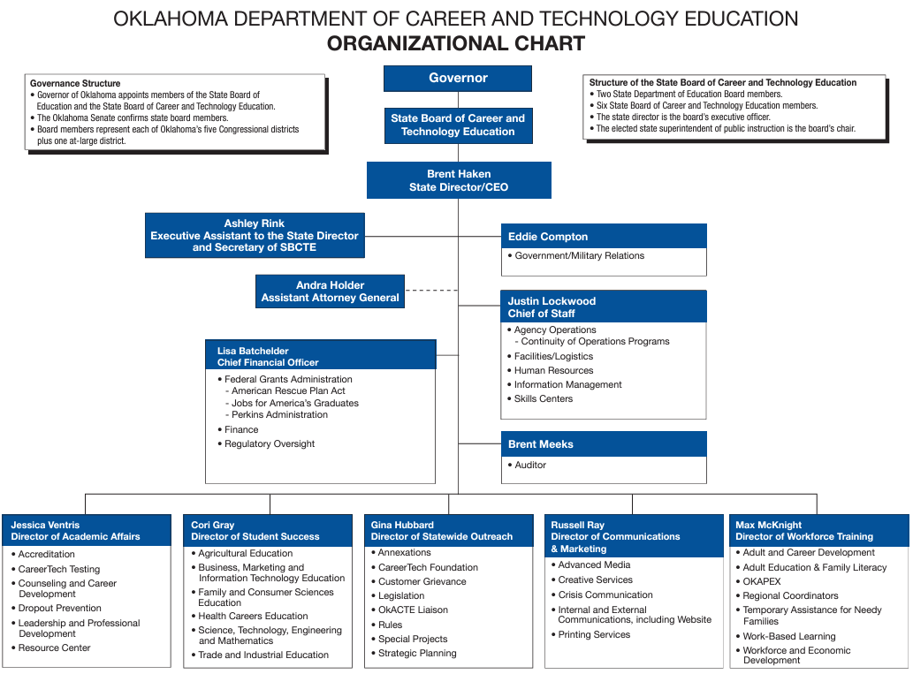
THE AGENCY
220 FTE/231 budgeted
26 Divisions
49 Skills Center Staff
Independent State Board
Location
Print Shop

Slide 25

How many State Directors have we had?
TEST YOUR KNOWLEDGE

Slide 26
State Directors:
1941-1967 J.B. Perky First State Director, System Architect
1967-1985 Dr. Francis Tuttle System Architect, Skills Centers, MAVCC Curriculum Consortium, Independent VoTech Board Formed
1985-1999 Dr. Roy Peters VoTech Testing Division, Carl Perkins Funding, White Glove
1999-2002 Dr. Ann Benson Name Change to CareerTech, School-To-Work, Keating
2002-2003 Pete Buswell Six Months
2004-2013 Dr. Phil Berkenbile Enrollments hit 500,000, Academics, RIFS/Budget Cuts
Interim Dr. Kay Martin
2013-2015 Dr. Bob Sommers Reorganization, Baldridge, Ag Programs in Tech Centers
2015-2022 Dr. Marcie Mack Budget Shortfalls, Pandemic
Interim Lee Denney
2023-present Brent Haken New Vision for Growth, Legislation, Funding, Agency Support

Slide 27
“The most important thing is to make sure the most important thing remains the most important thing.”
-Dr. Tom Friedemann
Thank you!

