Slide 1

ctYOU.org is like your best friend....sometimes you don't like it, but you always love it!
Jessi Beebe
Northeast Program Specialist

Slide 2
ctYou.org is the Learning Management System (LMS) we use at Oklahoma Department of CareerTech (ODCTE). You will also find important FCS information on ctYou.org.

Slide 3
ctYou.org can be used for many different things like finding standards and pacing guides to finding specific Regional/District information and even looking up FCS Friends in the Directory!

Slide 4
If you have not already done so you will need to create an account. Please use your school email address, if you don’t know it yet you can use your personal email. Just remember which email you used, if you ever have to use the forgot password function they will send the reset information to the email you used when you created the account.

Slide 5

Everything you feel when you are on ctYOU.org
Creating an Account

Slide 6
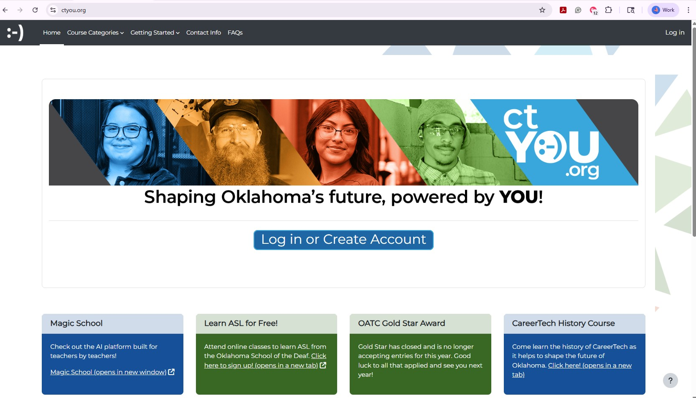
This is what you will see when you are on the ctYOU.org website: Notice the “Log In” section on the top right!

Slide 7
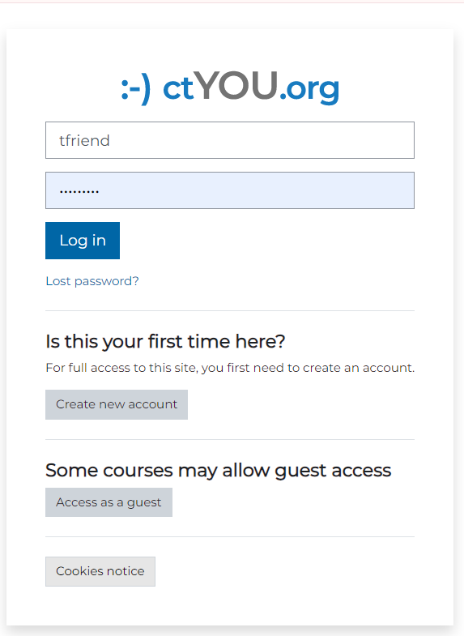
It is good to use your school email.
There are many pages you will be able to see as a guest, but it is good to get into the habit of logging in every time you get on to ctYOU.org
IT IS MORE THAN OKAY IF YOU ARE VIEWING THINGS AS A GUEST! Our resources are open, and if they aren’t, the password has been provided to you!
If you are not seeing information that you think should be up to date, be sure to clear your cookies.

Slide 8
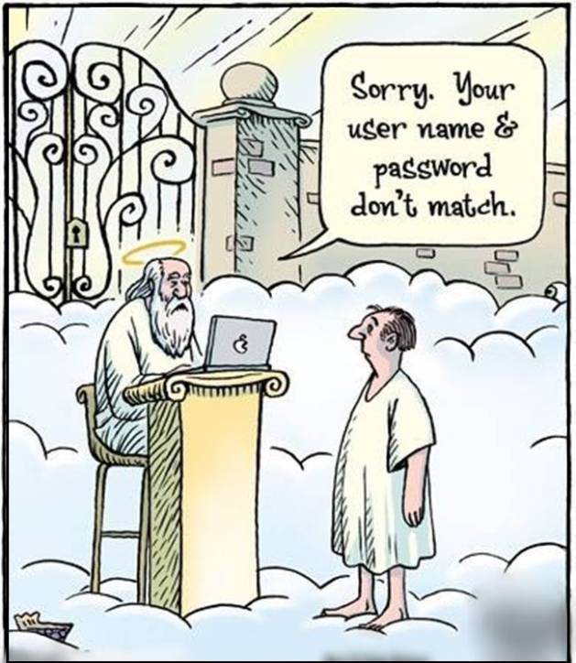
We CAN work wonders in our office, but we CAN’T remember your username and password for you.
We would love to help you once you are logged in!
In the event you forget your password, you can choose ‘Lost password?’. An email will be sent to the email address you used to create your account. School email is always easiest to remember.

Slide 9
If at any time you have forgotten your password you will have to use the Forgot Password function. If you continue to have problems after you’ve used the Forgot Password function or you have technical problems, please contact our office, and we can assist you.

Slide 10
Navigating to FCS landing page:
View top navigation pane.
Click “Course Categories”
The 8th Option to select is “FCS”
Click here to get to the FCS landing page

Slide 11
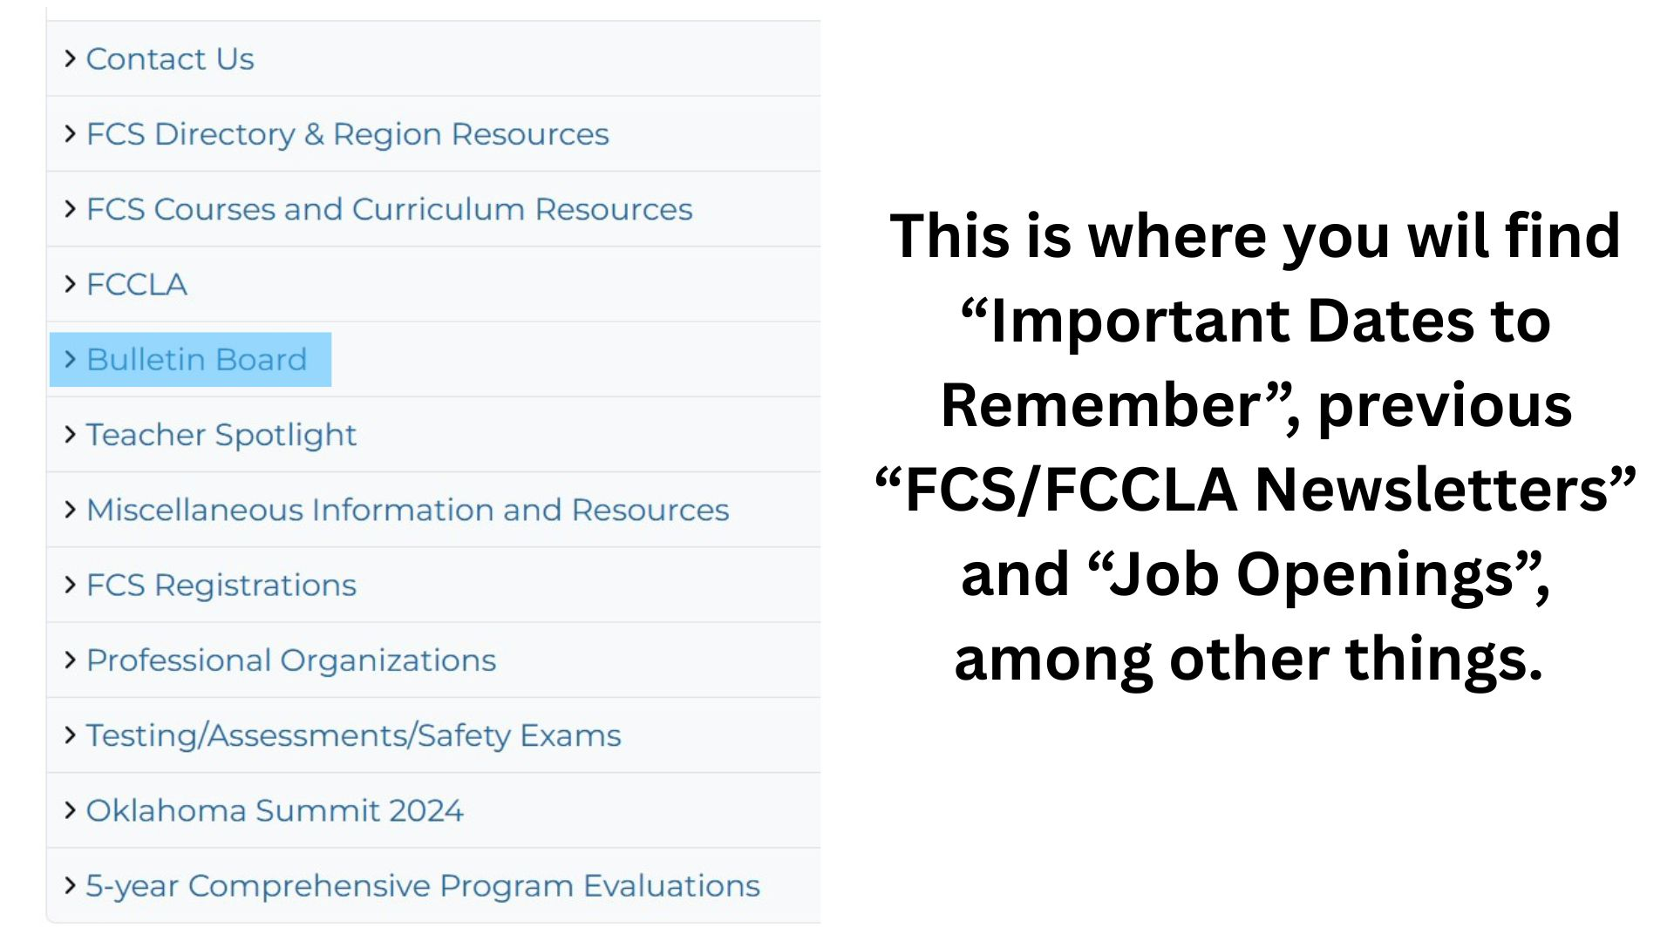

Slide 12
Bulletin Board highlights include but are not limited to:
Former newsletters
FCS & FCCLA Acronyms
Quick tour video to reference
Dates to Remember (state wide)
FCS Job Openings

Slide 13
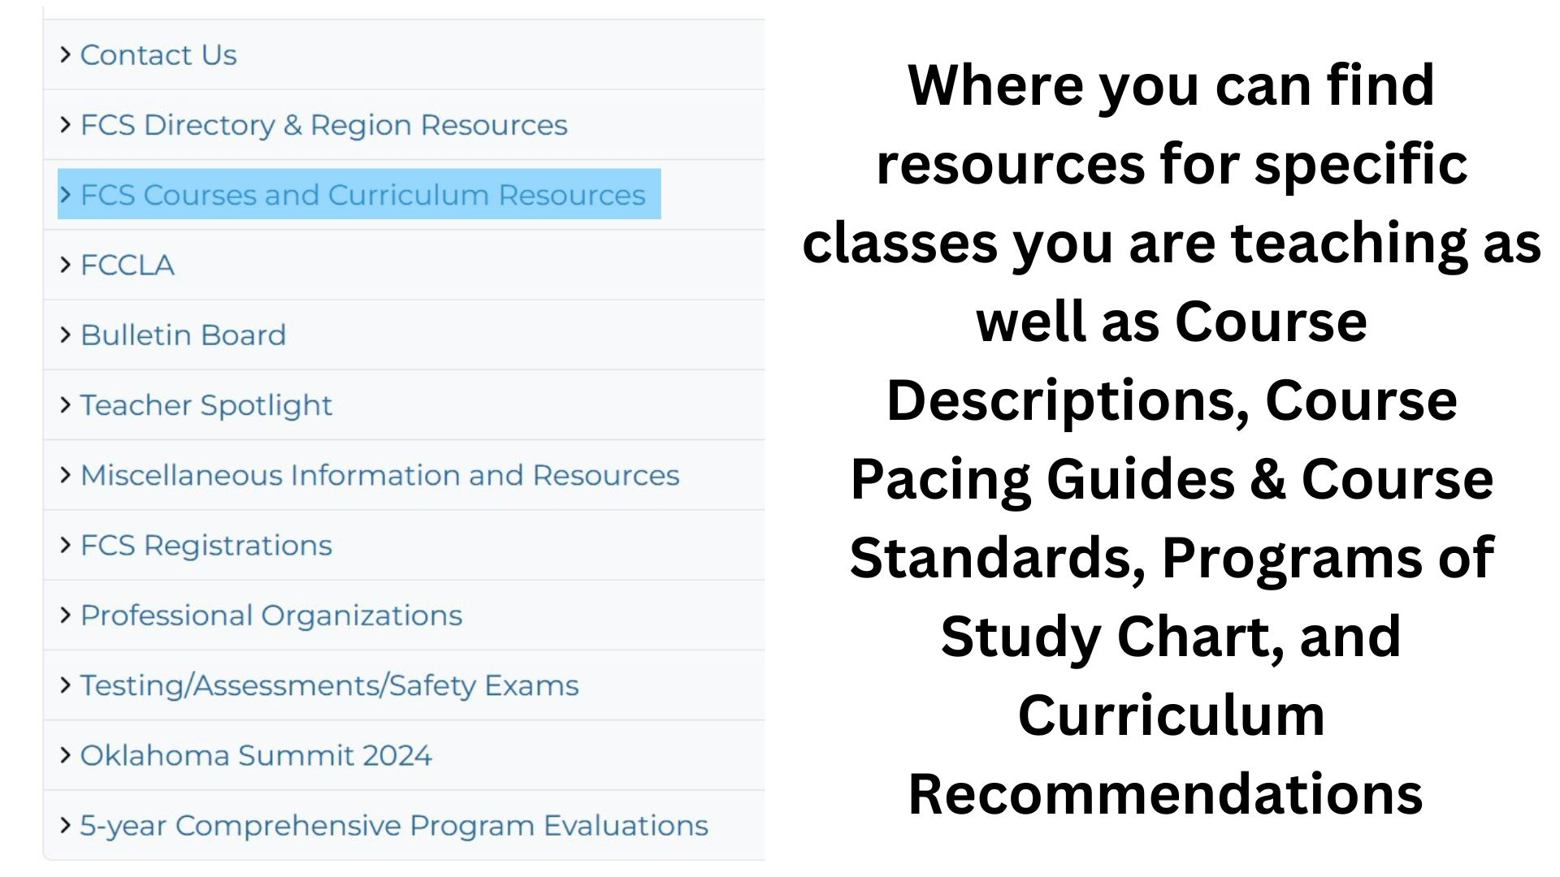

Slide 14
FCS Courses and Curriculum Resources is probably the most vital link for you to find on ctYOU.org
Here is where you go to:
See all of the courses that are approved for FCS teachers
Resources and project ideas for courses you are teaching
Pacing Guides
Program of Study
Curriculum Suggestions
Course descriptions

Slide 16
FCS Directory & Region Resources:
Specific dates for your district and region
Valuable information regarding FCCLA District Leadership Meetings as well as invoices for district dues
FCS Directory – contact information for FCS teachers across the state as well as pics to that you may put a face to a name if needed.
This is a secure location so you must be logged in to see this information.

Slide 17
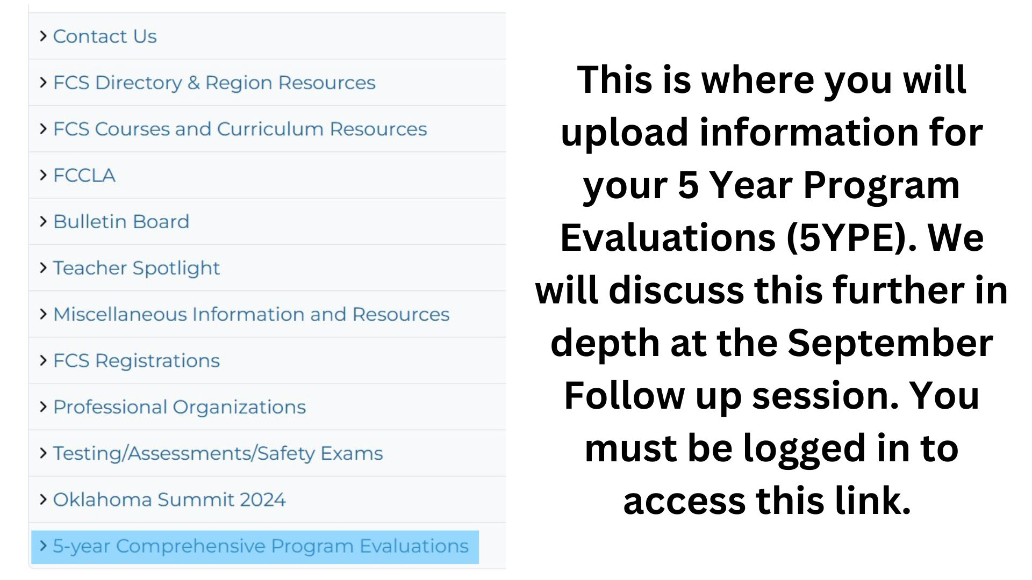

Slide 18
5-Year Comprehensive Program Evaluation:
You will be uploading supporting documents into this online folder.
Your Program Specialist will be using this to help complete your 5 year evaluation, but there are times that we do access this folder so it is important to keep the information up to date…..
DO NOT WAIT until the day before your evaluation to upload information.
Things we check on a yearly basis are:
  412 REPORTS/Program Spending
  Advisory Committee Meeting report

Slide 20
5-Year Comprehensive Program Evaluation:
You will be uploading supporting documents into this online folder.
Your Program Specialist will be using this to help complete your 5 year evaluation, but there are times that we do access this folder so it is important to keep the information up to date…..
DO NOT WAIT until the day before your evaluation to upload information.
Things we check on a yearly basis are:
  412 REPORTS/Program Spending
  Advisory Committee Meeting report

Slide 21
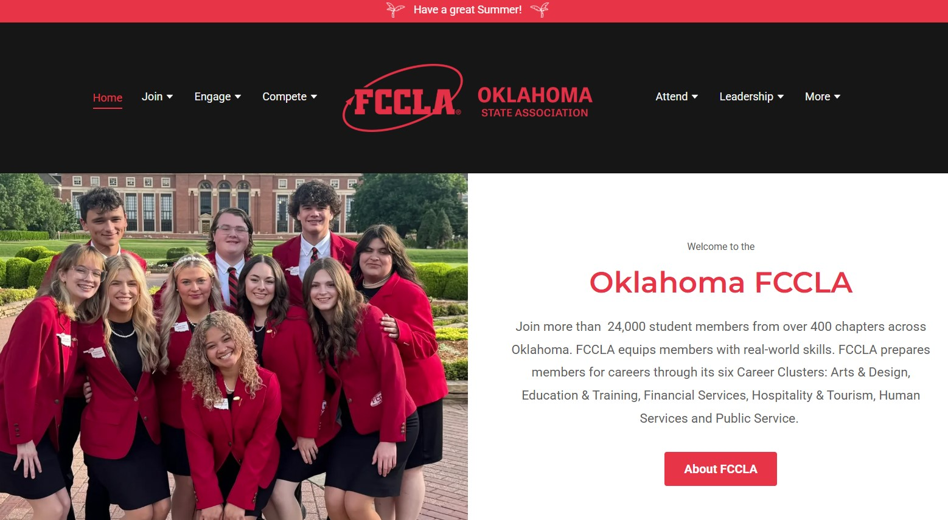

Slide 22
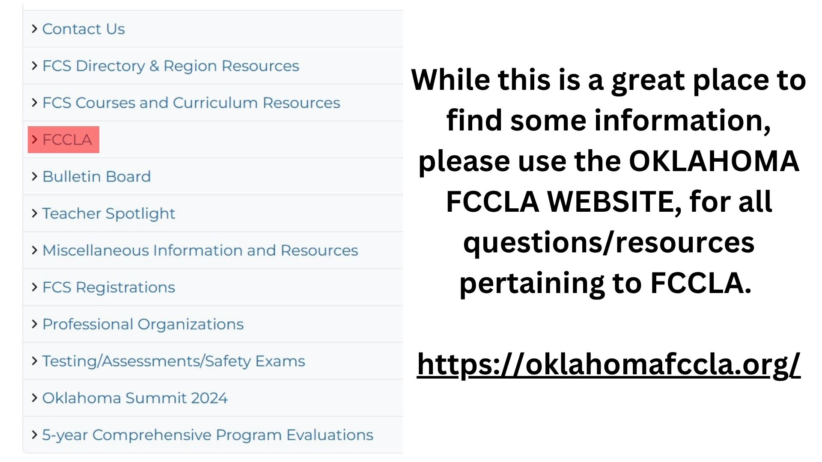

Slide 23
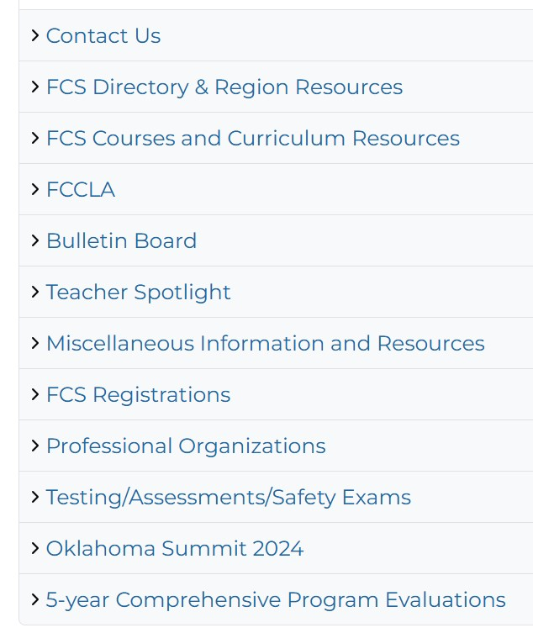
The 2 places you must use a password to enter are:
FCS Regions to view: “FCS Directory & Region Resources” (If you don’t see the current year, you will need to clear your cookies)
Testing/Assessments/Safety Exams to view: “FCS Safety Tests” (scroll down the Testing/Assessments page to find the FCS Safety Tests link)

Slide 24
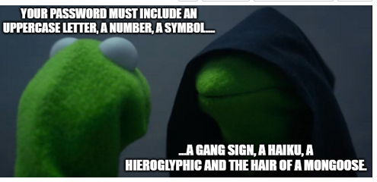
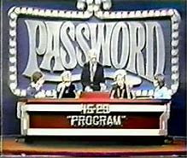
And the Password is…
Fc$2025

Slide 25
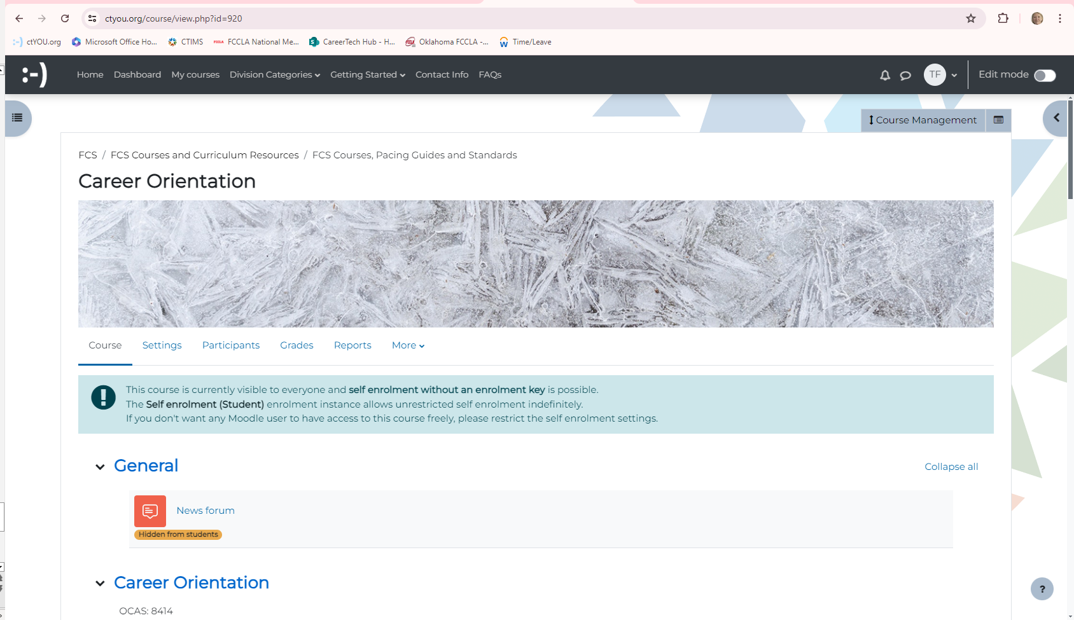
You can use these buttons to toggle back to previous pages
You can use these three buttons to create a side panel, although, I just feel that it is confusing at times…toggle on or toggle off…it’s your preference!

Slide 26
Any questions or comments over
ctYou.org

Slide 27
The End
Thank You!

Slide 28
ctYou.org

