Slide 1

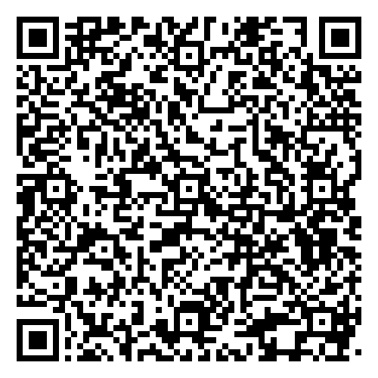
Food Lab Best Practices

Slide 2
Safety and Sanitation
Safety test- Pass with 100% https://ctyou.org/course/view.php?id=811
Safety test goes in your five-year folder https://ctyou.org/course/index.php?categoryid=708
Safety contract for parents and students to sign
https://docs.google.com/document/d/19b6RxzYsBviJ1sIJjNDm2uYxsnqD1rvp/edit?usp=sharing&ouid=111488197777607551310&rtpof=true&sd=true
Consider getting ServSafe approved
https://www.servsafe.com/ServSafe-Food-Handler/Get-Certified

Slide 3
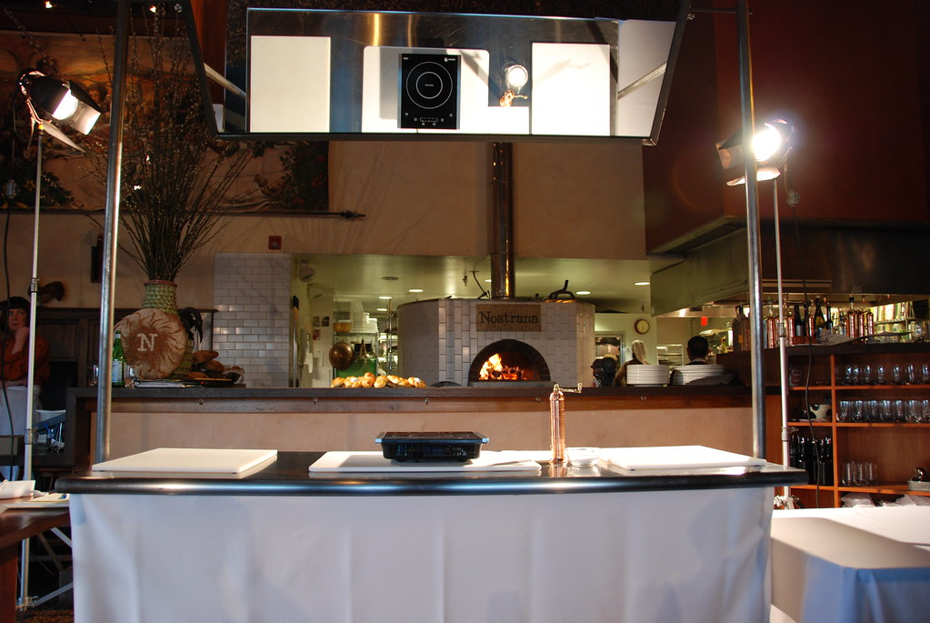
Demonstration Kitchen

Slide 4
Food Allergies
Very serious! You MUST know your students and their allergies!
Letter to parents:
https://docs.google.com/document/d/16s4oJzJYHznMFv23wRg0D9_oa9RuxMo7/edit?usp=sharing&ouid=111488197777607551310&rtpof=true&sd=true
https://docs.google.com/document/d/16SRUtrxSaI7azQpZuIhNT8dhMXPG6Oi5/edit?usp=sharing&ouid=111488197777607551310&rtpof=true&sd=true

Slide 5
Kitchen Set Up
Color-coded aprons-Got mine on Amazon
Aprons
Color coded utensils- Got zip ties from Amazon
Zip ties
Color coded dishes
Pantry for shared ingredients
Previous hour would set up kitchens for next hour

Slide 6
Preparing for Lab
Allrecipes.com- Stars, ratings etc
Yummily.com
Some teachers use a predetermined list of recipes
Give EVERY student a job! Make them rotate through the jobs with each lab. Examples:
https://docs.google.com/document/d/1KlKmLZU4wr_B_ghYK26TP6u7jT9gefu3/edit?usp=sharing&ouid=111488197777607551310&rtpof=true&sd=true
https://docs.google.com/document/d/1HU1d2_SWQCaPeR5ZvUE4BWyTGZviuKEh/edit?usp=sharing&ouid=111488197777607551310&rtpof=true&sd=true

Slide 7
Turning in Recipes, Labs, etc
Use a file-sharing system (Google)
In groups my students:
Turned in job selections
Picked recipes
Ordered ingredients ( I printed this list for my grocery list) https://docs.google.com/spreadsheets/d/1uSWSk3gZGFeWUxTvsCULFIXEXjs9FUej/edit?usp=sharing&ouid=111488197777607551310&rtpof=true&sd=true

Slide 8
During Lab
If half of your class is in lab, the other half needs an assignment.
Usually related to lab
If they don’t complete it, they don’t cook on their lab day
No tolerance policy on behavior issues

Slide 9
Finishing up a Lab
Have a checklist of expectations. Laminate it! Have the manager stay until the inspection is complete.
https://docs.google.com/document/d/140Q-T5isuS6NQHKfhcI7-RNmIcHtzuqe/edit?usp=sharing&ouid=111488197777607551310&rtpof=true&sd=true

Slide 10

Reflections and Rubrics
Have a scoring rubric
A place to write observations while grading
https://docs.google.com/document/d/1hP3E6JmnP8oLzQgXolnZRavAwp6RRlZa/edit?usp=sharing&ouid=111488197777607551310&rtpof=true&sd=true

Slide 11
Make up Labs
Make it easier for them “just to be there”
https://docs.google.com/document/d/10d2feTvzTS-mHhDOATvrpFudOynlDNlC/edit?usp=sharing&ouid=111488197777607551310&rtpof=true&sd=true

Slide 12
Closing your kitchen at the end of the year
Have a list of what you want done at the end of the year
Find a time to have students help. (finals)
https://drive.google.com/file/d/1IqCujrHp7DQt07WH85MFfjIzXB7eIXg-/view?usp=sharing

