Slide 1



MRS. QUICK’S GUIDE TO THE GALAXY
WINNING FORMULA FOR STAR EVENTS
Maybe.....

Slide 2
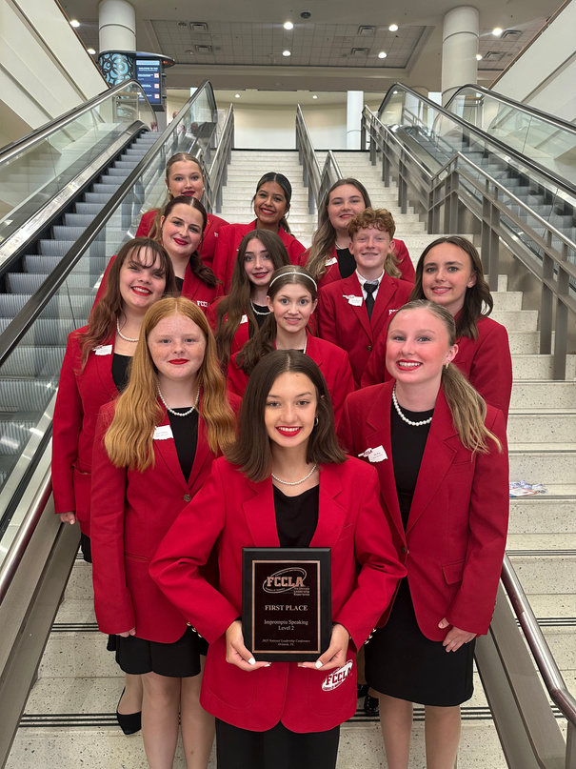
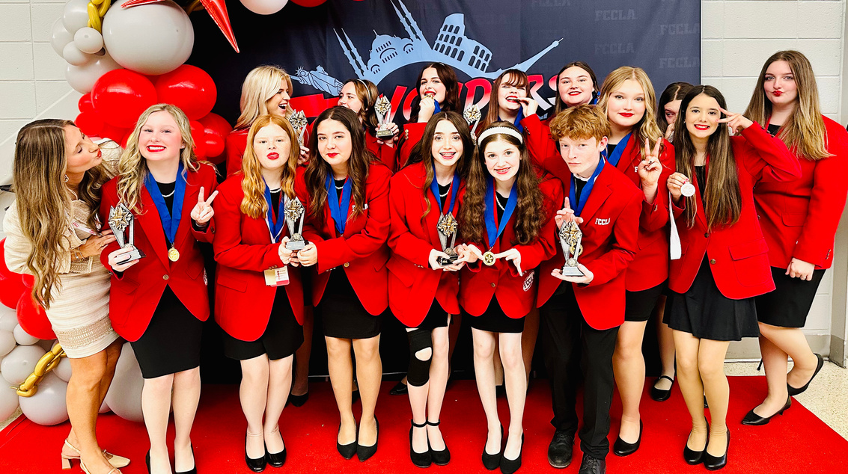
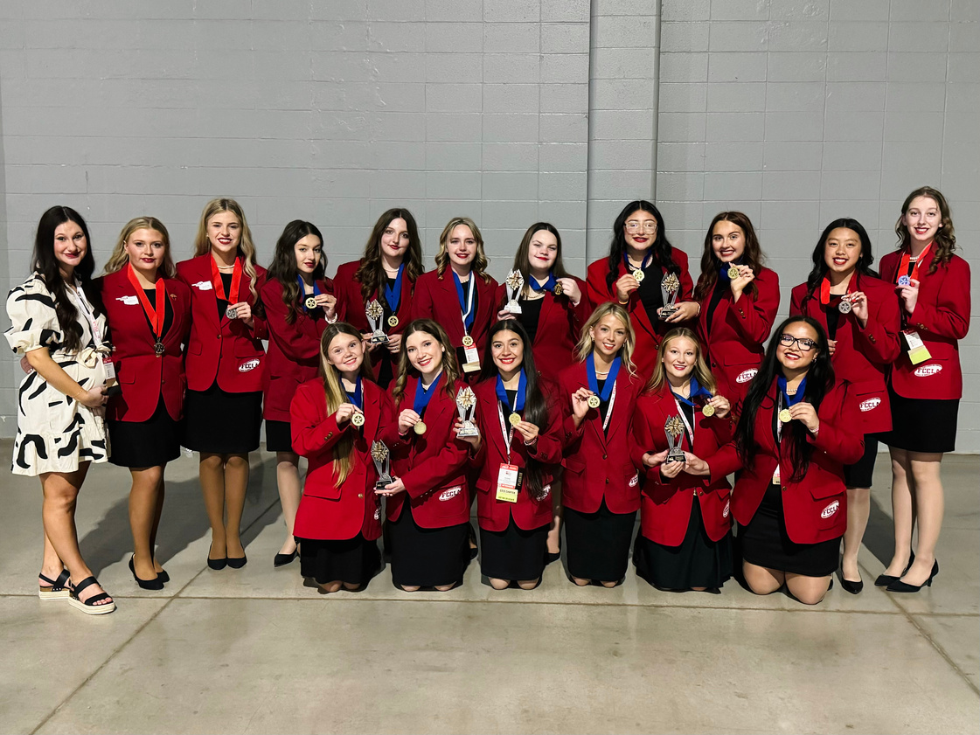
Aspen Evans-Quick
Stigler Public Schools
6 years, 5 at Stigler
18 state champions
4 runner’s up
2 National winners
1 National runner up
Alternatively certified, strong agricultural
background

Slide 3
Learning Objectives
At the end of the lesson, pupils should be able to:
Be able to read and locate the star events rubric(s)
3 key components of any star events project
Identify what a star event is

Slide 4
What is a STAR Event?
Students
Taking
Action
(with) Recognition
Competitive Events in which members compete at the regional/district, state, and national levels. Students are recognized for proficiency and achievement in chapter and individual projects, leadership skills, and career preparation. STAR Events allow students to compete individually or as a team. There are more than 30 STAR Events students can choose to compete in, all of which recognize participants who demonstrate their knowledge, skills, and abilities to actively identify an issue concerning families, careers, or communities, research the topic, and develop and implement a project to advocate for positive change.

Slide 5
How does this translate to the classroom?
What is one specific need you see in your community?
Write it down on your paper, then crumble it up.

Slide 6

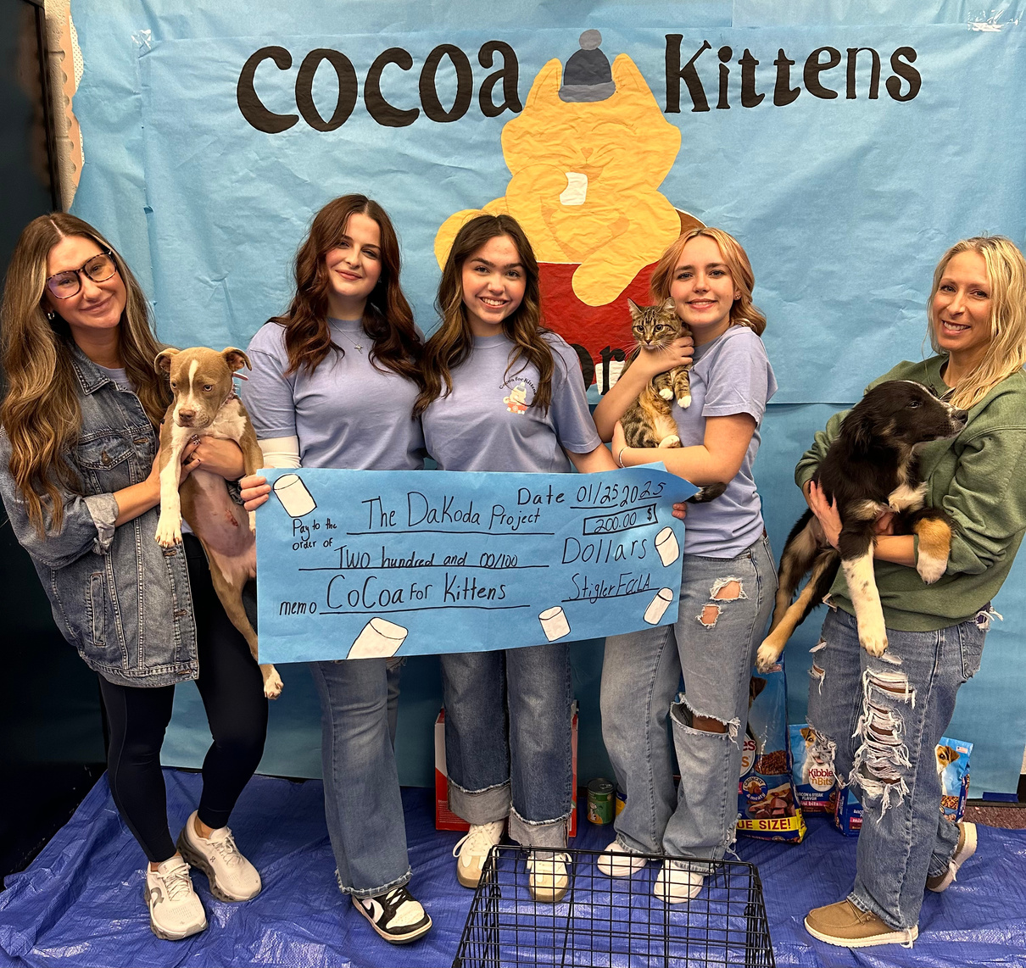
Buy In
Your students have to believe in their own ability to do good & bring about change. None of this matters if they are not createing an impact. The easiest way to make them see it? Address concerns that they see every day.

Slide 7


Read the Room... I mean Rubric
  Read the rubric, then read it again.
  Every rubric is different, do not assume.
  Following that rubric to a T should score you a 90, never underestimate the power of simply following the guidelines.
  Every points column needs its own page/paper.
  The title? Matters

Slide 8
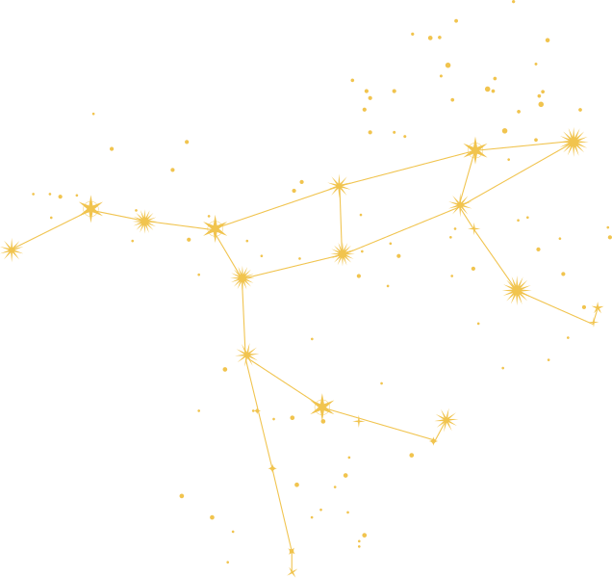

Walk it Out
We will all go over the rubric for Promote and Publicize together.
Each of these rubrics can be found and downloaded in the STAR events guide, in your teacher portal, at fcclainc.org

Slide 9

National program, who?
  Career Connection
  Community Service
  FACTS
  Families First
  Financial Fitness
  Power of One
  Stand Up
  Student Body
  Every single event that your students participate in should directly align with a National Program and Career Cluster.
  Your students should KNOW that program

Slide 10

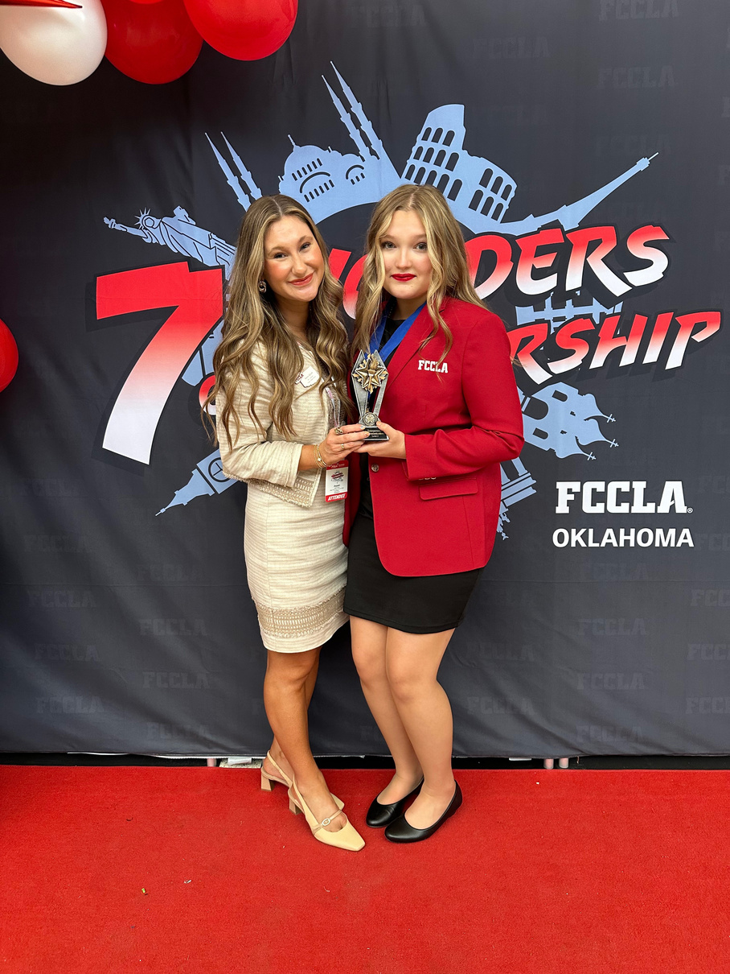
TALK ISN’T CHEAP
  Memorize that speech, no excuses
  Memorized is more professional, more personable, and gives your student an edge
  If they walk in with note cards, they will need them

Slide 11

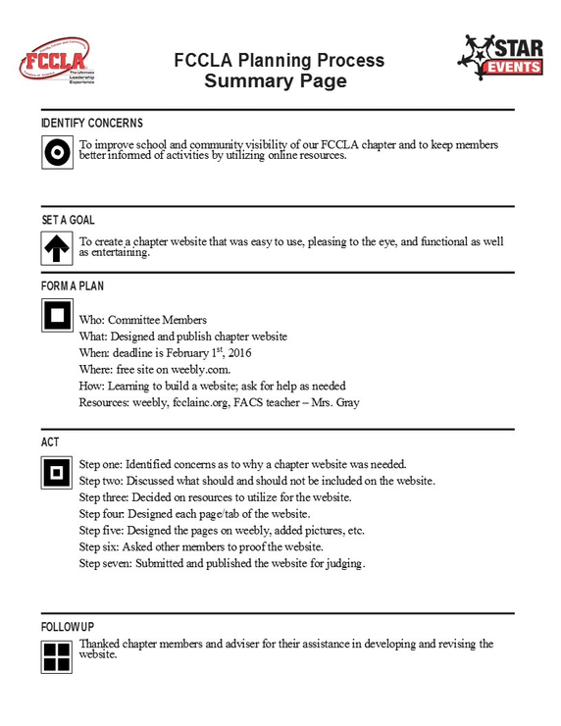
Plan using the Process
  Every event needs a planning process
  The entire document should be filled out
  More is more
  Know your process

Slide 12

First Impressions
  Most judges, just like people, will form an opinion in the first minute of viewing the project/meeting your students.
Introduction
How you dress
Cohesion
Handshake

Slide 13

Set your students up for success not failure
  It is your job to review their project, do not assume they did it correctly
  It is your job to ensure they have all required documents, remember, they are still learning, they forget
  It is your job to prepare them for questions, never send them in blind

Slide 14
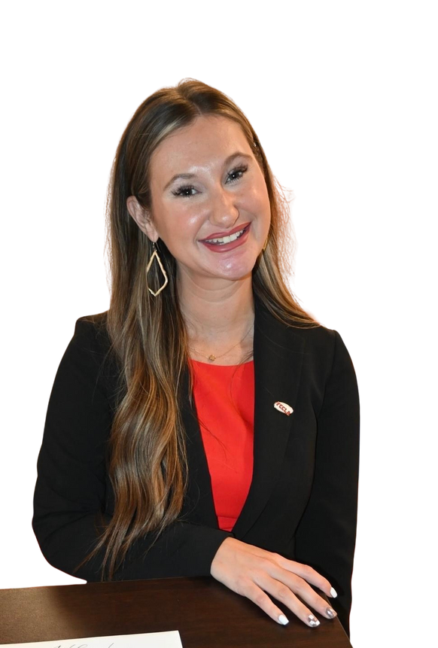
REMEMBER, IT IS ALL ABOUT IMPACT. HOW YOU HELPED YOUR COMMUNITY/STUDENTS MATTERS MORE THEN A MEDAL.
EMAIL: AQUICK@STIGLERPS.COM
CELL: 918.637.8603
PLEASE REACH OUT, I WOULD LOVE TO HEAR FROM YOU!

