Slide 1

BRITTANI PHILLIPS, OKLAHOMA FCCLA
STATE ADVISER

Slide 2
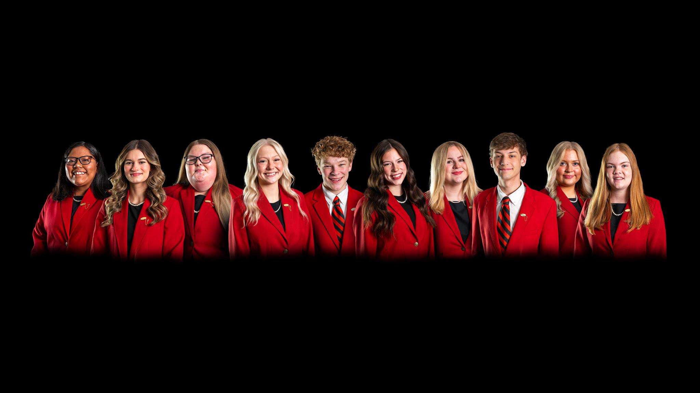
State Executive Council

Slide 3
Kendall Stout, State President – Stigler; Aspen Evans-Quick, Adviser
Kooper Walker, First Vice President – Kingston; Heather Henson, Adviser
Audree Elder, VP of Competitive Events – Putnam City North, Amanda Davis, Laura Harris, Gloria Nethery, Advisers
Amina Washington, VP of Community Service – Oklahoma Union; Shelby Munden, Adviser
Maddie Mueller, VP of Membership –Colbert; LaDonna Forester, Adviser
Gracelyn Vails, VP of Programs – Stigler, Aspen Evans-Quick, Adviser
Tyce Myers, VP of Public Relations – Edmond North, Cindy Conant and Kaitlyn Kirksey, Advisers
Aleighnna Rodriguez, Post-Secondary Officer – GPTC; Lori Grant
Tennyson Elrod-Spears, National VP of Community Service– Wright City; Lori Alford, Adviser

Slide 4
Contacting State Officers Reminder
Email the State Officers
  First initial, last name @okfccla.com
CC Brittani Phillips
Do not text/call directly

Slide 5
National Leadership Conference Recap
81 Events National Top 10
15 National STAR Event Champions
One Skill Demonstration Event National Champion
Two Challenge Test National Champions

Slide 6

National Leadership Conference Recap
Four students in the Fashion Show
Caney FCCLA – Financial Fitness National Runner-Up

Slide 7
National Leadership Conference Recap
Tennyson Elrod-Spears, National Vice President of Competitive Events

Slide 8
Membership
2024-2025 Membership Total:
  21,055 Members
  405 Advisers
  15% Growth
  1 Amazing Year!

Slide 9
Membership Packages
Fully funded programs – use $900 of 412 per chapter
Partially funded programs – use $450
Unlimited Package $1,090 + $15 for adviser
Up to 25 members
$545 +
$15 for adviser
Middle Level - $524
Postsecondary - $20 per member

Slide 10
Membership Package Benefits
Up to 25 Members AND Unlimited Members Packages Include:
Testing Readiness Resources One Year Subscription
Knowledge Hub One Year Subscription
One Adviser Academy Registration
One National Program Download of Choice
All benefits will expire July 31, 2026 and will not carry over for the next fiscal year

Slide 11
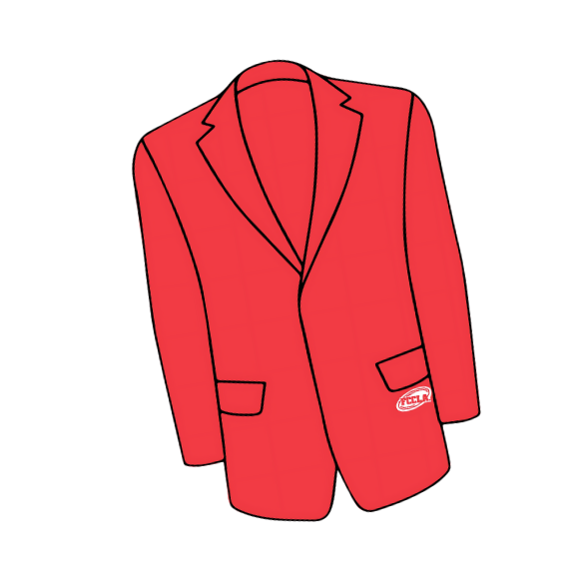
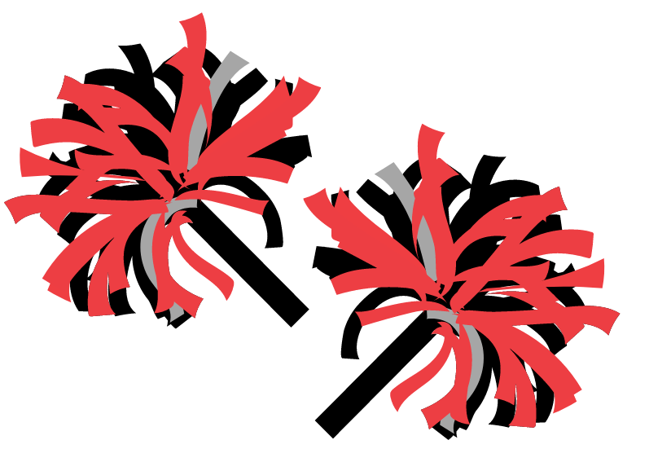

Membership Campaign -
Paint it Red for 26,000 members!
  Recruit –
    SPARK Week September
  Retain –
    Ribbons/recognition at State Convention
  Recognize –
    monthly challenges

Slide 12

Oklahoma FCCLA
SPARK Week
Strengthen Your Skills
Promote Your Passion
Amplify Your Chapter
Recruit Future Leaders
Kickstart Your Chapter

Slide 13
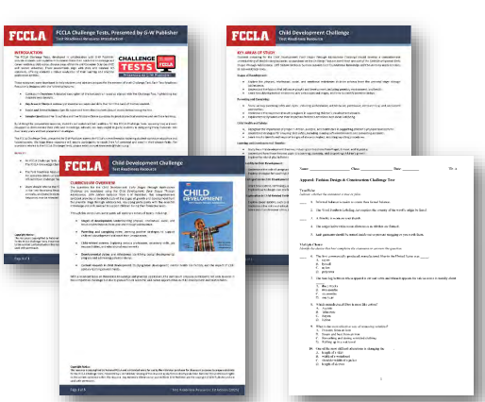
FCCLA Testing Readiness Resource
The FCCLA Challenge Test Readiness Resource was developed in partnership with Goodheart-Willcox Publisher to help chapter advisers prepare students for FCCLA’s Challenge Tests. These tests assess students’ academic knowledge and career-readiness skills in Family and Consumer Sciences and align with state and national FCS standards.
The resource provides structured tools to support targeted
preparation and strengthen student performance.
Curriculum overview aligned to the G-W textbook
Key areas of study highlighted for student focus
Critical topics and terms to review
Sample True/False and Multiple-Choice questions included
Note: All Challenge Tests, except the FCCLA Knowledge Challenge, are based on G-W curriculum.
Refer to the FCCLA Portal for official test specifications.

Slide 14
Brand Hub
The FCCLA Brand Hub is the official destination for accessing FCCLA’s approved branding, marketing, and promotional materials.
Designed to help chapters and state associations maintain consistency and professionalism in all communications.
What You Can Find on the FCCLA Brand Hub:
  Official FCCLA Logos - Downloadable logos for national programs, campaigns, and events in multiple formats.
  Brand Guidelines - Logo usage rules, color palettes, typography, and co-branding guidance.
  Templates - PowerPoint slides, flyers, certificates, and social media templates to streamline
communication.
  Messaging - Key language and positioning to promote FCCLA and its mission effectively.
  Multimedia Library - High-quality photos, graphics, and videos approved for use in FCCLA marketing.
Access: Available through the FCCLA Portal for members and advisers.

Slide 15


State and International Outreach Projects
Helping foster children and families in Oklahoma
Helping scholars in Ghana, Africa by funding a Home Economics classroom for the Pearl House Academy

Slide 16

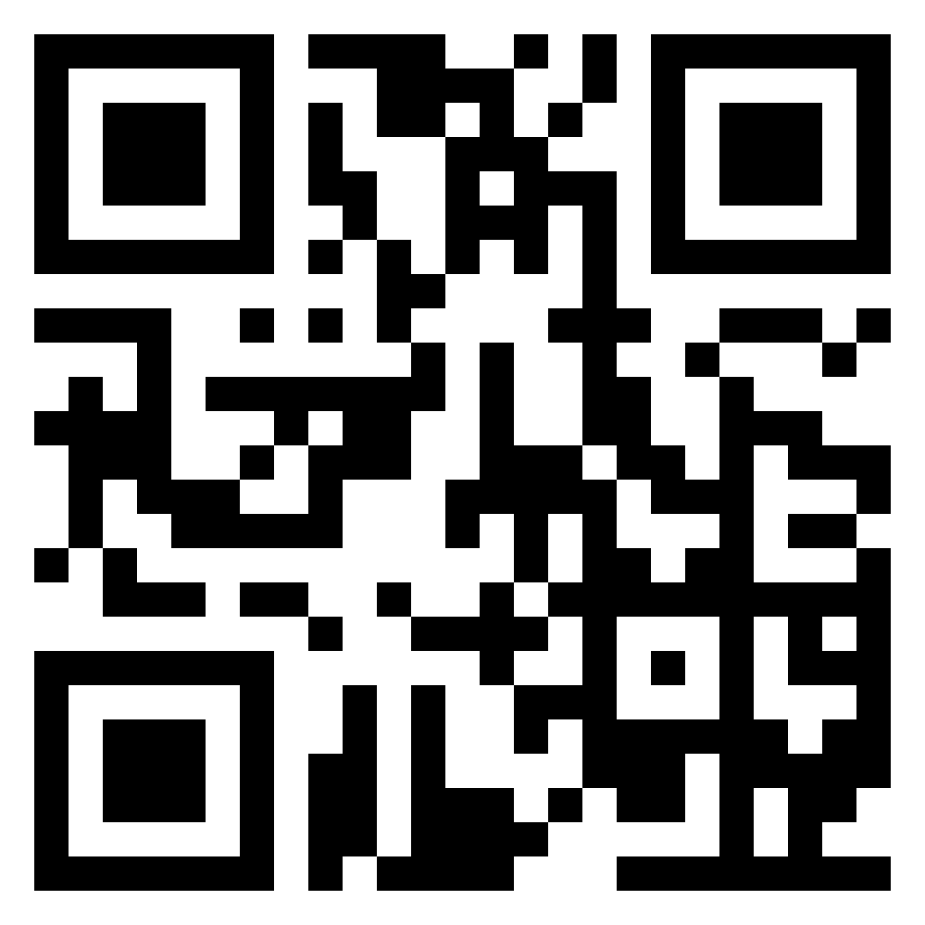
State and International Outreach Projects
Lasagna Love
  www.lasagnalove.org
Make Lasagnas, Spread Kindness

Slide 17
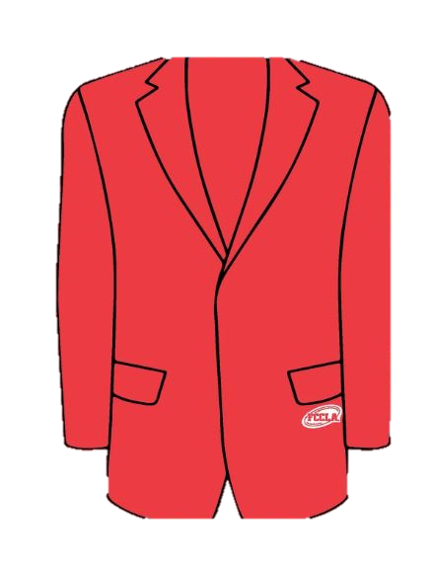
Official Jacket
Uniforms Today
Cost is $64
$300 from 412 used for uniforms
New “logotype” jacket NOT required

Slide 18
Competitive Events Updates
Children’s Literature theme: “A trip Around the World”
  Contestants share a story inspired by a country or culture – characters can travel to other countries, eat foods, experience new sites, ride on an airplane for the first time, etc.
Cake Decorating Theme: "A Trip Around the World"
Contestants create cakes inspired by a country or culture—think Eiffel Tower cakes, Japanese cherry blossoms, or Mexican fiestas.

Slide 19
Competitive Events
FCS Research Challenge
  Takes place at FCS Day at the Capitol
  Essentially a “science fair” project
  Great classroom project – begin now!

Slide 20
Competitive Events
OK FCCLA Meat Cooking Competition
Not being held this year
Increasing STAR Events to $10 per competitor per level.

Slide 21
Competitive Events
NEW: Personal Financial Literacy by EverFi
National STAR rubrics should be available August 15, 2024
Reminder: If your student placed first in their event at State STAR, they may NOT compete in the same event/level this school year

Slide 22
Competitive Events
NEW: STAR Events Toolkit
  Promote STAR Events
  Support STAR Event Competitors
  Celebrate
Created by Emily Faulkenberry,
VP of Competitive Events

Slide 23
STAR Event Bootcamp
Advisers only
September 25, 2025
FREE to attend

Slide 24
Scholarship Opportunities
Chapter Adviser Summit
  Provided by Oklahoma FCCLA Alumni & Associates
  $500 to offset cost of attending
  Deadline is September 1, 2024

Slide 25
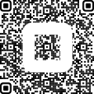
Scholarship Opportunity
NEW – Joann Carter Scholarship
South Region member that attends NLC
  $500 scholarship

Slide 26
FCCLA Events
Lead Conference
  North Region – September 11, Enid, Oklahoma
  Northeast Region – September 17, Glenpool, Oklahoma
  South Region – September 12, Duncan, Oklahoma
  Southeast Region – September 18, McAlester, Oklahoma
  Register up to 7 students by August 30th
  Must assign them to a “Leadership Track”
  $15 per student, no adviser fee

Slide 27
FCCLA Events
Riversports Day – September 21; cost is $35 per person
Take AIM – October 8, Meridian Technology Center (Guthrie Campus)
  Cost is $50 per student, $25 per Adviser
Get SET – December 4, Metro Technology Center

Slide 28
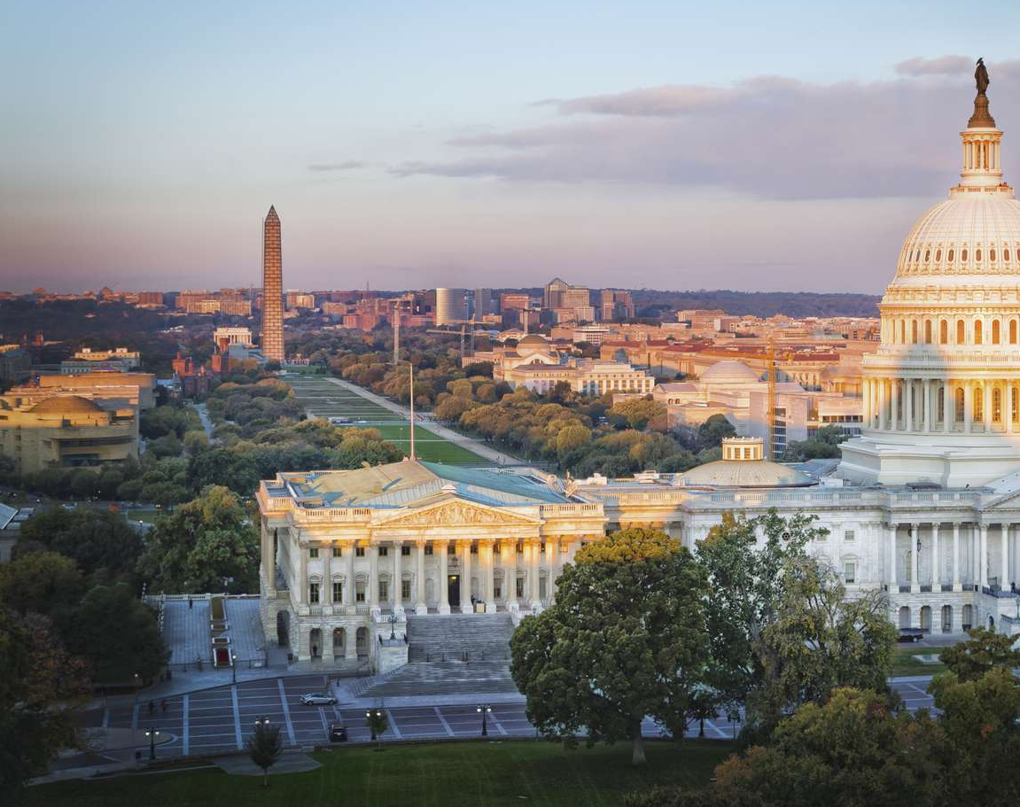
Capitol Leadership
Not held during election year due to safety in Washington, D.C.
Should resume October 2025

Slide 29
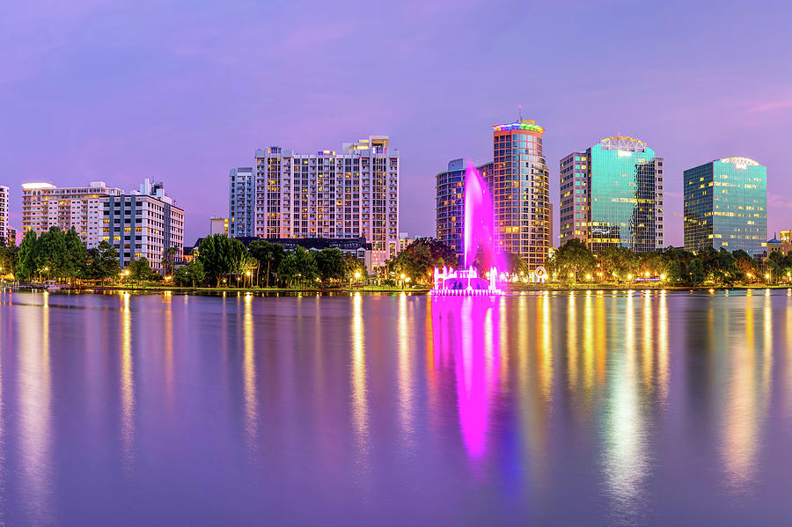
Chapter Adviser Summit
January 15-18, 2025
Orlando, Florida
$150 per person registration

Slide 30
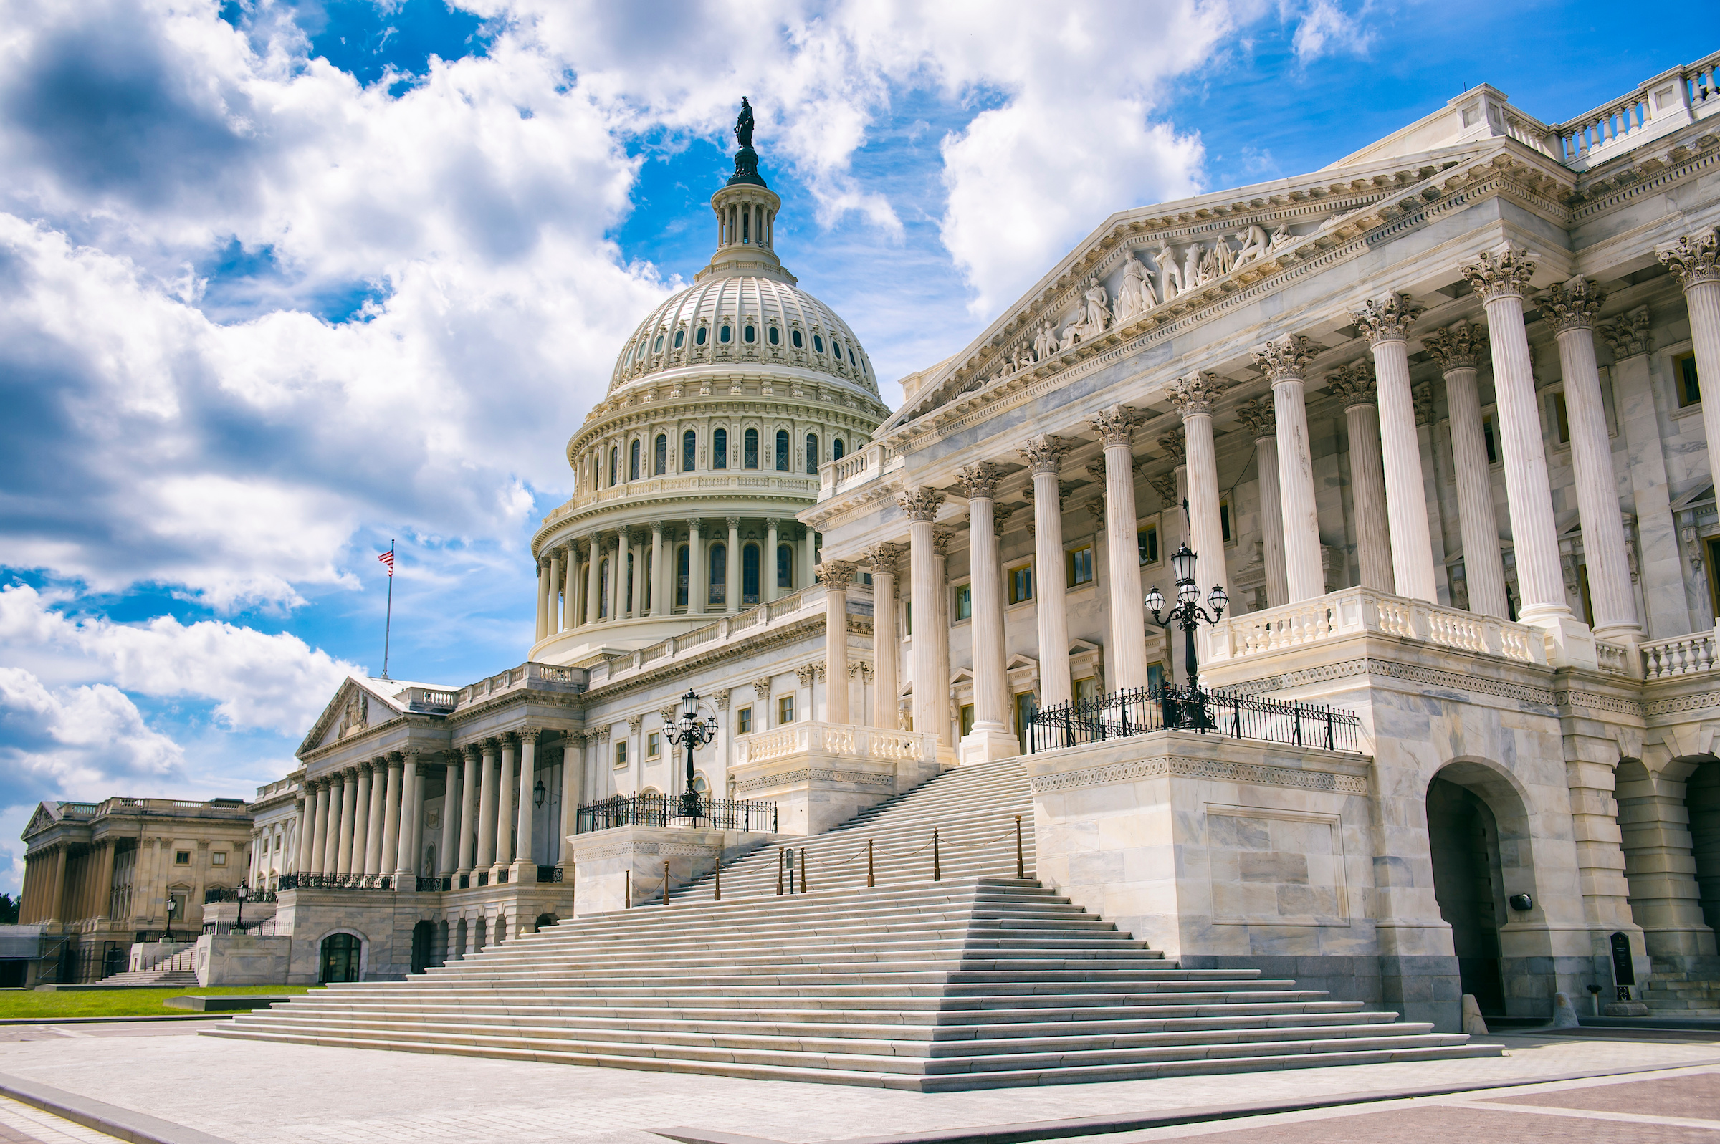
National Leadership Conference
July 6-10, 2026
Washington, D.C.
$160 per person
STAR Events $55 per person

Slide 31
FCCLA State Convention
April 2, 2026
Tulsa Cox Convention Center
80th Anniversary Campaign
  Donate $80 by March 1
    Ribbons at convention, chapter name on t-shirt, in program, and certificate

Slide 32
Special Event: Silent Disco
80’s themed Silent Disco
  80s attire is encouraged, not required!
April 1, 2026
$20 per student to attend (advisers are free and required to attend)

Slide 33
BRITTANI PHILLIPS, OKLAHOMA FCCLA STATE ADVISER

