Slide 1
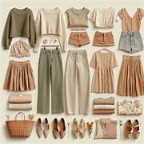

BUILDING YOUR CAPSULE WARDROBE
SIMPLIFY YOUR CLOSET, ELEVATE YOUR STYLE
Karin Davis - Fashion Design Tulsa Tech

Slide 2

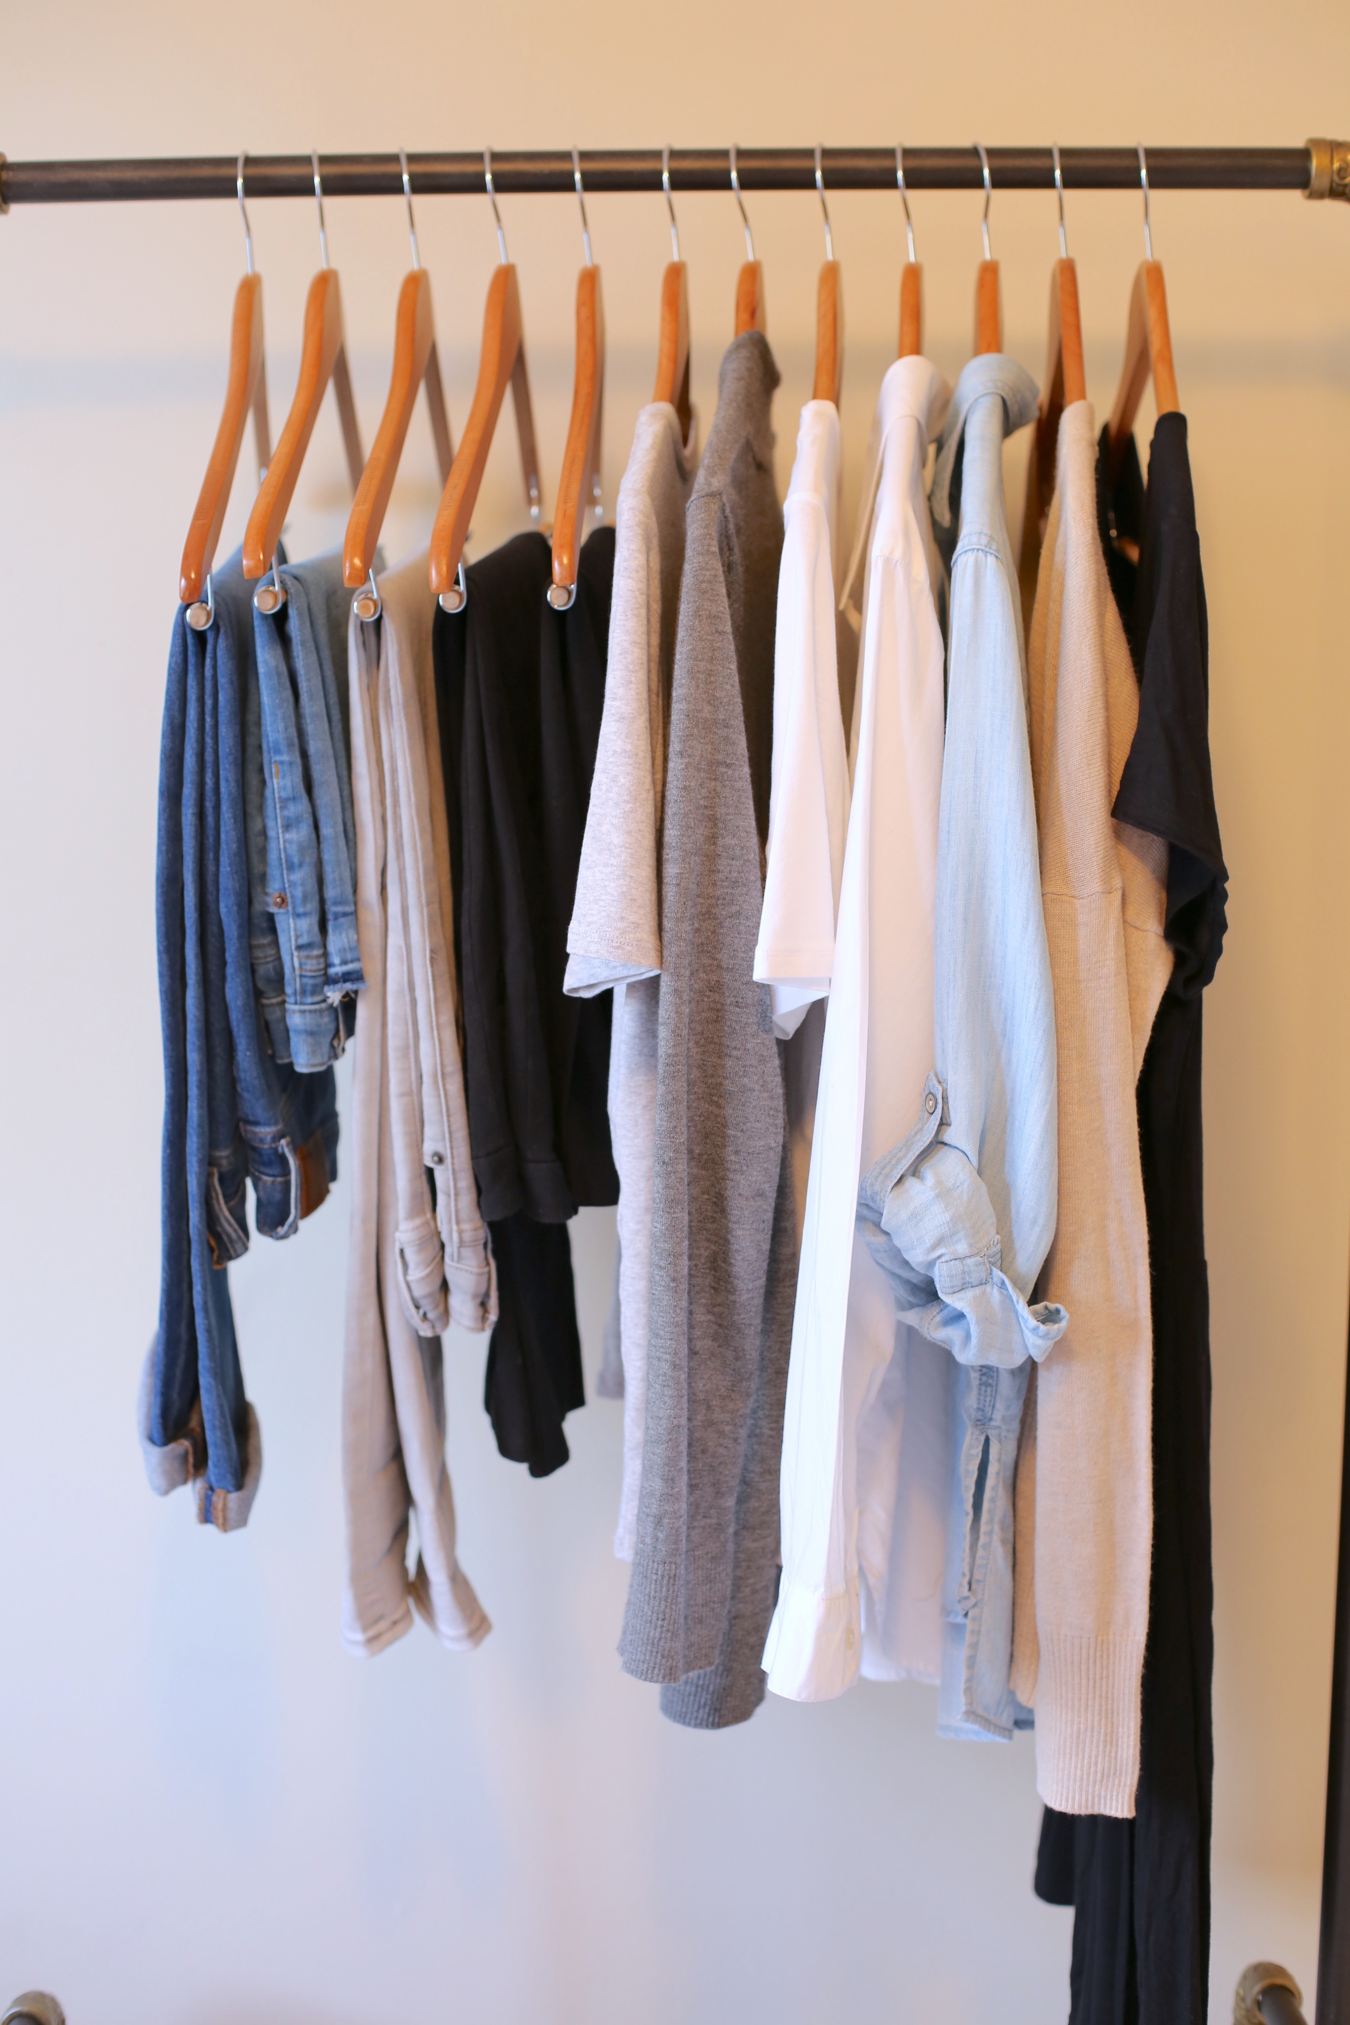
WHAT IS A CAPSULE WARDROBE?
A small collection of clothing that works together seamlessly.
Designed to create multiple outfits with fewer pieces.
Reduces decision fatigue and supports sustainable fashion.

Slide 3
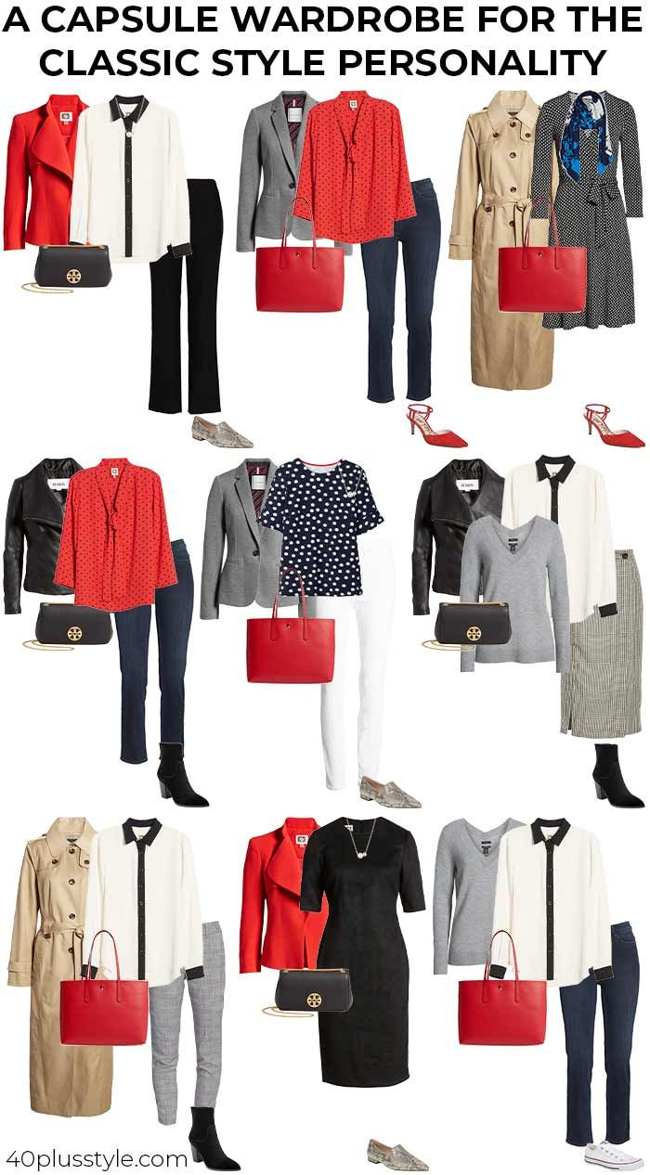
HISTORY OF A CAPSULE WARDROBE
Capsule wardrobes date back to the 1970s. The concept originated from Susie Faux, the owner of a London boutique called Wardrobe.
The concept took off in 1985 with designer Donna Karan’s first capsule collection called “Seven Easy Pieces.” The collection included a bodysuit, skirt, tailored jacket, dress, something leather, a white shirt, and a cashmere sweater. It was designed to take a woman from a day in the office to an evening out.
Capsule wardrobes are back in style in large part due to increased public interest in reducing the fashion industry’s environmental impact and greater demand for more sustainable and responsible manufacturing processes.

Slide 4
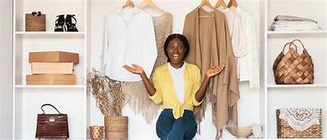
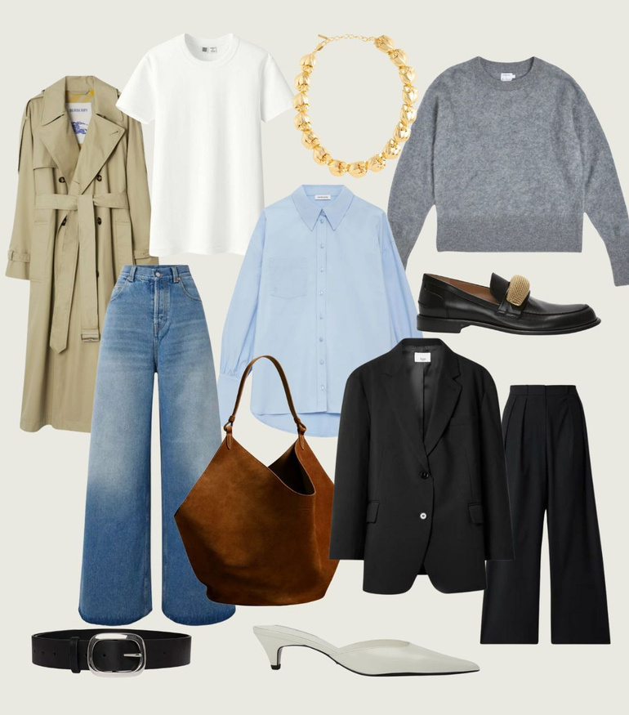
WHY IT IS
WORTH IT?
Saves Time
Reduces Clutter
Fewer clothes mean less decision-making
A simplified wardrobe makes your closet more organized
Saves Money
Eco-friendly
Invest in quality pieces that last longer
Less waste and consumption
Fit your personality
Customize to fit your personal style and lifestyle

Slide 5
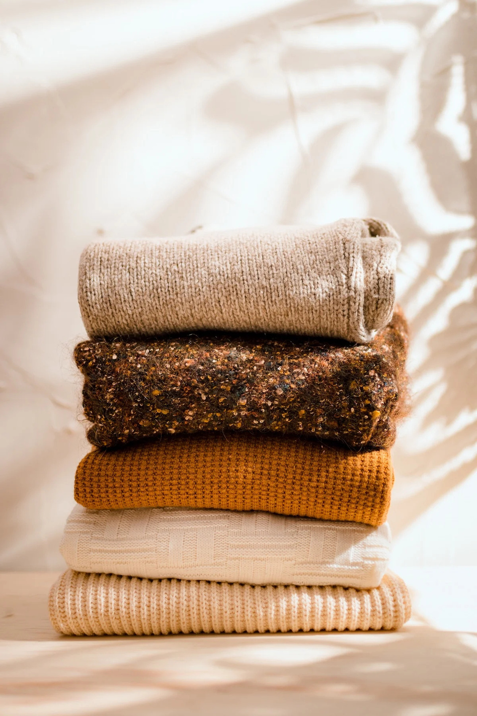
ESSENTIAL TIPS
Keep a primarily neutral color palette - Keeping most of your essential pieces neutral in color will make them much easier to mix and match. Neutral colors can include black, navy, gray, brown, camel, taupe, cream, white - what shade looks good on you?
Pop of color - Incorporate 1 or 2 accent colors that you love and that work with your complexion.. They will also add interest and personality to your capsule.

Slide 6

PICK TIMELESS, FUNCTIONAL, AND VERSATILE PIECES
  Timeless clothing is classic and will never go out of style - a white button-down shirt, a classic blazer, and straight-leg jeans.
  Functional clothing prioritizes comfort and practicality to fit your lifestyle. When choosing your pieces, consider factors like fabrics, shapes, lengths, overall style, and ease of care (think cleaning and maintenance).
  Versatile clothing pairs easily with other items. You can style them in different ways and wear them for various occasions.

Slide 7
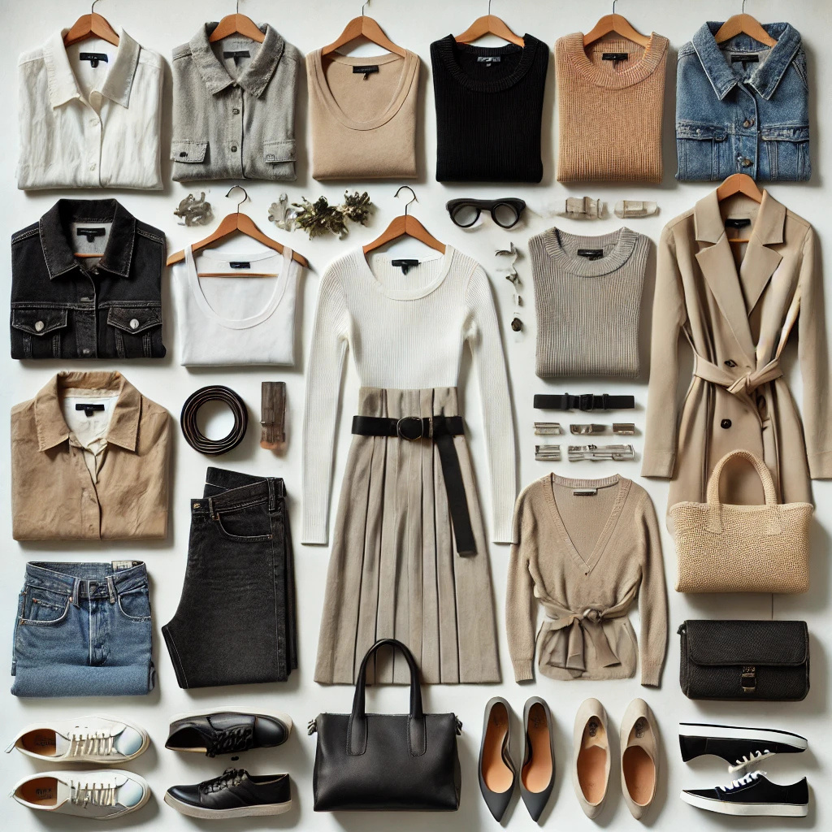
BEFORE SELECTING A PIECE FOR YOUR CAPSULE, ASK THESE QUESTIONS:
Is this item comfortable and practical, and does it suit my current lifestyle?
Will it pair easily with the other items?
Is this item easy to wear, clean, and maintain?
Can it be styled in different ways and dressed both up and down?

Slide 8
GETTING STARTED
Clear out clothes you don’t wear or love.
Choose a cohesive color palette
Invest in high-quality, versatile pieces.
Identify your personal style and lifestyle needs

Slide 9
STEP 1: DECLUTTER YOUR CLOSET
Assess Every Item
Use the 3-Pile Method
Sort through your clothes and decide the essentials from unnecessary items
Create the 3 piles - Keep, Donate/Sell, and discard to streamline your wardrobe
Follow the 80/20 Rule
Most people only wear 20% of their wardrobe 80% of the time - keep what matters
White, black, gray, or beige shirts, blouses, and sweaters

Slide 10
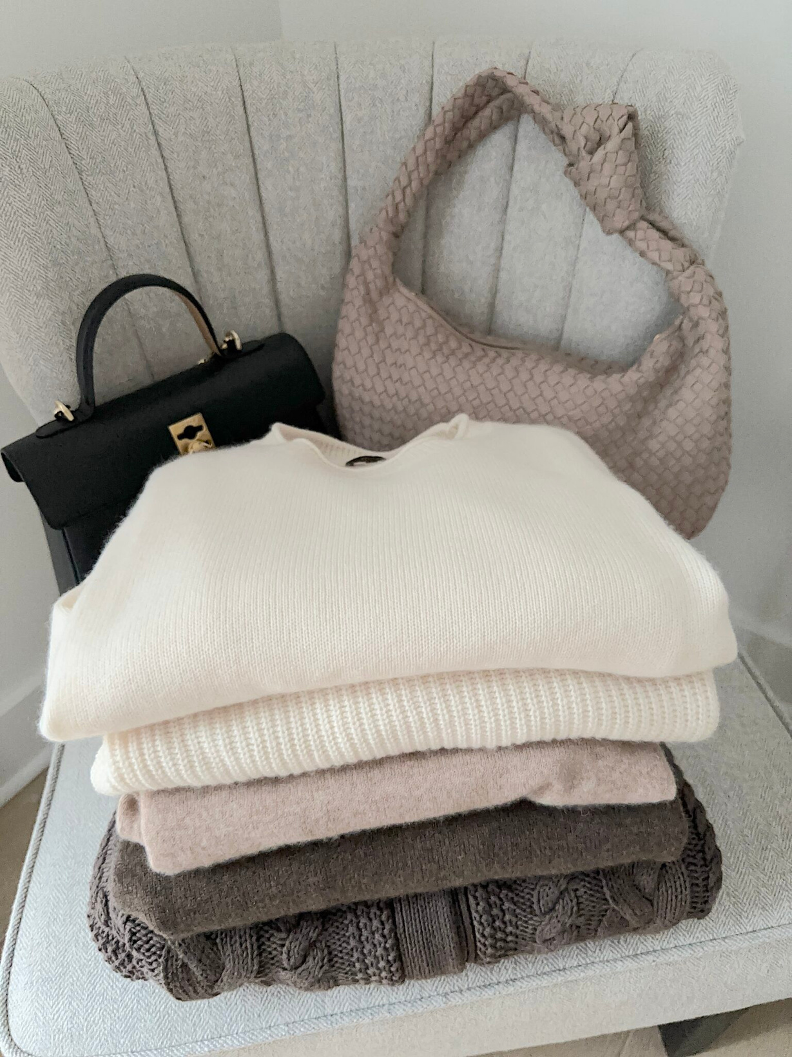
CLOTHES THAT YOU LOVE
Sort what remains so you can easily see everything you have within each category
  Jeans
  Pants
  Skirts
  Shorts
  Tees and tanks
  Tops and blouses
  Sweaters
  Dresses
  Coats and jackets

Slide 11
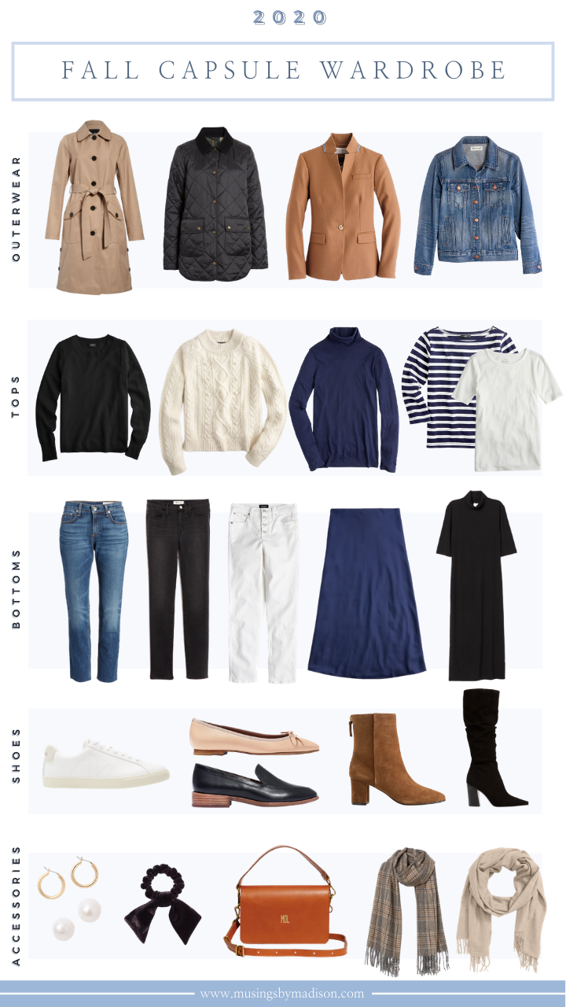
STEP 2:
PICK YOUR CAPSULE PIECES
It is time to start choosing your staple pieces
Start with your favorite items in each category you pulled out in Step 1. For example, if you have a favorite pair of black denim, you may want to choose 1-2 pairs of jeans with similar characteristics in different washes to round out the category.
Choose your capsule pieces by going down the list, one category at a time, starting with the staple pieces

Slide 12
WOMEN’S SAMPLE CAPSULE WARDROBE FOR FEMALES
This is a minimalist wardrobe ranging from 28 to 41 pieces. Depending on the season, where you live, your lifestyle, and what you like to wear. It will make a difference in the categories and the number of clothing items that you own.
  2-3 pairs of jeans 2-3 jackets, coats, and blazers
  3-5 pairs of shoes 2-3 belts
  2-3 pants, leggings, and trousers 2-3 bags
  2-3 shorts
  1-2 skirts
  5-7 T-shirts/tank top
  3-4 tops & blouses
  2-3 sweaters
  1-2 dresses

Slide 13
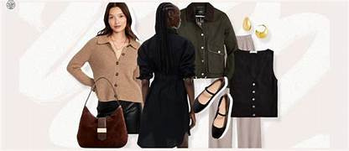
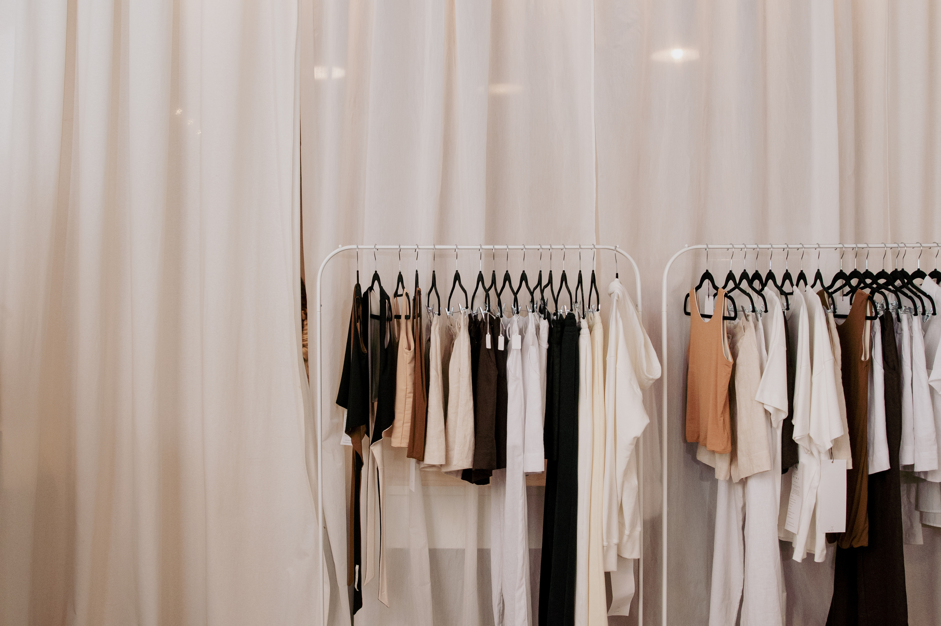
Step 3
CREATE SOME MINIMALIST OUTFITS
Having pre-planned, everyday outfits will make one feel exponentially more comfortable with a smaller wardrobe
Create 7-10 everyday outfits (or more) with your selected garments.
By planning your outfits, saves you time and mental energy moving forward.

Slide 14
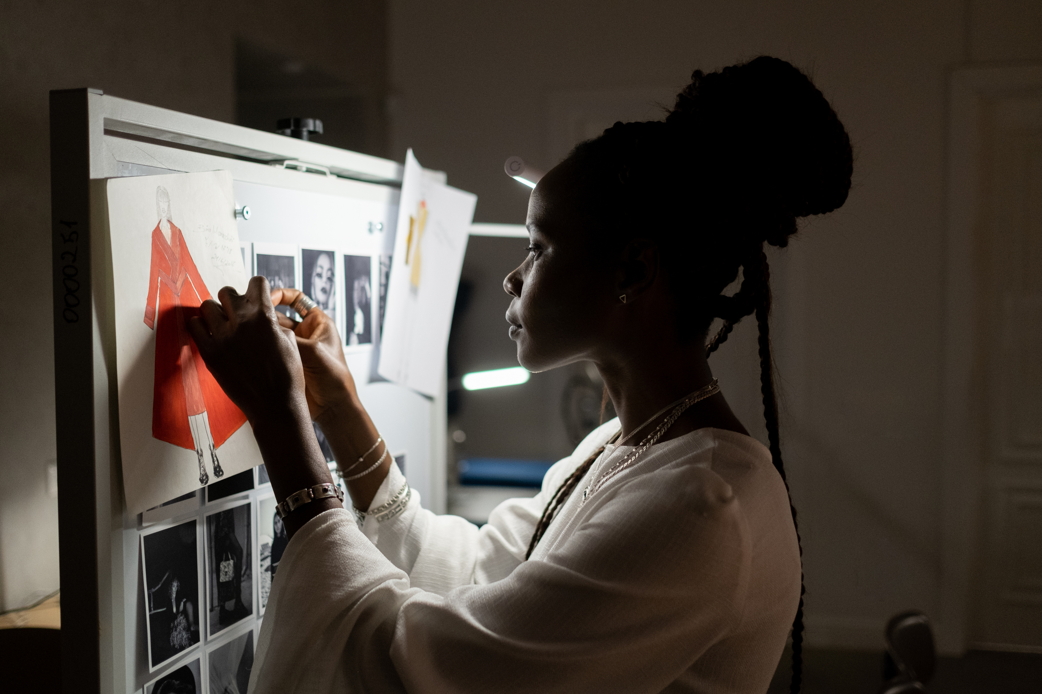
TIPS FOR CREATING OUTFITS
Get inspired
Layer and style for interest.
Pinterest is an excellent source of inspiration
Don’t forget layers, shoes, and accessories. They can really add to an outfit.
Start with one item.
See how many different looks you can make with one pair of bottoms or a favorite top.

Slide 15
TIPS FOR CREATING OUTFITS
Take photos
Look for weak links
Take a picture of outfits you love with your phone so you can reference them in the future.
If you find something that will only work one or two ways, consider whether it’s worth keeping.
Identify the gaps
If an item only works 1 or 2 ways, consider if it’s worth keeping.

Slide 16
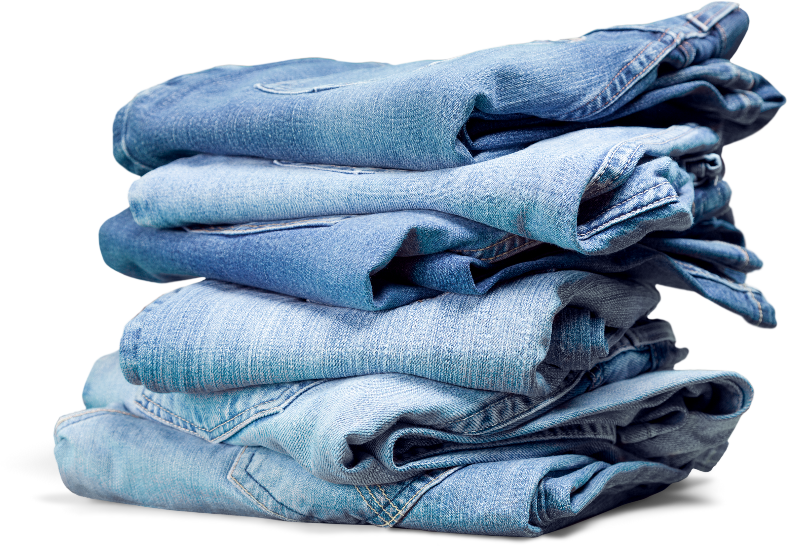
WHAT’S NEXT?

Slide 17
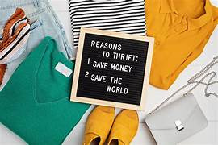
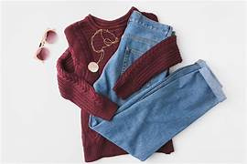
WHAT’S NEXT?
Carve out a section of your closet for your capsule pieces. If you can, move everything else to a different closet or location that’s out of sight.
What to do with the rest of your clothes
  Donate or sell ASAP. Grab those items you are ready to part with and get them out within the next few days.
  Declutter again after 30 days. Go through your non-capsule clothes again after 30 days.
Resist the urge to add items back. Give yourself a few weeks to get comfortable with your new, smaller wardrobe and experience the benefits

Slide 18
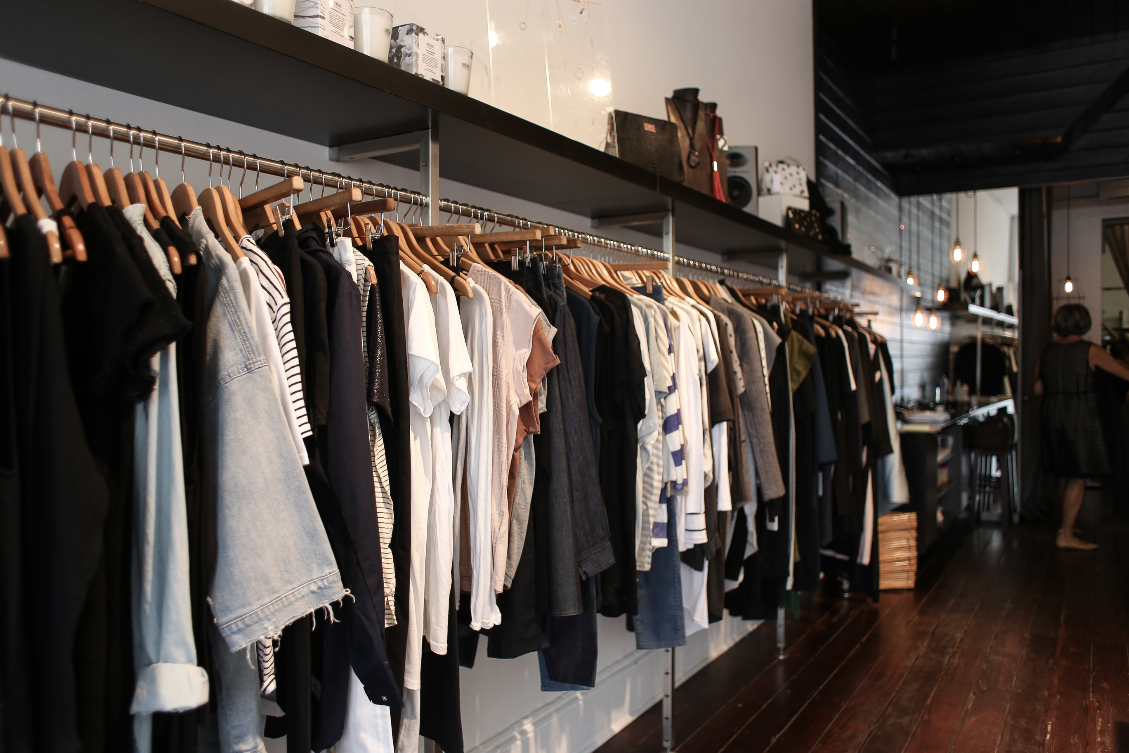
POSSIBLE CAPSULE FORMULAS
There are two well know formulas to possibly to follow
1st Formula
3-3-3 Method
  33 items ÷ 3 months = streamlined rotation
  What’s included: clothing, shoes, outerwear, accessories.
What’s exempt: underwear, sleepwear, workout gear, sentimental jewelry.

Slide 19
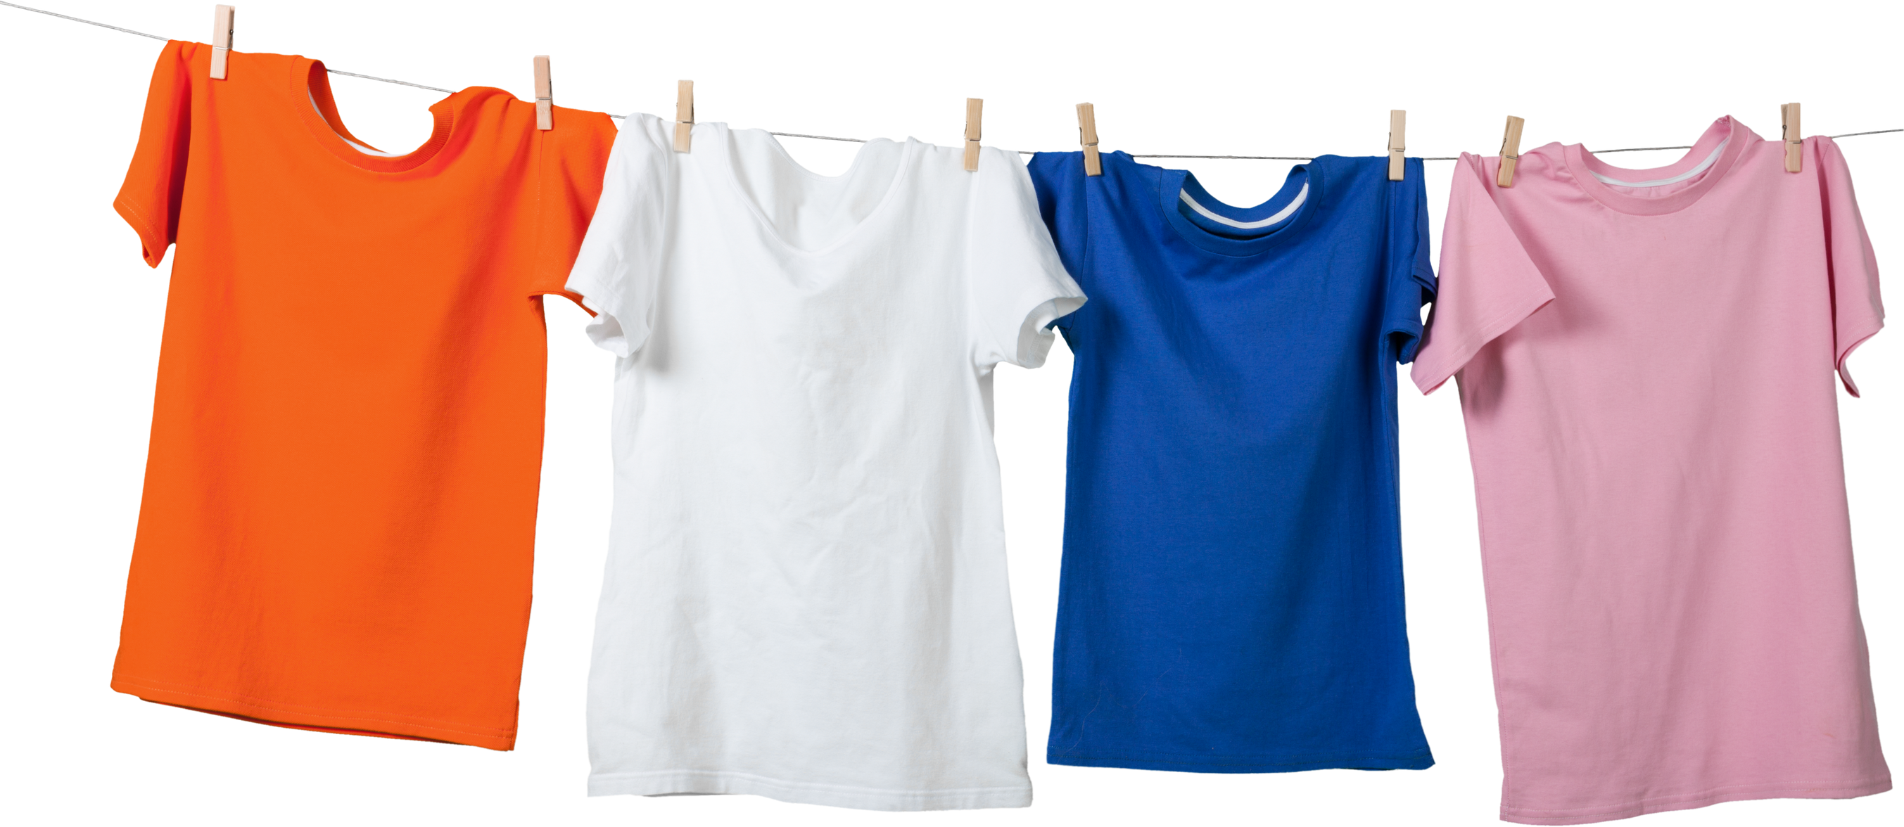
2ND CAPSULE FORMULA
2nd Possible Formula to Use
5-4-3-2-1 Packing Rule
Perfect for vacations yet surprisingly handy for daily life:
  5 top
  4 bottoms
  3 pairs of shoes
  2-layering piece
  1 “wild card” (dress, jumpsuit, or loungewear)

Slide 20

WHERE TO SHOP

Slide 21
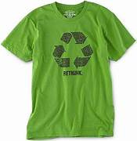

WHERE TO SHOP
Shopping Sustainably
Buy Less
Thrift or Upcycle
Support Ethical Brands
Choose quality over quantity
Find unique, eco-friendly pieces
Avoid fast fashion; choose sustainable options

Slide 22

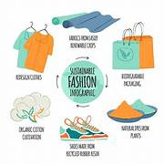
SUSTAINABLE SHOPPING
Choose Quality Over Quantity
Support Ethical Brands
Invest in quality over quantity; ask, "Will I wear this 30 times?"
Look for sustainable brands like Patagonia, Everlane, and Veja.
Thrift & Upcycle
Avoid Fast Fashion
Shop second-hand (Poshmark, ThredUp) or refresh old clothes.
Skip trendy, cheaply made items; focus on timeless, durable pieces.

Slide 23
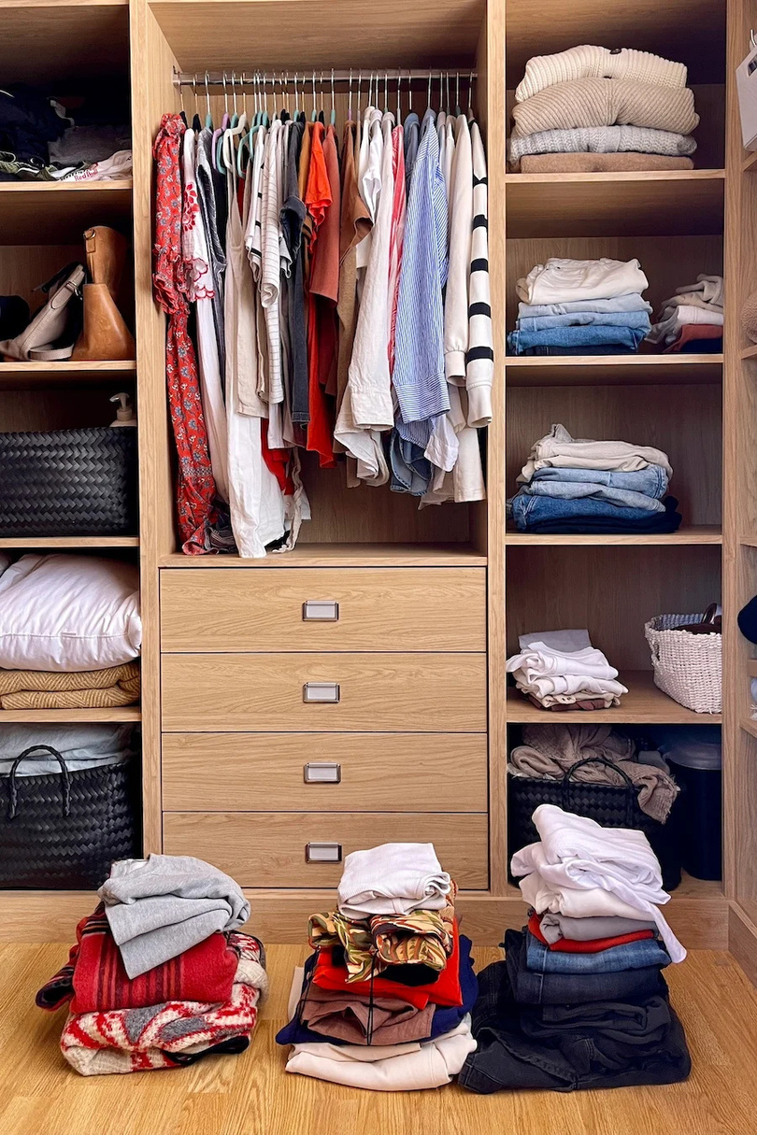
Examples Capsule Wardrobe Based on Different Styles

Slide 24
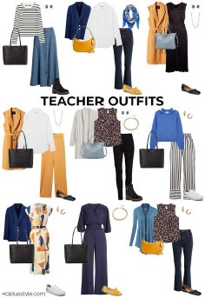
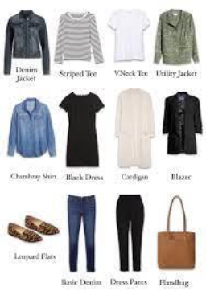

Slide 25
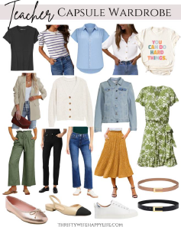
Another example

Slide 26
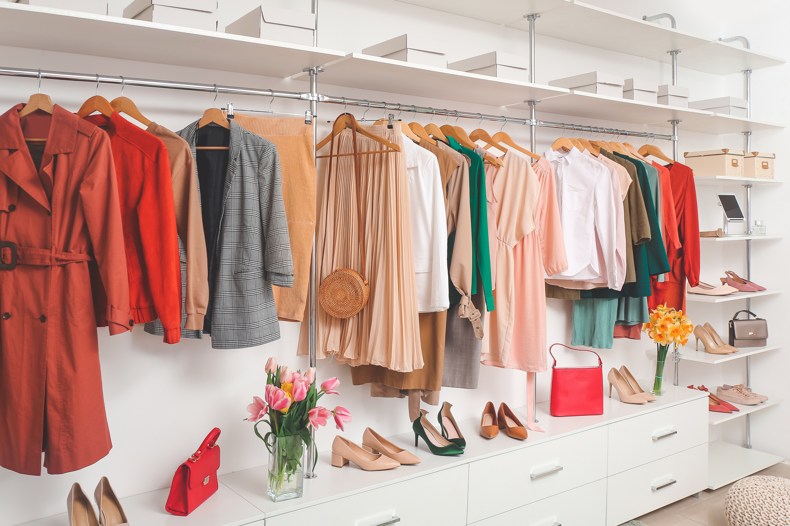
WHICH CLOTHES?

Slide 27
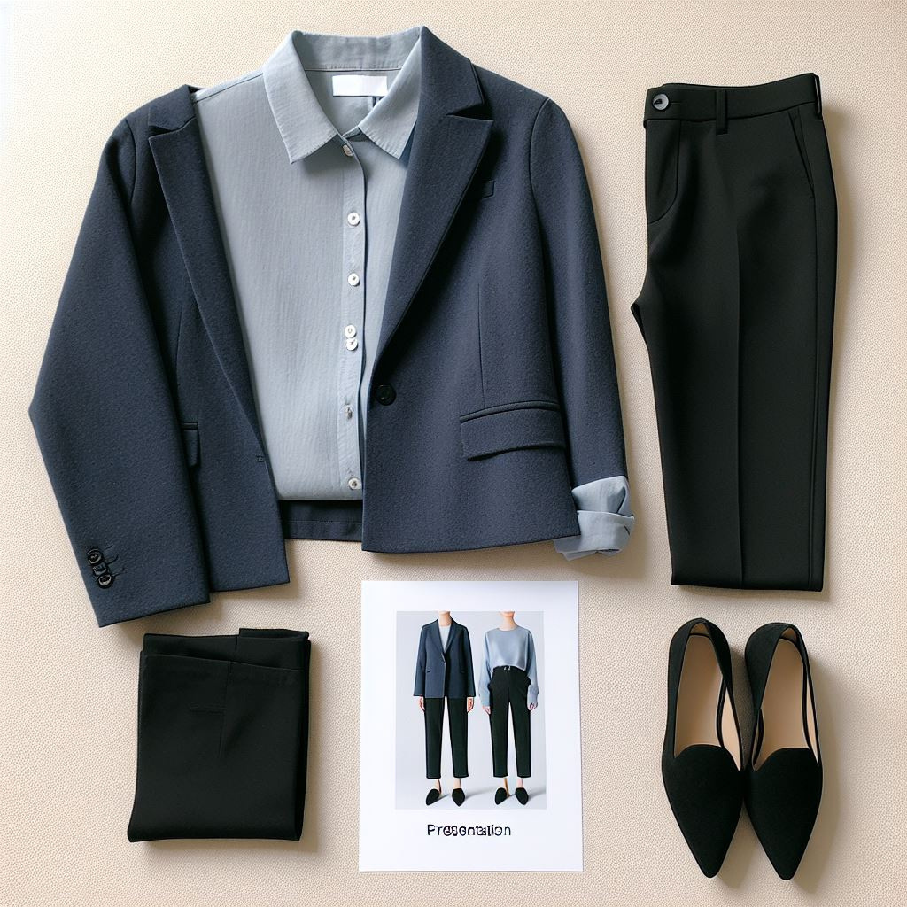
Business Casual
Pieces: Black trousers, light blue button-down blouse, navy blazer, black pointed-toe flats.

Slide 28
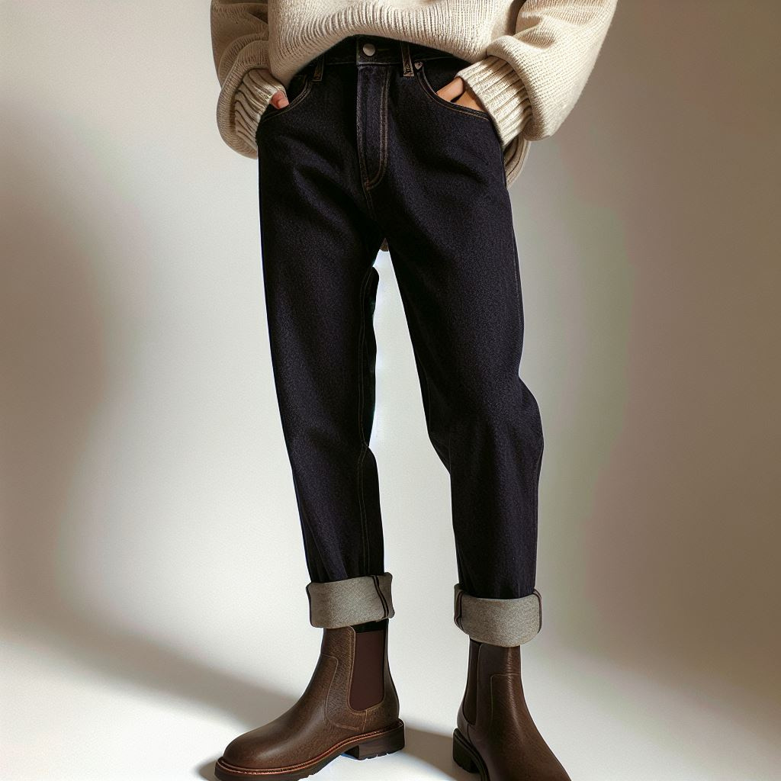
Comfortable and Chic
Pieces: Dark wash bootcut jeans, cream-colored sweater, brown ankle boots.

Slide 29
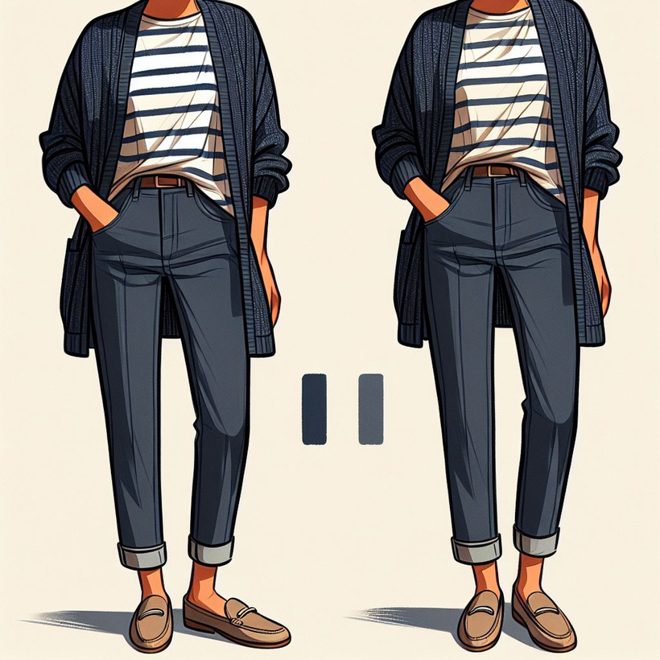
Casual Day
Pieces: Dark wash straight-leg jeans, navy and white striped t-shirt,cardigan, tan loafers.

Slide 30
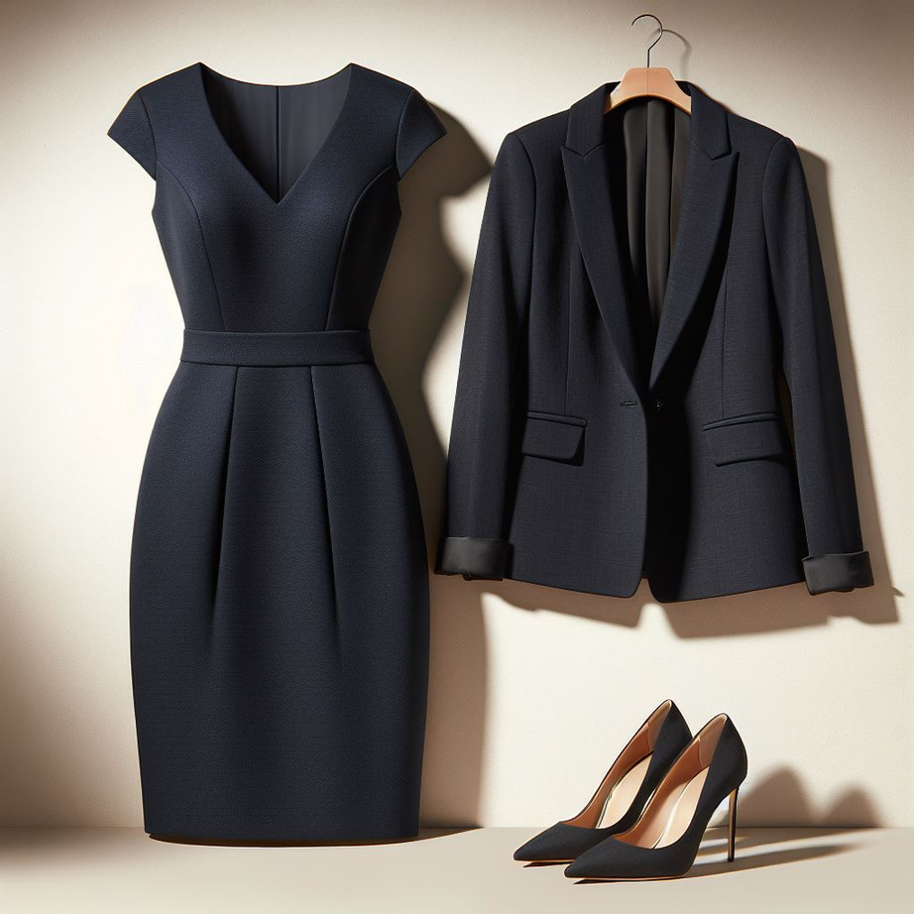
Outfit that is a must
Pieces: basic dress, jacket, heels

Slide 31
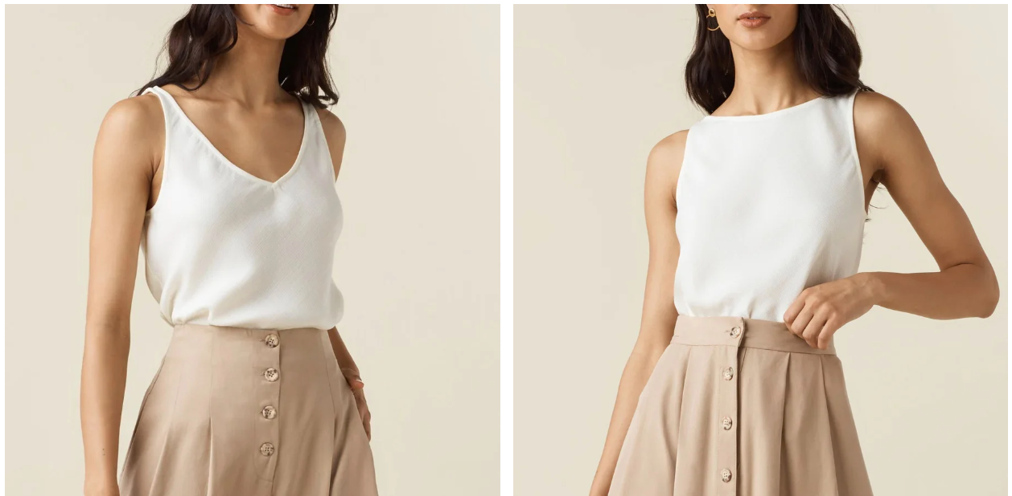
Tank Top
Consider the width of the straps when choosing tank tops. Sleeveless tops with slightly wider straps (½-inch to 2-inches) will work for various occasions even without anything layered over.

Slide 32
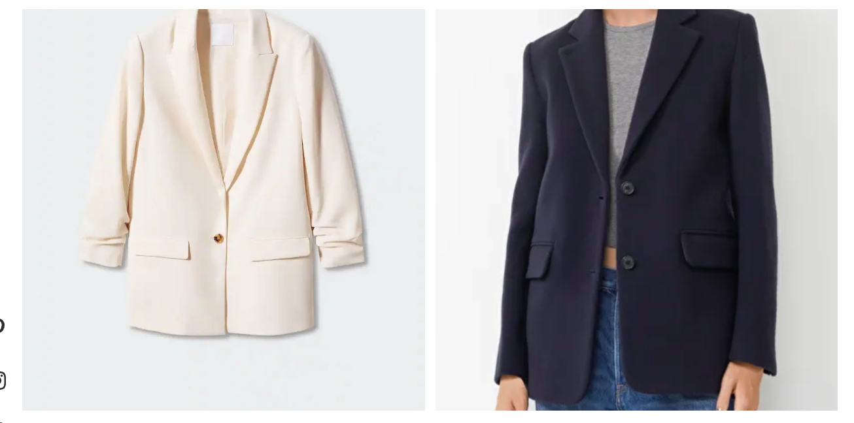
Blazer
A linen or wool blazer can be a great seasonal statement piece, but a midweight cotton or cotton-blend blazer will be less season-specific and likely more versatile throughout the year.

Slide 33
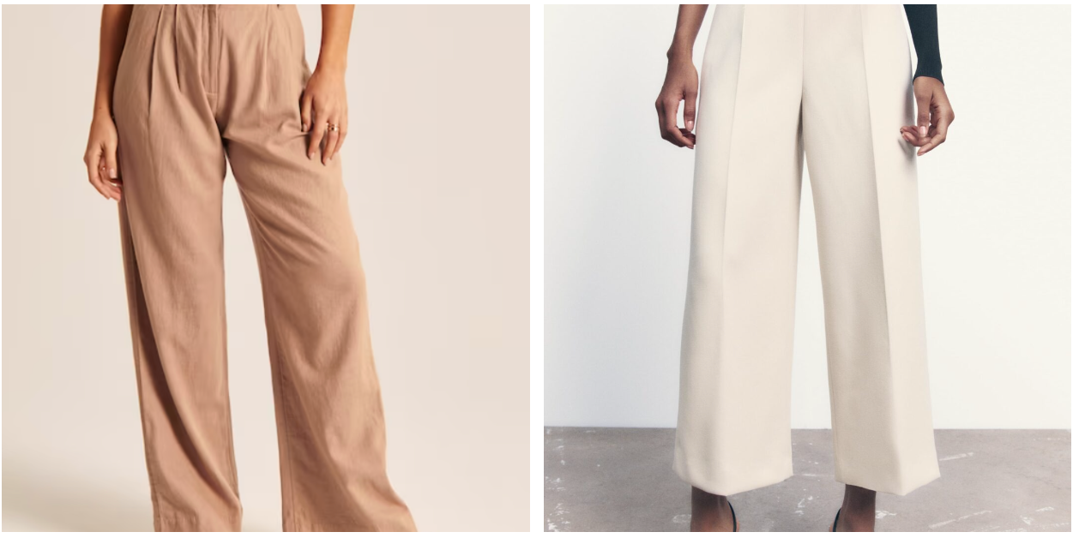
Trousers
Culotte trousers can be worn year-round and feel less formal than full-length trousers. Pair them with slim or chunky boots in fall and winter and pointy flats, mules, pumps, or open-toe wedges when spring and summer are in full swing.

Slide 34
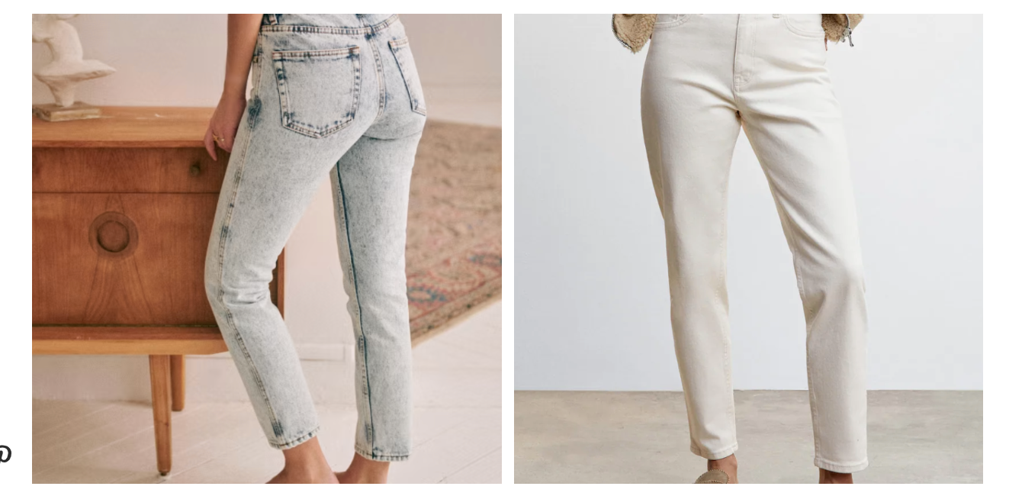
Classic Jeans
straight-leg, skinny, or wide-leg are examples of different styles
Think about what jeans are timeless
Having a few different styles and washes of jeans will give you maximum versatility and allow you to dress up or down the outfit

Slide 35
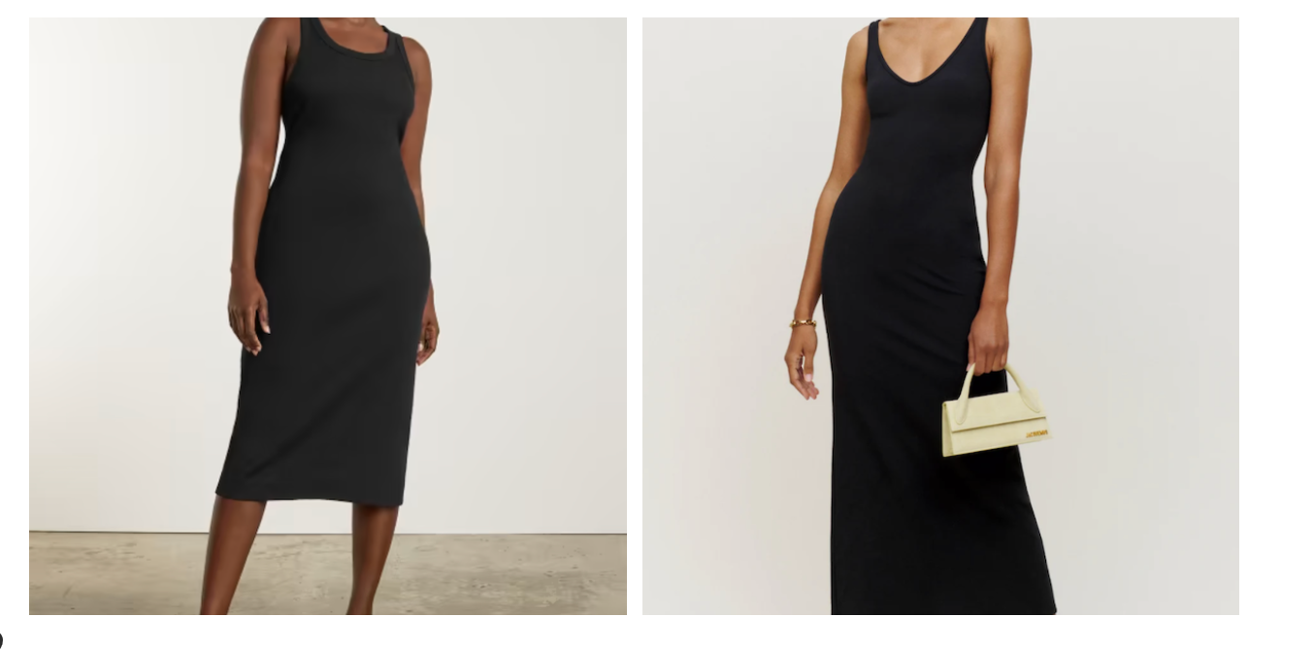
Black Dress
A long-sleeved black dress will be good for cooler weather, but a black sleeveless or short-sleeve dress can be worn year-round —alone or layered under a cardigan, blazer, or jacket during colder months.

Slide 36
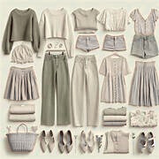
KEY TAKEAWAYS:
  Less Clutter, More Style – A streamlined wardrobe simplifies choices while keeping your style elevated.
  Save Time & Money – Invest in quality pieces that mix and match effortlessly.
  Versatile & Sustainable – Fewer items, more outfits, and a positive environmental impact.
  Personalized to You – Your capsule should reflect your lifestyle, preferences, and needs.
Start small, experiment, and enjoy a wardrobe that truly works for you!

Slide 37
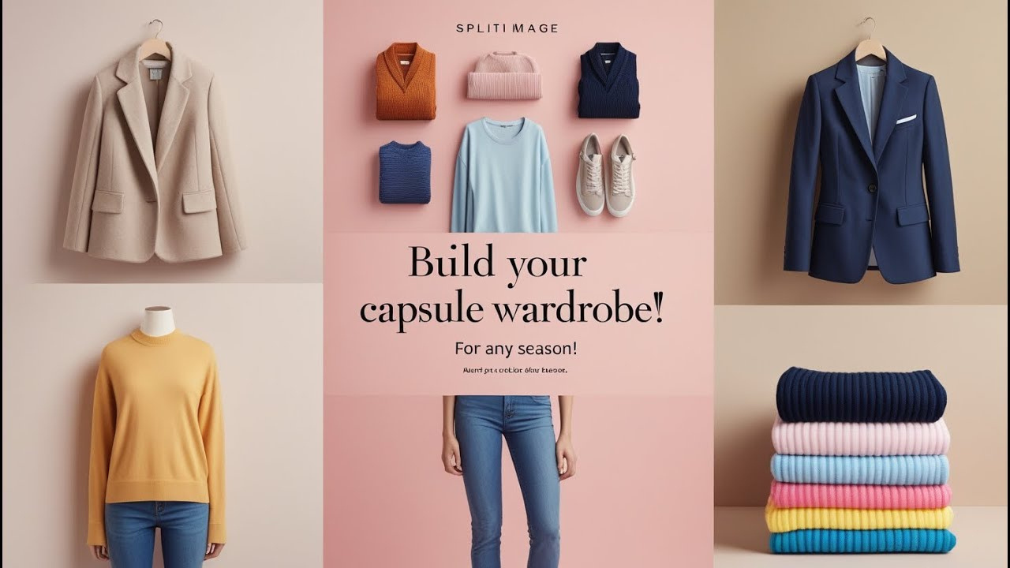
Are there any questions?
Good Luck!

