Slide 1



Holly's Highlights:
Key Updates & Reminders
Essential Information for
CareerTech FCS Educators

Slide 2


Slide 3



Slide 4
Welcome to
Oklahoma
Summit

Slide 5

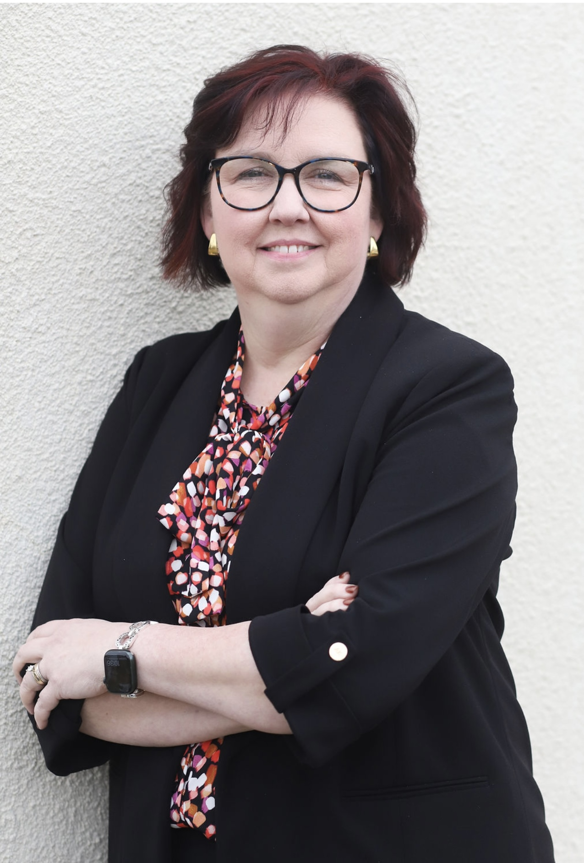
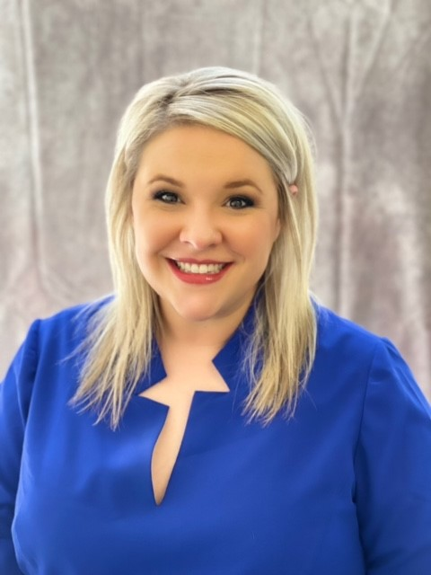

Holly Hanan
State Program
Manager
Brittani Phillips
FCCLA
State Adviser

Slide 6
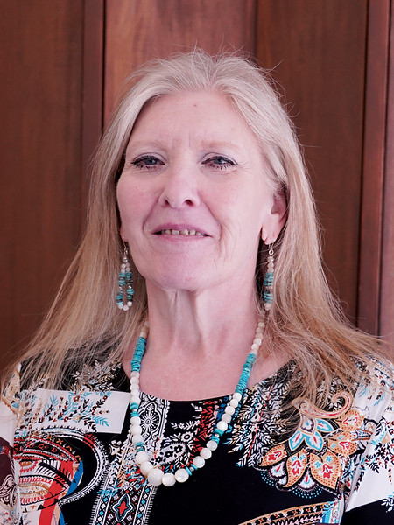
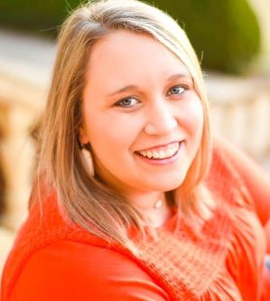
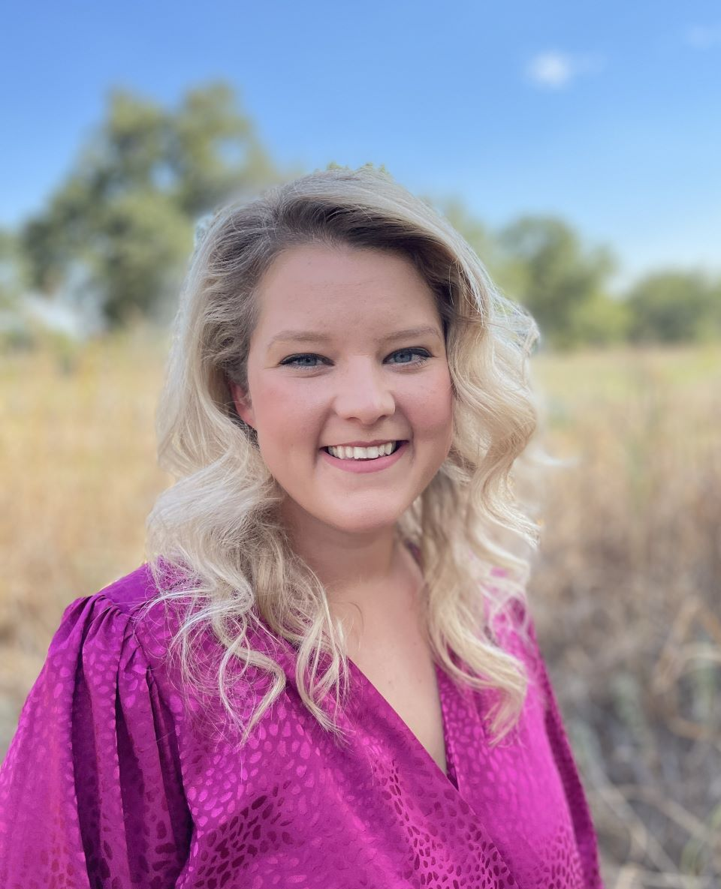
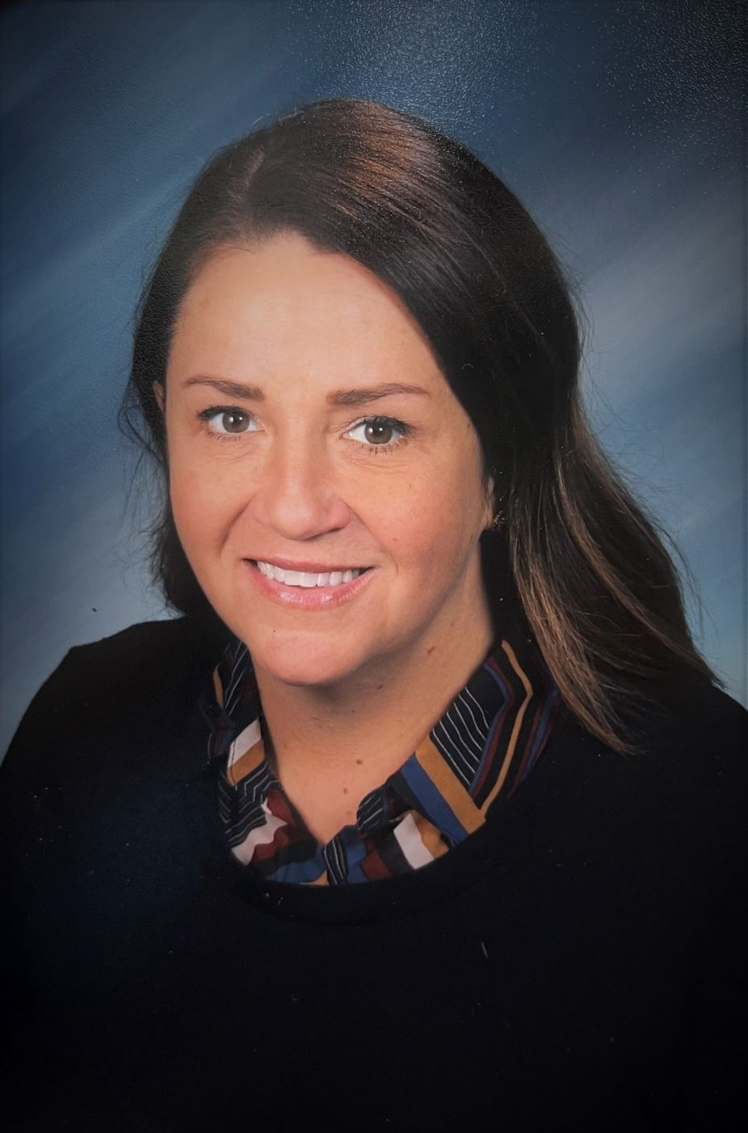
Teena Friend
---
North Region
Jessi
Beebe
---
Northeast Region
Jessica
Maker
---
South Region
Christina Spurgin
---
Southeast Region

Slide 7
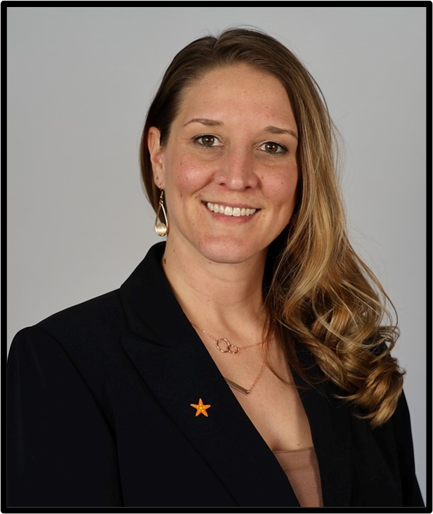
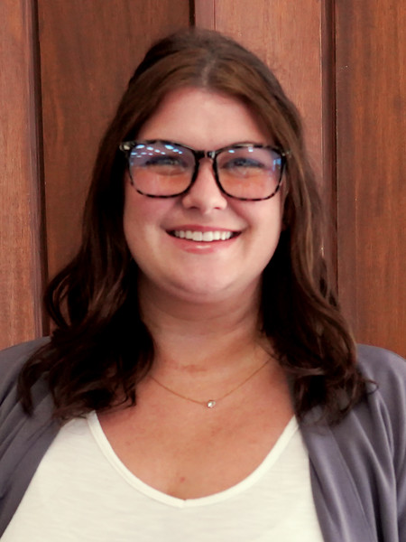
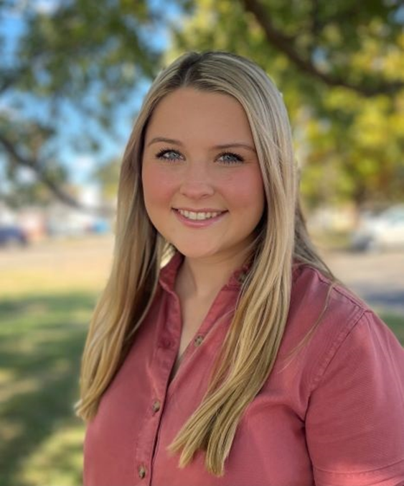
Tiffiany Peters
Ashli
Hall
Malynn
Broomfield
FCS
Administrative
Assistant
FCS
Administrative
Assistant/
FCCLA Bookkeeper
FCS
Student
Intern

Slide 8
FCS Programs
K12- 376
Technology Center 56
Total 432

Slide 9
New Programs
Broken Arrow Sequoyah 8th grade
Moore HS
Owasso 7th grade
Thackerville HS
Tulsa Street School
Southmoore HS
Wayne HS
Westmoore HS
Wilson HS

Slide 10
Program Increases
Half to Full Time
Broken Bow MS
Collinsville MS
Savannah HS

Slide 11
Teachers Wanted
Checotah HS
Lawton LRC
Wilburton HS

Slide 12

Program Funding
Full-time= $8,000
Part-time= $4,000
Salary Supplement
Full-time= $2,200
Part-time= $1,100

Slide 13
District Changes
Necessary to adjust
to help equalize
regions and districts

Slide 14



Branding
The goal is to present a unified image for all FCS programs, including a consistent message and visual identity
No longer FACS or Home Economics

Slide 15
Public Image
  Permission to post students on social media Consent forms are needed for any public-facing student content. Applies to photos, social media, websites, etc.
  Professional appearance
    Aprons, chef coats, hair pulled up, safety measures, proper official dress, pressed clothing, etc.
  Convey a professional image
    Legislators see what you are doing in your programs.
  Official dress for students= professional dress for advisers

Slide 16
Career
Clusters
New Model- 2025

Slide 17

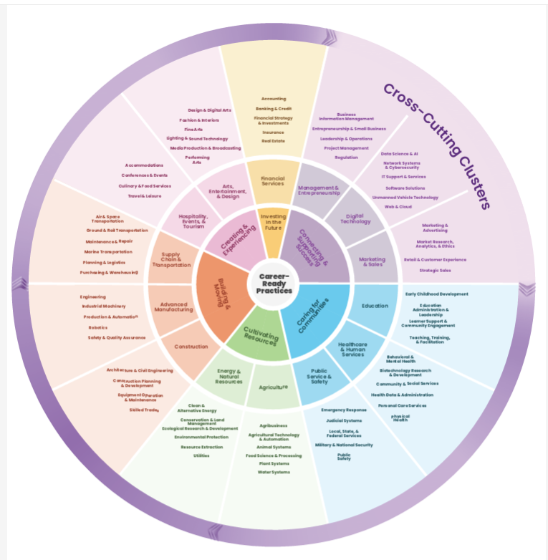

Slide 18
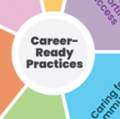
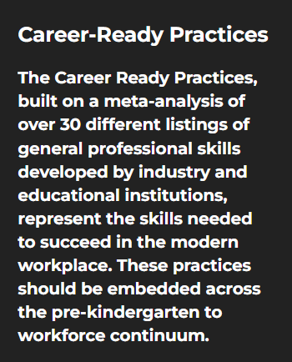







Career-Ready Practices
Exploratory-- 21st Century Skills– Job readiness skills

Slide 19
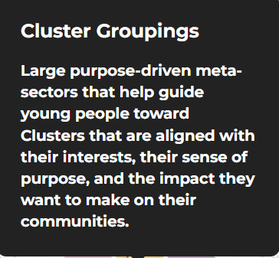
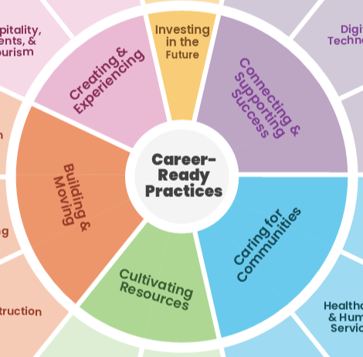







Slide 20
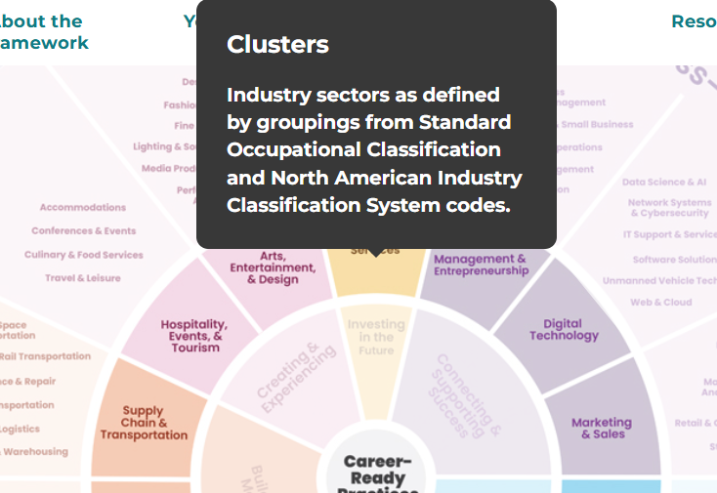





Slide 21
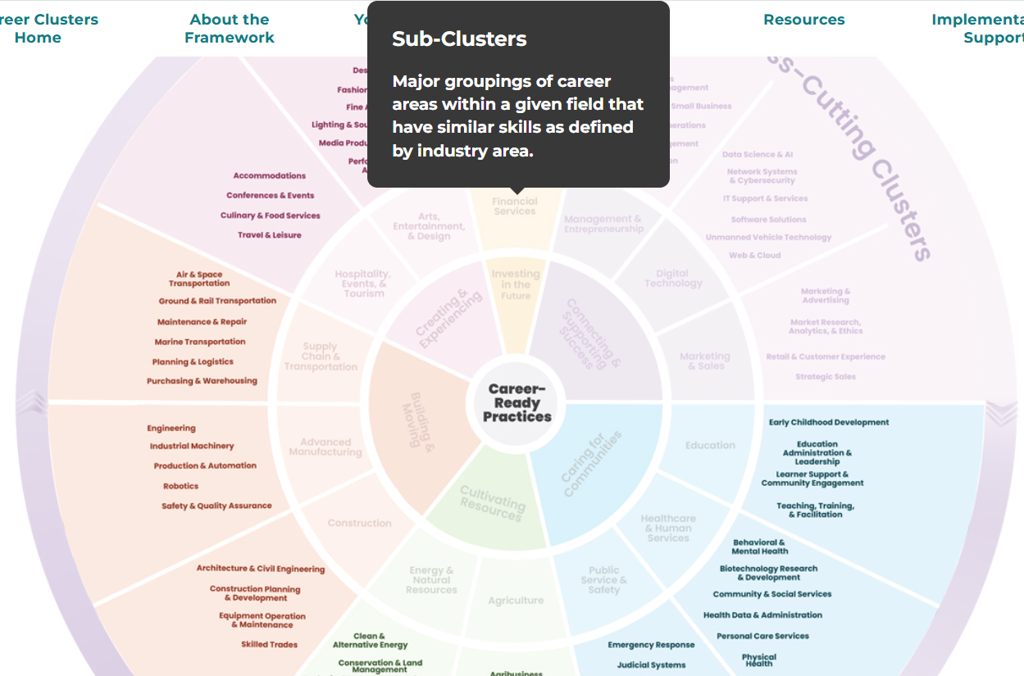





Pathways

Slide 22
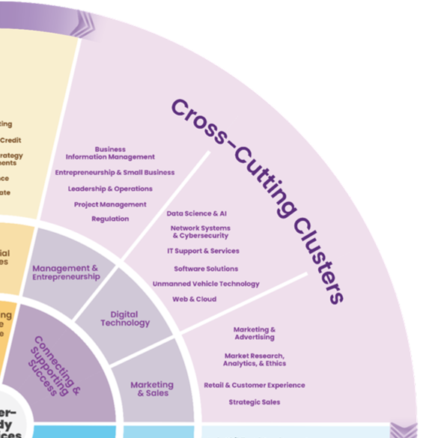
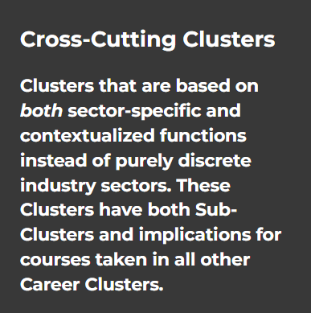

Slide 23
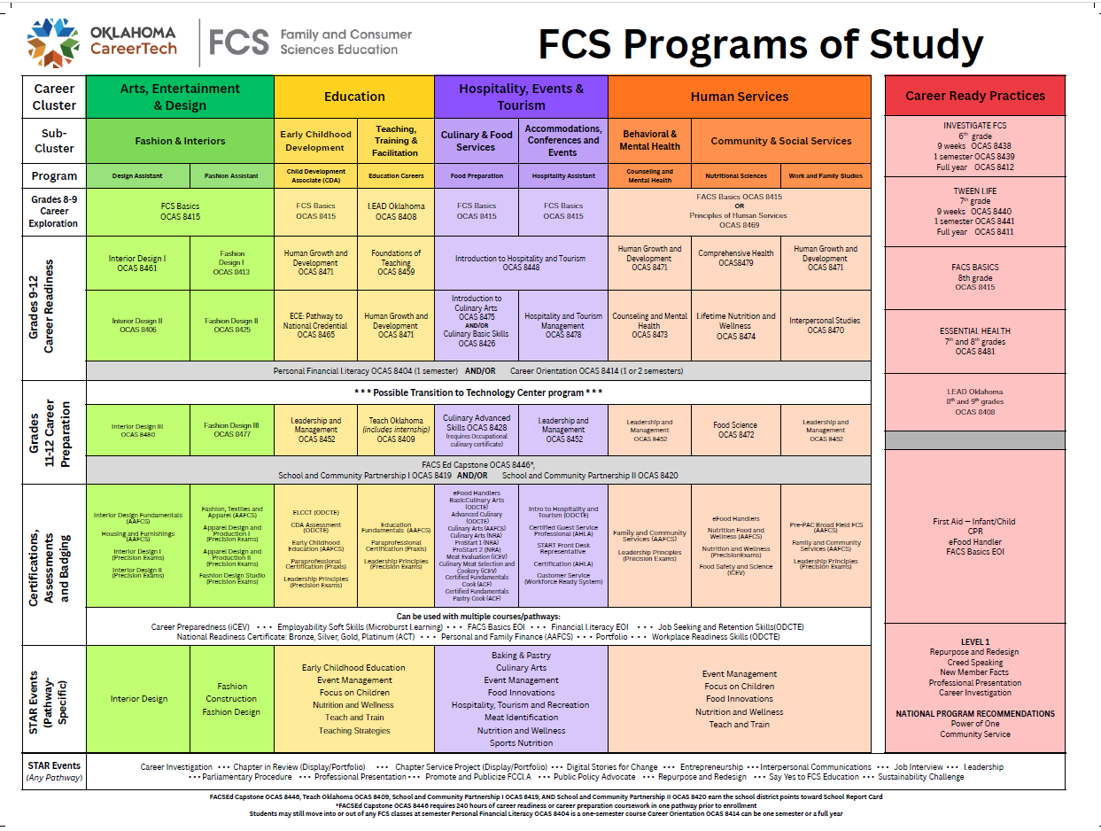

Slide 26


Slide 27

Instructional Framework
Technology Center Programs

Slide 28
Streamlined state programs
Completed all submissions and approvals in record time
Aligned programs across the state

Slide 29
Required Attendance
  Oklahoma Summit
  Lead Conference/ Fall PI meeting
  District Leadership Conference
  District STAR Events
  FCCLA State Convention
  Spring PI meeting
  *Region STAR Events if you district is hosting
  ** New Teacher Academy

Slide 30
Student Conferences
FCCLA events- Should ALWAYS have students with you in attendance.
Lead Conference
District Leadership Conference
STAR Events
Say Yes to FCS Day
Take AIM
Get SET
FCS Day at the Capitol
State Convention
National Leadership Conference
Advisors should
NEVER
outnumber the students in attendance!

Slide 31
Expectations
When attending an event
  Be on time
  Participate
  Stay until the end
Be good stewards of the money (chapter or program)

Slide 32
Communication
Allow at least 24 hours for a response.
Your patience is appreciated: 400+ teachers, only one of each of us.
Please contact State Staff during regular office hours. 7:00-4:30

Slide 33
District Dues
District dues must be paid annually
If your program is delinquent, you will not be allowed to participate until your account is current.
District Counselors and Bookkeepers will notify our office (Brittani and Holly) as to who is delinquent.

Slide 34
Key points about a high-quality Career and Technical Education (CTE) program:
Industry-Driven: demand-focused education platform
Skill-Focused: industry-recognized certifications
Comprehensive: wide range of pathways
Essential Skills: essential skills
Seamless Transition: link training & employment
Brent Haken, ODCTE
State Director
Notes:
Industry-Driven: The program is a "demand-focused education platform" that directly responds to the current and future job needs of local businesses and industries.
Skill-Focused: It provides training centered on acquiring industry-recognized certifications that are both relevant and up-to-date.
Comprehensive: It offers a wide range of pathways, from traditional trades to advanced technology, and serves a diverse population, including K-12 students, adults, and those in correctional facilities.
Essential Skills: The curriculum integrates "essential skills," often called soft skills, and utilizes Career and Technology Student Organizations (CTSOs) to help students develop them.
Seamless Transition: It's designed to create a direct link between training and employment, ensuring a "seamless transition" for students moving into the workforce.

Slide 35

Our focus is:
Develop quality programs.
STRETCH

Slide 36


Slide 37
Certifications & Assessments
What Is the Value of a Digital Badge?
Badges are a verifiable tool that transforms your knowledge and skills into a tangible snapshot of your capabilities, allowing you to advance your career without bias.
Who Will Notice?
» Employers
» Recruiters
» Colleagues
» Clients

Slide 38
Provide opportunities for certifications, assessments, and badging.
Proof of credible programs and instruction.
These are vital for student success.

Slide 39
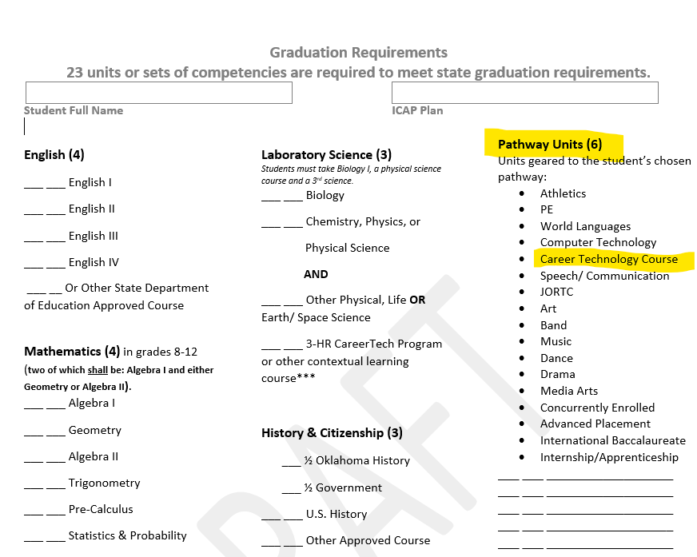
Graduation Requirements
Sample

Slide 40
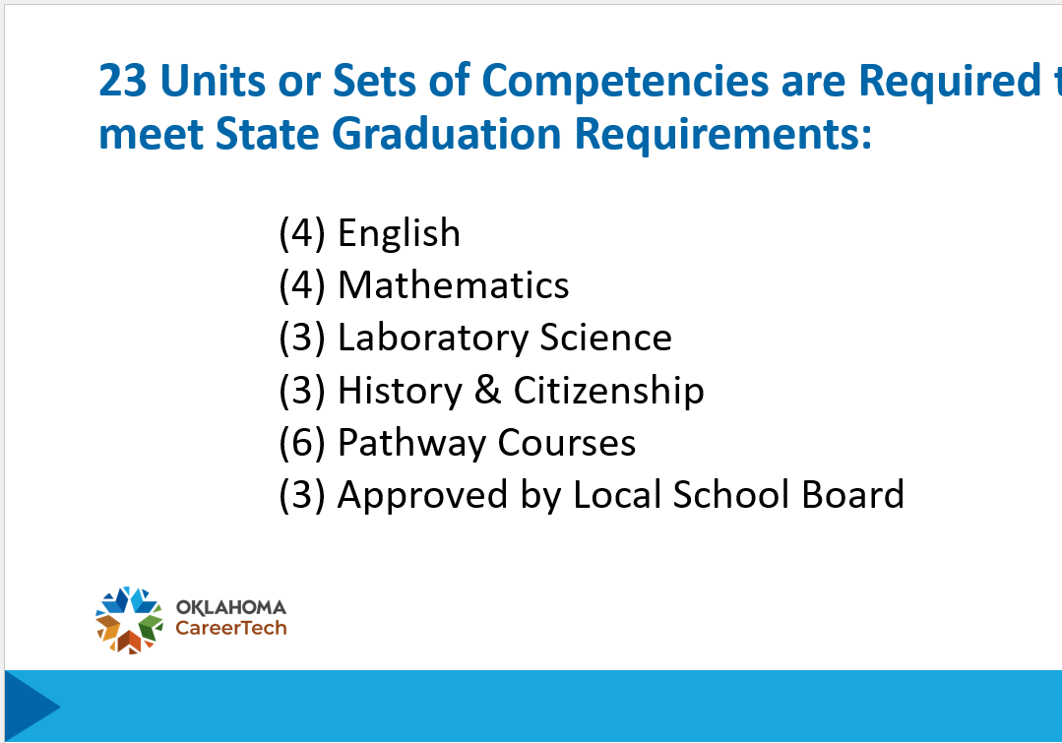

Slide 41
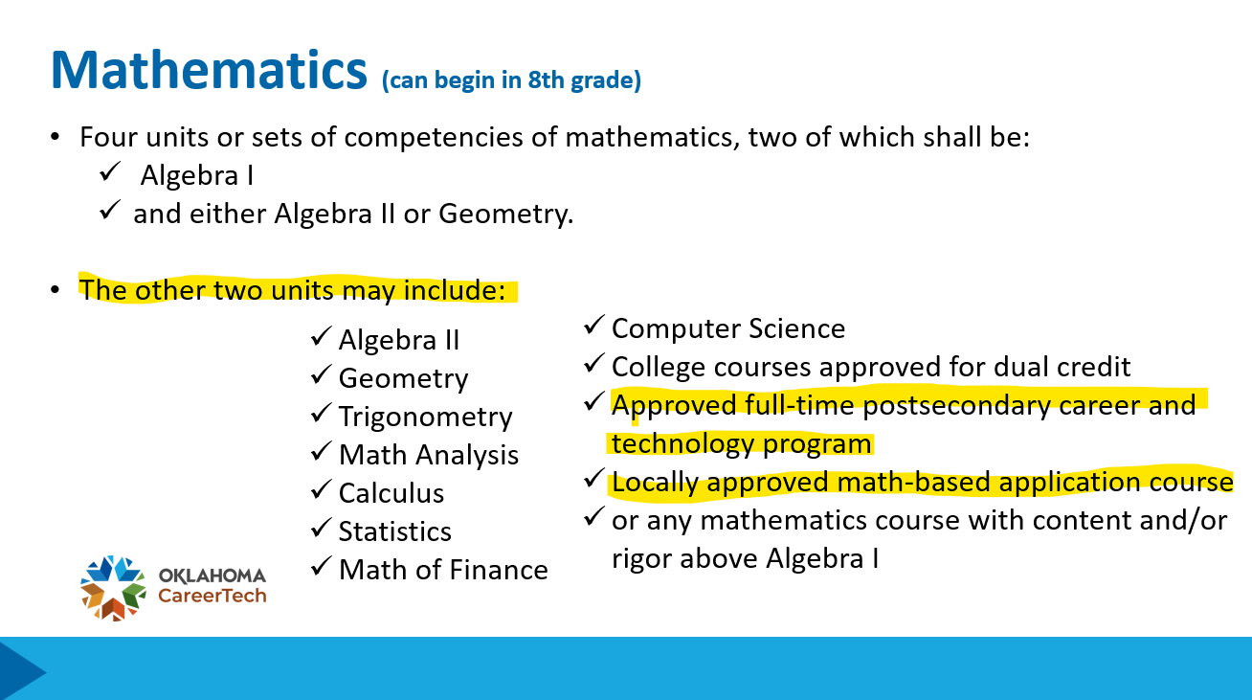

Slide 42
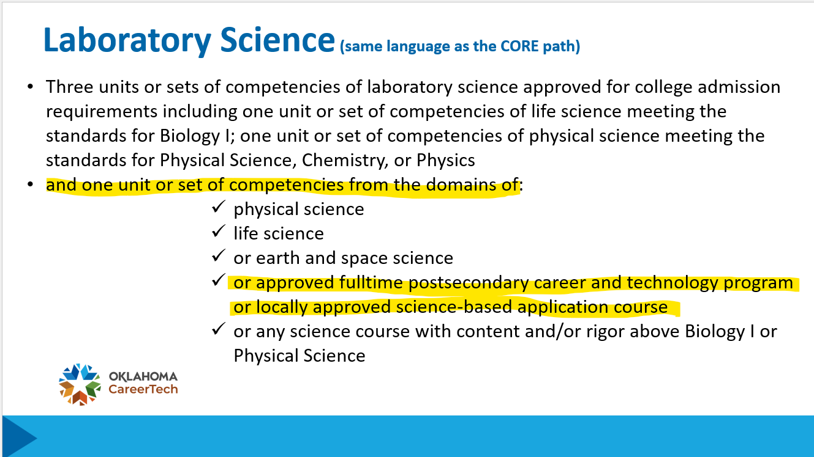

Slide 43
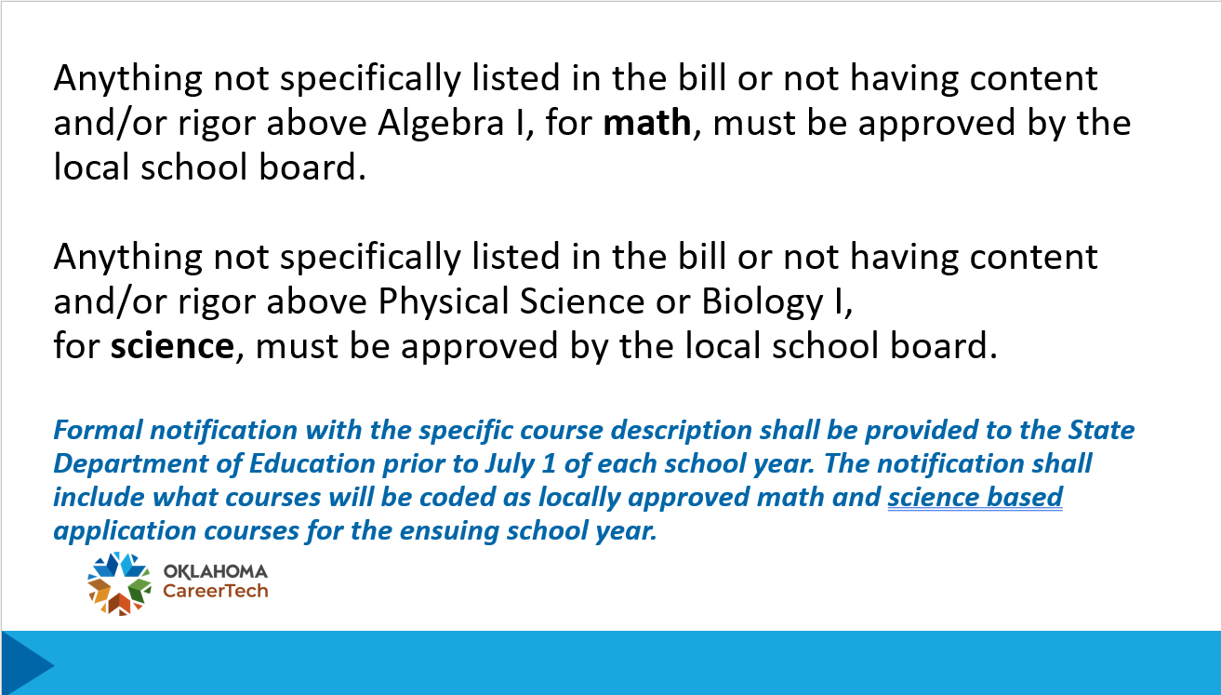

Slide 44
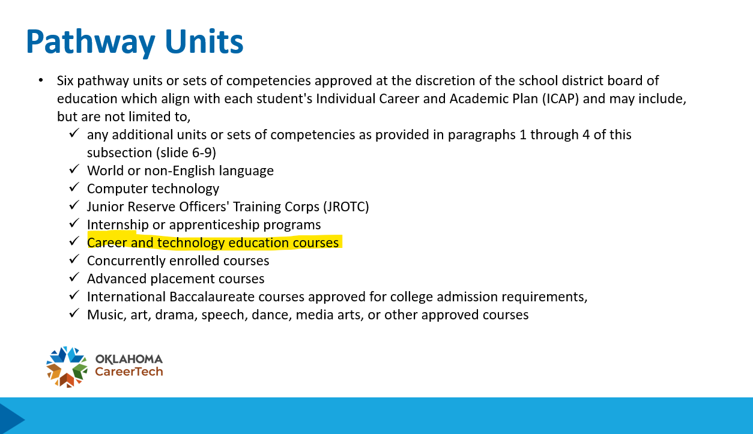

Slide 45
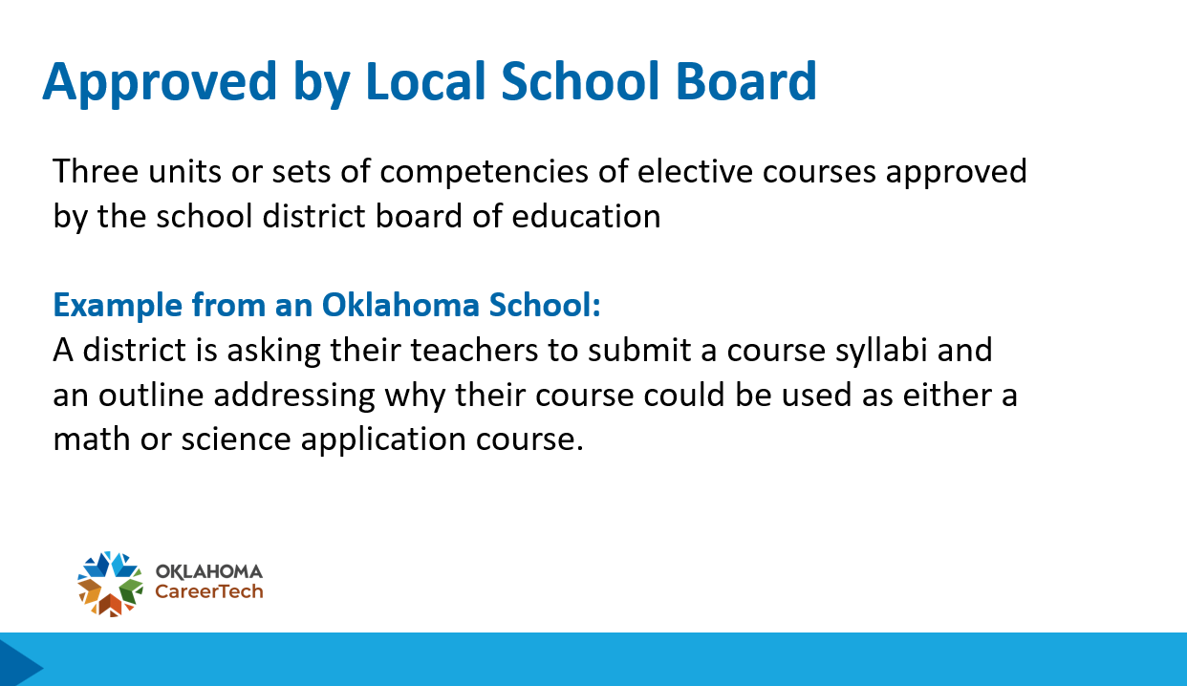

Slide 46
Program Folders
& Audits
Update your program folders annually.
Desk audits will ensure documentation is complete.

Slide 47


Oct 30, 2025

Slide 48

Registration opens
Jan 6, 2026

Slide 49
FCS Research Challenge
Guidelines will be updated
and posted by August 31.

Slide 50


Slide 51
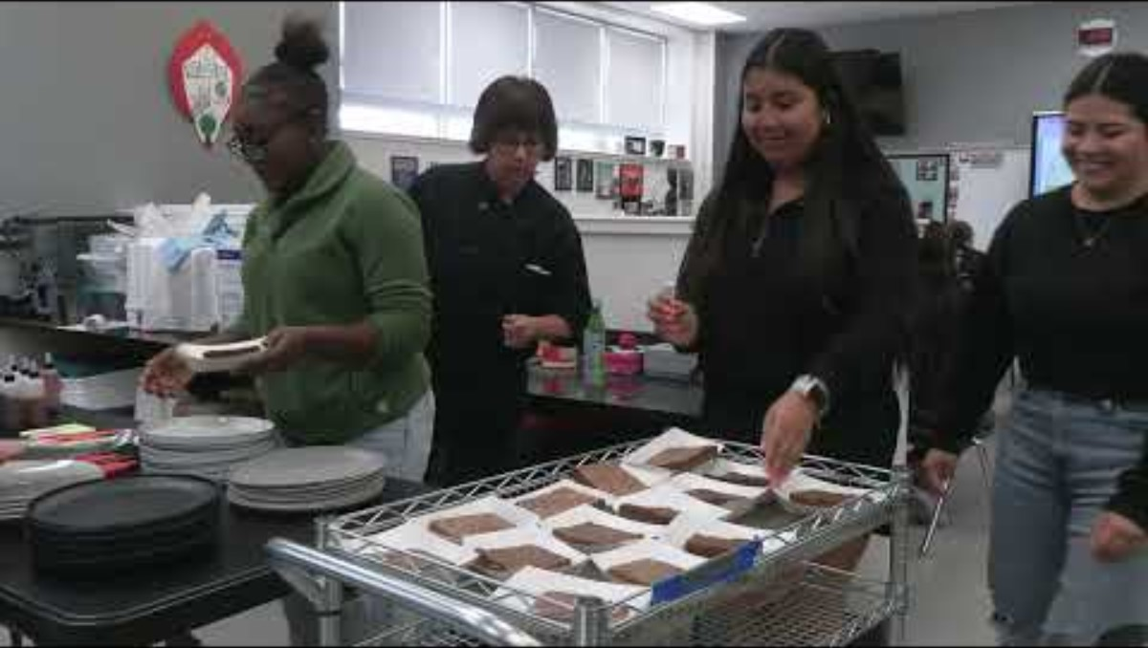

Slide 52

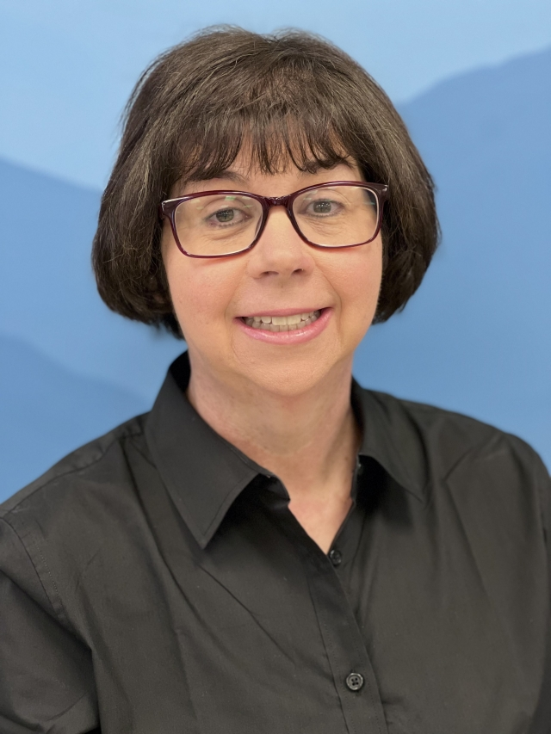
Melissa
Evon
Elgin FCS Instructor

Slide 53
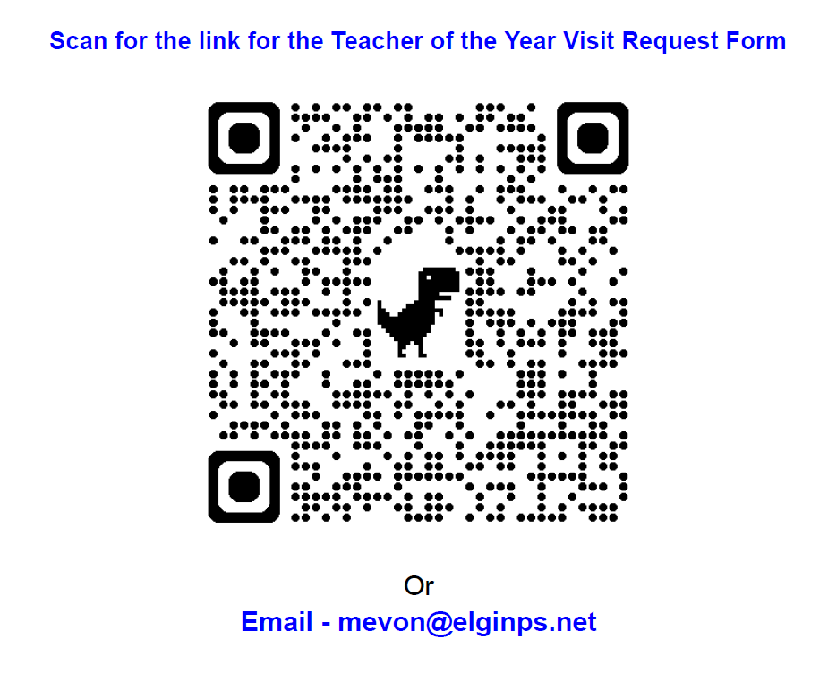

Slide 54
Today’s Agenda
District Pictures
Workshops
Lunch- FCCLA Updates
Workshops
Region/District meetings

Slide 55


