Slide 1



Welcome to
Region Meetings
Region
*Please sit with your districts*

Slide 2
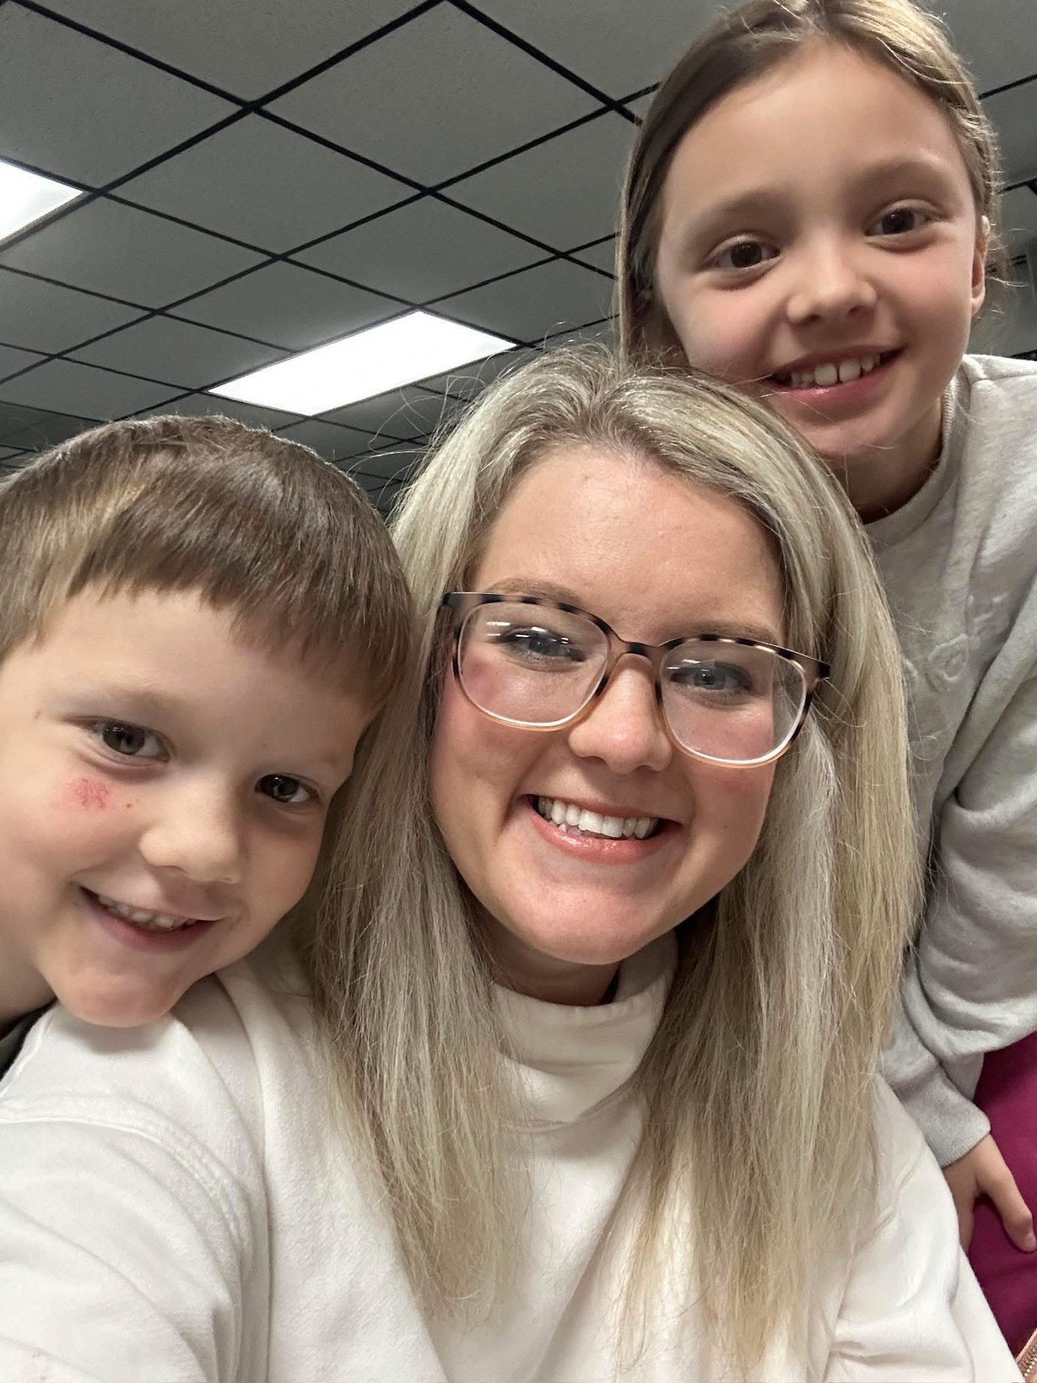
Program Specialist
Contact Info: ​
  jessica.maker@careertech.ok.gov​
  405-743-5464
Personal Info: ​
  Del City Alum ​
  OSU FCSED Alum
  Taught at Guthrie JH, HS, and Meridian Tech
  School Board Member
  Passionate for kids, education, and FCS

Slide 3
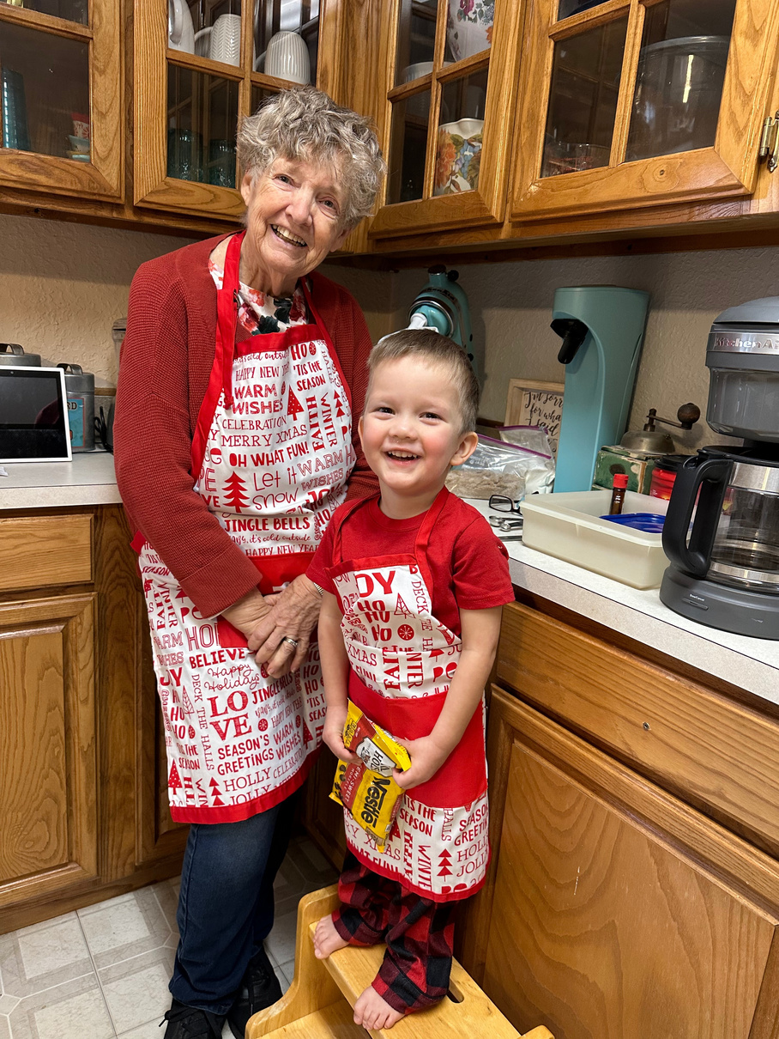
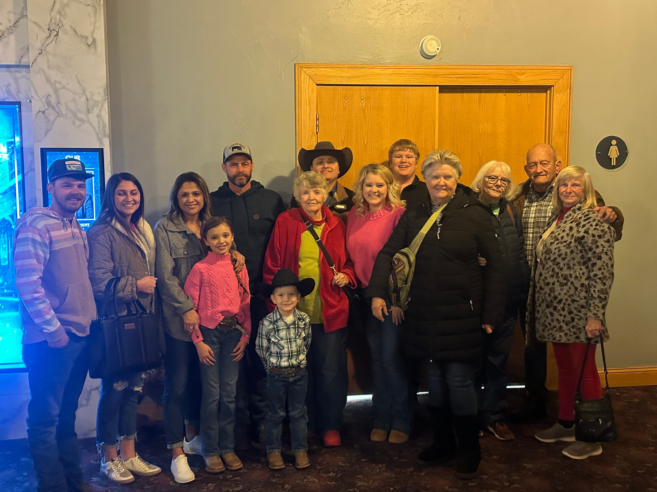
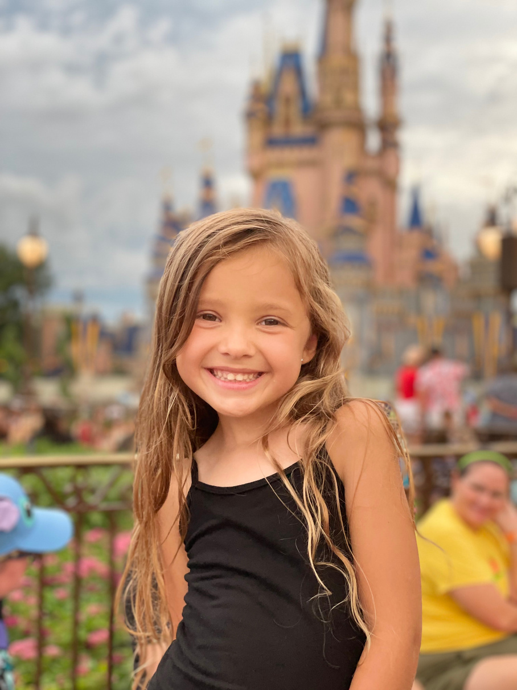
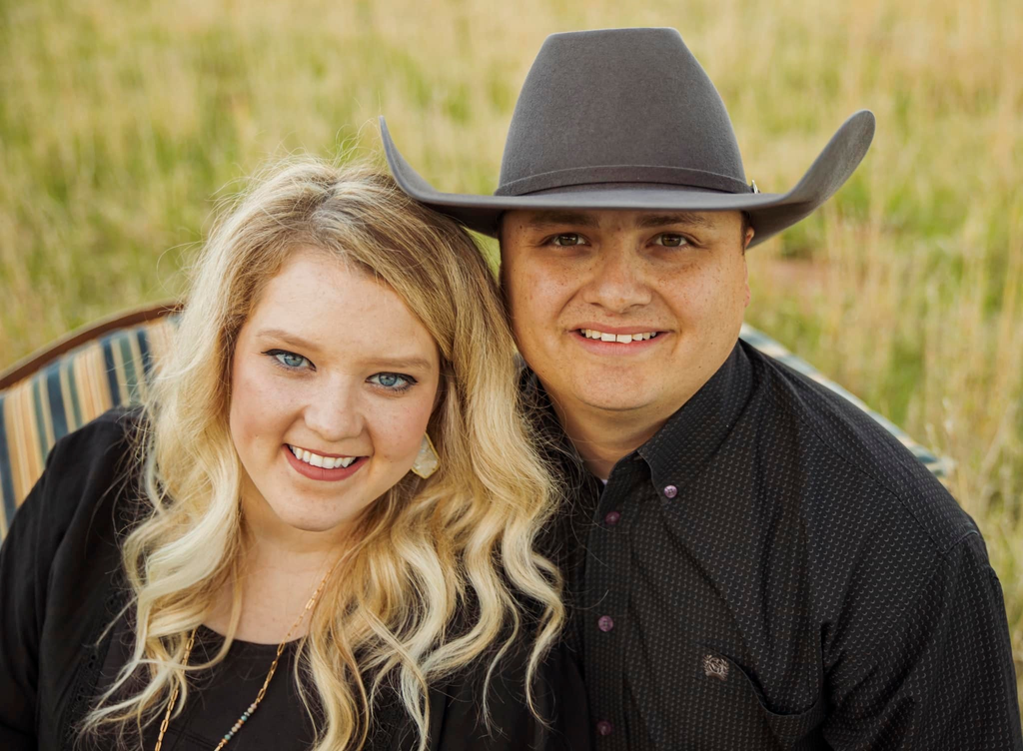
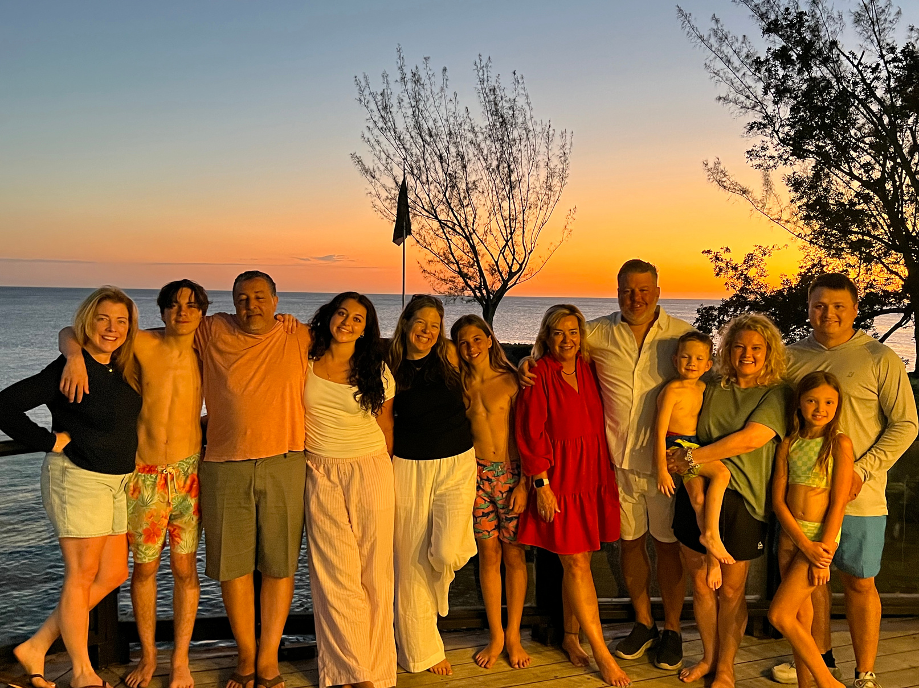
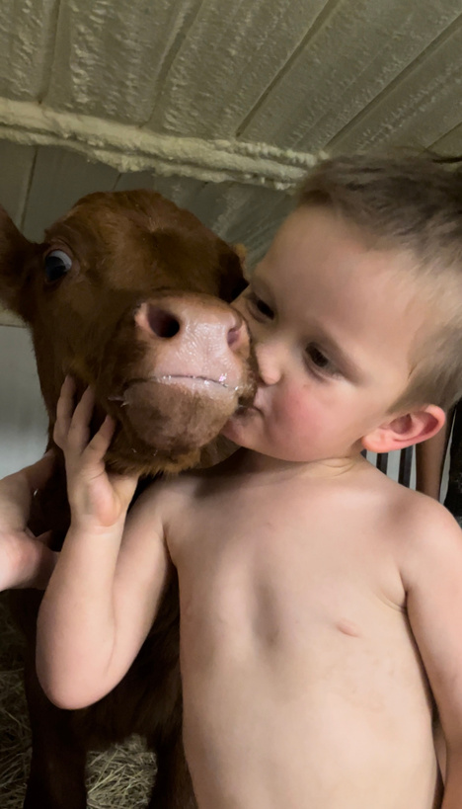

Slide 4
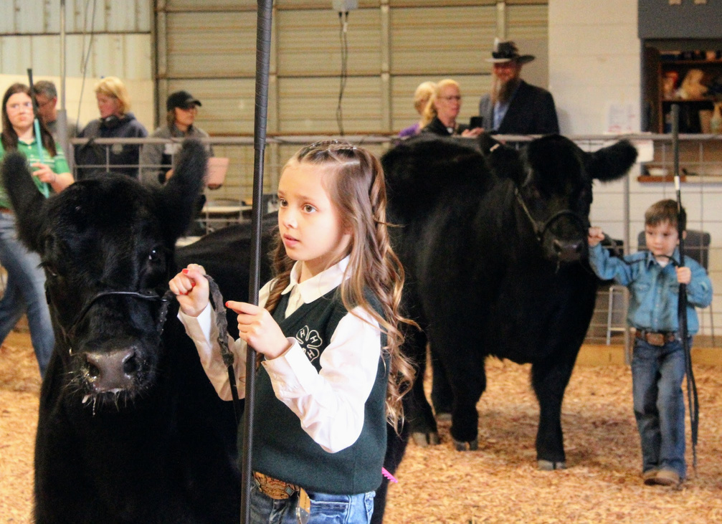
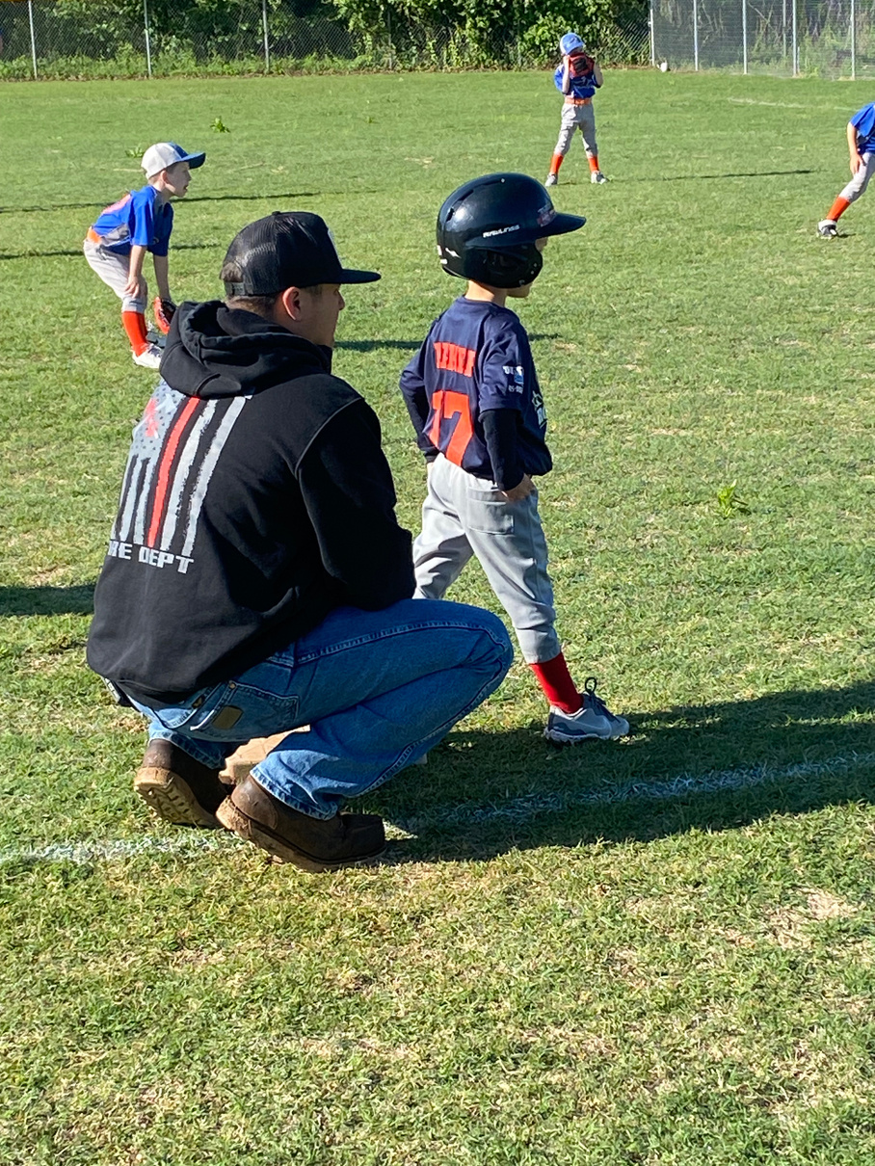
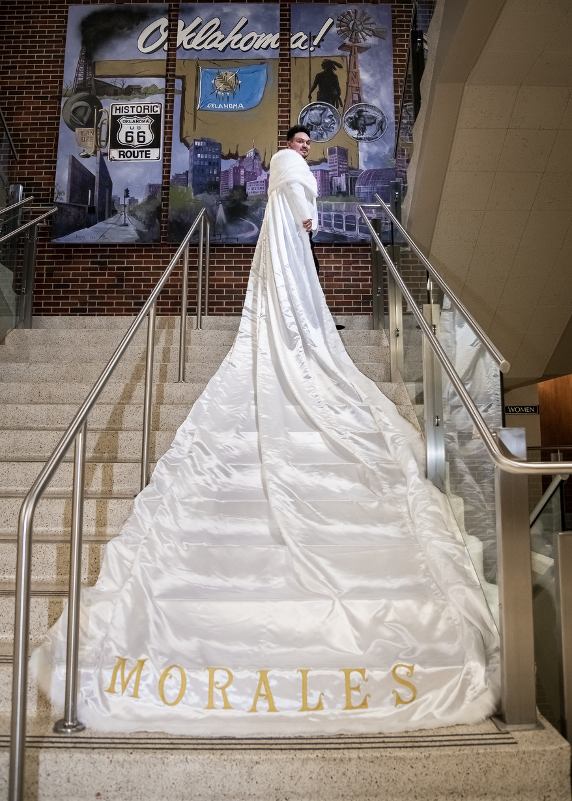
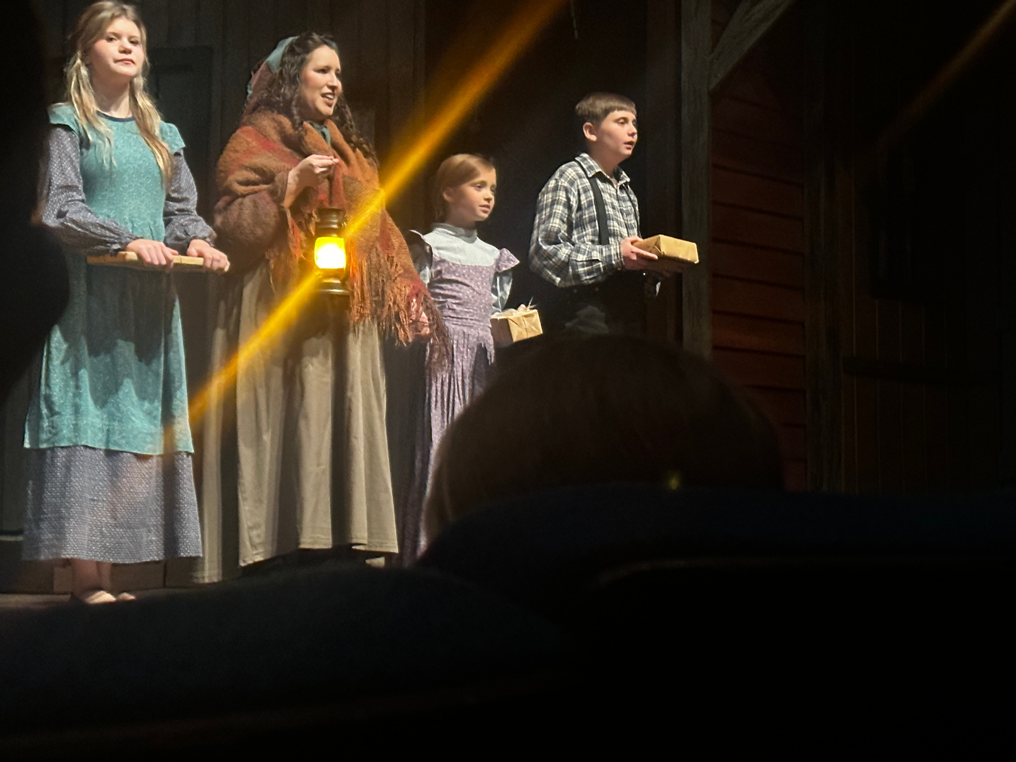


Slide 5
~PSA~
This entire powerpoint will be posted to ctyou after ok summit. You can review it using this link:
Scribe to get you to Region Specific Resources

Slide 6

TEACHER CHANGES!
S1
S2
S3
S4
S5
  Cache HS-
    Robyn English
  Cordell HS-
    Keely Bobeck
  Altus HS-
    Emma Place
  Western Tech, CA-
    Alexander Thomison
  Lawton LRC
    OPEN
  Great Plains, CA
    OPEN
  Wayne HS-
    Andrea Wartchow
  Union City-
    Heather Babione
  PC West HS-
    Lacy Curtis
  Mustang HS-
    Tina Roby
  Mustang MS-
    Jennifer Valadez
  Hefner MS-
    Julie Meder
  PC-Mayfield MS
    OPEN
  Fletcher HS-
    Brooke Wagstaff
  Wilson HS-
    Kelli Kana
  Elgin HS-
    Kelly Elledge
  Westmoore HS-
    Kimberly Griffin
  Southmoore HS-
    Darcy Malezer
  Westmoore HS-
    Ashley Craft
  Moore HS-
    Kelli McCaskill
  Moore HS-
    Taryn Fowler Kelley
  Noble HS-
    Susan Swopes
  OKC- Capitol Hill-
    Shelley Mitchell
  OKC- NW Classen-
    Jacob Gray
  Newcastle HS-
    Ashten Johnson
  OKC- Southeast HS-
    Ericka Barnett
  OKC- Douglas HS-
    Glenn Downey
  OKC- Rogers MS-
    Linda LeClear

Slide 7
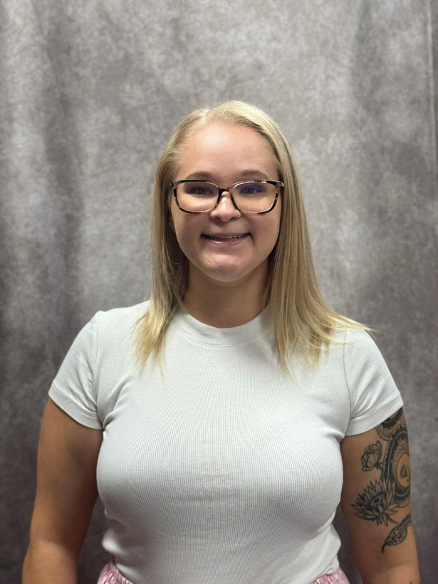
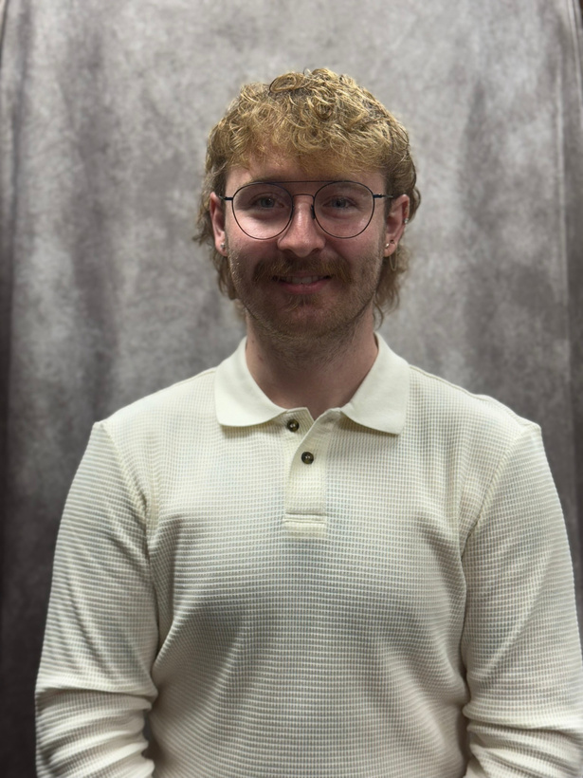
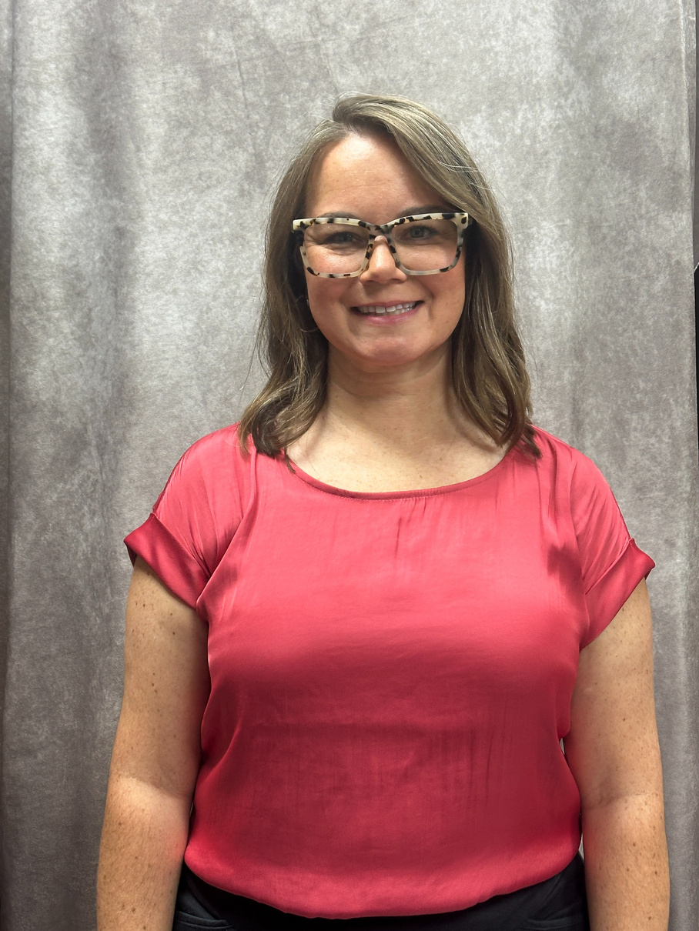
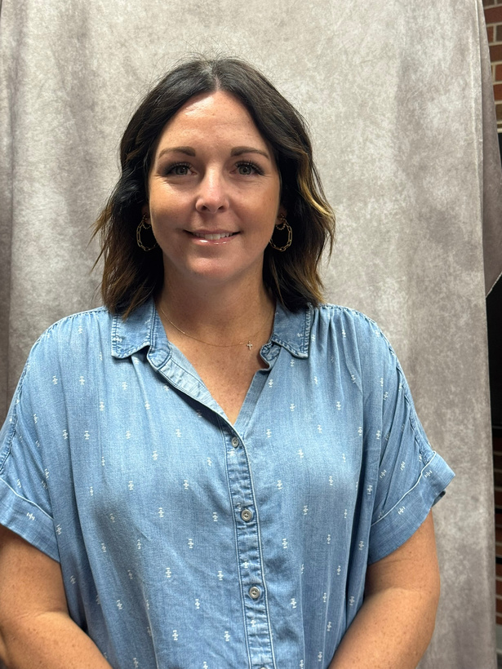
S1
EMMA PLACE:
ALTUS HS
ALEXANDER THOMISON
WESTERN TECH, CULINARY
ROBYN ENGLISH
CACHE HS
KEELY BOBECK
CORDELL HS

Slide 8
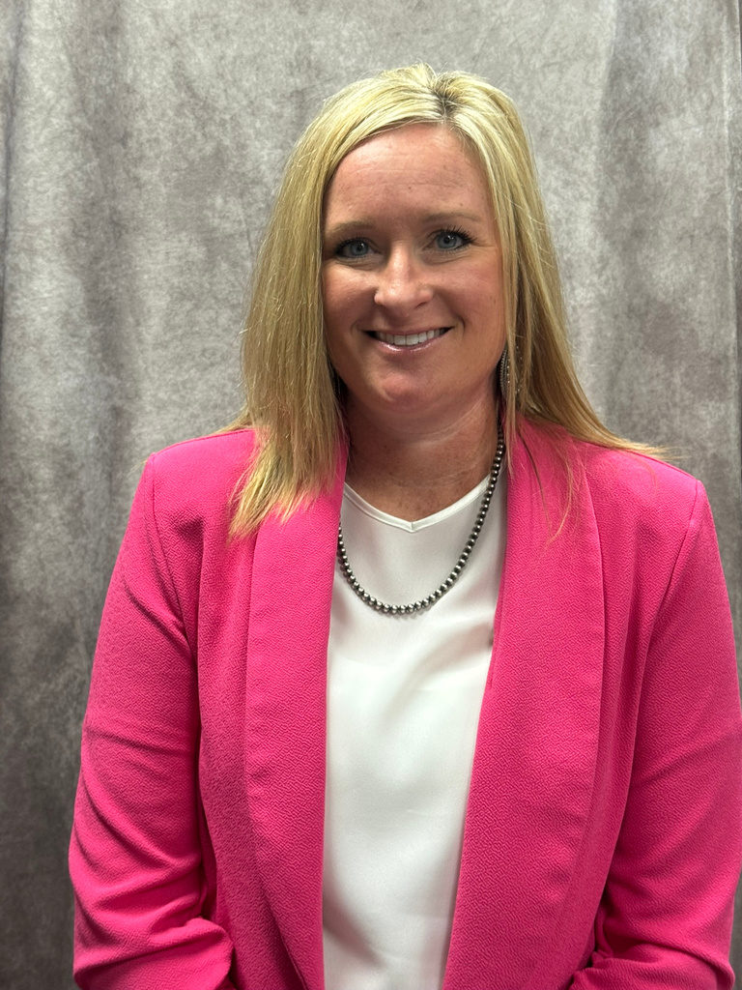
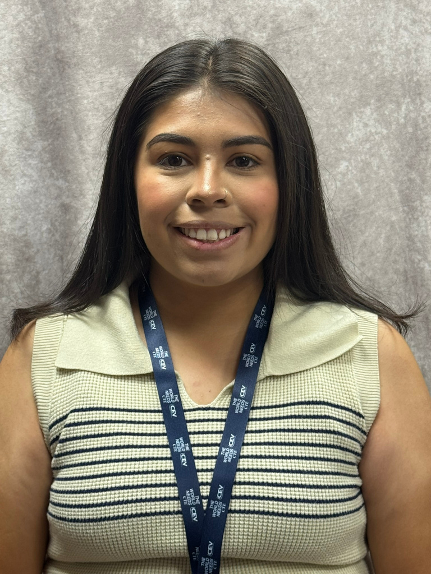
S2
S3
ANDREA WARTCHOW
WAYNE HS
JENNIFER VALADEZ
MUSTANG NORTH MS

Slide 9
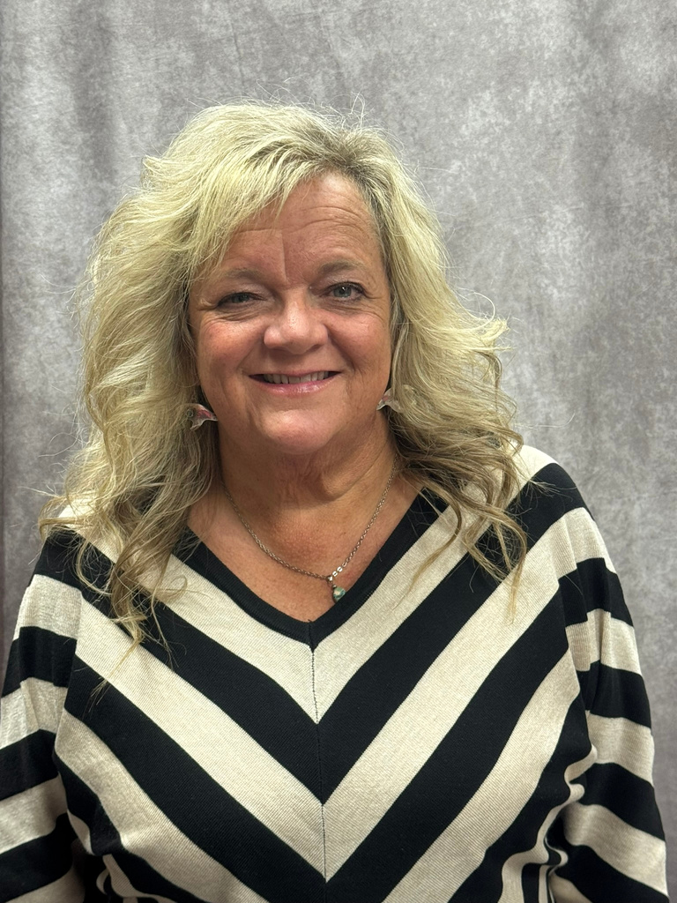
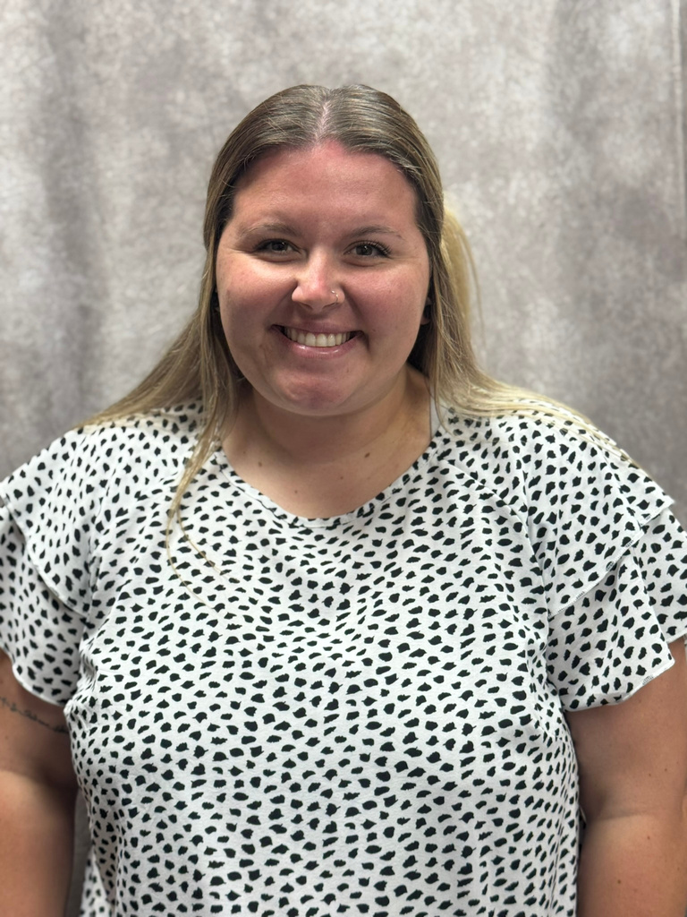
BROOKE WAGSTAFF: FLETCHER HS
S4
KELLY ELLEDGE: ELGIN HS

Slide 10
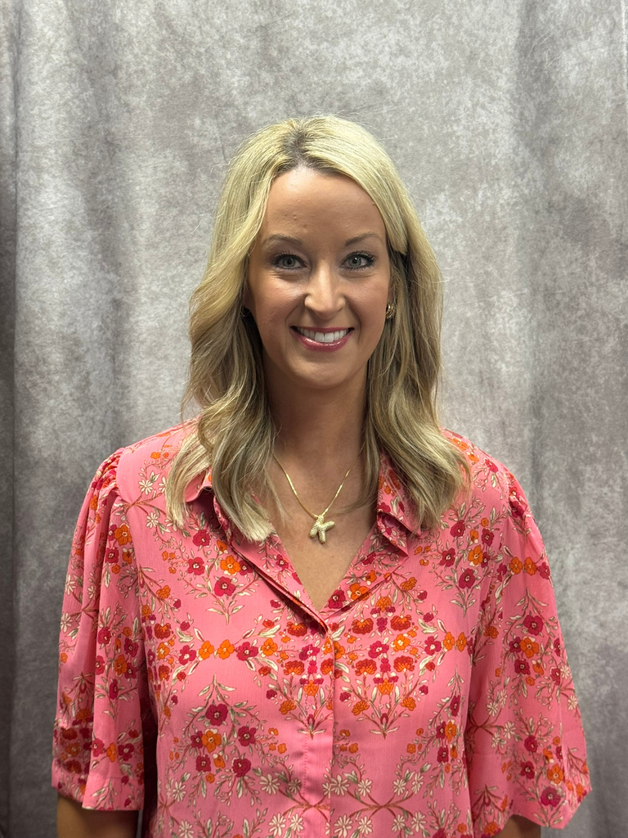
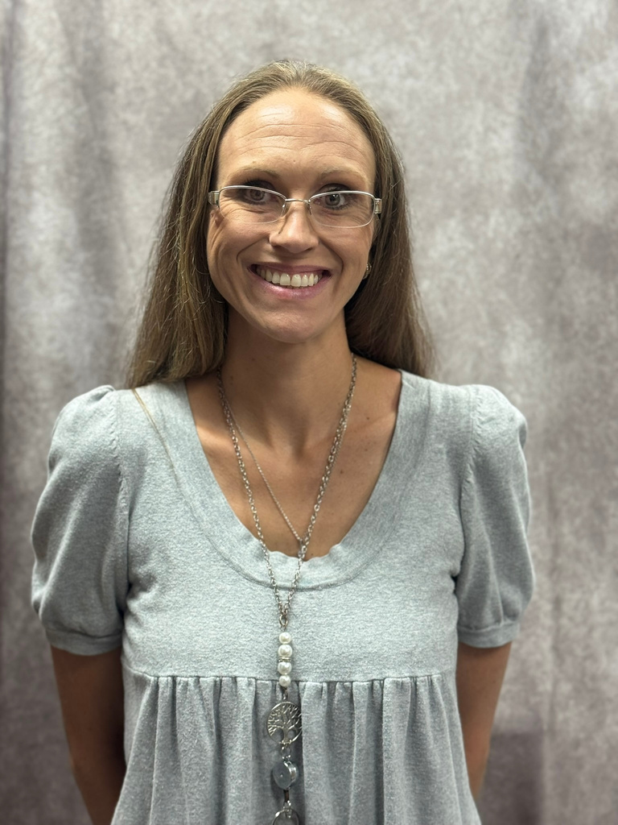
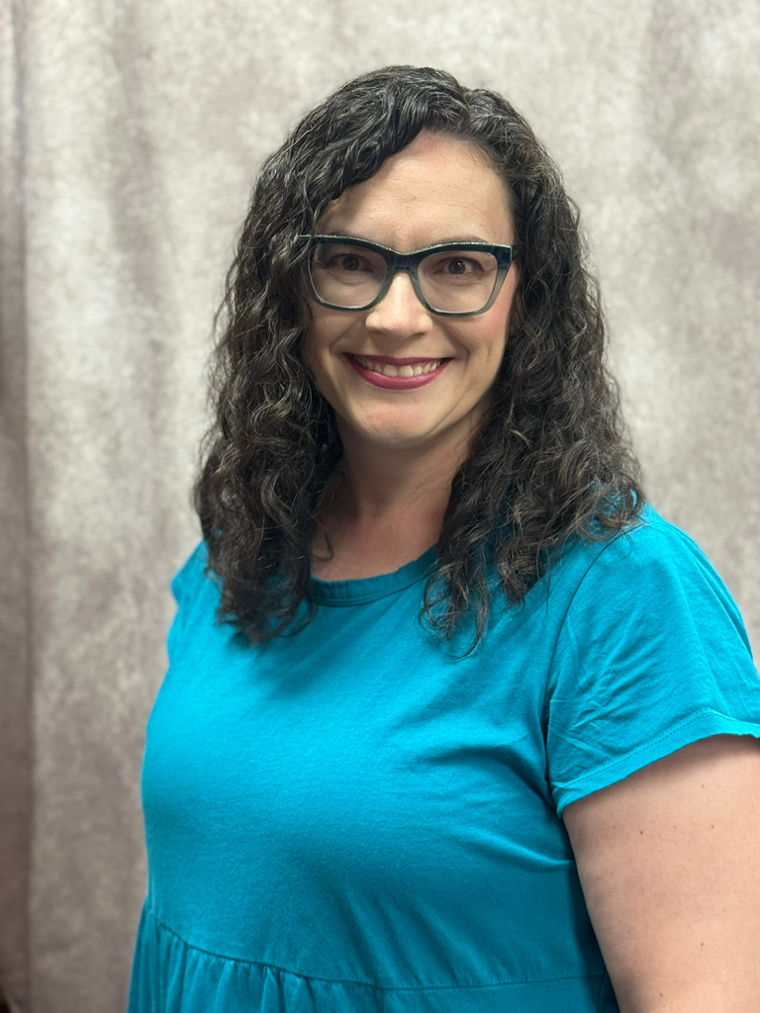
S5
DARCY MAELZER
SOUTHMOORE HS
KELLI MCCASKIL
MOORE HS
TARYN FOWLER-KELLEY
MOORE HS

Slide 11
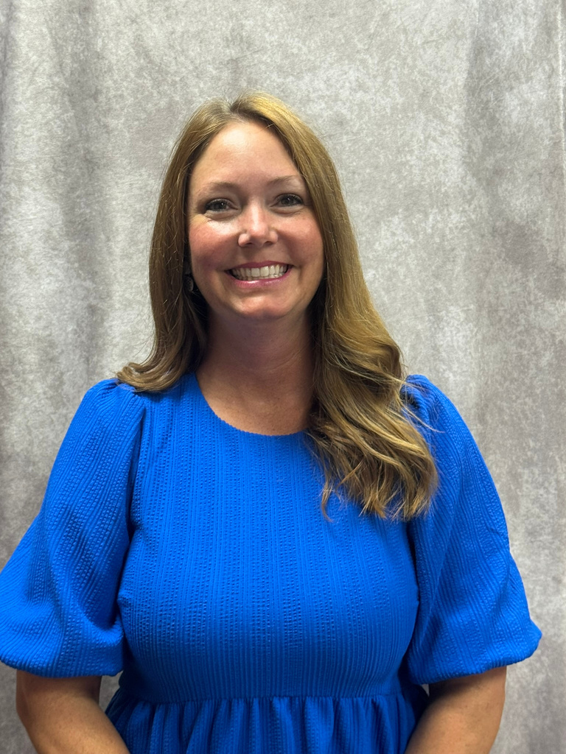
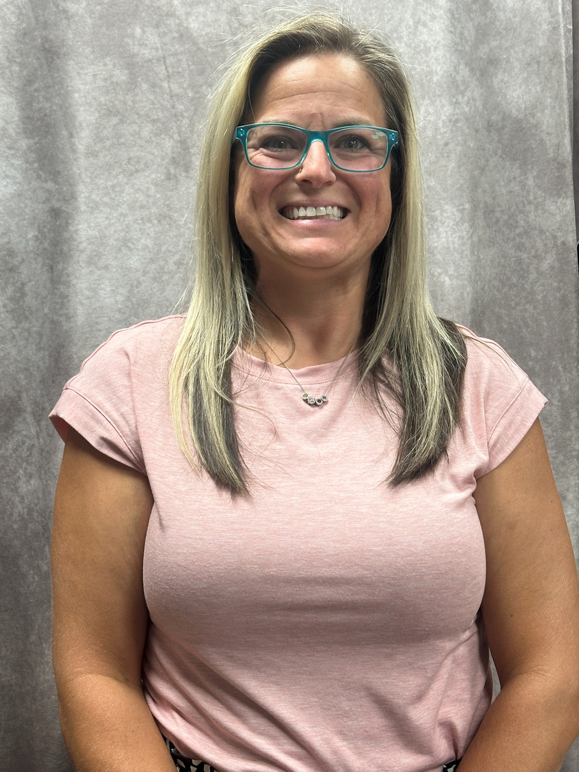
S5
SUSAN SWOPES
NOBLE HS
ASHLEY CRAFT
WESTMOORE HS

Slide 12
JOB OPENINGS!
There are still several jobs openings across the state. If you know someone who would like to teach FCS, send them to our job listings on ctYOU under the FCS/Bulletin Board/FCS Job Openings!

Slide 13

FCS PROGRAM FUNDING
412 MONEY
SALARY STIPEND
8000
2200
FULL TIME PROGRAMS
(411 MONEY)

Slide 14




USING 412 MONEY
Classroom Equipment
  Appliances
  Sewing Machines
  Laptops/Tablets
Instructional Supplies
  Curriculum/Textbooks
  Simulations/Real Care
  Food Lab Ingredients
Professional Development
  Chapter Adviser Summit
  Vision Conference
  May Workshops

Slide 15

Let’s
BBBR
BUILDING BLOCKS TO
BETTER RELATIONSHIPS

Slide 16






BBBR CURRICULUM
Oklahoma Family and Consumer Sciences is once again partnering with The Dibble Institute through a contract awarded by the Oklahoma Department of Human Services to offer the Building Blocks for Better Relationships (BBBR) program. This curriculum, specifically designed for Oklahoma FCS classrooms,
12 LESSONS
  Build Resiliency
  Learn to self-soothe and regulate emotions
  Develop empathy
  Develop Stronger Communication Skills
  Learn problem solving
  Support healthy, lasting relationships

Slide 17

It’s
Free
WHAT’S INCLUDED?
  1 full day of curriculum training
    Hotel, Mileage, and per diem paid
  1 printed teacher’s edition
  Student workbooks
  Digital Access

Slide 18

And
$$$
YOU GET..
  $200 Stipend for attending training
OR
  $100 Stipend for 2nd year BBBR teachers
  $150 Stipend for submitting teacher and student pre-tests
  $150 Stipend for submitting student post-tests
  $100 Stipend for teaching 3+ courses a day

Slide 19
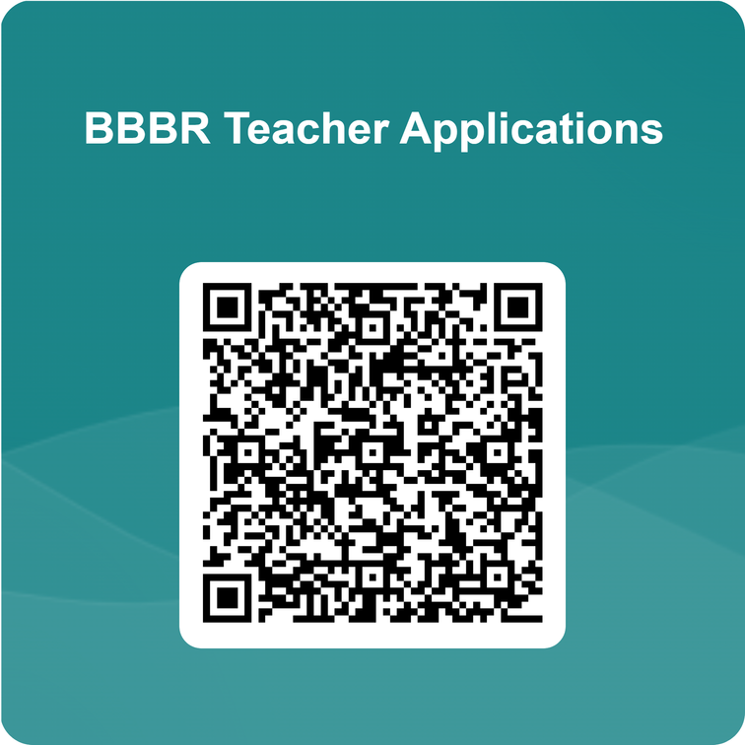
ELIGIBILITY
  Any FCS course 7th - 12th grades
  Can be taught in multiple classes
REQUIREMENTS
  Submit application
  Attend training Aug. 27 in Stillwater
    turn in reimbursement form
  Teacher and Student pre-tests by due date
    Fall- Sept. 19, 2025
    Spring- Feb. 20, 2026
  Teach 12 lessons to a minimum of 60 total students
  Post-tests of at least 90% of students that were pre-tested by due date
    Fall- Dec. 19, 2025
    Spring- May 20, 2026
  Submit feedback

Slide 20
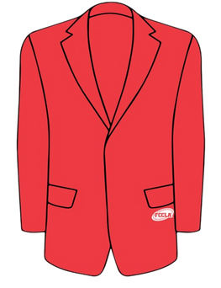
ADDITIONAL EXPENDITURES FY26
$900 FCCLA AFFILIATION PER CHAPTER
$300 OFFICIAL DRESS/CONFERENCE DRESS/CHEF ATTIRE

Slide 21
CTYOU HELP
www.ctYOU.org
  Create an account (tip use a personal email)
  It is okay if you are viewing items as a guest... you will have the password to anything that is locked.
  Locate helpful resources like:
    Region/District info
    Course Resources
    FCCLA Information
    Safety Tests/FCS Directory (Fc$2025)
    5 Year Comprehensive Evaluation Folders for your program

Slide 22

FCS DIRECTORY
located on ctYOU
Fc$2025

Slide 23

GRADUATION REQURIEMENT REFORM

Slide 24
CAREER INTEGRATION IN THE CLASSROOM
  Guest speakers
  OK Career Guide
    Training
    OK Career Guide Curriculum
    Connect 2 Business
  These integrations can be used to help students with their Individual Career Plan (ICAP)

Slide 25

OKLAHOMA BEEF COUNCIL
  More information will be available in the FCS/FCCLA Weekly Newsletter
  Grants available for up to $250 reimbursement
  Application deadline is Sept. 30th
  Questions can be directed to Sammy Head at SHead@oklabeef.org

Slide 26


CERTIFICATIONS

Slide 27

PROGRAM REPORTING
Follow-Up Reports Open
CESI Reports initial submission
Submit DSE Judges
CESI Reports additional students added
Oct. 1
Oct. 31
Jan. 31
Sept. 30
Nov. 30
May 31
Salary & Teaching Report
Follow up Reports Due
CESI Final Reports Due
5 yr Folders Updated
Advisory Committee Report
412/314 Reports

Slide 28


SALARY & TEACHING REPORT: DUE SEPT 30TH
  Add your entire school day! Don’t forget your plan period and your lunch!
  If you have an ‘Other’ such as advisory or study hall please note it in the comments.​
    DO NOT place students in an “OTHER” course; unless you are teaching a FCS-related course. If student numbers are listed in other, an explanation is needed describing what material is being taught.​

Slide 29

SALARY & TEACHING REPORT: DUE SEPT 30TH
  The ‘Contact Info’ section
      Use someone who can answer questions about your contract.​
  In the salary section, if you put any amount in the other box you must put a comment itemizing that amount.
    Example: $1500 should be broken down to $1000 Student Council, $500 Sr. Class Sponsor.
    DO NOT INCLUDE THE FCS STIPEND $2200.​
  Break down of what goes in each category of the Salary Information:​
    Base Salary: your base salary
    Health: any type of Insurance i.e.: health, life, etc.
        Itemize in the comment section what amount is paid for each different insurance.​
    Retirement: all school-paid retirements​
    Other: extra duty pay other than FCCLA​
  In the acknowledgment section note which pathways you teach.

Slide 30
PROGRAM EVALUATIONS
Sentinel HS
Clinton HS
Weatherford HS (2)
Central High
Minco HS
Mustang HS (5)
Mustang Central MS
Mustang MS
Mustang North MS
Emerson Alt (2)
John Marshall HS
NW Classen (2)
Star Spencer
Capitol Hill HS(2)
Capitol Hill MS
Rogers MS
Jefferson MS
Roosevelt MS
Southeast HS
US Grant HS (2)
Webster MS
Wheeler MS
Douglas HS

Slide 31
CAREERTECH ACCREDITATIONS
RED RIVER TECH
NOV. 19-20
SOUTHWEST TECH
DEC. 9-11

Slide 32

NEW TEACHER VISITS
CHECK YOUR EMAIL FOR DATE CONFIRMATION
STARTING LATER
THIS WEEK

Slide 33

Our Websites
The Newsletter
Your Email
Oklahoma FCCLA
ctYOU.org

Slide 34


Slide 35
25-26 OATFCS OFFICERS
President: Mary Dushane
N-VP: Lisa Favalora
Pres.-Elect: Amanda Faulkenberry
NE-VP: Brenna Humphrey
S-VP: Tina Clawson
Past President: Rita Hartwick
SE-VP: Richard Boone
Secretary: Kelly Brock
Occ. VP: Bobbie Back
Treasurer: Mary Beth Carver
Div. Advisor: Holly Hanan
Treasurer-Elect: Emily Colvin

Slide 36
GET INVOLVED WITH OATFCS
OATFCS MEMBERSHIP
TIME COMMITMENT
CORRESPONDENCE
Will need OATFCS members to work on committees and legislative networks to improve FCS programs in Oklahoma.
The time commitment of serving with OATFCS is about 1-3 meetings a year.
Typically correspondence occurs via mail, email, or fax.
WILL NEED VOLUNTEERS FROM EACH REGION

Slide 37

THANK YOU FOR SERVING
Membership Committee
  Work to increase membership in OATFACS
  maintains a communication network
Public Information Committee
  Recognize teachers and programs making outstanding contribultions to FCS
  promote curriculum showcase
Scholarship Committee
  review applications of scholarships
  determine scholarship recipients
Nominating/Awards Committee
  Recruit applicants for the scholarship program.
  Assist with hosting awards ceremony.

Slide 38


Slide 39
2025-2026 SEC
President​
Kendall Stout, Stigler HS​
​
First Vice President​
Kooper Walker, Kingston HS​
​
Vice President of Community Service​
Amina Washington, Oklahoma Union HS
​
Post Secondary Officer​
Aleighnna Rodriguez, Great Plains Tech Center​
​
National VP of Community Service​
Tennyson Elrod-Spears, Wright City HS
Vice President of Membership​
Maddie Mueller, Colbert HS​
​
Vice President of Programs
Gracelyn Vails, Stigler HS​
​
Vice President of Public Relations​
Tyce Myers, Edmond North HS​
​
Vice President of Competitive Events​
Audree Elder, Putnam City North HS​
​
Vice President of Marketing
Adrianna Allen, Sallisaw HS​

Slide 40
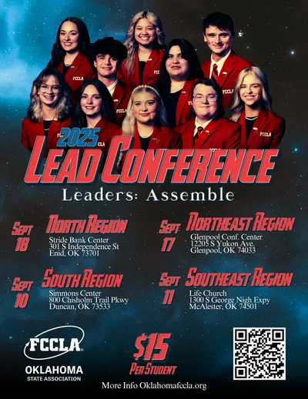
LEAD REGISTRATION DEADLINE:
AUGUST 28TH
DON’T WAIT!
REGISTER NOW!

Slide 41

NATIONAL LEADERSHIP CONFERENCE:
WASHINGTON, DC
JULY 6-10, 2026

Slide 42

NLC CHAPTERS RECOGNITION - TOP 10 PLACEMENT
Bridge Creek High School FCCLA- 4 Events in TOP 10
Lindsay High School FCCLA- 3 Events in TOP 10
Great Plains Tech-PS FCCLA- 4 Events in TOP 10
Fox High School FCCLA- 1 Event in TOP 10
Putnam City North FCCLA - 2 Events in TOP 10

Slide 43
OATFCS YEARS OF SERVICE

Slide 44

EMAIL ME

Slide 45
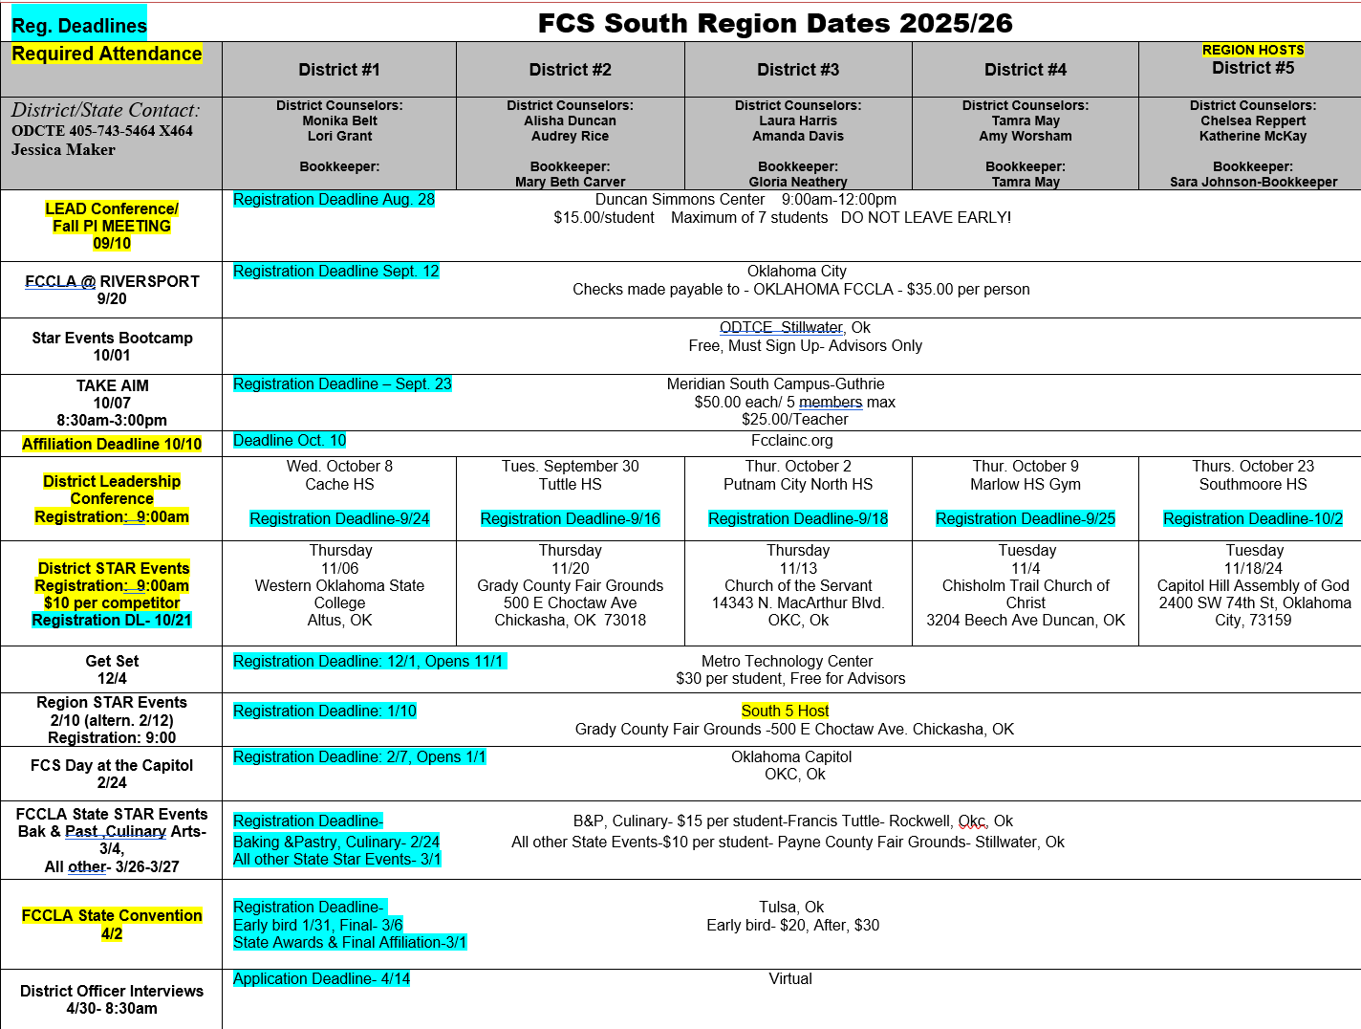

Slide 46
PLEASE MOVE INTO YOUR DISTRICT SECTIONS FOR DISTRICT PLANNING MEETINGS

Slide 47
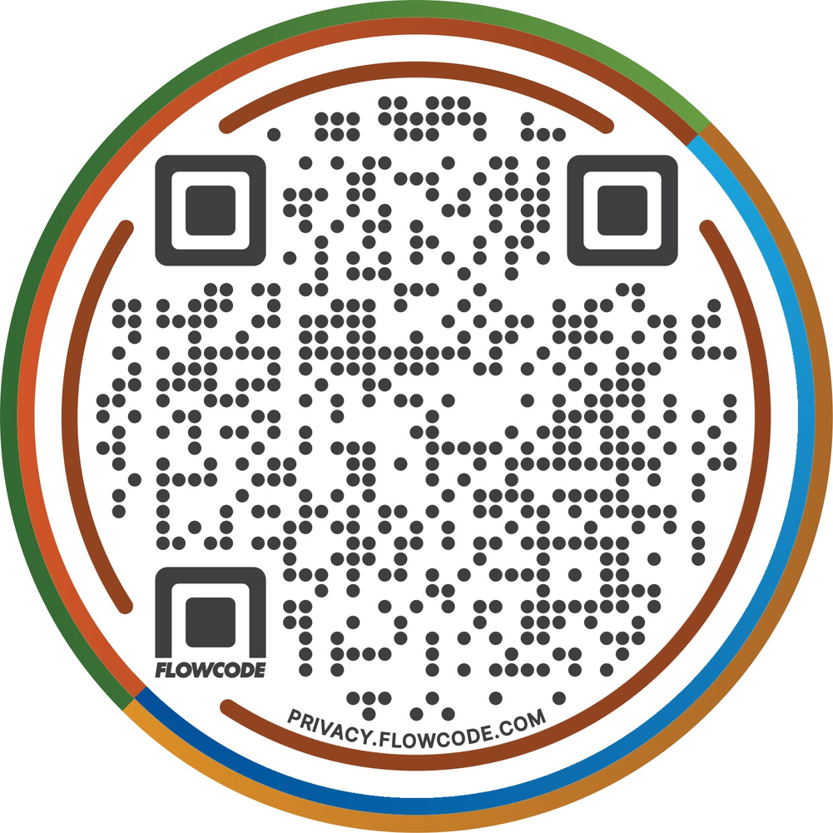
QR CODE VERIFICATION
Below is the QR Code you will use for your verification forms for this year. This will take you to a digital form to complete. You will need to answer every question. Then it will be emailed to you so you can print it.

