Slide 1




BEST PRACTICES IN SEWING LABS

Slide 2
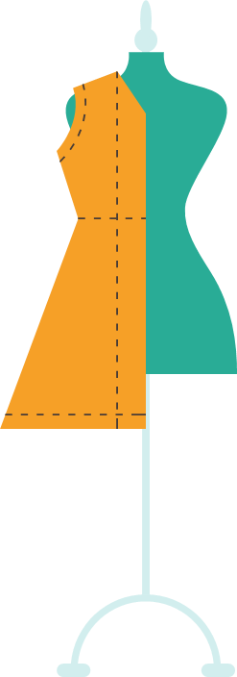
WHY DO I NEED SEWING SKILLS?
To take care of my basic sewing needs.
  Button
  Tears/rips
To repurpose old items into something new.
  Tee shirt bags
  Pet toys
  Sheets into clothing or curtains
To save money
  Fabric is very affordable
  Many basic items are very affordable when you make them yourself
  Repair is cheaper than buying new…..
  Home décor!!!
To help others
  Volunteering
  Urgent needs

Slide 3
WHY DO I NEED SEWING SKILLS?
Help with my future career
  Medical?
    https://www.facebook.com/SurgMedia/videos/1703668306377292/
  Fabric Industry?
    https://www.youtube.com/watch?v=H6RGDWOn6SA
  Fashion Industry?
    https://www.ted.com/talks/suzanne_lee_grow_your_own_clothes#t-339757
    https://www.facebook.com/MotivationalSpeakerJoshSundquist/videos/303175040538079/

Slide 4

SKILLS LEARNED
Technical Reading
Repair
Organization
Using a Machine
Hand/Eye Coordination
Perseverance
Safety

Slide 5
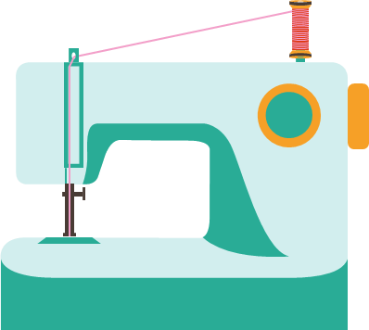
PARTS OF A SEWING MACHINE
https://www.dawnsommersfashionstudio.com/construction-level
Game: Singer Says (DEMONSTRATE)
Game: Sew and Tell (DEMONSTRATE)

Slide 6




TOOLS AND SAFETY
Assign each group a tool, then combine into a presentation
Guess the Gadget- tool stations set up around the room. Either you know it or you make me laugh
Notion Commotion- Bingo but with sewing tools in the squares
Must make 100% on the sewing test. I’m teaching safety at every step of the parts and the tools.

Slide 7

HAND SEWING IDEAS
Connect the Dots
Monsters, Tooth Fairy Pillows, bookmarks- Work with elementary class
Ornaments https://ithinksew.com/jolly-winter-ornaments-pdf-pattern-4-kinds
Thread doodling
Felt Friends at Hobby Lobby
Start to Sew (Facebook) Lots of sewing kits from all over
Fidget Mazes (free one on Nasco)
Stitch Videos
https://www.youtube.com/@francesheiman4362
https://www.youtube.com/watch?v=1FknfumFPX8

Slide 8

MACHINE SEWING
With donated fabric, AirPods case ithinksew.com
9 patch pillow
If students want to pay or fundraise, I used Pineapple Appeal, but there are tons of companies.
Classy Threads- Turtles

Slide 9



COMMUNITY SERVICE
Start to Sew (on Facebook) Canvas Bags- Used for food program at school
Locker Caddy- Used these for phone storage for teachers
Dignity Bibs for nursing home
Dog or Cat Beds for Shelter https://ithinksew.com/free-catdog-bed

Slide 10
TEACHERS PAY TEACHERS AND FREEBIES
Machine sewing drivers license
Lots of sewing activities
Free Patterns ithinksew.com/products/Freepattern

Slide 11

HELPFUL HINTS
Sewing Stained Glass for downtime
Always use two whiteboards- One for help one for helpers
Sewing ambassadors
Encourage them to bring in clothing they need to mend. Ties what they are learning to practical use

