Slide 1


Slide 2
Operating Room Tour
https://www.babycenter.com/2_labor-birth-tour-operating-room_10388407.bc

Slide 3

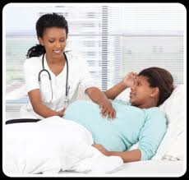
A physician or surgeon specializing in the care of women during and after childbirth.
Makes the incisions.
Performs the C-Section Surgery.

Slide 4

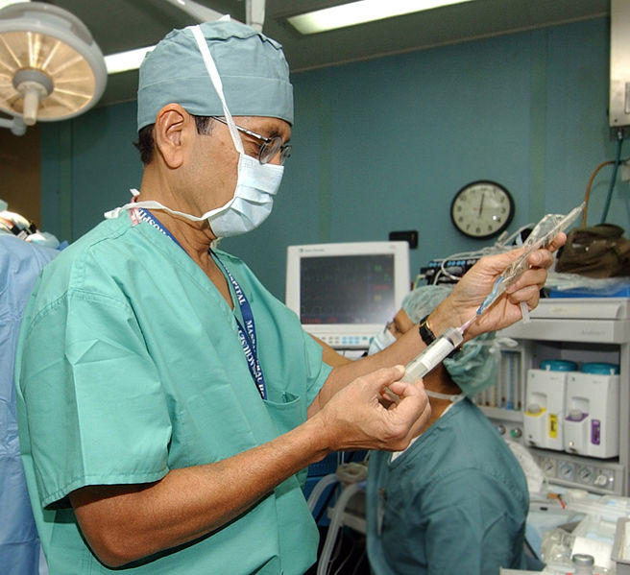
Doctor who administers the anesthetic medication to the patient undergoing surgery.
They monitor the patient's vital signs as the surgery progresses to ensure the safety of the patient.

Slide 5

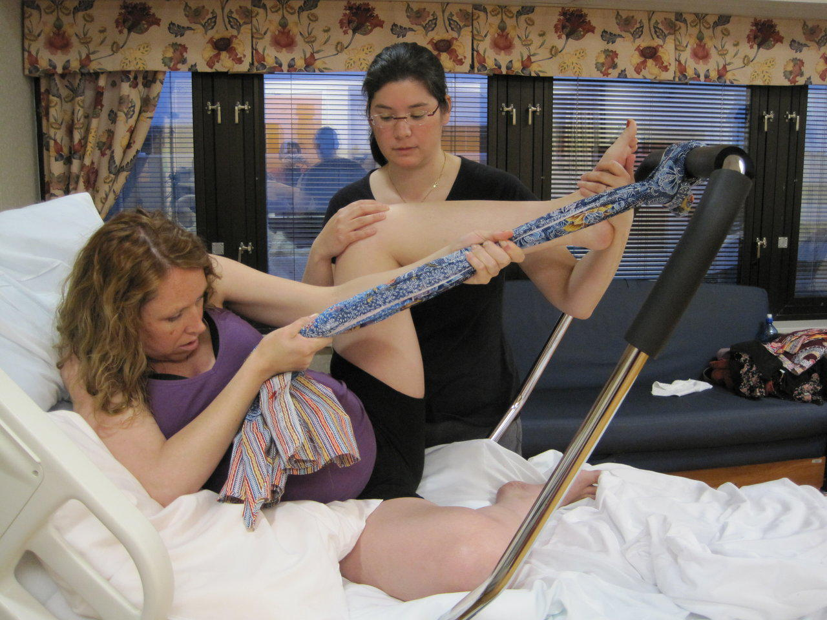
Will be medicated and numb from the chest down.
Lie on the table with their ARMS stretched out to their side. (jesus position)
Need arms down for IV fluid. And blood pressure on.
They have curtain in front of their chest, to prevent them from seeing what is going on during the surgery.

Slide 6


A doctor who specializes in the medical care for the infant.
They may be present in the C-Section to ensure a there are no complications with the surgery.

Slide 7

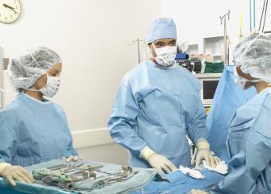
Hands doctor medical tools and monitors the mom on the table.
Counts supplies to ensure nothing is left inside the mother.
Brings baby over to pediatrician to be weighed, measured and cleaned.

Slide 8

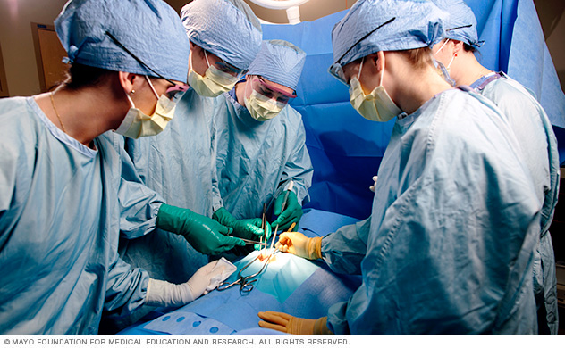
There as an extra set of hands to assist with the surgery

Slide 9
Simulation Time!

Slide 10

Using your phone research the salary of each different roles in your group
2. What layers did your group go through in order to delivery the baby?

