Slide 2
Escape Womb
Natural Birth and C-Section

Slide 3
Essential Question
What happens during a natural birth and a cesarean birth?

Slide 4
Lesson Objectives
Compare the differences between natural birth and a c-section.
Recognize the stages of natural birth.
Understand the process of cesarean birth.

Slide 5

Lines of Agreement
Read each statement or question carefully.
Decide on a position.
Create a line on the side of the room that represents your response.
Find a partner in the opposing line and discuss why you chose your answer.
Notes:
K20 Center. (n.d.). Lines of agreement. Strategies. Retrieved from https://learn.k20center.ou.edu/strategy/165

Slide 6
Which birthing option is easier?
Natural birth or C-section

Slide 7
Which option has the shorter healing time?
Natural birth or C-section

Slide 8
Agree or Disagree:
The whole labor and delivery process is generally quick (6 hours or less).

Slide 9
True or False:
After birth, you do not have physical limitations.

Slide 10


Labor and Delivery
With your group, cut out all the hexagons.
Based on what you already know about labor and delivery, connect the hexagons based on how they relate to each other.
You can connect more than two hexagons together.
Notes:
K20 Center. (n.d.). Honeycomb harvest. Strategies. Retrieved from https://learn.k20center.ou.edu/strategy/61
YouTube. (2021, September 21). K20 Center 5 minute timer. YouTube. https://www.youtube.com/watch?v=EVS_yYQoLJg

Slide 11

Labor and Delivery
Now walk around the room viewing the other Honeycomb Harvests.
Pay attention to how other groups have arranged their hexagons.
Once you return to your Honeycomb Harvest, discuss with the group and make any changes needed.
Notes:
K20 Center. (n.d.). Gallery walk / carousel. Strategies. Retrieved from https://learn.k20center.ou.edu/strategy/118

Slide 12

Natural Birth Guided Notes
Revisit your Honeycomb Harvest.
Using your guided notes, review your group’s work.
As a group discuss and make any needed changes.
Notes:
K20 Center. (n.d.). Frayer model. Strategies. Retrieved from https://learn.k20center.ou.edu/strategy/126

Slide 13
Essential Question
Lesson Objectives
What happens during a natural birth and a cesarean birth?
Compare the differences between natural birth and a c-section.
Recognize the stages of natural birth.
Understand the process of cesarean birth.

Slide 14

C-Section
With your group, cut out all the cards.
Place the 8 bold terms in a vertical line on your workspace in the order they are cut by the doctor.
Based on what you already know about c-sections, sort the remaining cards to the right of the bold terms that match.
Notes:
K20 Center. (n.d.). Card sort. Strategies. https://learn.k20center.ou.edu/strategy/147
YouTube. (2021, September 21). K20 Center 5 minute timer. YouTube. https://www.youtube.com/watch?v=EVS_yYQoLJg

Slide 15
C-section
Now you will walk around the room viewing the other groups’ Card Sorts.
Pay attention to how other groups have sorted their cards.
Once you return to your Card Sort, discuss with the group and make any changes needed.
Notes:
K20 Center. (n.d.). Gallery walk / carousel. Strategies. Retrieved from https://learn.k20center.ou.edu/strategy/118

Slide 16
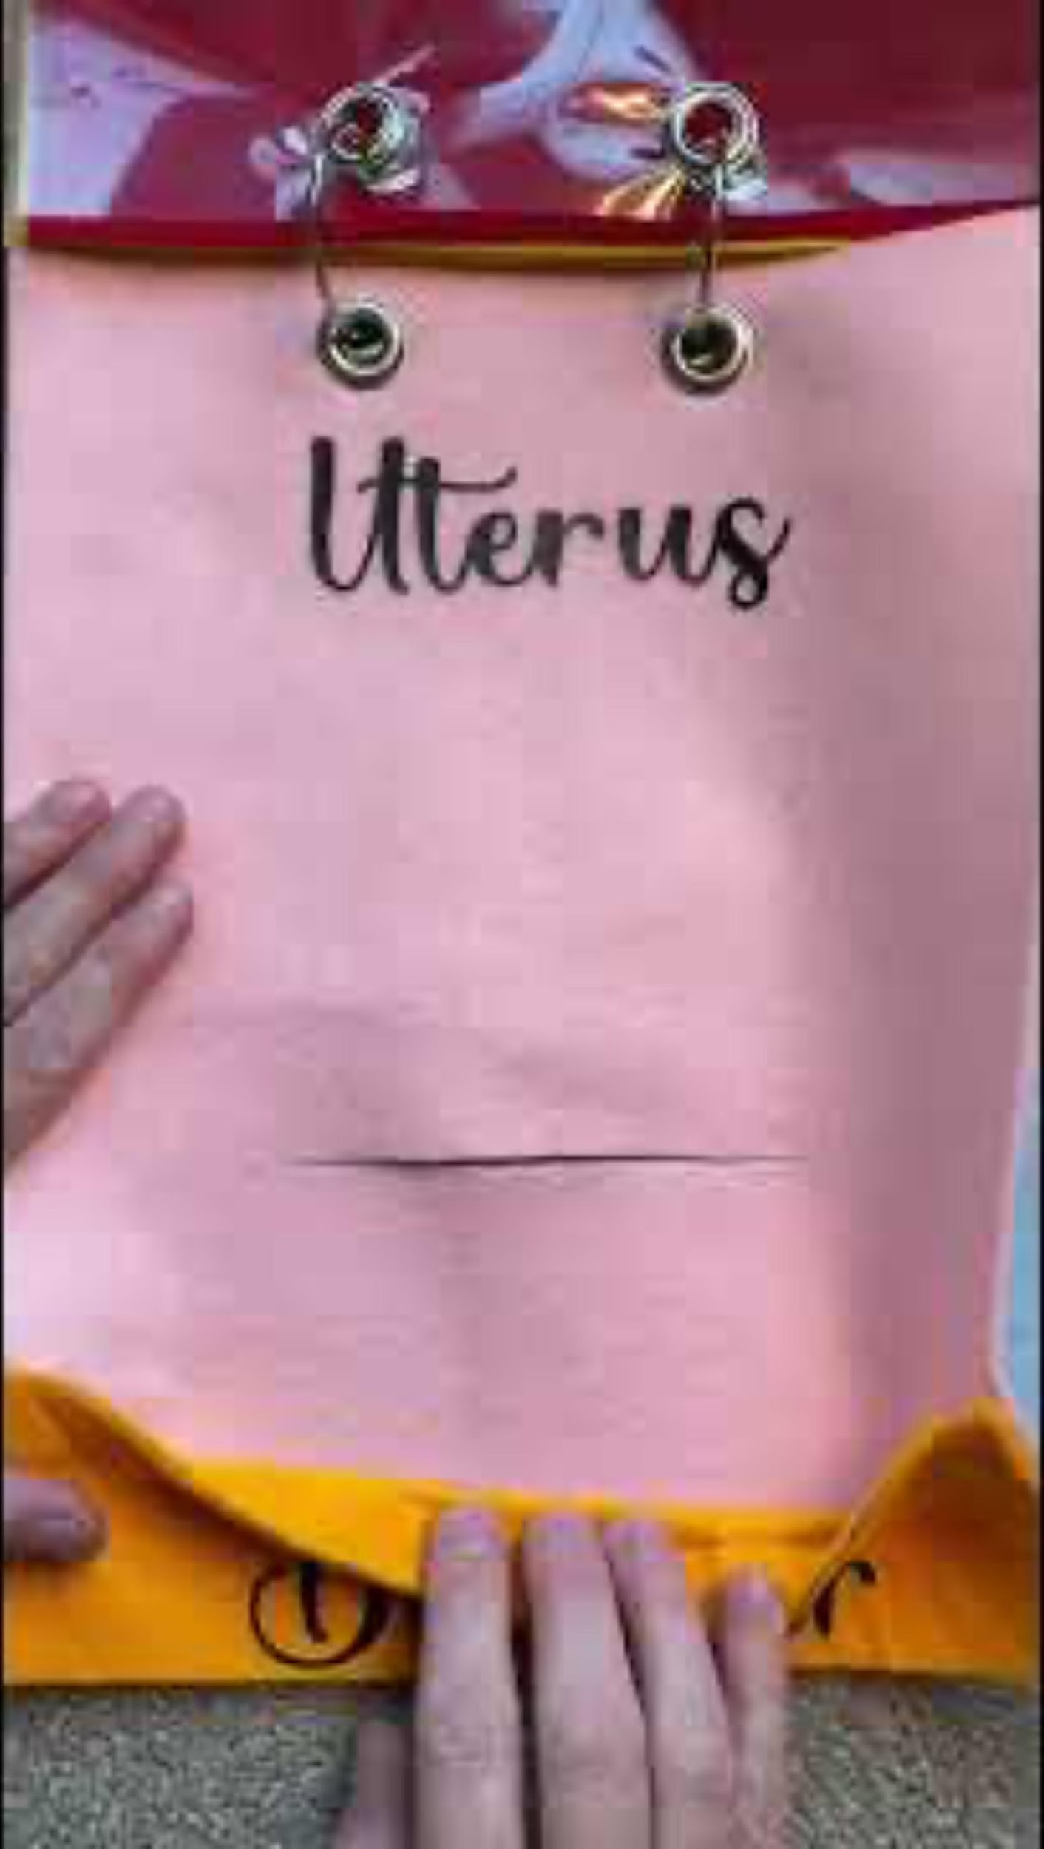
https://www.youtube.com/shorts/34lWQwoYddw
Notes:
YouTube. (2022, November 16). C-section anatomy {7 layers!} #csection #childbirtheducation #laboranddelivery #pregnancyjourney. YouTube. https://www.youtube.com/shorts/34lWQwoYddw

Slide 17
Essential Question
Lesson Objectives
What happens during a natural birth and a cesarean birth?
Compare the differences between a natural birth and a c-section.
Recognize the stages of natural birth.
Understand the process of cesarean birth.

Slide 18

https://www.youtube.com/watch?v=SK6nVL0yH_g
Notes:
YouTube. (2023, November 1). K20 ICAP- obstetrics nurse - escape womb. YouTube. https://www.youtube.com/watch?v=SK6nVL0yH_g

Slide 19

Natural Birth vs C-section
Think of all that you have learned over the last few days.
Compare and contrast natural birth and c-section.
Divide your paper in half for each type of birth.
Divide each half into three sections.
Record the following on your sheet of paper.
  S - Surprising
  I - Interesting
  T - Thought provoking
Notes:
K20 Center. (n.d.). Surprising, interesting, troubling. Strategies. Retrieved from https://learn.k20center.ou.edu/strategy/926

Slide 20
Lines of Agreement
Reread each statement or question carefully.
Decide if your opinion has changed.
Create a line on the side of the room that represents your response.
Notes:
K20 Center. (n.d.). Lines of agreement. Strategies. Retrieved from https://learn.k20center.ou.edu/strategy/165

Slide 21
Which birthing option is easier?
Natural birth or C-section

Slide 22
Which option has the shorter healing time?
Natural birth or C-section

Slide 23
Agree or Disagree:
The whole labor and delivery process is generally quick (6 hours or less).

Slide 24
True or False:
After birth, you do not have physical limitations.

