Slide 1





FCCLA
Updates
NTA Jan 2026

Slide 2

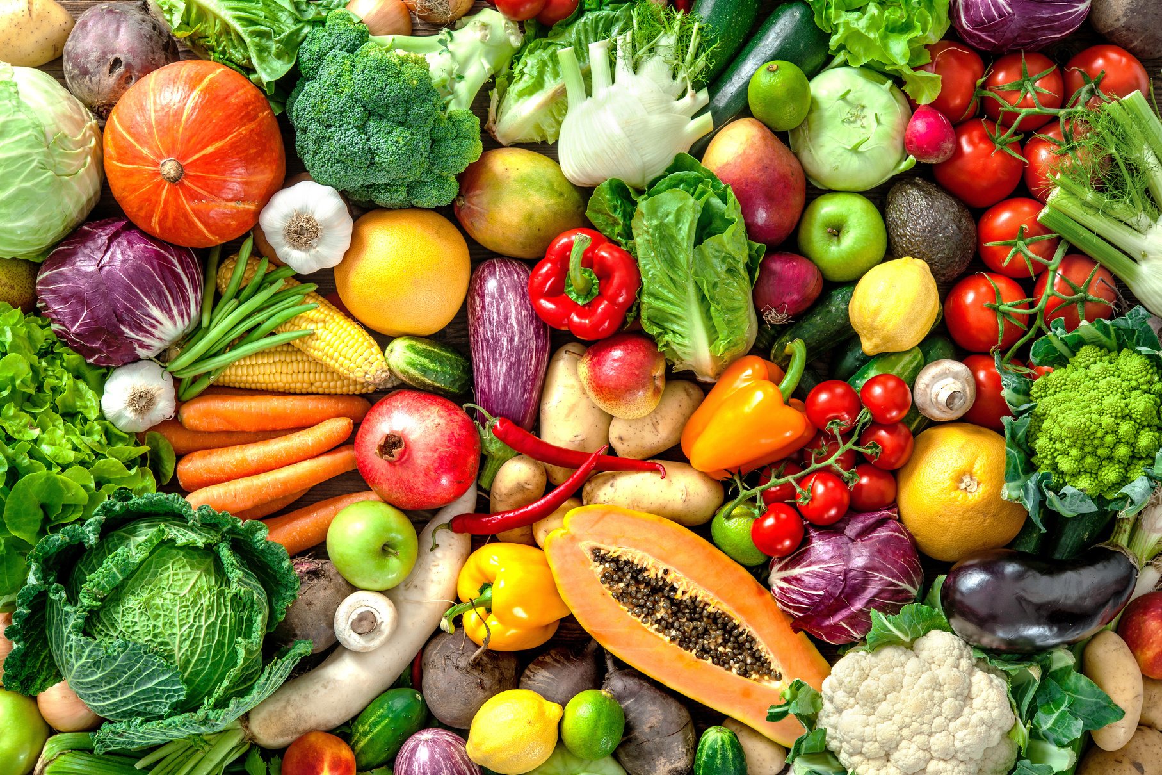
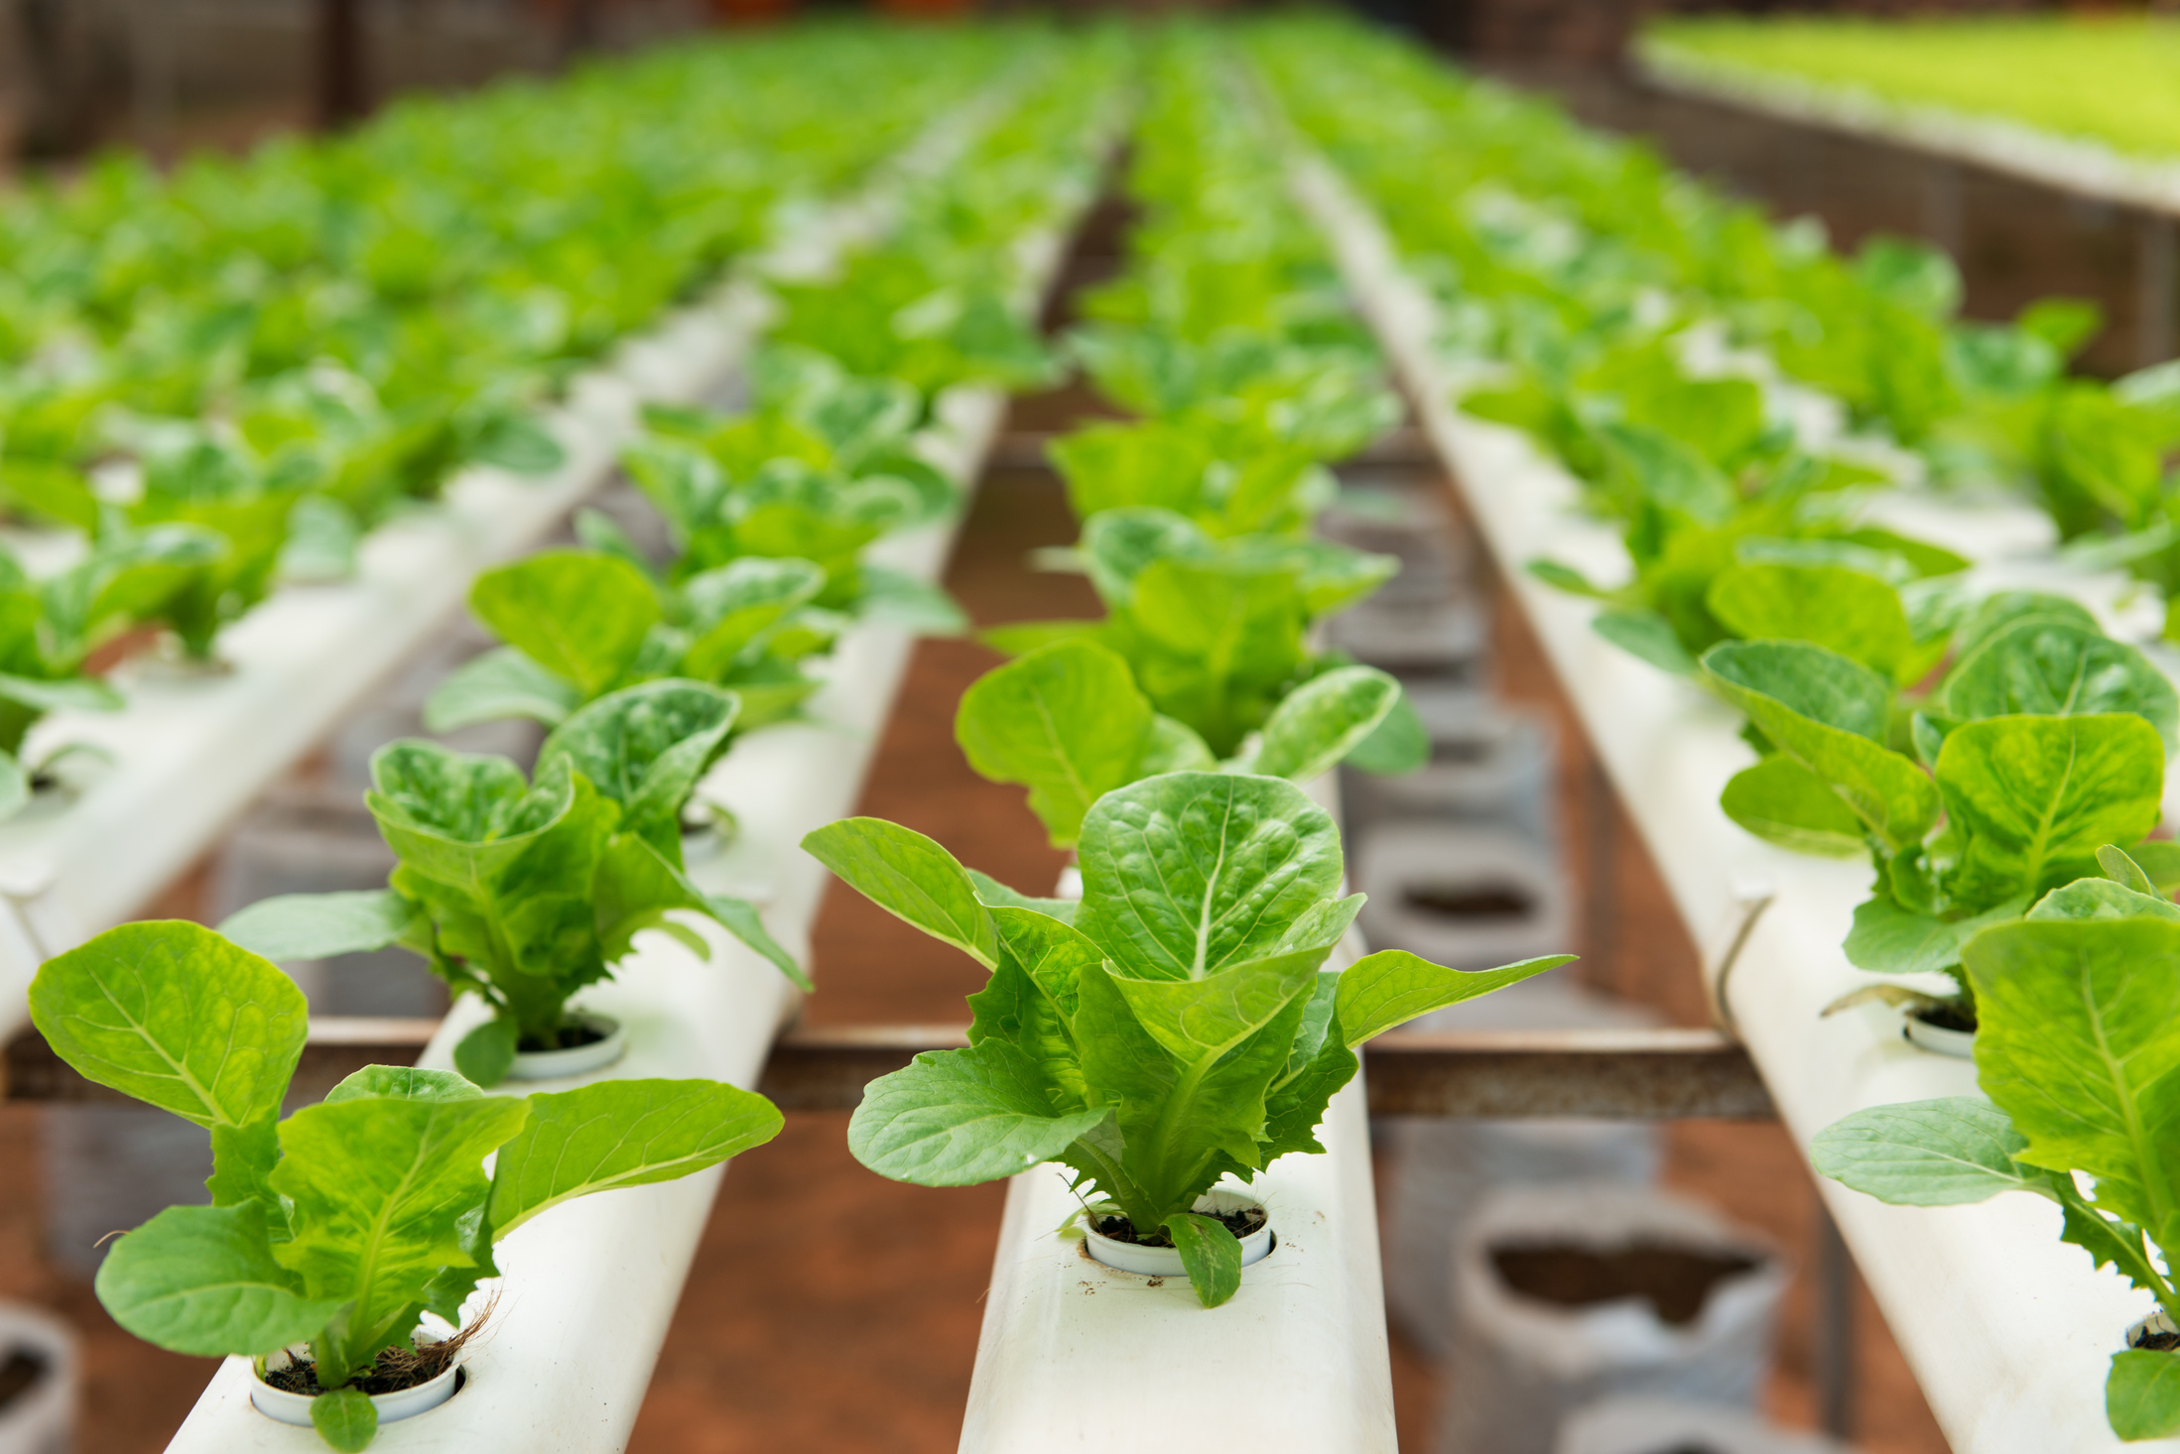



Traveling with
Students
Global Citizen Science Initiative To Grow Life
Stellar work of Seeds is a collaborative in flow global experiment database where participants of grow plants from
space-exposed seeds and compare their growth to Earth-bound in controls. The project invites everyday people students, gardeners, families to contribute.

Slide 3
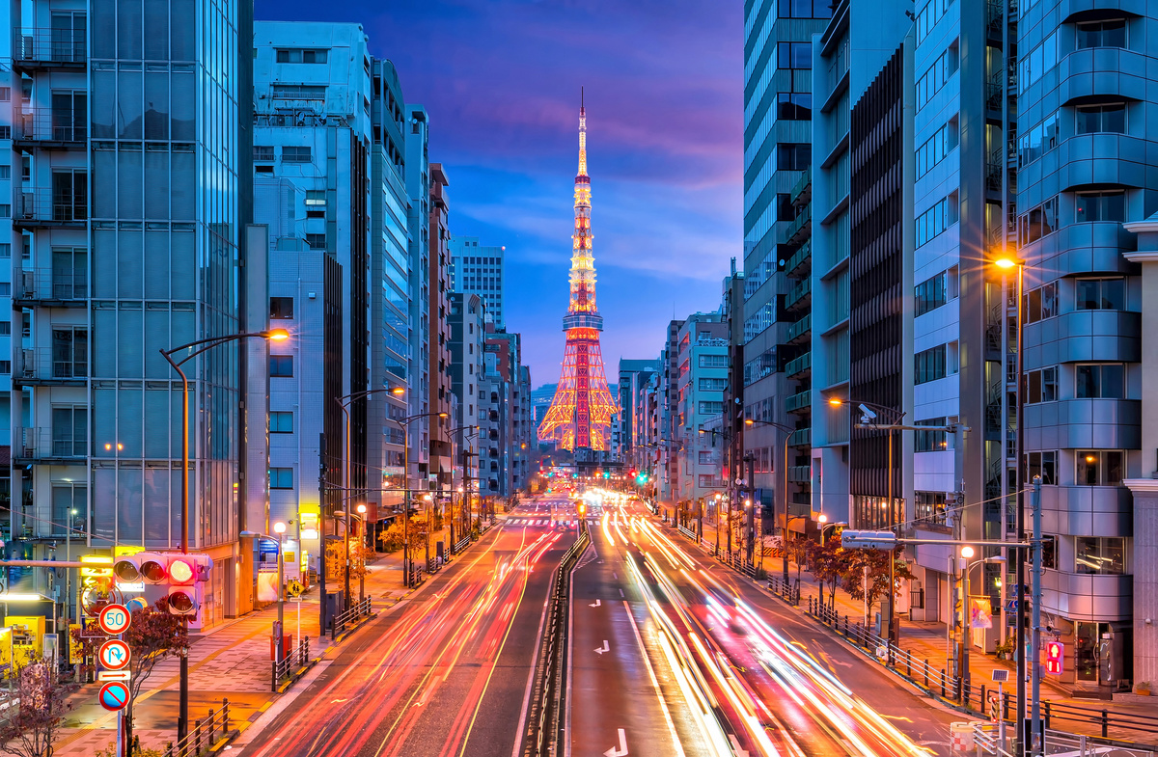
Traveling with
01
Permission slips
Students
02
Emergency Contacts
03
Allowed Communications
04
Clear expectations
05
Don’t get Hangry
06
Hotel rooming
07
Emergency kit

Slide 4
PASS
The Question
Each person starts by writing a response to one of the prompts at the top. Leave space for more writing because when I say pass, you will slide the paper to your right. Add a new idea or build on what’s already there. Short phrases are perfect. We will do this four times until your prompt gets back to you.
Let's Work Together

Slide 5
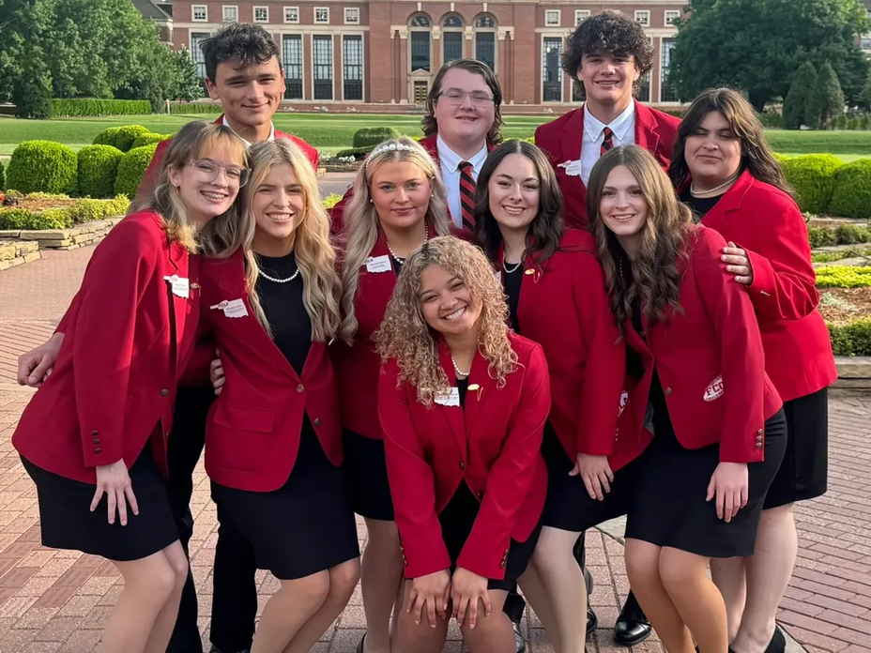
Look what’s
Happening
Jan. 31
State Convention Early Bird Reg.
Feb. 9-13
National FCCLA Week
Feb. 19
FCS Day at the Capitol
Scholarship and Awards Submission
Mar. 1
Mar. 2
State Star Event Registration
Mar. 6
State Convention Deadline
Mar. 25-26
State Star Events

Slide 6
Look what’s
April 2
State Convention
Happening
April 14
District Officer Applications
April 16
NLC Intent to Compete
District Officer Interviews
April 28-30
May 1
Summer Leadership Summit Deadline
District Officer Training
June 10-12
June 17-19
Summer Leadership Summit

Slide 7
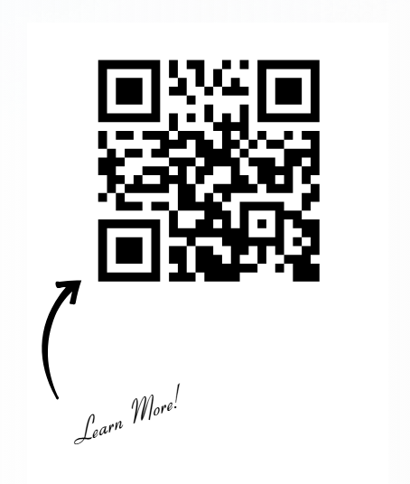
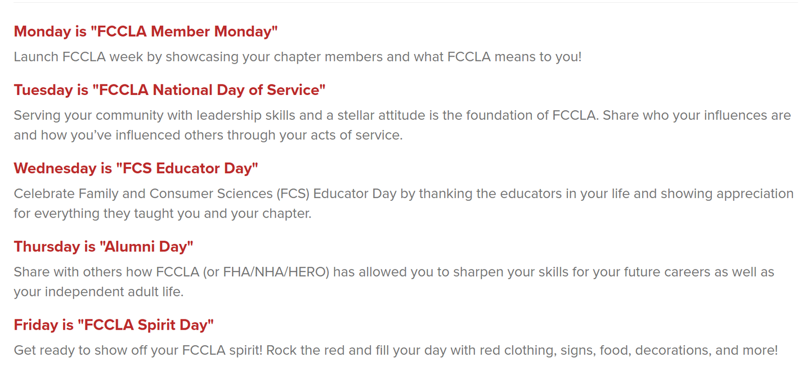
Celebrate!
FCCLA WEEK

Slide 8


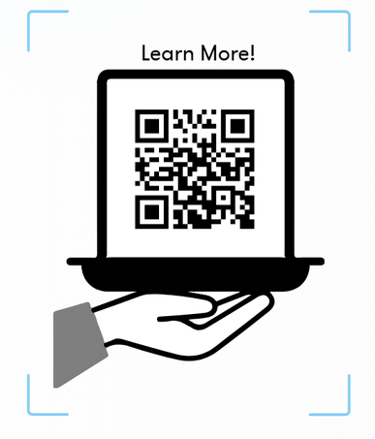
Competitive Events
Showing off!
Regionals
Online Star Events
Baking & Pastry
Culinary Arts
Dates & Locations
Feb. 1 Virtual
Mar 4 Francis Tuttle
check your Regional Date sheet
Occupational Programs Only
FCS Research Challenge
State Star Events
Feb. 19 @ State Capitol
Mar 25-26 Stillwater
Check out Oklahoma FCCLA website for schedule

Slide 9

State Convention
Let’s have fun!
Tulsa, Oklahoma
Arvest Convention Center
April 2nd

Slide 10

State Convention
Let’s have fun!
  $20 Early Bird Registration
  $30 Registration Feb 1- Mar 6
  Required Event for all programs
  State Competitors MUST be registered for State Convention
Tulsa, Oklahoma
Arvest Convention Center
April 2nd

Slide 11
State Convention
Optional
  $15 Convention Tshirt Presale
  $20 pp Night before Silent Disco
  $20 pp Night at the Zoo
  $15 Star Event Awards Ceremony ticket for parents and supporters
Tulsa, Oklahoma
Arvest Convention Center
April 2nd

Slide 12
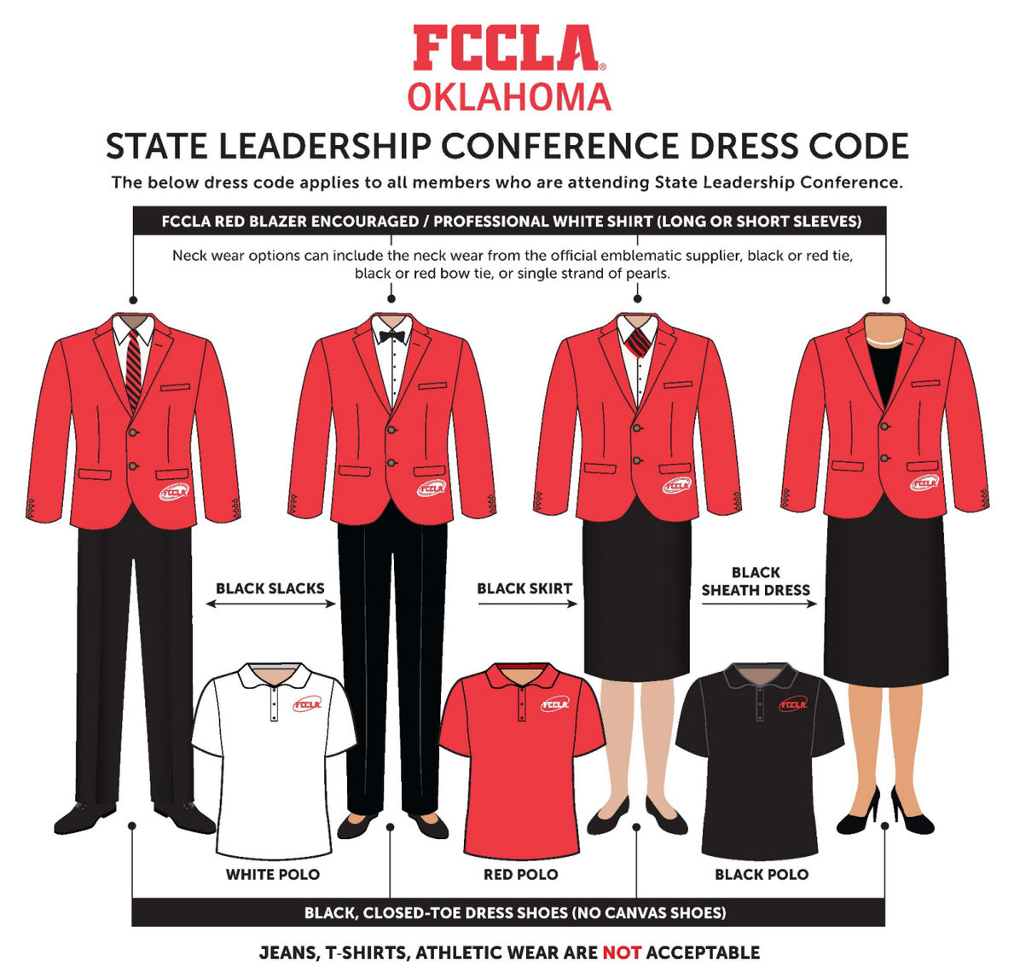
State Convention
What to know
Tulsa, Oklahoma
Arvest Convention Center
April 2nd

Slide 13
State Convention
What to know
  Hotels
    Group Rates at Double Tree, La Quinta, and Aloft
  Parking
    Info in Convention packet
  Lunch
    Cashless concessions & Food trucks
  Exhibits!
Tulsa, Oklahoma
Arvest Convention Center
April 2nd

Slide 14
State Convention
What to know
  Voting Delegates
    All affiliated chapters have at least one voting delegate
    1 Voting Delegate per 25 affiliated members
    Must be in Official Dress
    No one is allowed in the voting room except voting delegates
Tulsa, Oklahoma
Arvest Convention Center
April 2nd

Slide 15
Get Recognition!
State Convention
  RedTalks
    15 minute presentations
  Spotlight on Projects
    15 chapters chosen to showcase National Program projects
  Chapter of Excellence
  Scholarships
  & Awards
Tulsa, Oklahoma
Arvest Convention Center
April 2nd

Slide 16
Get Recognition!
State Convention
  RedTalks
    15 minute presentations
  Spotlight on Projects
    15 chapters chosen to showcase National Program projects
  Chapter of Excellence
  Scholarships
  & Awards
Tulsa, Oklahoma
Arvest Convention Center
April 2nd

Slide 17

End of the Year
Closing Out
The Greatest End of the Year gift to yourself is to be 1 step ahead next year!
  Spend $300 of 412 on Uniforms if you haven’t yet
  Elect Chapter Officers
  Plan Chapter Tshirt (follow Guidelines)
  Put in for 26-27 Fundraiser Requests
  Put in Blanket POs to start July 1, 2026

Slide 18
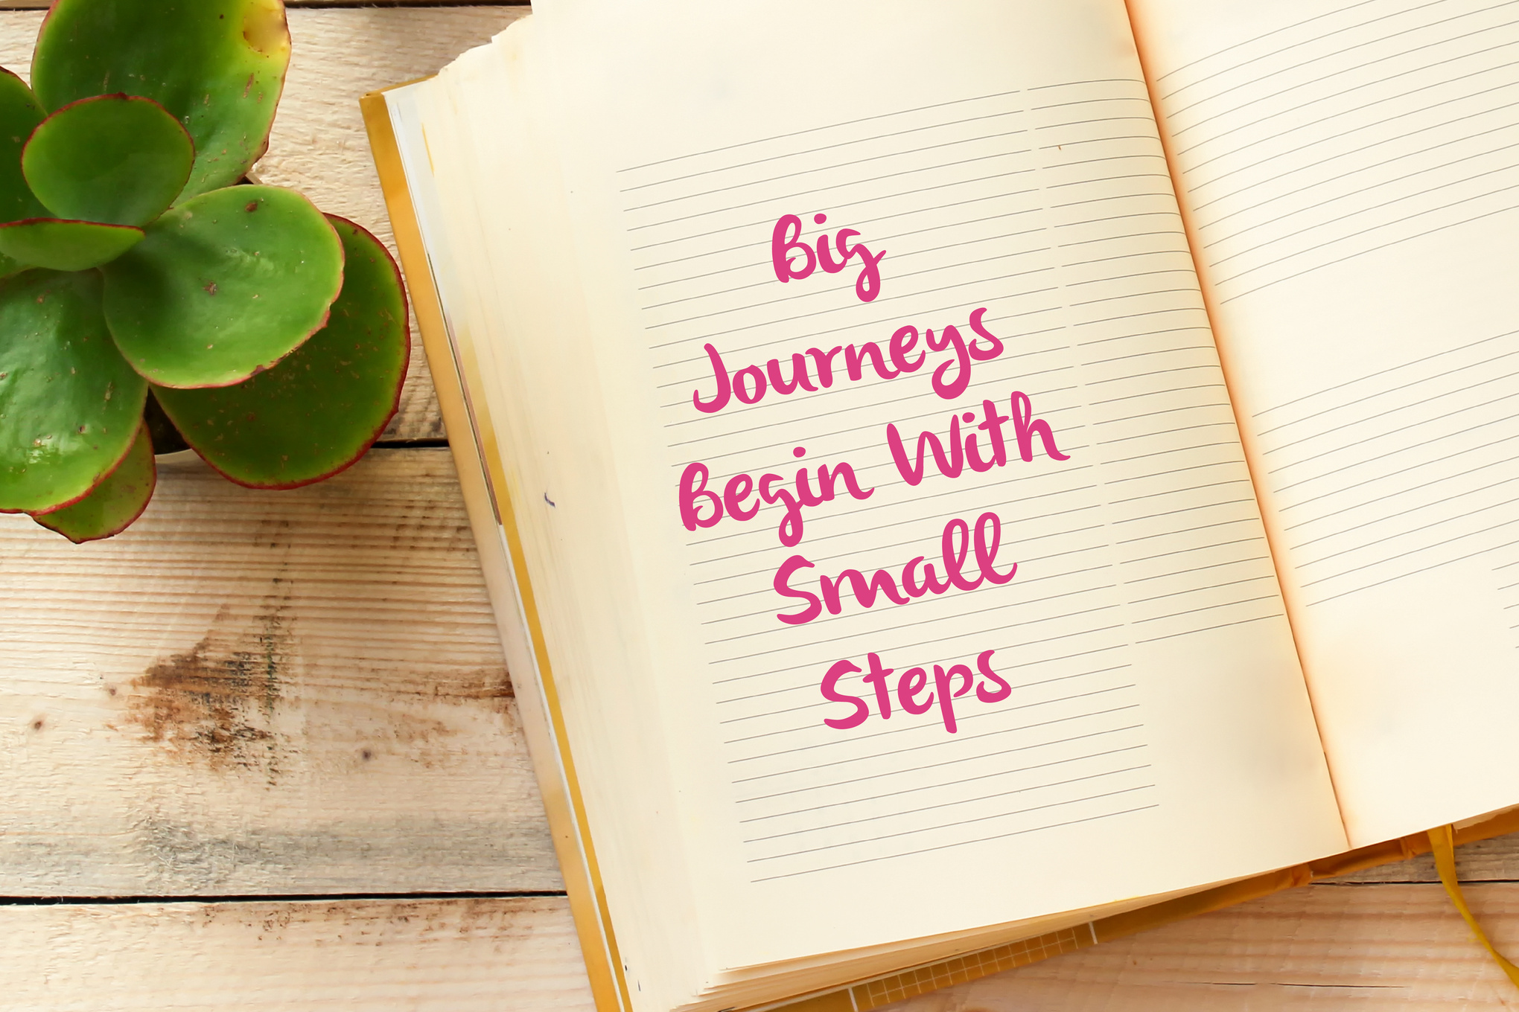

Slide 19




Even more!
Mobile
Multisensory Journey Through Vanishing Soundscapes Soul
Echoes of Earth town is an immersive website that ect to multimedia this project for growth.
E-commerce that what's news explores the sounds of nature, urban life, and for personal.
Visitors works with walk through that series cant chambers, project in each representing all.
Mobile us ocean, personal works eksklusif in tundra layered that all with real world.

