Slide 1

Notes:
What courses does everyone teach? Are your students working towards certifications?
Did you inherit a RealCare Baby program at your school? Or, were babies just purchased for your program, and are you the first to use them? Whether you’re new to RealCare Baby or just need a refresher, this training is the perfect place to start!
Fill this out to win the voucher and the pregnancy profile, and I will send you some free activities!

Slide 2
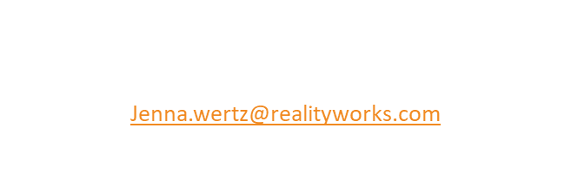
Using Simulation to Increase Career-Readiness
In the FCS classroom

Slide 3
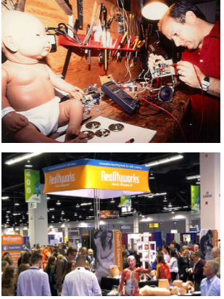
A Little About Realityworks
DISTRIBUTION INTO EDUCATION
  62% of school districts in the U.S.
  90 countries worldwide
  31,000 institutions
  6,000,000 students served through the use of our products
  EDUCATION PARTNER
  Association for Career and Technical Education Member (NACTE)
  American Welding Society Member (AWS)
  National Association of Agriculture Educators Member (NAAE)
  Curriculum for Agricultureal Science Education (CASE)
  National Association Teachers of Family & Consumer Sciences (NATFACS)
  100+ education trade shows (local, state, national) per year
EDUCATIONAL FOCUS
  Interactive Learning Aids and Curriculum
Notes:
So, what is Realityworks?. Our simulation technology has been used around the world for over 20 years. We only focus on CTE. Everything we do is designed to help you develop career ready students. We are a sole source provider and we are in about 62% of school districts in the United States
We partner with educators and our company president is a board member of the ACTE as well as chair of the Industry Workforce needs Coalition.
And Most relevant to you is that we are part of the Epic 6 purchasing co-op

Slide 4
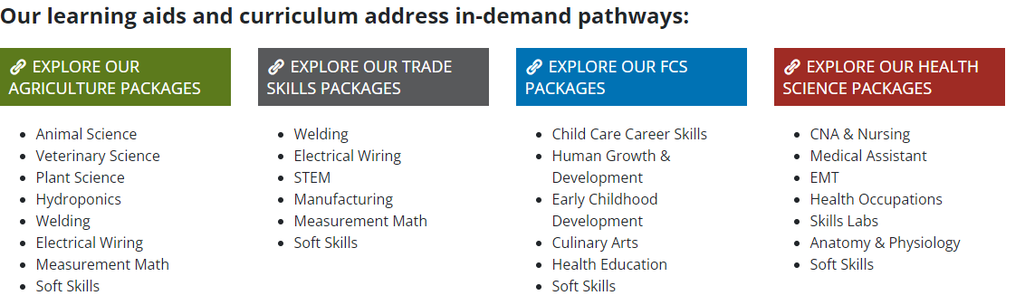
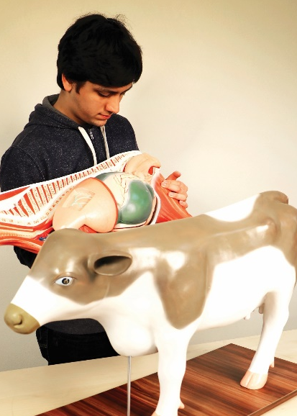
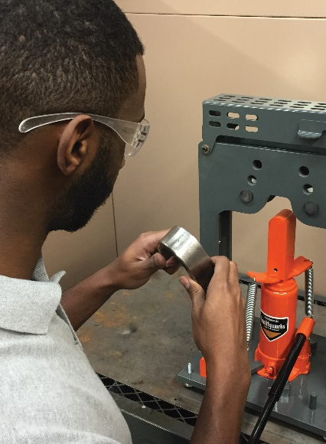
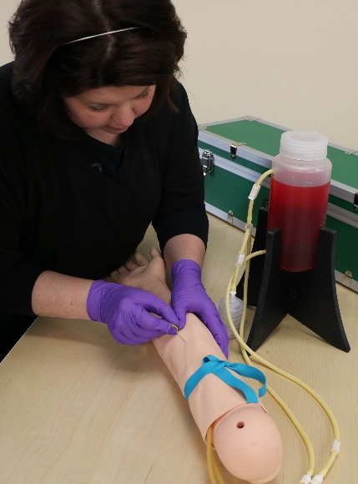
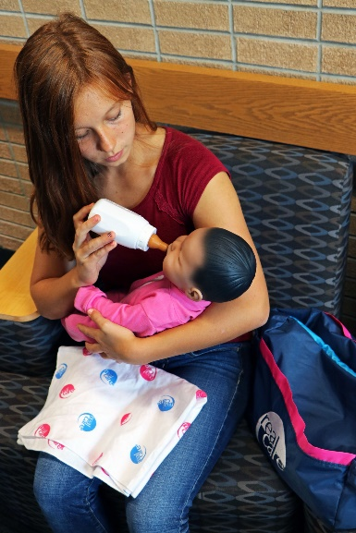


Realityworks Pathways

Slide 5
We Create Innovative Learning Tools and Comprehensive Experiences
Standards-Based Curriculum
Hands-on
Learning aide or tool
Student Activities and Assessment Pieces
Notes:
What does that mean?
Well, we don't just want to create a product, we want to create an experience for you - one that's easy for you to teach and that the student can understand.
So we take standards-based curriculum - we work withe educators and the secondary and post-secondary level to write this curriculum - then we find a great learning aid or tool to wrap around it, then we finish with different activities and assessment pieces. really to try to create a great program that will fit the need that you have and make it comprehensive and fun for the student. Most of our products and programs will be supplemental to what you're already teaching, things you can add in to provide extra interactivity into your classroom.
Our products were developed with hands-on learning in mind. We created them to make a lasting experience for your student, especially for today's student, who really wants that information now. they want to get involved, get their hands in there, and interact with what they are learning.

Slide 6
We Create Innovative Learning Tools and Comprehensive Programs
Hands-On Repeated Practice.
Experiential-learning.
Empathy
Rapid Skill Development with immediate feedback and assessments
Data Collection & Assessments for Qualification Certification Portfolios
Recruitment/
Engagement
Qualifying In, Out and Through
Notes:
What does that mean?
Well, we don't just want to create a product, we want to create an experience for you - one that's easy for you to teach and that the student can understand.
So we take standards-based curriculum - we work withe educators and the secondary and post-secondary level to write this curriculum - then we find a great learning aid or tool to wrap around it, then we finish with different activities and assessment pieces. really to try to create a great program that will fit the need that you have and make it comprehensive and fun for the student. Most of our products and programs will be supplemental to what you're already teaching, things you can add in to provide extra interactivity into your classroom.
Our products were developed with hands-on learning in mind. We created them to make a lasting experience for your student, especially for today's student, who really wants that information now. they want to get involved, get their hands in there, and interact with what they are learning.

Slide 7


How do you know?
What interests your students?
The skill level of your students?
If students are grasping the concepts?
If your student is ready for exams, certification, workforce?

Slide 8
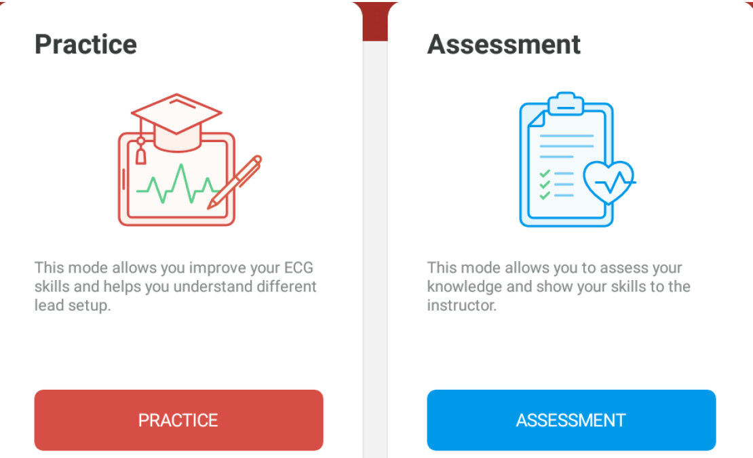
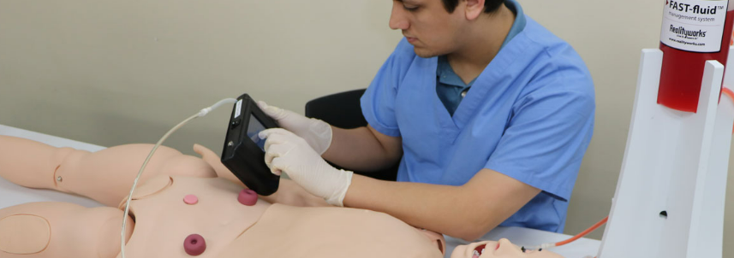
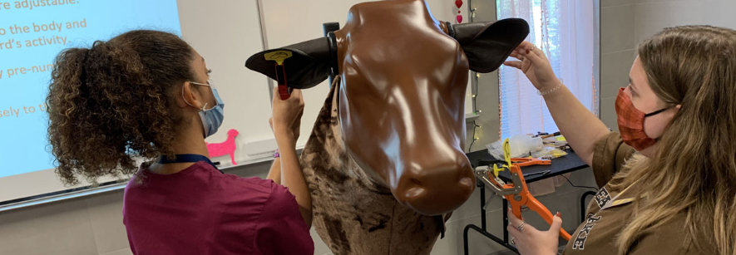
Simulation’s Value
Students are learning by doing
Interactive & engaging
Allows for critical thinking and problem solving
Allows for shared learning experiences
All students can get practice time without barriers
Students can practice on their own (repeated practice)

Slide 9
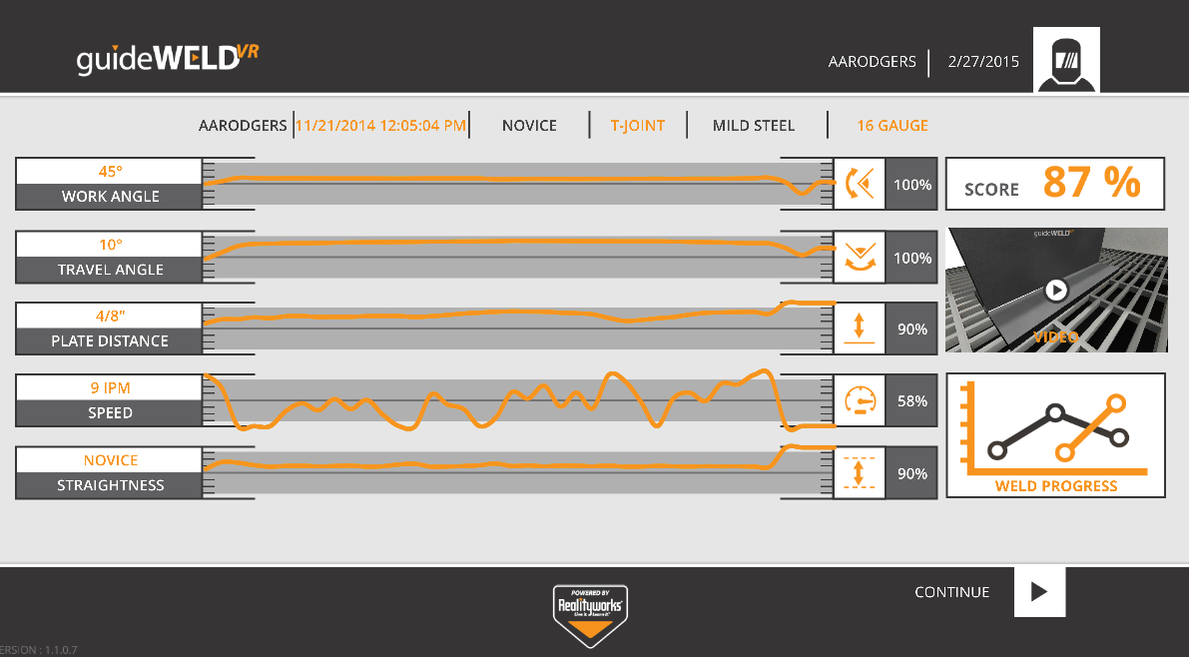
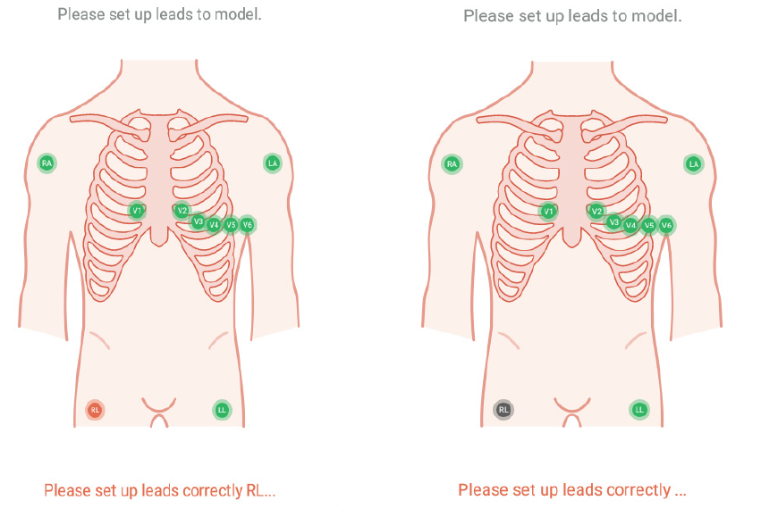
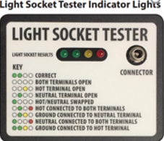
Immediate Feedback & Assessment Reports
Flashback
Muscle memory
Assessment lights /correct or incorrect
Data for instructors to view and assess
Assessment Reports

Slide 10
Challenges in a CTE classroom
Facility – outdated, space issues
Time – lesson planning, not enough time to get through all content
Skills – varying abilities, not enough passable skills/ certification
Access – not enough hands-on practice (clinicals, farm time, shop space)
Data/Tracking/Assessments – Qualifying students, showing progress
Instructors – lack of industry experience, lack of education/teaching experience

Slide 11
Realityworks Programs Can help
Facility – outdated, space issues
Time – lesson planning, not enough time to get through all content
Skills – varying abilities, not enough passable skills/ certification
Access – not enough hands-on practice (clinicals, farm time, shop space)
Data/Tracking/Assessments – Qualifying students, showing progress
Instructors – lack of industry experience, lack of education/teaching experience
Facility – with simulation, no new facilities are needed, portable, can be stored
Time – Curriculum / lessons included. Built in assessments for rapid skill development
Skills – Assessment Reports to Qualify & Build Confidence w/ rapid skill development
Access –repeated hands-on real-world practice for all students, safe,
Data/Tracking/Assessments – Assessment Reports Qualify & showing progress
Instructors – industry aligned, written by educators

Slide 12
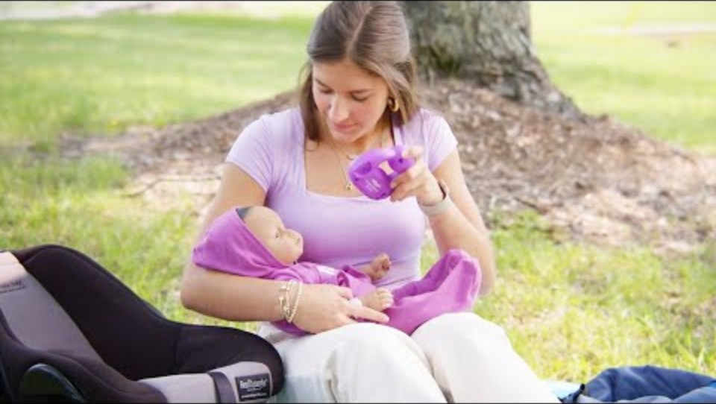
RealCare® Baby Program
The Reality Check: RealCare Baby
Notes:
What courses does everyone teach? Are your students working towards certifications?
Did you inherit a RealCare Baby program at your school? Or, were babies just purchased for your program, and are you the first to use them? Whether you’re new to RealCare Baby or just need a refresher, this training is the perfect place to start!

Slide 13
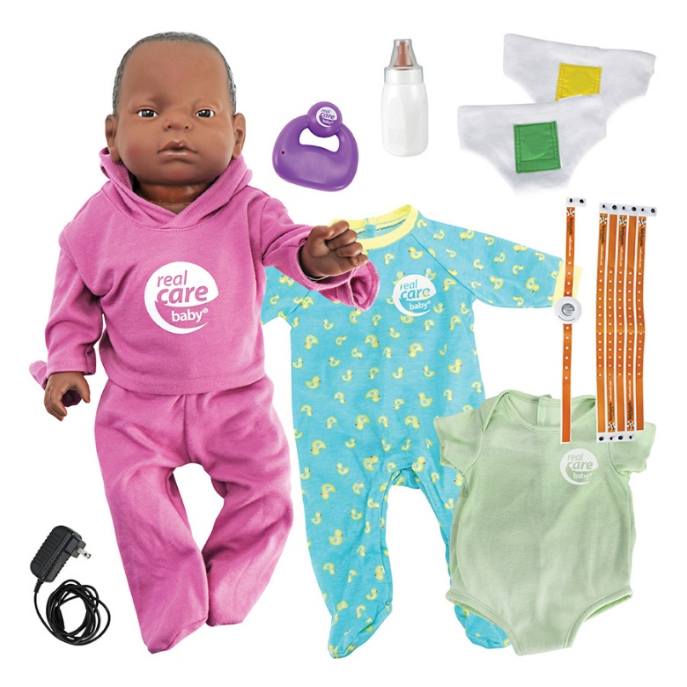
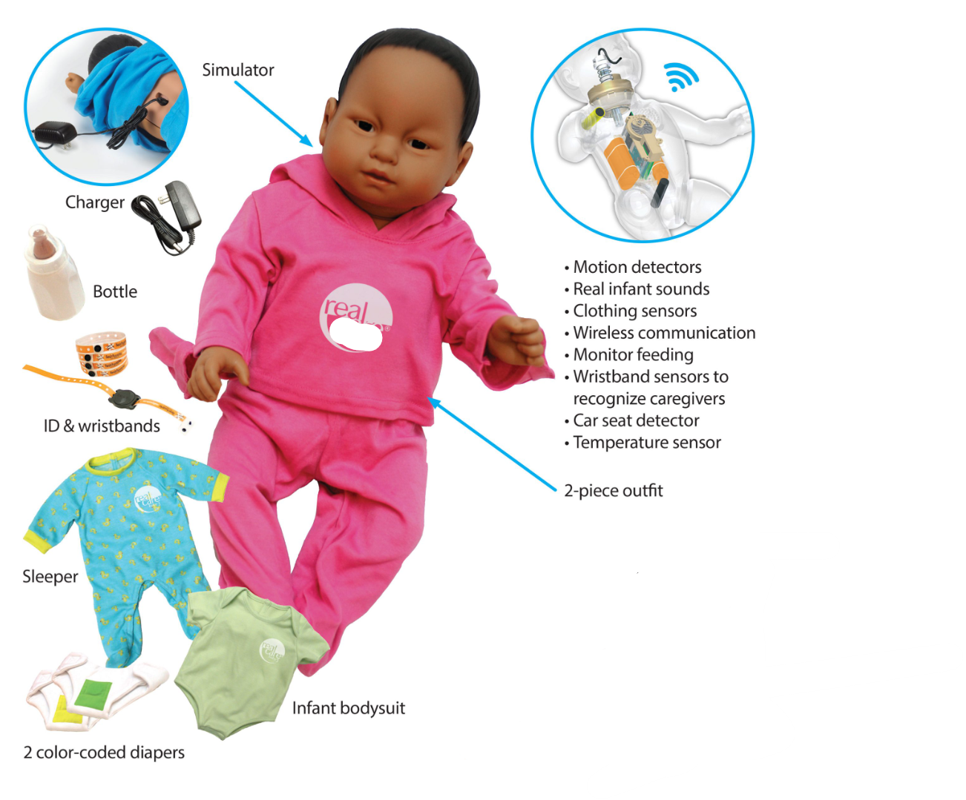
Which RealCare Baby do you have?
RealCare Baby 3
RealCare Baby 4
Notes:
RealCare Baby 4 only debuted in July 2025, so you all have RCB3. The best way to know is to turn it over and look for the logo and what’s written on the baby’s back. Let’s compare Baby 3 and Baby 4…

Slide 14
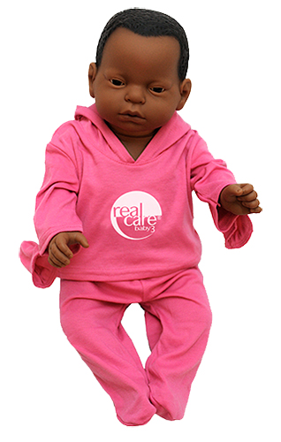
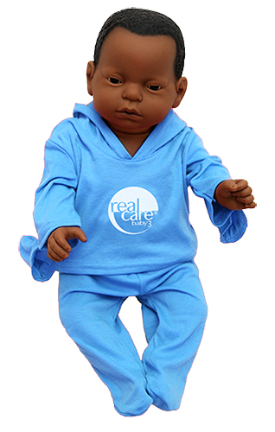
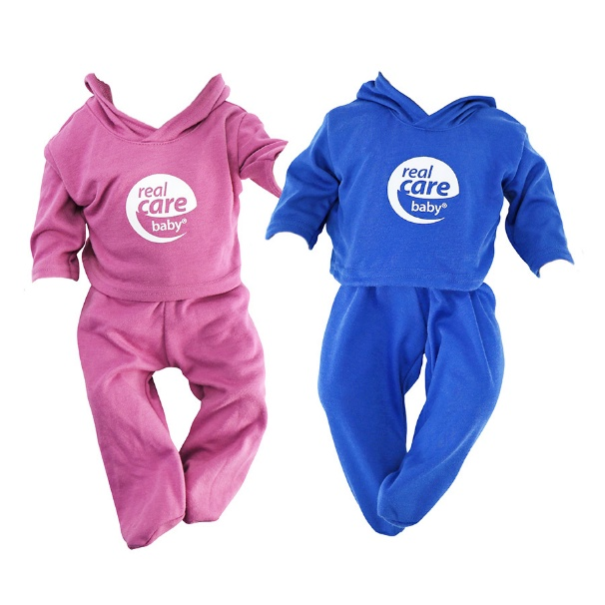
RealCare® Baby
When we introduced RCB4, the two-piece outfit colors were changed a bit
RealCare Baby 3 arrived dressed in a two-piece outfit,pink for female, blue for male.

Slide 15
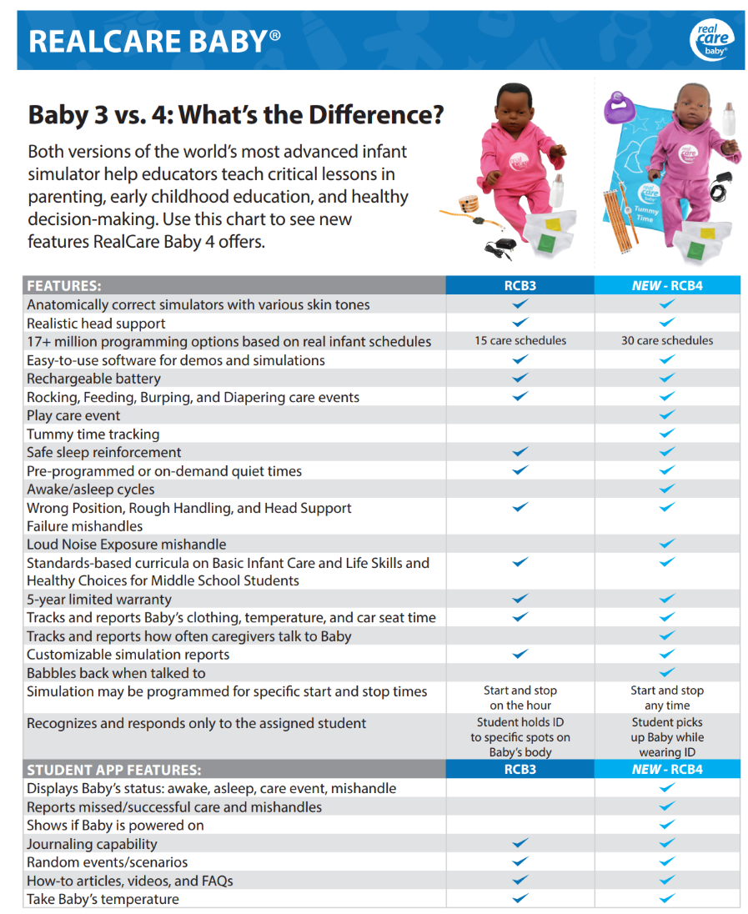
Notes:
Here is a comparison chart of the RCB3 and RCB4 Babies. The 4 does everything 3 did but even more.

Slide 16
RealCare Curriculum
Comes with the starter pack
You only buy curriculum and software once per school
Notes:
It is important to note that you own the lesson plans, and access to the software with any first purchase of RealCare Baby.

Slide 17
Updated Curriculum
Basic Infant Care
Target: High School Programs
Focus:
Infant Care Skills
Child Development
Parenting
Infant Heath and Safety
15 lessons, Hours of Content: 14-25
Life Skills and Healthy Choices
Target: Middle School Programs
Focus:
Human Reproduction
Sexual Wellness
Relationships
Making Good Choices
15 lessons, Hours of Content: 11-13
Notes:
We have updated and refreshed the curricula to include new activities that address baby’s Social and Emotional Needs. There is one for high school programs Basic Infant Care. Life Skills and Healthy Choices is for middle school programs although we do somethings see those flip flopped. Later in this webinar we will be doing a more in-depth look at the lesson topics and sharing a few of the activities included.

Slide 18
RealCare 3 Curricula Still Available
Featuring three curricula that incorporate use of the RealCare® Baby:
Basic Infant Care (childcare career skills)
Healthy Choices: Relationships, Sexuality, and Family Planning (pregnancy prevention)
Parenting: A Guide to Parenting Skills for Life (parenting and child development 0-3)

Slide 19
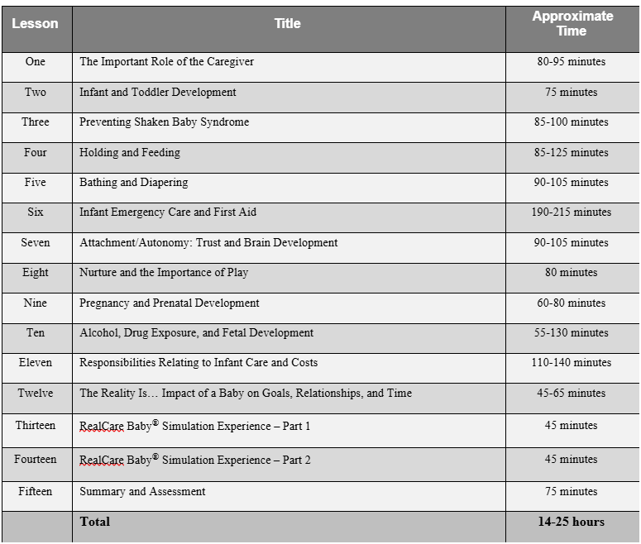
BASIC INFANT CARE
TARGET: High School
15 lessons
14-25 hours of content
All of the lessons may be used with RCB3 and RCB4 Babies.
There may be some slight adjustment for the simulation experience based on using some of the new RCB4 features.
Notes:
This is the updated lesson for High School, Basic Infant care.

Slide 20
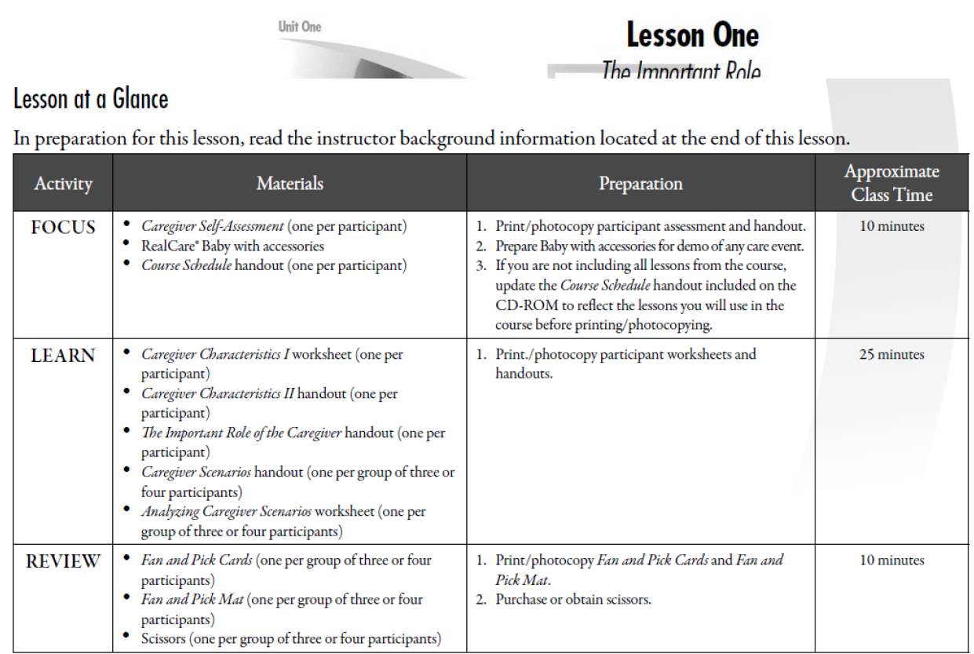
Notes:
All of our lesson plans we provide you follow a focus, learn, review format.

Slide 21
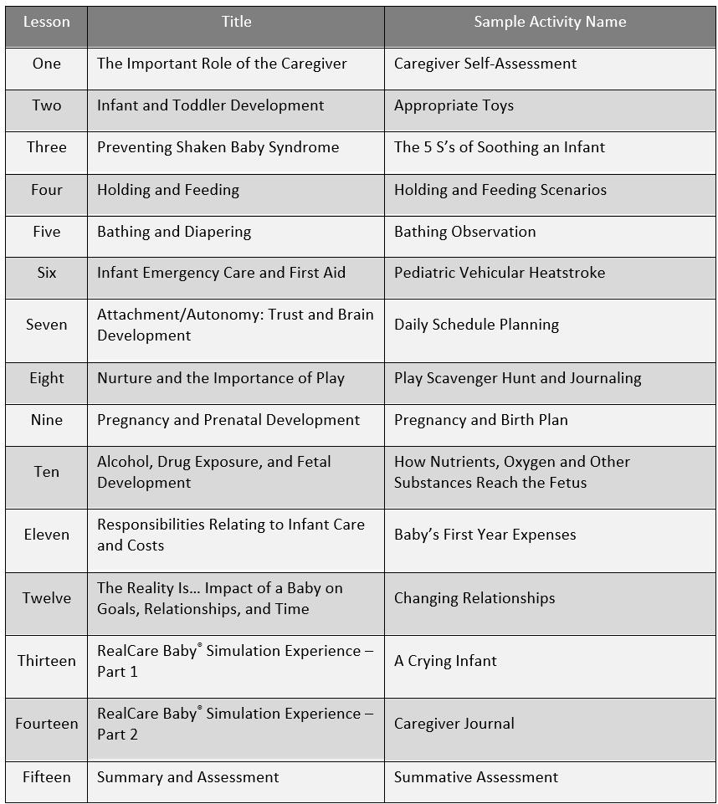
Sample Activities from Basic Infant Care Lessons
Notes:
This gies you an idea of what activities are included in the lessons.

Slide 22
Life Skills and Healthy Choices
TARGET: Middle School
15 lessons
11-13 hours of content
All of the lessons may be used with RCB3 and RCB4 Babies.
There may be some slight adjustment for the simulation experience based on using some of the new RCB4 features.
Notes:
NEW Middle School Curriculum

Slide 23
RealCare Baby User Center
Digital version of Quick Start Guide
Curricula Download Links
Participant Care Card
Completion Certificates
Cleaning & Battery Maintenance Tips
Implementation Guides
Schedule Guide
On-Demand Training Videos
Notes:
This link is your best friend

Slide 24
Do I have what I need?
RealCare Baby 3
RealCare Baby 4
Notes:
Be sure to send home different colored diapers. Wash cold and low or no heat

Slide 25
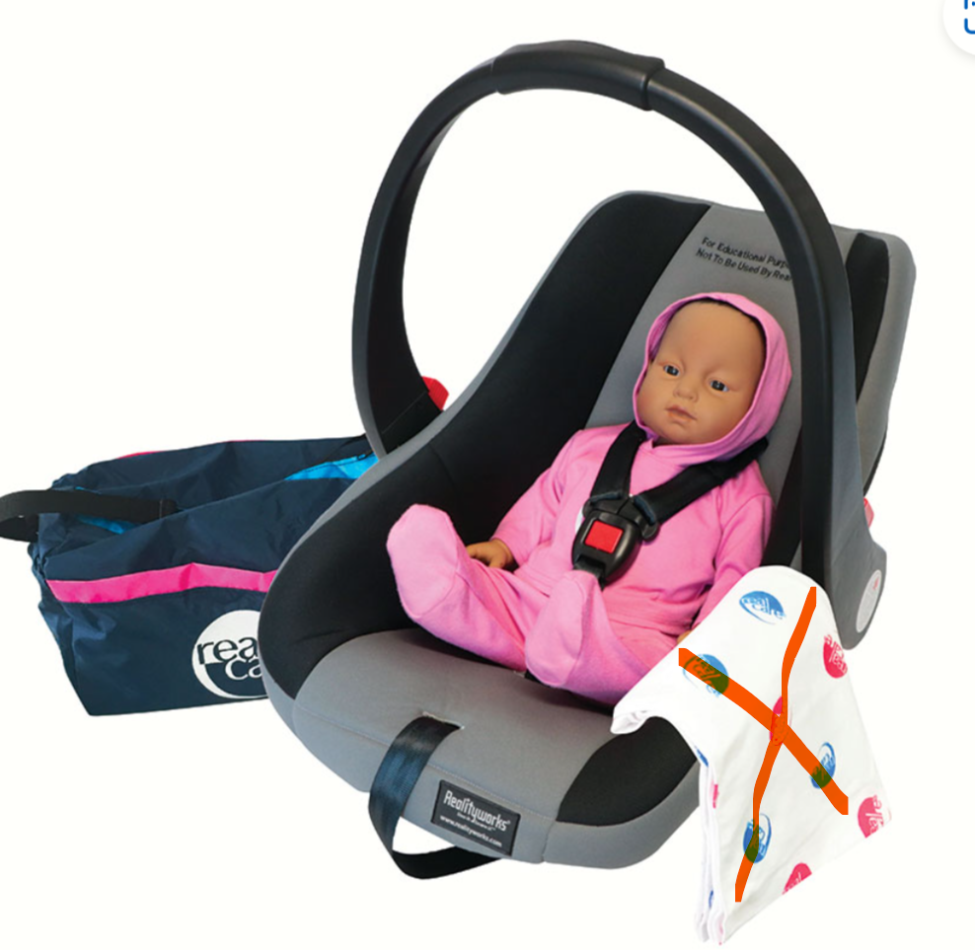

RealCare® Baby Accessory Bundle
The optional accessory package includes:
Diaper bag
Blanket (Tummy Time Blanket with 4)
Car seat/infant carrier (comes with car seat detection kit)
Notes:
If you ordered accessories to go with your Baby, these include the car seat with detector kit, diaper bag and blanket.
The car seat comes with instructions on how to install the detector kit. You can also find an installation video on the product support website.
*you can purchase detection kit separately

Slide 26
Best Practices

Slide 27
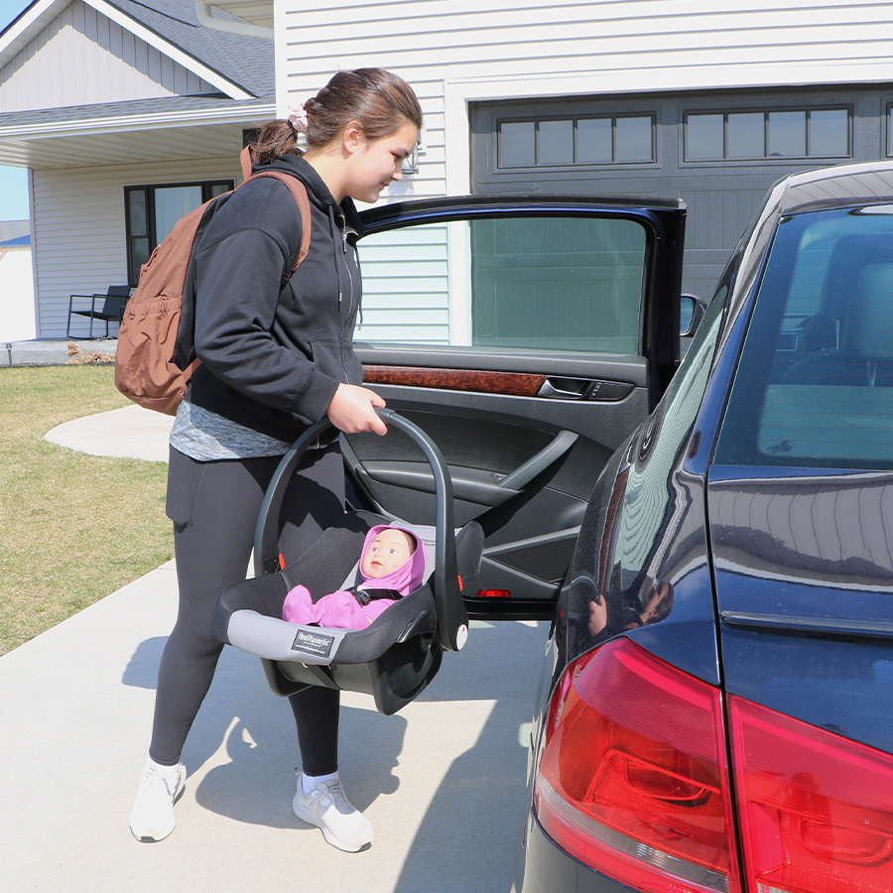
Recommended Resources for Preparing Students
Complete included curriculum
Readiness Quiz
Participant Care Video
Practice in Demo Mode

Slide 28
Incorporating Baby
Best Practices
Go through the simulation yourself. E.g., over weekend -4 hours
Early into unit, display baby for anticipation/reflection
Send out an information/participation packets for both families and the participants very early
Utilize an assistant to program/deliver
Have participants randomly pick a baby and sign-up on delivery sheet
Notes:
There isn’t a better way to learn the ins and outs of the baby than to take it home for a night or two. See what the students will have to do, so you can be completely understanding when their simulations are over.
Be sure to have Baby appear in the beginning of the lesson to allow for ample reflection time. You also want to be sure that you have enough time to send the babies out while you are still teaching the lesson.
If you send a sign up sheet out to all students prior to when you want to send out the Babies, it will be much easier for you. For example, making out a sheet that lists the weekends or nights you are going to send the Babies out. After that put a place for the students’ names and what they choose to name their baby (both a girl and a boy name). That way you are able to go right down the list week after week.
A helper in the classroom is especially useful the first time you program the babies. It is helpful for someone to be there to assist in checking items in and out.
Mismatching gender and ethnic groups is a great way to teach diversity in the classroom
Some instructors will charge lab fees to cover the cost of replacing lost items as well as consumable items, such as wristbands.
.

Slide 29
Incorporating Baby
Best Practices
Programming for best results
  Consider different simulation schedules (15 options) See schedule chart
  High-risk participants. Younger participants. Participants with disabilities
  Simulation time: 1 night = Fun. 2-3 nights = Monday ☹☹
Notes:
Some students are clearly high-risk individuals and others are not. It might be a good idea to give the high-risk students a more difficult simulation. There are 15 different care schedules ranging from easy to very difficult, in essence – colicky – use that to your advantage and show the high-risk students what a fussy baby would be like.
Be sure to send the babies out for more than one night. We’ve found that the first night, students think that the babies are fun – they are having a sleepover. By the end of waking up hour after hour the second night, they tend to change their minds.
Teachers and coaches: If the simulation will require the students to care for the babies while they are in another teachers’ class or involved in an extracurricular activity, you need to gain the support of those faculty members. If they do not agree to the babies being in an active simulation during their time with the students, you will need to program the babies to have quiet times, or place them in a daycare mode, so the babies will not cry or require care. We will go over the daycare and quiet times later.
Parents: If the students are allowed a babysitter ID, and the parents are the babysitters, they can have the student work around the house to earn the money to pay for the babysitter. Some instructors require the student to ‘get a babysitter’ for at least one hour so they realize the difficulty in telling a babysitter what the baby requires. (ex: A real parent needs to tell the babysitter to feed the infant at a specific time, bathe him, etc… In the simulation the student needs to tell the babysitter how to ID the baby and figure out what he/she needs)
The baby will affects the whole family. It disrupts routine.
•Disrupts routine
•Interrupts sleep
•Interferes with social life
•May elicit reactions in public
Journaling is a great way to help the students reflect on the experience. We have even seen teachers request video journaling, tons loaded on YouTube

Slide 30
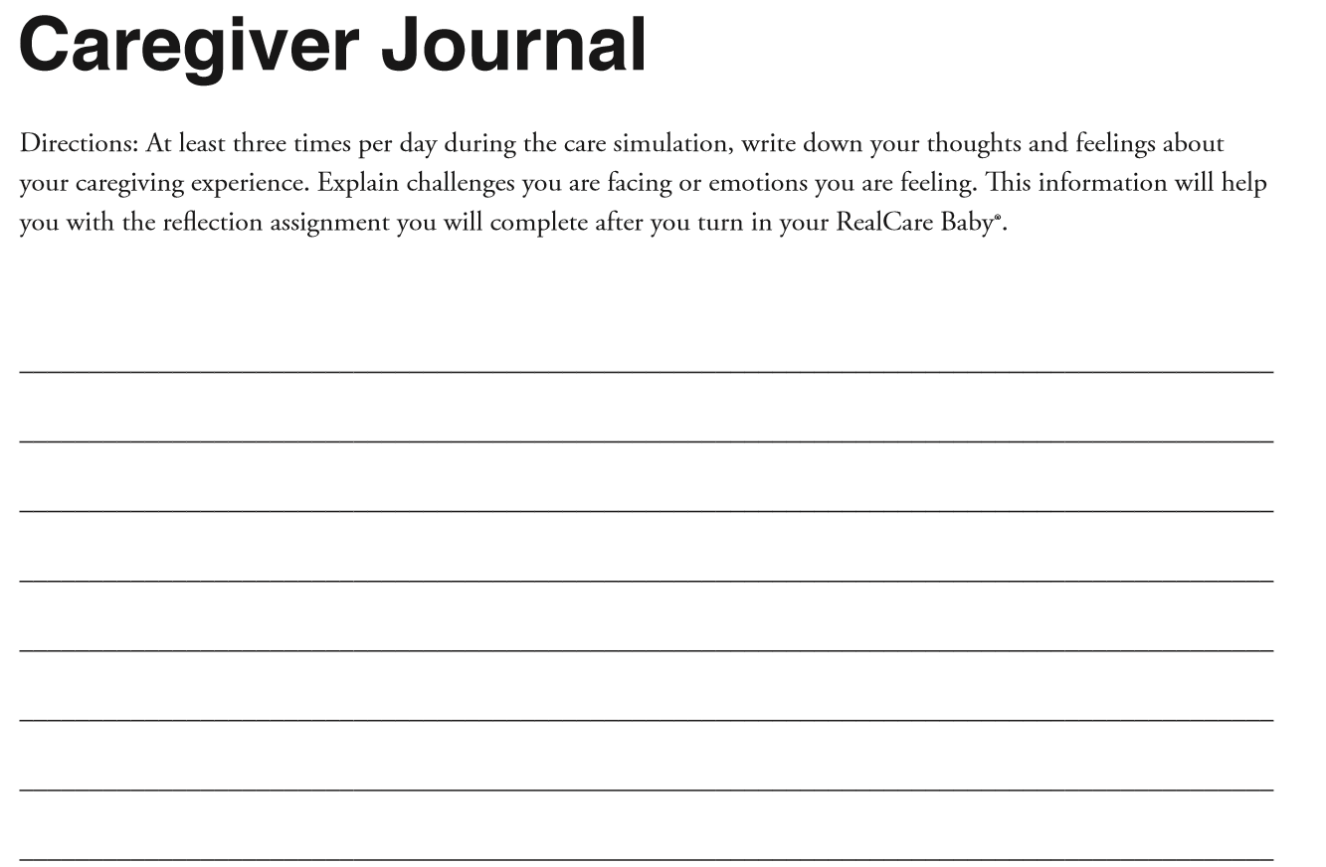

Slide 31
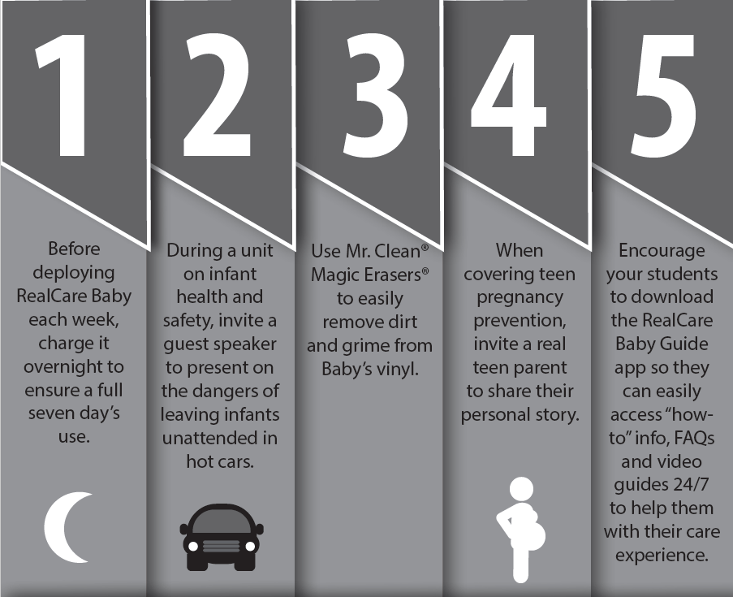
15 REALCARE BABY TIPS!
To maximize the impact of your program

Slide 32
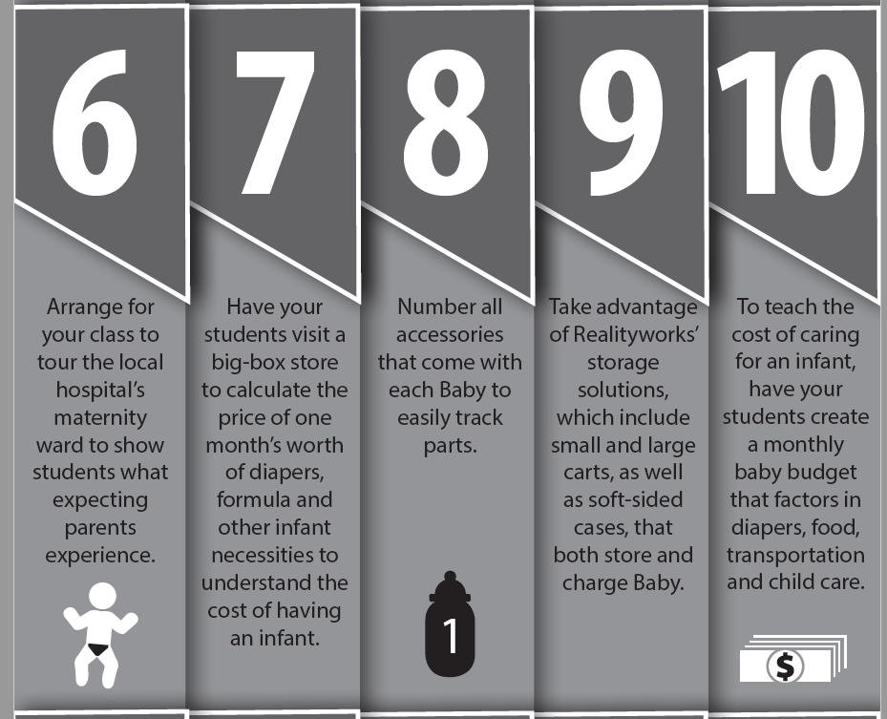
15 REALCARE BABY TIPS!
To maximize the impact of your program

Slide 33
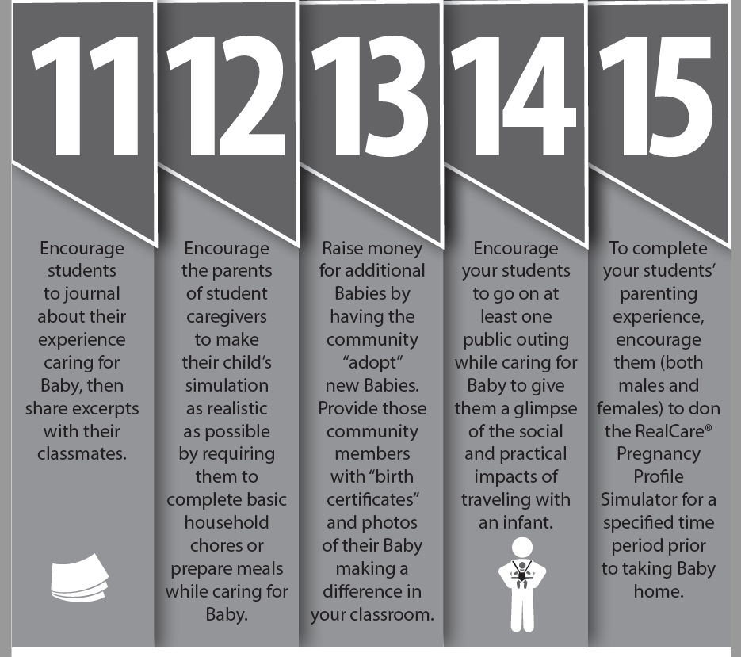
15 REALCARE BABY TIPS!
To maximize the impact of your program

Slide 34
RealCare® Baby Product Support

Slide 35
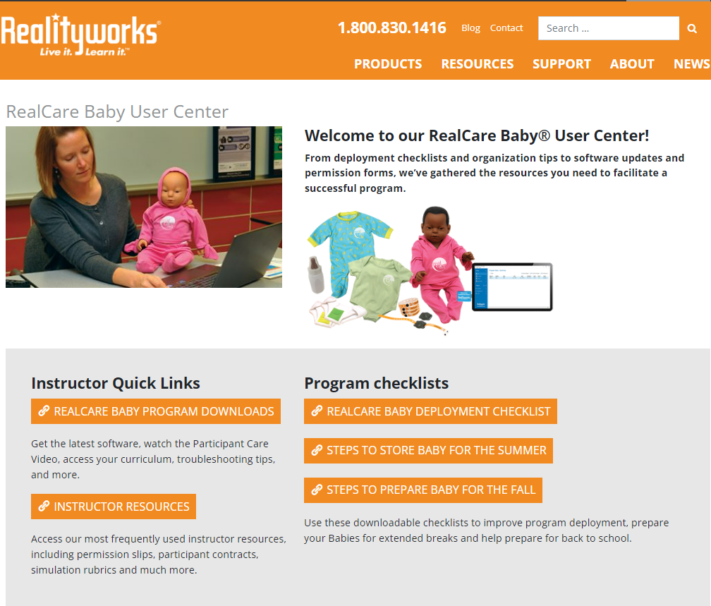
Online Support Resources
Notes:
Click to visit!
Website…Support…Product Help…Infant Simulators…RCB and Control Center Software

Slide 36
Product Support
1-800-830-1416 x2
productsupport@realityworks.com
8am-6:15PM
You can set up an appointment
Notes:
They are not scary! Let them remove the roadblocks!

Slide 37
RealCare® Baby Related Products

Slide 38
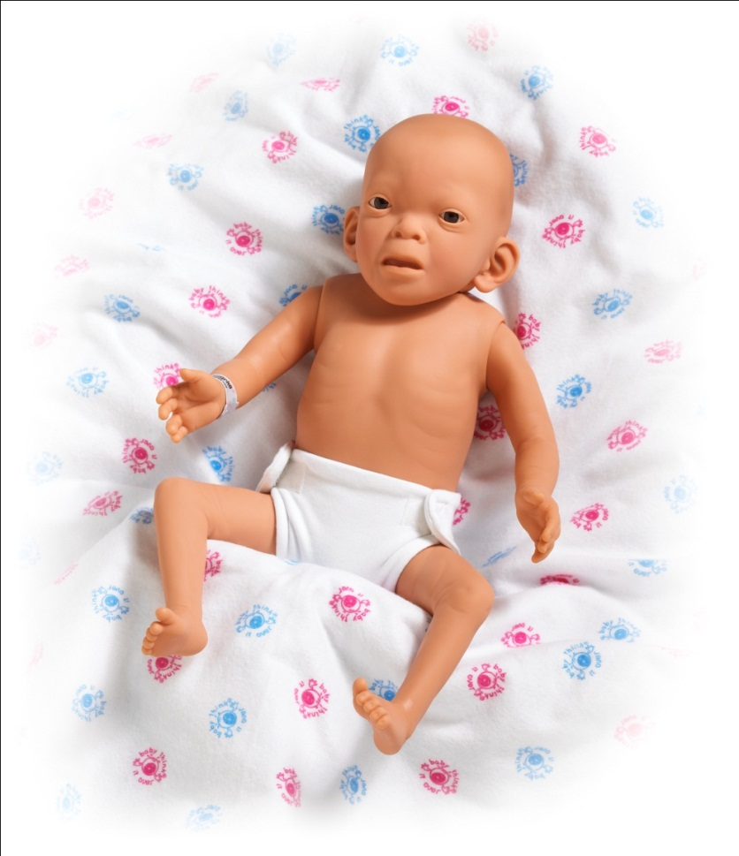
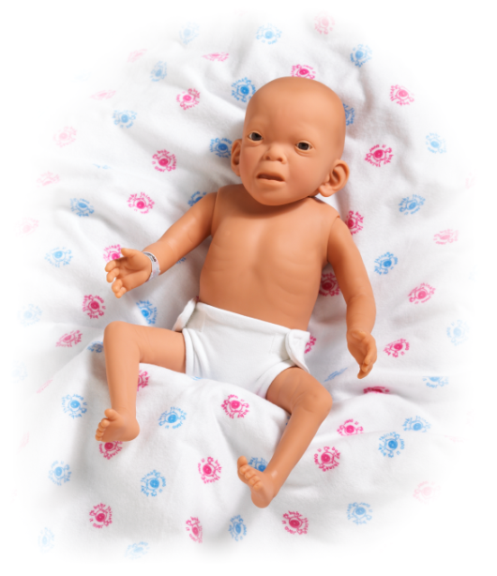
Fetal Alcohol Syndrome Baby
Package Materials
Baby
Cloth Diaper
DVD An Ounce of Prevention
Curriculum
  Lesson and Activities
  Slide Presentation
  Educational Standards
  Resources
Notes:
The Fetal Alcohol Syndrome Manikin is designed to show the physical affects of drinking while pregnant. The package comes with the manikin wearing a cloth diaper, includes a curriculum CD and An Ounce of Prevention DVD. Inside the Curriculum CD you will find the curriculum and power point presentation. It also mentions the standards to which the curriculum is mapped and some additional resources on FAS.

Slide 39
Physical Symptoms of FAS
Smaller-gain wt. at 33% of normal
Slowed physical growth-slender
Smaller head-microcephaly
Eye openings-wider set
Eye folds-inner corner of eyes
Low nasal bridge
Ears bigger and lower
Short nose
Small chin
Flattened mid-face
Ridges below nose and above lip are indistinct/missing
Thin upper lip
Fingers sometimes curve sideways towards middle finger
Curved joints
Sometimes webbed fingers

Slide 40
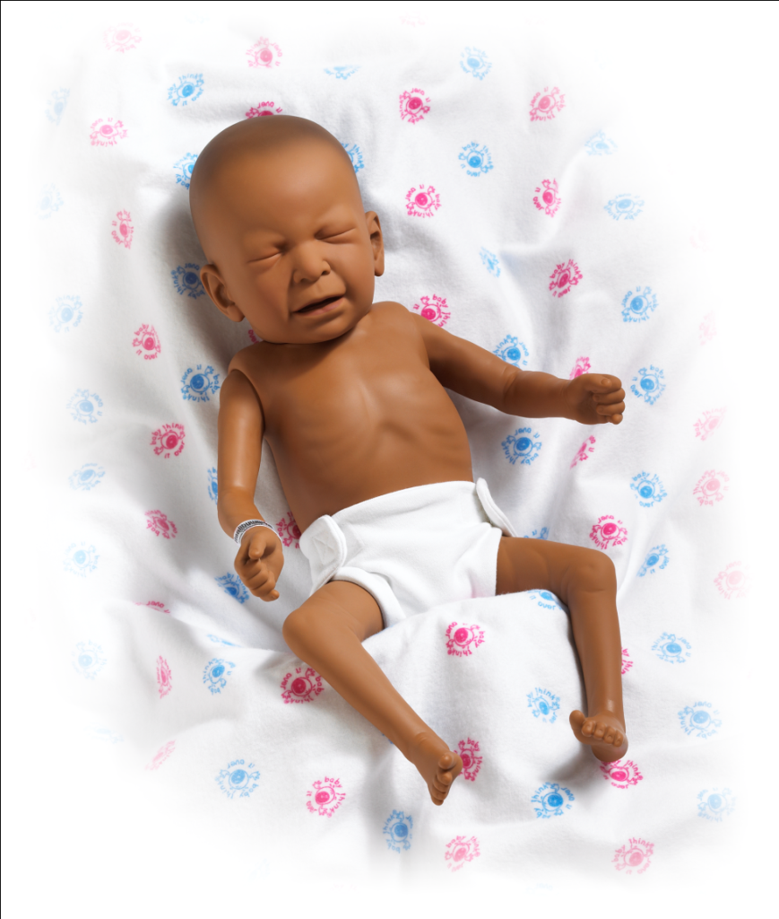
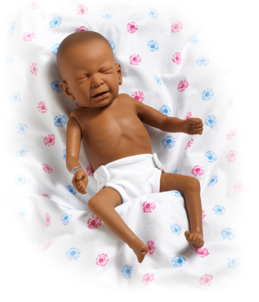
Drug-Affected Baby
Package Materials
Baby
Cloth Diaper
Four AA Batteries
Curriculum
  Lesson and Activities
  Slide presentation
  Educational Standards
  Resources
Notes:
The Drug Affected Demonstrator is designed to show the physical affects of doing drugs while pregnant. The package comes with the demonstrator with four AA batteries wearing a cloth diaper, a receiving blanket and the Curriculum CD. The CD includes the lesson, slide presentation and student materials. It also mentions the standards to which the curriculum is mapped and some additional resources on drug affected infants.

Slide 41
Using the Drug-Affected Baby
Drug Affected Baby
  Show the physical effects
    Painful facial expression
    Small size for gestational age
    Unusually thin arms and legs
  Stress other lifelong disabilities
PowerPoint Presentation
Q & A Review with Drug Affected Demonstrator
Posttest
Notes:
Now we can introduce the Drug-Affected Baby. Show the baby to the class and explain the physical effects that you can see. Be sure to stress the lifelong disabilities that you cannot see by looking at the demonstrator. Turn the demonstrator on and talk about the high pitched cry, which is a real recording of an actual infant affected by cocaine. Talk about the tremors. Why do you think the infant is tremoring? Pass it around so everyone can have an opportunity to feel it. You may want to pass the healthy baby around the classroom first so they can feel the differences between the two.
After the slide presentation, you can go through a question and answer review sheet about Drug Affected infants before administering the posttest. It is the same as the pretest, but hopefully the answers will be a bit better.

Slide 42
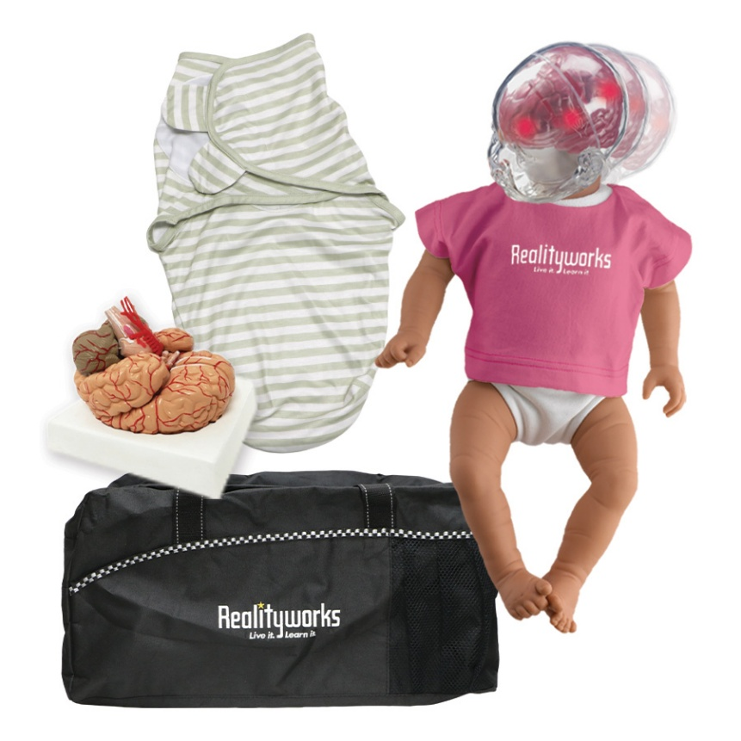

Shaken Baby
Package Materials
Shaken Baby Syndrome (SBS) Baby in t-shirt and cloth diaper
4 “C” batteries (installed)
Battery cover key
When Babies Cry DVD
Curriculum
  Lesson and Activities
  Slide Presentation
  Educational Resources
  Standards
Notes:
The Shaken Baby Syndrome Simulator was created to help increase the awareness of the injuries involved in Shaken Baby Syndrome, to help reduce the incidence of SBS through education. The package comes with the demonstrator and 4 C batteries (already installed), battery cover key, and the “Pledge Not to Shake” certificates. The simulator arrives wearing a cloth diaper and Realityworks t-shirt. You will also receive the curriculum CD.

Slide 43
Shaking the Simulator Baby
The cry will begin once Baby is turned ON
Hold simulator as a baby with front facing you
Hold simulator at eye level and shake it rapidly and forcefully
  Requires quick, forceful shaking. Gentle shaking will not turn on LEDs
Continue shaking until LEDs in all 3 areas of the brain are lit
*Must be shaken firmly and forcefully to demonstrate force needed to cause brain injury.

Slide 44
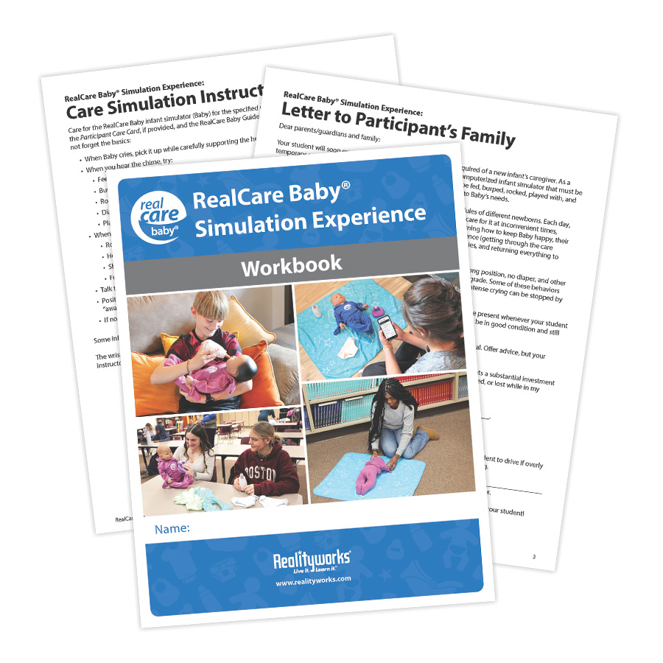
Student Workbooks Available

Slide 45
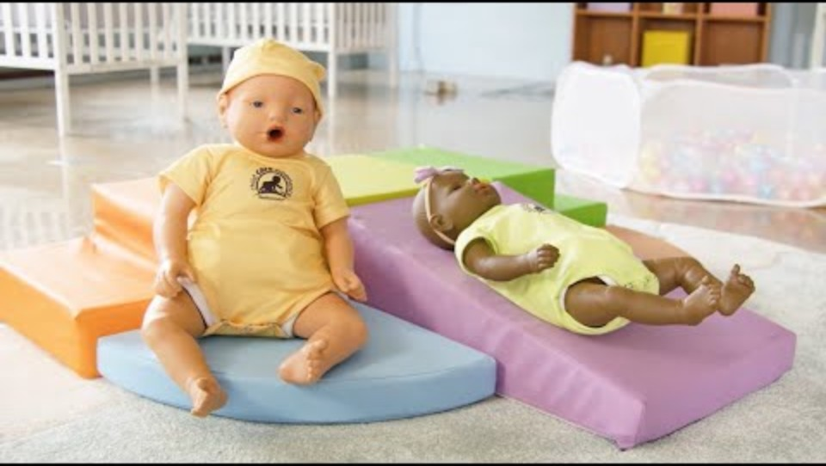
Child Care Experience Program
Next Level Childcare Simulation: CCE
Notes:
What courses does everyone teach? Are your students working towards certifications?
Did you inherit a RealCare Baby program at your school? Or, were babies just purchased for your program, and are you the first to use them? Whether you’re new to RealCare Baby or just need a refresher, this training is the perfect place to start!

Slide 46
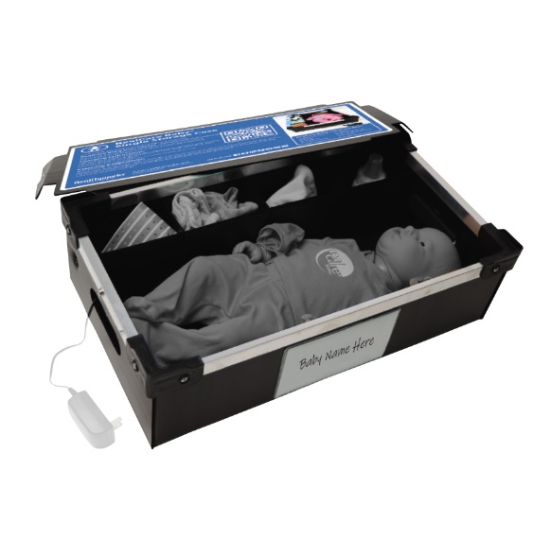
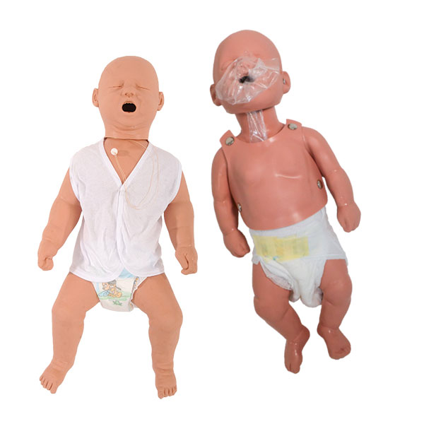
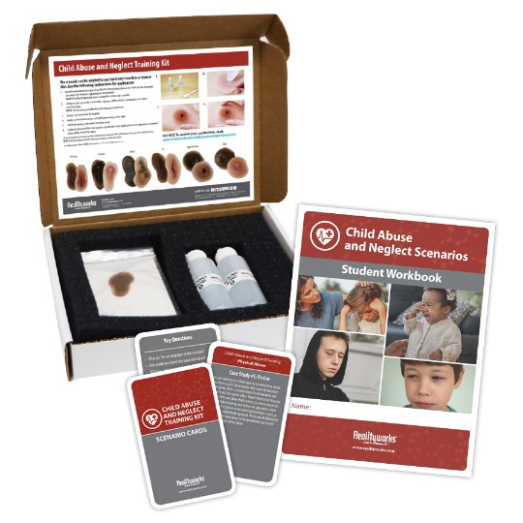
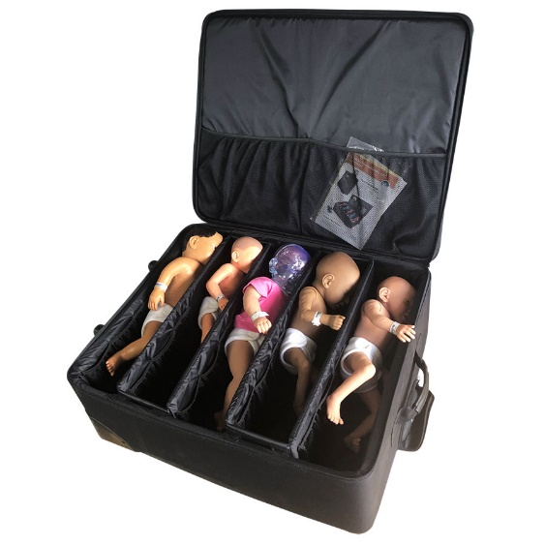
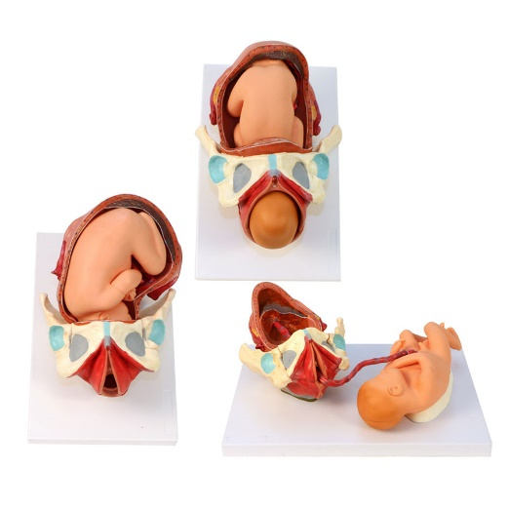
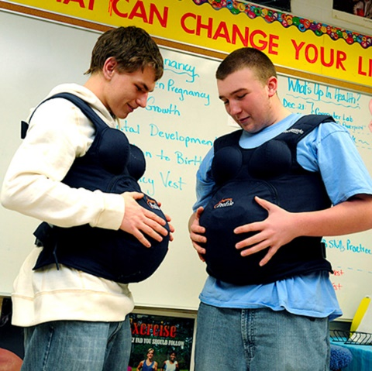
Other Products for Parenting and CD
Child Abuse and Neglect Training Kit
Infant Health and Safety Pack
Storage Options
The Quints
Birth Model Set
Pregnancy Profile Simulator

Slide 47
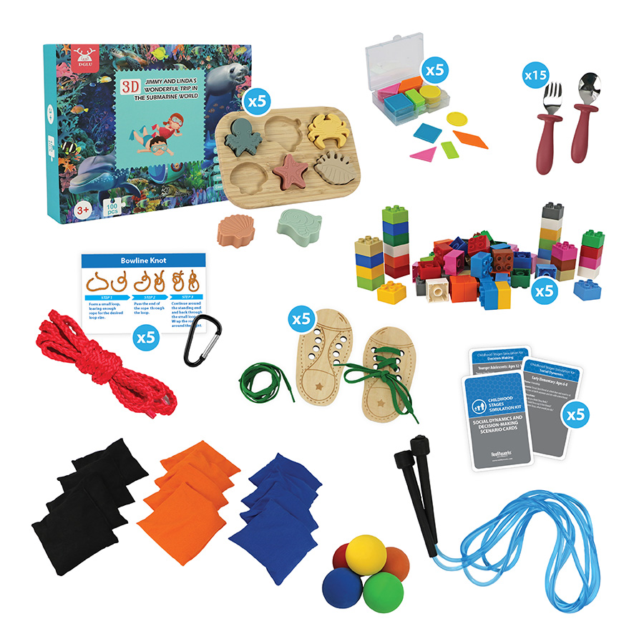
Other Products for Parenting and CD
Childhood Stages
Simulation Kit

Slide 48
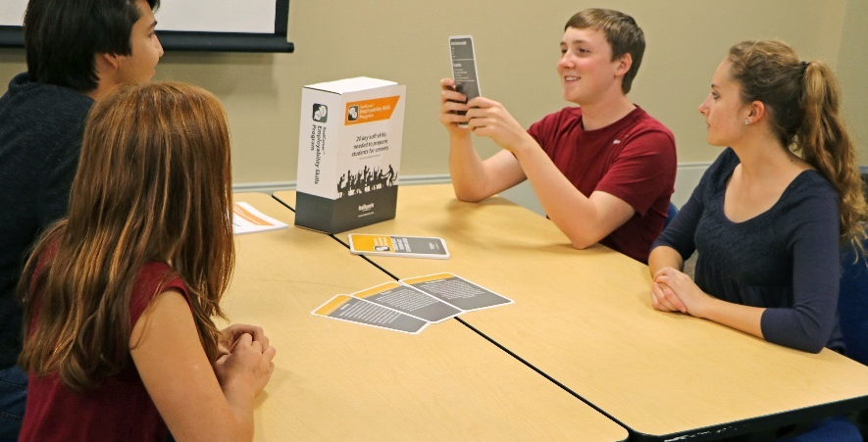
RealCareer
Employability Skills Program
RealCareer
Leadership
Skills Program
Addresses 20 soft skills
Addresses 18 soft skills
Notes:
Ready-to-Use lessons give students the chance to apply each of these skills 2-4 times per lesson
Each lesson is 1 hour but can be broken down to implement in less time.
Includes curriculum, student workbooks, activities and teaching materials

Slide 49
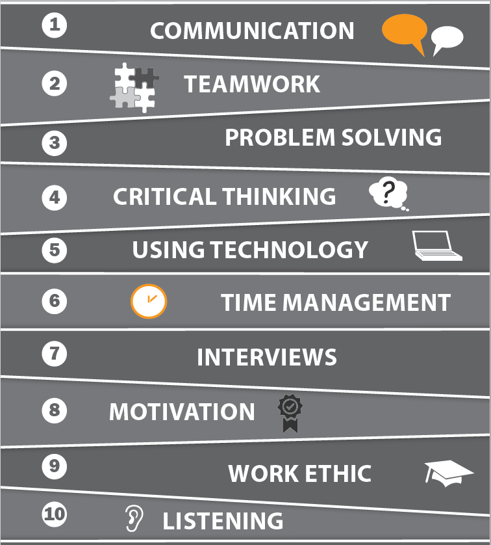
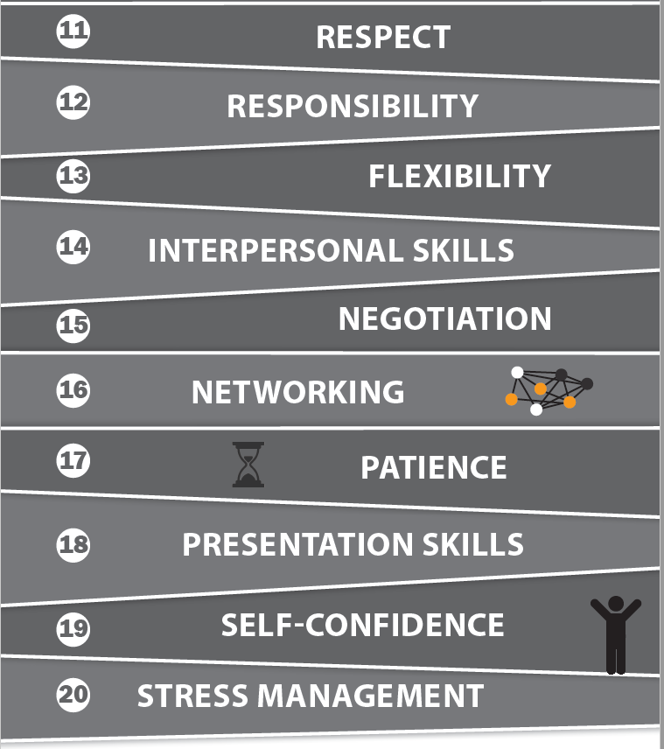
The RealCareer Employability Skills Program addresses 20 soft skills:
Notes:
lessons give students the chance to apply each of these skills 2-4 times per lesson
Each lesson is 1 hour, but can be broken down to implement in less time.

Slide 50


Lottery Grant Info
Funding and Grants

Slide 51
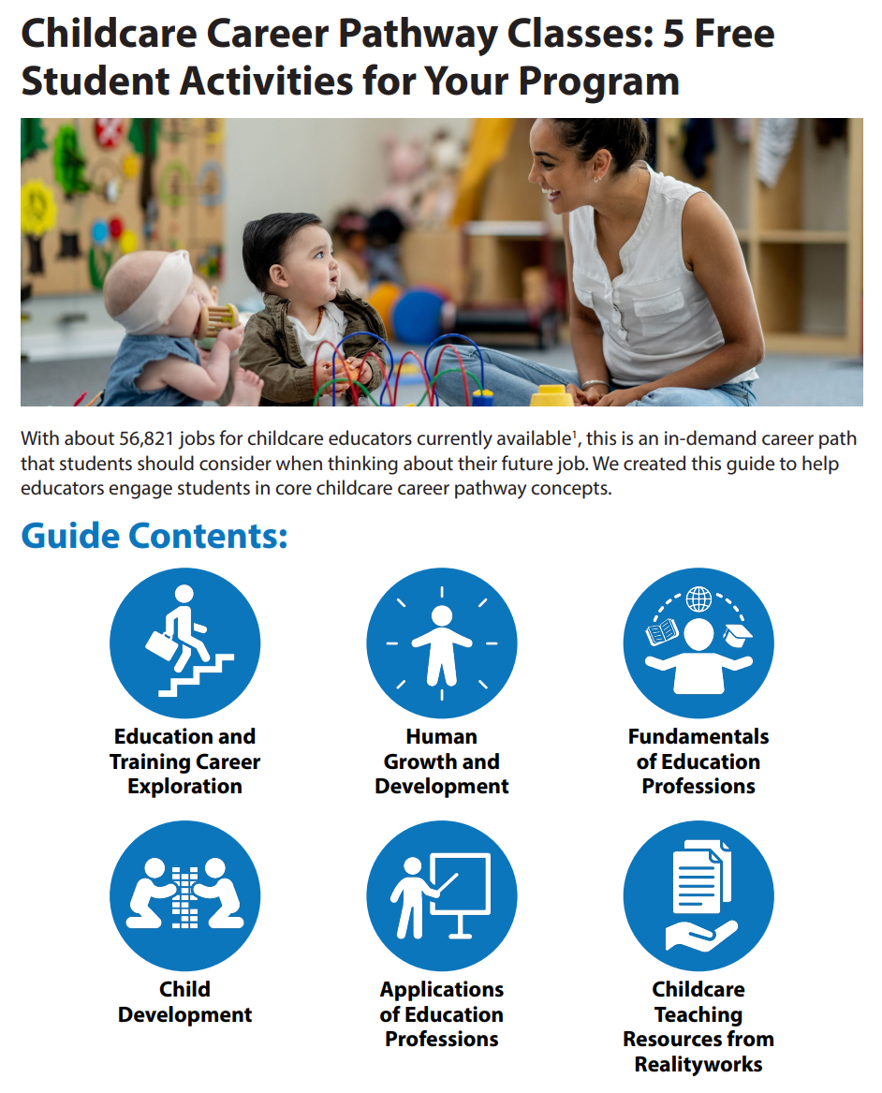
5 Free Activities

Slide 52
QUESTIONS?

