Slide 1

LTC Workshop – Testing Information
Jennifer Palacio
Assessment Manager

Slide 2
HPCP Test Site Coordinator
Train/monitor local test sit personnel (including CSOs if applicable)
Ensure the security of testing materials & verifies all policies/procedures are followed
Coordinate HPCP test registration, collecting fees, & administration
Score clinical skills examinations (if applicable)
Distribute results to candidates and maintain testing records

Slide 3
TRAINING/MONITORING LOCAL TEST SITE PERSONNEL
All test site personnel associated w/ the HPCP certification process:
Must be listed on the HPCP Test Site Directory
Attend training on HPCP processes and procedures
New Process – complete all new paperwork with FY MOU agreement
Only need to be updated when new staff added
Can send an email to remove staff w/out completing new forms
Complete a Testing Personnel Training Requirement Form
Sign a Confidentiality Agreement (not required for CSOs – agreement is part of request form)

Slide 4
Certification Test | Minimum Qualifications
Home Health Care Long Term Care | Registered Nurse with an unrestricted license One year experience
ICF/IID Care | Licensed or Registered Nurse with an unrestricted license OR Qualified Intellectual Disabilities Professional (QID) One year experience
Adult Day Care, Residential Care | Licensed or Registered Nurse with an unrestricted license One year experience
TRAINING/MONITORING LOCAL TEST SITE PERSONNEL
Clinical Skills Observers (CSOs)
Prefer CSOs not be instructors – if so, cannot observe own students
Must administer 2 clinical skills exams per Fiscal Year
CSO Qualifications – verified on OK Bd of Nursing & Multi-state compact
Notes:
Reasons for removal in Test Site Coordinator Manual for CNA & CMA

Slide 5
TRAINING/MONITORING LOCAL TEST SITE PERSONNEL
Test Site Coordinator is responsible for requesting/training CSOs
CSO must complete: (manual on website)
Current list on sFTP system showing test sites approved for each CSO. CSO must have a request form and be issued a certificate/letter for each approved test site.
Request form on website - must include resume
Orientation on administering scenarios
Review CSO Manual
Complete 2 shadowing experiences with approved CSO

Slide 6
ENSURING THE SECURITY OF TESTING MATERIALS
All testing materials must be stored in a secure, locked location only accessible by personnel listed on test site directory
Coordinator copies/distributes testing materials on “as-needed” basis
Coordinator must have open access to all testing functions performed in facilities affiliated with his/her test site in order to verify that HPCP tests are being handled/administered to/by qualified individuals & in accordance with state and local HPCP testing policies

Slide 7
COORDINATING TEST REGISTRATION, COLLECTING FEES, AND ADMINISTRATION
Memorandum of Understanding (MOU) – renewed each FY
Agreements between HPCP office, Test Sites, Partnering Agencies
Outline the processes for each entities responsibilities
Agreements made between HPCP office & Partnering agencies first
Most pricing set by partnering agencies
Agreements then made with HPCP office & Test Sites
Per the agreements, the HPCP office needs to be the first place you contact with candidate testing issues, questions on procedures, technical issues
If a partnering agency needs to be contacted, the HPCP office will do that for you
We need to be the point of contact – middleman of sorts for any questions
We need to retain documentation of anything out of the ordinary
Also, answer we receive may need to be shared with all testing sites and we can then get the info out quickly and update our documentation

Slide 8
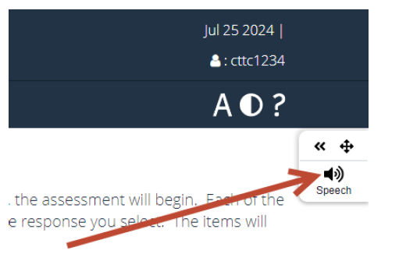
ADMINISTRATION START EXAM
Login to Questionmark with Candidate Information
Candidate clicks on Start Button to Begin
Use Candidate Information Sheet & Retain in Testing Folder
If you have issues closing out the exam, try Alt + F4, Right-click, Close

Slide 9
Maintain Test Records
Testing & Training records need to be separate (instructors have access to training information, but should not have access to testing records)
All testing records should only be accessible to individuals listed on test site directory
Documentation requirements outlined in Cheat Sheet Supplement
provides credibility – no other testing site would have them together
Keep records no less than 4 calendar years (current, plus 3 previous)

Slide 10
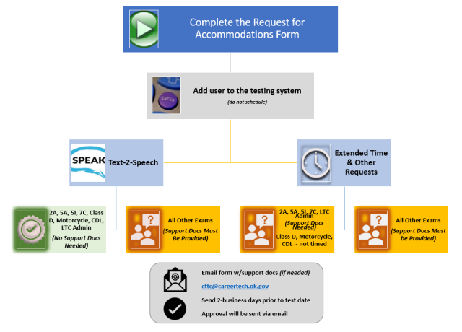

Accommodations

Slide 11
Nurse Aide & CMA Information
Coordinating Registration & Scheduling (HCP Coordinator Manual & CSO Manual)
Nurse Aide – (CNA Testing File Documentation Checklist)
Coordinate # of clinicals performed in a day
7 – LTC, HHA
10 – ICF/IID, RCA, ADCA
Training verification form (orange copy) or Approval Letter from OSDH (only last 1 year) – verify matches candidate info
Photo ID issued by government entity w/in the U.S.
Proof of the SSN:­ Social Security Card/W2, Official Tax Return. If unable to provide proof of SSN, a SSN Attestation Form must be completed
Nurse Aide – (CNA Testing File Documentation Checklist)
Affidavit of Lawful Presence – see info sheet for requirements. Retain original & supporting docs for non-citizens in candidate testing folder
Notes:
Verification form – signature at the top can match the second area if RN Supervisor is also instructor. Verify with Jason regarding LPN’s teaching up to 16 hours (should they sign?)
It is important to get the social security # correct because state will not issue certs/licensure to someone that is not current on taxpayer/other obligations
Affidavit – US citizens do not have to complete a new form when deeming or retesting. For non-citizens, if more than a month have them sign another one because required documentation does have expiration dates. They must have a SS#.

Slide 12
Nurse Aide & CMA Information
CMA – (CMA Testing File Documentation Checklist)
CMA – (CMA Testing File Documentation Checklist)
Photo ID issued by government entity w/in the U.S.
Verification of current LTC/HHA/DDCA certification
CMA & CMA-I – (CMA Testing File Documentation Checklist)
Training verification form (orange copy) or Approval Letter from OSDH (only last 1 year) – verify matches candidate info
Affidavit of Lawful Presence – see info sheet for requirements. Retain original & supporting docs for non-citizens in candidate testing folder
Proof of the SSN:­ Social Security Card/W2, Official Tax Return. If unable to provide proof of SSN, a SSN Attestation Form must be completed
OSDH Form 504 documenting completion of training req’s
Verification of current CMA certification
Notes:
Verification form – signature at the top can match the second area if RN Supervisor is also instructor.
It is important to get the social security # correct because state will not issue certs/licensure to someone that is not current on taxpayer/other obligations
Affidavit – US citizens do not have to complete a new form when deeming or retesting. For non-citizens, if more than a month have them sign another one because required documentation does have expiration dates. They must have a SS#.

Slide 13
Clinical Skills Scenarios – schedule extra 15 minutes for preparing volunteer/providing instructions/answer questions (only time candidate can ask questions)
Administered in actual care-giving situation or in a laboratory setting that resembles environment in which candidates will function on the job – access to running water
All equipment and supplies provided by test site – CSO must make sure that everything is accessible &candidate knows where to retrieve items listed
Volunteers/Residents
HHA/LTC – 60 minutes for 7 clinical skills
DDCA/RCA/ADCA/SHA – 45 minutes for 4 clinical skills (3 for SHA)
AUA – 60 minutes for 4 clinical skills
Many skills can be performed on manikin
Some skills it is better for a “live” person
Cannot be another student in CNA or be a CNA
Prefer non-medical person & need to be 18

Slide 14
Scenarios include both critical, non-critical tasks, and vitals (nurse aide only)
Scenario consists of: - some sites color code sections – volunteer, candidate, etc
Scenario consists of: - some sites color code sections – volunteer, candidate, etc
Critical tasks – usually deal with safety & infection control – must perform all with 100% accuracy
Non-Critical tasks – associated with performing tasks correctly – 80%
Vitals, Input/Output – measure w/in acceptable limits – see scoring sheet
Cover Sheet – Candidate Info to be completed by Coordinator prior to the exam
Candidate Information – Scenario, Instructions, Document Sheet
Volunteer/Resident Info – instructions, consent form
CSO Information – equipment list, CSO Instructions, Scenario, Candidate Instructions, Documentation Sheet
Evaluation Grid – marked by CSO as the candidate performs task
Score Sheet – completed by Coordinator (or designee) – nurse aide only

Slide 15
Any other Questions?

Slide 16





Contact Information
cttc@careertech.ok.gov
Shared email account monitored by several people
Jennifer.palacio@careertech.ok.gov
My direct email
Website: https://www.okhcp.com
Social Media

