Slide 1
Teaching Adult Learners
February 19, 2026

Slide 2
Objectives
Positive learning environment
Techniques to “Sell it”
Meaningful and engaging place to learn
Fun and games for instruction

Slide 3
Questions to ask yourself…
Begin with the end in mind
By the end of class, what do learners need to know?
(What strategies will you use to relay the information?)
How will they/you know they have learned it?
(How will you assess the learning?)
What will they be able to do with it?

Slide 4
Positive Learning Environment
The habits and behaviors your students develop in your classroom will translate to the workplace.
The greater the challenge, the more meaningful the reward.
Learning can be fun, fun can be motivating, and you are responsible for creating that environment.
Students learn best when they are active participants in the learning process.
It takes creativity!

Slide 5
Techniques to “Sell It”
The atmosphere you create for students is key.
Have clear goals and high expectations.
Create lesson plans that are fresh and involve a variety of interactions—lecture, discussion, videos or observation, performing hands on practice or skill checks.
Provide short bursts of information.
Relationships are the key—be passionate about your students’ success.

Slide 6
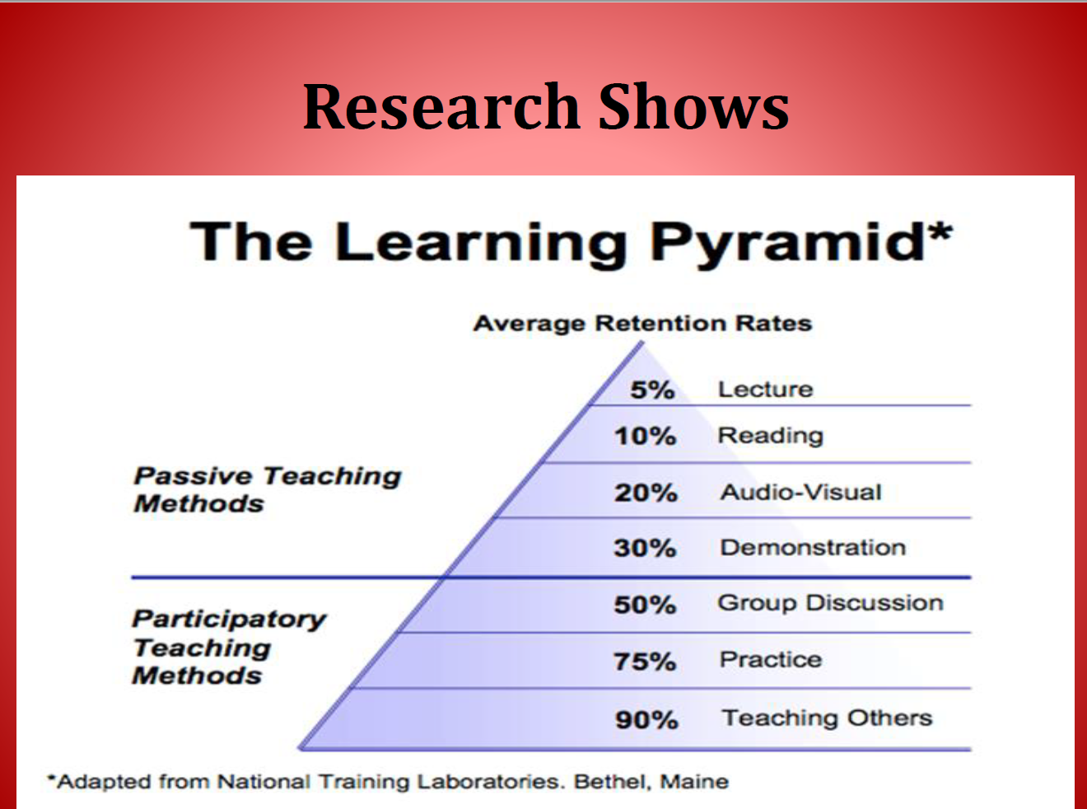

Slide 7
A Meaningful and Engaging Place to Learn
Students can learn.
Motivation has the greatest impact on student learning.
It’s more than just delivering content—you are a tic toc, an entertainer, an expert and the prime motivator.
Create challenges that create student success. Make students believe they can learn.

Slide 8
Fun and Games for Instruction
Content/Motivation/Teamwork

Slide 9
Content
Must have a clear connection to the curriculum
Use to introduce a lesson.
Use as an instructional strategy.
Use for review.

Slide 10
Motivation
Students want to participate in fun activities.
Enjoyment and engagement are vital to the learning process.
The attitude of the instructor conveying enjoyment is key!
Fun is contagious!!!

Slide 11
Teamwork
Develops personal characteristics for success.
Being a team member is one of the many employability “soft skills” students will need to be successful in the work environment.
Involves collaboration.
Provides opportunities for teachable moments.
Provides real world simulation.
Working together develops energy, motivation and engagement between students.

Slide 12
Medical Terminology--DICEY
Fold a sheet of paper into thirds vertically
On the left side, Number your paper from 1-10 , and label it Prefix
In the middle, Number your paper from 1-10, and label it Root Word
On the left side, Number your paper from 1-10, and label it Suffix

Slide 13
Rules of the game
Create teams of 5-10 or by table
Each team should have 1 dice
When I say go…
One person rolls the dice until they get the number 3
Everyone else is writing as many answers as possible on their page
When the dice hits a 3, you pass it to the right and the same process repeats
The first group for all students to get 10 in each column wins.

Slide 14
Stand for True
True/False Review
A review question will be asked.
If you believe the answer is True, stand up.
If you believe the answer is False, stay seated.
If the answer is False, your table will give an explanation.
This not only gets students moving, but you can also get immediate feedback on their learning.
Can also use “thumbs up” for TRUE or “thumbs down” for FALSE

Slide 15
Now, you try! Adapt this game to Long Term Care terms or skills

Slide 16
Match the Description to the Profession
On an index card write…
Dental Hygienist
EMT-Paramedic
Podiatrist
Nurse Midwife
Audiologist
Athletic Trainer
Optometrist

Slide 17
Dental Hygienist
Fluoride application
Remove stains and deposits
Takes radiographs
Does preliminary exam of the teeth

Slide 18
EMT-Paramedic
ACLS
Endotracheal Intubation
Transports victims
ECG interpretation

Slide 19
Podiatrist
Can diagnose athlete’s foot
Designated as a DPM
Plantar fasciitis treatment
Treats ingrown toenails

Slide 20
Nurse Midwife
Total care for normal pregnancy
Newborn delivery
Designation as a CNM
Teaches childbirth classes

Slide 21
Audiologist
Adjusts hearing aids
Develops hearing protection programs
Tests noise levels in workplace

Slide 22
Athletic Trainer
Designated as an ATC
Applies tape to support body parts
Teaches proper sports nutrition
Resource for rehabilitation and conditioning

Slide 23
Optometrist
Visual acuity
Prescribes contact lenses
Measures intraocular pressure
Treats conjunctivitis

Slide 24
For more great ideas—ask to be on the HSE email list for a weekly “Did You Know” email
and
Follow the Health Science Educators Association Facebook Group.

Slide 25
Presented by:
Lara Morris, Health Science Supervisor
Ok Dept. of Career Tech Education
Lara.morris@careertech.ok.gov

