Slide 1
Train the Trainer
02.19.2026
Frequently Asked Questions, Now Answered

Slide 2
Training Files
What should they contain?

Slide 3
LTCA
CMA
If they are also deeming, be sure to have their deeming hours included.

Slide 4
CMA/CEU (CMA Update)
Many programs only keep a class file for their update classes, this is fine
Please remember to email class attendance list to NAR@health.ok.gov after class

Slide 5
CMA-IA
CMA-RG

Slide 6
The program received a DEFICIENCY!
NOW WHAT?

Slide 7
First Steps
The first thing is to take a deep breath and relax!
Most deficiencies are only documentation errors and easily corrected
Take notes at the exit meeting, because we will discuss:
What errors were found
Ways to fix the errors

Slide 8
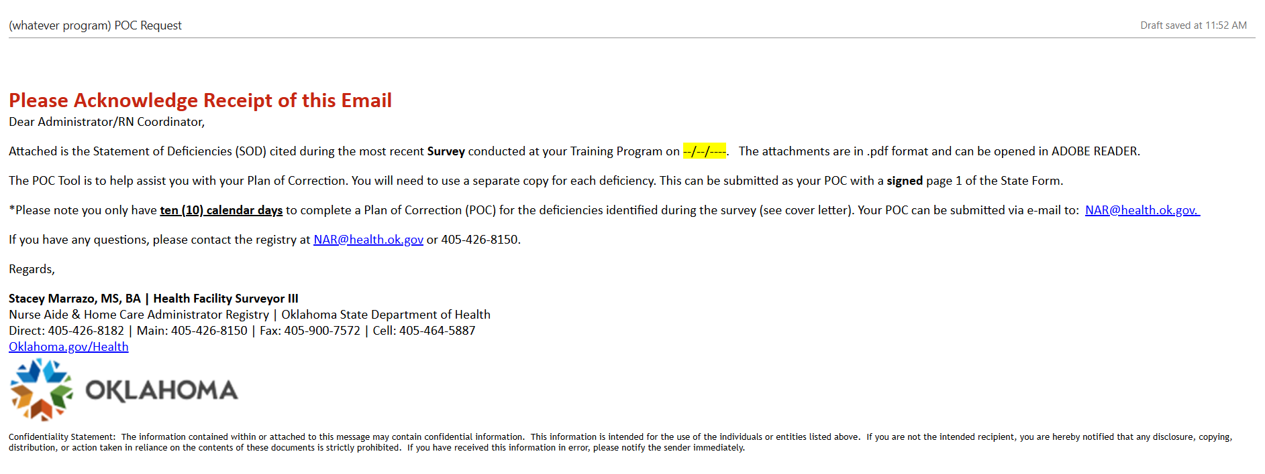
After the survey
You will receive an email, usually within3 to 4 business days, from NAR@health.ok.gov
Notes:
There will only be 1 survey attached to this email, with the SOD letter and the POC tool.

Slide 9
State Form
How to read it

Slide 10
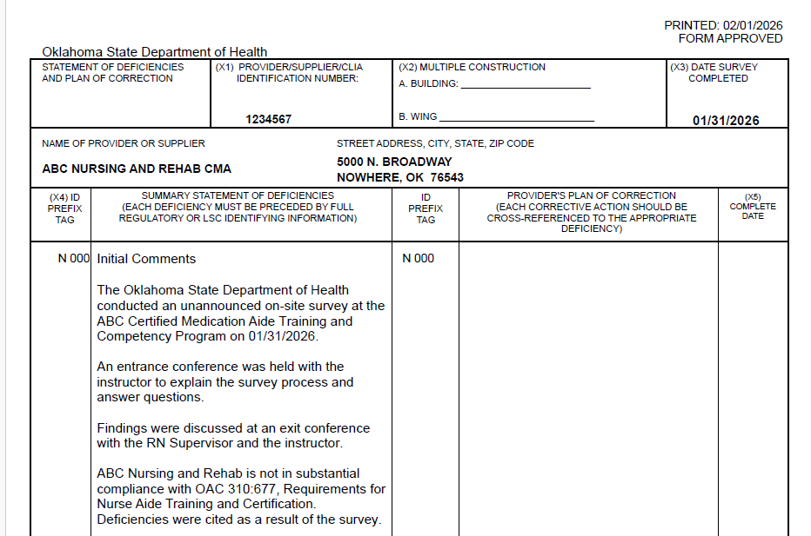






Page 1
TOP OF PAGE:
Program number
Date of survey
Name of program
Address of program
Initial comments

Slide 11
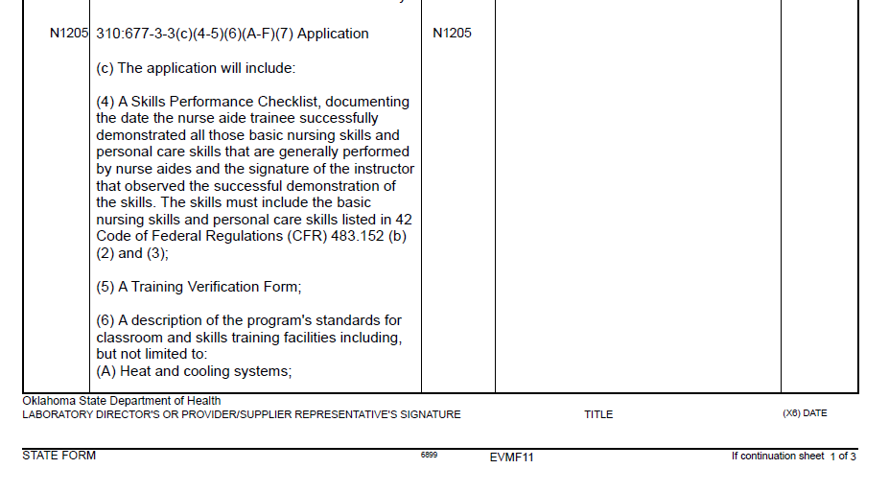



Page 1
BOTTOM OF PAGE:
ID Prefix or Tag#
Rule number and language
Event ID
Program admin sign & date above Event ID
Notes:
The rule may be a long one that takes the information to page 2. Most deficient practice surveys are 2 to 3 pages

Slide 12
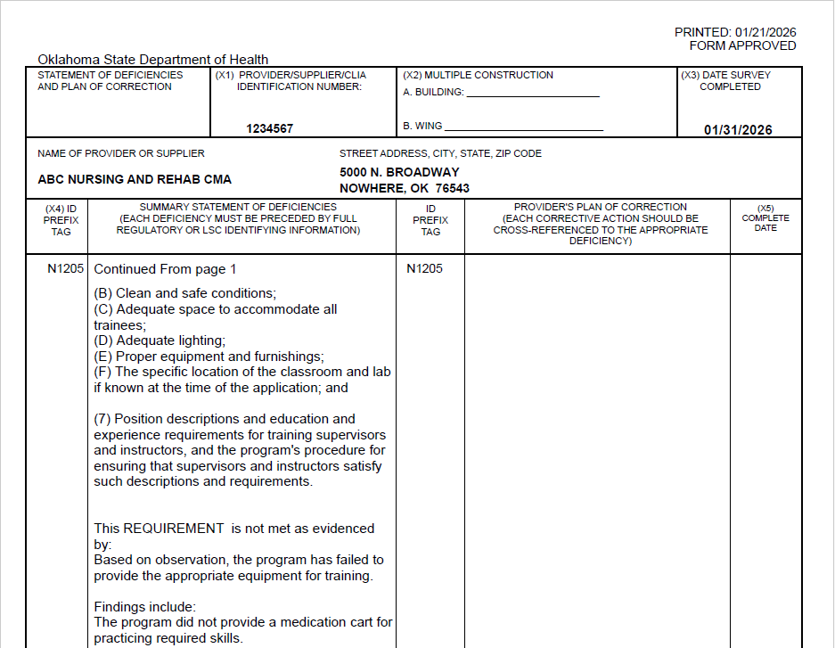



Page 2
TOP OF PAGE:
Same program info across the top of the page
ID tag continued
Based on statement and Findings are what are found during the survey.

Slide 13
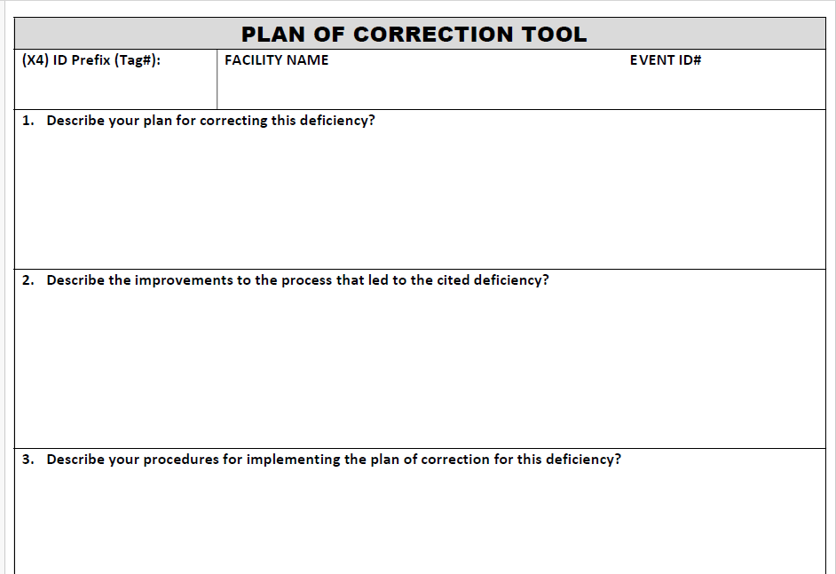


POC Tool
TOP OF PAGE:
ID Prefix or Tag#
Name of program
Event ID
First 3 questions

Slide 14
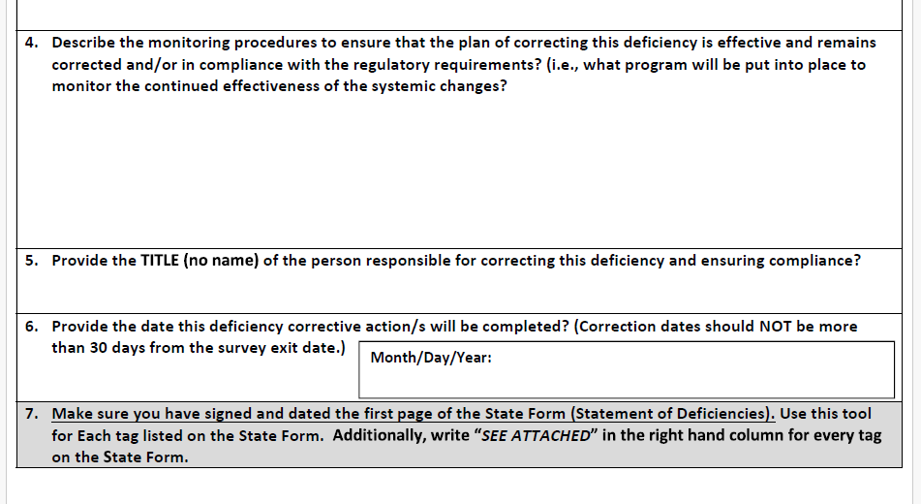
POC Tool
BOTTOM OF PAGE:
Last 2 questions
Who is be implementing to POC
Date of completion

Slide 15
Return SIGNED State Form & completed POC Tool WITHIN 10 DAYS of receipt to NAR@health.ok.gov

Slide 16
Q & A

