Slide 1


Your Path to Your Future
Lesson One
Awareness

Slide 2
$331,000
Notes:
What does this number ($331,000) represent? A: The lifetime earning difference of earning your high school equivalency or not. Take a moment to ask students how that money could change their lives. Ask how it could affect generational poverty.
Before moving to next slide, ask students, “How does education level impact earning potential?” Students should answer before you show the next slide. Ask students to guess the difference in lifetime earnings, then show the next slide.

Slide 3
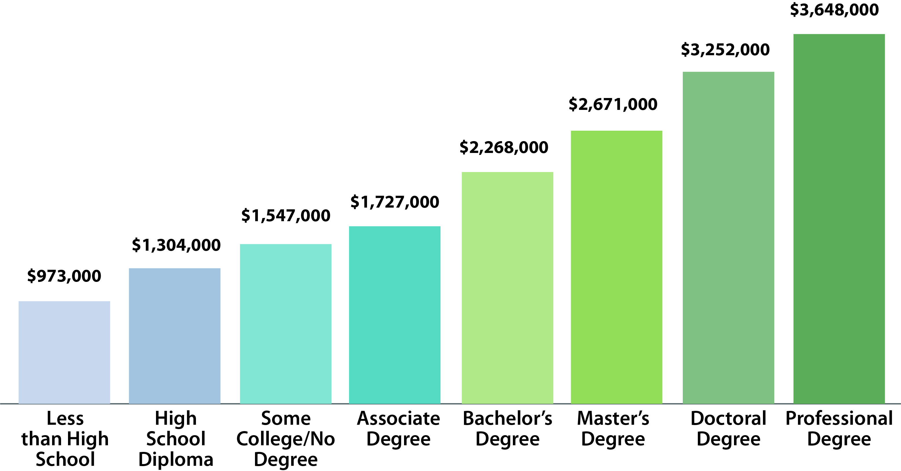
FIGURE 1: MEDIAN LIFETIME EARNINGS [45 YEARS] BY HIGHEST EDUCATIONAL ATTAINMENT in 2020 DOLLARS
331,000
Skilled Trades
Notes:
What does this number ($331,000) represent? A: The lifetime earning difference of earning your high school equivalency or not. Take a moment to ask students how that money could change their lives. Ask how it could affect generational poverty.
Before moving to next slide, ask students, “How does education level impact earning potential?” Students should answer before you show the next slide. Ask students to guess the difference in lifetime earnings, then show the next slide.
Annual salaries
Less Than High School $21K
High School Diploma $30K
Some College/No Degree $31K
Associate Degree $38K
Low End Trade Skills $48K
Bachelor’s Degree $49K
Master’s Degree $59K
High End Trade Skills $60K
Doctoral Degree $72K
Professional Degree $81K

Slide 4
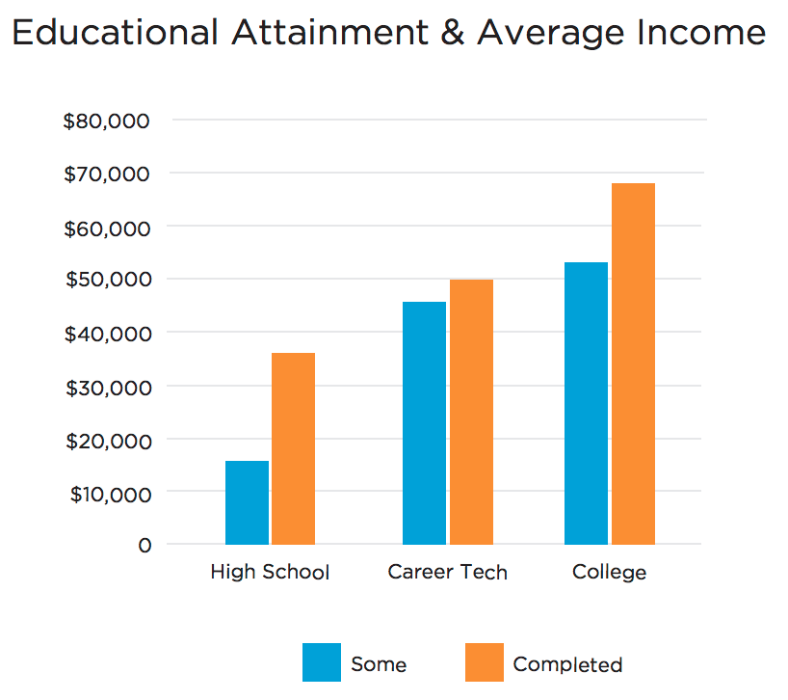
High School
CareerTech
College
Notes:
How do salaries compare among those who never started postsecondary education, those who started but didn’t complete it and those who completed some form of it? A: Use the bar graph to illustrate that those who receive their high school equivalency earn significantly more (55% more) money in Oklahoma. Those who start at a CareerTech technology center but don’t finish still earn significantly more than those with only an HSE.

Slide 5
- 23%
+ 23%
Notes:
What do you think red (-23%) and green (+23%) represent about jobs in Oklahoma? A: Show Oklahoma Works chart and discuss the anticipated industry growth in Oklahoma. 53% of new jobs in Oklahoma will require training beyond a high school diploma by 2025.

Slide 6
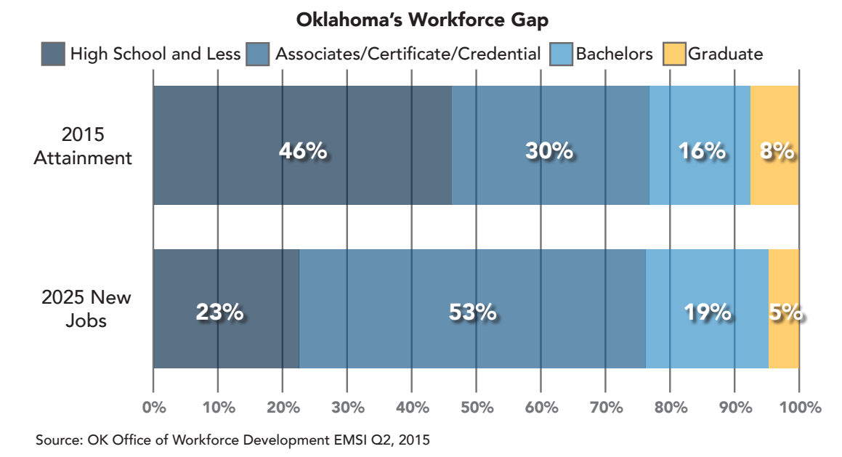
High School and Less
Associate/Certificate/Credential
Bachelor’s
Graduate
Notes:
What do you think red (-23%) and green (+23%) represent about jobs in Oklahoma? A: Show Oklahoma Works chart and discuss the anticipated industry growth in Oklahoma. 53% of new jobs in Oklahoma will require training beyond a high school diploma by 2025.

Slide 7
What are the single greatest contributors to someone not completing school?
Notes:
What are the single greatest contributors to individuals not completing school? A: 36% report bullying as the reason for dropping out, but the No. 1 response was lack of support from family. Expectations from spouses/partners, parents, children, friends and employers increase the likelihood of an individual to take action toward degree completion. You’ve got to build your support network now!

Slide 8
How many times will most people (in the U.S.) change jobs in their lifetimes?
Notes:
According to multiple sources, including Forbes, the average American will change jobs 25 times in his or her lifetime.

Slide 9
How has job security changed over the last 50 years?
Notes:
How has job security changed over the last 50 years? A: Answers will vary. Mention unions and right-to-work.
Some states have laws commonly known as right-to-work laws. Oklahoma is one of these states. The law makes it illegal to require as a condition of employment that an employee is a member or nonmember of a labor organization.

Slide 10
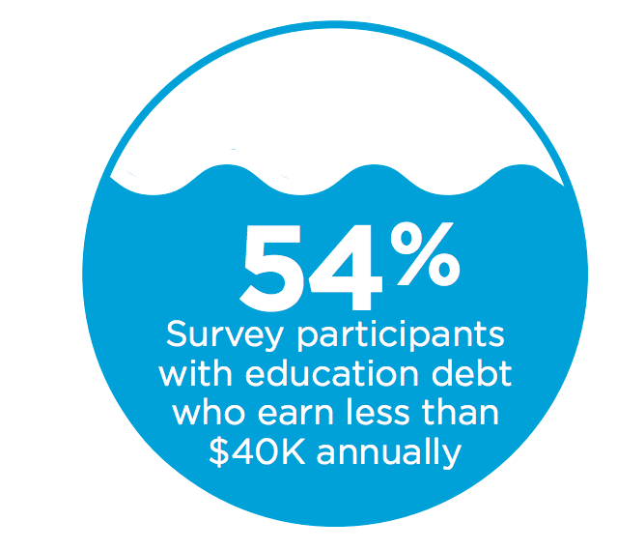
Notes:
Why do you need a plan? A: Money! 54% of people surveyed in Oklahoma have education debt but earn less than $40,000 annually. Having a plan will help prevent this.

Slide 11
Job vs. Career
Notes:
To help students understand the difference between a job and a career, write “JOB” and “CAREER” on the board and brainstorm what they think is meant by both. Record answers on the board (e.g., demographics of workers, wages vs. salary, promotion, paid leave, etc.). Summarize the definitions: Job equals the work position that you have at any point in time, and career equals the path of your jobs over time.

Slide 12
Certified Nursing Assistant > Surgical Technologist > RN
Secretary > Administrative Assistant > Manager
Teacher > Social Worker > Consultant
Notes:
Explain: The goal is to think about your career and not just the next job. Students can do this by creating a map of where they are going. Let’s look at some examples of career paths: (Slide 12)
Certified Nursing Assistant > Surgical Technologist > Registered Nurse: This path is in the health career field. Are these jobs? Careers? Both?
Secretary > Administrative Assistant > Manager: This career path could be within many different fields or sectors.
Teacher > Social Worker > Consultant: This path focuses on jobs that use similar skills, but in different fields or sectors.

Slide 13
What is Career Planning?
What is it? What does it involve? What’s the outcome?
Notes:
Place students in groups of 3-5 and give them a large sheet of paper from the sticky pad along with markers. Ask the students to brainstorm what they think is meant by career planning and to write down their answers. They should discuss what they think career planning is, what it involves and what the outcome might be. Give the students 5-8 minutes to complete the task, then ask them to post their answers on the wall. One person from each group will explain their responses.
Summarize with the following points.
What is career planning?
Identifying what you’re good at
How your skills, talents, values and interests translate into work
Matching your skills, etc., to existing jobs
Matching your career goals to your financial needs
A process
A need to make good decisions
By doing career planning you can find good answers that meet your needs on your schedule.

Slide 14
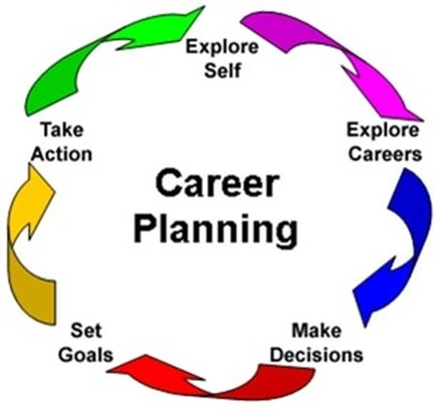

Notes:
Explain: Career planning is a lifelong process. Display the Career Planning Model and use the chart below to give students an overview of what this process entails. This can be an opportunity for you to share how your career has evolved and what factors contributed to changes, but be brief.
Follow the chart in the teacher guide,
Teacher Tip: Depending on the needs and interests of the class, you can further break down the sections of the process and ask students to decide which parts of the career planning process they are most interested in learning about. This can guide you in how best to engage students with the curriculum.

Slide 15



Overview:
Notes:
Course Overview:
Creating a goal sheet to build one’s ICAP
Setting short-term and long-term goals with SMART goal-setting
Decision-making and analysis
Identifying interests, skills and work values through surveys
Exploring labor market statistics for growing industries
Exploring labor market statistics for specific occupations related to student interests
Exploring training or education needed for target goal
Budgeting
Identifying components of successful and unsuccessful applications
Preparing for and answering common interview questions
Developing Job Search Tools
Opportunities for case management with instructor and ICAP execution
Hand out check sheet to be use with the OK Career Guide program to complete individual career academic plans.

Slide 16
ABE -> College -> Job/Career
ABE -> Training/Certificate Program -> Job/Career
ABE -> Better Job or Promotion -> ?
Notes:
Ask students to take a moment and consider their long-term goals. What types of careers do they have in mind? Will training be necessary? Will extra education be necessary? Should they visit a CareerTech technology center or community college or university? Are they just here to get a diploma for a promotion at a job they already have? Understanding that throughout the exploration process this may change, they should tentatively decide on a path today.

Slide 17




