Slide 1


Your Path to Your Future
Lesson Ten
Resume / Cover Letter / References

Slide 2
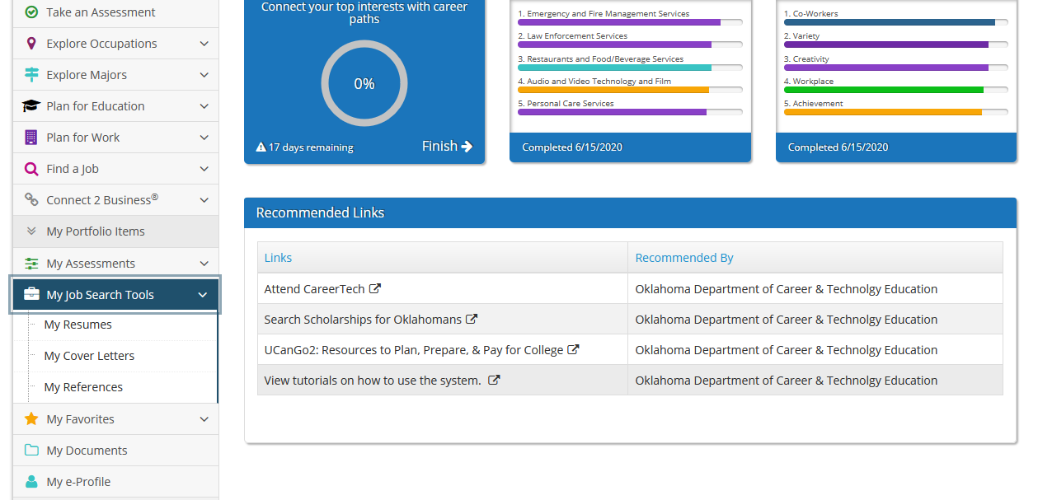
Notes:
Then log into OKCareerGuide.org and have students follow instructions to create their own resume. Click on My Job Search Tools on the left hand menu and select My Resumes.

Slide 3
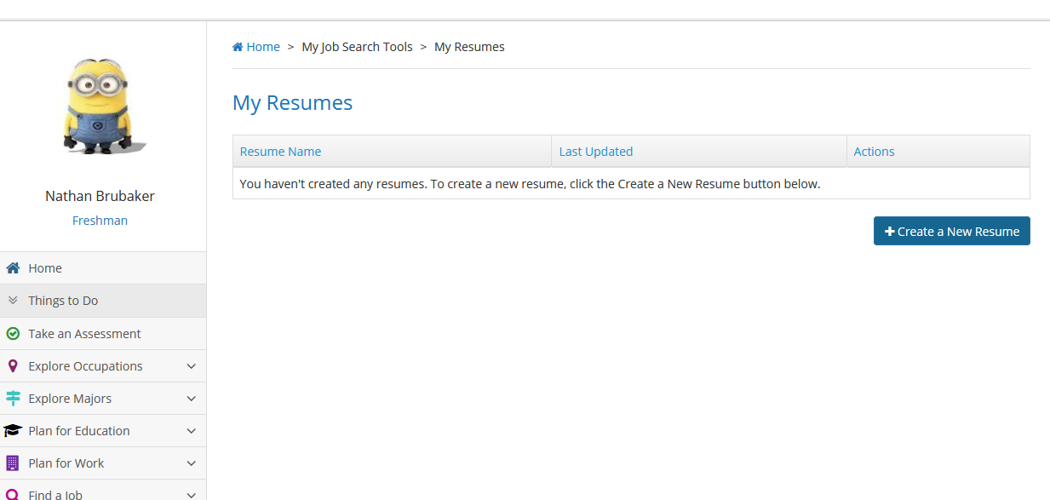
Notes:
After opening up My Job Search Tools and clicking on My Resumes then click. Create New Resume
Fill in the basic info then add as many sections as you can.
When finished save and preview in the different styles.
This should be updated each year.

Slide 4
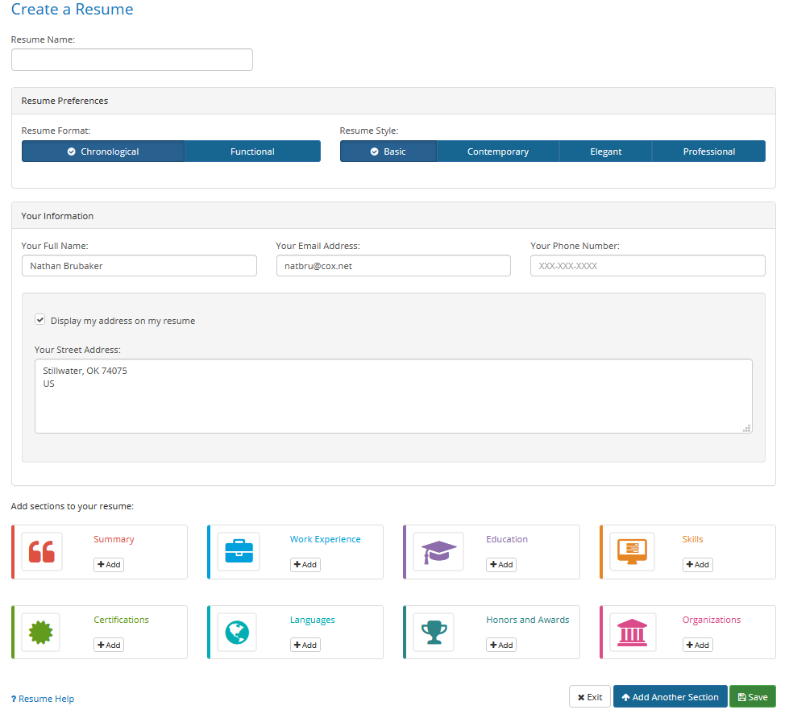
Notes:
After opening up My Job Search Tools and clicking on My Resumes then click. Create New Resume
Fill in the basic info then add as many sections as you can.
When finished save and preview in the different styles.
This should be updated each year.

Slide 5
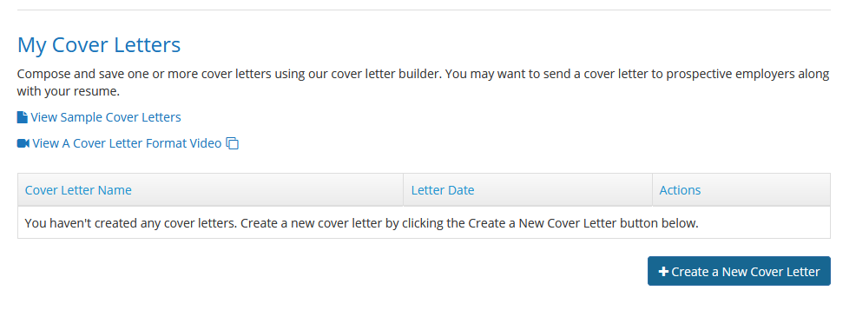
Notes:
Pass out the sample cover letter 1 and 2. Log into ODCareerGuide.org.
Click on My Job Search Tools on the left hand menu and select My Cover Letter and view the sample cover letters and video.
Click on and start a cover letter. Address it to one of the business you are researching.

Slide 6
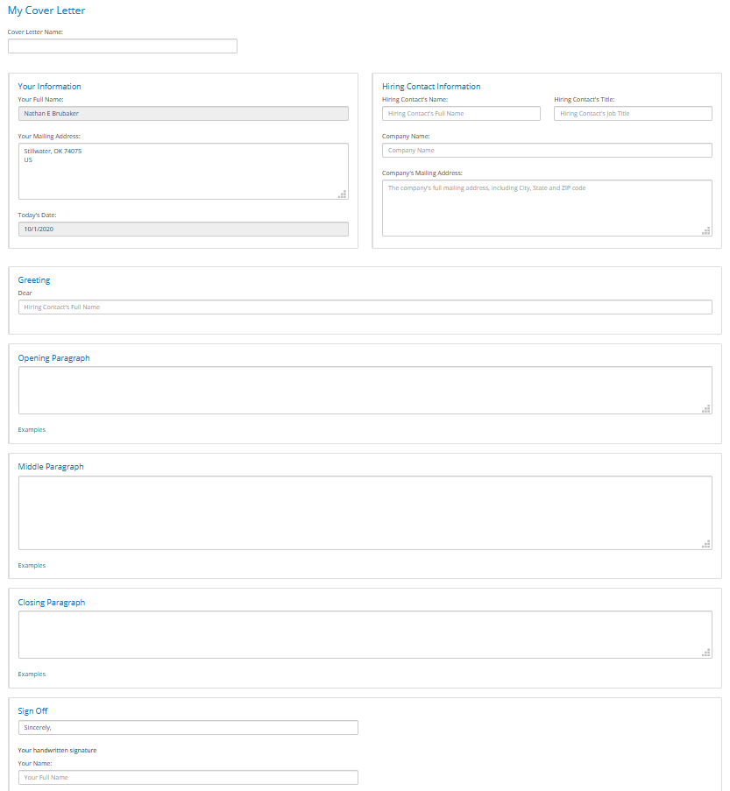

Slide 7
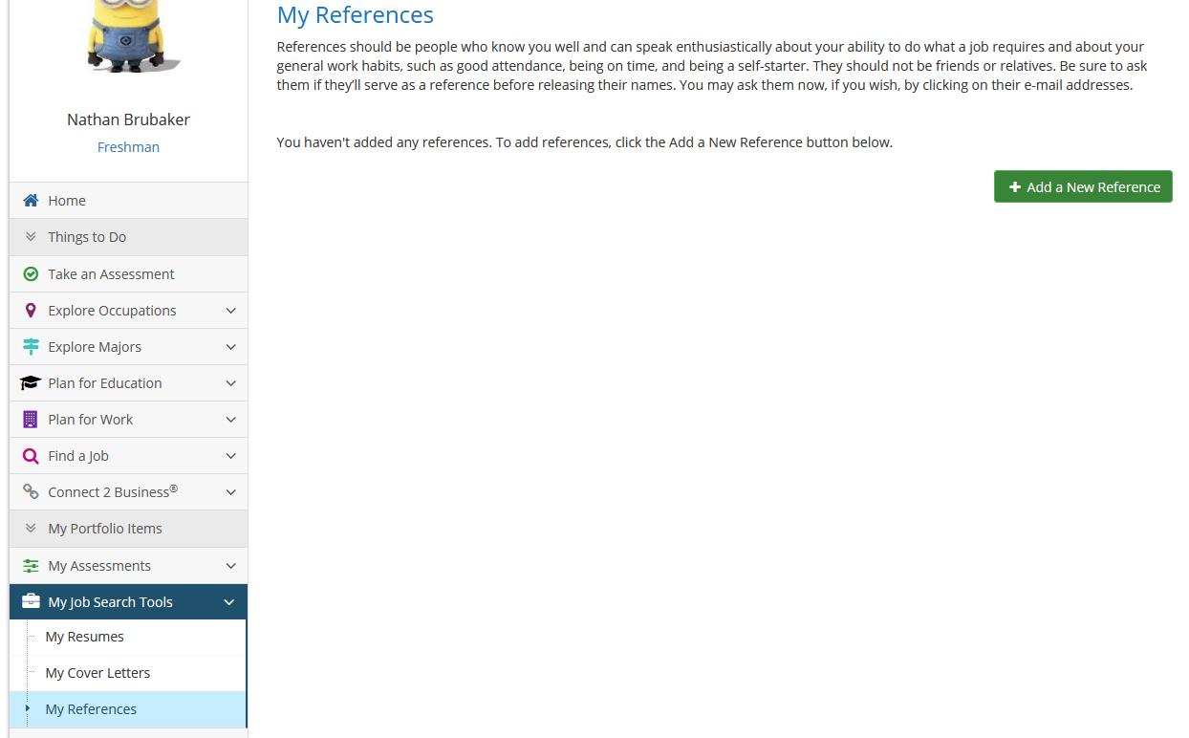
Notes:
, click on My References and fill out information

Slide 8
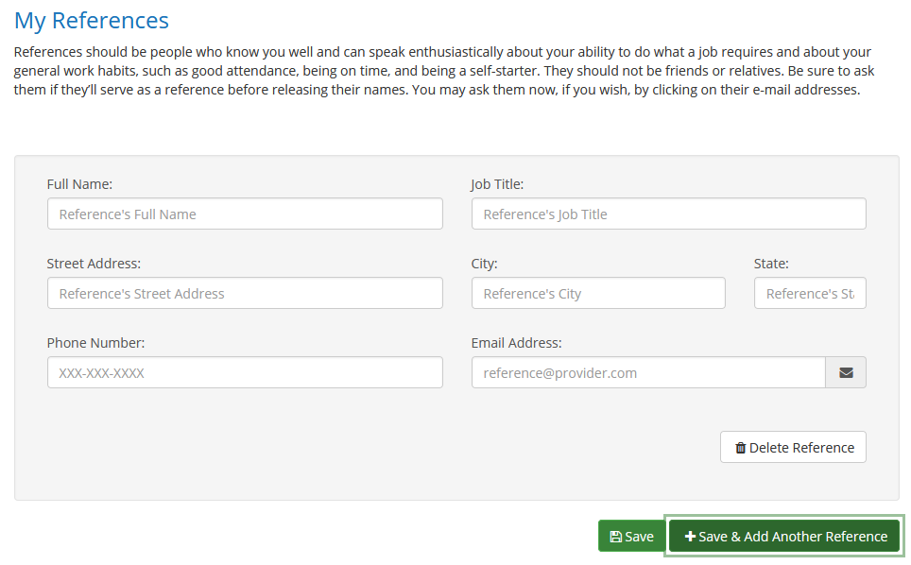

Slide 9





