Slide 1


Your Path to Your Future
Lesson Four
Self Exploration

Slide 2

Transferable Skills Video
https://www.youtube.com/watch?v=kJJOw_GtNGo
Notes:
Ask students to share any stories about the following scenarios: jobs they were good at but didn’t like; workplaces that felt toxic or made them hate their jobs; jobs they were excited about but where they did not know what to do; jobs they enjoyed but decided to leave and why. (Slide 2)
Watch transferable skills video at https://www.youtube.com/watch?v=kJJOw_GtNGo and ask students to explain what transferable skills are.
Transferable skills are abilities and specific skills learned through life and job experiences are directly related to attributes of other jobs. You may have never worked as a receptionist before, but because you helped an elderly family member manage a household, called and made doctor’s appointments, organized daily medications and made sure mail was taken care of, you now have transferable skills that are typical requirements for entry level receptionist positions.
Are you using transferable skills you learned in a different job or that someone taught you prior to working in the job you have today?
People have more transferable skills than they think. Even if you have never worked outside the home, you still have transferable skills. Today we will take a short assessment to identify some of your transferable skills and even get results of what job titles might be appropriate.

Slide 3

Interests Video: https://www.youtube.com/watch?v=scgqCyxe1QY
or
https://www.youtube.com/watch?v=OfDAaPbQ1T0
Notes:
After watching the two videos, raise your hand if you applied for your current job because the job duties really interested you.
Who would like to have a job that matched up with your interests?
What are some of your job interests? (e.g., working outside, working with my hands, working indoors, working in a position that allows me to be creative, etc.)
When we work in a job or career industry that really aligns with our interests, we are more likely to be satisfied with the job and stay longer (have more longevity).

Slide 4

Work Values Video:
https://www.youtube.com/watch?v=qPZFHPfNWQQ
Notes:
What are some of your work values?
Sometimes we think we know what our work values, interests, and transferable skills are; but there may be some you overlook or do not think is significant or pertinent. There may be some of you in the room that have no clue what work values, interests or transferable skills are, and that is just fine! Today we are going to take some on-line assessments that will help you identify what is important to you in a workplace setting, as well as skills you already have that could transfer into a different job.

Slide 5
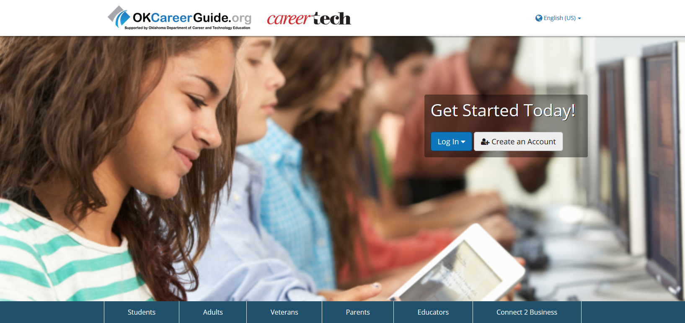

Slide 6
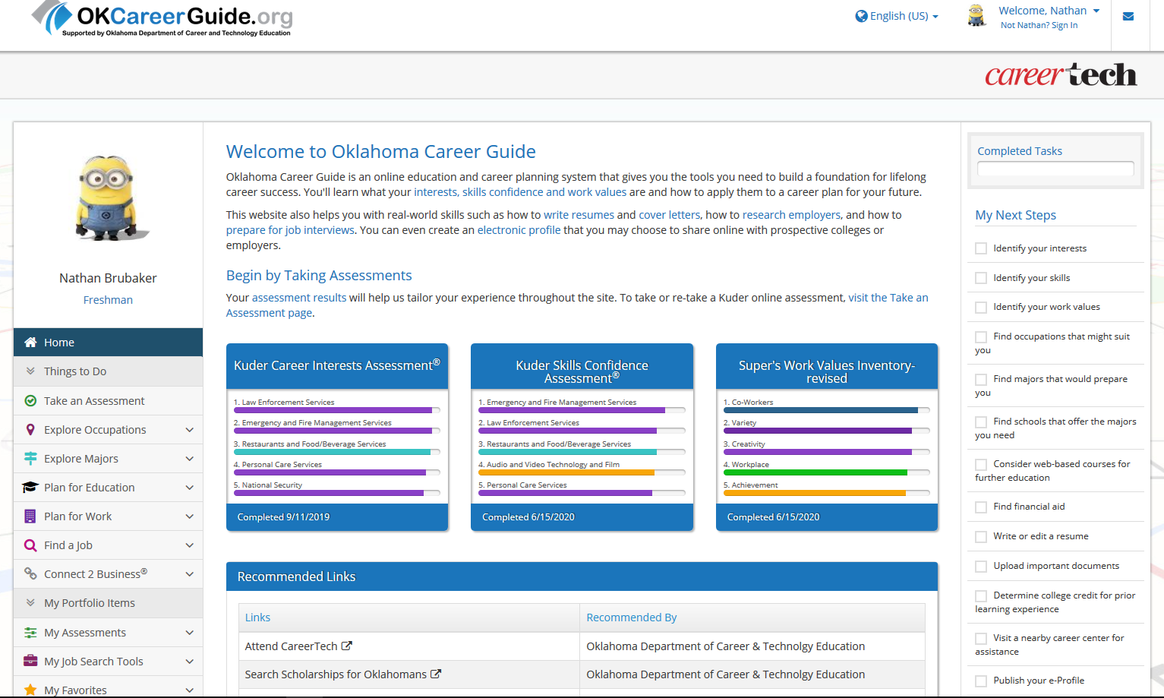

Slide 7
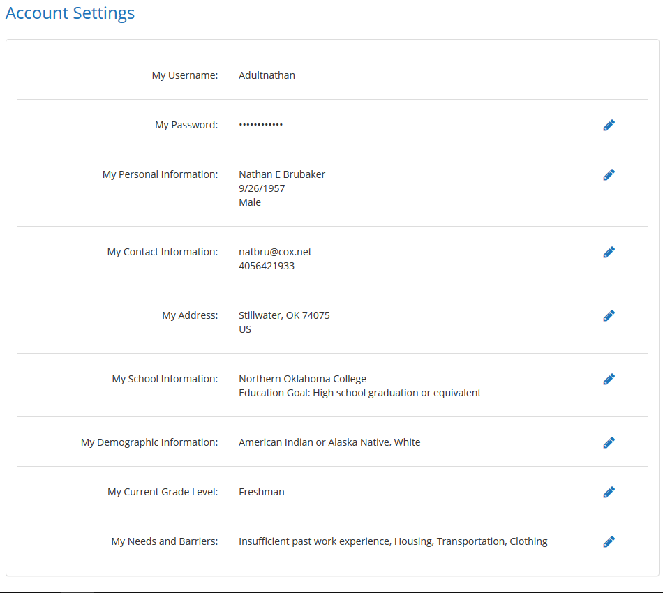
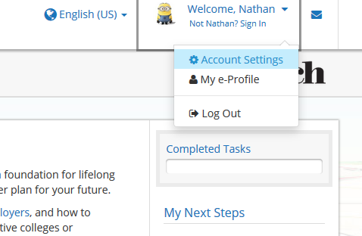

Slide 8
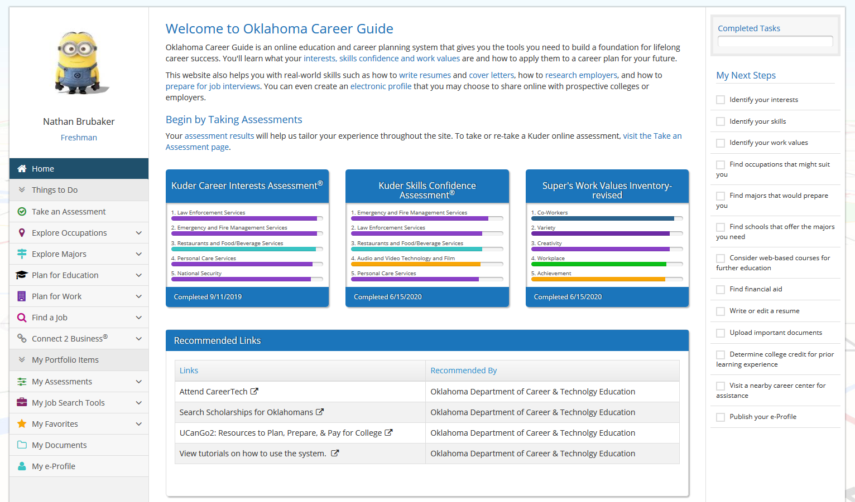

Slide 9





