Slide 1


Your Path to Your Future
Lesson Eight
Barriers

Slide 2

Notes:
Often overlooked in career planning are the barriers to securing a job. What does it take to get a job? Select one or two jobs the students have identified in their research and write them on the board. Ask students to list the skills and education or certification required for these jobs.

Slide 3

Notes:
Sometimes people just aren’t qualified for jobs that are of interest to them, which is definitely a barrier to employment. Even though some parts of the hiring process are out of applicants’ control, there are factors that they can control.
Factors that are within applicants’ control (Slide 3)
Getting the necessary education and training.
Having previous work experience with transferable skills.
Talking to others who are in similar jobs and asking them about the qualifications.
Having complete and accurate job applications and resumes.
Showing up on time to interviews.
Sending thank-you letters.
Having a positive attitude.
Having good references.
Factors not within applicants’ control:
Age.
Race/ethnicity.
Gender.
Weight.
Sexual orientation.
Involvement in the justice system.
Discuss how the factors we don’t have control over sometimes become barriers.
Why would an employer not hire someone because of age, gender, sexual orientation, race/ethnicity? (Possible answers: Age and weight could be a liability or involve health care costs, gender could be related to sexism or an image the company is presenting, race and ethnicity can be barriers due to racism, involvement in the justice system could be seen as taking a risk if applicants are not truly reformed.)

Slide 4
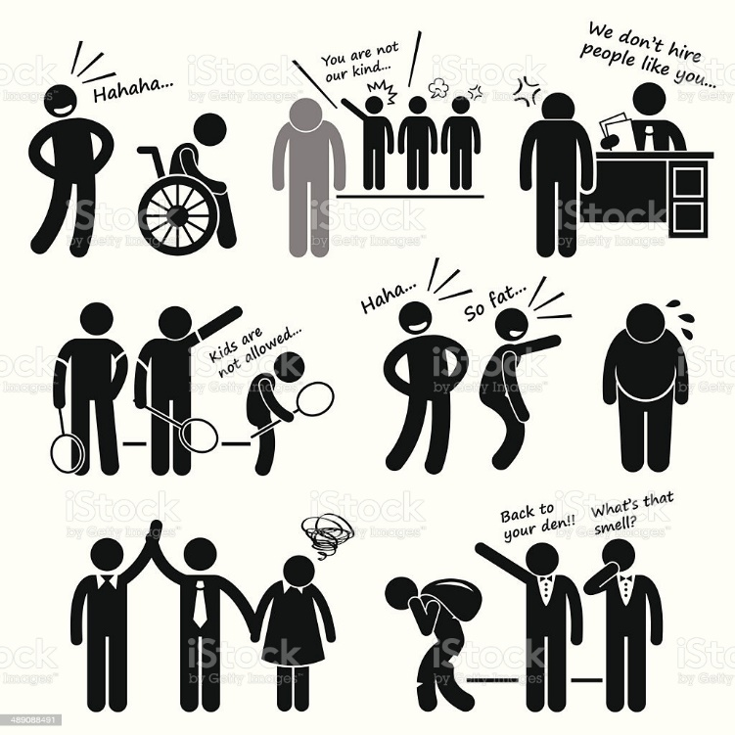


Prejudice vs. Discrimination
Notes:
Discuss how prejudice refers to preconceived negative beliefs, attitudes or feelings.
Explain that discrimination refers to actions and behaviors that may be based on prejudices. Discrimination is illegal in many cases, but prejudice is not.

Slide 5

