Slide 1
SPRING PI
Teena Friend, North Region Program Specialist

Slide 2
Agenda

Slide 3
Roll Call
Updates from State Office
Important Dates
Items to Remember
District Counselor Rotations
OATFCS Updates
Oklahoma Summit Info
FCCLA Updates
District Planning
Professional Development
Adjourn

Slide 4
OK FCS Updates

Slide 5
Important Planning Dates
District Officer Training Camp (June 10-12, Camp Tulakogee, Wagoner, OK)
Ultimate Leadership Camp - Anadarko, OK (June 16-18) $150
Fall PI & LEAD Conference (Sept. 17th - Glenpool Conf. Center).
District Leadership Conference & STAR Events (Dates TBD)
Region STAR Events (Feb. 5th, 2027)
Notes:
SLS- dates and location?

Slide 6
Important Dates Cont.
May Workshops
Mental Health First Aide $30
Culinary Day @ Francis Tuttle - $50
New Teacher Academy Dates
July 21st-23rd, 2026
September 22nd, 2026
January 19th, 2027
OK Summit - Tulsa, OK (August 3-4, Tulsa)
Say YES to FCS Day - Stillwater, OK (Oct. 29)

Slide 7
FCS Positions Open
 | NORTH | NORTHEAST | SOUTH | SOUTHEAST
1 |  | Owasso 7th Grade Center | Canute HS Clinton HS Hollis HS Altus HS
2 |  |  | Chckasha Middle School
3 | Yukon High School, Culinary Yukon Middle School | Catoosa HS Jenks HS (2 NEW) Glenpool HS (NEW) | Mayfield MS Western Oaks MS Hefner MS | Konowa HS
4 |  | Checotah HS |  | Bokoshe HS Poteau HS
5 | Chandler HS |  |  | Atoka HS

Slide 8

Additional FCS Job Openings found at:
FCS Bulletin Board - ctYOU
OSSBA Website
Job Board

Slide 9
May 31st Deadlines
FINAL CESI Reports - May 31st
412 Expenditure Reports (5YF) - May 31st
Final FY26 Fiscal Reports due on September 30th
Advisory Committee Reports (5YF) - May 31
2-3 Best Practices (5YF) - May 31st
Classroom Inventory (5YF) - May 31st
FCCLA Connections Magazine Articles - May 31st

Slide 10
412 Money
Spend it!!!
Next year, you will also be able to spend $500 on FCCLA Official dress & $1105 to affiliate your chapter.

Slide 11
POs/Financial Processes
It is not enough to just turn it into your finance Office!!!
You should be tracking encumbered and paid money and your remaining balances throughout the year.
Tool to help you with this!

Slide 12
OKFCS North Program Evaluations: 2026 - 2027
Blackwell HS
Blackwell MS
Cashion HS
Frontier HS
Geary HS
Kingfisher HS
Medford HS
Newkirk HS
Ponca City HS
Ponca City East MS
Ponca City West MS
Watonga HS
Dates will be given at OK Summit

Slide 13
PLEASE!
READ THE ENTIRE NEWSLETTER EACH TUESDAY!
If you are not receiving the newsletter, reach out to Tiffiany.Peters@careertech.ok.gov IMMEADIATELY - There is a special process for you to be added back.
it holds the most up to date information from our state FCS office

Slide 14
Utilize FCS Extension Agents
fIND YOUR EXTENSION AGENT
OSU FCS Extension agents have many different sets of skills and program curriculum that could be very valuable in your classroom.

Slide 15
FCCLA District Counselor Rotations
Rotation Year - everyone has moved up the District Duty Sheet i.e. you may have a new STAR event to run at DSE.
District Counselor responsibilities are assigned for 2 years out of every 20 years in the district.
This responsibility is part of the expectations of a FCS program in good standing.
Communication - District Counselors should communicate with their DOs AND the DOs FCCLA Advisers regarding all matters related to District Leadership

Slide 16
District Counselor Expectations
Advise in the N District in FCCLA activities
District Leadership Conference
District STAR Events
Assist at Region STAR Events
Periodically check in with District Officer Team and their advisers to meet the deadlines assigned by the state office for these events.
Work with the District Officer team & their advisers to arrange transportation to DOT Camp (June 10-12th)
Attend DOT Camp (June 10-12th)
Arrive to District Events early to set up with the District Officer team.
Work with District Bookkeeper to secure decor for DLC and hospitality items for DSE.

Slide 17


Slide 18
Years of Membership!
Please initial and make necessary corrections to the Years of Membership list and return to Program Specialist.
Questions?Please contact Holly Hanan at holly.hanan@careertech.ok.us

Slide 19
Become an OATFCS Officer
The applications are due May 1,2026
to mdushane@commercetigers.net and holly.hanan@careertech.ok.gov
The current positions that are open:
President-Elect - 3 Year Term
Treasurer
S Vice President- 2 Year Term
SE Vice President – 2 Year Term
We NEED officers to ensure strength in our Division!

Slide 20


Slide 21
OATFCS Scholarships
Teacher Scholarship: $500 scholarship for current OATFCS member who is working toward teacher certification, degree or completing industry certification requirements for ODCTE.
Application link: https://docs.google.com/document/d/1IVqOD7wIqKlcyy9DtMYUVZFHquToAsICDXy3ttFZUyM/edit?tab=t.0#heading=h.gjdgxs
Student Scholarship: Two $500 scholarships will be awarded to students interested in becoming Family and Consumer Sciences teachers.
Application link: https://docs.google.com/document/d/1BNXundKmI4nET-tZOc9pPKGazD6_k1wc/edit?tab=t.0
Opportunity Fund: A $500 stipend will be awarded to an OATFCS member for extended educational/professional activity.
Application link: https://docs.google.com/document/d/1kUeI-7Dr4dPyi8v53llk1cbtvOr7m1zv/edit?tab=t.0

Slide 22
OATFCS CURRICULUM SHOWCASE
One of our most popular sessions at Oklahoma Summit
Successful classroom activity, project, assignment, etc.
Curriculum Showcase presentation apply applications are due July 1
This year VISION conference will be New Orleans, LA from December 2-5, 2026.

Slide 23
OATFCS CURRICULUM SHOWCASE
5 applicants will be selected to present and will receive a $50.00 stipend for participating.
Presenters will be judged by a panel of teachers.
The first place showcase will represent OATFCS at the ACTE Vision 2025 held December 2-5th in New Orleans!
OATFCS will provide a $725 stipend towards travel expenses, upon attendance at ACTE.
Must be an OATFCS member to participate.
Application: Curriculum Showcase Application

Slide 24
FCS Day at the Capitol
Registration will open on Jan. 7th 2027
Event will be on Feb. 25th, 2027
FCS Research Challenge will be the same day...
More details to come at OK Summit

Slide 25

Aug. 3-4, 2026 in Tulsa

Slide 26
OKLAHOMA SUMMIT
August 3-4, 2026
Tulsa Cox Convention Center
FCS Division will be at the Tulsa Convention Center both days!
Plan Hotels accordingly!

Slide 27
OKLAHOMA SUMMIT
Registration opens on May 1, 2026!
How to Register:
Follow this link: https://www.okacte.org/oklahoma-summit-info
Visit ctYOU.org under FCS Registrations for another a direct link.

Slide 28
OKLAHOMA SUMMIT
Registration Fees for OK Summit Conf.
Attendees | Early Bird through July 12 | After July 12
OkACTE Member Rate | $75 | $100
Non-Member Rate | $250 | $275
Registration Fees for FCS Conference $40

Slide 29
Professional Organizations
OkACTE | $60
ACTE | $80
OATFCS | $35
Total: | $175
Be a part of your Professional Organizations!

Slide 30
OkACTE Membership Dues Installment Plan
Deadline for the 2 payment installment plan is August 7, 2026.
Visit the OkACTE Membership Dues Installment Plan online or contact Carmen Jones at cjones@okacte.org

Slide 31
Required
events

Slide 32
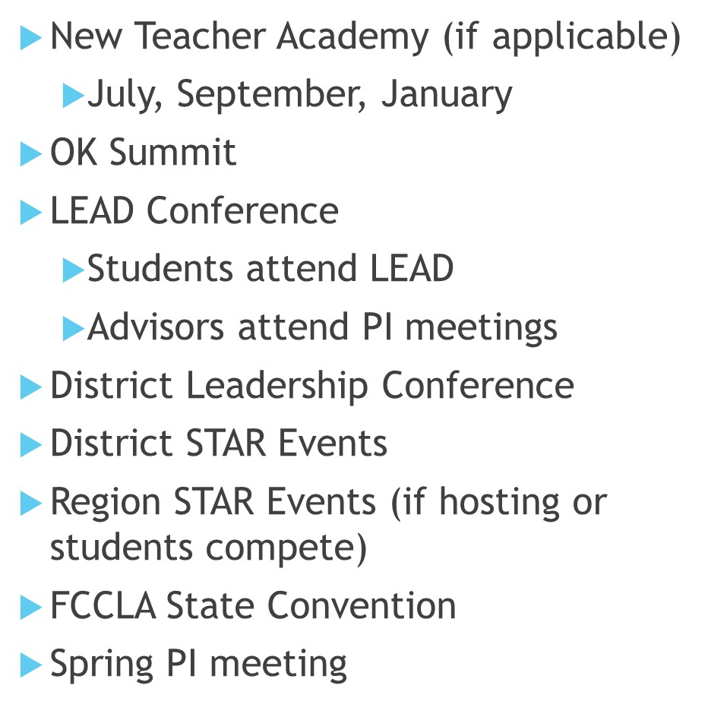
Required Events!

Slide 33


Slide 34
State Officers
President Tyce Myers Edmond North HS | First VP Addison Swift Adair HS | VP Community Service Stephanie Glenn OK School for the Blind
VP of Competitive Events Kaylee Eckhardt Cherokee HS | VP of Membership Nathalie Martinez Westville HS | VP of Public Relations Acelyn Snow Seiling HS
VP of Marketing Lilly McCart Timberlake HS | National Officer Candidate Kooper Walker Kingston HS | National Officer Candidate Kaycee Kimberling Stigler HS
VP of Development Demarcus Officer Guthrie HS

Slide 35
FCCLA Need to Know Info:
STAR Event Trophies
Have your winner send a thank you card to the person’s name on the sticker of their trophy. It matters!!!
Outstanding Financial Balances
REMINDER! If you have outstanding balances from this fiscal year, including National FCCLA Balances, you will not be able to affiliate/register for anything in Aug.
Please call the office to confirm if you may have a balance BEFORE leaving for summer.
Connection Magazine articles
due May 31st and the form forsubmission will be on the OKFCCLA Website.

Slide 36
District Officer Training (DOT)
ATTENDANCE REQUIRED for all District Officers --> If they do not attend they forfeit their District Officer position, and their chapter will be charged $175.
The First District ADVISER is free, 2nd District ADVISER is paid for by District Funds. There will be an electronic waiver emailed to all counselors and officers. It MUST be completed prior to camp. Campers should arrive between 12 - 1 PM, having already had lunch. Camp will begin at 1 PM on June 10th, and will end at 11 AM on Friday June 12th.
District Advisers should obtain a copy of district expenditure report before arriving at DOT.
DATES: JUNE 10-12TH @ Camp Tulakogee - Wagoner, OK

Slide 37
State STAR Event Rubrics – View & Download by July 1
Oklahoma-specific STAR Events (Cake Decorating, Children's Literature, Creed Speaking, Culinary Grill, Meat ID, Work Ready, New Member Facts), along with Baking & Pastry, Culinary Arts, and Parliamentary Procedure, used paper rubrics, which will be returned at your Spring PI Meeting. All other events were digitally scored and are available online.
🔗 View Results and Download Rubrics ➡ Click "Results" on the left side of the page ➡ Click “View PDF” for a snapshot of your chapter ➡ Click “Download” for each rubric
🔐 Use the same User ID and Password you used to register for STAR Events/National Portal. ⏳ Rubrics will be deleted on July 1, 2026. Please download and save now—once deleted, they cannot be recovered! 📌 Some events only had two evaluators. You may only see E1, E2, and RC rubrics for events with two judges.

Slide 38
Ultimate Leadership Camp (ULC)
Two Day OPTIONAL Camp for FCCLA members who would like to gain more leadership skills and jump into our dynamic organization!
Registration is OPEN!
$150 per student - includes a t-shirt, lodging, & meals
REGISTRATION DEADLINE: May 15
DATES: JUNE 16-19TH @ Oakridge Camp - Anadarko, OK

Slide 39
FCCLA LEAD Conference
ATTENDANCE REQUIRED for all FCCLA Chapters. Attend your Region’s LEAD Conference as FALL PI meetings will be taking place during the workshop sessions. The conference is for chapter officers/leaders and prepares them for their chapter leadership roles. $15 per person with limit 7 per chapter - 9AM-12PM
September 9th - Duncan, South Region
September 10th - McAlester, Southeast Region
September 16th - Glenpool, Northeast
September 17th - Enid, North Region
REGISTRATION DEADLINE: August 28th, 2025
DO NOT LEAVE THE CONFERENCE BEFORE 12PM

Slide 40
Other Upcoming Events
STAR Event Bootcamp
September 29th, 2026
Cost - FREE!
Location - Meridian Guthrie Campus
Includes lunch
New Membership Recruitment Activity being planned. Info is TBD
Take AIM
October 7th, 2026
Cost - $50 per person
Location - Meridian Guthrie Campus
Includes lunch and polo for attendees

Slide 41
Fall Leadership Institute
Fall Leadership Institute (FLI)
Orlando Oct 17-20, 2026
Anaheim Nov 12-15, 2026
Registration open May 1, 2026
Very limited spots available
Visit the National FCCLA Website for more information

Slide 42
Capitol Leadership
Don’t miss this amazing opportunity to travel to Washington, D.C., and advocate for Family and Consumer Sciences education and FCCLA, the Ultimate Leadership Experience!
Dates: Will take place Fall 2027

Slide 43
Oklahoma FCCLA - State Events
FCCLA State Convention 2027
April 1st, 2027 - TULSA
State STAR Event Competitions
March 24-25, 2027 - STILLWATER
State Culinary Arts & Baking and Pastry Events
March 2027, Location TBD
FCCLA Week
February 9-13th, 2026

Slide 44
Wrapping Up the Year
Elect New Local Officers
Create T-shirt designs for next year
Work with new officers to create a membership recruitment campaign
PAY FCCLA STATE AND NATIONAL INVOICES
If school allows, open Purchase Orders for the new fiscal year dated July 1 for:
T-shirts
Affiliation (made payable to National FCCLA)
Lead Conference (made payable to OK FCCLA)
Take AIM (made payable to OK FCCLA)
STAR Event registrations (made payable to OK FCCLA)
FCCLA District/District Conference fees (made payable to your district bookkeeper)
FCCLA State convention (made payable to OK FCCLA)

Slide 45
Helpful Links:
OK FCS/FCCLA Newsletters
New Teacher Academy Registration
OATFCS Website
OkACTE Website
Oklahoma Summit Registration
OkACTE Dues Installment Plan

Slide 46
District Planning

Slide 47
Professional Development

Slide 48
Thank you!

