Slide 1
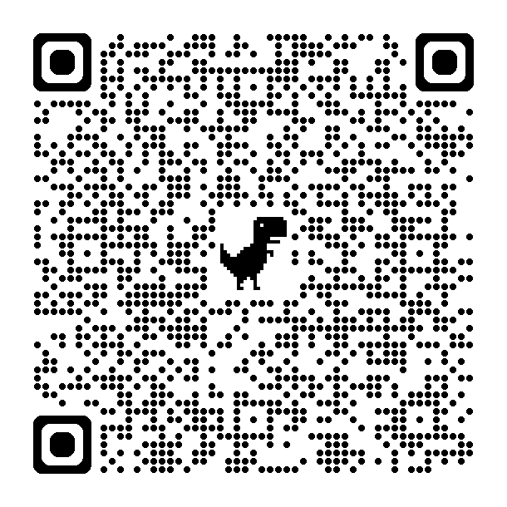



YEAR LONG
PLANNING
Your FCCLA Chapter &
FCS Basics

Slide 2
ABOUT ME...
AND MY SCHOOL
AUDREY RICE
MINCO HIGH SCHOOL
  6th year
  Minco High School
  Oklahoma State - Design, Housing, and Merchandising
  Alternative Certification
  Preps/Courses - FCS Basics, Human Growth & Development, Interior Design, and Hospitality & Tourism
  35 miles SW of OKC
  Approx. 185 students in the HS
  8-20 students per FCS class
  60-70 FCCLA members annually
  5-7 local officers
  Other CTSOs - FFA & BPA

Slide 3
TODAY’S TO DO LIST
  Tips on planning your chapter’s year
  Collaborating & communicating with your officer team & chapter members
  Utilizing CTYou for course ideas & lesson planning
  What Minco HS’s FCS Basics year looks like

Slide 4
YOUR YEAR
AUGUST
SEPTEMBER
OCTOBER
NOVEMBER
DECEMBER
JANUARY
FEBRUARY
MARCH
APRIL
MAY
JUNE
JULY

Slide 5
YOUR YEAR
  Gather ALL your calendars
    Regional Date Sheet from your Program Specialist
    Master Calendar from your school [Sports schedules, homecomings, Band, other CTSOs, breaks, etc.]
    Personal
  Blank Program of Work
    CTYou > Course Categories > FCS > 5 Year Comp. Programs > Program Evals > FCCLA Chapter Program of Work
  FCCLA Adviser Binder
    All things FCCLA
    Master FCCLA Calendar, Medical Forms, Fundraiser Info, Chapter Meeting Info, Impact Hours, Event Flyers, etc.

Slide 6
YOUR YEAR
  Meet w/Your Officer Team
    In person
    Tell them to bring their ideas.
    Together, you will collaborate and set up your entire year’s calendar. [For the most part].
    Try your best to schedule around your officer team.
  Set Your Dates
a. Choose a consistent day/time for chapter meetings.
b. Start with August/Sept. and work your way through each month.
c. Set dates for the major events.
Meetings, fundraisers, social events, community service activities,
etc.

Slide 7

MANAGING OFFICERS
  Meet frequently
    At least once per month, as an entire group
  Start a GroupMe or other communication thread
  Send them weekly reminders of upcoming events
    GroupMe message, FCCLA bulletin board, etc.
  Use them as your “go-to” in whichever classes you have them
    Most will JUMP at the opportunity to complete small chapter tasks during class.
  Ask them their opinions & ideas frequently [And use those ideas]
    The most involved they are in the chapter decision making, the more invested they’ll be

Slide 8
MANAGING MEMBERS
  Give FCCLA updates in EVERY CLASS - EVERY PERIOD.
  Start a local FCCLA Google Classroom or similar page to share any & all announcements to ALL MEMBERS.
  Create an FCCLA bulletin board in your just outside of your room.
  RECOGNIZE members for their accomplishments, new things they are trying, places they’ve been able to visit, etc.
  You will likely gain more than a handful of members just by sharing FCCLA updates frequently. Many students have FOMO...
  Ask them their opinions & ideas too!

Slide 9
TOP 10 TIPS & REMINDERS
  Other events & ideas WILL pop up... That’s ok!
  It’s IMPOSSIBLE to plan around everything... That’s ok!
  Utilize your officer team - Make them do the work.
  Become BFFs with your finance clerk - Work closely with them and they will be willing to work with you.
  Monthly To Do List - Purchase Orders needed, DEADLINES, registrations, transportation requests, etc. TAKE IT ONE MONTH AT A TIME, if you need to.
  DO NOT MISS DEADLINES!
  Only stay after hours 1-3X per week to knock out lesson planning, the administrative side of things, etc.
  AVOID THE BURNOUT!
  Talk to your Mentor Teacher.
  You’ll find your niche.

Slide 10
PLANNING FCS BASICS
SUN
MON
TUE
WED
THU
FRI
SAT
The intro class for all FCS students.
“A little bit of everything.”
There’s something here for every type of student.
Curriculum available...
  OkACTE CIMC
    Link on next slide
    Email Specialist
  Goodheart Wilcox
    Link on next slide
Standards & Pacing Guides available...
  CTYou.org

Slide 11


https://www.g-w.com/
https://oklahoma.gov/careertech/educators/curriculum/catalog.html

Slide 12
CTYOU.ORG
https://ctyou.org/
>Course Categories
>FCS
>FCS Courses & Curriculum Res
[You can also find the CIMC digital resource here]
>FCS Course Resources, Pacing Guides, and Standards

Slide 13
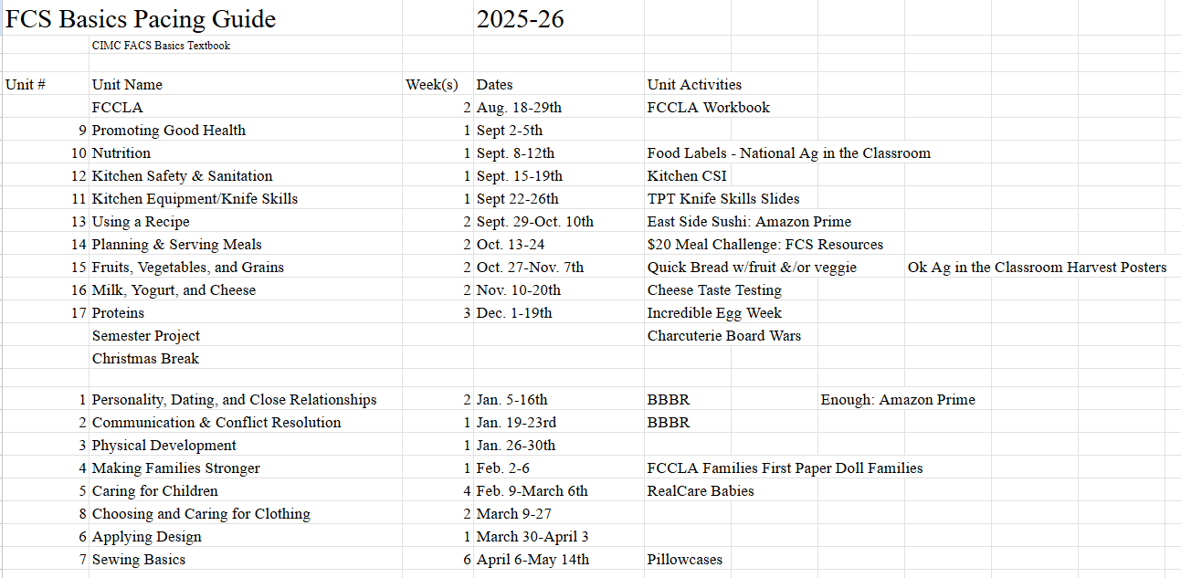

Slide 14
GOALS OVERVIEW
REMEMBER...
  Utilize your officer team
  Keep an Adviser Binder
  Take it one month at a time
  Explore CTYou.org
  Other helpful lesson sites...
    Familyconsumersciences.com
    Teacherspayteachers.com
    FCCLAinc.org [Check out the Hub for teaching resources]
    Oklahoma.agclassroom.org
    agclassroom.org [National Ag in the Classroom site]

Slide 15
YEAR LONG
PLANNING
Audrey Rice
arice@minco.k12.ok.us

Slide 16
Added Info...
Member Point Sheet
Graduation Cords Point Sheet
A point sheet is a great way to hold members accountable and give them incentive to participate. However... this may not be something you feel like tackling your first year.

